Slide 1


Eric Pitman Summer Workshop in Computational Science
Intro to
Project Introduction
Jeanette Sperhac & Amanda Ruby

Slide 2
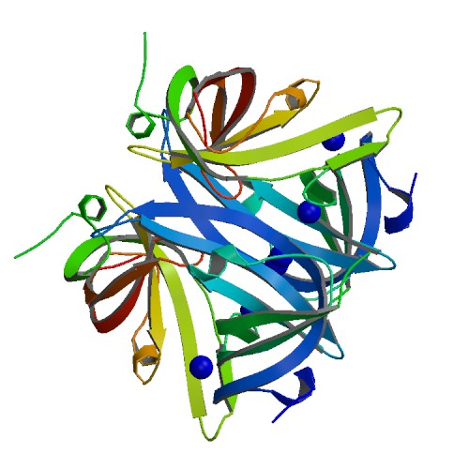
Introducing the Workshop Project
Here's what we'll cover:
The story of the HWI protein crystallization data
The Questions
So what's a classifier?
Inside the dataset
The Project in RStudio
Exploring the Proteins
What you'll need

Slide 3
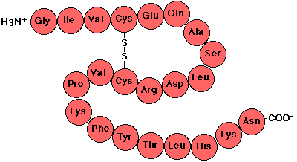
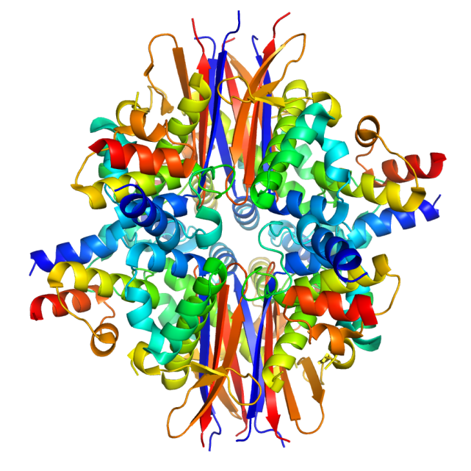
Proteins
Proteins are large biological molecules, composed of long chains of amino acids
These chains fold into complex structures, allowing the protein to perform biological tasks
STRUCTURE AND FUNCTION ARE VERY CLOSELY RELATED

Slide 4
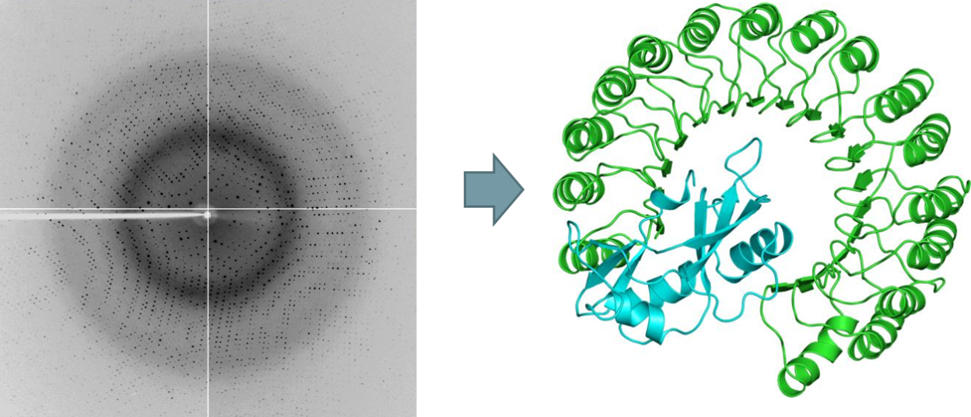
X-Ray Crystallography
Protein crystals are bombarded with x-rays. The x-rays are diffracted, giving structural biologists a way to determine structure
Herbert A. Hauptman developed the mathematical model to convert reflections to molecular structures
The process requires protein crystals

Slide 5
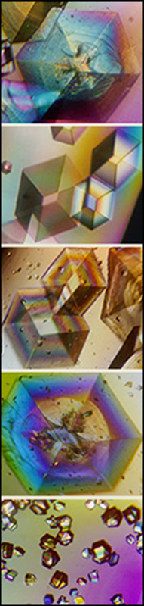
Crystallization
Trying to get a protein to “crash out” of solution, in an orderly fashion
Requires a precise set of conditions, which vary from protein to protein
Included in this precise set of conditions: a chemical cocktail
Cocktails are combined into screens (==generations)

Slide 6
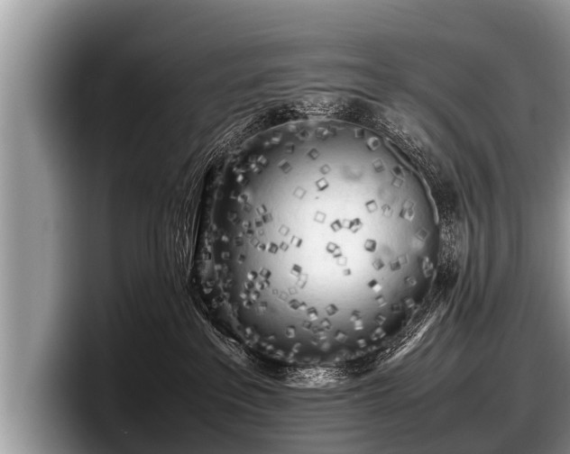
Introducing the Workshop Project
To achieve this (protein structure):
We must get this (pure, crystallized protein):
Protein Data Bank ID: 3dm3

Slide 7
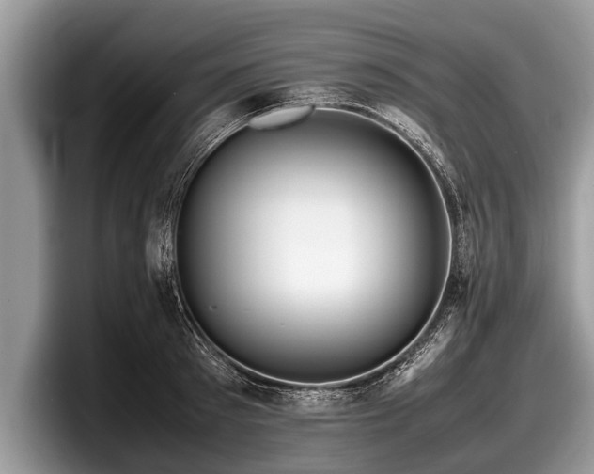
HWI Protein Crystallization Data
Which sample contains a crystallized protein?
(Can we make this decision for 3 million samples?)

Slide 8
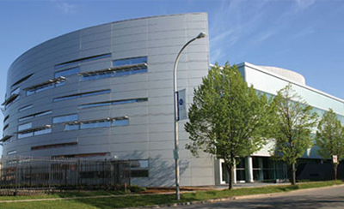

Real Data, Local Data
HWI lab work
CCR processing

Slide 9
1. Laboratory Work: HWI
A protein is placed in 1536 wells on an experimental plate.
A different chemical cocktail is added to each well.
Photos of each well are taken at different timepoints.
Which proteins crystallized in which cocktails, at which timepoints?

Slide 10
2. Automatic Classifier: CCR
An automatic classifier helps identify crystallized samples:
Compute measures that describe the photo of each sample.
Classifier assigns probability that each sample contains crystallized protein.

Slide 11
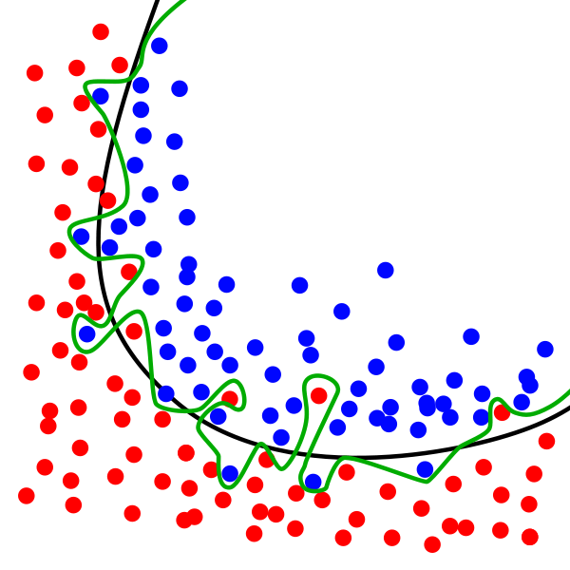
3. But...
The classifier is only ~70% accurate, so:
Human expert classifies each sample. This is the final word.

Slide 12
39936 Experimental Records
We have a photograph of each experiment:
13 proteins
In 1536 chemical cocktails
At 2 different time points

Slide 13
39936 Experimental Records
We have information about each one:
Classifier score (value between 0 and 1)
Human assignment (truth): crystal/non-crystal
Some other stuff...
Not this one
Crystallized!

Slide 14

Automated Classifiers
Class 1
Class 2
This classifier has assigned data points
into two classes, 1 and 2.

Slide 15
Automated Classifiers
How does this work?
Classifier is run multiple times on each data point
The results are converted to a probability that a crystal was seen
Class 2
Class 1

Slide 16
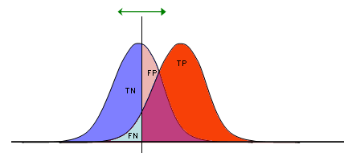
Classifier Performance
threshold
threshold
TP = true positive
TN = true negative
FP = false positive
FN = false negative
↑
Count
0
Classifier Score →
1
Our classifier assigns scores that lie between 0 and 1.
We can overplot two kernel density plots:
One of human-classified crystal examples
One of human-classified non-crystal examples
...both with classifier score on the x axis

Slide 17
Classifier Performance
threshold
threshold
TP = true positive
TN = true negative
FP = false positive
FN = false negative
↑
Count
0
Classifier Score →
1
Pick a threshold (cut point) for classifier scores:
above it, consider all examples to be positive (crystal)
below it, consider all examples to be negative (not crystal).
No matter where we cut, we get some classifications wrong!

Slide 18
Classifier Performance
threshold
threshold
TP = true positive
TN = true negative
FP = false positive
FN = false negative
↑
Count
0
Classifier Score →
1
After we pick a threshold, we can see four types of outcomes:
True and False Positive (crystal)
True and False Negative (not crystal).

Slide 19
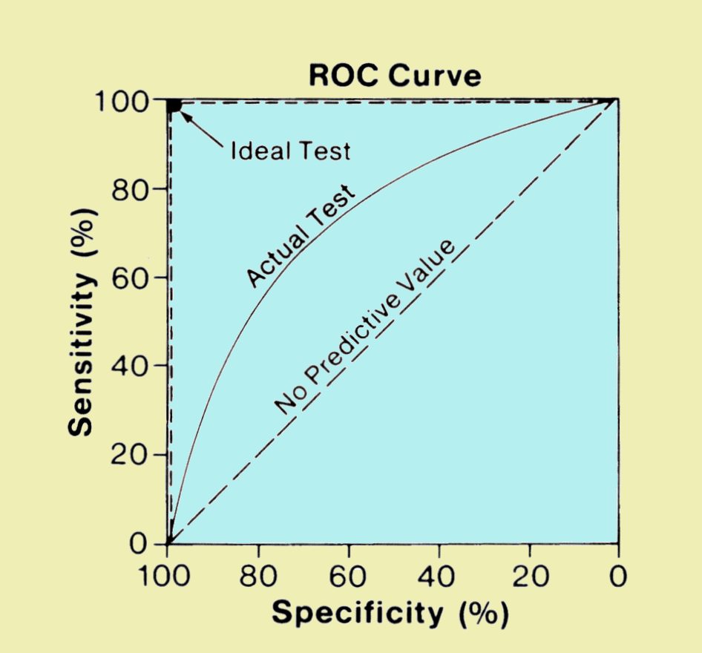
ROC Plots and Classifiers
Evaluate the performance of a binary classifier
Vary the threshold or cut point, vary the sensitivity/specificity ratio

Slide 20
Sensitivity vs. Specificity
Specificity (true negative rate): the ability to classify non-crystals as non-crystals.
Sensitivity (true positive rate): the ability to classify crystals as crystals

Slide 21
Meet Your HWI Dataset
The data frames:
experiment: 39936 rows
sample: 13 proteins
drop: 3930 rows (1536 chemical cocktails)
expUrl: 39936 rows (one per experiment)
13 × 1536 × 2 = 39936
proteins
cocktails
timepoints
experiments

Slide 22
Experiment Data: 39936 Rows
experiment data frame describes the crystallization experiments:
read_no: 39936 values, identifies experiment
sample_id, plate_no: 13 values, identifies protein
week_no: 2 timepoints
cocktail_no: 1536 unique values
human_crystal: crystal or not?
class3_crystal: probability of crystal
13 × 1536 × 2 = 39936
proteins
cocktails
timepoints
experiments

Slide 23
Sample Data: 13 Different Proteins
sample data frame describes the proteins:
Identify each protein:
  sample_id, p_number, targetdb_status, name
experimental_molecular_weight
concentration of the protein
seq: sequence of amino acids in protein
seq_len: number of amino acids
targetdb_ref: PDB (Protein Data Bank, www.rcsb.org)
targetdb_status: unique protein code on PDB

Slide 24
Drop Data: 3930 Rows
drop data frame describes the components of the chemical cocktails:
Identify each chemical cocktail (1536 in total):
  cocktail_no + solution_component_no
concentration of the solution component
name of the solution component
ph: pH of the solution component

Slide 25
expUrl Data: 39936 Rows
expUrl data frame contents:
read_no: identifies experiment
image_url: URL of the experiment image

Slide 26
RStudio:
The Workshop Project
Project
In the RStudio Workspace:
Create Project from Git Version Control
Clone Git Repository
  git://github.com/ubccr/hsws.git
Load the HWI datasets...

Slide 27
RStudio:
Project Data
HWI data are text files with csv format.
Formatted to load straight into an R data frame
Columns are labeled by name
csv == comma separated values

Slide 28
RStudio and csv:
Two ways to load data
1. RStudio Workspace:
Select Import Dataset: From Text File
Select a .csv file to Open
Use Heading=Yes
2. Or, from the command line:
Set the Working Directory
Load command:
> drop=read.csv(“drop.csv”)

Slide 29
Exploring Proteins
BLAST algorithm
  Protein sequence comparison
  R package: bio3d
  NCBI BLAST web interface
Protein Data Bank
Protein Data Bank ID: 3dm3

Slide 30
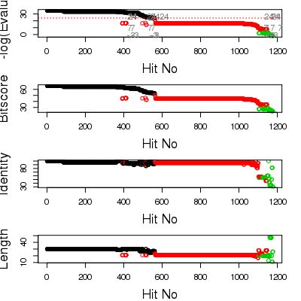
Exploring Proteins: bio3d BLAST
blast.pdb() returns:
bitscore
evalue
mlog.evalue
pdb.id
plot.blast() returns:
Summary and plot of BLAST hit statistics
BLAST results, PDB ID 4Q21
bio3d package documentation:
http://thegrantlab.org/bio3d/html/index.html

Slide 31
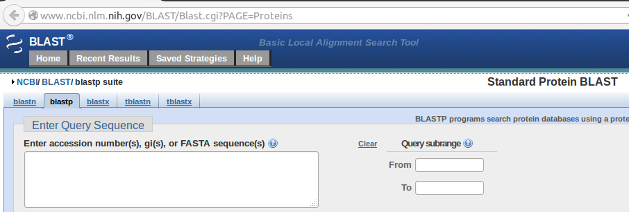
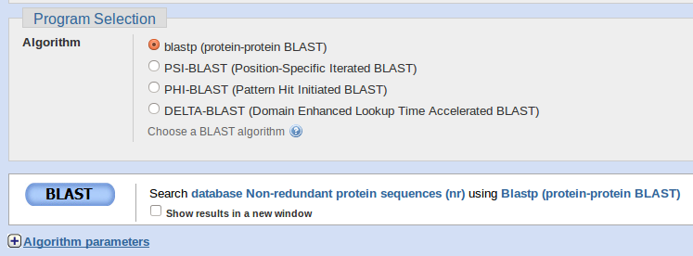
Exploring Proteins: NCBI BLAST
EIKDTYNIGELSPGMTATFEGEVISALPIKEFKRADGSIGKLKSFIVRDETGSIRVTLWDNLTDIDVGRGDYVRVRGYIREGYYGGLECTANYVEILKKGEKIES

Slide 32
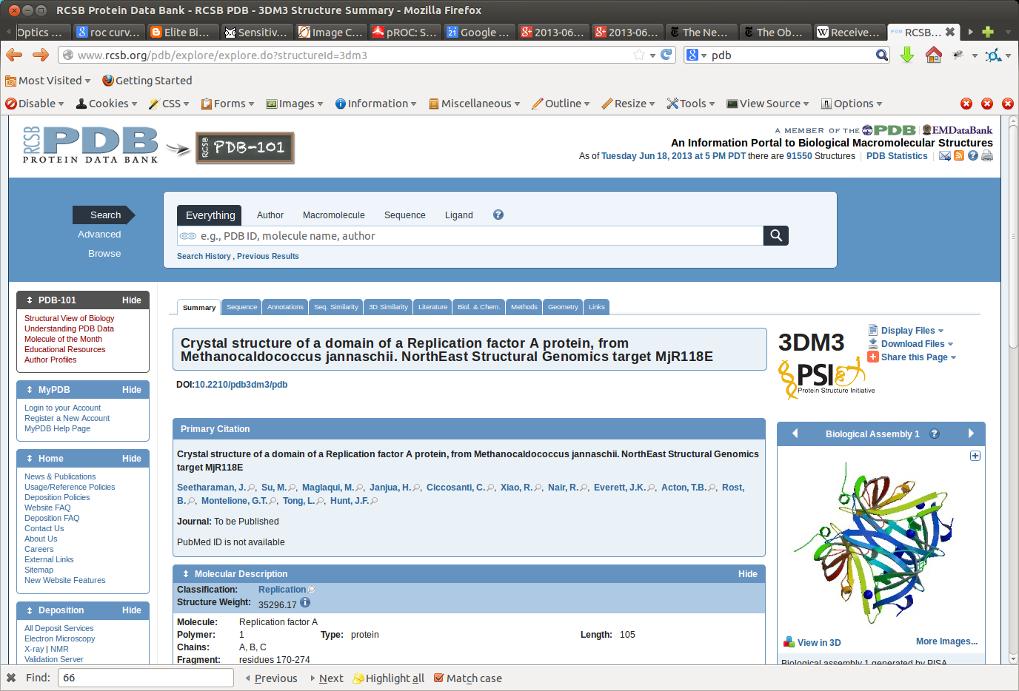
Exploring Proteins: rcsb.org
Enter PDB ID

Slide 33
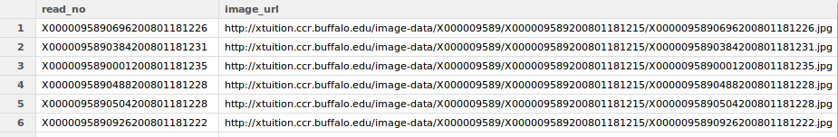
Exploring Proteins
Check the data frame expUrl for links
to the experimental images.
Can you identify the crystallization state?

Slide 34
The questions
How does the automated classifier perform?
What trends do we see in timeseries data?
What trends do we see in crystallization of the proteins across the different cocktails?
What can we learn about the proteins?
Not this one
Crystallized!

Slide 35
Project: you'll need...
Data load
  read.csv() R function
File transfer: WebDAV
  Copy files to your workstation from hpc2.org
  Useful for creating your presentation slides
factorify() function
  Apply to a data frame after subsetting; updates factor levels
  source generalFactorifyFunction.R
Optional: Jmol protein viewer on hpc2.org

Slide 36
1. Classifier Performance Focus
Data file: experiment.csv
Epi R package: ROC()
R functions:
  sapply()
  Kernel density estimation: density()
  data.frame()
R graphics:
  hist(), plot()
Provided function compareDensityPlots()

Slide 37
2. Timeseries Crystallization Focus
Data files:
  experiment.csv
  sample.csv
R functions:
  merge(), length(), table(), round()
R graphics:
  boxplot(), hist(), pie(), barplot(), legend()

Slide 38
3. Cocktail by Protein Focus
Data files:
  Experiment.csv
  Sample.csv
  Drop.csv
R functions:
  table(), unique(), sum(), length(), which(), dim(), merge()
R graphics: boxplot(), pie(), barplot()

Slide 39
4. Protein Exploration Focus
Data files:
  expUrl.csv, experiment.csv, sample.csv
PDB (protein data bank): www.rcsb.org/pdb
NCBI BLAST web interface
R “bio3d” package: blast.pdb(), plot.blast()
R functions:
  plot() – for scatterplots
  lm() – linear model to fit data to a line
  abline() – plot a linear model
  cor() – examine correlations

Slide 40
The Project Groups
Andrew
Soumya
Cameron
Deborah
Robbie
Prerna
Taras
Kathan
Ian
Murton
Karena
Bhaskar

