Slide 1
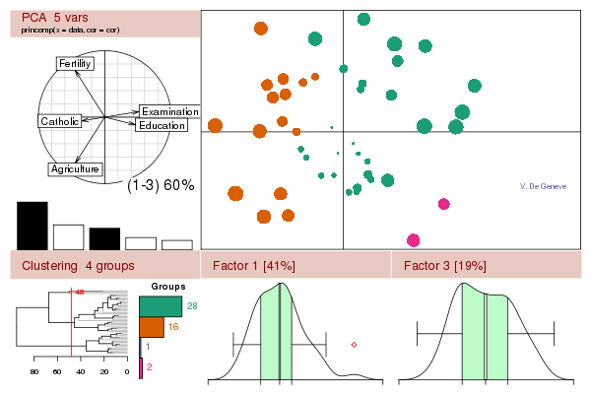
2013 Eric Pitman Summer Workshop in Computational Science
...an introduction to R, statistics, programming, and getting to know datasets

Slide 2
Introducing: Workshop Staff
Jeanette Sperhac, Scientific Programmer, UB CCR
and intrepid assistants:
Ryan Mraz, RIT
Sam Steffan (alumnus of this workshop!), UNC
Brian Narby, Pitt

Slide 3

Intro to
0. Setup on hpc2.org
- Register on hpc2.org
- Intro to RStudio
- Set up RStudio Projects with GitHub
- File transfer: using WebDAV

Slide 4


Workshop computing environment
hpc2 server
(webserver, RStudio)
You
are
here!
Student workstation
(Firefox browser)

Slide 5
Register on hpc2.org
You must have an email address...
On hpc2.org website, click Register link
Fill in required fields; submit
Follow link to Create New Account page
Choose username and password; specify email address; submit
Click link on confirmation email; sign in

Slide 6
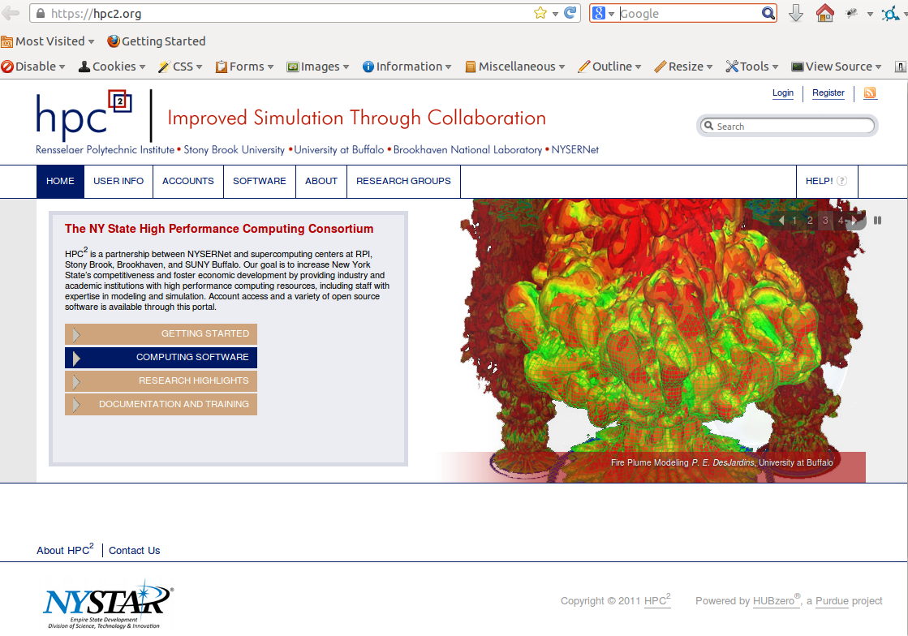
Register on hpc2.org

Slide 7
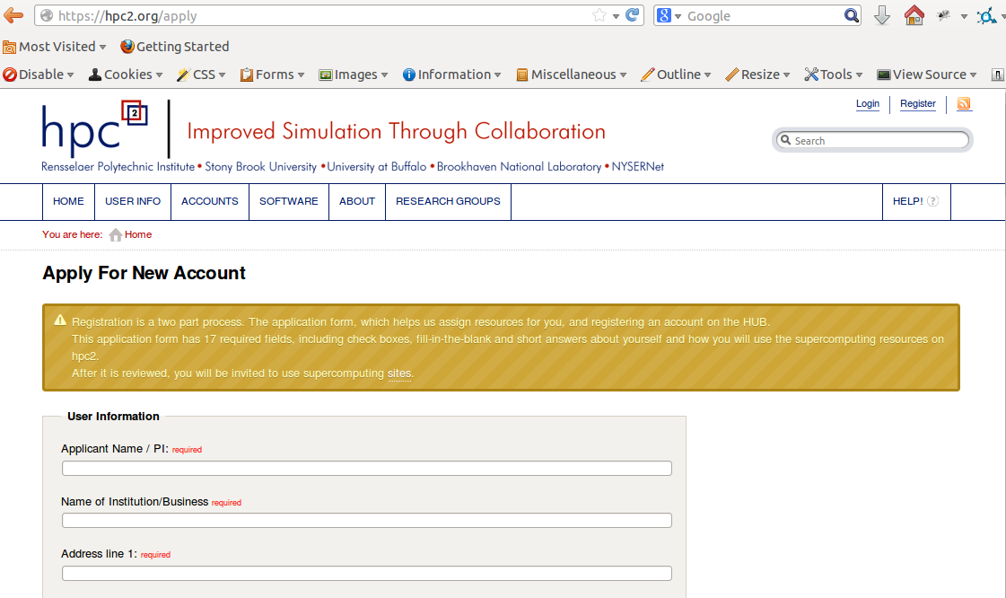
Fill in required fields and submit

Slide 8
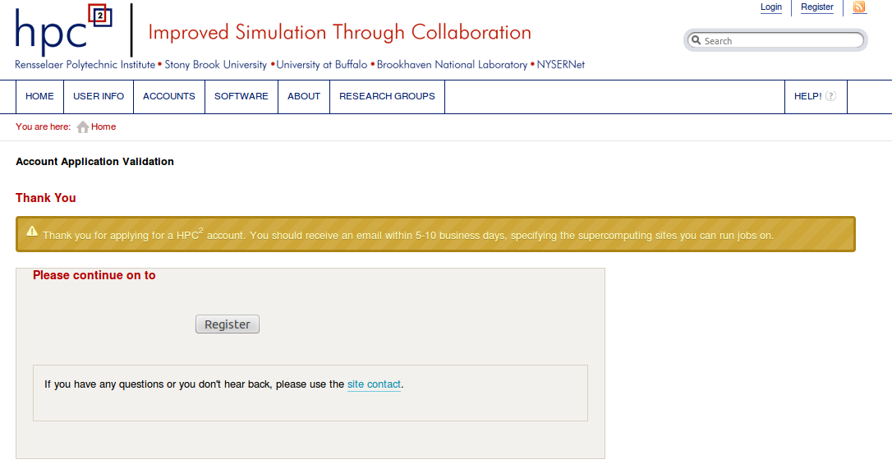
Click “Register”

Slide 9
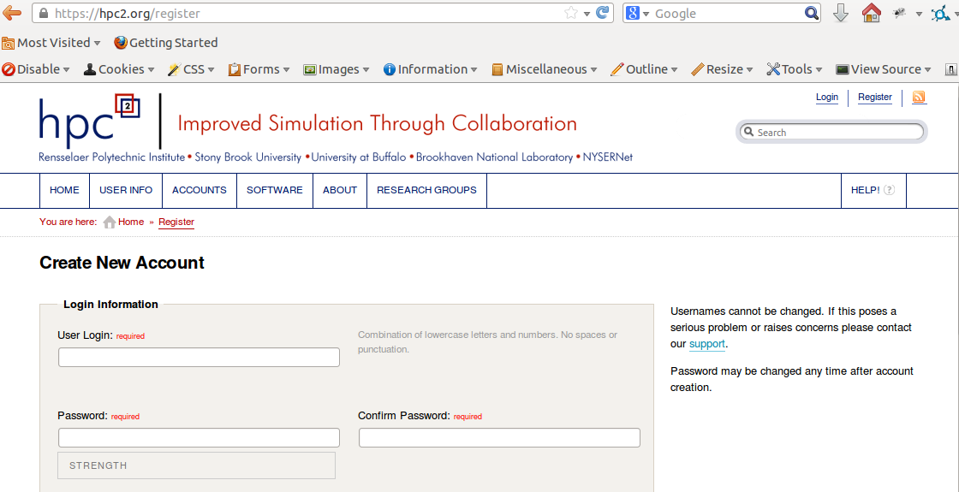
Pick a login name and password

Slide 10
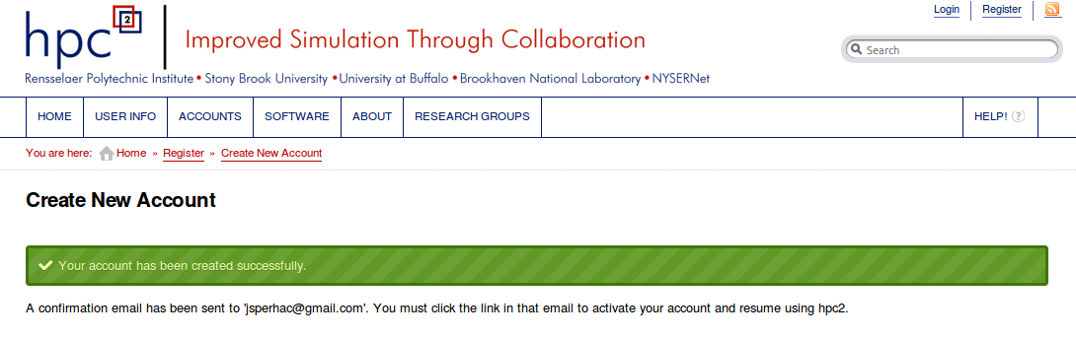
hpc2 new account created

Slide 11
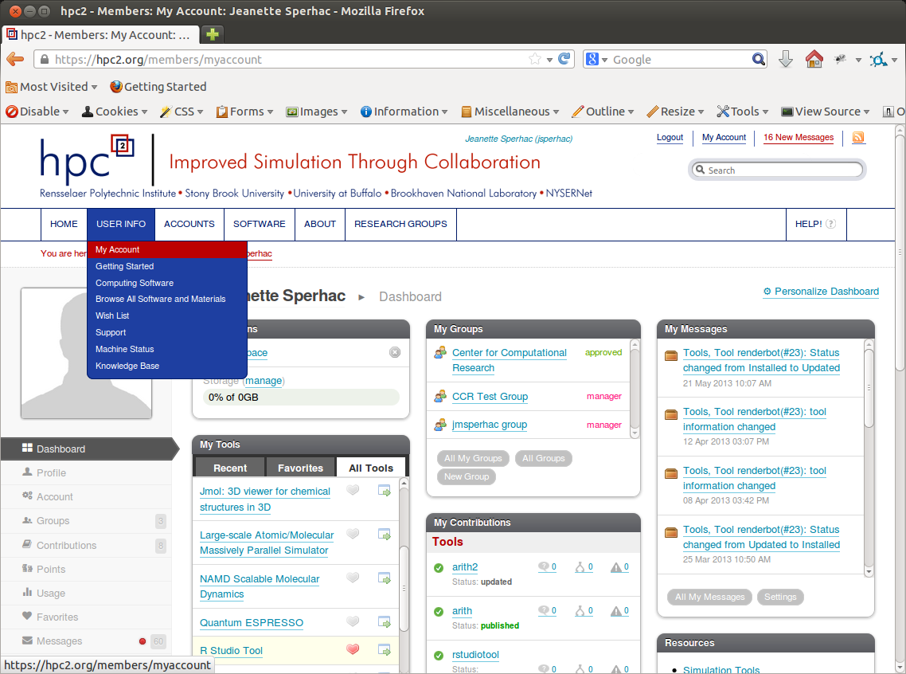
Dashboard
RStudio

Slide 12
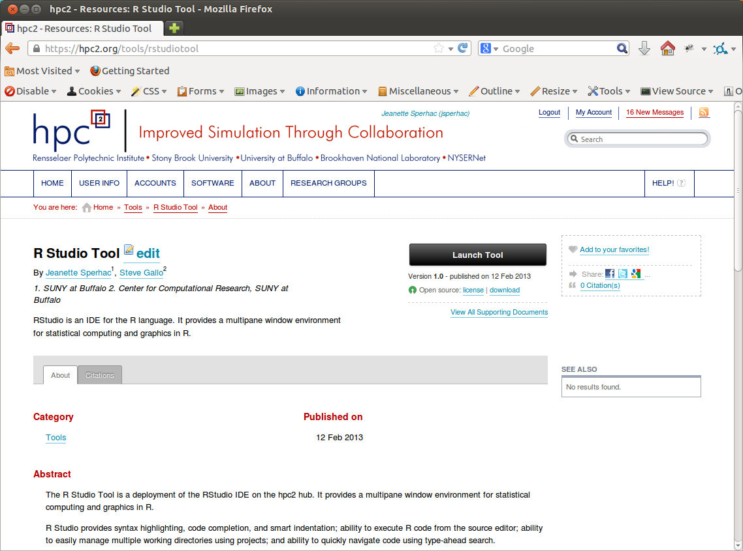

Slide 13
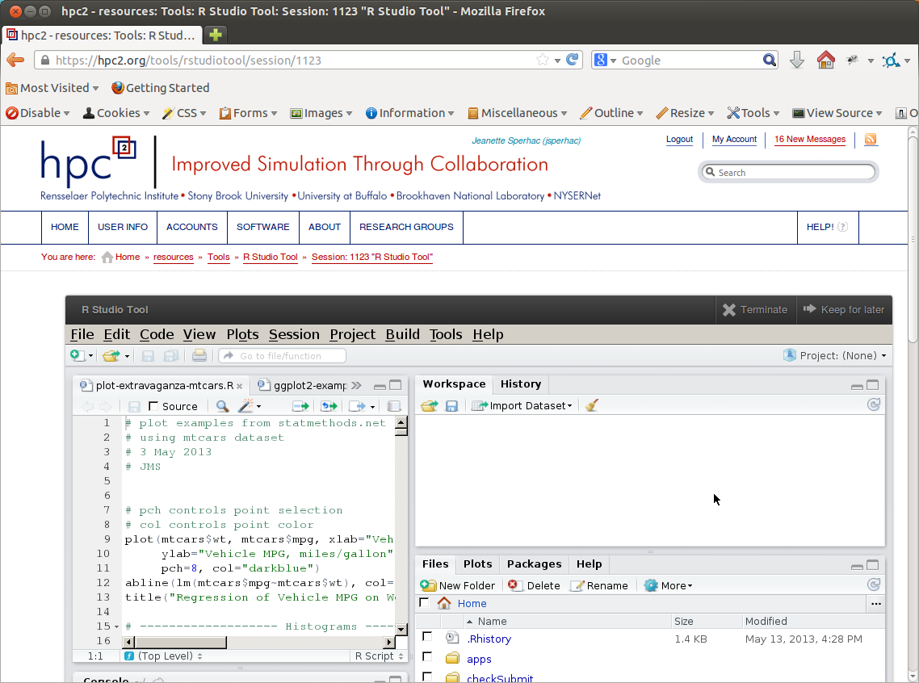
hpc2 My Tools: R Studio Tool
Rstudio session:
Terminate
Suspend

Slide 14
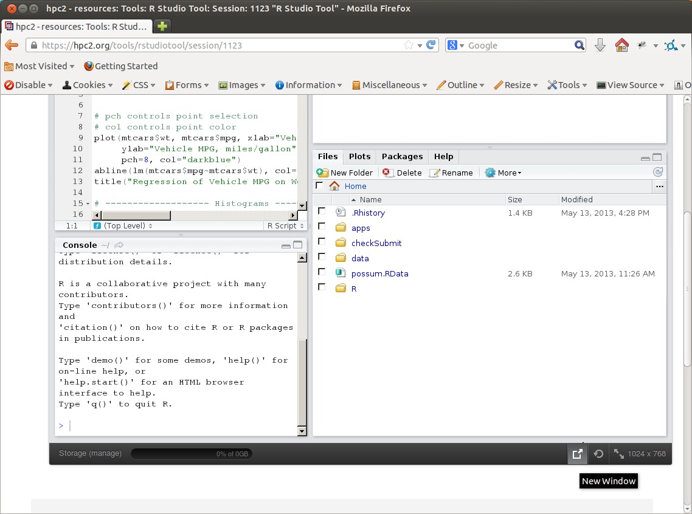
Rstudio window:
Pop out
Refresh
Expand

Slide 15
GitHub
GitHub server
View files
Pull files and data
Student workstation
hpc2 server

Slide 16
Workshop Files and Data: GitHub
GitHub server
Pull R source files
Create RStudio project
Student workstation
hpc2 server

Slide 17
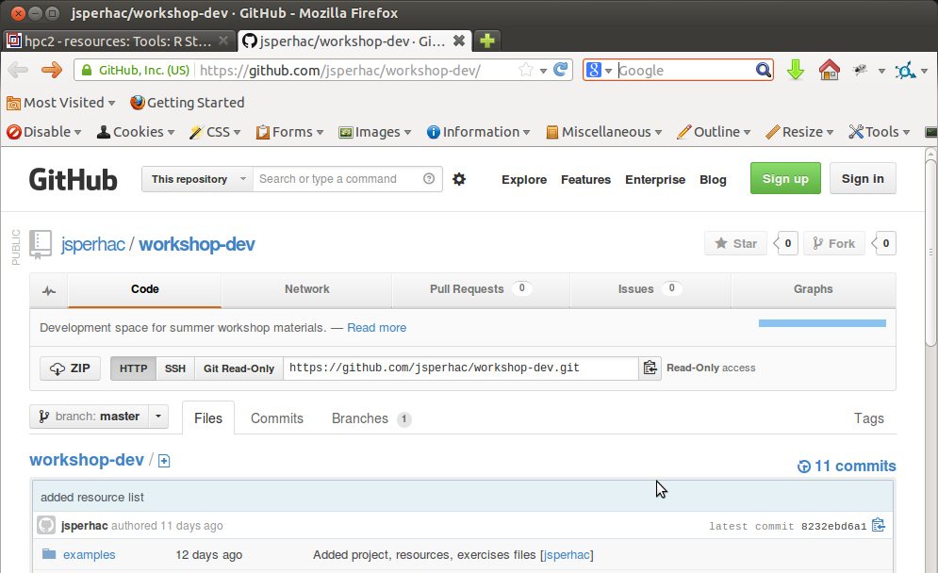
Workshop Files and Data: GitHub
Student workstation
hpc2 server

Slide 18
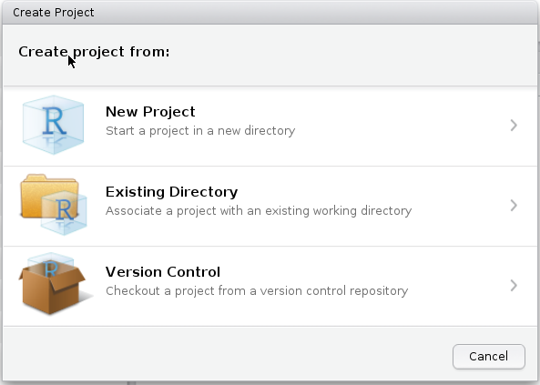
Create project in RStudio
1. In the RStudio menu:
Select Project: Create Project
Select Version Control

Slide 19
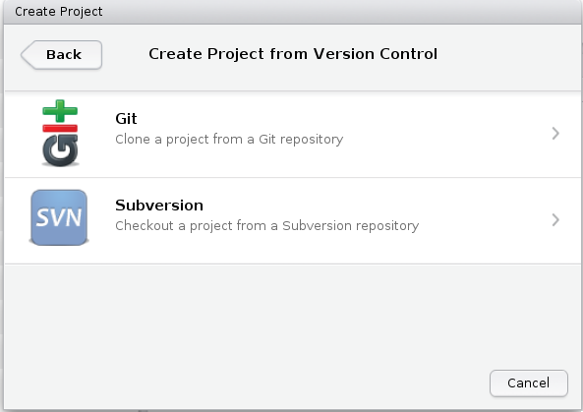
Create project in RStudio
2. In RStudio:
Next, select Git

Slide 20
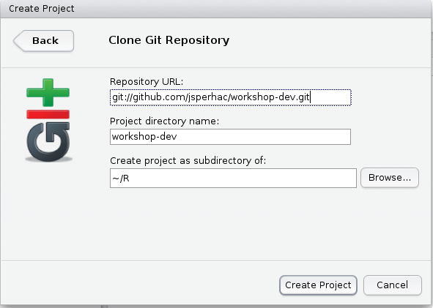
Create project in RStudio
3. In RStudio:
Type the Repository URL as shown
Use a unique project directory name
git://github.com/jsperhac/workshop-dev.git

Slide 21
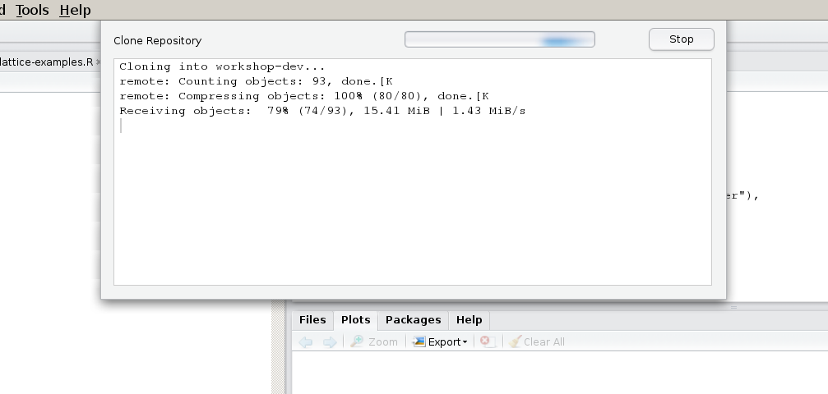
Create project in RStudio
4. RStudio copies the files from GitHub to your
home directory on hpc2.

Slide 22
Create project in RStudio
Selecting the project sets the working directory
Your RStudio project contains directories:
  examples
  exercises
  project
  resources

Slide 23
File transfer
WebDAV
hpc2 server
You'll need file transfer for
adding graphics files to your
presentation slides
Student workstation

Slide 24
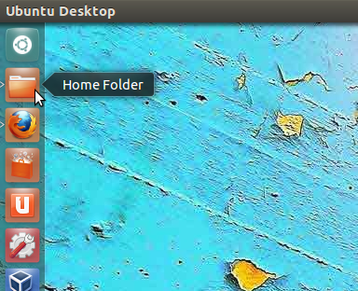
File transfer: WebDAV
Home folder
Student workstation

Slide 25
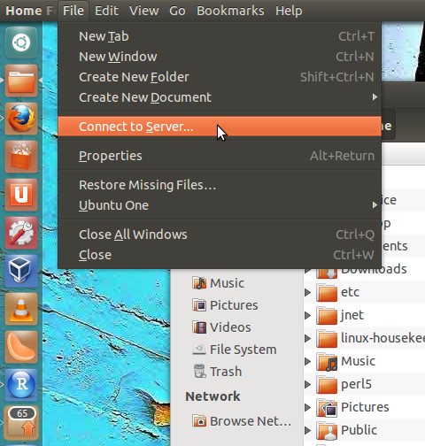
File transfer: WebDAV
File: Connect to Server...
Student workstation

Slide 26
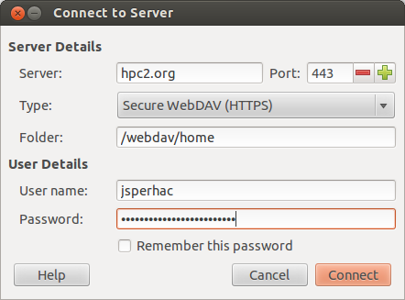
File transfer: WebDAV
Use your hpc2 user credentials
Student workstation

Slide 27
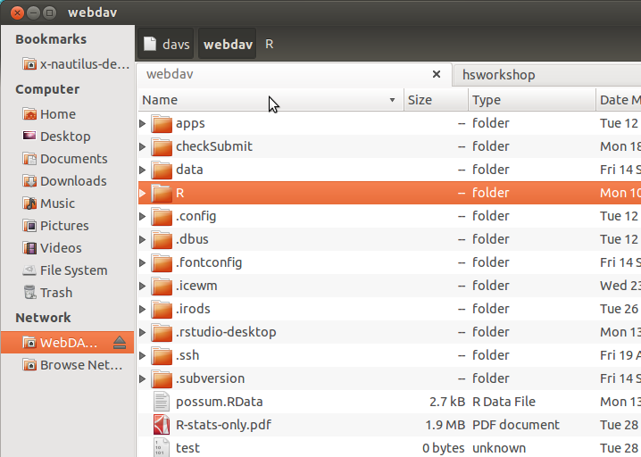
File transfer
WebDAV
hpc2 server
Student workstation

