Slide 1
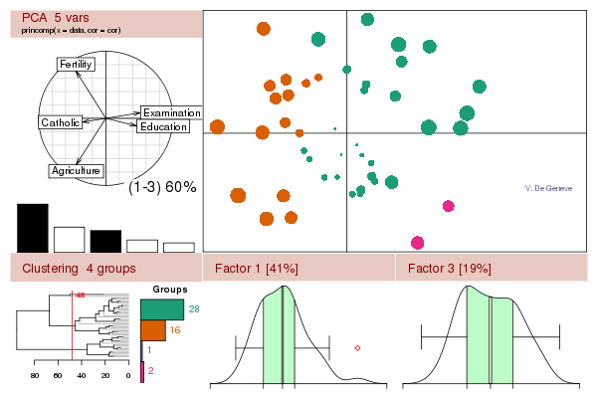
2013 Eric Pitman Summer Workshop in Computational Science
24 June to 5 July 2013
Center for Computational Research
B1-125

Slide 2
2013 Eric Pitman Summer Workshop in Computational Science
5 July 2013
Presentations: Zebro Room, 11 am
Reception Following: B1-306

