Slide 1


Eric Pitman Summer Workshop in Computational Science
Intro to
RStudio Tips
Jeanette Sperhac

Slide 2
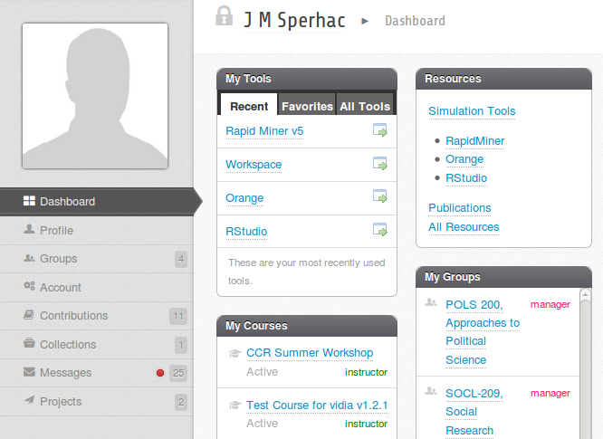
VIDIA Dashboard: RStudio Tool

Slide 3
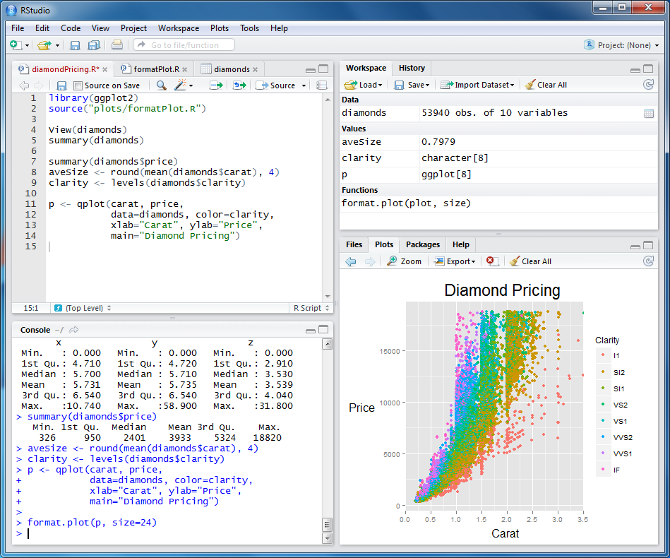
RStudio environment
2. Workspace
(Variables)
and
History
1. Editor
4. Console
3. Plots, etc.
Notes:
RStudio “Interactive Development Environment” (IDE)
Provides four windows simultaneously:
- Editor window with multiple tabs: write/save scripts
- Workspace/History window: current variables, recent commands
- Files/Plots/Packages/Help
- Console window: where you issue commands

Slide 4
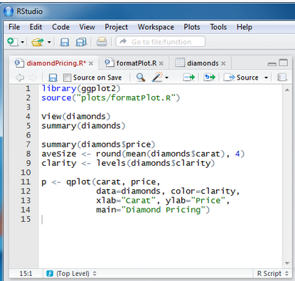
Editor window
Edit and save scripts.
Notes:
RStudio “Interactive Development Environment” (IDE)
Provides four windows simultaneously:
- Editor window with multiple tabs: write/save scripts
- Workspace/History window: current variables, recent commands
- Files/Plots/Packages/Help
- Console window: where you issue commands

Slide 5
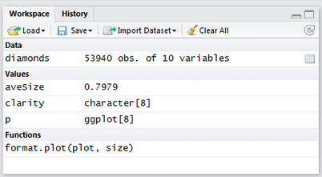
Workspace and History window
Pick a tab to:
View current variables
View historical commands
Notes:
RStudio “Interactive Development Environment” (IDE)
Provides four windows simultaneously:
- Editor window with multiple tabs: write/save scripts
- Workspace/History window: current variables, recent commands
- Files/Plots/Packages/Help
- Console window: where you issue commands

Slide 6
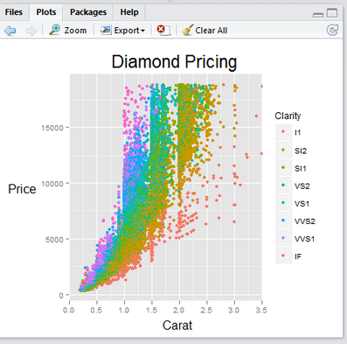
Plot window
Pick a tab to:
View current Files and Directories
View current Plots
Review loaded Packages
Read Help and Documentation
Notes:
RStudio “Interactive Development Environment” (IDE)
Provides four windows simultaneously:
- Editor window with multiple tabs: write/save scripts
- Workspace/History window: current variables, recent commands
- Files/Plots/Packages/Help
- Console window: where you issue commands

Slide 7
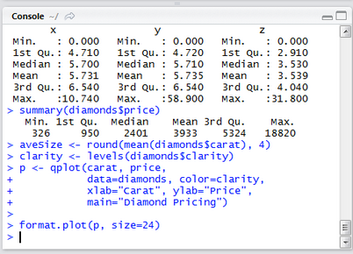
Console window
The command line:
Issue commands
See the results
Get error messages
Notes:
RStudio “Interactive Development Environment” (IDE)
Provides four windows simultaneously:
- Editor window with multiple tabs: write/save scripts
- Workspace/History window: current variables, recent commands
- Files/Plots/Packages/Help
- Console window: where you issue commands

Slide 8
RStudio environment: summary
2. Workspace
(Variables)
and
History
1. Editor
4. Console
3. Plots, etc.
Notes:
RStudio “Interactive Development Environment” (IDE)
Provides four windows simultaneously:
- Editor window with multiple tabs: write/save scripts
- Workspace/History window: current variables, recent commands
- Files/Plots/Packages/Help
- Console window: where you issue commands

Slide 9

R Practical Matters
R is case sensitive (R != r)
Command line prompt is >
To run R code: use command line, or save script and source(“script_name”)
To separate commands, use ; or a newline
The # character marks a non-executed comment
To display help files:
?<command-name> or ??<command-name>

Slide 10
RStudio basics and tips
Up-arrow and history pane: access and edit previous commands
You can change window size in the IDE by dragging window borders
Ctrl-L clears the console window
Broom icon clears Workspace or Plots
Is your Project loaded? Check upper right.

Slide 11

...is free
If you want to experiment further with R and RStudio, you can install them on your favorite operating system at home.
First, install R:
http://cran.r-project.org/
Then, install the Rstudio IDE:
http://www.rstudio.com/ide/

