Slide 1
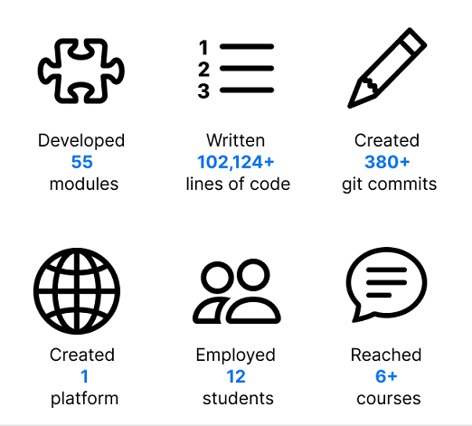
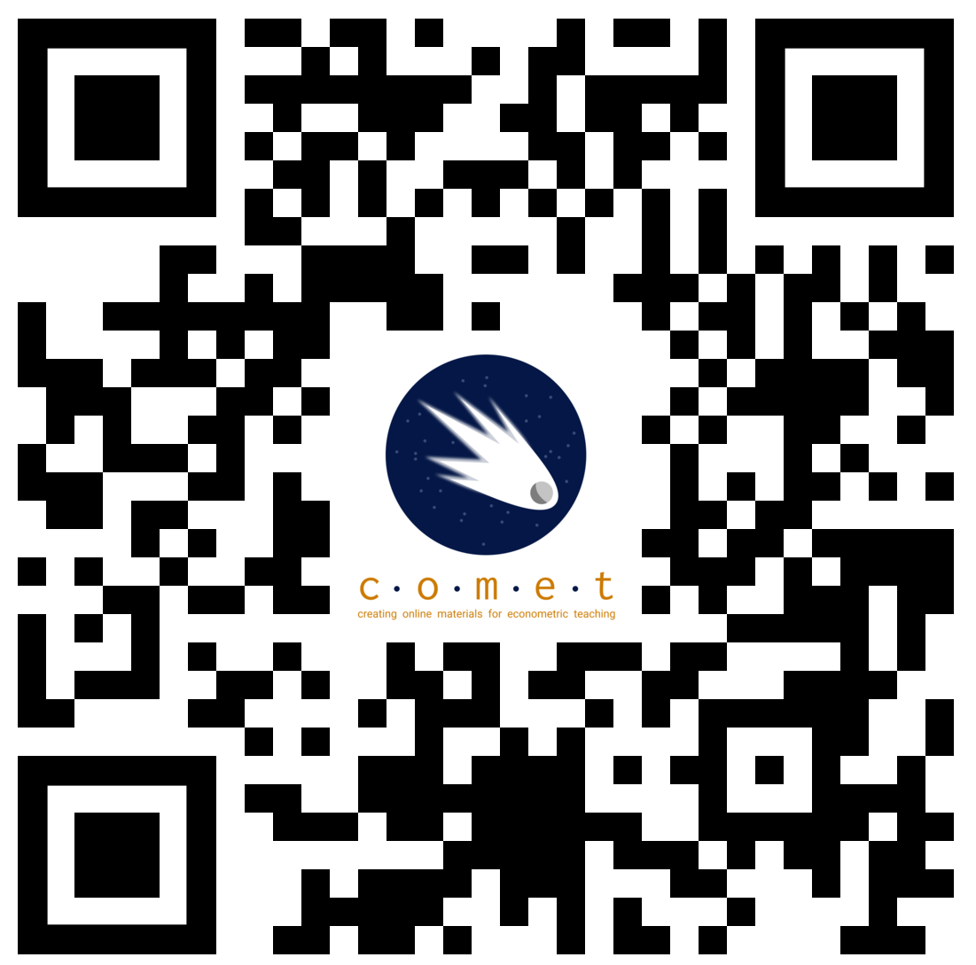
Vancouver School of Economics (VSE) – Faculty of Arts – UBC-V
COMET: Developing interactive learning modules for hands-on-econometrics skills
Marina Adshade (VSE, UBC-V), Jonathan Graves (VSE, UBC-V), Emrul Hasan (VSE, UBC-V)
Introduction
All economics students take several courses applied statistical methods for economic (econometrics). Many students struggle with this material, particularly when it comes to practical applications and hands-on experience – putting them at a disadvantage following graduation or in more advanced courses.
Surveys of students indicated that after completing these courses:
Few felt ready to do applied research
A majority lacked confidence with using applied tools and modelling
A large minority had no experience using statistical software or applying econometrics
These experiences tracked with those of faculty who reported students struggled to apply economic tools, and lacked fundamental skills in econometrics which the Vancouver School of Economics (VSE) has identified as key learning and program outcomes.
Our TLEF: COMET
The goal of this large TLEF project, which we dubbed “COMET” (for Creating Online Materials for Econometrics Teaching”) is to address these gaps by creating a collection of hands-on modules designed around best practices for teaching statistics.
These modules, focused on economic questions, models, and data, use interactive notebook-based technologies (Jupyter) to synthesize analysis, discussion, and conceptualization into a single learning experience.
Module Design
Our modules cover specific topics from our core econometrics courses. Each typically includes:
An open-source dataset, typically from real-world sources like the Census of Canada.
A Jupyter Notebook which outlines the topic and guides students through applying the technique to the data.
A set of interactive and reflective exercises students perform as they move through the notebook, which provide feedback or provoke deeper thinking.
Notebooks are formatted for either independent or guided study in several modalities, including flipped classroom, lab, or in-class exercises.
All our material is open-sourced under a CC-by-NC 4.0 licensed and is free to use
JupyterNotebooks
Our approach is based on Jupyter notebooks, which are a modern and proven pedagogical tool for teaching applied statistics. Notebooks have several key benefits:
They are language agnostic, allowing us to support several statistical languages in the same widely-supported framework
They support “literate computing” which interleaves discussion, reflection, and computation
They can be run via the cloud, in a web-browser, abstracting away from computer hardware or software requirements
The last point is particularly since it means students do not need special software or a good computer to use statistics. It also means the tool is easier to integrate with assistive technologies which work with web-browsers.
Year 1: Kickstarting the Project
Our project has completed 1 year of funding, and has been very productive:
We also estimate that it saved students $90,000+ dollars relative to buying a STATA license for some of the core targeted courses.
Next Steps
We are currently starting our second year, and our priorities includes:
Collecting and evaluating student feedback from year 1 courses and focus groups
Improving existing modules to be more compartmentalized and easier to use
Expanding to additional courses and languages based on curricular needs
Improving the infrastructure for the project
Integrating more assessments and tools for assessment into the project
We are also working to extend the tools beyond economics as part of COMET+ where we have brought on faculty from Geography, Sociology, and the Centre for Computational Social Science.
We are also exploring the students-as-partners framework as a tool for continual development post-TLEF
Interested? Get Involved!
As part of our project we are interested in helping students and faculty using computational tools and statistics learn more about these kinds of frameworks, and their use in classrooms or research, and are happy to help support you.
We offer workshops, advice, and support
Get in touch via comet.project@ubc.ca
Acknowledgements
We gratefully acknowledge the financial support for this project provided by UBC Vancouver students via the Teaching and Learning Enhancement Fund
We also thank UBC’s LTHub, CTLT, and PIMS Syzygy for technical support and advice.
Website and Main Resource Library
We created an open-source library of our tools and resources which students can read, or can launch the Jupyter notebooks using one of our pre-defined hubs.
Try it yourself at https://comet.arts.ubc.ca/ or by scanning the code below.

