Slide 1
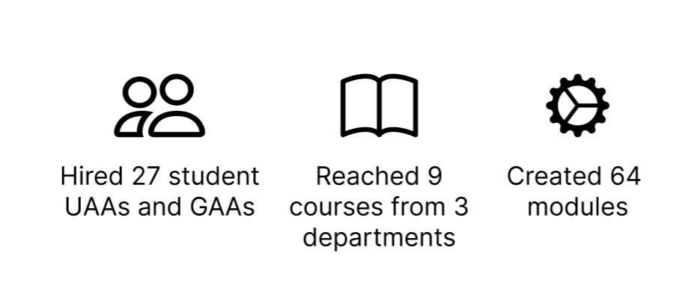
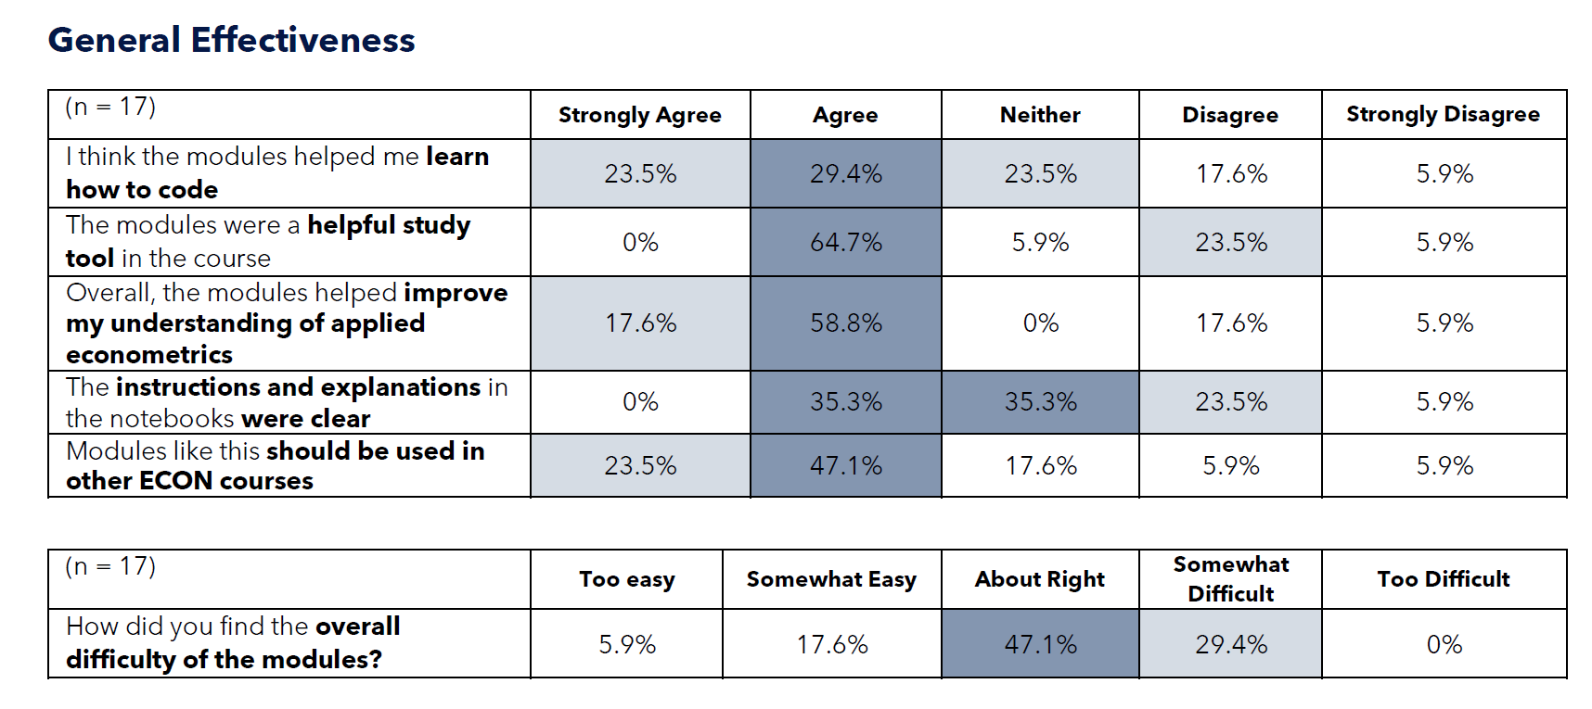
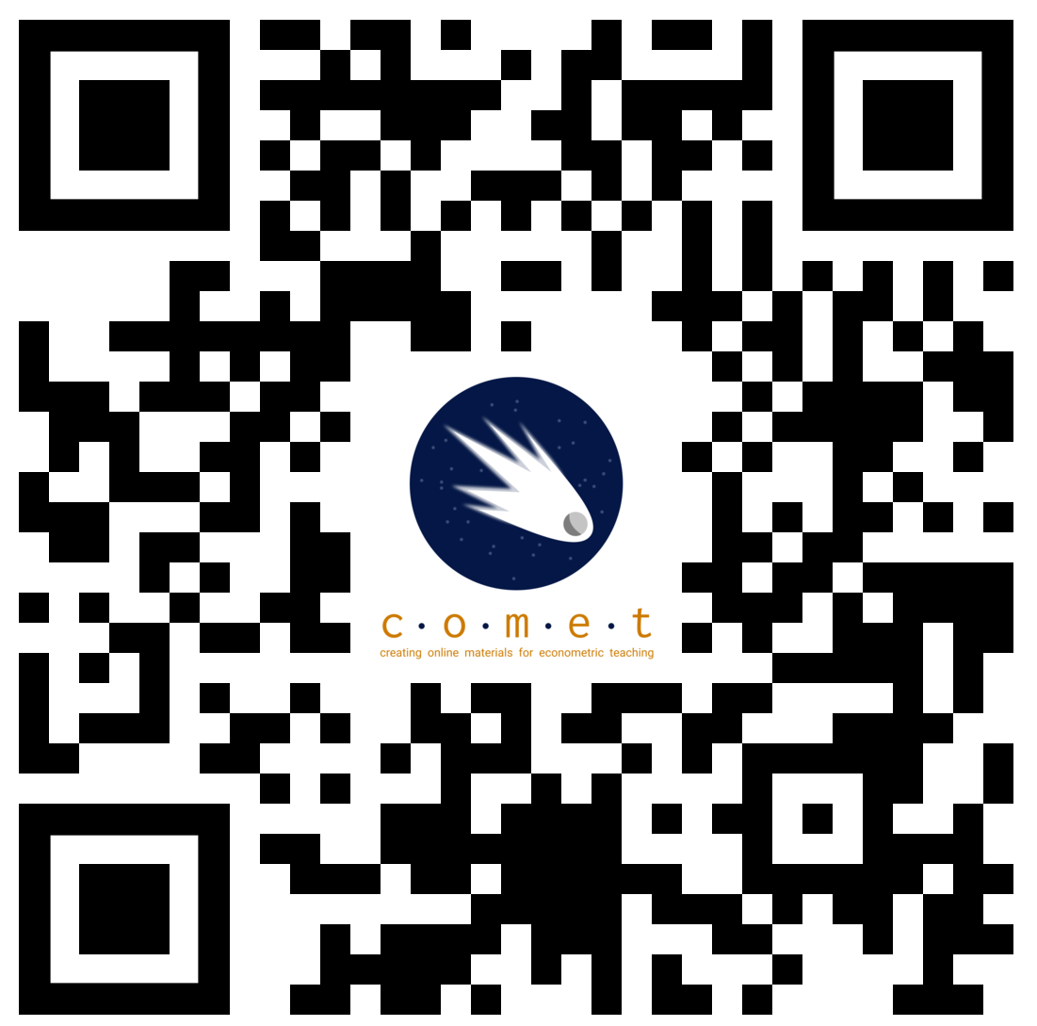
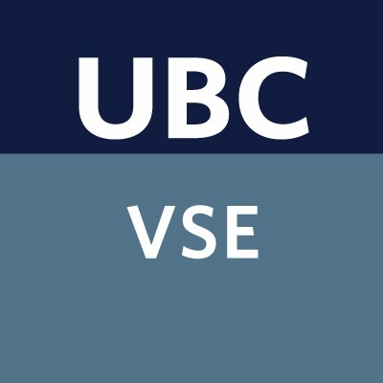
Vancouver School of Economics (VSE) – Faculty of Arts – UBC-V
COMET: Developing interactive learning modules for hands-on-econometrics skills
Marina Adshade (VSE, UBC-V), Jonathan Graves (VSE, UBC-V), Emrul Hasan (VSE, UBC-V)
Introduction
Applied statistical methods for economics (econometrics) are important skills for the Vancouver School of Economics’ students. However, many students struggle with econometrics, particularly when using these skills with real-world data. This creates problems for them following graduation or in more advanced courses.
Surveys of students showed that, prior to our project, among students completing our econometrics courses:
Few felt ready to do applied research.
A majority lacked confidence using applied tools and modelling.
A large minority had no experience using statistical software or applying econometrics.
These results agreed with faculty members who reported that students struggled to apply econometric skills in later courses.
Our TLEF: COMET
To solve this program, we created this a large TLEF project, named “COMET” (for Creating Online Materials for Econometrics Teaching”). Our goal is to create to a collection of hands-on “learning modules” which incorporate best-practices for teaching statistics.
These modules talk about economic questions, models, and data, and they use interactive notebook-based technologies to combine analysis, discussion, and theory into a single learning experience.
We have made dozens on them on different econometric topics and work with other units to add other areas.
Module Design
Each module covers a specific topic applied topic from econometrics or a related field. They include:
A Jupyter Notebook which outlines the topic and guides students through an application using open-source data.
A set of interactive exercises which provide feedback or provoke deeper thinking.
We designed the notebooks for independent study, flipped classrooms, labs, or as in-class exercises.
All our material is open-sourced under a CC-by-NC 4.0 licensed and is free to use.
JupyterNotebooks
Our approach uses Jupyter notebooks, which are a proven pedagogical tool for teaching applied statistics. Notebooks have several benefits:
They are cross-language, which lets us teach several statistical languages in the same framework.
They support “literate computing” skills which combine discussion, reflection, and computation.
They can be run via the cloud, in a web-browser, so students don’t need special software or a good computer to use the notebooks.
The web-based framework also means the tool is easier to use with assistive technologies which work with web-browsers.
Years 1 & 2: Start of the Project
Our project has completed 2 of the 3 years of its funding. Over that time we:
The topics for our notebooks included:
Regression and statistical analysis.
Geographic computation.
Machine learning and large language models.
Reviews of fundamental statistics.
We evaluated our project using a mixed-methods approach. Some of the results are below. We learned:
Student learned well from the modules.
Quality was the most important attribute.
Videos were surprisingly counterproductive.
Next Steps
In our final year, we are planning to:
Get students more involved in developing and improving notebooks by making the code more accessible.
Developing notebooks on selected advanced topics, like using AI models.
Creating a “Teaching with Jupyter” series to help new faculty use these tools.
Improving and automating our development process to make it easier to use and maintain.
We are also doing a Universal Design for Learning project with these notebooks to make them more accessible.
Interested? Get Involved!
As part of our project we are interested in helping students and faculty learn more about these kinds of frameworks, and their use in classrooms. We are happy to help support you!
We offer workshops, advice, and development support for new notebooks.
Get in touch via comet.project@ubc.ca
Year 1 Assessment Results
Our evaluation found that students generally liked the notebooks and found them useful, but wanted more exercises, and fewer errors.
Try it out at
comet.arts.ubc.ca
We gratefully acknowledge the financial support for this project provided by UBC Vancouver students via the Teaching and Learning Enhancement Fund
We also thank UBC’s LTHub, CTLT, and PIMS Syzygy for technical support and advice.

