Slide 1
Sketch of a simple casing model:
not even remotely to scale
10cm
1cm
1cm
1cm
Drilling Mud
1 S/m
Summary:
Mud: 10cm diameter
1 S/m
μ₀
Casing: 1cm thickness
5.5 x 10^6 S/m
100 μ₀
Cement: 2cm thickness
10 Ωm
μ₀
Collar: 1cm thickness
5.5 x 10^6 S/m
100 μ₀
Above Reservoir: 1400m thick, 10 Ωm
Invaded zone: 1cm thick, 5 Ωm
Shale: 50m thick, 5 Ωm
Invaded zone (5 Ωm)
Reservoir: 50m thick, 50 Ωm
Invaded zone: 2cm thick, 40 Ωm
Collar
0.5 m
Above Reservoir:
10 Ωm
1400 m
1.5 km
Invaded, 5 Ωm
1cm
Cement: 10Ωm
Casing: 5.5 x 10^6 S/m, 50 μ₀
Shale:
5 Ωm
50 m
0.5cm
Reservoir:
50 Ωm
Invaded 5 Ωm
50 m
2cm

Slide 2
Sketch of Geologic Model:
Also not remotely to scale
Summary:
Above Reservoir: 1400m thick, 100 Ωm
Shale: 50m thick, 5 Ωm
Reservoir: 150m thick, 50 Ωm
Resistive region: 200m x 200m x 30m
150 Ωm
100m from well
Center in same plane as well
Below
To depth
100 Ωm
Above Reservoir:
10 Ωm
1400m
1.5 km
Casing Model: See previous slide
Shale:
5 Ωm
50m
200m
10m
Reservoir:
50 Ωm
100m
Res. region:
150 Ωm
30m
50m
10m
Below Reservoir:
30 Ωm

Slide 3
10cm
1cm
Drilling Mud
1 S/m
Above Reservoir:
10 Ωm
1.5 km
Inductive Source
Galvanic Source
Casing: 5.5 x 10⁶ S/m, 50 μ₀
Shale:
5 Ωm
Reservoir:
50 Ωm
150 μ₀
30m

Slide 4
Drilling Mud
1 S/m
1.5 km
Inductive Source
Galvanic Source
Casing: 5.5 x 10⁶ S/m, 50 μ₀
150 μ₀
15m
10cm
1cm

Slide 5
Above Reservoir:
10 Ωm
1410m
1.5 km
Casing Model
50m
Shale:
5 Ωm
200m
10m
Reservoir:
50 Ωm
Resistive Region
150 Ωm
50m
30m
100m
10m
Below Reservoir:
30 Ωm
To depth

Slide 6
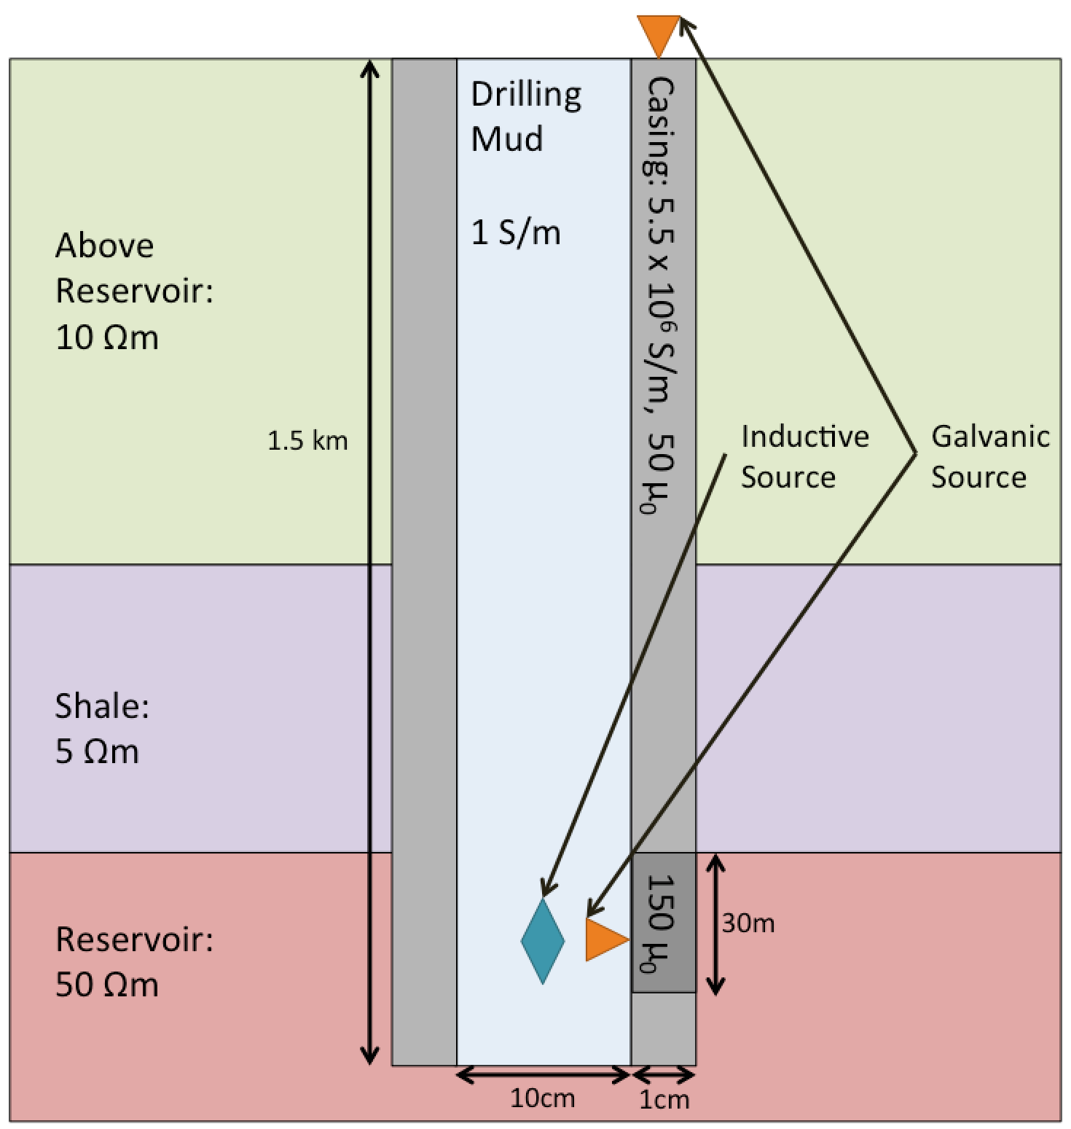
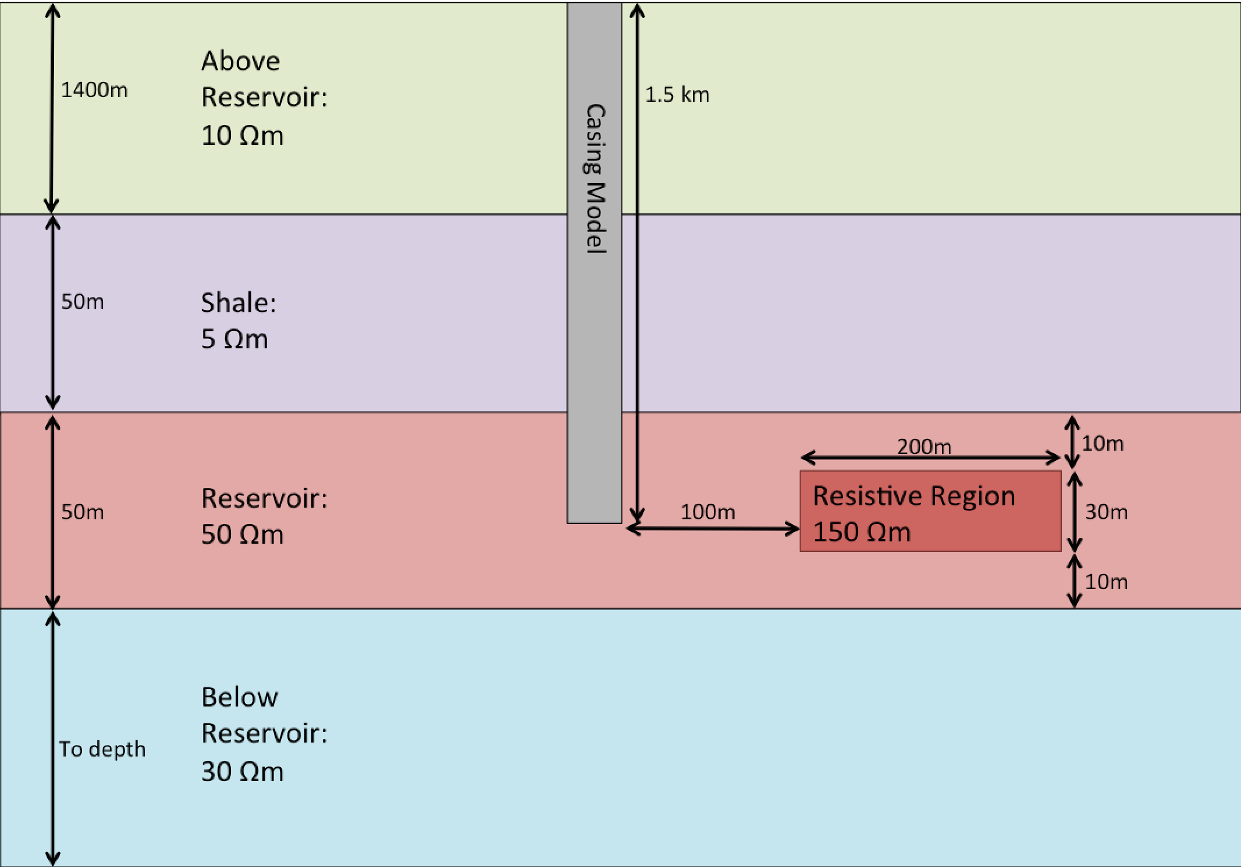

Slide 7
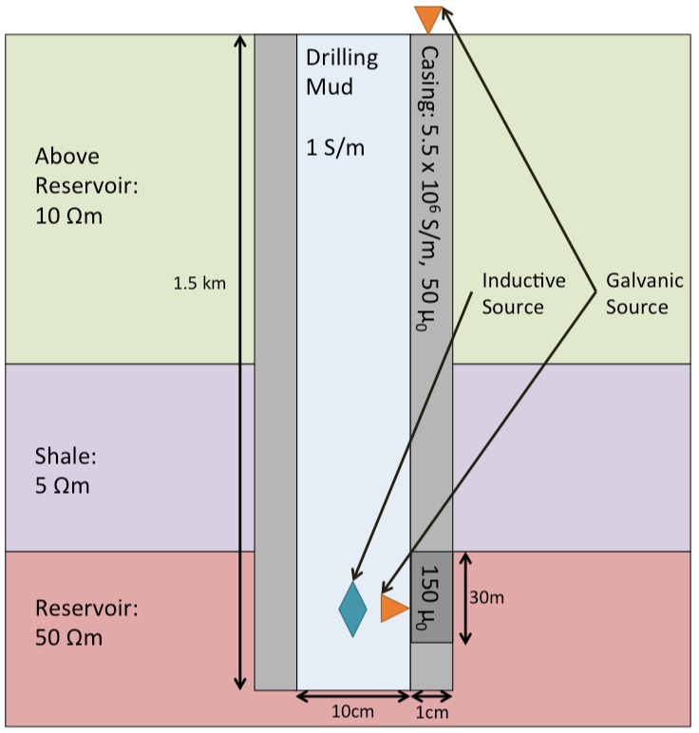
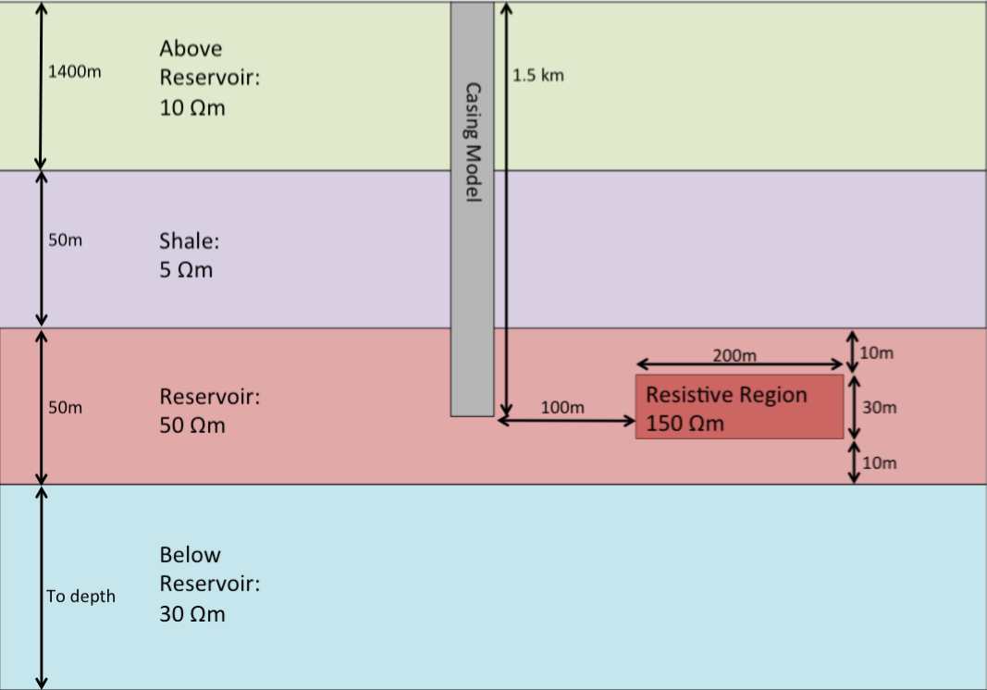

Slide 8
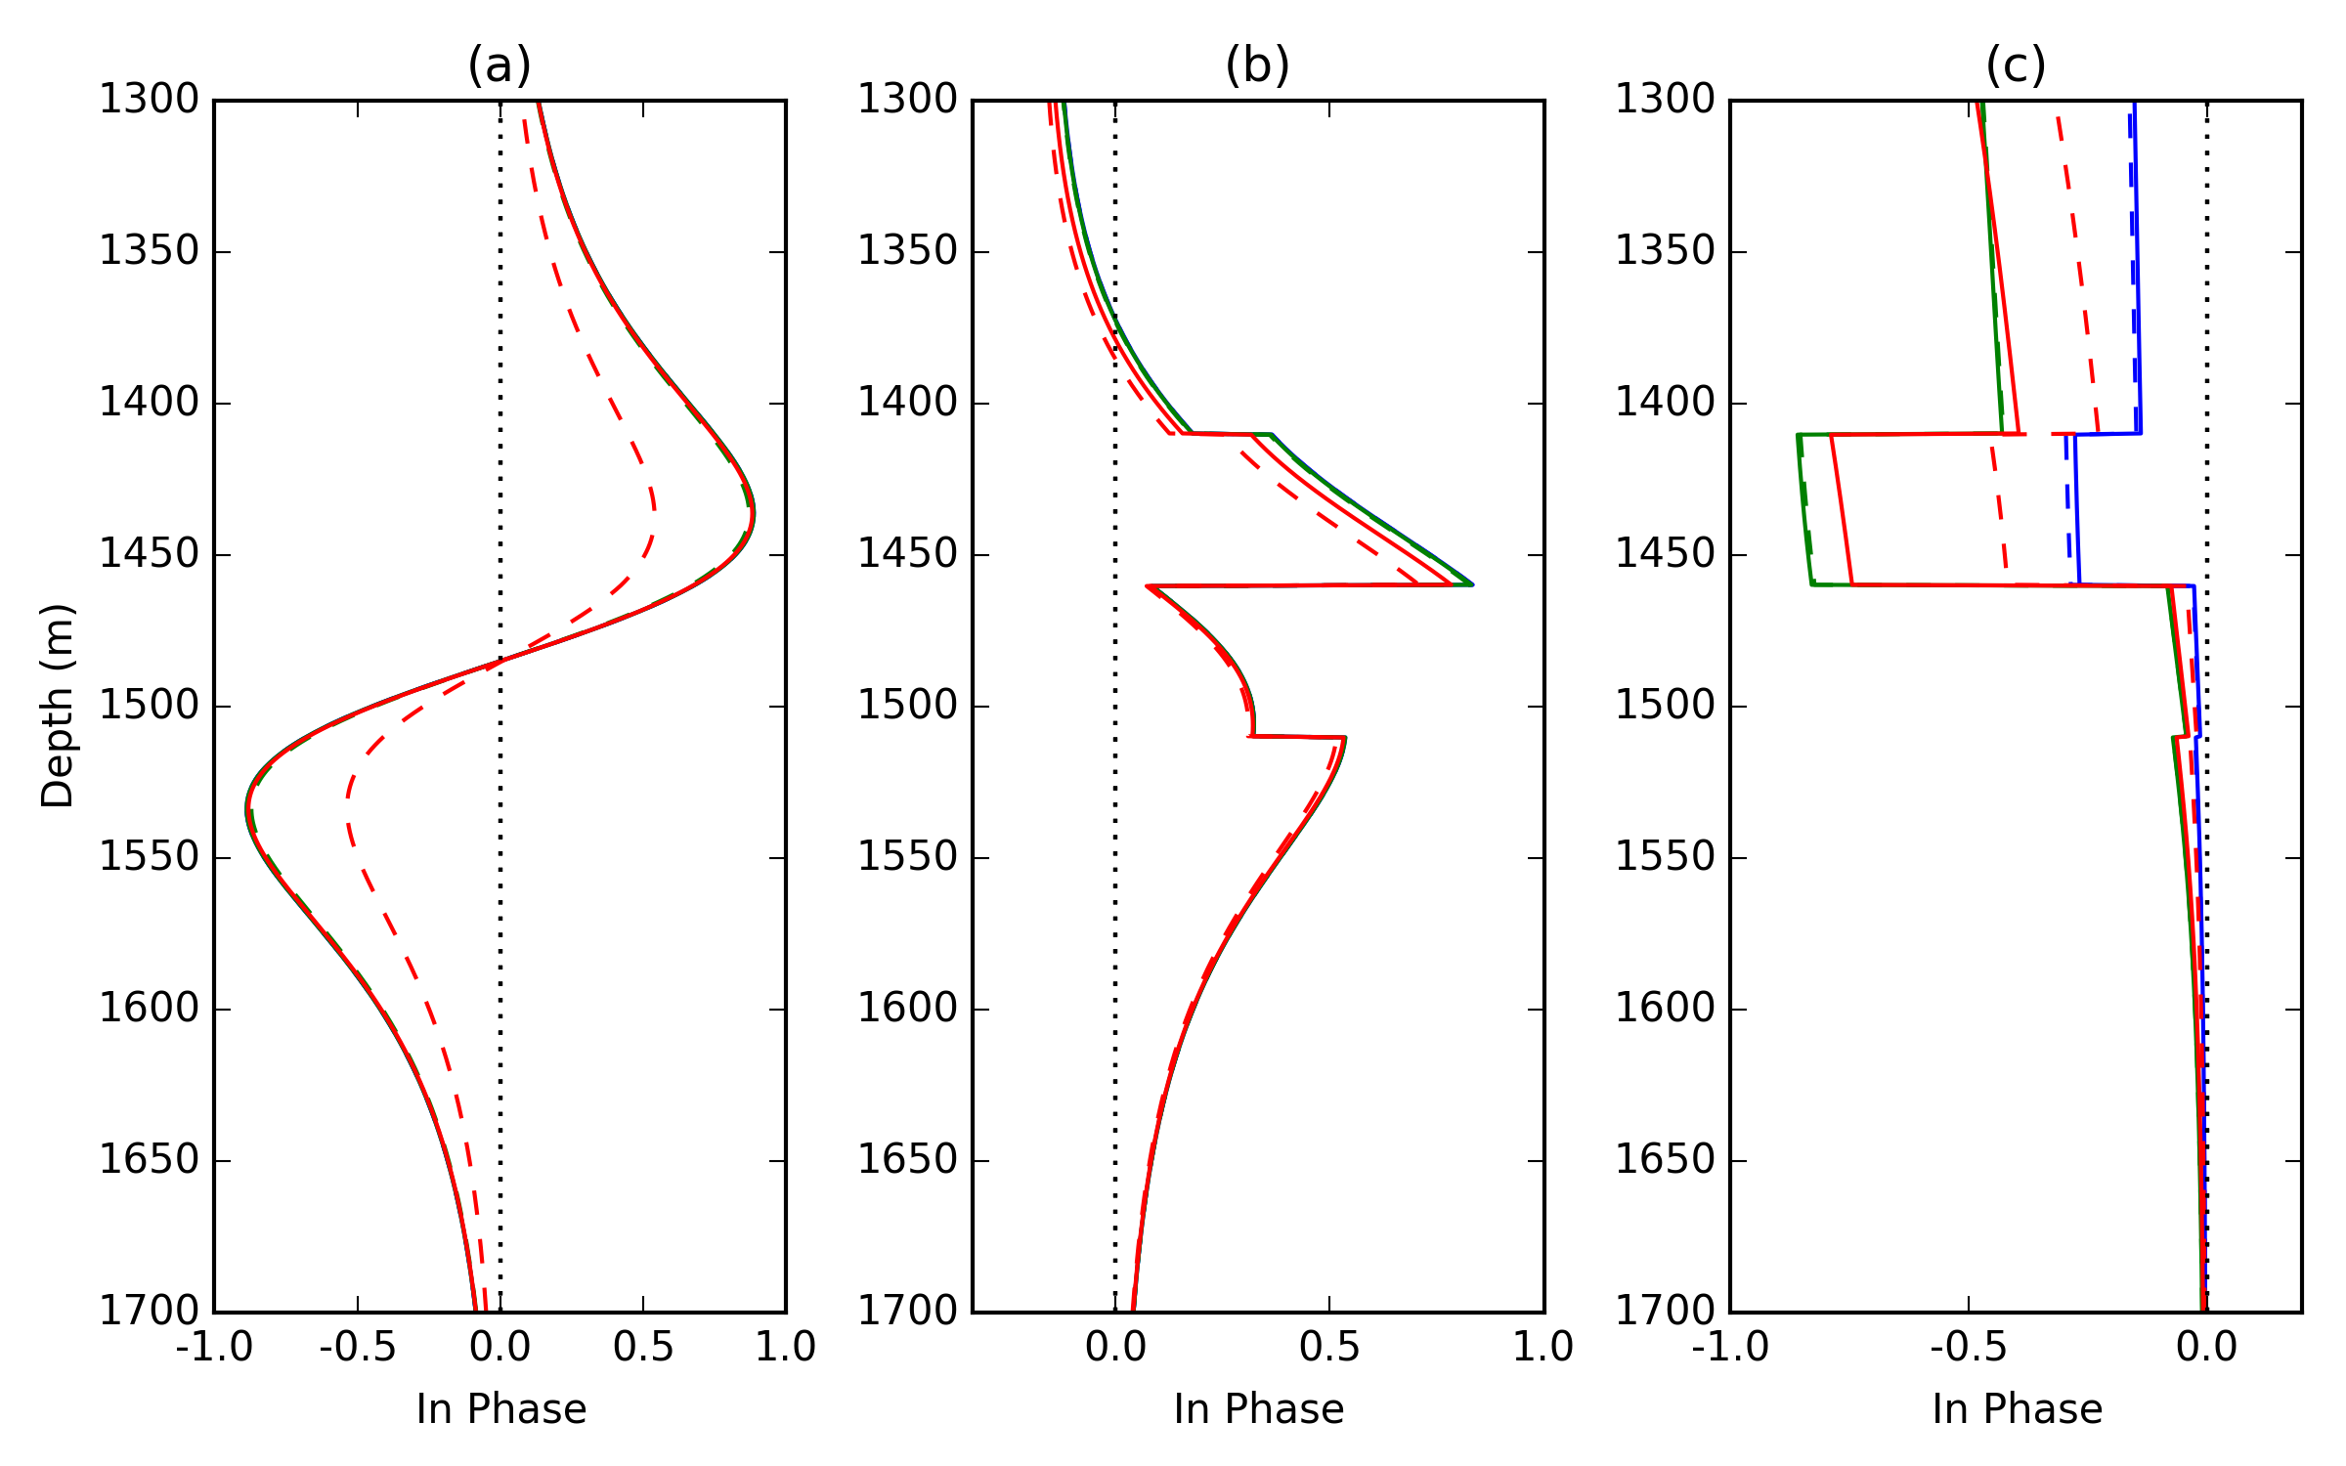
(c)
…
(a)
(b)

Slide 9
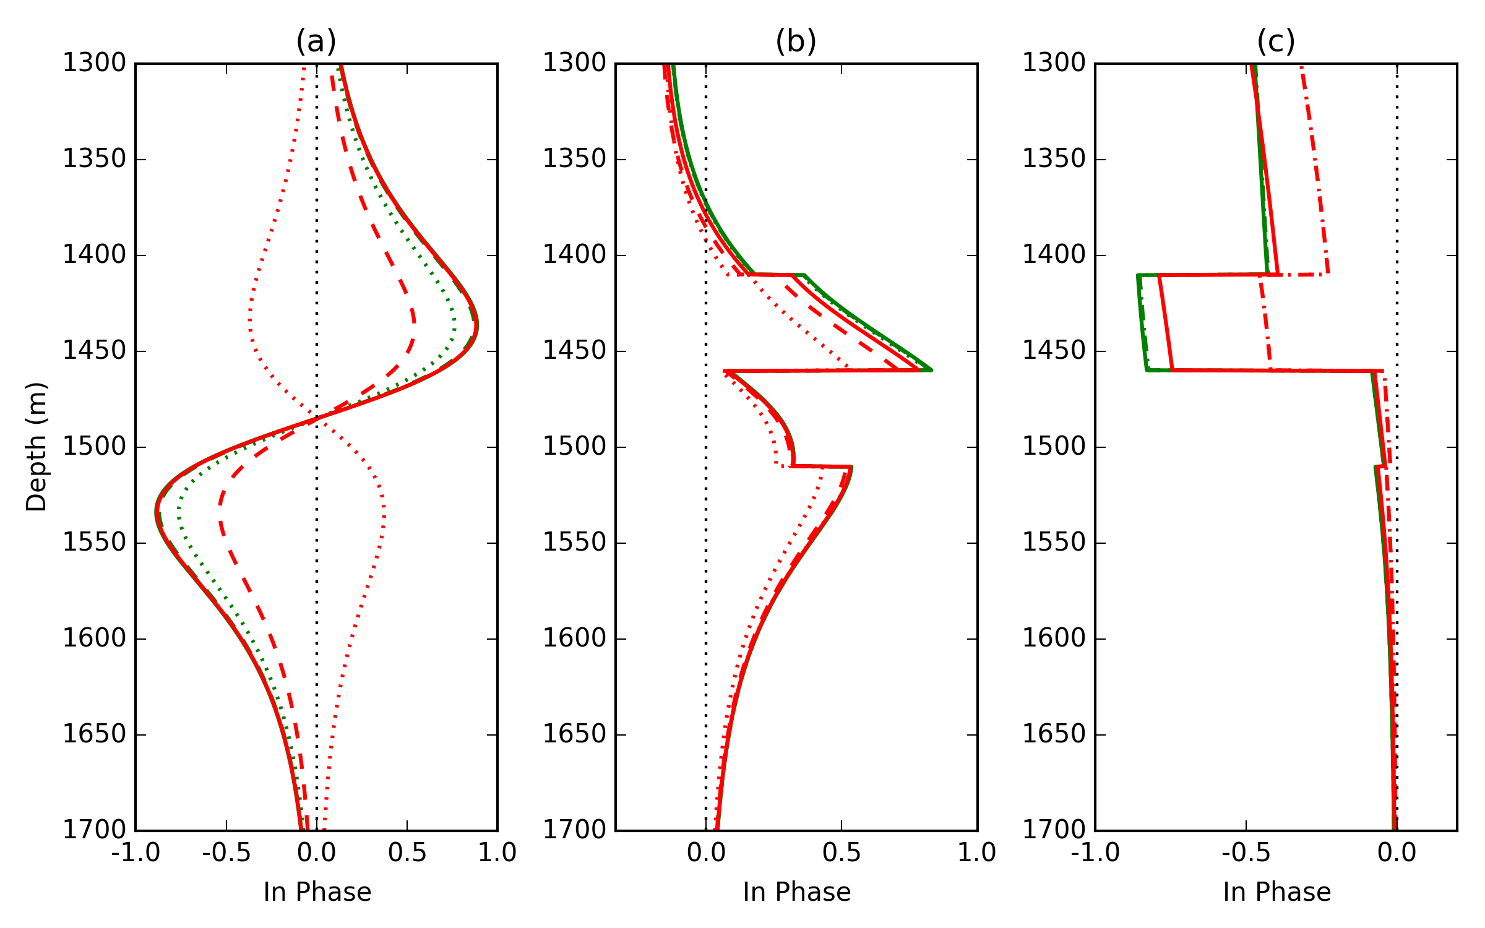
(c)
…
(a)
(b)

