Slide 1
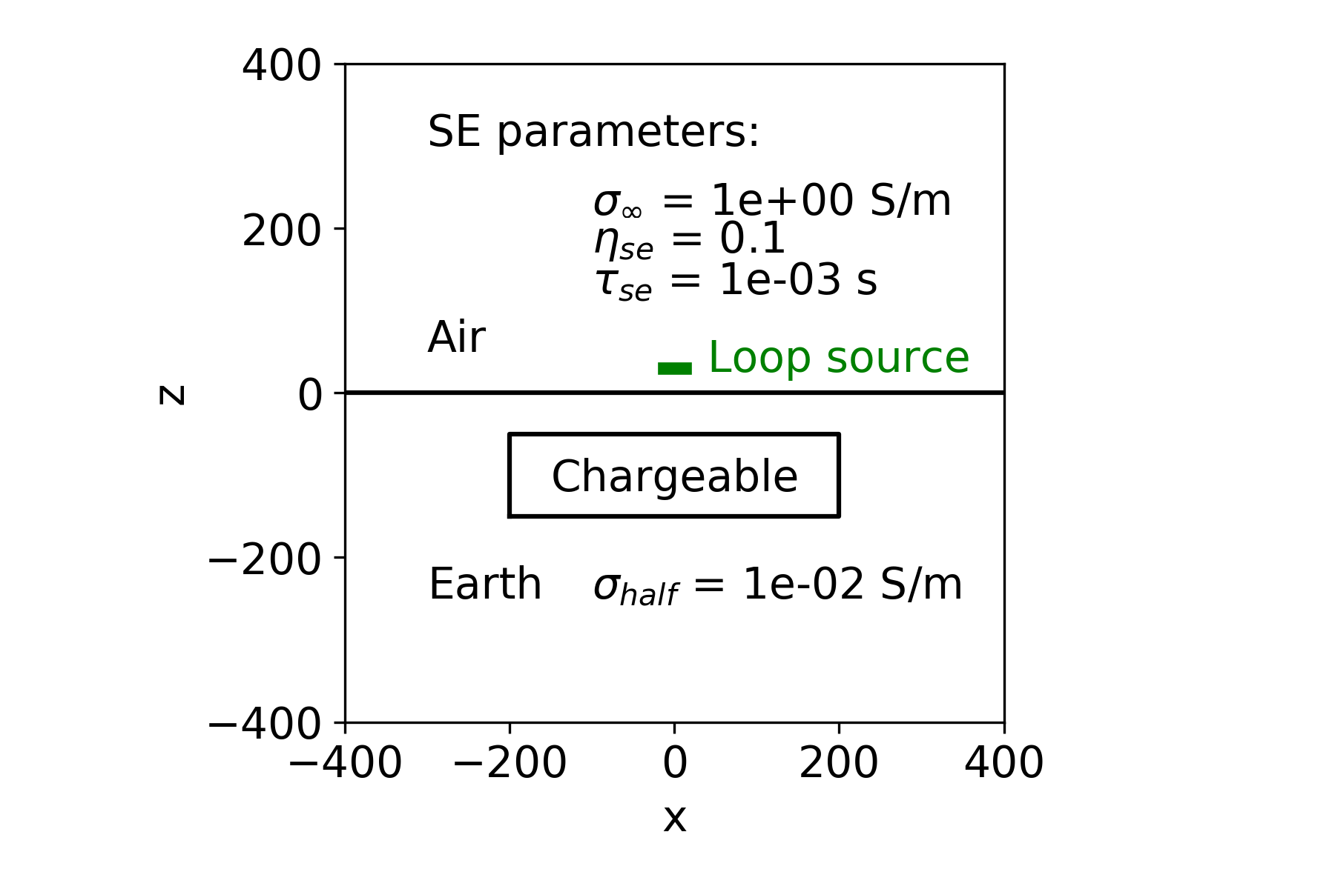
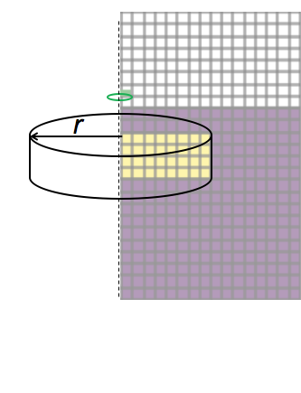
Cylindrically Symmetric Mesh
z (m)
z_{top}
h
x (m)

Slide 2
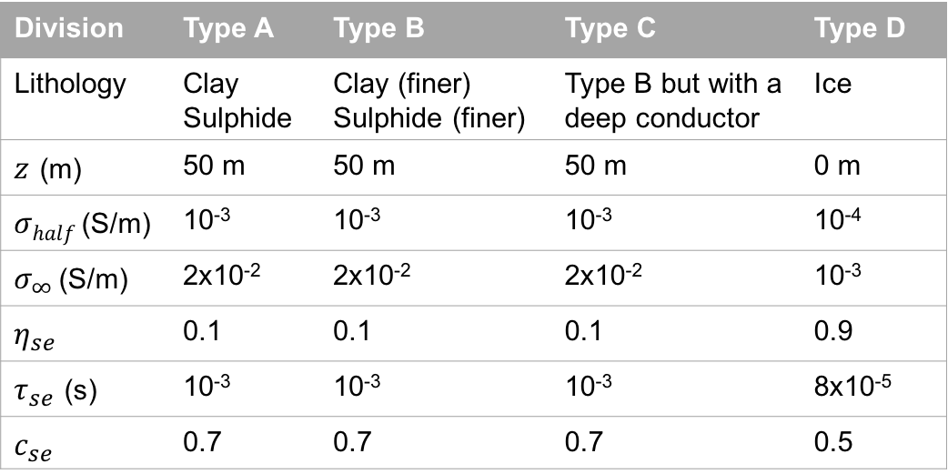
Division | Type A | Type B | Type C | Type D
Lithology | Clay Sulphide | Clay (finer) Sulphide (finer) | Type B but with a deep conductor | Ice
$z$ (m) | 50 m | 50 m | 50 m | 0 m
$σhalf$(S/m) | 10⁻³ | 10⁻³ | 10⁻³ | 10⁻⁴
$σ_{∞}$(S/m) | 2x10⁻² | 2x10⁻² | 2x10⁻² | 10⁻³
$$η_{se}$$ | 0.1 | 0.1 | 0.1 | 0.9
$τ_{se}$ (s) | 10⁻³ | 10⁻³ | 10⁻³ | 8x10⁻⁵
$$c_{se}$$ | 0.7 | 0.7 | 0.7 | 0.5

