Slide 1
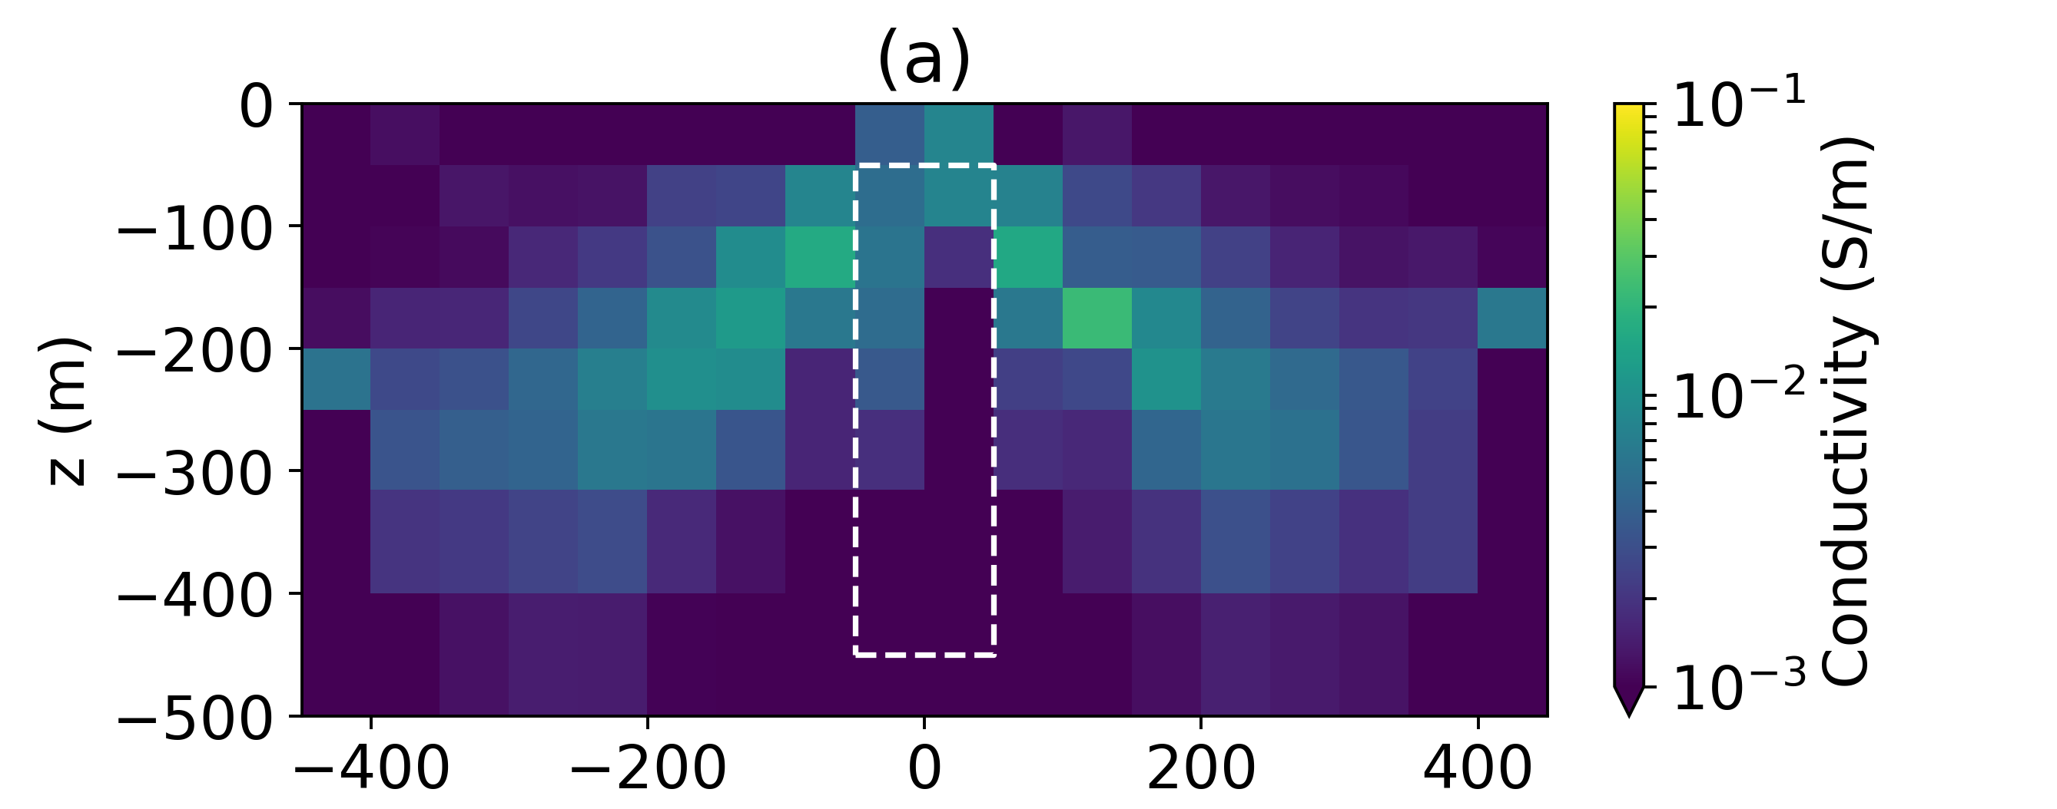
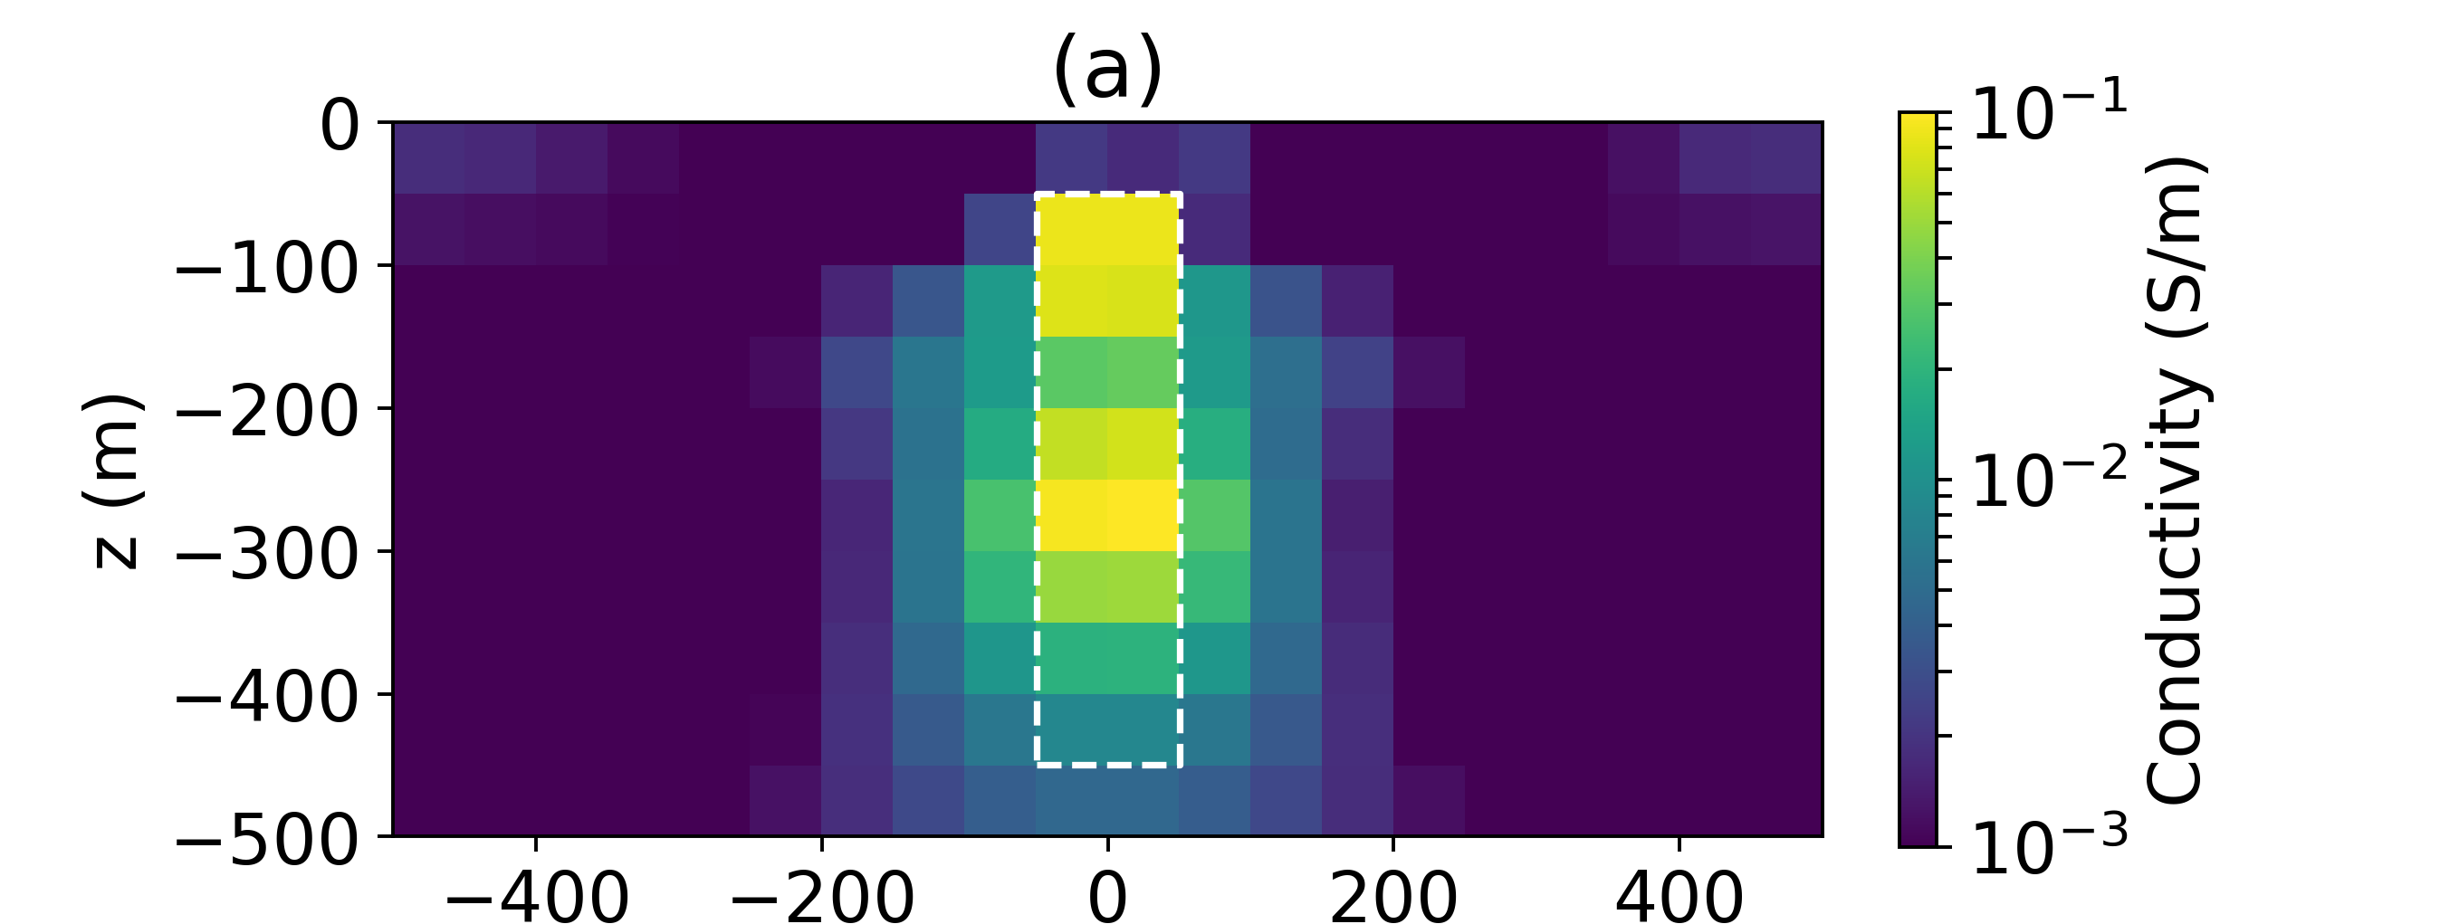
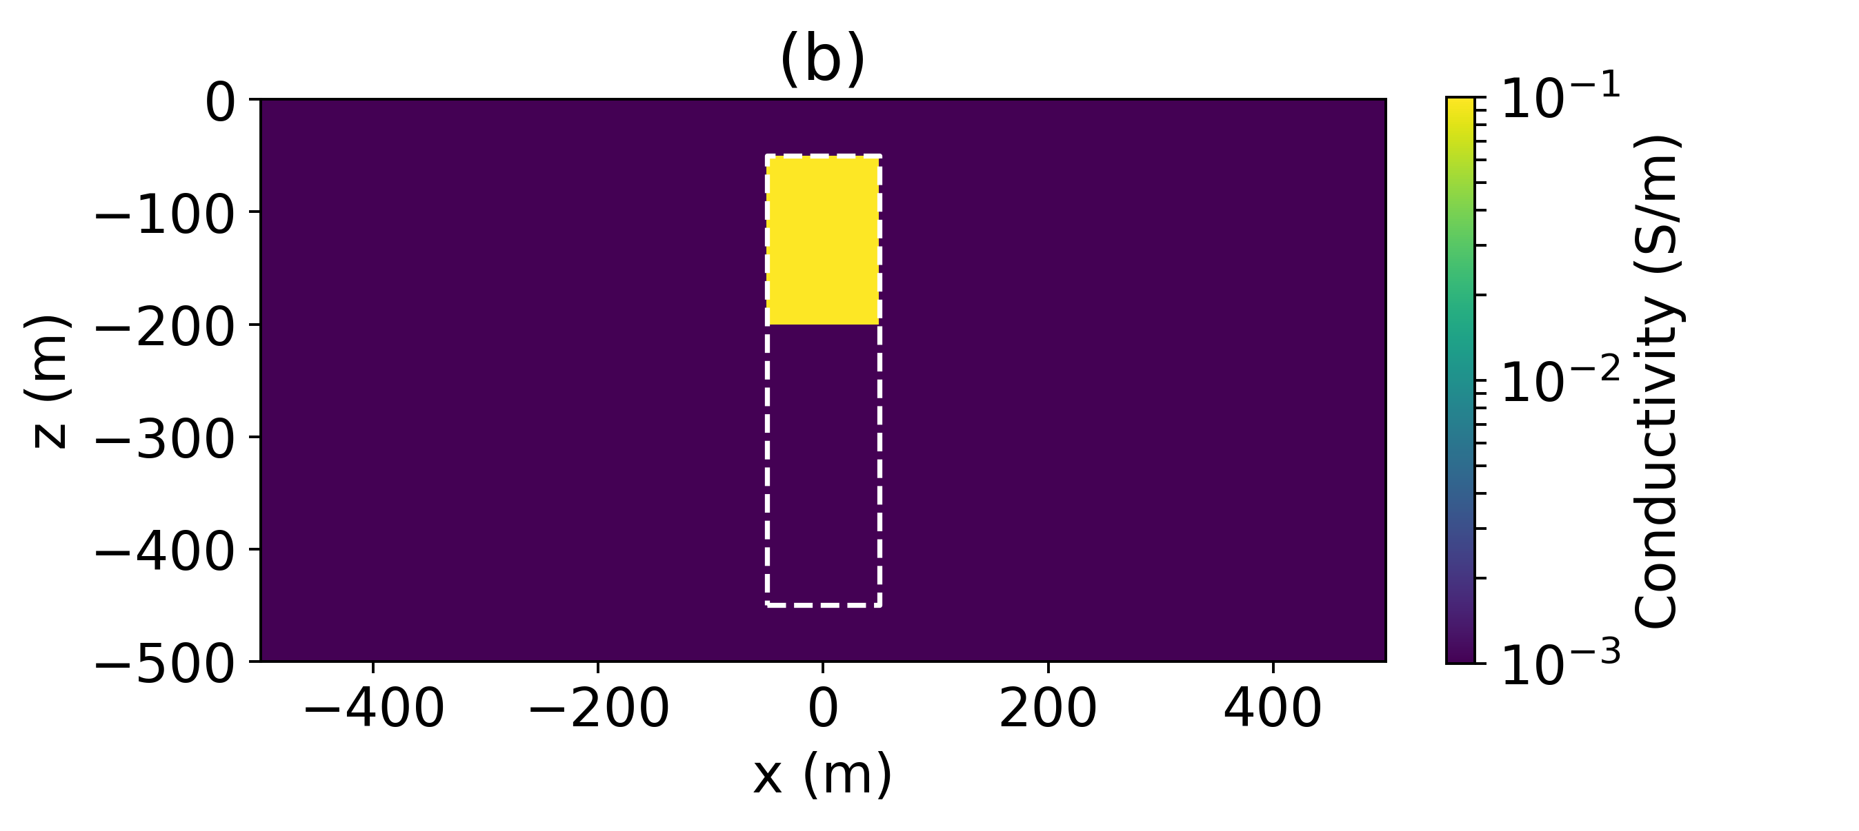
(a)
Conductivity (S/m)
(b)
z (m)
Conductivity (S/m)
(c)
Conductivity (S/m)
x (m)

