Slide 1

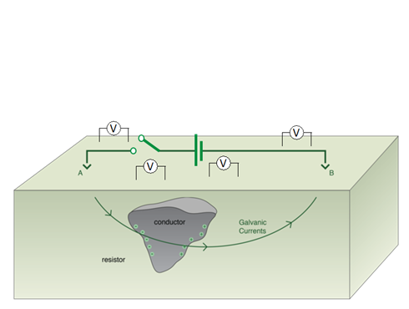
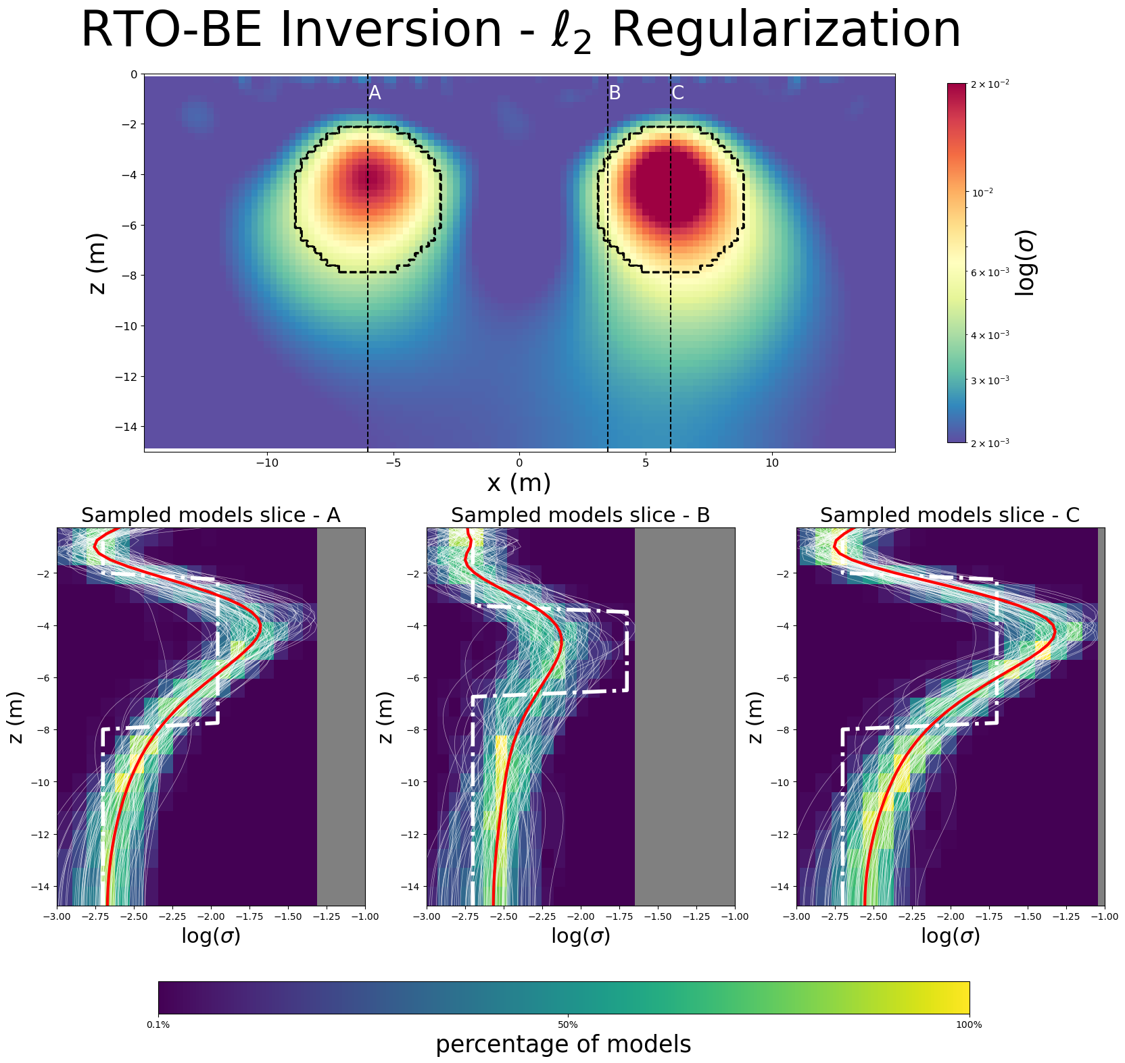
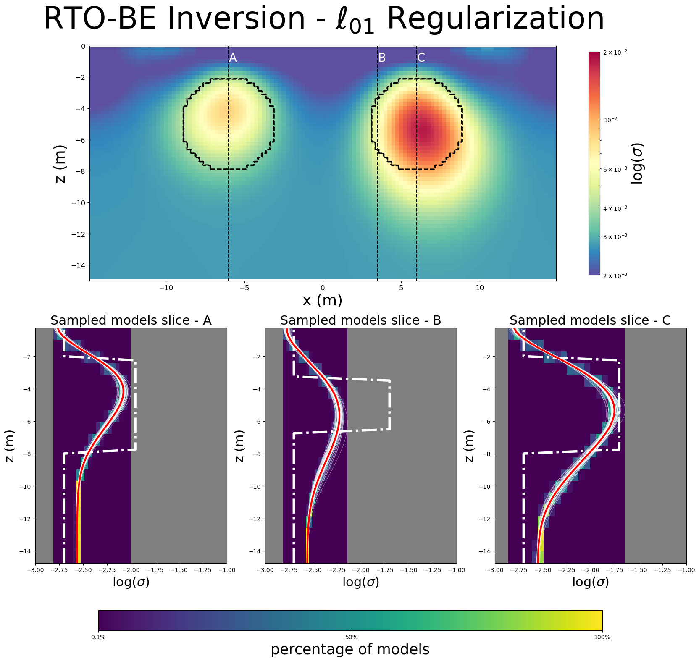
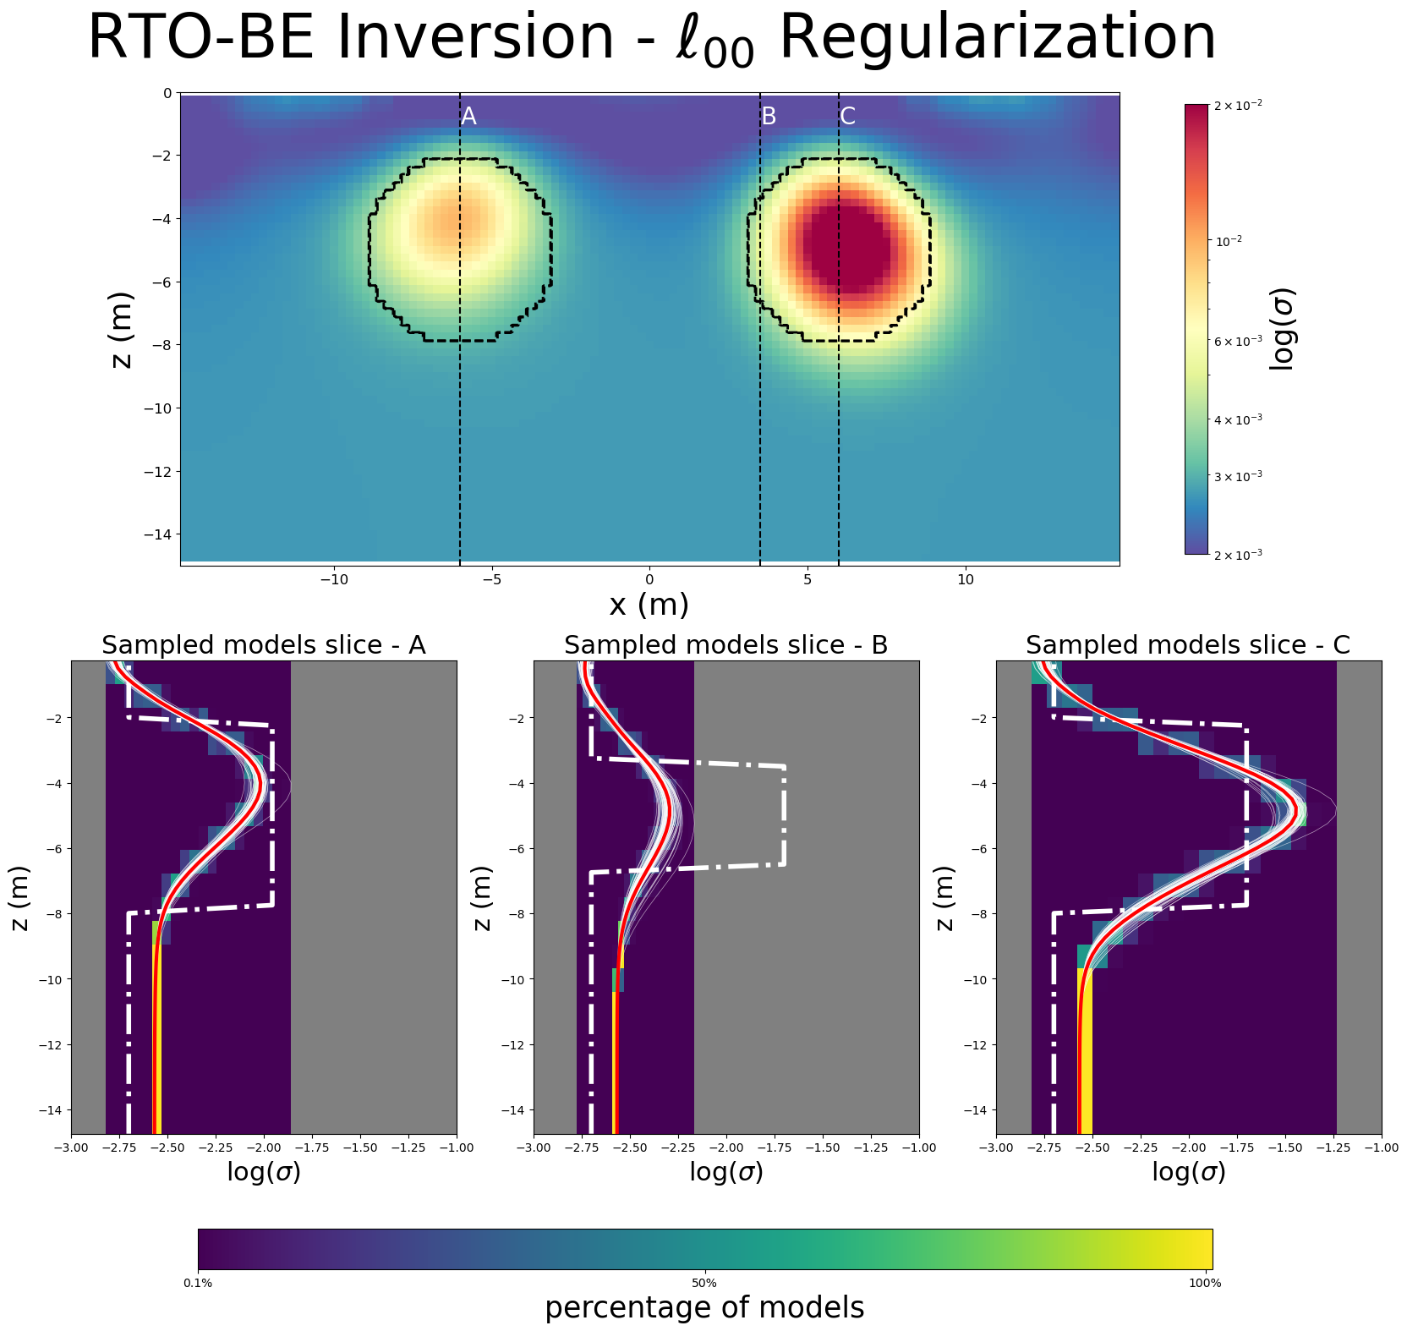
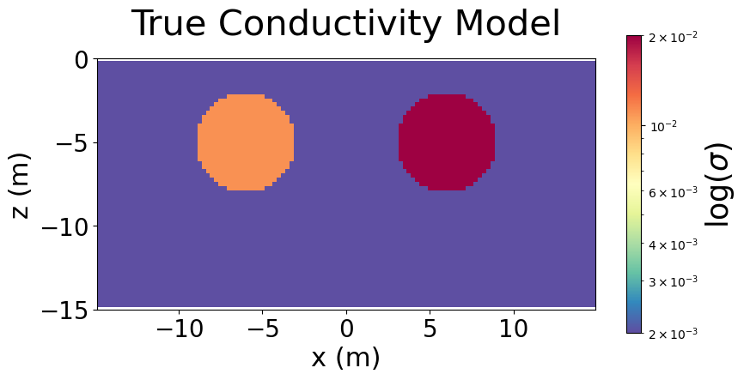
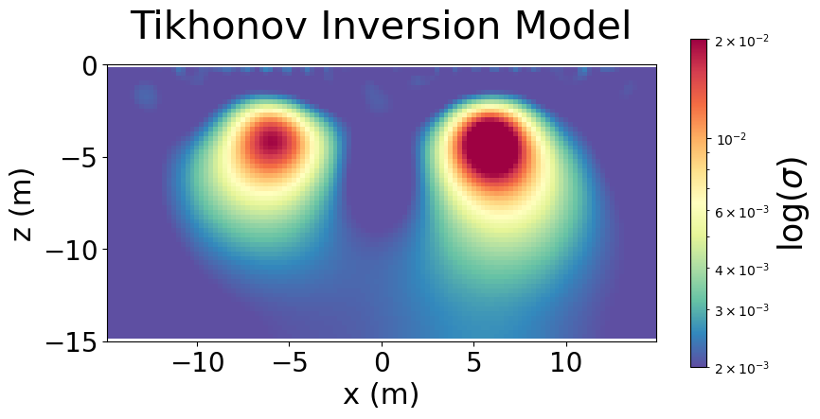
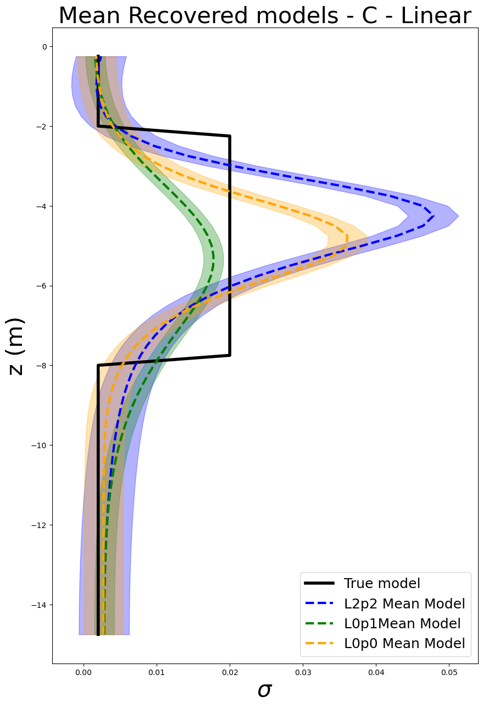
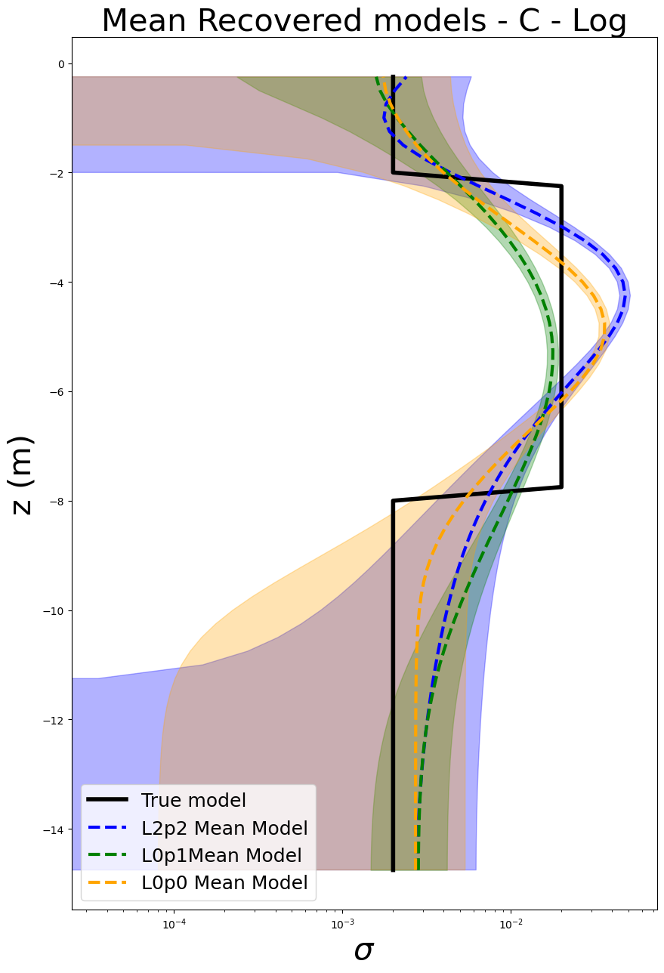
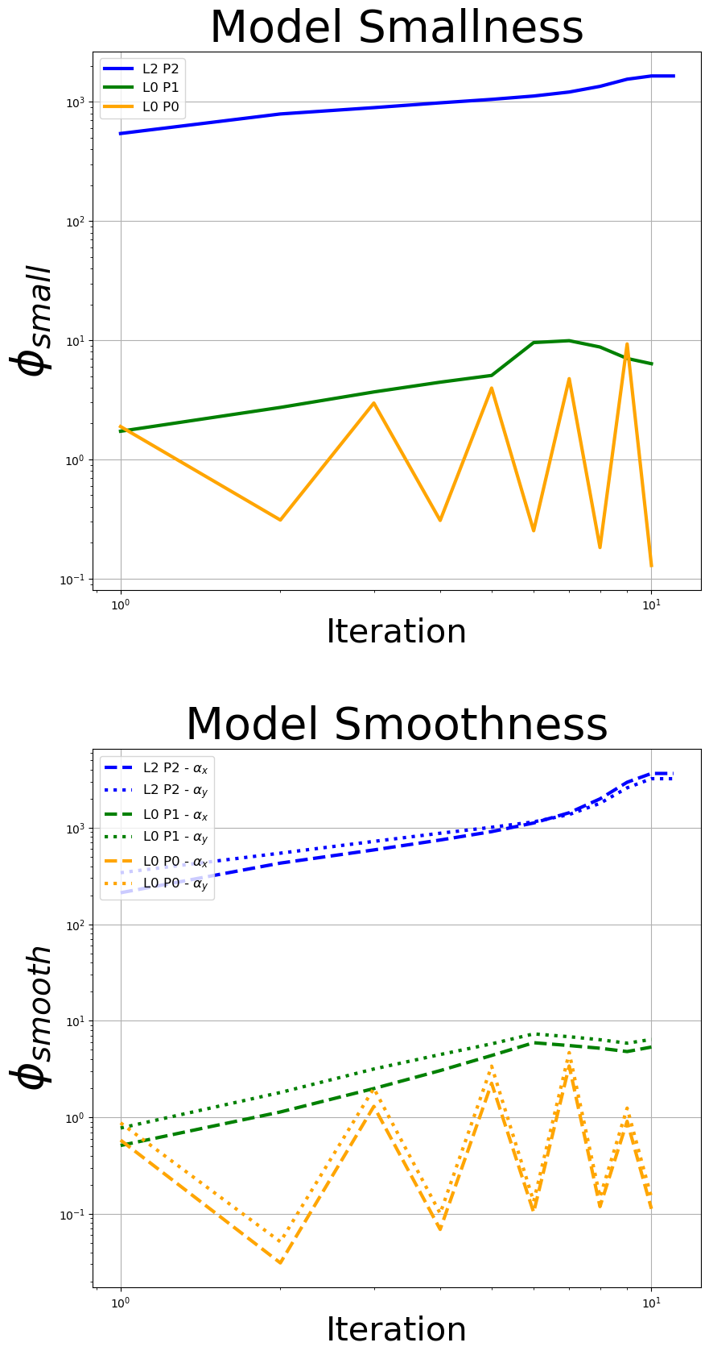

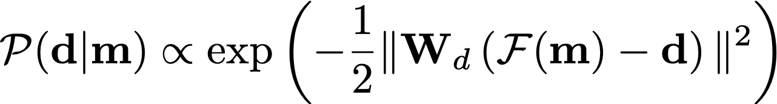
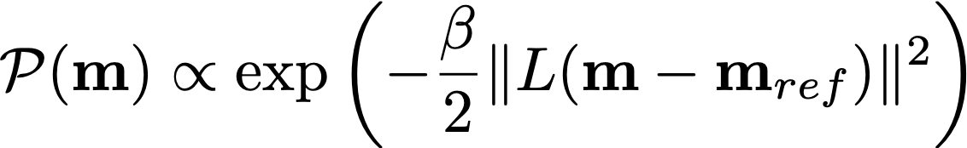
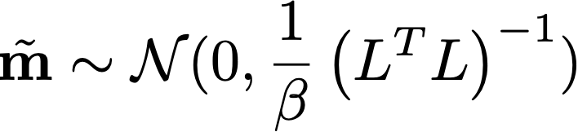
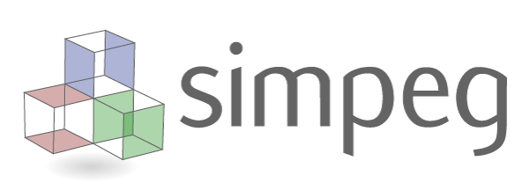


Comparing strategies for assessing uncertainty with geophysical inversions for mineral exploration
Johnathan Kuttai, Lindsey J. Heagy
gif.eos.ubc.ca
Motivation
Simulation and Inversion
Drilling plays a crucial role in exploration programs, and geophysical data often aid in choosing drill locations. Electromagnetic methods, sensitive to subsurface conductivity, are commonly used to create subsurface models for this purpose. However, geophysical inversions are inherently non-unique, as multiple Earth models can fit the data. Therefore, the uncertainty in the obtained models is of interest. However, formal uncertainty quantification poses a challenge, given the difficulty in translating the ultimate decision into a mathematical framework. Our work is to aim at using a blend of deterministic and Bayesian methods to assess uncertainty.
Direct-current resistivity physical property.
Pole-dipole & dipole-pole array acquisition.
The amount of regularization is set using a beta estimator.
background set to the median of the calculated apparent resistivity data. Initial model = 381 Ωm
90Ωm
20Ωm
500Ωm
Objectives
To explore the uncertainty in inversions by utilizing various combinations of prior norms.
Assess the strengths and weaknesses for addressing uncertainty-related questions
Methodology
Summary
Bayesian form:
The marginal and prior are:
Draws models by sampling the perturbed data distribution and minimize the negative log likelihood objective function
Randomize then optimize
(Bardsley J 2014, Blatter,D 2022)
Perturbed data:
Perturbed model:
The choice of prior norm directly influences the uncertainty.
L2 norm uncertainties are near equally uncertain through out the model.Particularly where the simulation has no sensitivity.
Sparse norms are more confident in their predictions. And where the simulation is not sensitive, the model strongly assumes it is defined by the prior.
The L2 norm, even where it is not sensitive, still estimates closer to the true background. The sparse norms only estimate the true background where the data is sensitive (e.g near surface).
Physical properties are well defined but edges of interfaces are difficult to resolve, even within the uncertainty bounds.
Tarantola, A. (2005). 10.1137/1.9780898717921, Fournier, D., & Oldenburg, D. W. (2019).10.1093/gji/ggz156, Bardsley, J. M., Solonen, A.,, Haario, H., & Laine, M. (2014). 10.1137/140964023, Blatter, D., Morzfeld, M., Key, K., & Constable, S. (2022). 10.1093/gji/ggac242
Powered by:
github.com/simpeg
slack.simpeg.xyz
simpeg.xyz

