Slide 1
Using convolutional neural networks to classify UXO with multi-component electromagnetic induction data
Jorge Lopez-Alvis¹, Lindsey J. Heagy¹, Douglas W. Oldenburg¹, Stephen Billings², Lin-Ping Song²
¹University of British Columbia, ²Black Tusk Geophysics, Inc.
This work is supported by DoD SERDP project MR22-3487

Slide 2
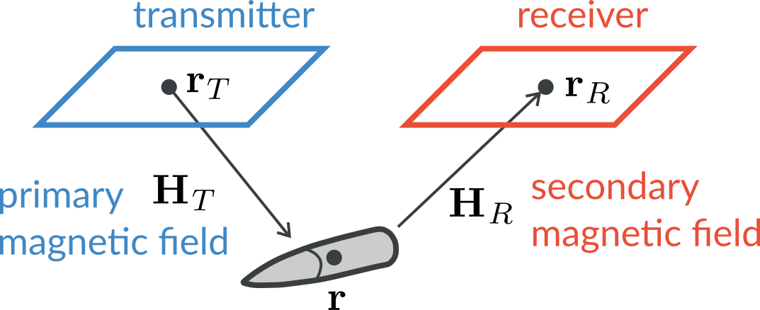
Time-domain EM response of a UXO

Slide 3
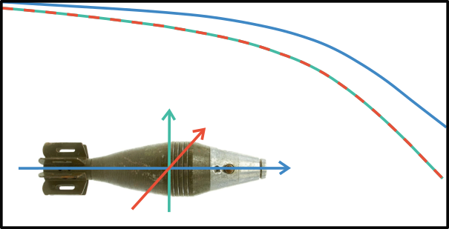
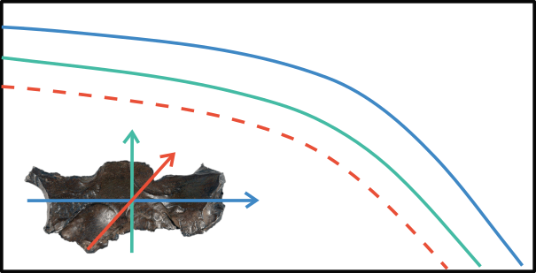
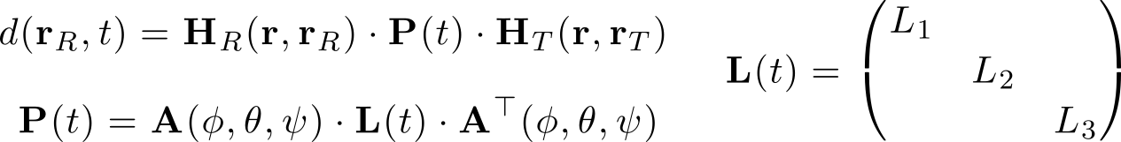
Time-domain EM response of a UXO
UXO
L1
L2 = L3
not UXO
L1
L2 ≠ L3
time

Slide 4
Time-domain EM response of a UXO
UXO
L1
L2 = L3
not UXO
L1
L2 ≠ L3
traditional approach: use inversion to get these and then
classify by comparing L(t) with ordnance library
time

Slide 5
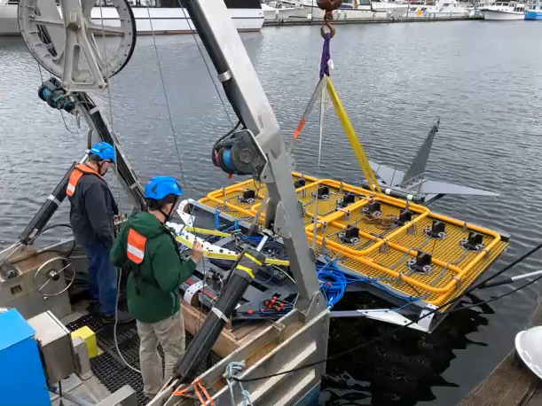
Survey and system
UltraTEMA-4 system:
4 transmitters
12 receivers (3-component)
27 time channels
Height above seabed: ~1 m
Notes:
Locations accuracy: objective: 95% within 50 cm
Platform altitude: +- 0.3 m for 90%
Platform attitude: +- 5º for 90%
Blind grid for detection and classification (detect targets and reject false alarms)
1.8m x 1.8m loops
Avoid early time channels (but still able to use 150-200 microsecs)

Slide 6
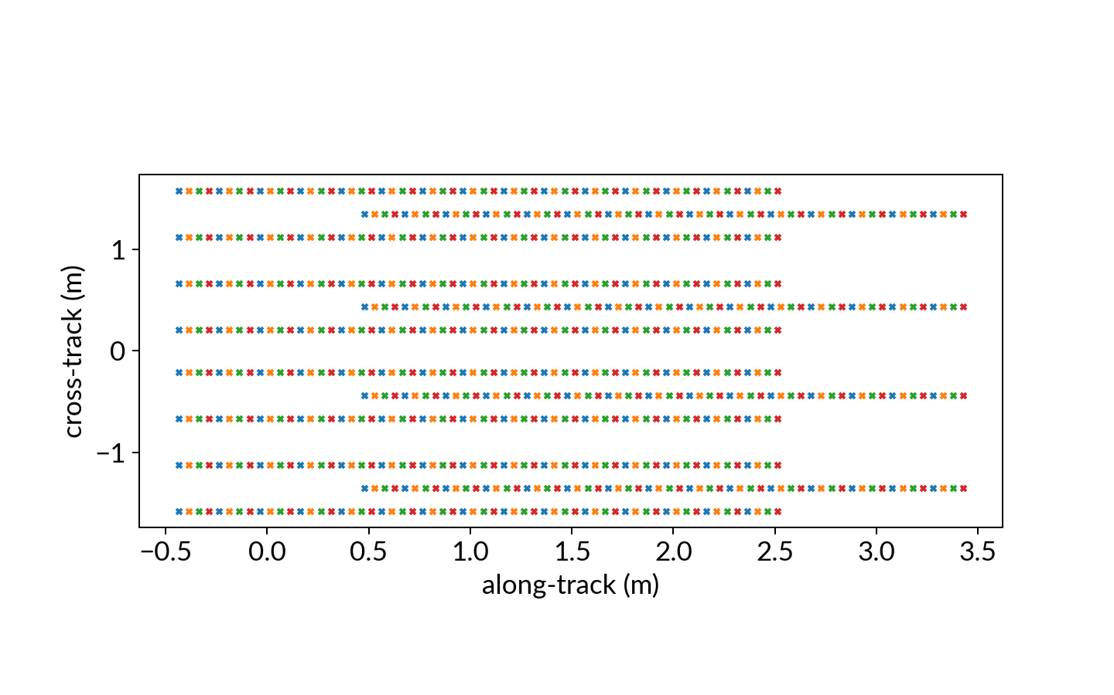
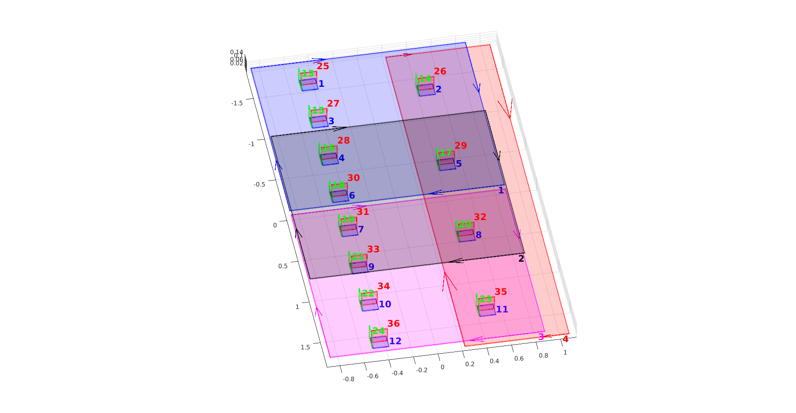
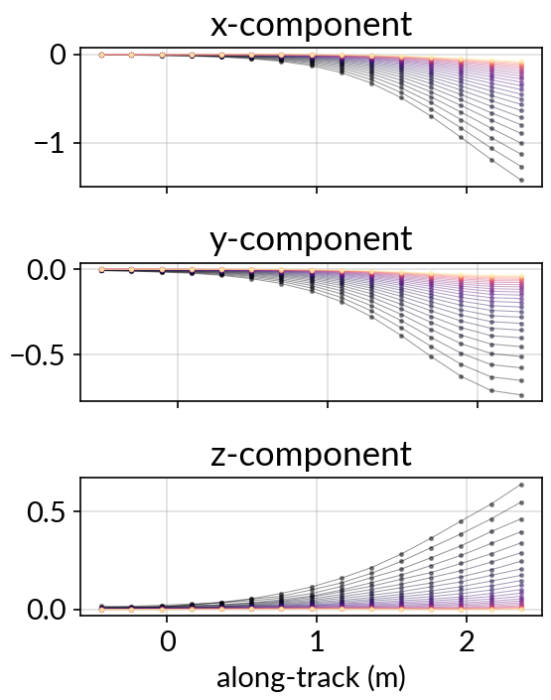
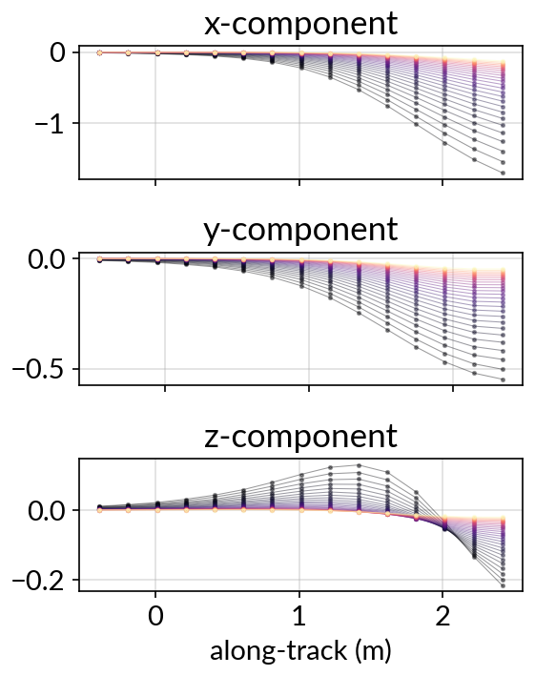
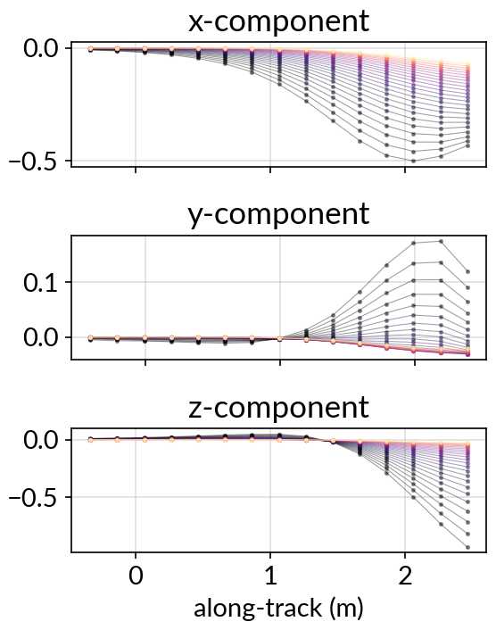
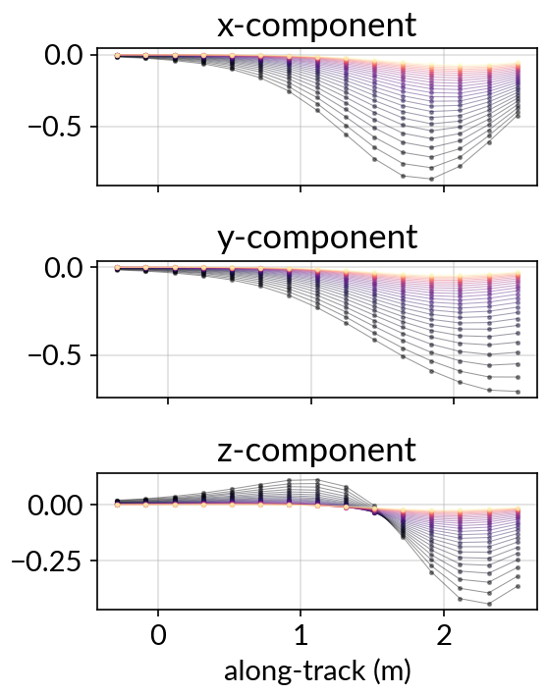
Data
Receiver 1
UXO
cross-track
moving
direction
Receiver 12
time
along-track
Transmitter 1
Transmitter 2
Transmitter 3
Transmitter 4

Slide 7
Data
Receiver 1
UXO
cross-track
moving
direction
Receiver 12
time
along-track
Transmitter 1
Transmitter 2
Transmitter 3
Transmitter 4

Slide 8
Data
Receiver 1
UXO
cross-track
moving
direction
Receiver 12
time
along-track
Transmitter 1
Transmitter 2
Transmitter 3
Transmitter 4

Slide 9
Data
Receiver 1
UXO
cross-track
moving
direction
Receiver 12
time
along-track
Transmitter 1
Transmitter 2
Transmitter 3
Transmitter 4

Slide 10
Can we classify directly from EM data?
Convolutional neural networks (CNNs)
Convolutional filters look at spatial / temporal features in the data
Training EM data for UXO classification:
Available library of ordnance objects with polarizations
Fast geophysical simulations
output
input
https://towardsdatascience.com/a-comprehensive-guide-to-convolutional-neural-networks-the-eli5-way-3bd2b1164a53

Slide 11
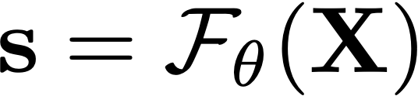

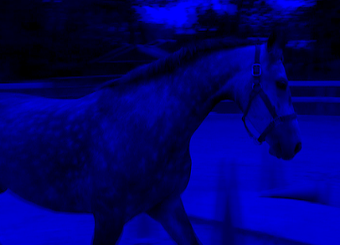

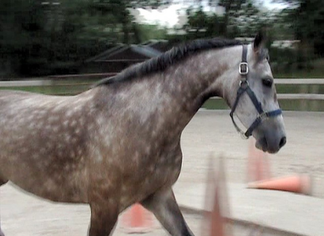
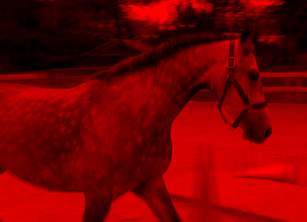
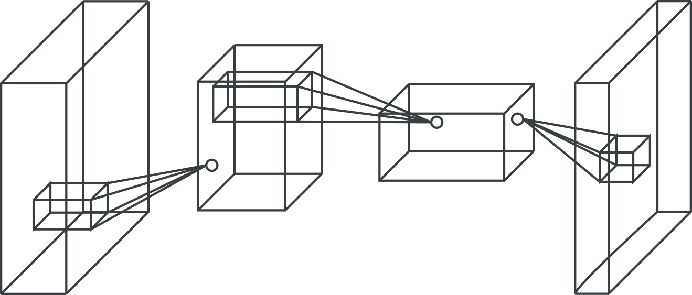

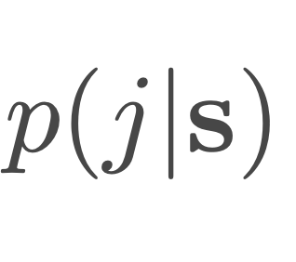
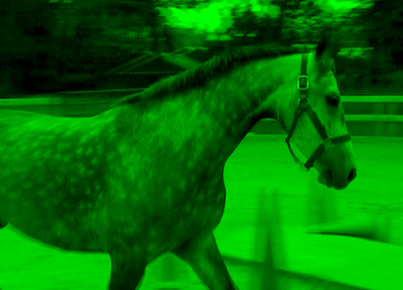

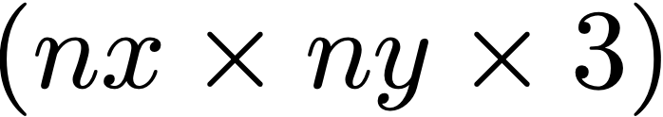
Convolutional Neural Networks (CNNs)
Supervised classification problem
provided data with labels, construct a function (network) that outputs labels given input data
Input
Features
Neural network
Class probabilities
predicted
true
Image segmentation

Slide 12

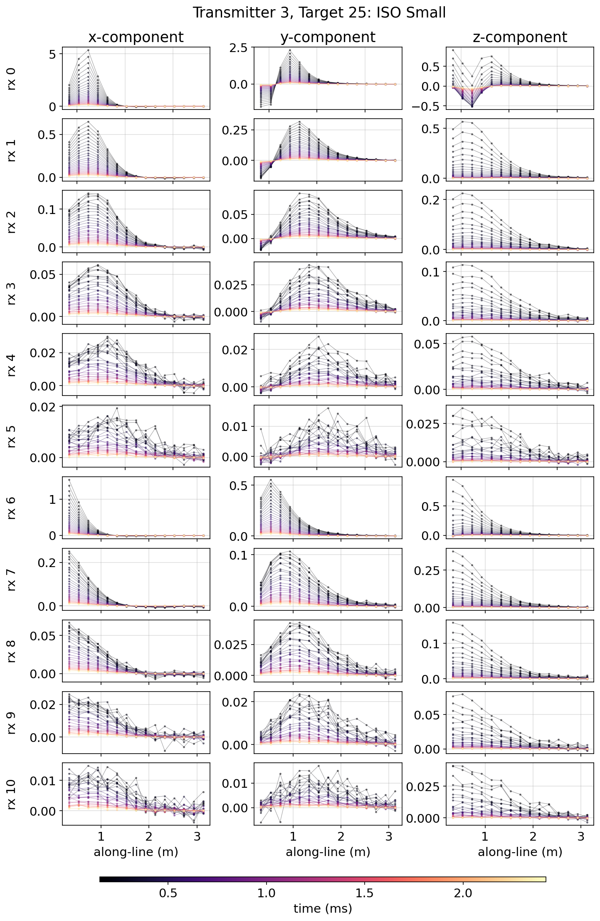
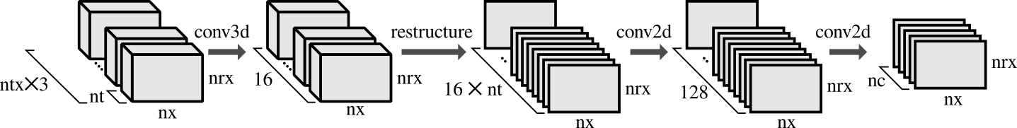

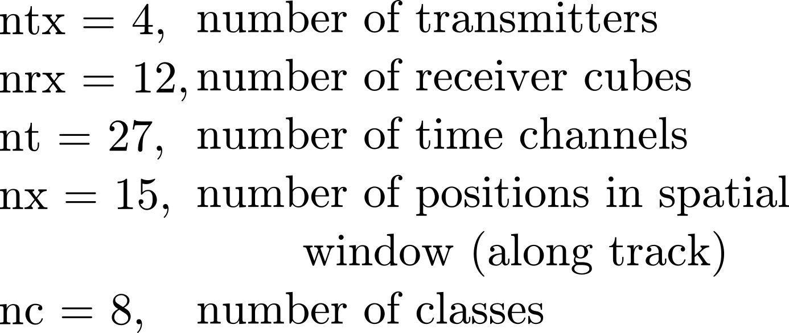
Convolutional Neural Networks (CNNs)
How do we translate these things to the UXO classification problem?
Input
Features
Neural network
predicted
Class probabilities
true
nrx
nx

Slide 13
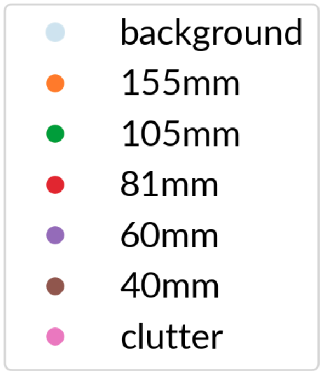
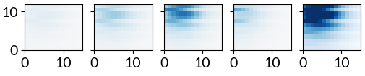

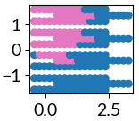
Defining label masks
Sum of magnitudes
Magnitude for each transmitter
Label mask
receiver
number (nrx)
T1
T2
T3
T4
threshold
color is different
for each class
along track
position (nx)
send back to footprint
of system
For time channel #5
cross track distance (m)
along track distance (m)

Slide 14
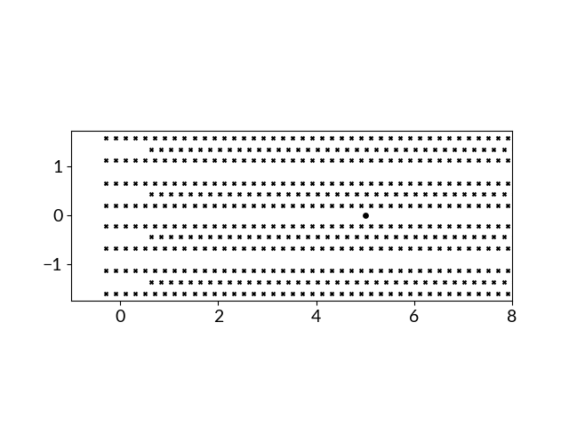
Application to a line of data
Input features are created by using a sliding window:
cross track (m)
UXO
along track (m)

Slide 15
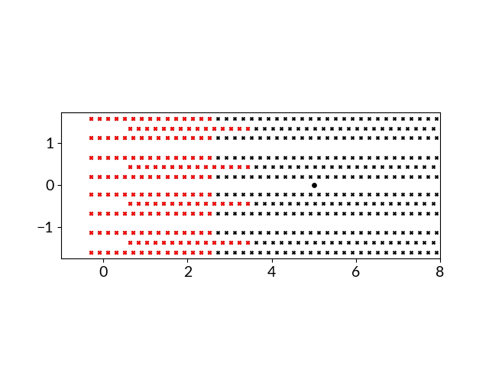
Application to a line of data
Input features are created by using a sliding window:
cross track (m)
along track (m)
sliding window

Slide 16
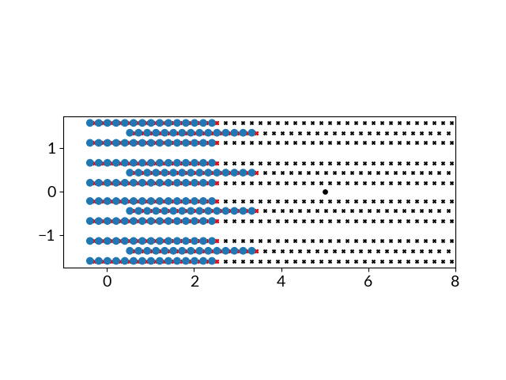
Application to a line of data
Input features are created by using a sliding window:
cross track (m)
along track (m)
Neural network output (class)

Slide 17
Application to a line of data
Input features are created by using a sliding window:
cross track (m)
along track (m)

Slide 18
Application to a line of data
Input features are created by using a sliding window:
cross track (m)
along track (m)
Single acquisition line with three objects (classification results)
cross track
along track

Slide 19
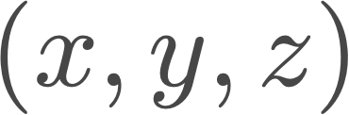
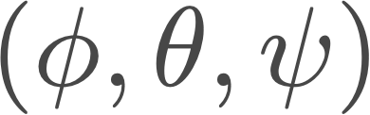
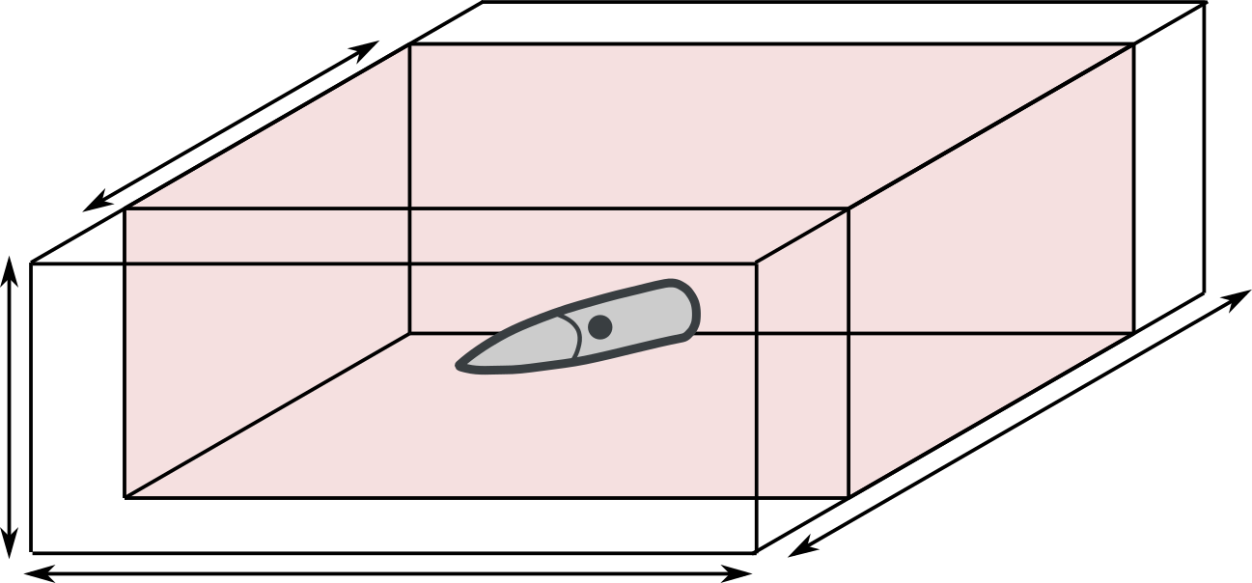
Training dataset: dipole forward model
7 classes:
background
155 mm
105 mm
81 mm
60 mm
40 mm
clutter
# of realizations:
Training (multi-class): 400,000
Validation: 10,000
Randomly assign:
Target class
Location
Orientation
Noise level: approximate from background areas in the field data
1.5 x W
0.5 m
2.5 x W
3 m
W - width of the system

Slide 20
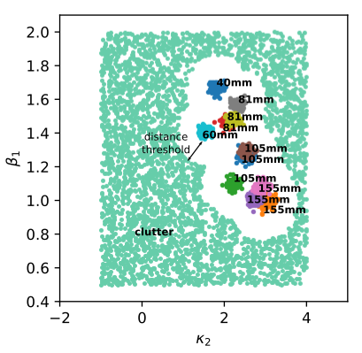

Clutter design
Physics-based parameterization of EM decay:
9 parameters in total:
Estimate values for UXOs in ordnance library
Define a distance threshold
Fill the remaining space with clutter objects

Slide 21
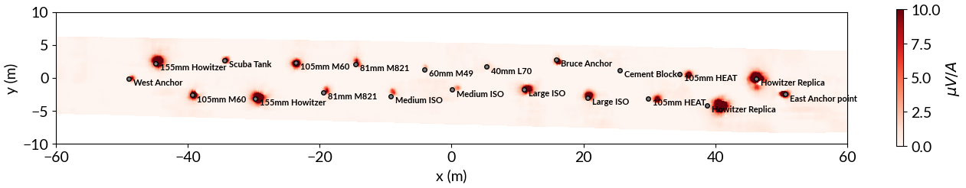
Field data - Sequim Bay test site (2022)
7 acquisition lines
Current workflow requires seawater response removed
Some ISOs present, we used only UXO objects to train (e.g. medium ISO ~ 81mm)

Slide 22

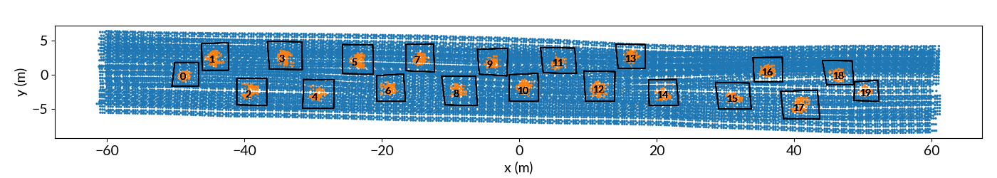
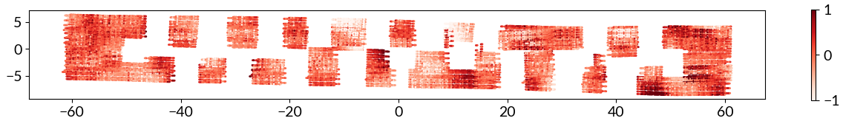
Get correlated noise using a binary classifier
object
get spatially correlated noise from this subset of field data

Slide 23
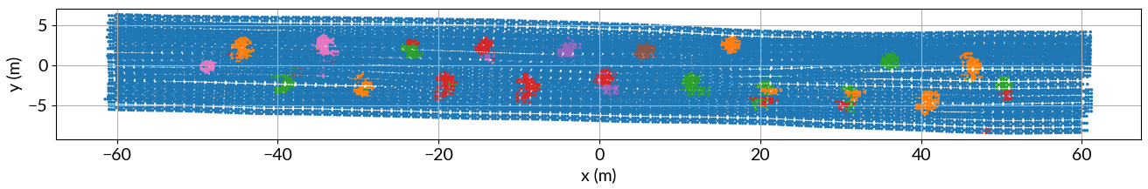
Classification map (output of CNN)

Slide 24
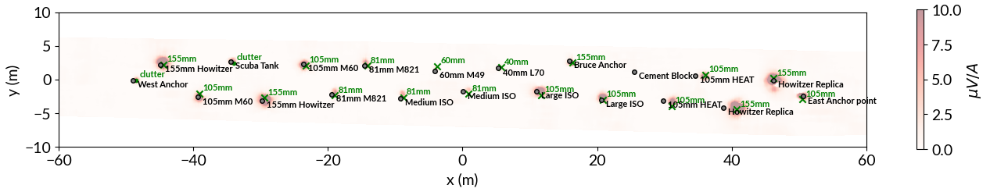
Predicted labels vs truth labels - field data
ground truth
predicted label

Slide 25
Predicted labels vs truth labels - field data
ground truth
predicted label
Discriminated clutter

Slide 26
Predicted labels vs truth labels - field data
ground truth
predicted label
Discriminated clutter
Did not miss any UXO

Slide 27
Predicted labels vs truth labels - field data
ground truth
predicted label
Discriminated clutter
Did not miss any UXO
Classified to closest object in training dataset

Slide 28
Concluding remarks:
Key points:
image-segmentation architecture
clutter design and correlated noise are important
Some limitations:
not trained to handle multiple objects in the same window
objects used to generate synthetic data should be close to the objects on the field
Future work:
explore multi-target scenario (maybe instance segmentation)
combining with traditional approach

Slide 29

Concluding remarks:
Key points:
image-segmentation architecture
clutter design and correlated noise are important
Some limitations:
not trained to handle multiple objects in the same window
objects used to generate synthetic data should be close to the objects on the field
Future work:
explore multi-target scenario (maybe instance segmentation)
combining with traditional approach
Jorge Lopez-Alvis jlalvis@eoas.ubc.ca
Thank you!

Slide 30
Backup slides

Slide 31
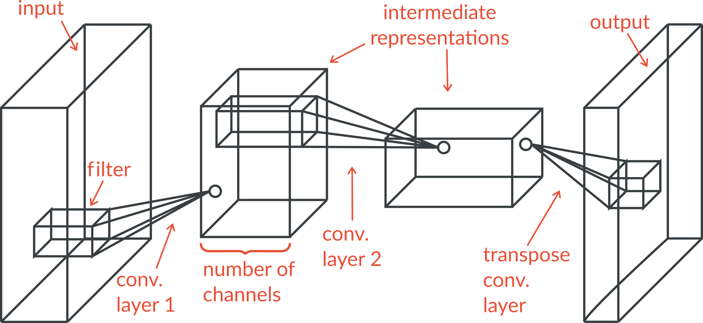
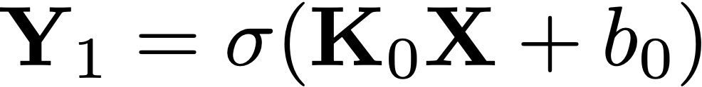
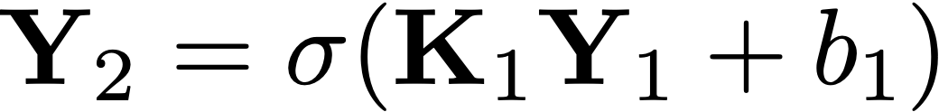

Convolutional neural networks (CNNs)
Mathematically:

Slide 32
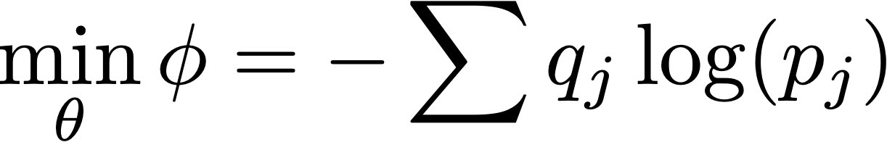
Convolutional Neural Networks (CNNs)
Training
define an optimization problem to estimate network parameters
Input
Features
Neural network
Class probabilities
predicted
trainable parameters
true
Measure: cross entropy loss

Slide 33
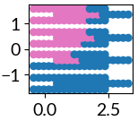
Convolutional Neural Networks
How do we translate these things to the UXO classification problem?
Input
Features
Neural network
predicted
Class probabilities
true

Slide 34

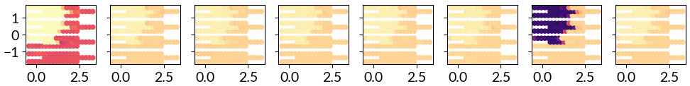
Probability layer and classification
probability
eight different classes:
background
155 mm
105mm
81mm
60mm
40mm
clutter0
clutter1
cross track distance (m)
point-wise classification according to max probability
along track distance (m)

Slide 35
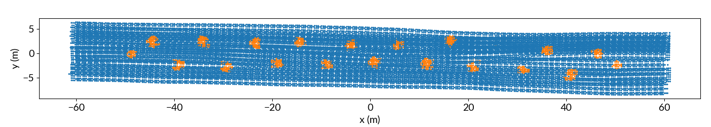
Anomaly detection (binary classifier)
object

Slide 36
Anomaly detection (binary classifier)
object
get spatially correlated noise from this subset of field data

Slide 37
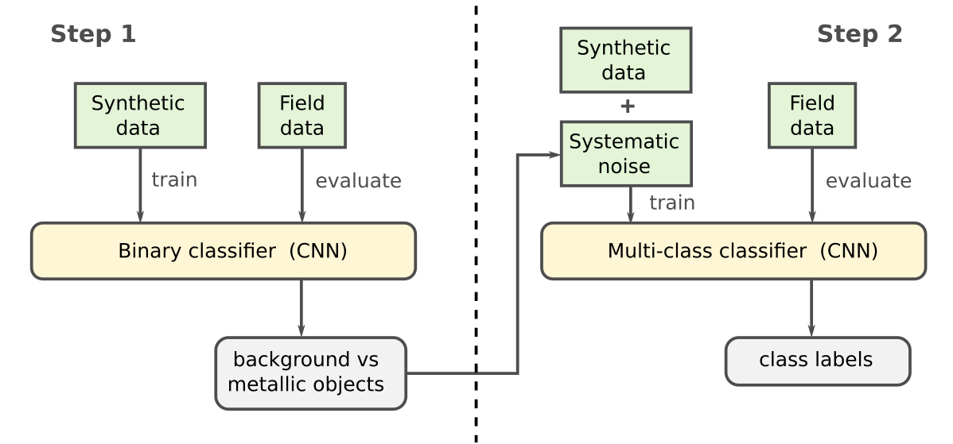
Working with field data: two step workflow
Anomaly detection
TOI classification
main goal: add realistic noise to the multi-class training dataset

Slide 38
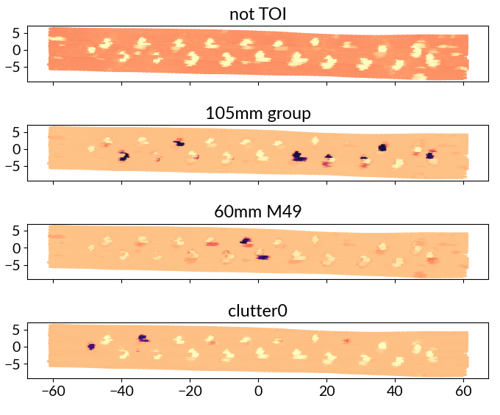
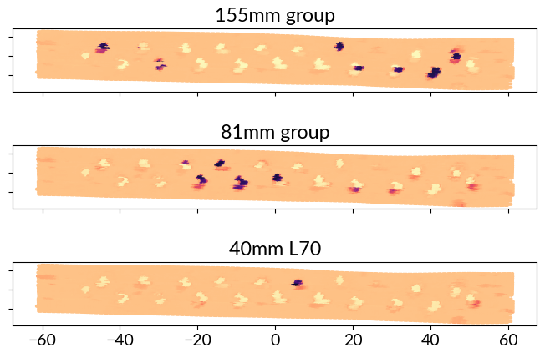
Classification map (probability output)
probability
background
x (m)
y (m)
x (m)

Slide 39
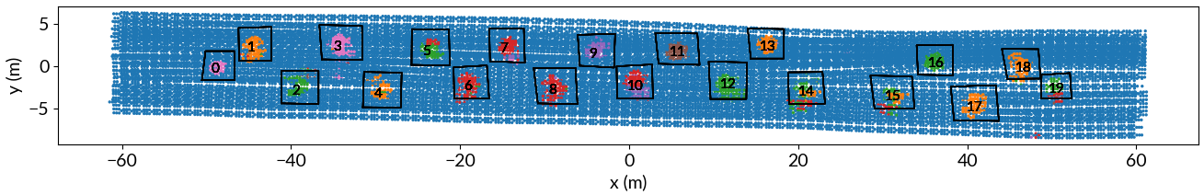
Divide in cells to get a single probability value per cell:

Slide 40
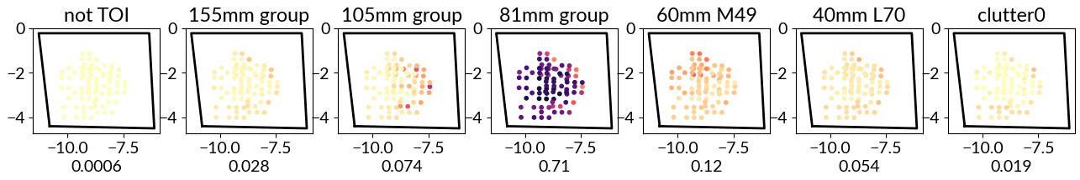
Divide in cells to get a single probability value per cell:
probability
Get average probability for cell and assign final label
average
probabilities
Assign label with highest probability: “81 mm”

Slide 41
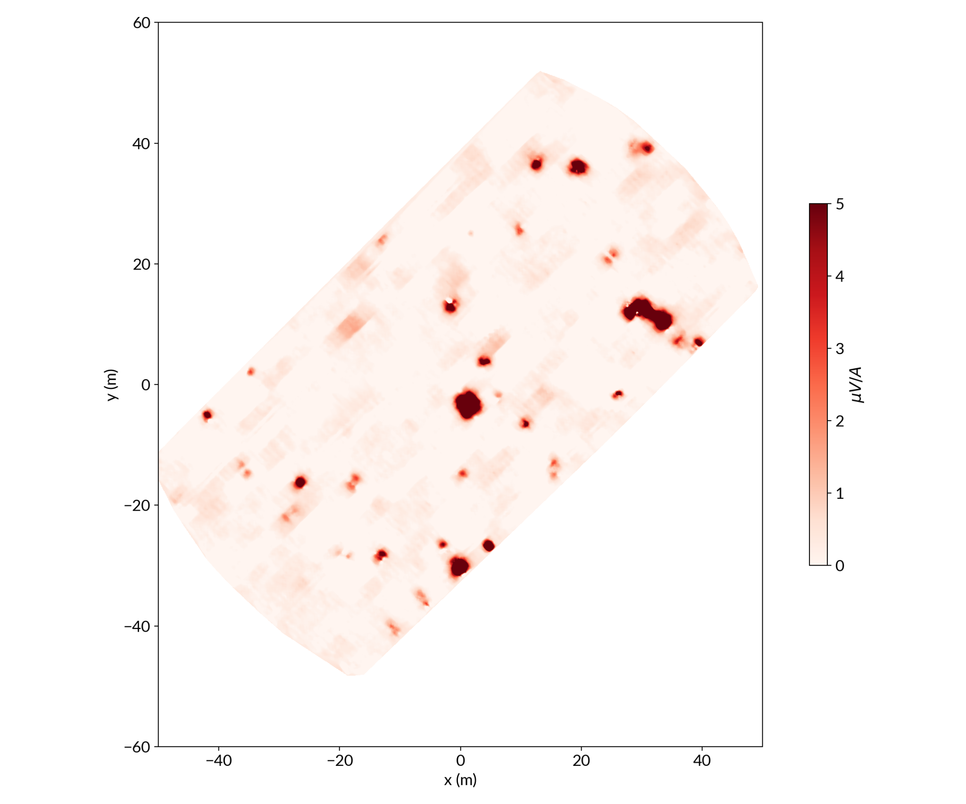
Blindgrid 2021
Sequim Bay

Slide 42

Blindgrid 2021
Sequim Bay

Slide 43

Blindgrid 2021
Sequim Bay
Predicted labels
Missed only 1 UXO (out of 15)
11 out of 16 clutter labeled correctly

Slide 44





Clutter design
L1 and L2
L3
disk
PCA was helpful to decide whether clutter objects are very close to UXOs:

