Slide 1
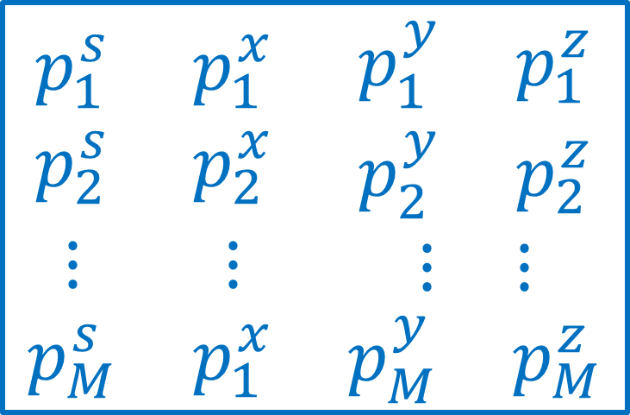
$$\begin{matrix}\begin{matrix}p_{1}^{s} \\ p_{2}^{s}\end{matrix} & \begin{matrix}p_{1}^{x} \\ p_{2}^{x}\end{matrix} & \begin{matrix}\begin{matrix}p_{1}^{y} & p_{1}^{z}\end{matrix} \\ \begin{matrix}p_{2}^{y} & p_{2}^{z}\end{matrix}\end{matrix} \\ ⋮ & ⋮ & \begin{matrix}⋮ & ⋮\end{matrix} \\ p_{M}^{s} & p_{1}^{x} & \begin{matrix}p_{M}^{y} & p_{M}^{z}\end{matrix}\end{matrix}$$

Slide 2
