Slide 1
Intro to Processing

Slide 2
Before today’s class
Clickers
Everyone has their clickers set up correctly
Repeat clicker questions from last lectures
Team members (hand in names)
Can every team bring at least one laptop every lecture?

Slide 3
What is Processing
Experiment with the Processing Development Environment.
Printing on the console

Slide 4
The Processing Language
Processing is a programming environment that aims to help create visually oriented applications, such as sketches, animations, and games.
Processing consists of:
The Processing Development Environment (PDE).
The software we will use to write and run our code in this course.
Has a minimalist set of features suitable for developing small programs
The Processing core API and other libraries
A collection of functions (aka commands or methods) for performing the different actions in a program.
A language syntax identical to Java.
Processing is Java, but with simpler syntax.
Processing was ported to other languages later (e.g. JS, Python).

Slide 5
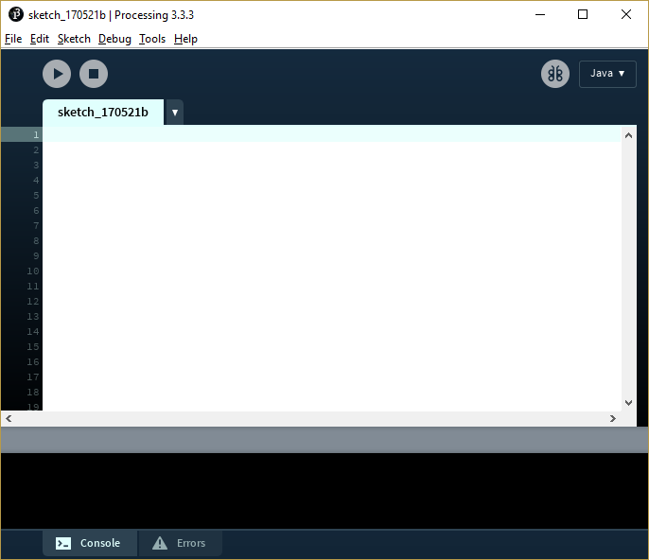
Processing Development Environment (PDE)
Menu
Run / Stop
Sketch name
The code represents a sketch. Each sketch is actually a subclass of the PApplet Java class
Your code goes into the Text Editor here
Message Area
Console and Errors Window

Slide 6
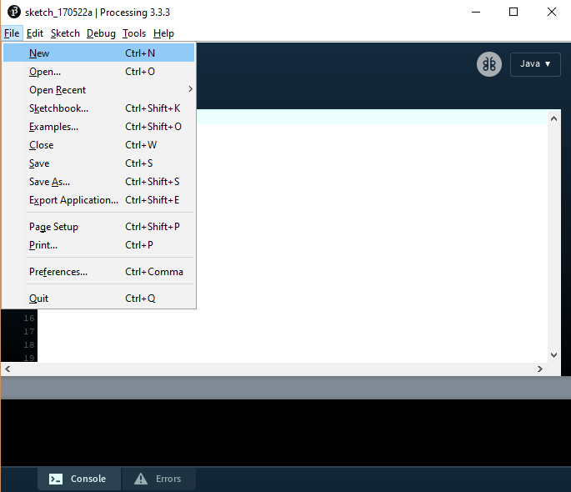
PDE: Creating and Running a Sketch
To create a program code file, select File->New or
Your new program is called a sketch in Processing. Sketches are saved in a folder on your computer called sketchbook.
To write your code, start typing in the Text Editor” area of the PDE.
Use the buttons Run and Stop on the toolbar to run or terminate your program.

Slide 7
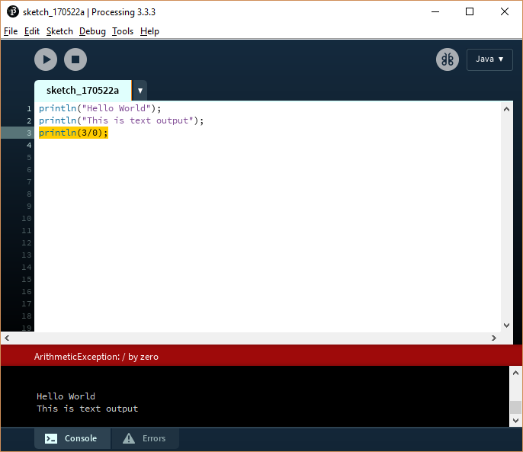
PDE: The Console Window
The console window displays
Text output, e.g. when printing text using print() and println() functions.
Error messages

Slide 8
Functions
A function is a sequence of statements that performs a specific action.
Creating a function avoids repeating statements and allows for better code organization.
A function must have a name. Whenever we want to perform the function’s action, we need to call (invoke) the function by its name.
For example, to print something on the console, we write
println("Hello World");
Processing comes with a library of predefined functions that may be used to perform different actions such as drawing shapes. To use these functions, you need to call their names with the appropriate parameters.
In Java, a function is also called a “method”.

Slide 9
Output Text to the Console
1
Use print() and println() to display the following text on the console. Note that the number 6 on the second line is computed as 3*2.

Slide 10
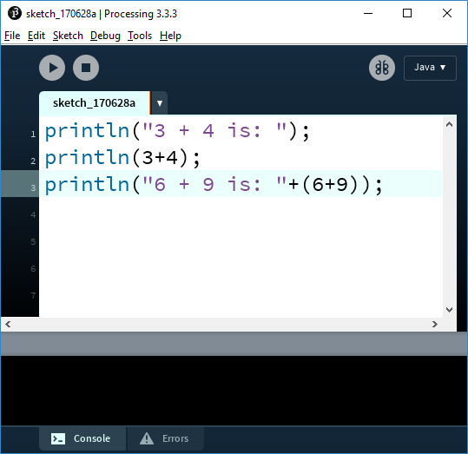
Output Text to the Console
2
What is the output of this program? Explain.

Slide 11
2D Coordinate System

Slide 12
The Coordinate System
Drawing on the screen is done by specifying coordinates which refer to a location on the screen.
By default
origin is the upper-left hand corner of the screen.
x coordinate is horizontal, getting bigger as we move right.
y coordinate is vertical, getting bigger as we move down.
x
(0,0)
(80,10)
(30,70)
y

Slide 13
Coordinate system
Assume we have the 100x100 sketch shown below. Each small square is 10x10 pixels. What is the (x , y) location of the point?
(30, 50)
(50, 30)
(3, 5)
(5, 3)
None of the above

Slide 14
Drawing Primitive Shapes
To draw shapes on the screen, we call the function that represent each shape with arguments representing the shape dimensions.
Example of primitive shapes
Point: point(90,60);
Line: line(50,10,70,20);
Rectangle: rect(10,25,40,20);
Ellipse: ellipse(50,70,40,20);
Function name
Parameters

Slide 15
Drawing Primitive Shapes, cont’d
0
10 20 30 40 50 60 70 80 90
x
Start point
End point
line(50,10,70,20);
rect(10,25,40,20);
80 70 60 50 40 30 20 10
top-left point
width
height
point(90,60);
ellipse(50,70,40,20);
y
center point
width
height

Slide 16
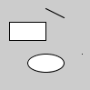
Drawing Primitive Shapes, cont’d
Here is the Processing code and output
// draw the shapes
line(50,10,70,20);
rect(10,25,40,20);
point(90,60);
ellipse(50,70,40,20);

