Slide 1
Fast Sorting on
Flash Memory Sensor Nodes
Tyler Cossentine, Ramon Lawrence
University of British Columbia Okanagan
tacossen@interchange.ubc.ca, ramon.lawrence@ubc.ca
http://people.ok.ubc.ca/rlawrenc/

Slide 2
Introduction
Sensor nodes are used in numerous domains for data collection and analysis. On device data processing increases the functionality and lifetime of a network.
Previous work has developed algorithms for sorting on sensor nodes with flash memory that use reads instead of writes due to the asymmetric costs. Previous algorithms did not use random reads that cost the same as sequential reads.
We propose Flash MinSort that uses random reads to rapidly sort in flash memory using a small amount of memory.
  Especially effective for temporally clustered sensor data.
  Two to ten times faster than previous approaches for small memory sizes where external merge sort is not executable.

Slide 3
Background – Sensor Nodes
Sensor networks are used in military, environmental, agricultural and industrial applications.
A wireless sensor node has an embedded processor, power management, sensing system, and a communications link.
  Small amount of DRAM: 1 to 100KB (working memory)
  Flash memory: 100KB to 10 MB (data storage)
Devices may process data locally, always send it back to a collection point called the sink, or do some combination of the two depending on the sensor network configuration.
  On device computation reduces communication and energy use.

Slide 4
Background – Flash Memory Chips
A flash memory chip consists of pages (512 bytes to 4 KB) that are combined into blocks (4 KB to 128 KB). A page must be erased before it can be written. The erase unit is typically a block of pages.
Reads and writes are done at the page level, although some devices support direct byte reads. Reads are 1.5 to 100 times faster than writes. Using flash memory requires transferring data from the flash device over the bus to the processor.
A flash memory chip does not perform wear levelling, address translation, or buffer management as provided by solid state drives that combine chips with additional DRAM and logic.

Slide 5
Previous Work – One Key Scan
The most memory efficient flash sorting algorithm is the one key scan algorithm [Anciaux et al. VLDB2003] that performs a read of the table for each distinct sort key value.
The algorithm stores two key values:
  current is the key value that is being output in this scan
  split is the next lowest key value after current and is updated while doing the scan.
  The algorithm needs an initial scan to determine the values of current and split.
Performance:
  Performs D + 1 scans, where D is # of distinct sort keys.
  Only uses space for 2 sort keys.
Note: With very small memory sizes, the size of the iterator state variables is critical where normally it is ignored!

Slide 6
Previous Work – Heap Sort
The heap sort algorithm, called FAST(1) [Part et al. Sys.&Soft.2009], uses a binary heap of size N tuples to store the smallest tuples during each scan. Another value, last, stores the largest sort key output so far.
Performance:
  Number of scans is T/N, where T is the # of tuples.
  One page buffer is used as an input buffer. Despite using more memory, this algorithm may be slower than one key scan if the number of distinct sort key values is small.
  Many scans if the number of tuples or the tuple size is large.

Slide 7
Previous Work – External Merge Sort
The standard external merge sort algorithm performs one read pass to construct sorted sub lists the size of memory, which are written to flash. The merge phase then buffers one page from each of the sub lists and merges them to produce an output.
Performance:
  Each merge pass requires writing a temporary result to flash:
    Reduces the amount of memory on device for storing actual data.
    Complicates issues of flash data storage and wear levelling.
  Usually require numerous merge passes with a small amount of memory available.
  Minimum amount of memory is 3 pages or 1536 bytes!
  Becomes more useful as memory size increases.

Slide 8
Prior Work Summary and Opportunities
External merge sort requires writing and significant memory that makes it non-executable in certain sensor applications.
Using reads instead of writes is a good strategy, but performing inexpensive random reads has not been previously used.
None of the algorithms adapt to the distribution of the data. Sensor data is clustered spatially and temporally in many applications such as environmental monitoring.
None of the current algorithms dominates the others as performance depends on the input data and its properties.

Slide 9
Flash MinSort
Flash MinSort uses random reads instead of sequential scans for retrieving only the tuples required.
The algorithm builds a dynamic index over the table that stores the minimum value in each region. Only the region (sequence of 1+ pages) with the minimum value is searched. The minimum value in the region is updated and the process repeats.
The algorithm maintains a current minimum value and next minimum value. It also uses an integer counter to represent the location of the next minimum tuple in a region (nextIdx).
  As the algorithm is scanning a region for records with key current, it also updating the minimum value in the region.

Slide 10
Flash MinSort - Example
Page
Data
Min
Pass #1
Pass #4
Output
Search min array.
Min 1. in pg. 1.
Search pg.1.
Find 1 in rec. 1.
Scan rest of page.
next=9, nextIdx=4
Output pg.7, rec. 4.
Min. pg. 1 set to 2.
1 (from pg. 1, rec. 1)
1
1 9 9 1
1
9
1 (from pg. 1, rec. 4)
2
9 9 9 9
Pass #5
1 (from pg. 7, rec. 2)
3
9 8 9 9
8
Search min array.
Min 1. in pg. 8.
Find 1 in rec. 1.
next=∞, nextIdx = 2
Stop scan at rec. 2.
1 (from pg. 7, rec. 4)
4
8 8 7 7
7
1 (from pg. 8, rec. 1)
6 6 6 5
5
1 (from pg. 8, rec. 2)
5
1 (from pg. 8, rec. 3)
6
4 4 3 2
2
Pass #2
Output pg.1, rec. 4.
Min. pg. 1 set to 9.
1 (from pg. 8, rec. 4)
7
2 1 2 1
1
2 (from pg. 6, rec. 4)
Pass #6
2 (from pg. 9, rec. 1)
8
1 1 1 1
1
Output pg.8, rec. 2.
next=∞, nextIdx = 3
3 (from pg. 6, rec. 3)
9
2 3 4 5
2
Pass #3
Search min array.
Min 1. in pg. 7.
Find 1 in rec. 2.
next=2, nextIdx=4
…
10
6 7 8 9
6
Pass #7
11
9 8 9 8
8
Output pg.8, rec. 3.
next=∞, nextIdx = 2
12
8 9 9 9
9
Flash MinSort: 39 page reads, 148 tuple reads, 1444 bytes read
One key sort: 120 page reads, 480 tuple reads, 9600 bytes read (10 passes) → 3X more I/O
Heap sort: 192 page reads, 768 tuple reads, 15 360 bytes read (16 passes) → 6X more I/O
Notes:
In the worst case with a random data set with all distinct sort key values, {\em Flash MinSort} has costs of 60 page I/Os, 240 tuple I/Os, and 4800 bytes which is still considerably better than the other two algorithms. The direct read version of {\em Flash Minsort} would only read 1920 bytes.

Slide 11
Flash MinSort Performance
In the ideal case, a region consists of only one page.
The amount of space required to store the minimum value per page is L_{K}*P, where L_{K} is the size of the key. If that is too much space, then group adjacent pages into regions.
  Minimum amount of memory is 4*L_{K} for two regions.
Performance:
  P = # of pages, T = # of tuples, N_{P} = # of pages in a region
  D_{R} = average # of distinct values in a region
 | Page I/Os
Worst Case | P + T * N_{P}
Best Case | 2 * P
Average Case | P * (1 + D_{R})

Slide 12
Flash MinSort – Direct Reads
If the flash chip supports direct byte reads (not just page reads), Flash MinSort is even more efficient as it only needs to read the keys while scanning instead of the entire tuple.
Performance:
  P = # of pages, T = # of tuples, N_{P} = # of pages in a region
  D_{R} = average # of distinct values in a region, R = # of regions
  L_{K} = size of key in bytes, L_{T} = size of tuple in bytes
 | Page I/Os | Byte I/Os
Worst Case | P + T* N_{P} | T * L_{K} + T * L_{T} + T * N_{P} * N_{T} * L_{K}
Best Case | 2 * P | T * L_{K} + T * L_{T}
Average Case | P * (1 + D_{R}) | T * L_{K} + T * L_{T} + R * D_{R} * N_{P} * N_{T} * L_{K}

Slide 13
Flash MinSort Performance Comparison
Considering only page reads Flash MinSort is:
  Faster than one key sort in all cases.
  Faster than heap sort unless input size is only a small multiple of the memory size (e.g. 2 to 5).
  Faster than external merge sort for a large spectrum of the possible configurations even while using less memory and performing no writes.
Algorithm | Page I/Os | Notes
Flash MinSort | P * (1 + D_{R})
One Key Sort | P * (1 + D) | Perform scan for each distinct key.
Heap Sort | P * (T * L_{T} ) / M | # scans based on # tuples
External Merge Sort (two pass) | P * (2 + X) | X is write-to-read ratio as algorithm must write as an intermediate step. Two pass is not likely for small memory sizes.

Slide 14
Sorting in Data Processing
Sorting a base table can be done with or without using an iterator implementation as the algorithm has direct access to the table stored in flash.
Flash MinSort requires the ability to perform random I/Os within the input relation which poses a challenge in the iterator model.
Solutions:
  Materialize the input relation before the operator. Used as an alternative to rescanning the input many times.
    Avoiding materialization is preferable due to the large write cost and the temporary space that is required.
  Exploit interesting orders for sorting and execute sort on base relation in the plan and preserve order throughout plan.
    May still be more efficient than performing sort as the last operation using other algorithms.

Slide 15
Experimental Evaluation
Experimental evaluation compares: Flash MinSort, one key sort, heap sort, and external merge sort.
Sensor device: Atmel Mega644p processor with speed of 8 MHz, a local memory size of 4KB, and an Atmel AT45DB161D chip with capacity of 2 MB. Flash page size is 512 bytes.
  The max. memory available for data processing is 2000 bytes.
  Node design was used for field measurement of soil moisture for use with an automated irrigation controller [Fazackerley 2010].
Data set:
  Three months of the live soil sensing data and generated ordered and random data sets. The real data set has 10,000 records (160KB) and 43 distinct values.
  Record size is 16 bytes. Sort key is a 2 byte integer.

Slide 16
Raw Device Performance
Time to read 50,000 records: 23 seconds
Time to write 50,000 records: 37 seconds
Write-to-read ratio: 1.8 times
Time to scan 50,000 keys: 21 seconds
Notes:
  On chip buffering did not impact performance compared to direct reads.
  Buffering a page in processor memory is more efficient that using on chip buffers due to bus communication and latency.
  Bus speeds affect write-to-read ratio. Even though writing is considerably slower on the chip, this was masked due to the speed of the processor and bus.

Slide 17
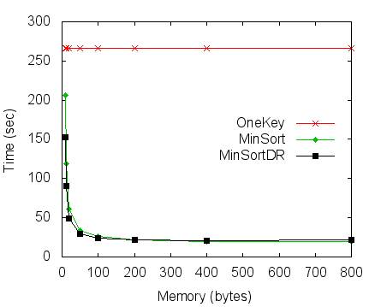
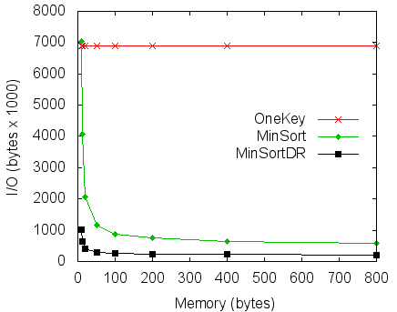
Real Data
  Heap sort is not shown as time is order of magnitudes longer:
    30 bytes (1 tuple): 10,000 passes, 24,403 sec.
    1200 bytes (74 tuples): 1671 seconds
  MinSortDR is direct read version of MinSort.
  External merge: 1536 bytes (3 pages): 7 passes, 143 sec.
Notes:
MinSortDR performs fewer I/Os than regular MinSort and is faster for small memory sizes. Further, it did not need to buffer a whole page for scanning to improve its performance, so its effective memory usage is even smaller. With 32 records per page, the 32 separate calls to memory for 2 bytes at a time are not greatly faster than one call to read a whole 512 byte page.

Slide 18
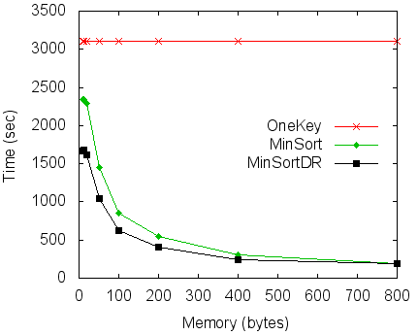
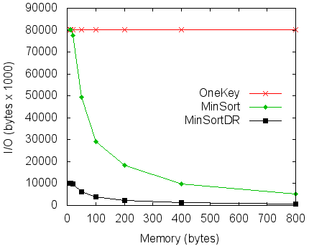
Random Data
  Data set with 10,000 records and 500 distinct values (1 to 500).
  Heap sort and one key sort have the same execution times regardless of the data set (random, real, or ordered).
  External merge sort took 155 seconds as the sorting during initial run generation took slightly more time.

Slide 19
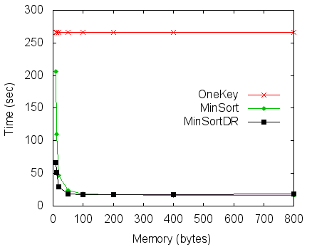

Ordered Data
  Sorted, real data set with 10,000 records and 43 distinct values.
  MinSort did not detect sorted regions but still gets a benefit by detecting duplicates of the same value in a region. MinSortDR stores a bit vector to detect sorted regions as a special case.
  External merge sort took 137 seconds.

Slide 20
Results Summary
MinSort is faster than one key sort and heap sort with or without using direct byte reads from the device.
  Especially good for sensor data that exhibits temporal clustering.
  MinSort is a generalization of one key sort, and performance of both algorithms depends on the number of distinct values.
Heap sort is not competitive for small memory sizes.
  Ratio of memory available versus sort data size is critical.
    For small nodes, have limited absolute and relative amount of memory.
External merge sort has good performance but only with a very large minimum memory consumption of 1536 bytes.
  For the real data set on this platform, external merge sort will never be faster regardless (assuming at least two passes).
  For environmental monitoring, dealing with the additional space and wear leveling complicates sensor design and performance.

Slide 21
Unexpected Insights
The key goal of flash memory algorithms is to reduce the number of writes as writes have an order of magnitude higher cost than reads.
But … Although the read and write speeds are very different, other system features are a big factor (processor, bus).
The performance is not all about I/O.
  An 8 MHz, 8-bit processor, although fast enough for the node operations, does affect database algorithm performance.
  Consider external merge sort that took 137 seconds in sorted case and 153 seconds in random case.

Slide 22
Future Work and Conclusions
Flash MinSort is a sorting algorithm especially designed for sorting in flash memory on small sensor nodes.
Its performance dramatically improves over previous algorithms by exploiting random I/Os to only retrieve tuples of interest.
Future work includes implementing an entire tiny database specifically for these sensor nodes which will use this sorting algorithm, and modifying the existing irrigation sensor application to use the database.

Slide 23
Fast Sorting on
Flash Memory Sensor Nodes
Tyler Cossentine, Ramon Lawrence
University of British Columbia Okanagan
tacossen@interchange.ubc.ca, ramon-lawrence@ubc.ca
http://people.ok.ubc.ca/rlawrenc/
Thank You!

