Slide 1
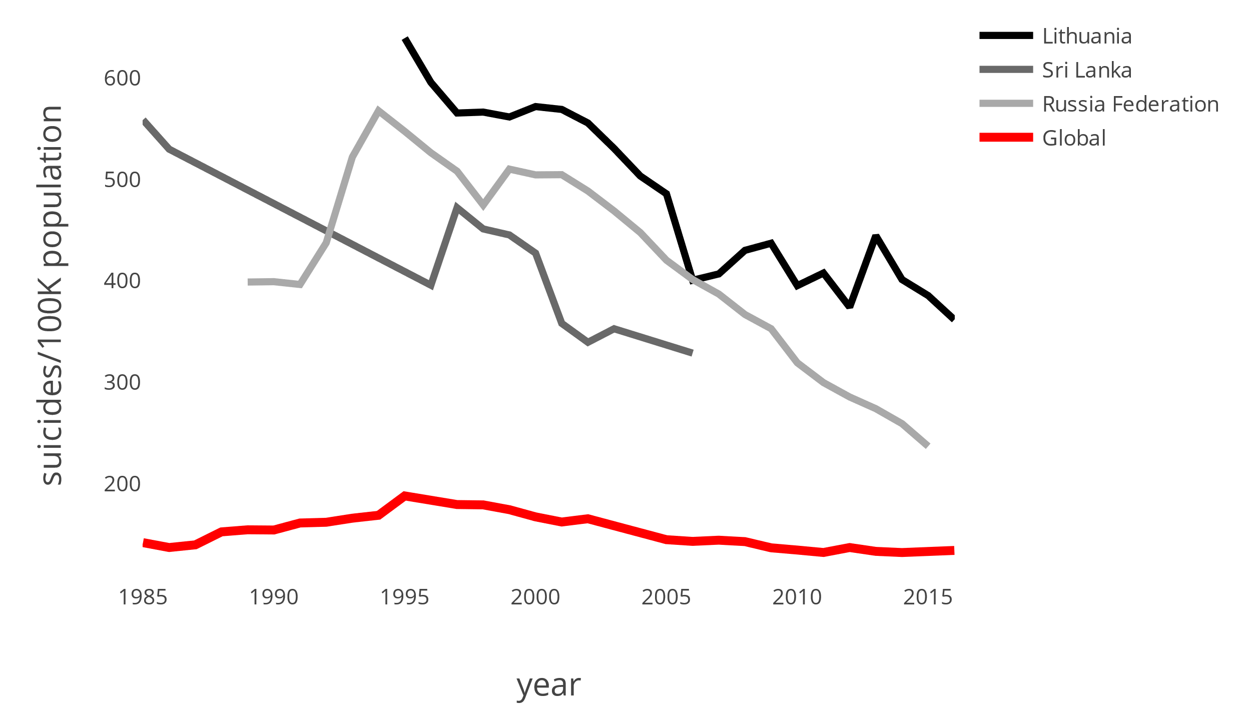
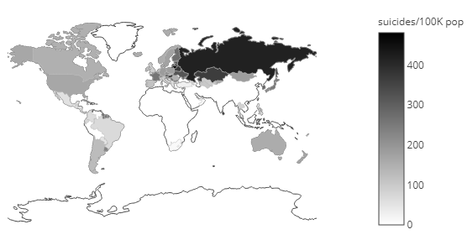
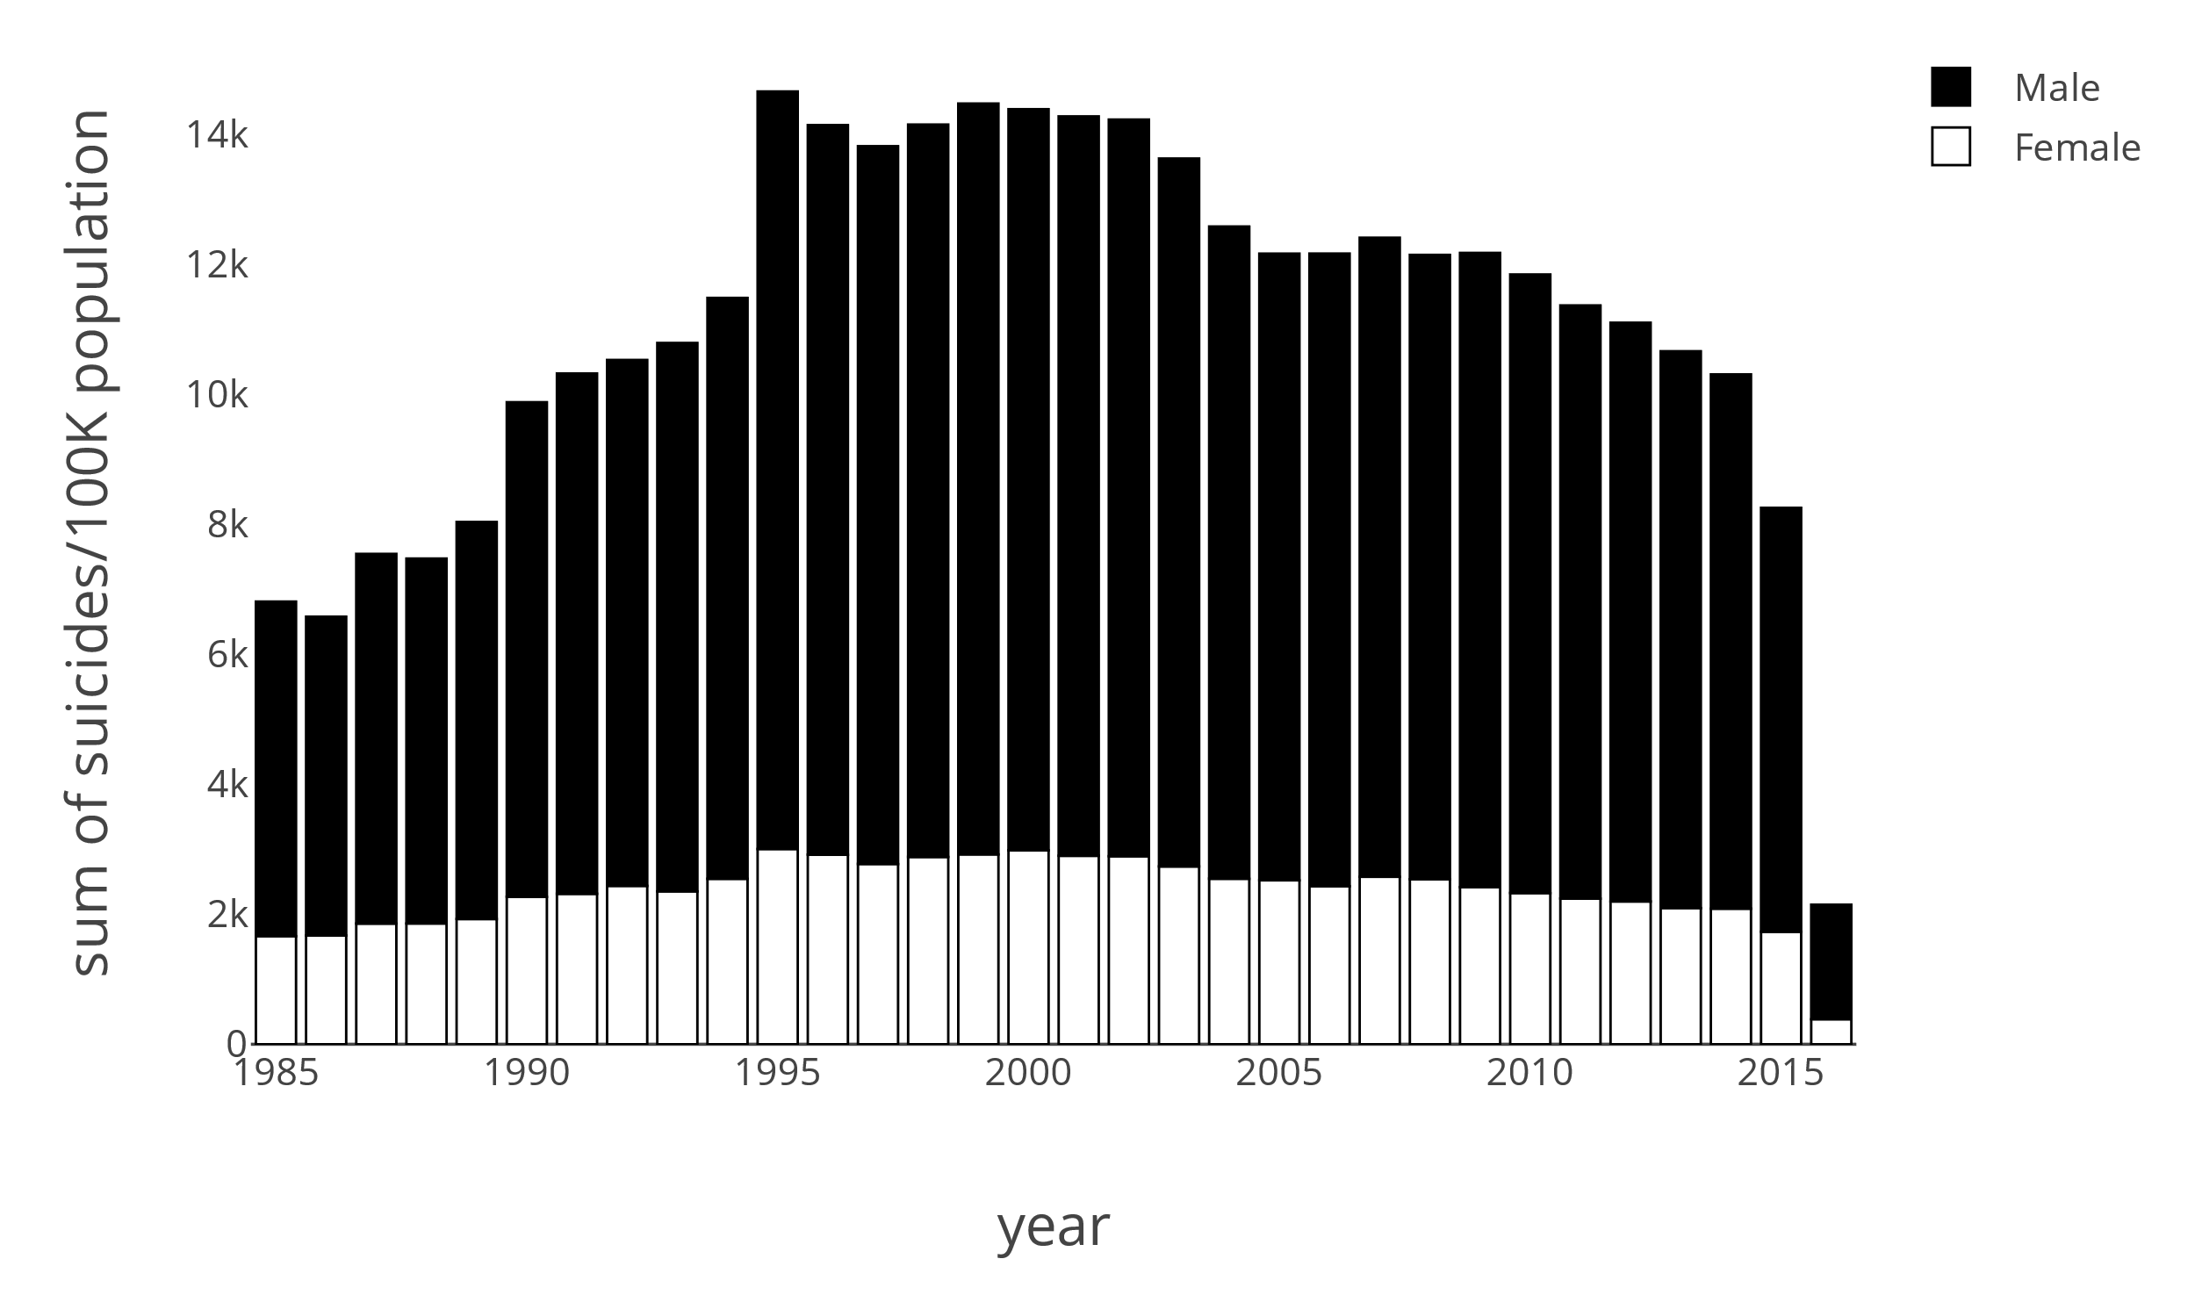
How are the suicide trends changing over time?
World Health Organization Suicide Trends
Mental health is about more than just mental illness. Everything from your age or gender, to the amount of sunlight in a day has been shown to affect your mental state.
The World Health Organization (WHO) reports suicide as one of the global leading causes of death. Here we show a brief analysis of the suicide rate data collected by the WHO. It is important to note that this data is limited by a country’s willingness to report. For example, Sri Lanka stopped reporting in 2006 and a number of countries did not report in 2016.
Where are the most suicides committed annually?
The 3 countries with the highest annual suicide rates are shown.
Overall the rates are decreasing but remain significantly above the global average.
Is there a difference between the sexes and their suicide rates?
Annually the top 3 countries where the most suicides are committed are: Lithuania, Sri Lanka, and the Russia Federation. In the Russia Federation, for example, ~418 individuals per every 100 000 of the population commit suicide annually.
Overall, males commit suicide in larger numbers than females.
Levannia Lildhar

