Slide 1
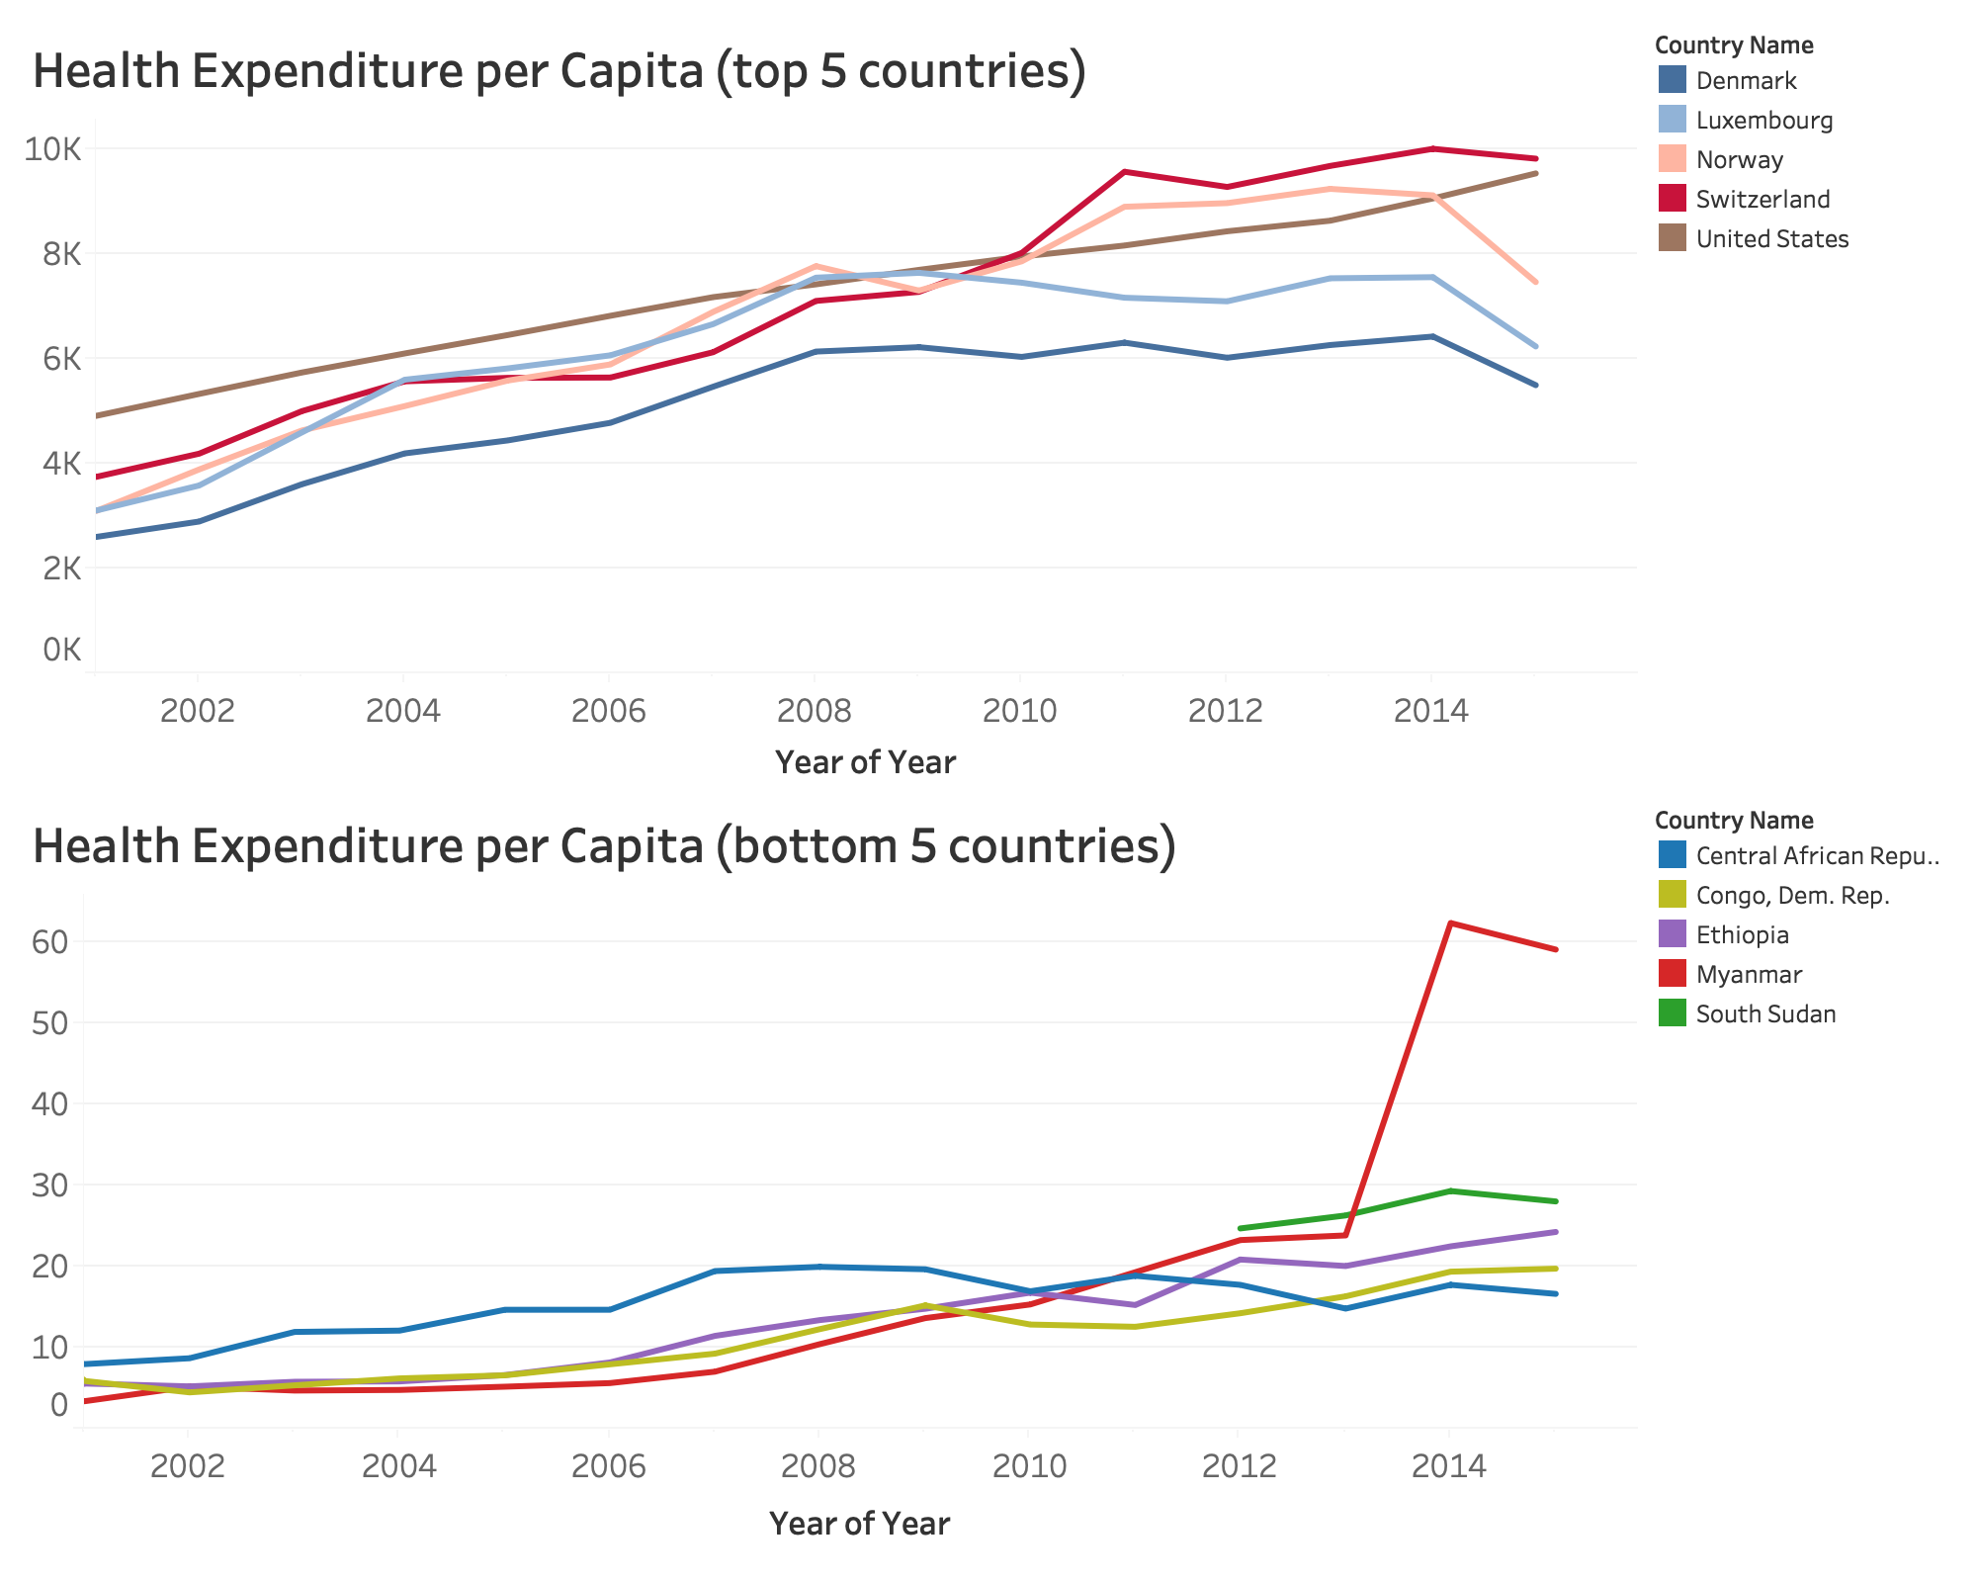
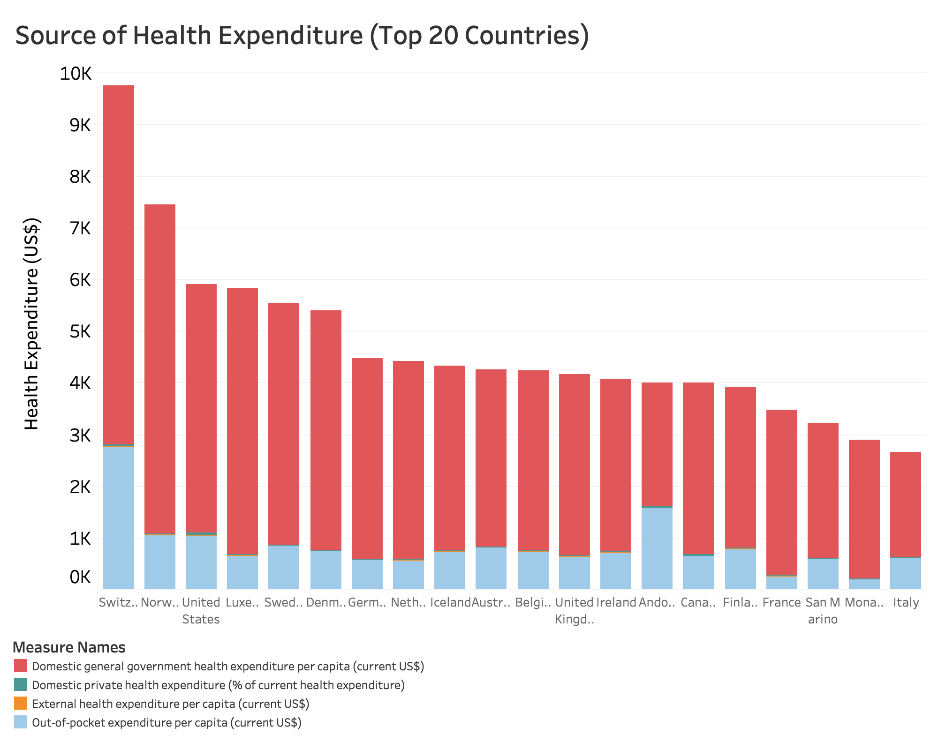
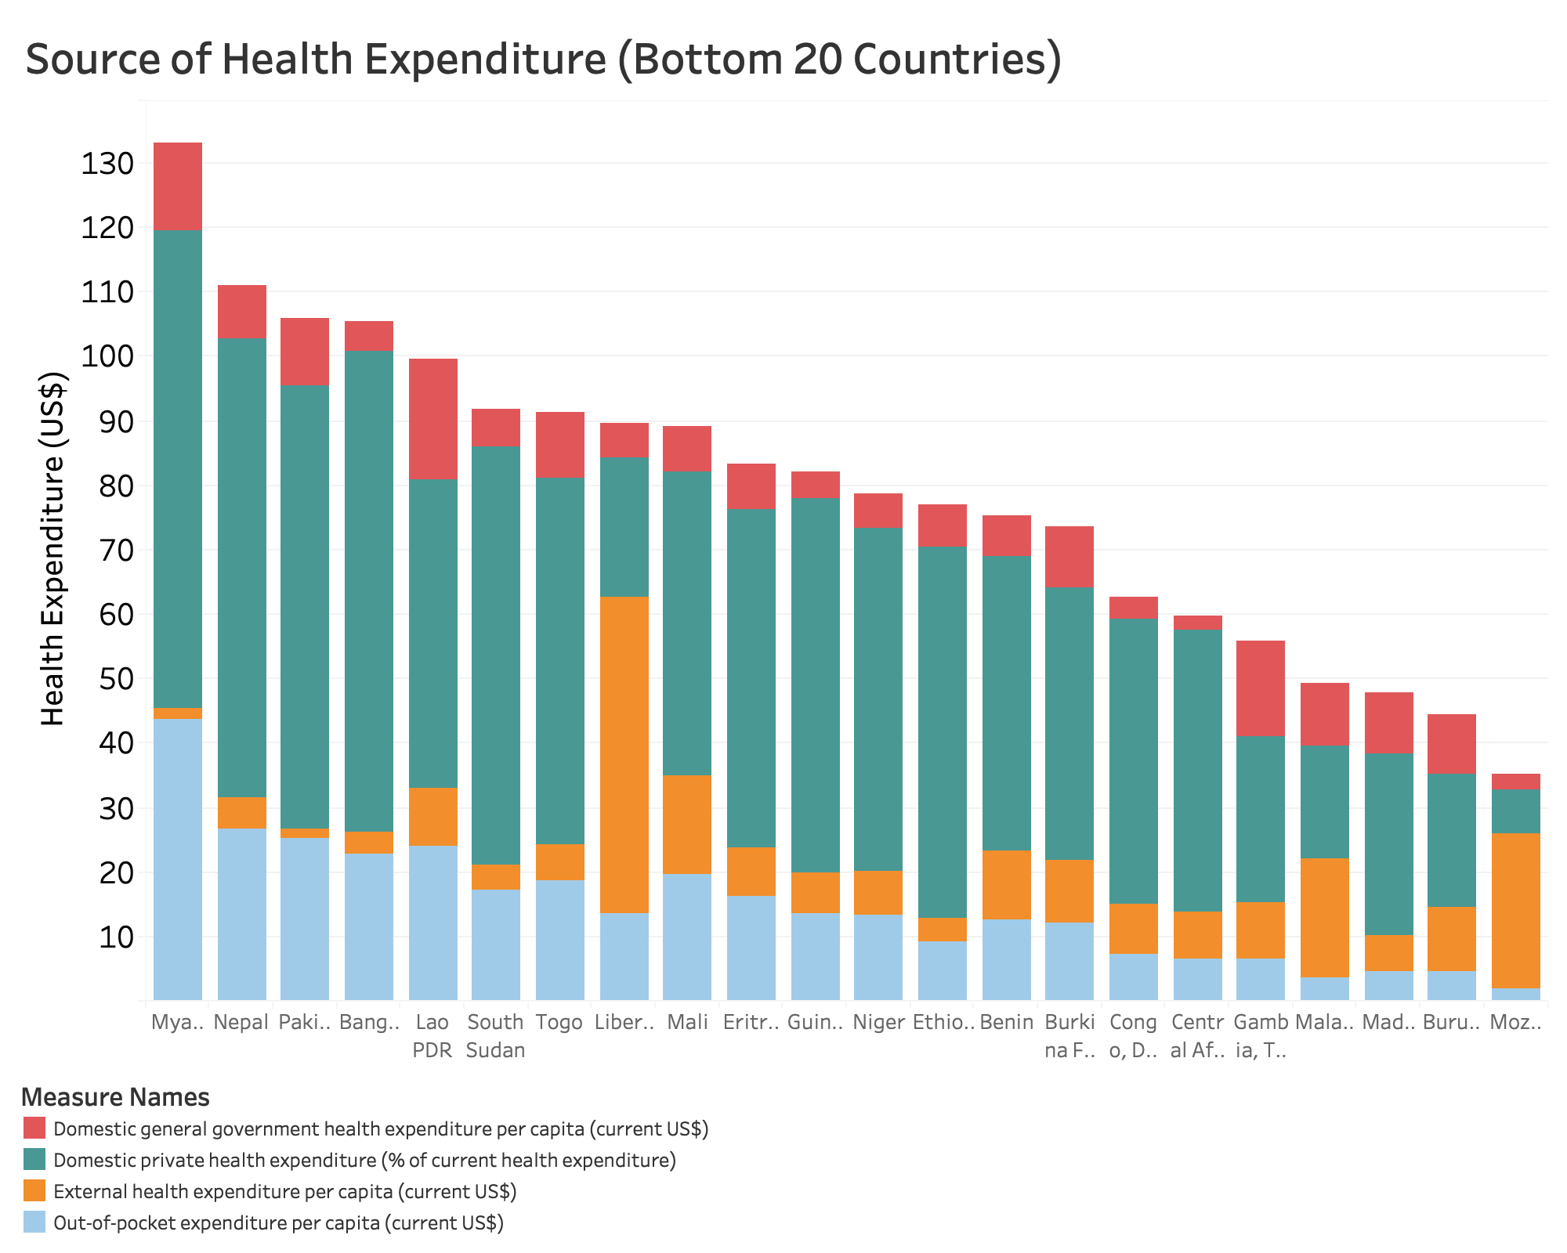
Who is Funding our health?
We are getting healthier
Developing world is catching fast
Health expenditure increase over time
Still huge gap in terms of total health expenditure
First world: governments pay
Low income world:
Domestic private fund
Out-of-pocket (excuse me??)
Government fund: limited by GDP
Out-of-pocket: vulnerable under poverty situation
What do we do?
External funding should be encouraged
Economy growth

Slide 2
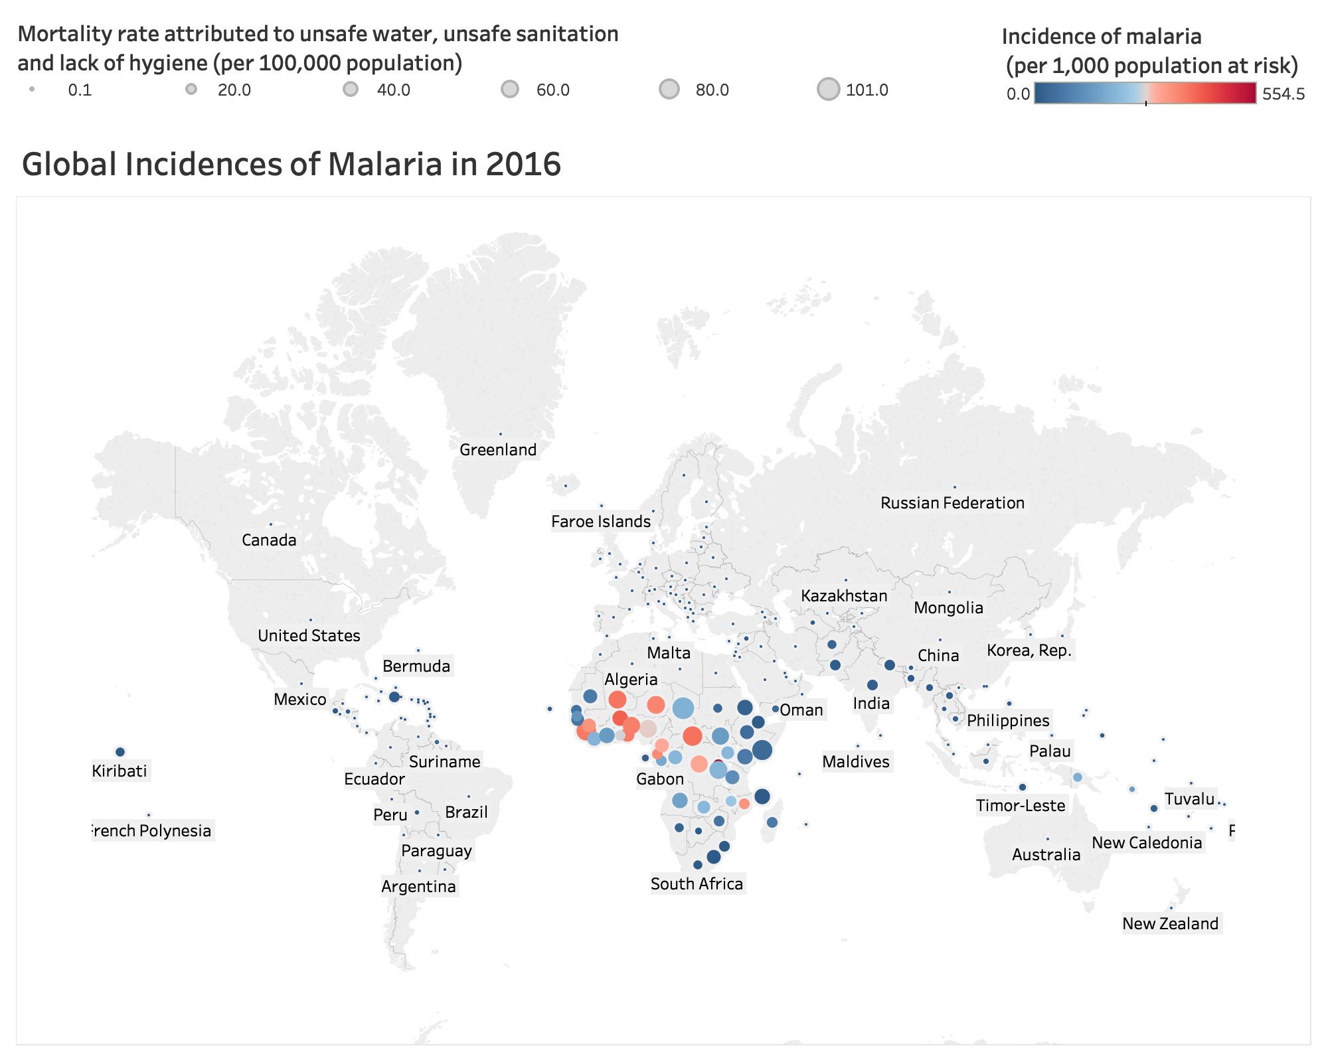
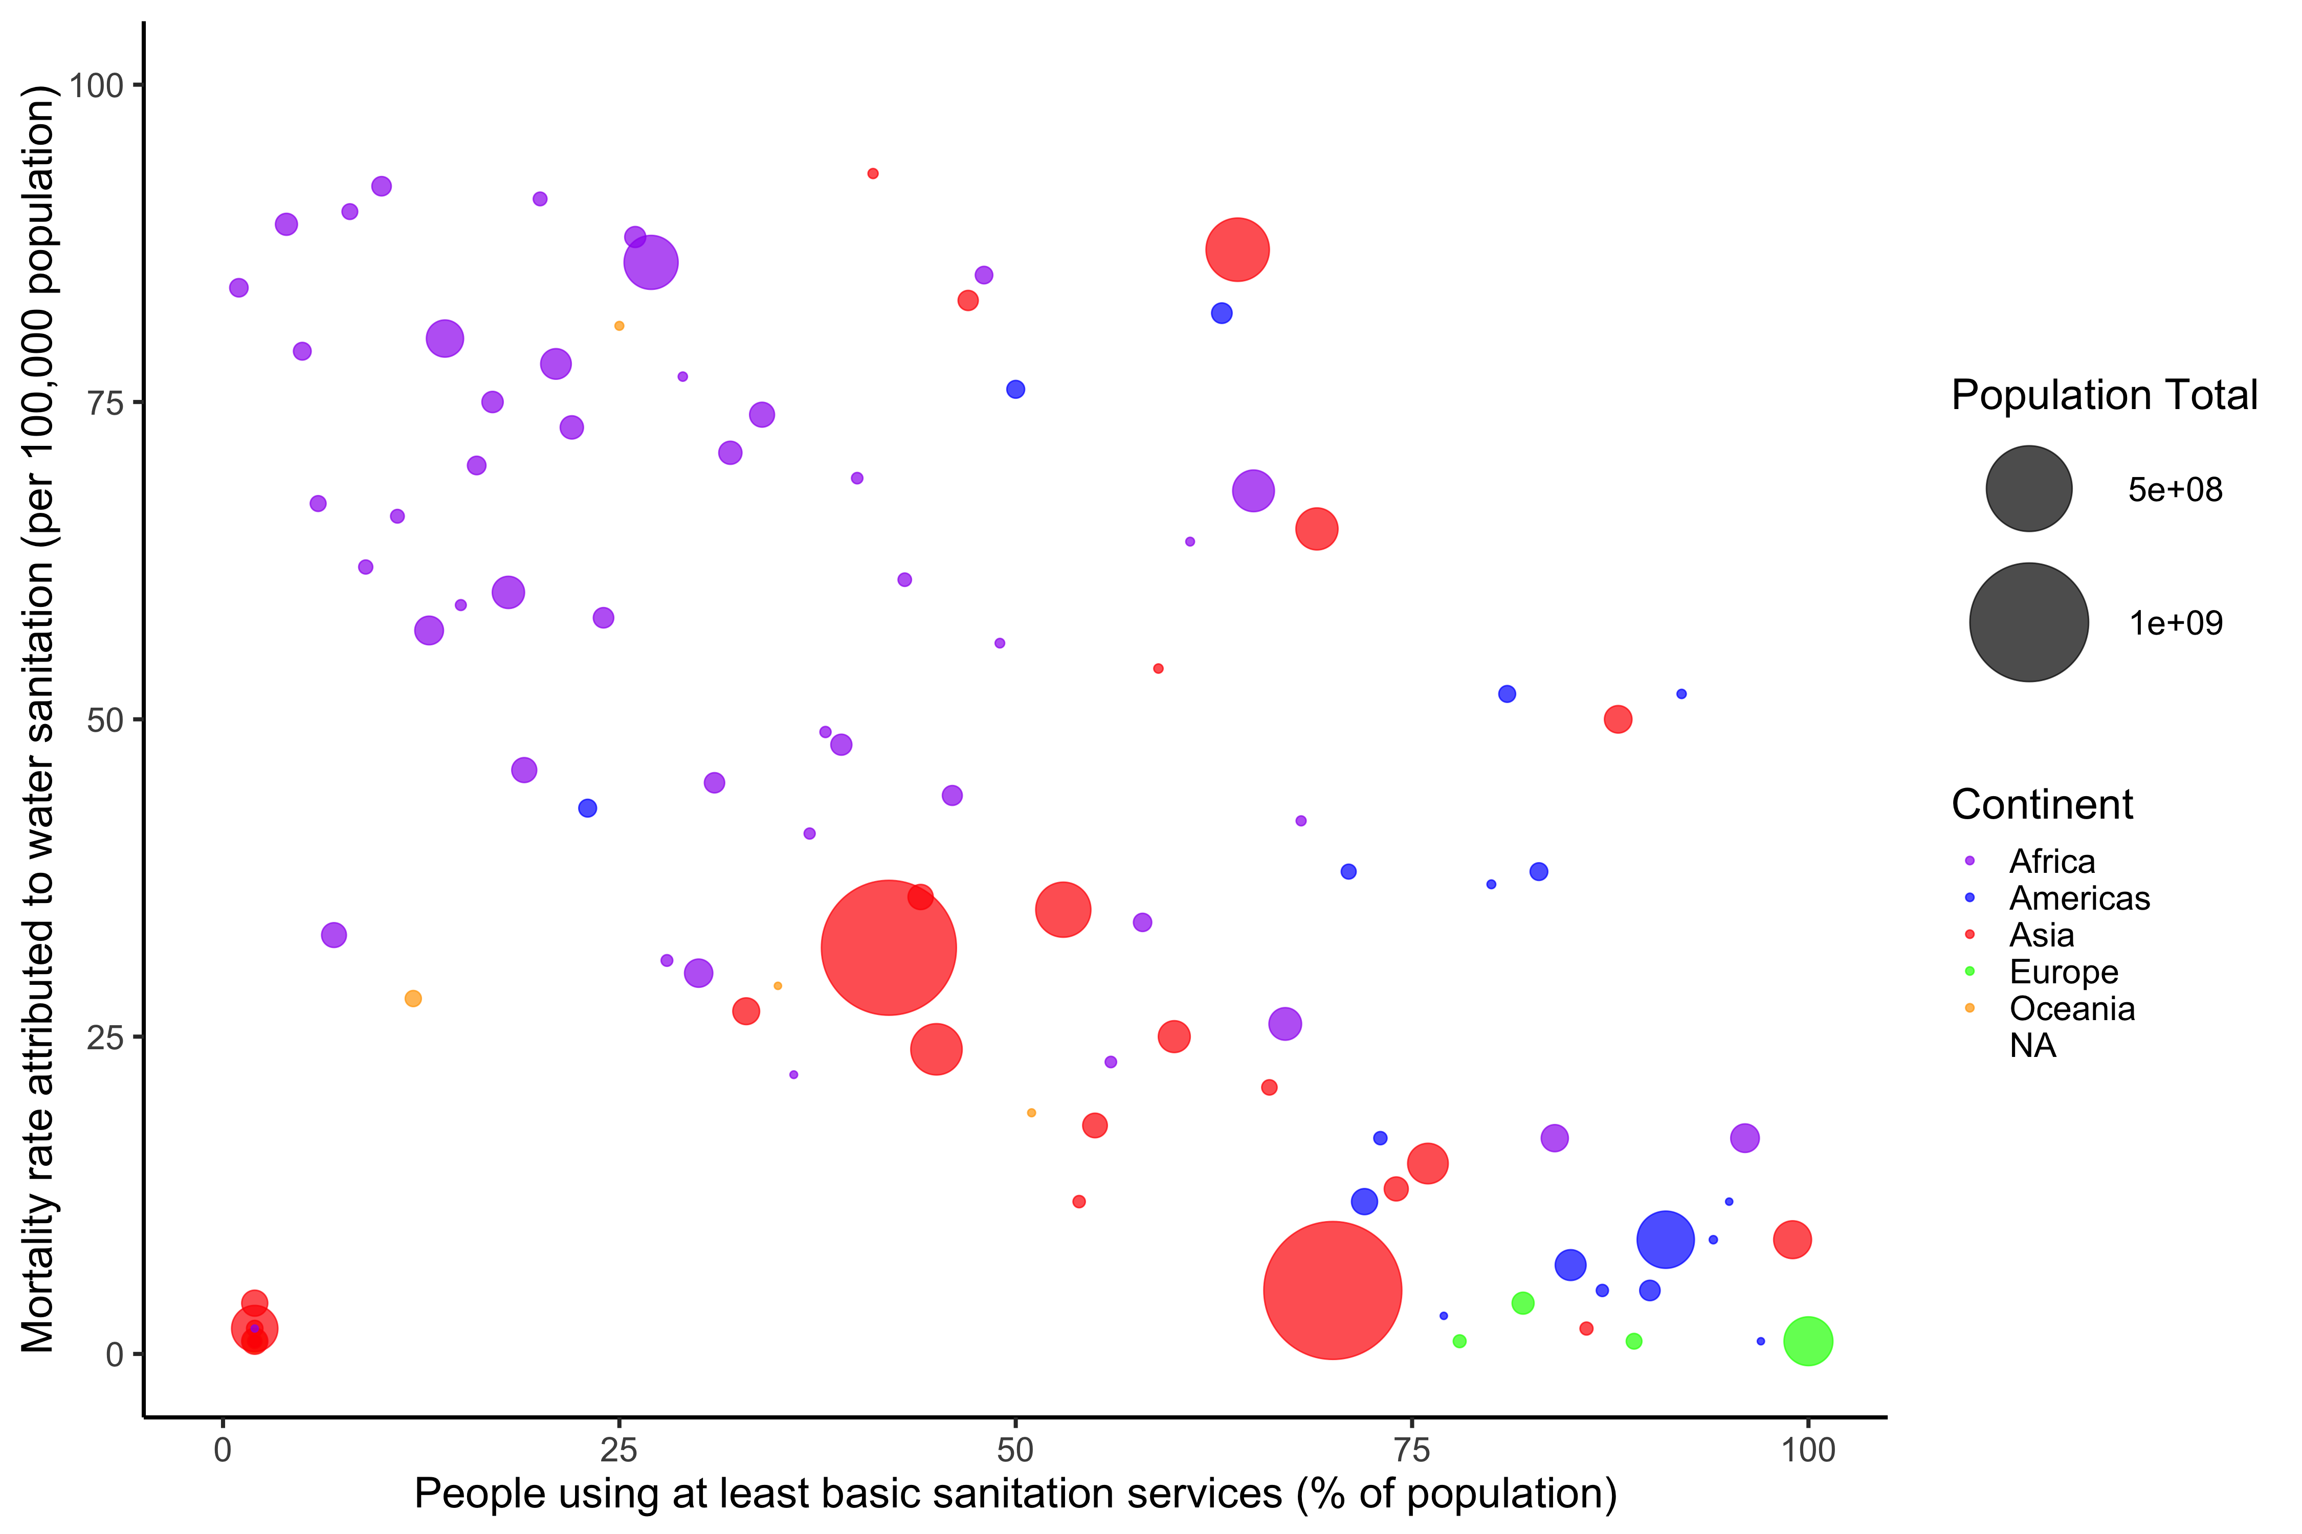
Health Threat from Unsafe Water Sanitation
Cost of sanitation is not in health expenditure
Very much ignored!
Water purification facilities,
sanitation infrastructure

