Slide 1
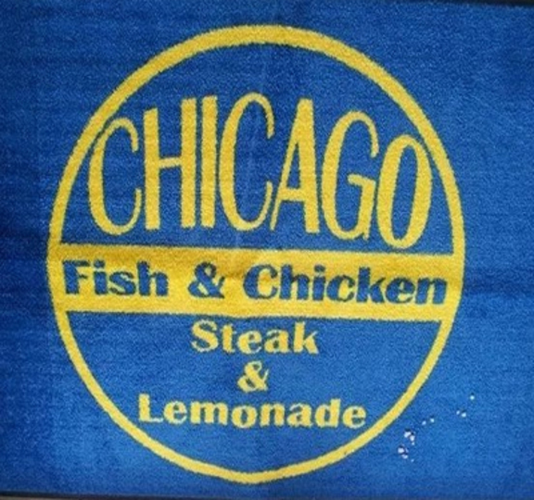
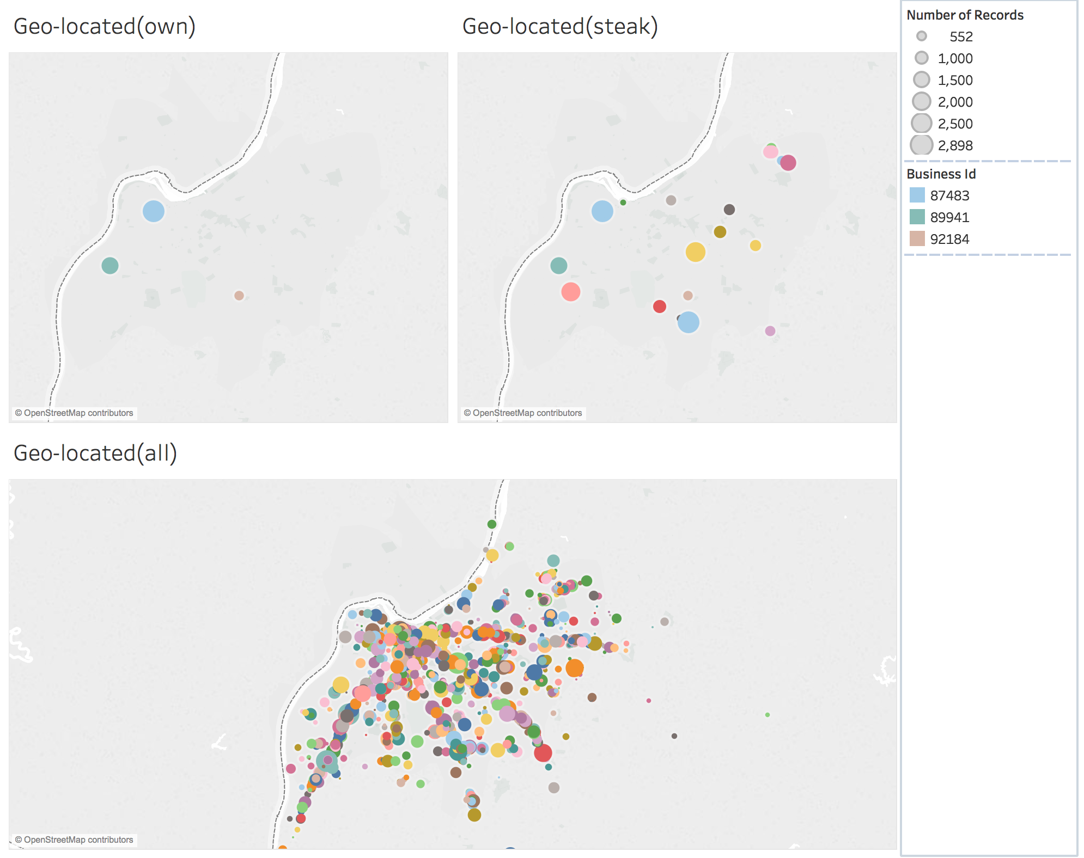
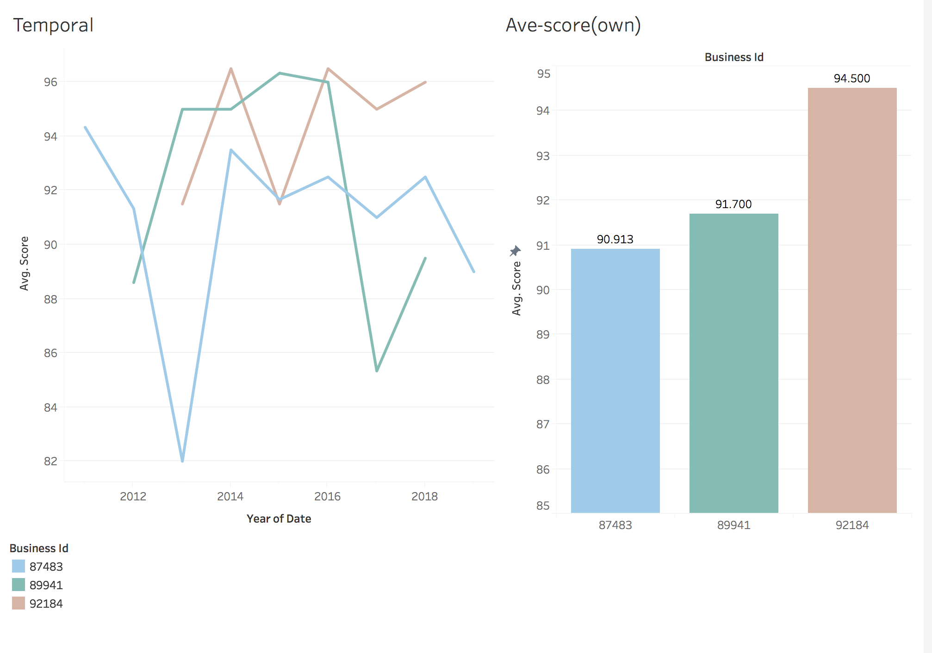
Inspection analysis for Chicago Steak and Lemonade Restaurant
Rui Li (Violet)
How does the score change over time?
Which branch has the lowest score?
Where are the businesses geo-located?

Slide 2
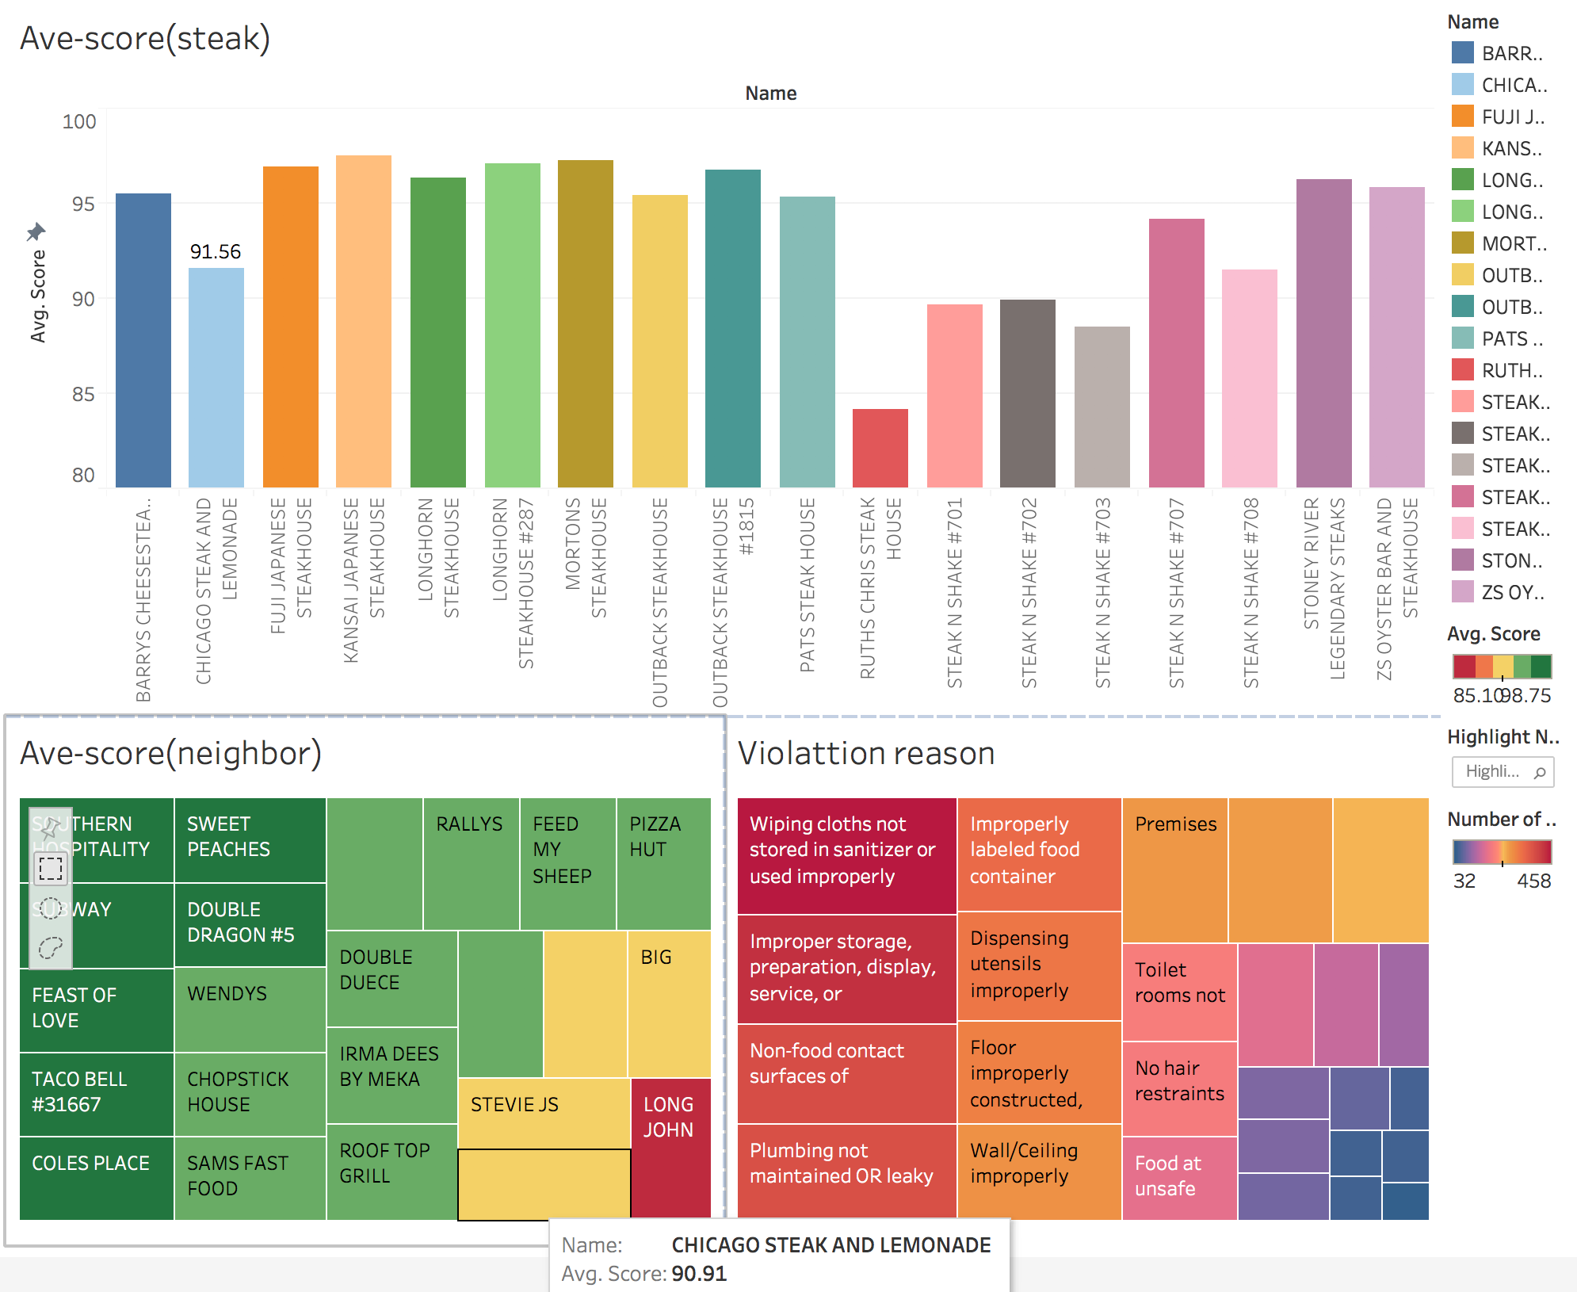
Compare to others
Compared to other steak restaurants, does our restaurant perform better?
Compared to neighbor restaurants, does our restaurant perform better?
What’s the main source of violations in our restaurants?

