Slide 1
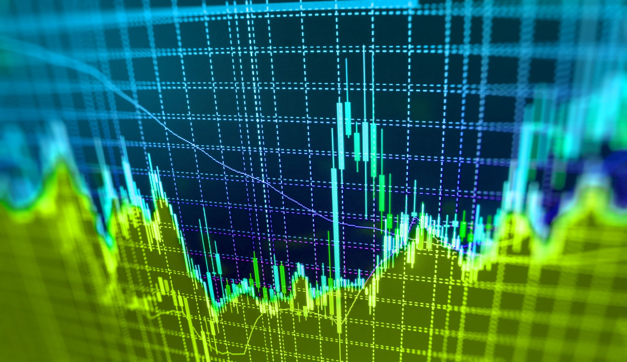
Cryptocurrency Reporting Dashboard
Afreen Shakeel
Akshita Chooramani

Slide 2

Presentation layout
What are the goals of the dashboard?
How did we meet the dashboard goals?
Walkthrough of the dashboard
What techniques did we use?
What can be added to the dashboard in future?

Slide 3
What are the goals of the dashboard?

Slide 4
Concepts in scope
Explanation of what exactly is cryptocurrency and how is it different from USD
Show the performance of all cryptocurrencies in our dataset
Which cryptocurrency should the user invest in?
How much would it cost to invest in a particular cryptocurrency?
Notes:
Explanation of what exactly is cryptocurrency and how is it different from USD
Show the performance of all cryptocurrencies in our dataset
Bitcoin vs others (one at a time) – from overview
OHLC performance of all cryptocurrencies – from deepdive1
Which cryptocurrency should the user invest in?
Rolling Avg of closing price – from deepdive2
Rolling Avg of market cap – from deepdive2
How much would it cost to invest in a particular cryptocurrency?
Buy and Sell tab
How to buy and sell cryptocurrencies
My Account

Slide 5
Concepts out of scope
Prediction of a future price value
Comparison of commodities vs currency

Slide 6
Target audience
Investors who are interested in investing in cryptocurrency
People who want to explore about cryptocurrency
People who want to compare the value of crypto vs modern currency

Slide 7
How did we meet the dashboard goals?

Slide 8
Research
What is a cryptocurrency?
How is it different from a modern currency?
How can one mine a bitcoin?
What is blockchain technology?
Is mining same across all cryptocurrency?
How can one invest in cryptocurrencies?

Slide 9
Data collection and wrangling
Datasets were downloaded from different sources of Kaggle and compiled together
Created our own dataset with current price of some modern currencies
Challenges
Deciding which cryptocurrencies to use out of 4000+ available currencies
Deciding what time frame to use
Wrangling
Adding the name
Fixing the dates in a standard format
Fixing the data type of Volume and Market Cap
Null value treatment

Slide 10
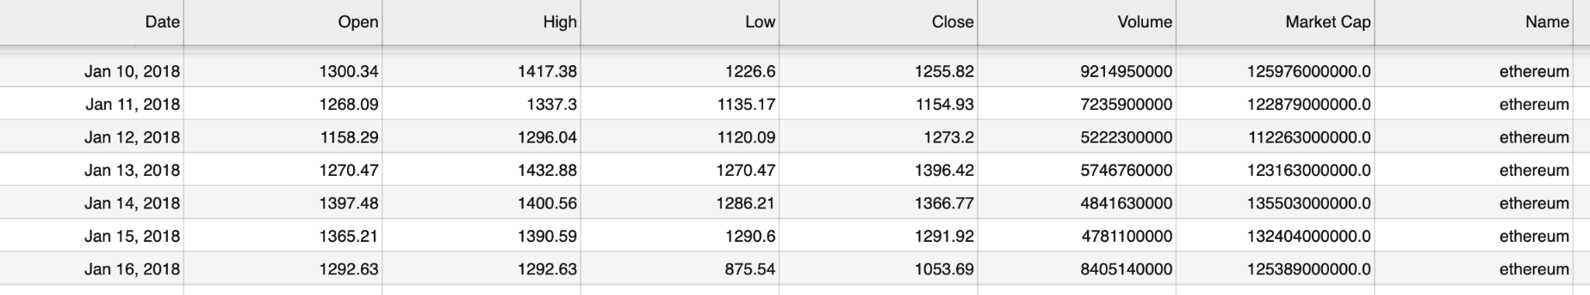
Processed data

Slide 11
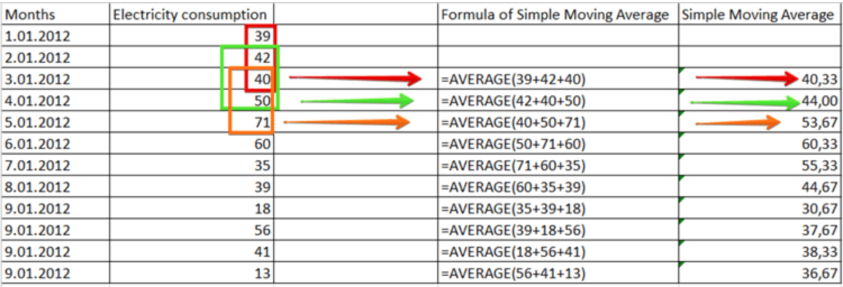
Key performing indicator – Rolling Average
Prices often move up and down by themselves due to external factors such as seasonality, major events, and factors that we cannot control
To remove this unwanted noise and gain a real grasp of data, we used a rolling average
Rolling averages help us focus on the long-term impact of prices/volumes without losing sight of the short-term changes
Why did we create this KPI?
How is it created?

Slide 12
Key performing indicator – Exchange Rate
Created a data set of current price of 1 modern currency to USD
1 SGD = 0.75 USD
Wrangled the data to get the latest price of 1 cryptocurrency (data was already in USD)
1 Ethereum = 0.763358 USD
Created a function to get the permutation of values
Modern currency value is converted to USD
Function
Cryptocurrency value is converted from USD to required modern currency
Input = USD value of modern currency
Output = USD value of cryptocurrency
Notes:
Modern currency value is converted to USD
Function
Input = USD value of modern currency
Output = USD value of cryptocurrency
Cryptocurrency value is converted from USD to required modern currency

Slide 13
Walkthrough of the dashboard
Notes:
App layout explanation
Why did we choose this graph?
Deployment and challenges faced in the Deployment

Slide 14
App layout
Why this graph?
Deployment

Slide 15
What techniques did we use?

Slide 16
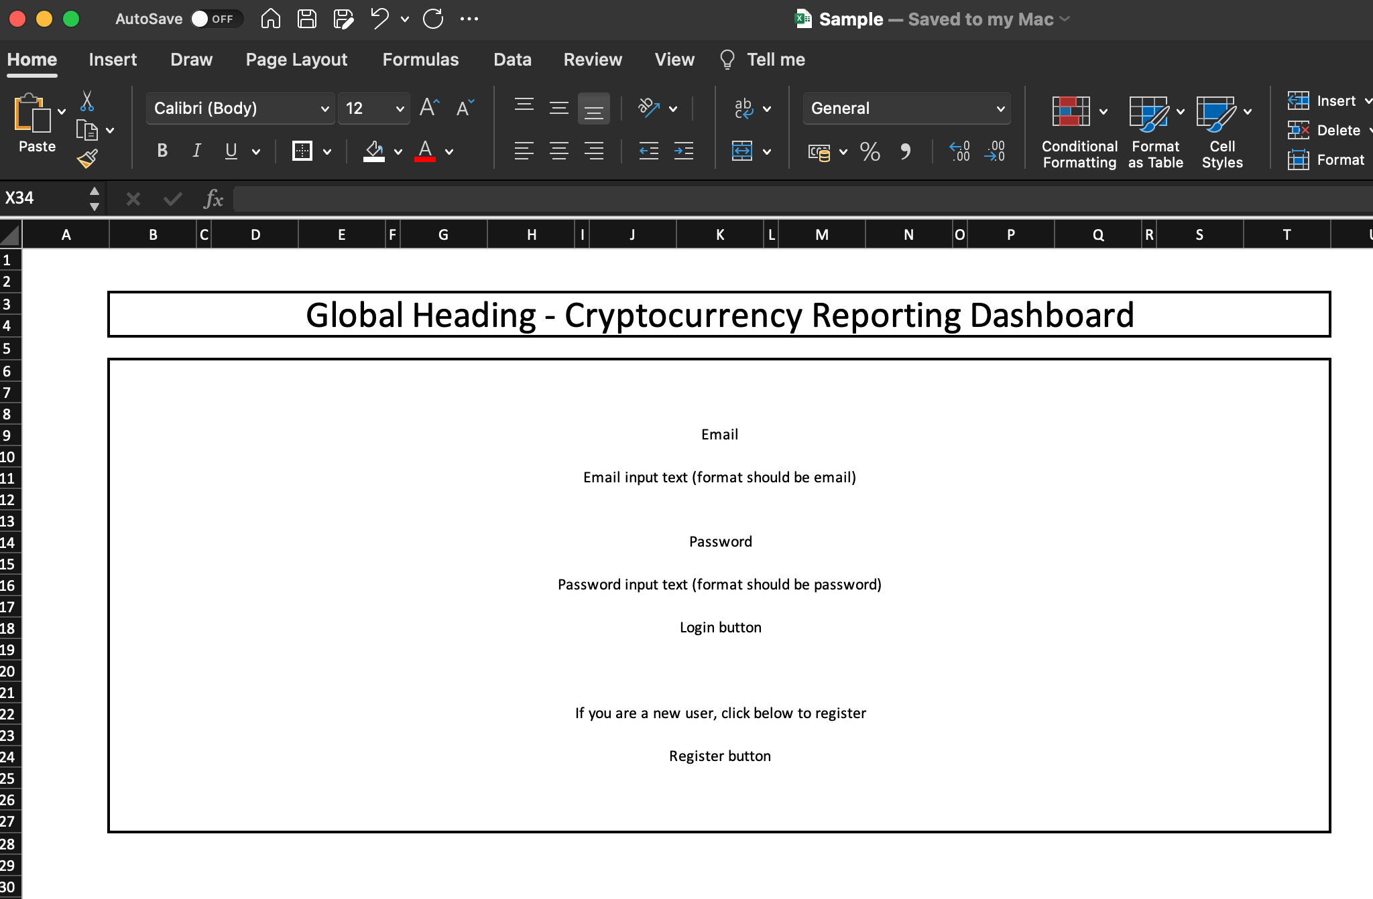
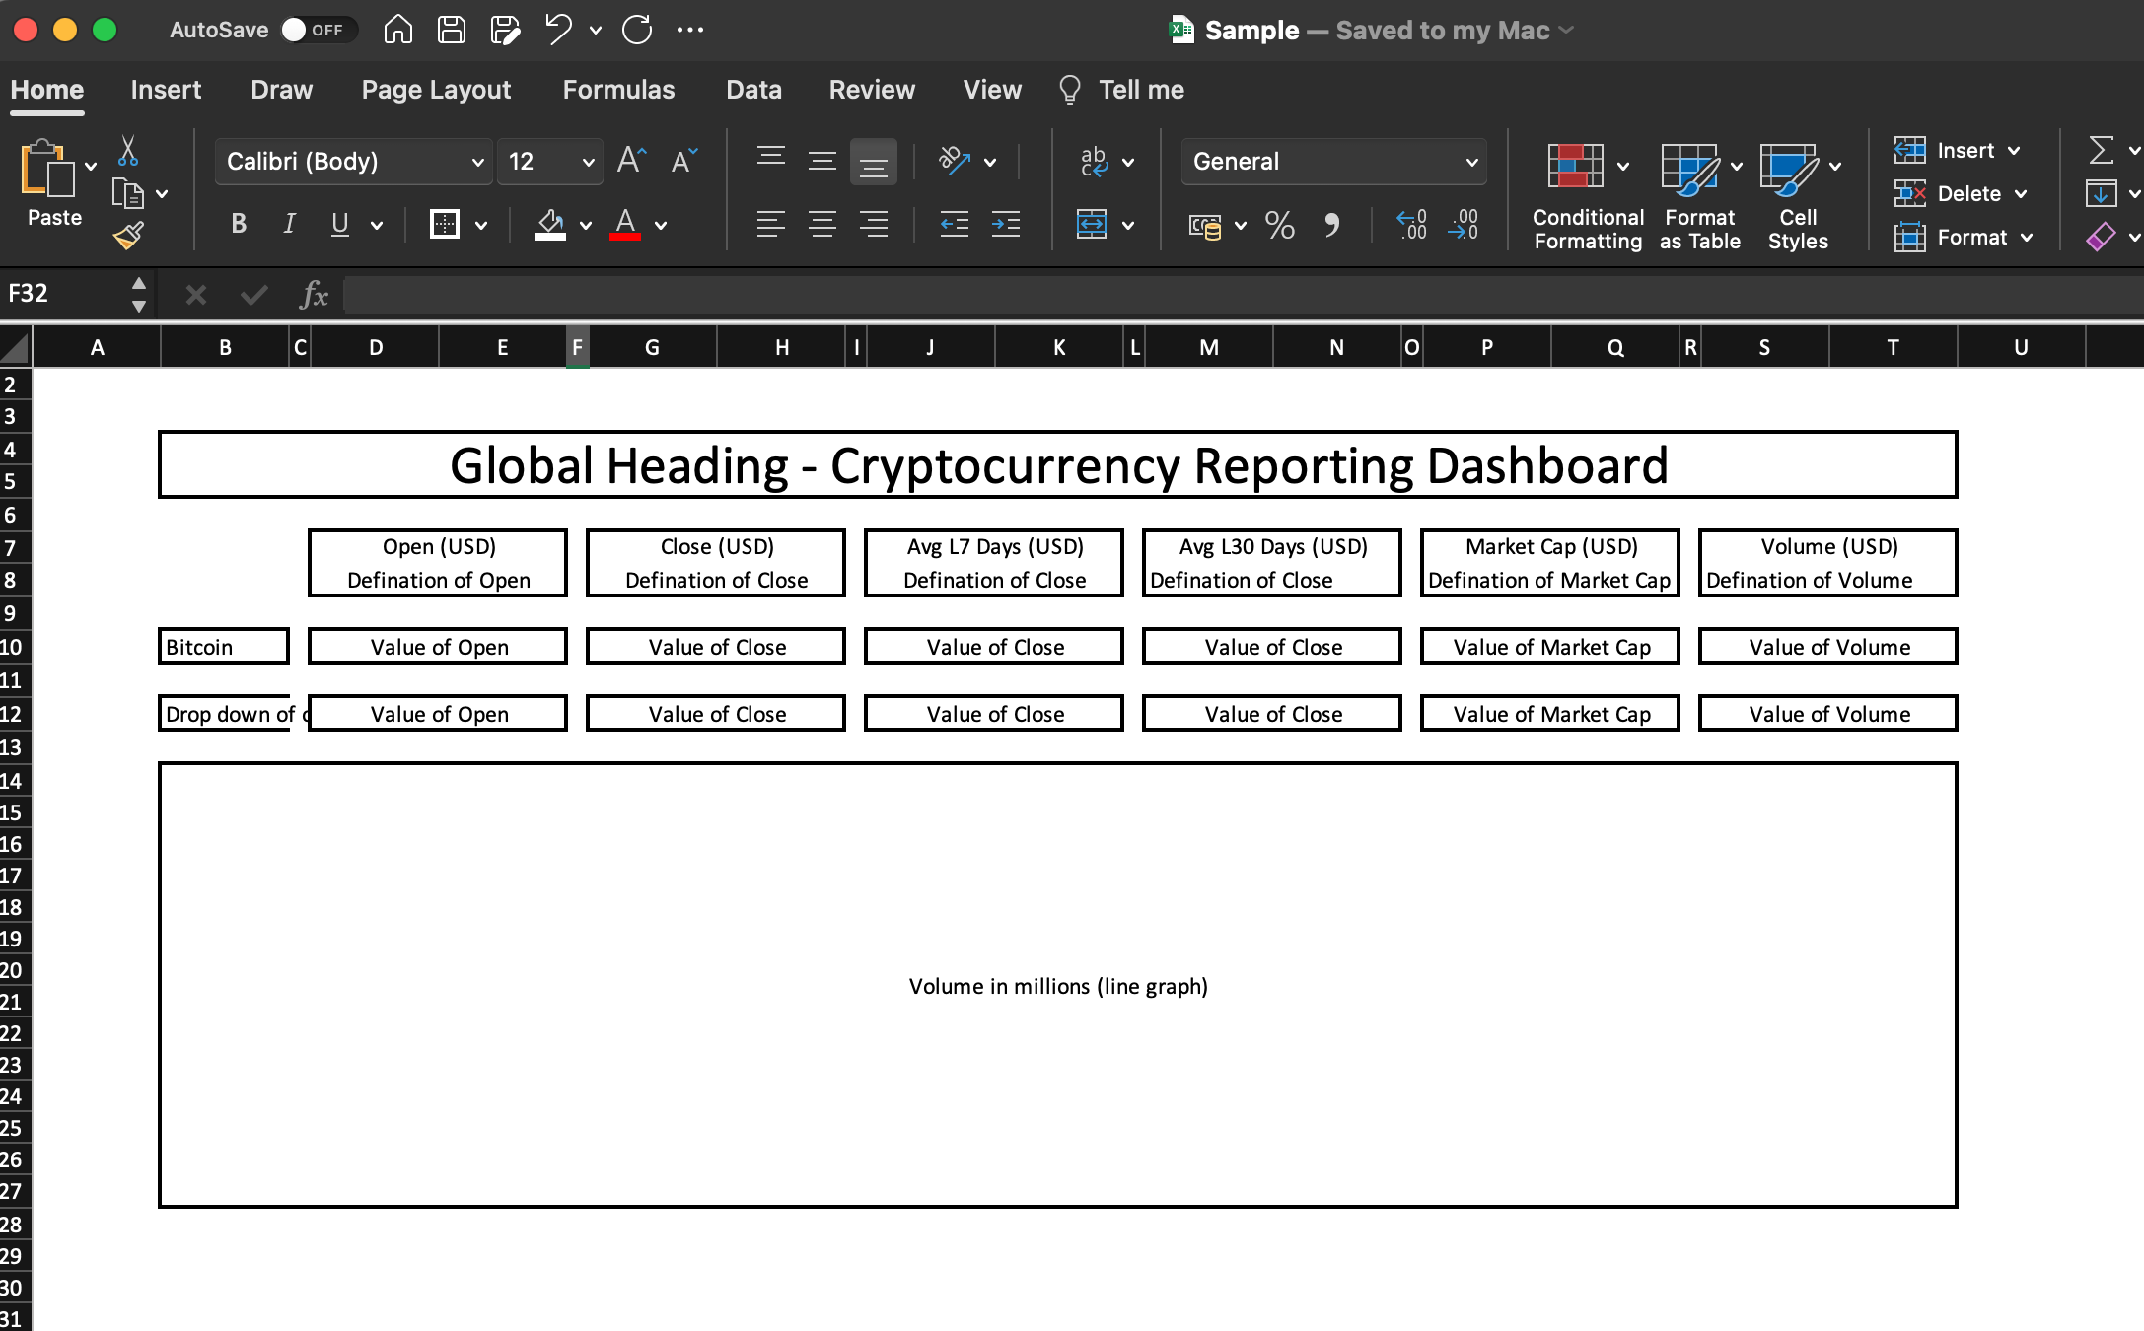
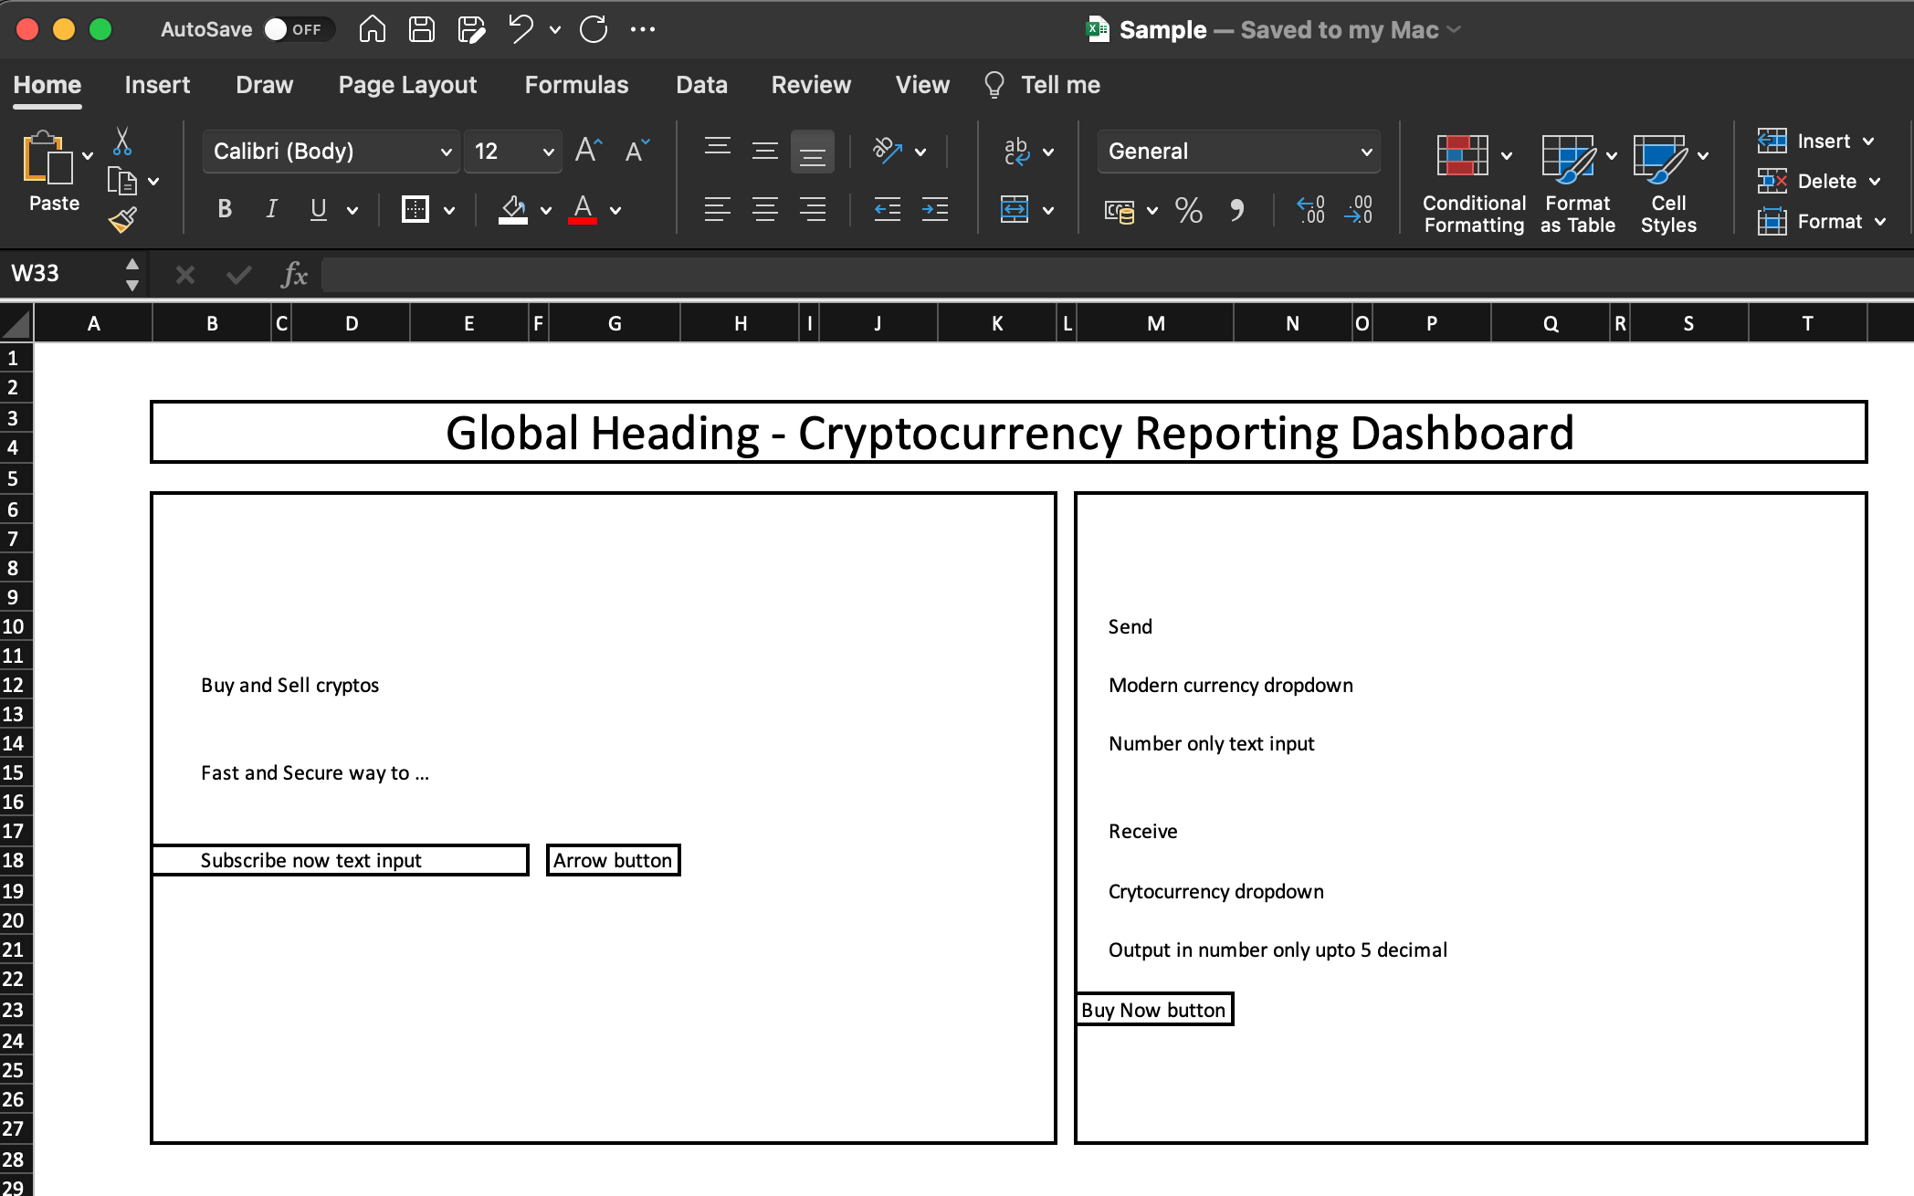
Wireframe

Slide 17
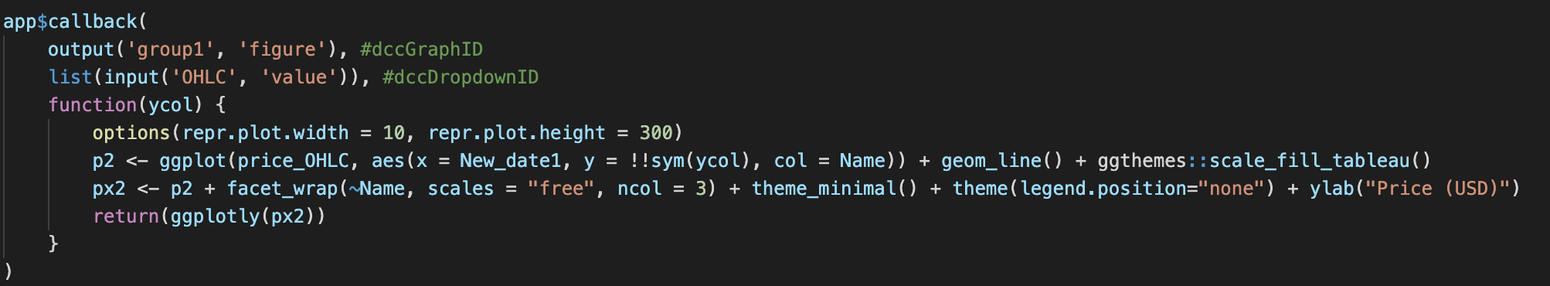
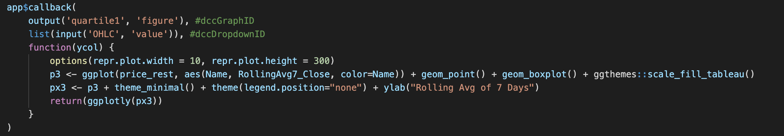
Graph codes
Basic codes used so that graph does minimal calculations

Slide 18
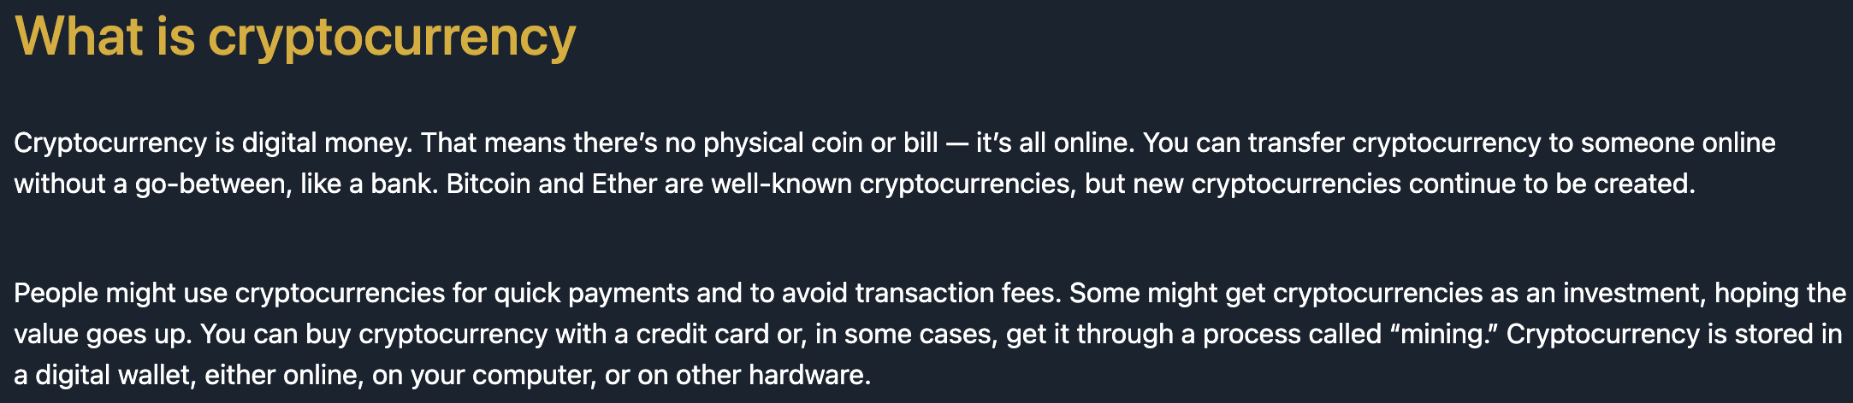
Things we improved from python to R dashboard
Added tabs
Incorporated peer feedback
Added levels for deep dive

Slide 19
What can be added to the dashboard in future?

Slide 20
Add more data
Add more KPIs
Exchange Rate
Add more functionalities
Time period can be increased
# of cryptos can be increased
Commodities (oil, gold etc) can be added
Year to date performance
Year on Year index / Month on Month index
PxM (Past x month's avg etc)
Connect to an API
Add more modern currencies
Calendar or slider for time range
Price prediction of crypto currencies
Connect to Binance portal to complete the "Buy now" transaction

Slide 21
Thank you

