Slide 1
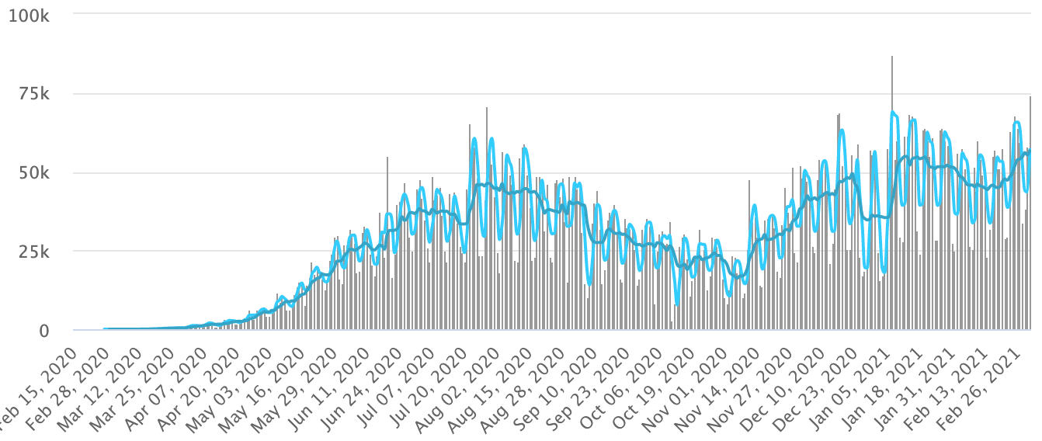
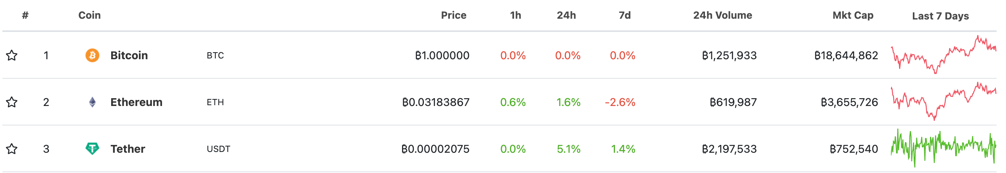
Bitcoin Avg Price
Dash Avg Price
Iota Avg Price
Waves Avg Price
Bitconnect Avg Price
Filter to select few crypto currencies
Filter Date
Filter Month
Filter Year
7 days moving avg (darker blue)
Convert from
3 days moving avg
Bitcoin
1
Convert to
CAD
61,532.81

