Slide 1
MDS Big Advanture
Henry(Yiheng) Luo
Yuhong Chen

Slide 2
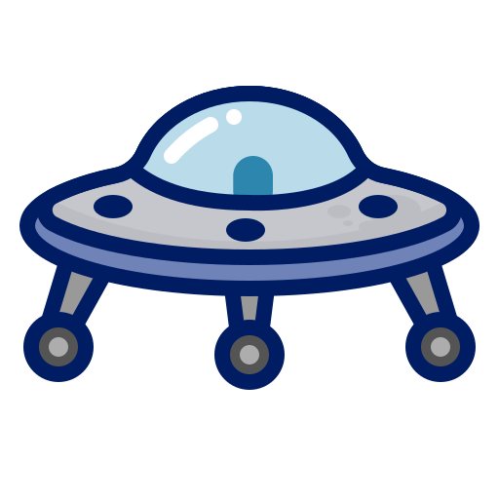
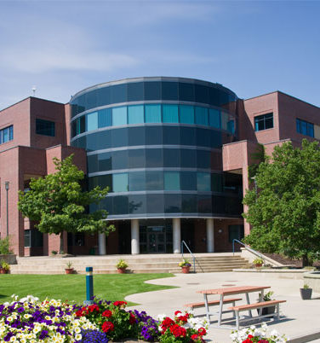

It is an ordinary day in the MDS program, you finished the morning classes and went to Tim Hortons for lunch. All of a sudden, you hear a big bang sound tearing through the sky. You looked up, UFOs! Alien vessels are hovering over the science building, aliens are landing on the roof! People around you started screaming and running. You suddenly realized something important, your laptop is still in the building, and you haven't submitted the lab in it! You need to go get your laptop!
ADVENTURE

Slide 3
4 USEFUL FUNCTIONS

Slide 4

CONTENT
1
2
3
4
PLAY
BUY
FIGHT
ADVANCE
Ask for the player’s actions and update the game world
Players can buy foods and get special items at Tim Hortons
Fight against aliens on each floor
Advance after defeating the aliens

Slide 5
3 SUB-PACKAGES

Slide 6
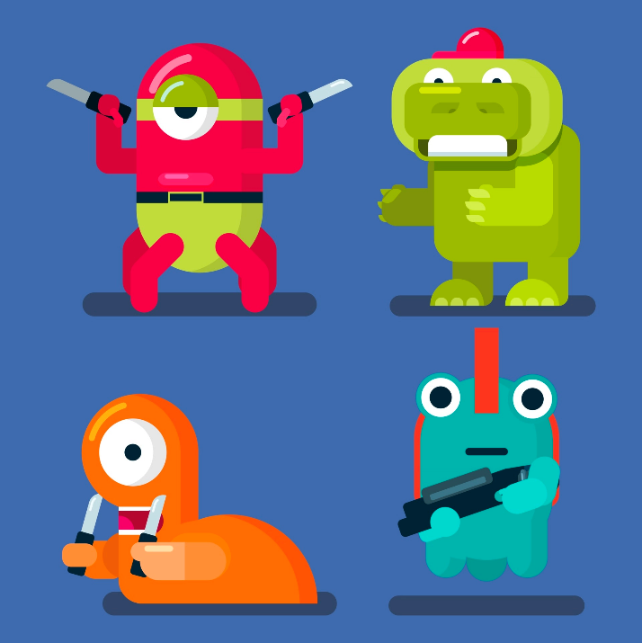
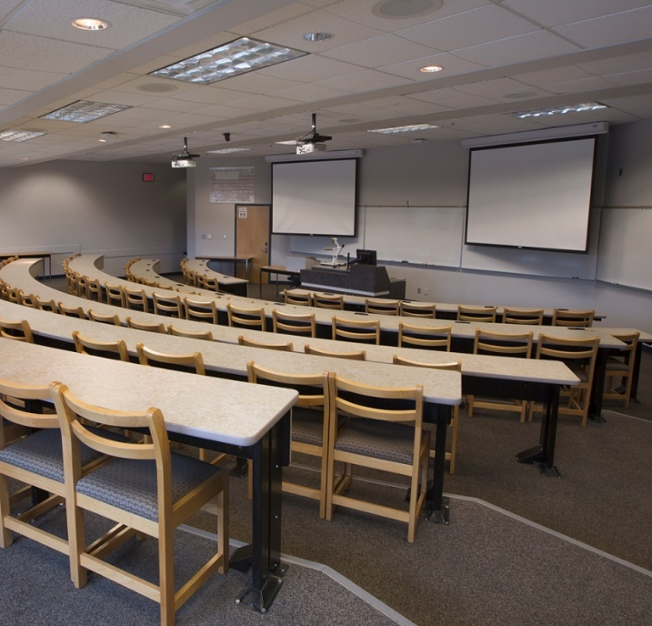
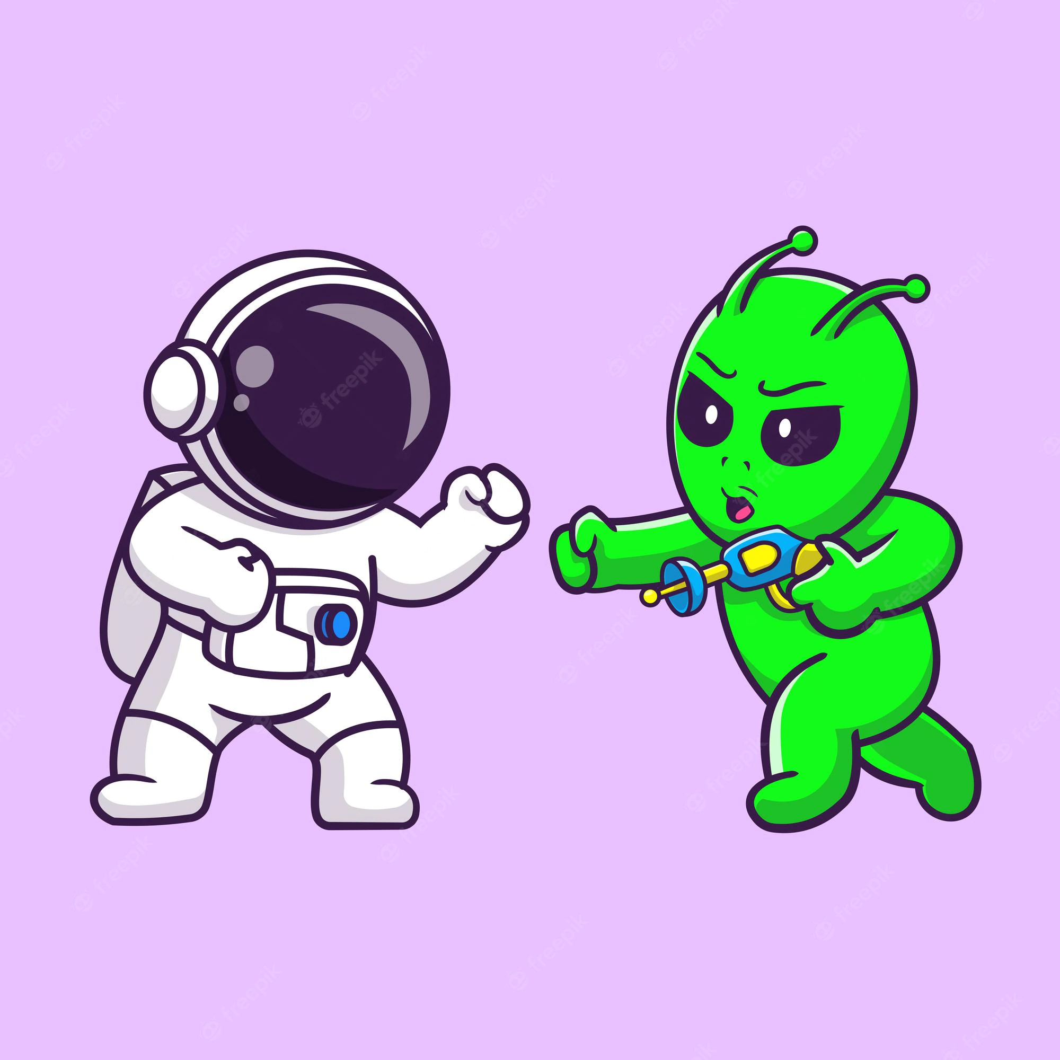
1
2
3
CHARACTER
SCENE
PLAY

Slide 7
/character

Slide 8

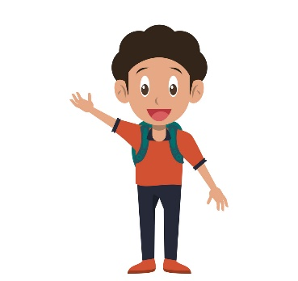
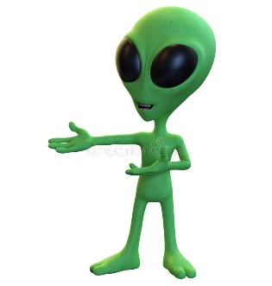
Character
Attribute: health, power
Method: display, fight, get/set heath/power
Player(Character)
Alien(Character)
Attribute: health, power, money, items
Method: buy; advance; retreat; defeat, getMoney
Attribute: health, power, money
Method: die, dropMoney, getStatus

Slide 9
/scene

Slide 10
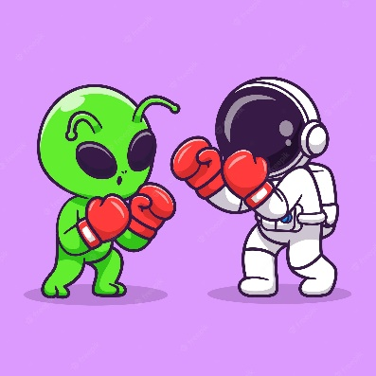

Level(Scene)
Tim’s(Level)
Attribute: location, plot, alien, status
Method: getAlien; getStatus; isVisited, visit
Attribute: location, plot, item
Method: sell, reward, checkInventory

Slide 11
/play

Slide 12
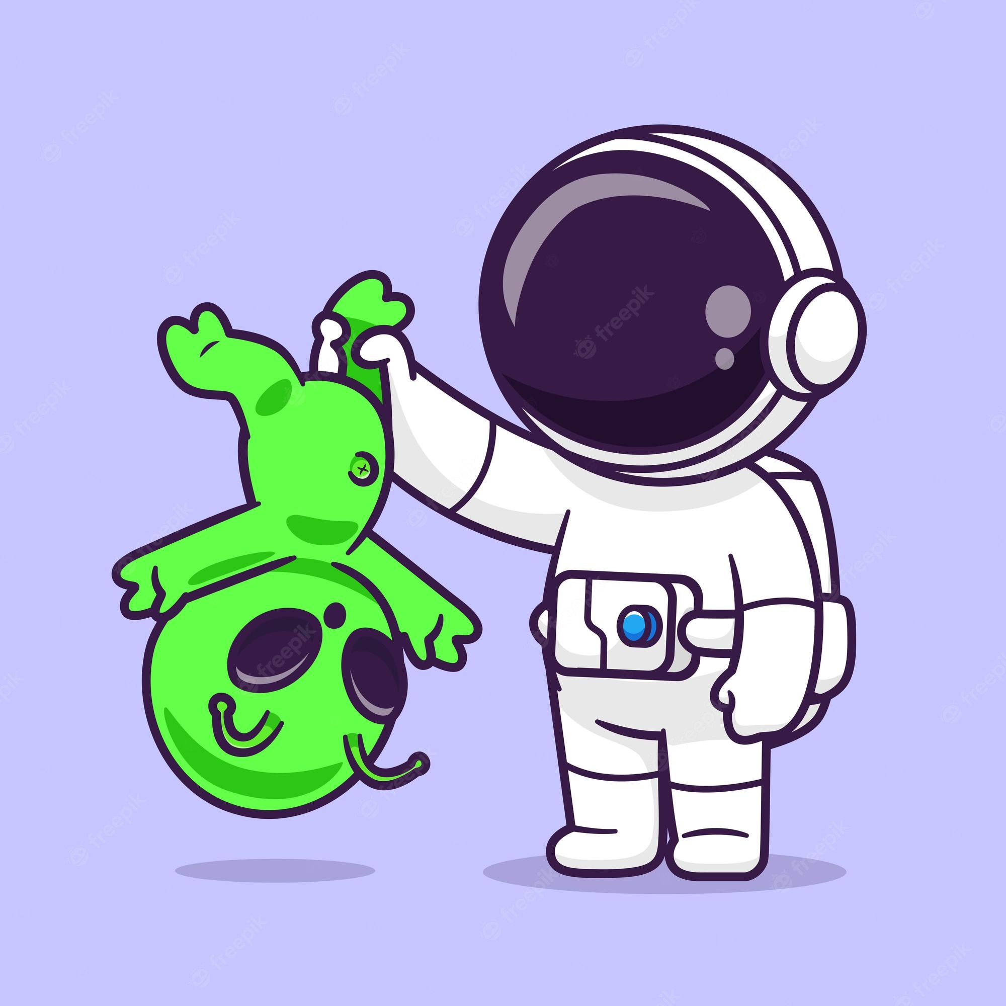
Play
Attribute: player, all the aliens, all the levels, a map containing all the levels
Method: buyItem; play; fight; win

Slide 13
Thank you

