Slide 1





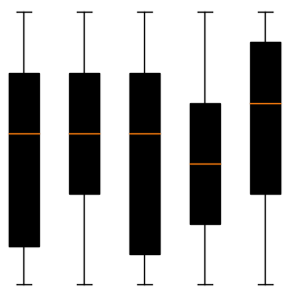

IMDB Dashboard (Preview)
Plots
Statistics
Predictions
Movie Rating Trends Over Time
Distribution of Movie Ratings
Top Directors by Average Rating
Genre Distribution of Movies
Budget vs. IMDb Rating
Ratings by Genre

