Slide 1
Tournament Simulator - tourny
Jamie Breault
Andre Gnandt

Slide 2
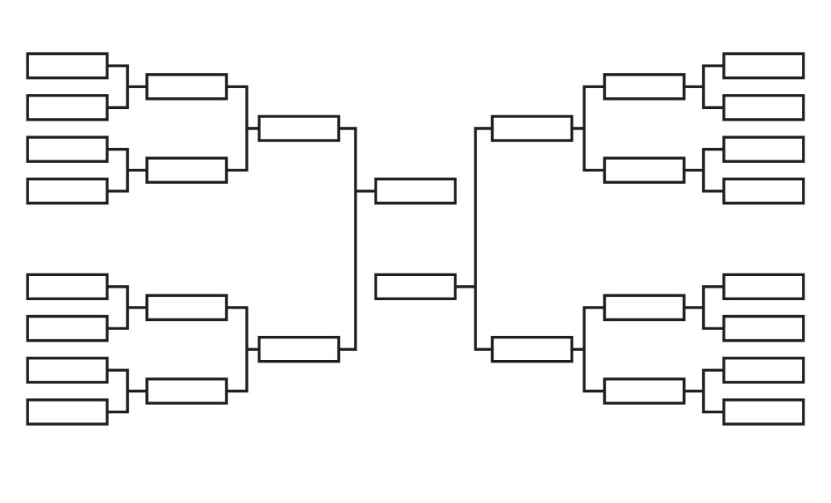
Introduction
Do you like:
  Sports?
  Video games?
  Chess?
Then you could use a TOUNAMENT SIMULATOR!!!

Slide 3
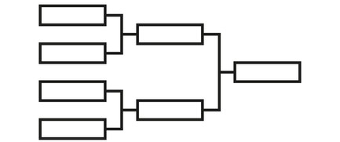
Sub-Package 1 (structure) Module 1 (foundation)
Holds all code needed to simulate individual tournaments
Classes:
  Team (name, quality)
  Match (list of 2 Teams, winner)
  Round (list of Matches, round number)
  Tournament (list of Teams, pairing type)

Slide 4

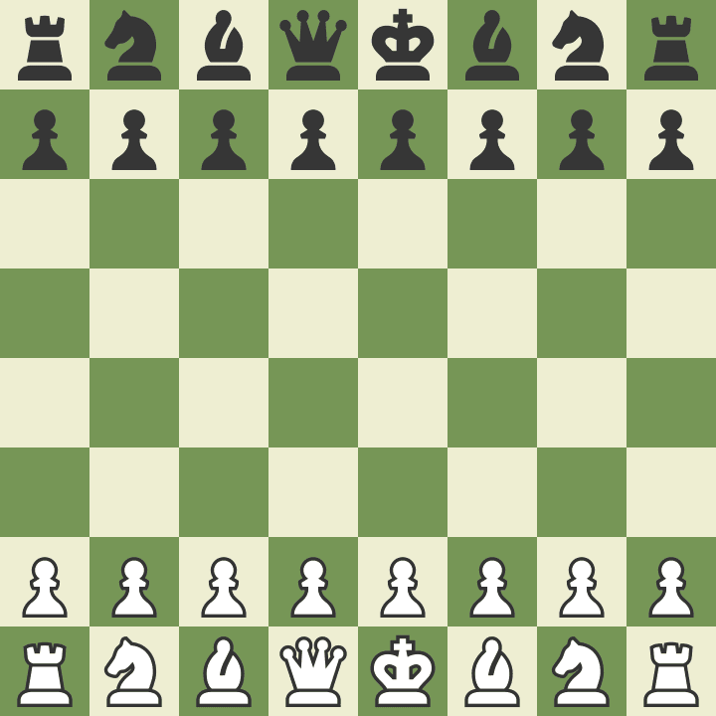
Sub-Package 1 (structure) Module 2 (samples)
Preset Teams and lists of Teams
Users can use these instead of custom Teams if they want to
Top 16 Players
32 Teams

Slide 5
Sub-Package 2 (analysis) Module 1 (tournament)
Functions to analyse Tournaments
  Eg: Given a Tournament, what is the probability of each Team winning? Simulate thousands of runs and average the results
Tournament
(List of Teams, Pairing Type)
Number of Runs
(Eg: 100,000)
{
”Canada”: 0.54,
“Mexico” : 0.26,
“Haiti”: 0.19,
“USA”: 0.01
}

Slide 6
Sub-Package 2 (analysis) Module 2 (team)
Functions to analyse Teams
  Eg: Given a Tournament and a Team, what is the probability of that Team reaching each Round
Tournament
(List of Teams, Pairing Type)
Team
(In the Tournament)
Number of Runs
(Eg: 100,000)
{
”No Wins”: 0.14,
“Round 1” : 0.36,
“Round 2”: 0.29,
“Undefeated”: 0.11
}

Slide 7
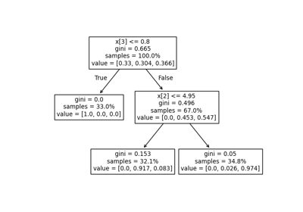
Sub-Package 3 (visualization) Module 1 (single)
Functions to visualize the results of a Tournament
  Eg: We will use decision tree functions from Scikit-Learn to visualize completed Tournaments

Slide 8
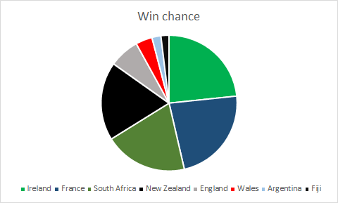
Sub-Package 3 (visualization) Module 2 (analysis)
Functions that visualize results from the analysis sub-package
  Eg: A pie chart that shows the chance of each Team winning a Tournament
  Eg: A pie chart that shows the chance of a Team reaching each Round

