Slide 1

GIT GOOD
An Introduction to Version Control
Presented by
UB SCIENTISTA

Slide 2
How do you collaborate on code?
Working on a team, you need to share code. How?
Email?
Google Docs?
Dropbox?
Paper?
Photos?
US Postal Service?
What if two or more people have to work on the same file(s) at the same time?

Slide 3

Let’s use git!
What can git do?
Version and source control
Tracks all changes submitted to codebase
Revert changes
Create working branches without affecting stable releases (i.e., “safe”)
Tells you when you have merge conflicts
Why git?
It’s free!
Widely used and an industry standard

Slide 4
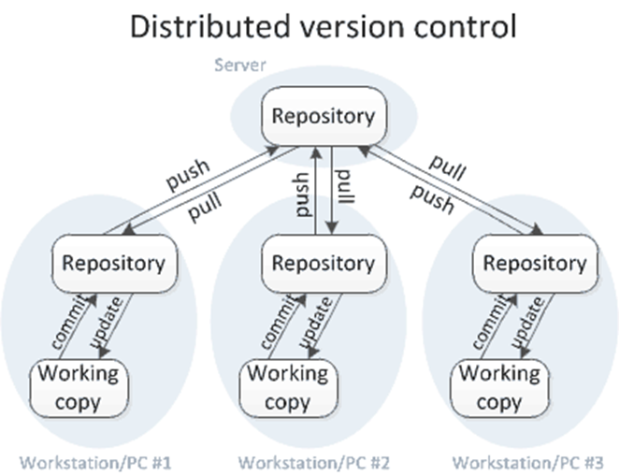
git and Distributed Version Control

Slide 5
git set up
Remote server hosts your repository
Every user maintains a local copy of the entire repository
You will need to install git if it doesn’t come with your OS
On a unix machine (linux):
On a Windows machine:
Will need to install a bash client, like GitBash (aka, Git for Windows: https://git-for-windows.github.io/)

Slide 6

Remote repository
We’ll use GitHub
Make sure you have a GitHub account!
Other services:
BitBucket
SourceForge

Slide 7
some git commands
Make a new repository
git init
Update a remote repo
git add
git commit
git push
Connect to a repo
git clone
Update a local repo
git pull
Notes:
git init

Slide 8
Updating the Remote Repository
git add <filename>
Tell git that you want it to track <filename>
git commit
Updates changes to your local repo
Add a meaningful commit message (using the -m flag)
git push
Updates the remote repo with the changes committed to your local repo
Lets your team access your changes (using git pull to get the changes)
Will warn you to git pull first, if there are remote changes
Notes:
git init

Slide 9
Connecting to a Repository
git clone <repoLocation>
Copies the entire repository to your local directory
https
git clone https:/…
ssh
git clone git@…
Must create ssh keys and upload your public ssh key to the server
Notes:
git init

Slide 10
Pull often!
git pull <repoLocation>
Copies the most up-to-date code from the server to your local copy of the repo
Can cause a local merge conflict
PULL OFTEN
Notes:
git init

Slide 11
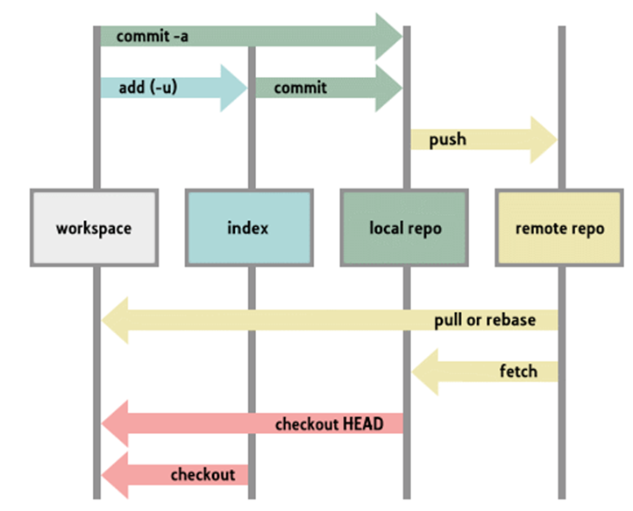
git Structure
Notes:
git init

