Slide 1
Big Data Architecture – Real-Time Fraud Detection, AML
Venkataraghavan thottiyam venkatakrishnan
Bellevue university

Slide 2
Problem Statement & Challenges of Financial Sector
Increasing instances of fraudulent activities –
unauthorized credit card transactions.
suspicious account activities.
money laundering.
Challenges:
Huge transaction volumes.
Real time detection and response.
Efficient compliant AML monitoring , action and reporting
Scalable and secure data handling and storage.
Regulatory Compliance

Slide 3
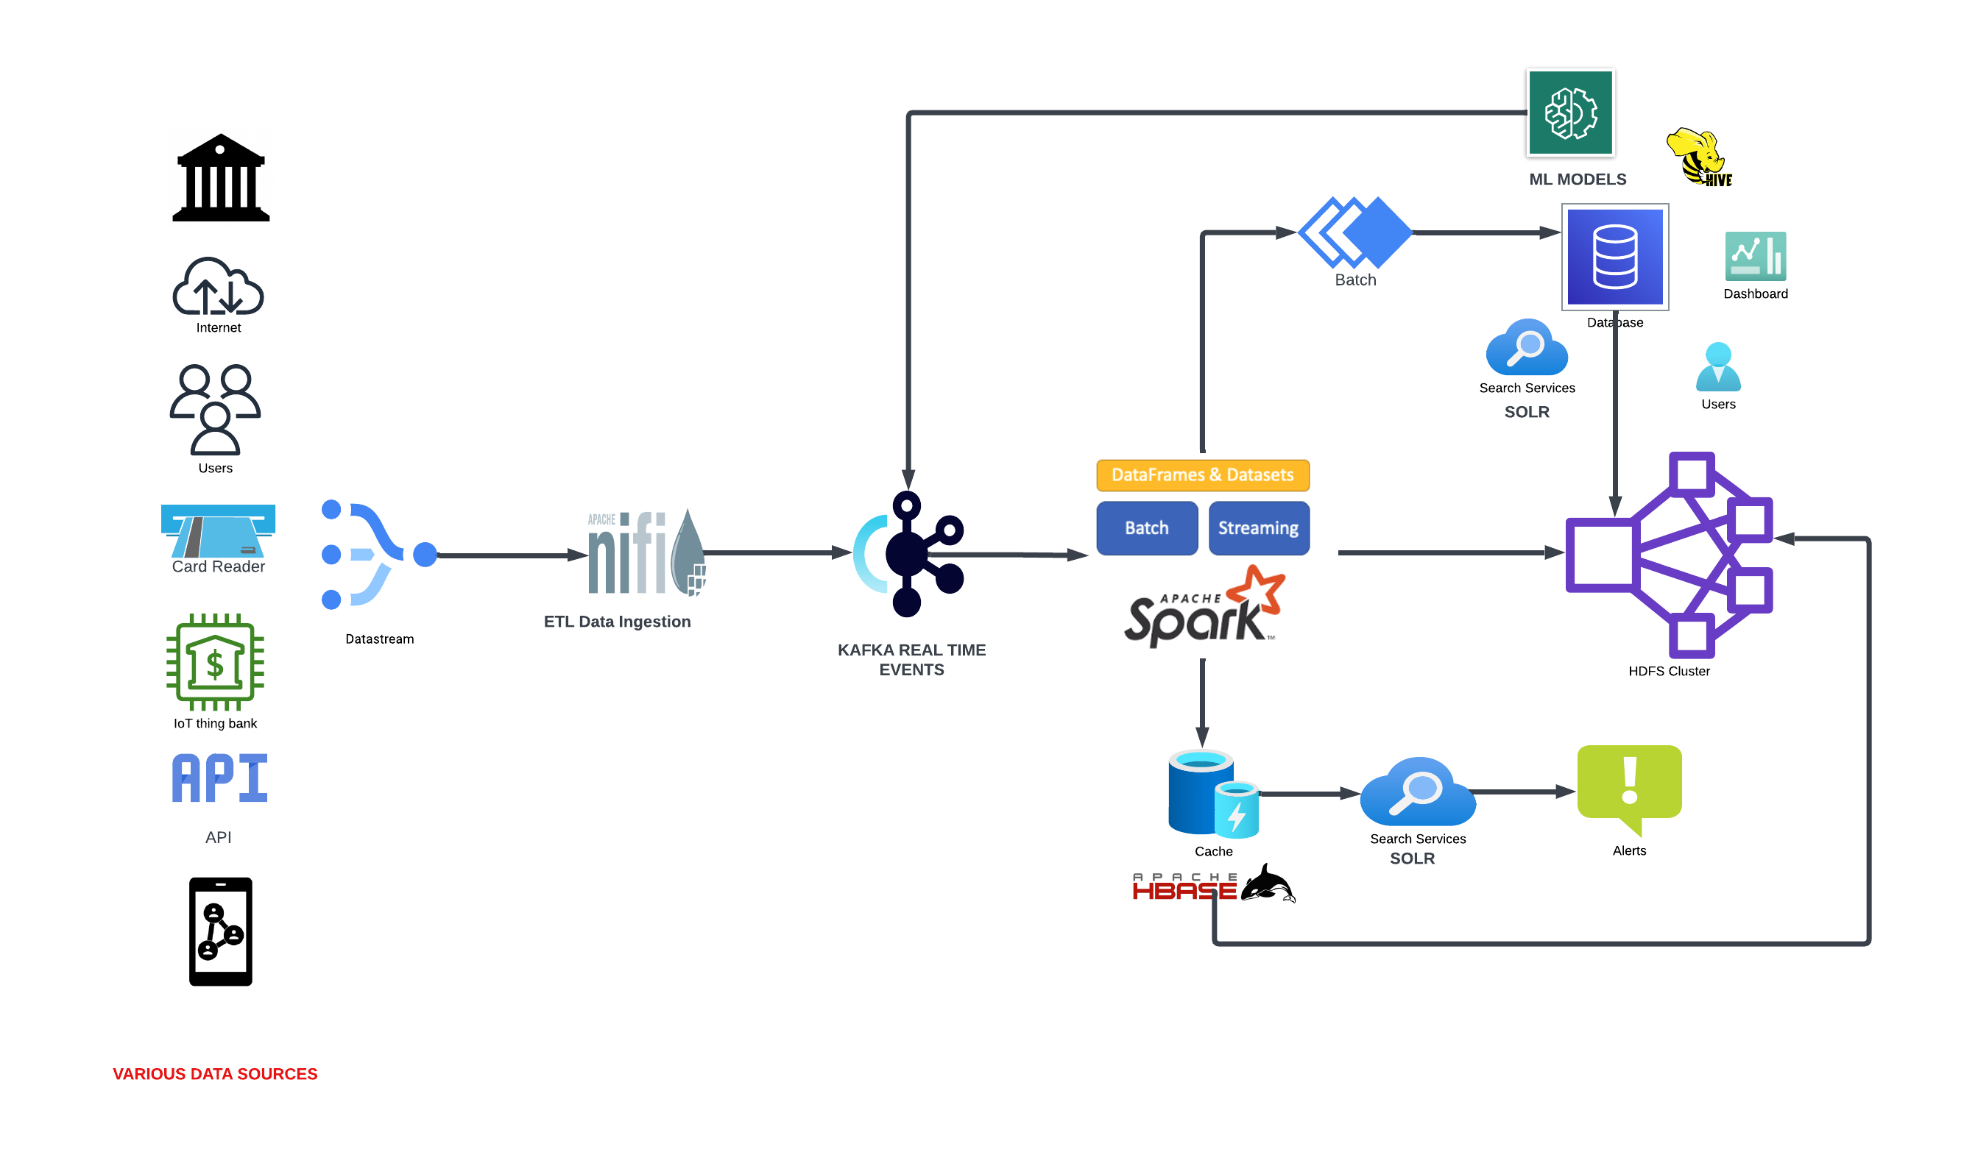
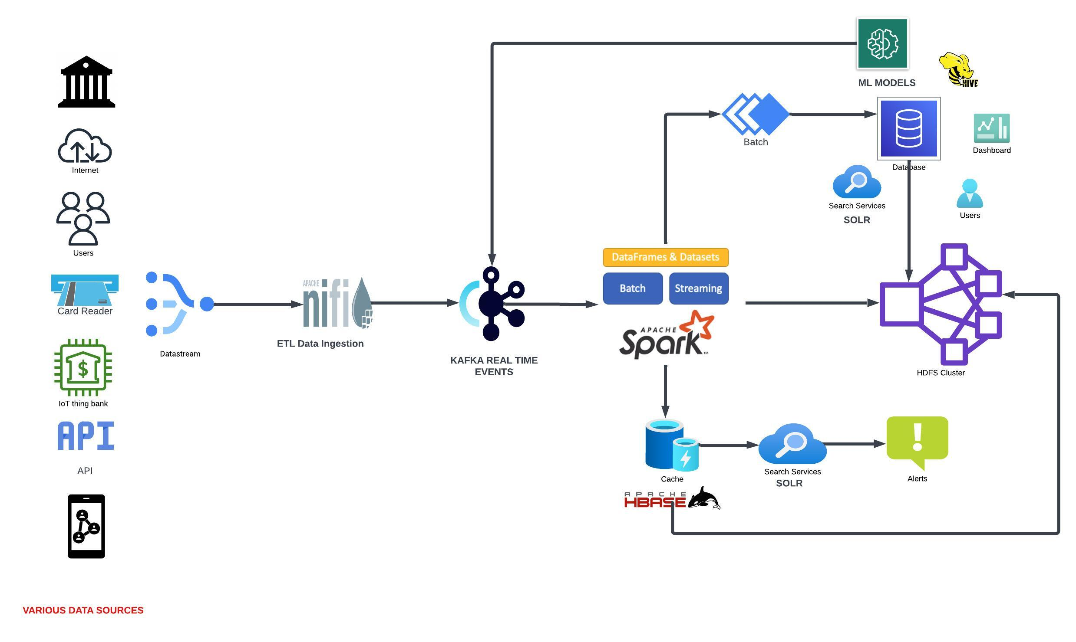
Proposed Architecture - High Level

Slide 4
Proposed Architecture - High Level
NiFi: Ingests data from multiple sources and performs initial ETL operations.
Kafka: Transports and buffers data in real-time.
HBase: Stores real-time data with low-latency access.
HDFS: Stores batch data, providing scalable and fault-tolerant storage.
YARN: Manages cluster resources for processing.
Spark: Performs both real-time and batch data processing and analysis.
Hive: Allows SQL-like queries on large datasets stored in HDFS.
Solr: Provides powerful search and indexing capabilities for efficient data retrieval.

Slide 5
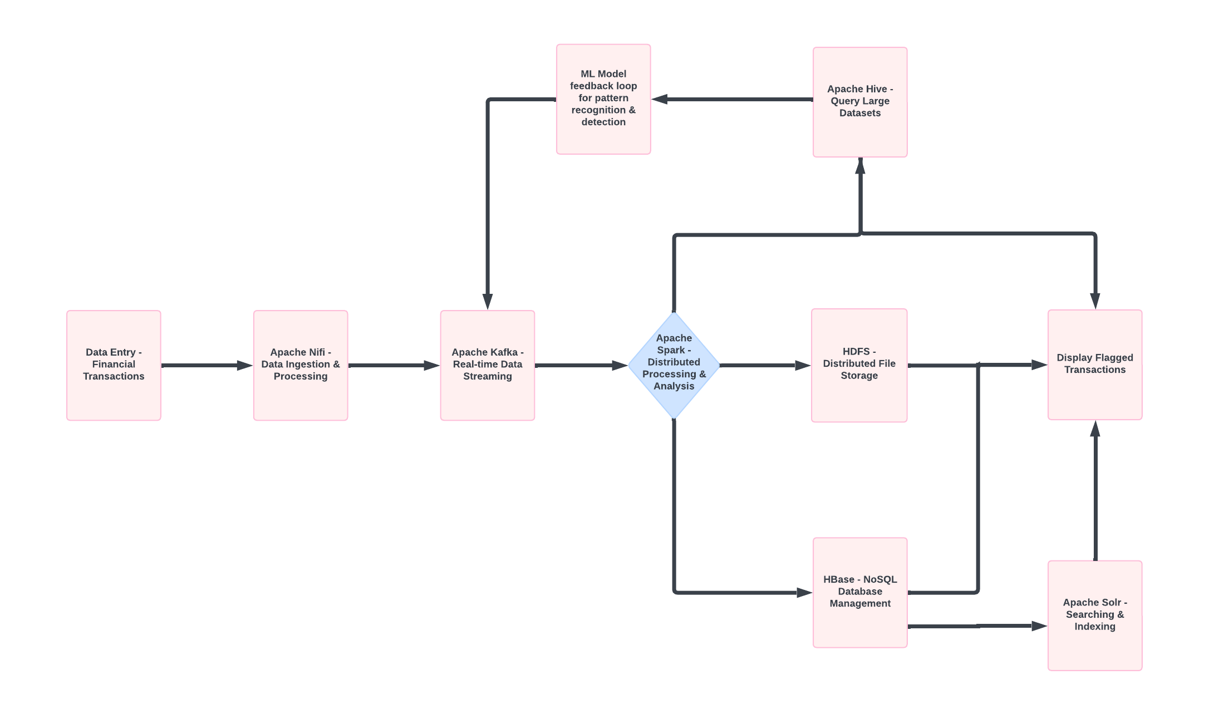
Data Flow and Real-Time Analysis

Slide 6
Data Storage, Retrieval, and Advanced Analysis
HDFS (Batch Storage): Provides scalable and fault-tolerant storage for large volumes of transactional data, enabling historical analysis.
HBase (Real-Time Storage): Offers low-latency access to real-time data, crucial for immediate fraud detection and response.
Hive: Facilitates complex queries and analysis on batch data stored in HDFS, using SQL-like syntax.
Real-Time Search: Solr indexes data for fast search capabilities, enabling efficient real-time monitoring and quick response to potential fraud.
Advanced Analysis: The data from HDFS will be analyzed with ML models which will be fed back to Kafka for detection and pattern recognition.

Slide 7
Benefits and Conclusion
Mitigates Fraud Risks: Real-time detection and automatic blocking of fraudulent transactions reduce financial losses.
Enhanced Customer Trust: Prompt security notifications and proactive fraud prevention increase customer confidence.
Regulatory Compliance: Ensures adherence to global banking regulations, avoiding legal and financial penalties.
Scalability and Efficiency: The architecture supports vast transaction volumes and complex analyses, ensuring robust performance and reliability.

