Slide 1
Data Mining
Practical Machine Learning Tools and Techniques
Slides for Chapter 8, Data transformations
of Data Mining by I. H. Witten, E. Frank,
M. A. Hall, and C. J. Pal

Slide 2
Data transformations
Attribute selection: Scheme-independent and scheme-specific
Attribute discretization: Unsupervised, supervised, error- vs entropy-based, converse of discretization
Projections: principal component analysis (PCA), random projections, partial least-squares, independent component analysis (ICA), linear discriminant analysis (LDA), text, time series
Sampling: Reservoir sampling
Dirty data: Data cleansing, robust regression, anomaly detection
Transforming multiple classes to binary ones
error-correcting codes, ensembles of nested dichotomies
Calibrating class probabilities
Notes:
12/11/16
2
2

Slide 3
Just apply a learner? NO!
Scheme/parameter selection
Treat selection process as part of the learning process to avoid optimistic performance estimates
Modifying the input:
Data engineering to make learning possible or easier
Modifying the output
Converting multi-class problems into two-class ones
Re-calibrating probability estimates
Notes:
12/11/16
3
3

Slide 4
Attribute selection
Attribute selection is often important in practice
For example, adding a random (i.e., irrelevant) attribute can significantly degrade C4.5’s performance
Problem: C4.5’s built-in attribute selection is based on smaller and smaller amounts of data
Instance-based learning is particularly susceptible to irrelevant attributes
Number of training instances required increases exponentially with number of irrelevant attributes
Exception: naïve Bayes can cope well with irrelevant attributes
Note that relevant attributes can also be harmful if they mislead the learning algorithm
Notes:
12/11/16
4
4

Slide 5
Scheme-independent attribute selection
Filter approach to attribute selection: assess attributes based on general characteristics of the data
In this approach, the attributes are selected in a manner that is independent of the target machine learning scheme
One method: find smallest subset of attributes that separates data
Another method: use a fast learning scheme that is different from the target learning scheme to find relevant attributes
E.g., use attributes selected by C4.5 and 1R, or coefficients of linear model, possibly applied recursively (recursive feature elimination)
Notes:
12/11/16
5
5

Slide 6
Scheme-independent attribute selection
Attribute weighting techniques based on instance-based learning can also be used for filtering
Original approach for doing this cannot find redundant attributes (but a fix has been suggested)
Correlation-based Feature Selection (CFS):
Correlation between attributes measured by symmetric uncertainty:
Goodness of subset of attributes measured by breaking ties in favour of smaller subsets
Notes:
12/11/16
6
6

Slide 7
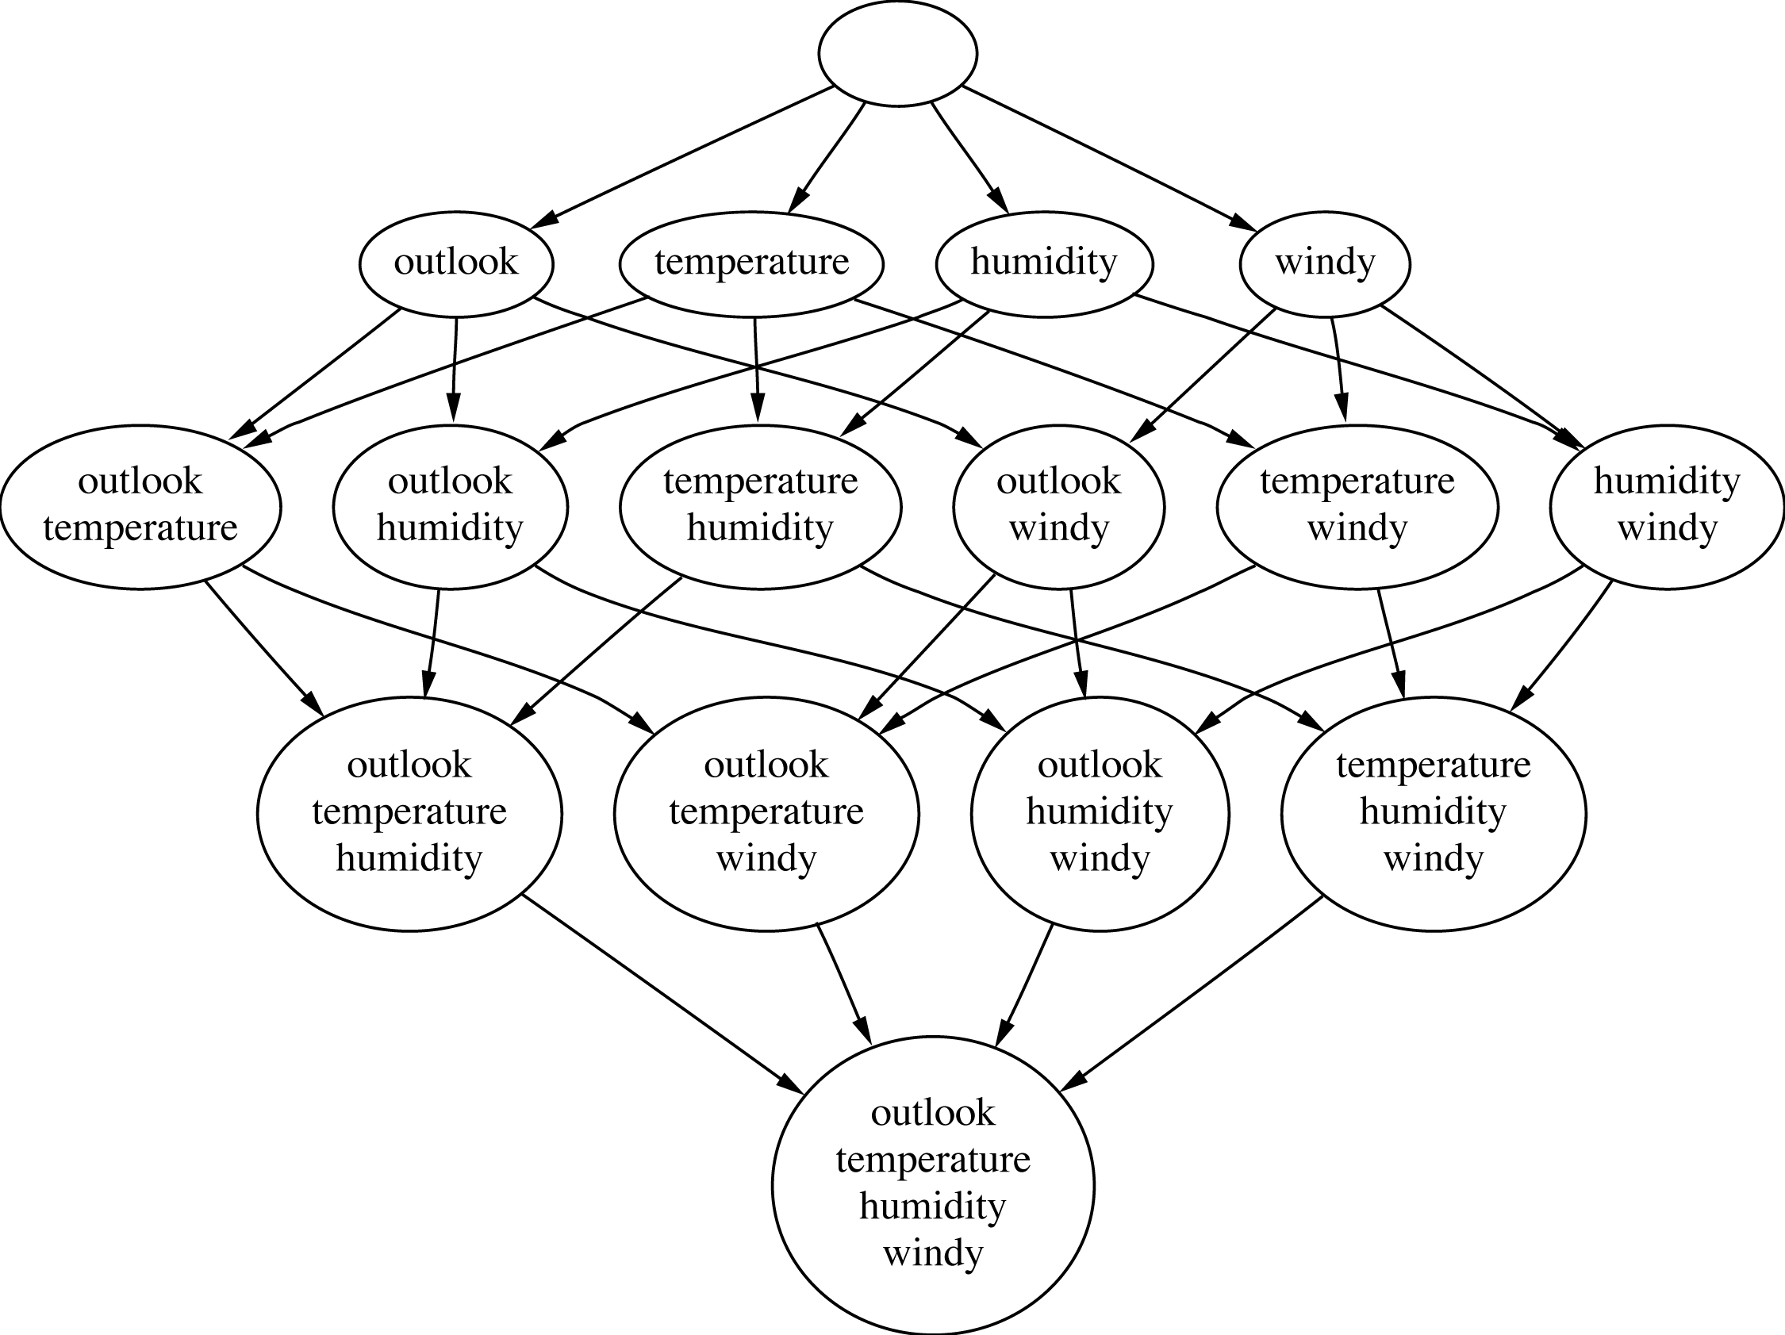
Attribute subsets for weather data
Notes:
12/11/16
7
7

Slide 8
Searching the attribute space
Number of attribute subsets is exponential in the number of attributes
Common greedy approaches:
forward selection
backward elimination
More sophisticated strategies:
Bidirectional search
Best-first search: can find optimum solution
Beam search: approximation to best-first search
Genetic algorithms
Notes:
12/11/16
8
8

Slide 9
Scheme-specific selection
Wrapper approach to attribute selection: attributes are selected with target scheme in the loop
Implement “wrapper” around learning scheme
Evaluation criterion: cross-validation performance
Time consuming in general
greedy approach, k attributes  k²  time
prior ranking of attributes  linear in k
Can use significance test to stop cross-validation for a subset early if it is unlikely to “win” (race search)
Can be used with forward, backward selection, prior ranking, or special-purpose schemata search
Scheme-specific attribute selection is essential for learning decision tables
Efficient for decision tables and Naïve Bayes
Notes:
12/11/16
9
9

Slide 10
Attribute discretization
Discretization can be useful even if a learning algorithm can be run on numeric attributes directly
Avoids normality assumption in Naïve Bayes and clustering
Examples of discretization we have already encountered:
1R: uses simple discretization scheme
C4.5 performs local discretization
Global discretization can be advantageous because it is based on more data
Apply learner to
k -valued discretized attribute or to
k – 1 binary attributes that code the cut points
The latter approach often works better when learning decision trees or rule sets
Notes:
12/11/16
10
10

Slide 11
Discretization: unsupervised
Unsupervised discretization: determine intervals without knowing class labels
When clustering, the only possible way!
Two well-known strategies:
Equal-interval binning
Equal-frequency binning (also called histogram equalization)
Unsupervised discretization is normally inferior to supervised schemes when applied in classification tasks
But equal-frequency binning works well with naïve Bayes if the number of intervals is set to the square root of the size of dataset (proportional k-interval discretization)
Notes:
12/11/16
11
11

Slide 12
Discretization: supervised
Classic approach to supervised discretization is entropy-based
This method builds a decision tree with pre-pruning on the attribute being discretized
Uses entropy as splitting criterion
Uses the minimum description length principle as the stopping criterion for pre-pruning
Works well: still the state of the art
To apply the minimum description length principle, the “theory” is
the splitting point (can be coded in log₂[N – 1] bits)
plus class distribution in each subset (a more involved expression)
Description length is the number of bits needed for coding both the splitting point and the class distributions
Compare description lengths before/after adding split
Notes:
12/11/16
12
12

Slide 13
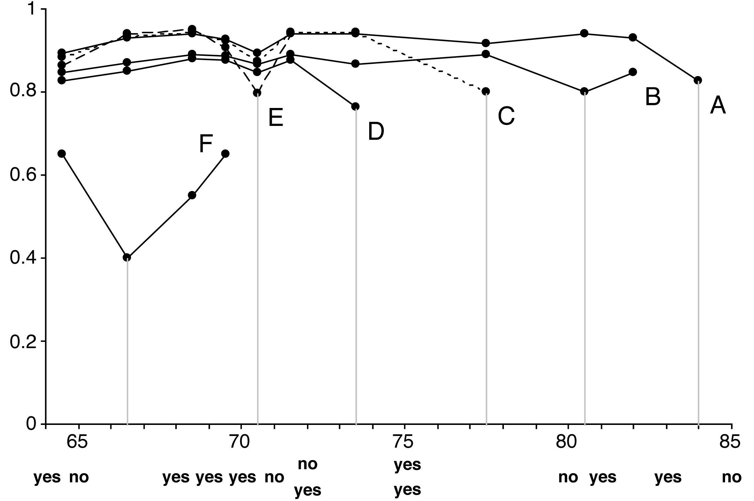
Example: temperature attribute
Temperature
64 65 68 69 70 71 72 72 75 75 80 81 83 85
Play
Yes No Yes Yes Yes No No Yes Yes Yes No Yes Yes No
Notes:
12/11/16
13
13

Slide 14
Formula for MDL stopping criterion
Can be formulated in terms of the information gain
Assume we have N instances
Original set: k classes, entropy E
First subset: k₁ classes, entropy E₁
Second subset: k₂ classes, entropy E₂
If the information gain is greater than the expression on the right, we continue splitting
Results in no discretization intervals for the temperature attribute in the weather data
Notes:
12/11/16
14
14

Slide 15
Supervised discretization: other methods
Can replace top-down procedure by bottom-up method
This bottom-up method has been applied in conjunction with the chi-squared test
Continue to merge intervals until they become significantly different
Can use dynamic programming to find optimum k-way split for given additive criterion
Requires time quadratic in the number of instances
But can be done in linear time if error rate is used instead of entropy
However, using error rate is generally not a good idea when discretizing an attribute as we will see
Notes:
12/11/16
15
15

Slide 16
Error-based vs. entropy-based
Question: could the best discretization ever have two adjacent intervals with the same class?
Wrong answer: No. For if so,
Collapse the two
Free up an interval
Use it somewhere else
(This is what error-based discretization will do)
Right answer: Surprisingly, yes.
(and entropy-based discretization can do it)
Notes:
12/11/16
16
16

Slide 17
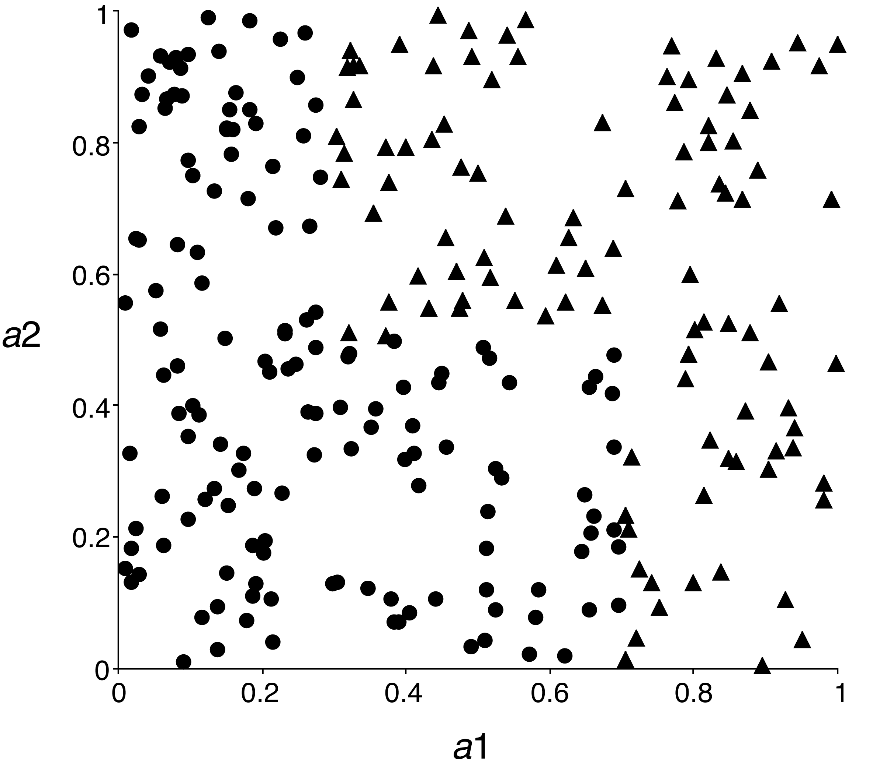
Error-based vs. entropy-based
A 2-class, 2-attribute problem
Entropy-based discretization can detect change of class distribution
Notes:
12/11/16
17
17

Slide 18
The converse of discretization
Make nominal values into “numeric” ones
Can use indicator attributes (as in IB1)
Makes no use of potential ordering information if “nominal” attribute is actually ordinal
Alternative: code an ordered nominal attribute into binary ones as in M5’
Inequalities are explicitly represented as binary attributes, e.g., temperature < hot in the weather data
Can be used for any ordered attribute
Better than coding ordering into an integer (which implies a metric)
In general: can code binary partition of a set of attribute values as a binary attribute
Notes:
12/11/16
18
18

Slide 19
Projections
Simple transformations can often make a large difference in performance
Example transformations (not necessarily for performance improvement):
Difference of two date attributes
Ratio of two numeric (ratio-scale) attributes
Concatenating the values of nominal attributes
Encoding cluster membership
Adding noise to data
Removing data randomly or selectively
Obfuscating the data
Notes:
12/11/16
19
19

Slide 20
Principal component analysis
Unsupervised method for identifying the important directions in a dataset
We can then rotate the data into the (reduced) coordinate system that is given by those directions
PCA is a method for dimensionality reduction
Algorithm:
Find direction (axis) of greatest variance
Find direction of greatest variance that is perpendicular to previous direction and repeat
Implementation: find eigenvectors of the covariance matrix of the data
Eigenvectors (sorted by eigenvalues) are the directions
Mathematical details are covered in chapter on “Probabilistic methods”
Notes:
12/11/16
20
20

Slide 21
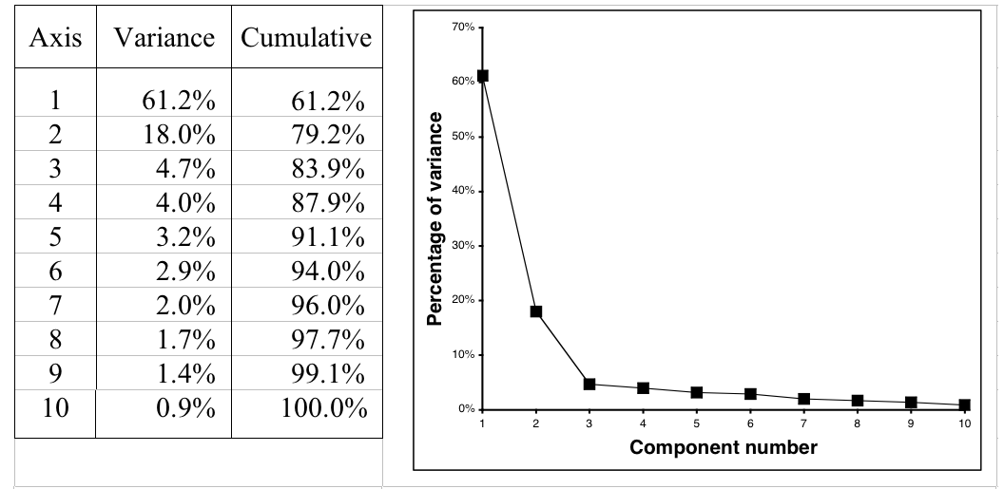
Example: 10-dimensional data
Data is normally standardized or mean-centered for PCA
Can also apply this recursively in a tree learner
Notes:
12/11/16
21
21

Slide 22
Random projections
PCA is nice but expensive: cubic in number of attributes
Alternative: use random directions instead of principal components
Surprising: random projections preserve distance relationships quite well (on average)
Can use them to apply kD-trees to high-dimensional data
Can improve stability by using ensemble of models based on different projections
Different methods for generating random projection matrices have been proposed
Notes:
12/11/16
22
22

Slide 23
Partial least-squares regression
PCA is often used as a pre-processing step before applying a learning algorithm
When linear regression is applied, the resulting model is known as principal components regression
Output can be re-expressed in terms of the original attributes because PCA yields a linear transformation
PCA is unsupervised and ignores the target attribute
The partial least-squares transformation differs from PCA in that it takes the class attribute into account
Finds directions that have high variance and are strongly correlated with the class
Applying PLS as a pre-processing step for linear regression yields partial least-squares regression
Notes:
12/11/16
23
23

Slide 24
An algorithm for PLS
Start with standardized input attributes
Attribute coefficients of the first PLS direction:
Compute the dot product between each attribute vector and the class vector in turn, this yields the coefficients
Coefficients for next PLS direction:
Replace attribute value by difference (residual) between the attribute's value and the prediction of that attribute from a simple regression based on the previous PLS direction
Compute the dot product between each attribute's residual vector and the class vector in turn, this yields the coefficients
Repeat from 3
Notes:
12/11/16
24
24

Slide 25
Independent component analysis (ICA)
PCA finds a coordinate system for a feature space that captures the covariance of the data
In contrast, ICA seeks a projection that decomposes the data into sources that are statistically independent
Consider the “cocktail party problem,” where people hear music and the voices of other people: the goal is to un-mix these signals
ICA finds a linear projection of the mixed signal that gives the most statistically independent set of transformed variables

Slide 26
Correlation vs. statistical independence
PCA is sometimes thought of as a method that seeks to transform correlated variables into linearly uncorrelated ones
Important: correlation and statistical independence are two different criteria
Uncorrelated variables have correlation coefficients equal to zero – entries in a covariance matrix
Two variables A and B are considered independent when their joint probability is equal to the product of their marginal probabilities:

Slide 27
ICA and Mutual Information
Mutual information (MI) measures the amount of info one can obtain from one random variable given another one
It can be used as an alternative criterion for finding a projection of data
We can aim to minimize the mutual information between the dimensions of the data in a linearly transformed space
Assume a model s = Ax, where A is an orthogonal matrix, x is the input data and s is its decomposition into its sources
Fact: minimizing the MI between the dimensions of s corresponds to finding a transformation matrix A so that
the estimated probability distribution of the sources p(s) is as far from Gaussian as possible and
the estimates s are constrained to be uncorrelated

Slide 28
ICA & FastICA
A popular technique for performing independent component analysis is known as fast ICA
Uses a quantity known as the negentropy J(s) = H(z) – H(s), where
z is a Gaussian random variable with the same covariance matrix as s and
H(.) is the “differential entropy,” defined as
Negentropy measures the departure of s’s distribution from the Gaussian distribution
Fast ICA uses simple approximations to the negentropy allowing learning to be performed more quickly.

Slide 29
Linear discriminant analysis
Linear discriminant analysis is another way of finding a linear transformation that reduces the number of dimensions
Unlike PCA or ICA it uses labeled data: it is a supervised technique like PLS, but designed for classification
Often used for dimensionality reduction prior to classification, but can be used as a classification technique itself
When used for dimensionality reduction, it yields (k-1) dimensions for a k-class classification problem
We will first discuss LDA-based classification (and, for completeness, QDA) before looking at data transformation

Slide 30
The LDA classifier
Assumes data modeled by a multivariate Gaussian distribution for each class c, with mean μ_{c} and a common covariance Σ
Assumption of common covariance matrix implies
the posterior distribution over the classes has a linear form and
there is a linear discriminant function for each class
The linear discriminant classifier is computed as
where n_{c} is the number of examples of class c and n is the total number of examples
Common variance matrix is obtained by pooling the covariance matrices from the different classes using a weighted average
The data is classified by choosing the largest y_{c}

Slide 31
Quadratic discriminant analysis (QDA)
The QDA classifier is obtained by giving each class its own covariance matrix Σ_{c}
In QDA, the decision boundaries defined by the posterior over classes are described by quadratic equations
The quadratic discriminant function for each class c is:
These functions, as the ones for LDA, are produced by taking the log of the corresponding Gaussian model for each class
Constant terms can be ignored because such functions will be compared with one another

Slide 32
Fisher’s linear discriminant analysis
Let us now consider Fisher’s LDA projection for dimensionality reduction, considering the two-class case first
We seek a projection vector a that can be used to compute scalar projections y = ax for input vectors x
This vector is obtained by computing the means of each class, μ₁ and μ_{2,} and then computing two special matrices
The between-class scatter matrix is calculated as (note the use of the outer product of two vectors here, which gives a matrix)
The within-class scatter matrix is

Slide 33
Fisher’s LDA: the solution vector
The solution vector a for FLDA is found by maximizing the “Rayleigh quotient”
This leads to the solution

Slide 34
Multi-class FLDA
FLDA can be generalized to multi-class problems
Aim: projection A so that y = A^{T}x yields points that are close when they are in the same class relative to the overall spread
To do this, first compute both the means for each class and the global mean, and then compute the scatter matrices
Then, find the projection matrix A that maximizes Determinants are analogs of variances computed in multiple dimensions, along the principal directions of the scatter matrices, and multiplied together
Solutions for finding A are based on solving a “generalized eigenvalue problem” for each column of the matrix A.

Slide 35
Fisher’s LDA vs PCA
Class A
Class B
x₂
FLDA
PCA
x₁
Adapted from Belhumeur, Hespanha & Kriegman, 1997

Slide 36
Text to attribute vectors
Many data mining applications involve textual data (e.g., string attributes in ARFF)
Standard transformation: convert string into bag of words by tokenization
Attribute values are binary, word frequencies (f_{ij}), log(1+f_{ij}), or TF × IDF:
Many configuration options:
Only retain alphabetic sequences?
What should be used as delimiters?
Should words be converted to lowercase?
Should stopwords be ignored?
Should hapax legomena be included? Or even just the k most frequent words?
Notes:
12/11/16
36
36

Slide 37
Time series
In time series data, each instance represents a different time step
Some simple transformations:
Shift values from the past/future
Compute difference (delta) between instances (i.e., “derivative”)
In some datasets, samples are not regular but time is given by timestamp attribute
Need to normalize by step size when transforming
Transformations need to be adapted if attributes represent different time steps
Notes:
12/11/16
37
37

Slide 38
Sampling
Sampling is typically a simple procedure
What if training instances arrive one by one but we don't know the total number in advance?
Or perhaps there are so many that it is impractical to store them all before sampling?
Is it possible to produce a uniformly random sample of a fixed size? Yes.
Algorithm: Reservoir sampling
Fill the reservoir, of size r, with the first r instances to arrive
Subsequent, instances replace a randomly selected reservoir element with probability r/i, where i is the number of instances seen so far
Notes:
12/11/16
38
38

Slide 39
Automatic data cleansing
To (potentially) improve a decision tree:
Remove misclassified instances, then re-learn!
Better (of course!):
Human expert checks misclassified instances
Attribute noise vs. class noise
Attribute noise should be left in the training set (i.e., do not train on clean set and test on dirty one)
Systematic class noise (e.g., one class substituted for another): leave in training set
Unsystematic class noise: eliminate from training set, if possible
Notes:
12/11/16
39
39

Slide 40
Robust regression
“Robust” statistical method  one that addresses problem of outliers
Possible ways to make regression more robust:
Minimize absolute error, not squared error
Remove outliers (e.g., 10% of points farthest from the regression plane)
Minimize median instead of mean of squares (copes with outliers in x and y direction)
Least median of squares regression finds the narrowest strip covering half the observations
Expensive to compute
Notes:
12/11/16
40
40

Slide 41
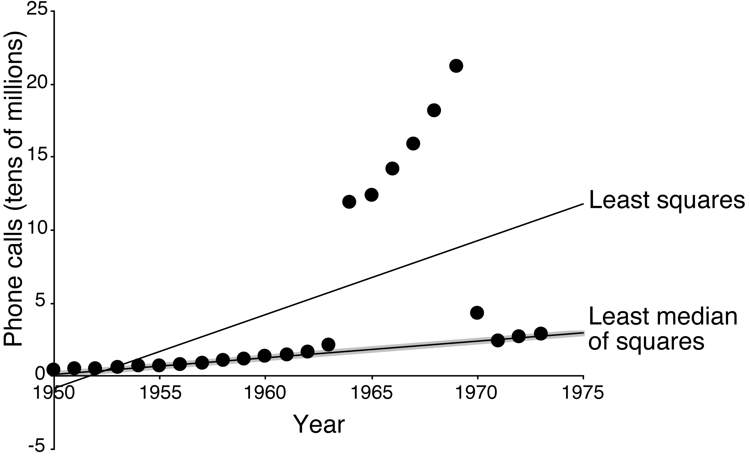
Example: least median of squares
Number of international phone calls from Belgium, 1950–1973
Notes:
12/11/16
41
41

Slide 42
Detecting anomalies
Visualization can help to detect anomalies
Automatic approach: apply committee of different learning schemes, e.g.,
decision tree
nearest-neighbor learner
linear discriminant function
Conservative consensus approach: delete instances incorrectly classified by all of them
Problem: might sacrifice instances of small classes
Notes:
12/11/16
42
42

Slide 43
One-Class Learning
Usually training data is available for all classes
Some problems exhibit only a single class at training time
Test instances may belong to this class or a new class not present at training time
This the problem of one-class classification
Predict either target or unknown
Note that, in practice, some one-class problems can be re-formulated into two-class ones by collecting negative data
Other applications truly do not have negative data, e.g., password hardening
Notes:
12/11/16
43
43

Slide 44
Outlier detection
One-class classification is often used for outlier/anomaly/novelty detection
First, a one-class models is built from the dataset
Then, outliers are defined as instances that are classified as unknown
Another method: identify outliers as instances that lie beyond distance d from percentage p of training data
Density estimation is a very useful approach for one-class classification and outlier detection
Estimate density of the target class and mark low probability test instances as outliers
Threshold can be adjusted to calibrate sensitivity
Notes:
12/11/16
44
44

Slide 45
Using artificial data for one-class classification
Can we apply standard multi-class techniques to obtain one-class classifiers?
Yes: generate artificial data to represent the unknown non-target class
Can then apply any off-the-shelf multi-class classifier
Can tune rejection rate threshold if classifier produces probability estimates
Too much artificial data will overwhelm the target class!
But: unproblematic if multi-class classifier produces accurate class probabilities and is not focused on misclassification error
Generate uniformly random data?
Curse of dimensionality – as # attributes increases it becomes infeasible to generate enough data to get good coverage of the space
Notes:
12/11/16
45
45

Slide 46
Generating artificial data
Idea: generate data that is close to the target class
T – target class, A – artificial class
Generate artificial data using appropriate distribution P(X | A)
Data no longer uniformly distributed -> must take this distribution into account when computing membership scores for the one-class model
Want P(X | T), for any instance X; we know P(X | A)
Train probability estimator P(T | X) on two classes T and A
Then, rewrite Bayes' rule:
For classification, choose a threshold to tune rejection rate
How to choose P(X | A)? Apply a density estimator to the target class and use resulting function to model the artificial class
Notes:
12/11/16
46
46

Slide 47
Transforming multiple classes to binary ones
Some learning algorithms only work with two class problems
Sophisticated multi-class variants exist in many cases but can be very slow or difficult to implement
A common alternative is to transform multi-class problems into multiple two-class ones
Simple methods:
Discriminate each class against the union of the others – one-vs.-rest
Build a classifier for every pair of classes – pairwise classification
We will discuss error-correcting output codes and ensembles of nested dichotomies, which can often improve on these
Notes:
12/11/16
47
47

Slide 48
Error-correcting output codes
Multiclass problem  multiple binary problems
Simple one-vs.rest scheme: One-per-class coding
Idea: use error-correcting codes instead
base classifiers predict 1011111, true class = ??
Use bit vectors (codes) sot that we have large Hamming distance between any pair of bit vectors:
Can correct up to (d – 1)/2 single-bit errors
class
class vector
a
1000
b
0100
c
0010
d
0001
class
class vector
a
1111111
b
0000111
c
0011001
d
0101010
Notes:
12/11/16
48
48

Slide 49
More on ECOCs
Two optimization criteria for code matrix:
Row separation: minimum distance between rows
Column separation: minimum distance between columns (and columns’ complements)
Why is column separation important? Because if columns are identical, column classifiers will likely make the same errors
Even if columns are not identical, error-correction is weakened if errors are correlated
3 classes  only 2³ possible columns
(and 4 out of the 8 are complements)
Cannot achieve row and column separation
ECOCs only work for problems with > 3 classes
Notes:
12/11/16
49
49

Slide 50
Exhaustive ECOCs
Exhaustive code for k classes:
Columns comprise every possible k-string …
… except for complements and all-zero/one strings
Each code word contains 2^{k–1} – 1 bits
Class 1: code word is all ones
Class 2: 2^{k–2} zeroes followed by 2^{k–2} –1 ones
Class i : alternating runs of 2^{k–i} 0s and 1s
last run is one short
Exhaustive code, k = 4
class
class vector
a
1111111
b
0000111
c
0011001
d
0101010
Notes:
12/11/16
50
50

Slide 51
More on ECOCs
#classes >> 10  exhaustive codes infeasible
Number of columns increases exponentially
But: it turns out that random code words have good error-correcting properties on average!
Alternatively, there are sophisticated methods for generating ECOCs with just a few columns
Note: ECOCs do not work with NN classifiers because errors of column classifiers will be perfectly correlated
But: works if different attribute subsets are used in nearest neighbor classifiers applied to predict each column/output bit
Notes:
12/11/16
51
51

Slide 52
Ensembles of nested dichotomies
ECOCs produce classifications, but what if we want class probability estimates as well?
E.g., for cost-sensitive classification via minimum expected cost
Nested dichotomies provide an alternative
Also decompose multi-class problems to binary ones
Work with two-class classifiers that can produce class probability estimates: yield multi-class probability estimates
Recursively split the full set of classes into smaller and smaller subsets
Set of instances is split into subsets corresponding to these subsets of classes
Yields a binary tree of classes called a nested dichotomy
Notes:
12/11/16
52
52

Slide 53
Example with four classes
Full set of classes: [a, b, c, d]
A two-class
classifier is learned
at each internal node
of this tree
Two disjoint subsets: [a, b] [c, d]
[a] [b] [c] [d]
Nested dichotomy as a code matrix:
Class | Class vector
a | 0 0 X
b | 1 X 0
c | 0 1 X
d | 1 X 1
Notes:
12/11/16
53
53

Slide 54
Probability estimation
Suppose we want to compute P(a | x)?
Learn two class models for each of the three internal nodes
From the two-class model at the root:
P({a, b} | x)
From the left-hand child of the root:
P({a} | x, {a , b})
Using the chain rule:
P({a} | x) = P({a} | x, {a , b}) × P({a, b} | x)
Issues
Estimation errors for deep hierarchies
How to decide on hierarchical decomposition of classes?
Notes:
12/11/16
54
54

Slide 55
Ensembles of nested dichotomies
If there is no reason a priori to prefer any particular decomposition, then use them all
Impractical for any non-trivial number of classes
Consider a subset by taking a random sample of possible tree structures
Implement caching of models for efficiency (since a given two class problem may occur in multiple trees)
Average probability estimates over the trees
Experiments show that this approach yields accurate multiclass classifiers
Can even improve the performance of methods that can already handle multiclass problems!
Notes:
12/11/16
55
55

Slide 56
Calibrating class probabilities
Class probability estimation is harder than classification:
Classification error is minimized as long as the correct class is predicted with maximum probability
Estimates that yield correct classification may be quite poor with respect to quadratic or informational loss
But: it is often important to have accurate class probabilities
E.g. cost-sensitive prediction using the minimum expected cost method
Notes:
12/11/16
56
56

Slide 57
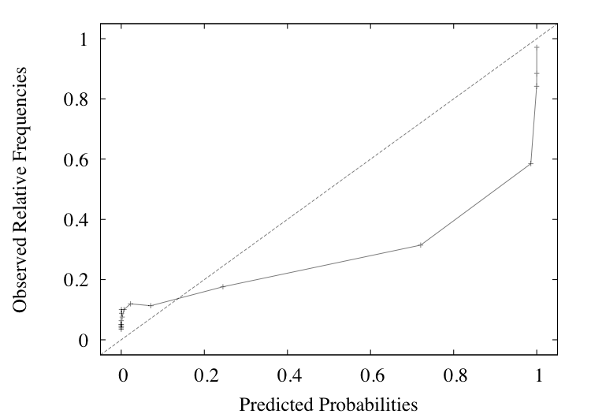
Visualizing inaccurate probability estimates
Consider a two class problem. Probabilities that are correct for classification may be:
Too optimistic – too close to either 0 or 1
Too pessimistic – not close enough to 0 or 1
Reliability diagram showing overoptimistic probability estimation for a two-class problem
Notes:
12/11/16
57
57

Slide 58
Calibrating class probabilities
Reliability diagram is generated by collecting predicted probabilities and relative class frequencies from a 10-fold cross-validation
Predicted probabilities are discretized into 20 ranges via equal-frequency discretization
We can use this for calibration of the probability estimates: correct bias by mapping observed curve to the diagonal
Yields a discretization-based approach to the calibration of class probability estimates
Discretization-based calibration is fast but determining an appropriate number of discretization intervals is not easy
Notes:
12/11/16
58
58

Slide 59
Calibrating class probabilities
Can view calibration as a function estimation problem
One input – estimated class probability – and one output – the calibrated probability
Reasonable assumption in many cases: the function is piecewise constant and monotonically increasing
Can use isotonic regression, which estimates a monotonically increasing piece-wise constant function: Minimizes squared error between observed class “probabilities” (0/1) and resulting calibrated class probabilities
Alternatively, can use logistic regression to estimate the calibration function
Note: must use the log-odds of the estimated class probabilities as input
Advantage: multiclass logistic regression can be used for calibration in the multiclass case
Notes:
12/11/16
59
59

Slide 60
Weka implementations
Attribute selection
CfsSubsetEval (correlation-based attribute subset evaluator)
ConsistencySubsetEval (measures class consistency for a given set of attributes, in the consistencySubsetEval package)
ClassifierSubsetEval (uses a classifier for evaluating subsets of attributes, in the classifierBasedAttributeSelection package)
SVMAttributeEval (ranks attributes according to the magnitude of the coefficients learned by an SVM, in the SVMAttributeEval package)
ReliefF (instance-based approach for ranking attributes)
WrapperSubsetEval (uses a classifier plus cross-validation)
GreedyStepwise (forward selection and backward elimination search)
LinearForwardSelection (forward selection with a sliding window of attribute choices at each step of the search, in the linearForwardSelection package)
BestFirst (search method that uses greedy hill-climbing with backtracking)
RaceSearch (uses the race search methodology, in the raceSearch package)
Ranker (ranks individual attributes according to their evaluation)

Slide 61
Weka implementations
Learning decision tables: DecisionTable
Discretization
Discretize (unsupervised and supervised versions)
PKIDiscretize (proportional k-interval discretization)
Discriminant analysis for classification
LDA, FLDA, and QDA (in the discriminantAnalysis package)
Discriminant analysis for dimensionality reduction
MultiClassFLDA (in the discriminantAnalysis package)
PrincipalComponents and RandomProjection
FastICA (independent component analysis, in the StudentFilters package)
StringToWordVector (text to attribute vectors)
PLSFilter (partial least squares transformation)
Resampling and reservoir sampling

Slide 62
Weka implementations
OneClassClassifier
Implements one-class classification using artificial data (available in the oneClassClassifier package)
MultiClassClassifier
Includes several ways of handling multiclass problems with two-class classifiers, including error-correcting output codes
END
Ensembles of nested dichotomies, in the ensemblesOfNestedDichotomies package
Many other preprocessing tools are available:
Arithmetic operations; time-series operations; obfuscation; generating cluster membership values; adding noise; various conversions between numeric, binary, and nominal attributes; and various data cleansing operations

Slide 63
Further Reading and Bibliographic Notes
Backward elimination, e.g., was introduced in (Marill & Green, 1963)
Kittler (1978) surveys feature selection algorithms in pattern recognition.
Best-first search and genetic algorithms are standard artificial intelligence techniques (Goldberg, 1989; Winston, 1992)
John (1997) shows that the performance of decision tree learners can deteriorate when new attributes are added
Langley and Sage (1997): the number of training instances must grow exponentially with the number of attributes in instance-based learning
The idea of finding the smallest attribute set that carves up the instances uniquely is from Almuallin and Dietterich (1991, 1992)
It was further developed by Liu and Setiono (1996)
Kibler and Aha (1987) and Cardie (1993) both investigated the use of decision tree algorithms to identify features for nearest-neighbor learning
Holmes and Nevill-Manning (1995) used 1R to order features for selection

Slide 64
Further Reading and Bibliographic Notes
Kira and Rendell (1992) used instance-based methods to select features, leading to a scheme called RELIEF for Recursive Elimination of Features
Gilad-Bachrach, Navot, and Tishby (2004) show how this scheme can be modified to work better with redundant attributes
The correlation-based feature selection method is due to Hall (2000)
The use of wrapper methods for feature selection is due to John, Kohavi, and Pfleger (1994) and Kohavi and John (1997)
Genetic algorithms have been applied within a wrapper framework by Vafaie and DeJong (1992) and Cherkauer and Shavlik (1996)
The selective naïve Bayes learning scheme is due to Langley and Sage (1994)
Guyon, Weston, Barnhill, and Vapnik (2002) present and evaluate the recursive feature elimination scheme in conjunction with support vector machines
The method of raced search was developed by Moore and Lee (1994)
Gütlein, Frank, Hall, and Karwath (2009) show how to speed up scheme-specific selection for datasets with many attributes using simple ranking-based methods

Slide 65
Further Reading and Bibliographic Notes
Dougherty, Kohavi, and Sahami (1995) show results comparing the entropy-based discretization method with equal-width binning and the 1R method
Frank and Witten (1999) describe the effect of using the ordering information in discretized attributes
Proportional k-interval discretization for Naive Bayes was proposed by Yang and Webb (2001)
The entropy-based method for discretization, including the use of the MDL stopping criterion, was developed by Fayyad and Irani (1993)
The bottom-up statistical method using the χ2 test is due to Kerber (1992)
An extension to an automatically determined significance level is described by Liu and Setiono (1997)
Fulton, Kasif, and Salzberg (1995) use dynamic programming for discretization and present a linear-time algorithm for error-based discretization
The example used for showing the weakness of error-based discretization is adapted from Kohavi and Sahami (1996)

Slide 66
Further Reading and Bibliographic Notes
Fradkin and Madigan (2003) analyze the performance of random projections
The algorithm for partial least squares regression is from Hastie et al. (2009)
The TFxIDF metric is described by Witten et al. (1999b)
Hyvärinen and Oja (2000) created the fast ICA method
Duda et al. (2001) and Murphy (2012) explain the algebra underlying FLDA
Sugiyama (2007) presents a variant called “local Fisher discriminant analysis”
John (1995) showed experiments on using C4.5 to filter its own training data
The more conservative consensus filter is due to Brodley and Fried (1996)
Rousseeuw and Leroy (1987) describe the least median of squares method and the telephone data
Quinlan (1986) shows how removing attribute noise can be detrimental

Slide 67
Further Reading and Bibliographic Notes
Barnett and Lewis (1994) address the general topic of outliers in data from a statistical point of view
Pearson (2005) describes the statistical approach of fitting a distribution to the target data
Schölkopf, Williamson, Smola, Shawe-Taylor, and Platt (2000) describe the use of support vector machines for novelty detection
Abe, Zadrozny, and Langford (2006), amongst others, use artificial data as a second class
Combining density estimation and class probability estimation using artificial data is suggested for unsupervised learning by Hastie et al. (2009)
Hempstalk, Frank, and Witten (2008) describe it in the context of one-class classification
Hempstalk and Frank (2008) discuss how to fairly compare one-class and multiclass classification when discriminating against new classes of data

Slide 68
Further Reading and Bibliographic Notes
Vitter (1985) describes the algorithm for reservoir sampling we used, he called it method R; its computational complexity is O(#instances)
Rifkin and Klautau (2004) show that the one-vs-rest method for multiclass classification can work well if appropriate parameter tuning is applied
Friedman (1996) describes the technique of pairwise classification and Fürnkranz (2002) further analyzes it
Hastie and Tibshirani (1998) extend it to estimate probabilities using pairwise coupling
Fürnkranz (2003) evaluates pairwise classification as a technique for ensemble learning
ECOCs for multi-class classification were proposed by Dietterich and Bakiri (1995); Ricci and Aha (1998) showed how to apply them to nearest neighbor classifiers
Frank and Kramer (2004) introduce ensembles of nested dichotomies
Dong, Frank, and Kramer (2005) considered balanced nested dichotomies to reduce training time

Slide 69
Further Reading and Bibliographic Notes
Zadrozny and Elkan (2002) applied isotonic regression and logistic regression to the calibration of class probability estimates
They also investigated how to deal with multiclass problems
Niculescu-Mizil and Caruana (2005) compared a variant of logistic regression and isotonic regression
They considered a large set of underlying class probability estimators
Stout (2008) describes a linear-time algorithm for isotonic regression based on minimizing squared error (called the PAV algorithm)

