Slide 1
PureFlow
Provisioning & Manage flow in SDN Network

Slide 2
Background
Its hard & take a time to provisioning devices to connect into SDN network (1 by 1).
Its hard to control flow inside devices (even via sdn controller).

Slide 3
PureFlow
PureFlow is an open source tools build from python, that can be use to provisioning devices and control flow inside the devices.
Provisioning (MikroTik & OpenVSwitch),
Modify Flow (OF 1.0).
next feature :
More devices supported,
Modify Flow OF 1.3 Supported,
Bulk Provisioning,
Improvement in Dashboard & Database system.

Slide 4
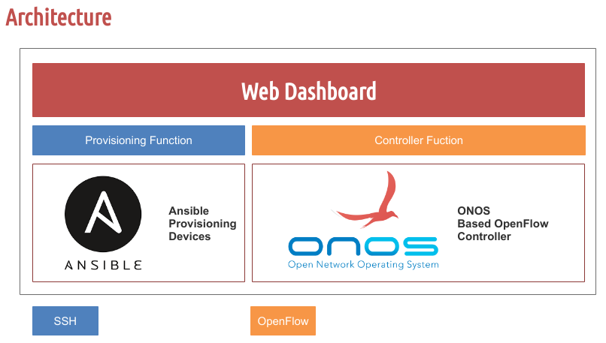
Architecture

Slide 5
Component
Ansible,
ONOS (Open Network Operating System),
Python (Flask).

Slide 6
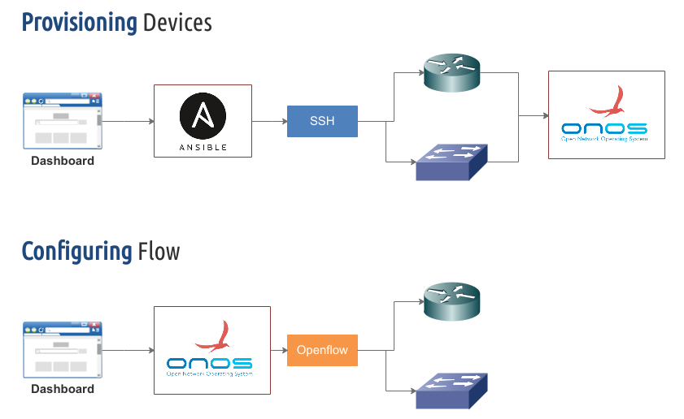
How its Works

Slide 7
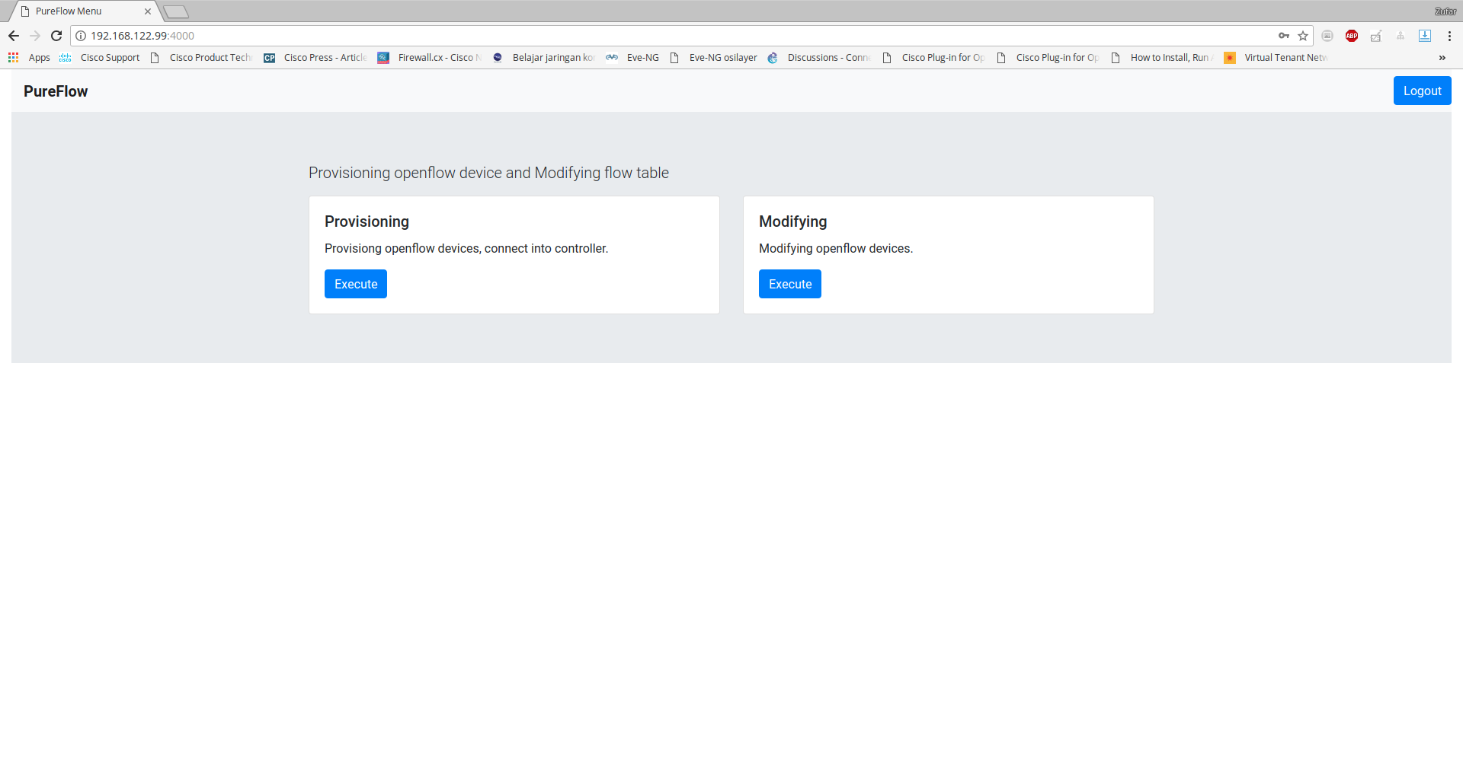
Main Menu

Slide 8
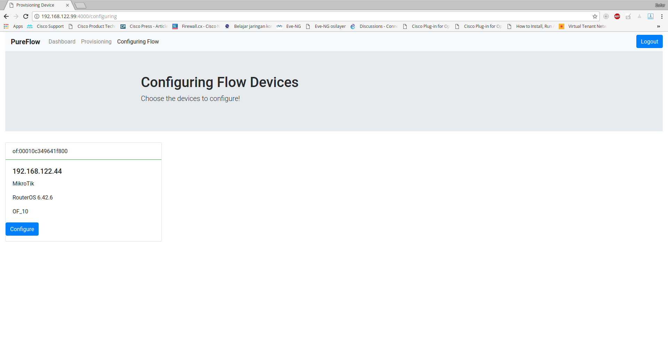
Configuring Flow

Slide 9
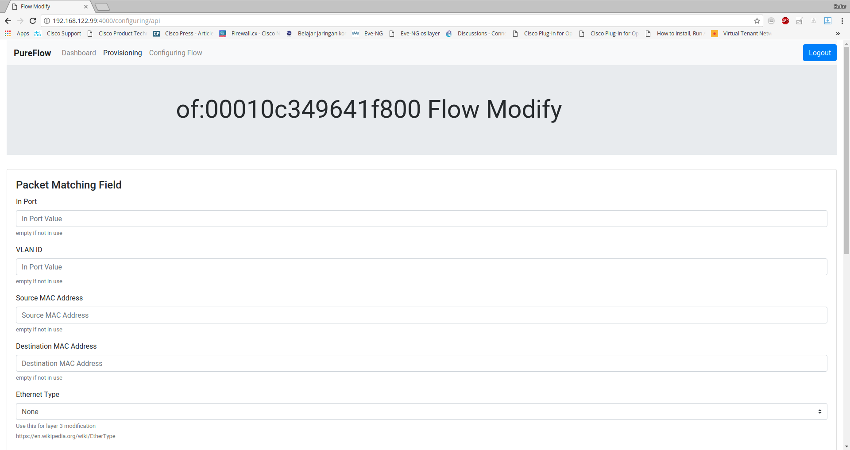
Configuring Flow

