Slide 1
Prediction of Credit Risk using Loan data
Kapil Agrawal
2014B3A3579P
Bits Pilani, Pilani Campus

Slide 2
Credit Risk
Credit risk is defined as the potential that a bank borrower or counterparty will fail to meet its obligations in accordance with agreed terms.
In simple words, It measures how much the borrower’s deviates from his/her promises.
In Credit Risk Management, the term “DEFAULTER” means the customer who fails to pay the loan.

Slide 3
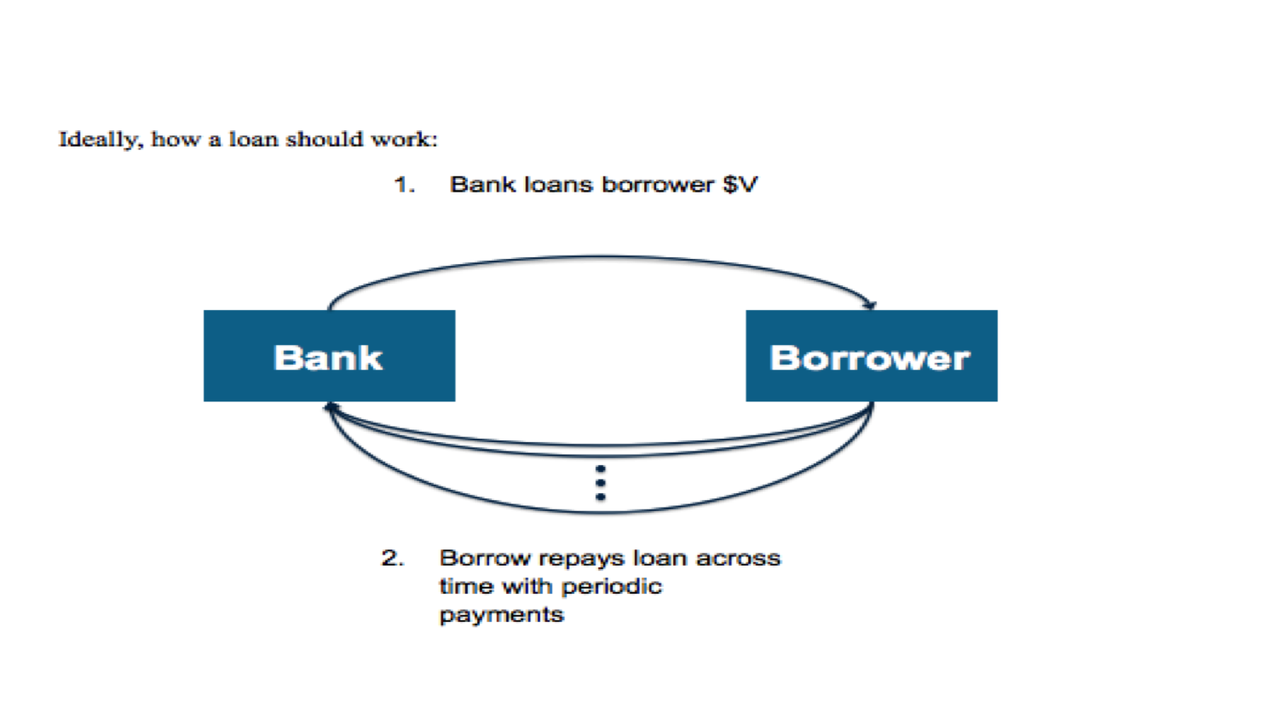
Credit Risk Management

Slide 4
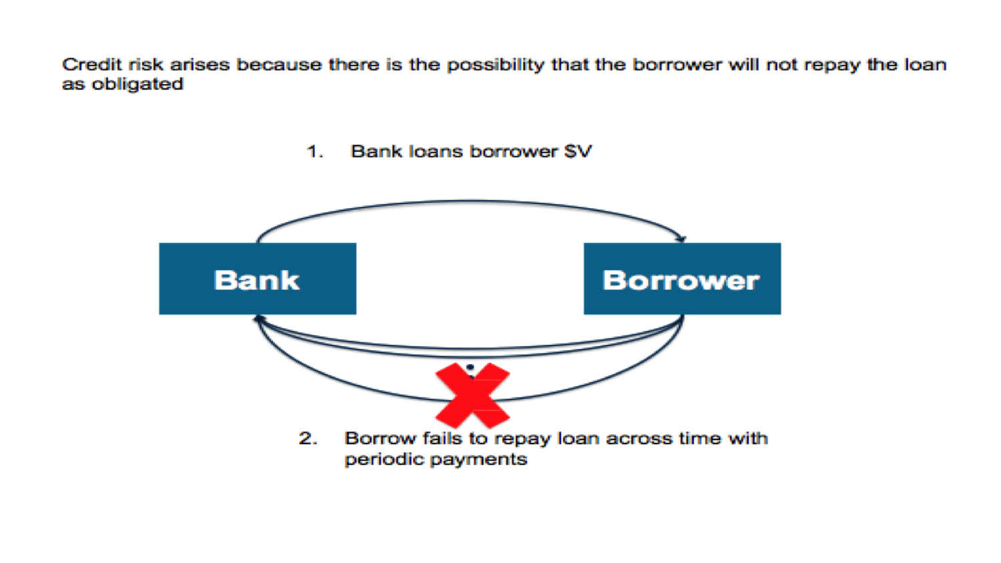
Credit Risk Management

Slide 5
What is credit risk prediction ?
Bank provided the data of customer’s loan details and whether that customer have successfully paid his loan or not.
From the given data, we need to analyze what factors are suitable for bank and what factors will favor credit risk.
So we can predict to which customers, bank should give loan and to which customers, bank should not give loan.

Slide 6
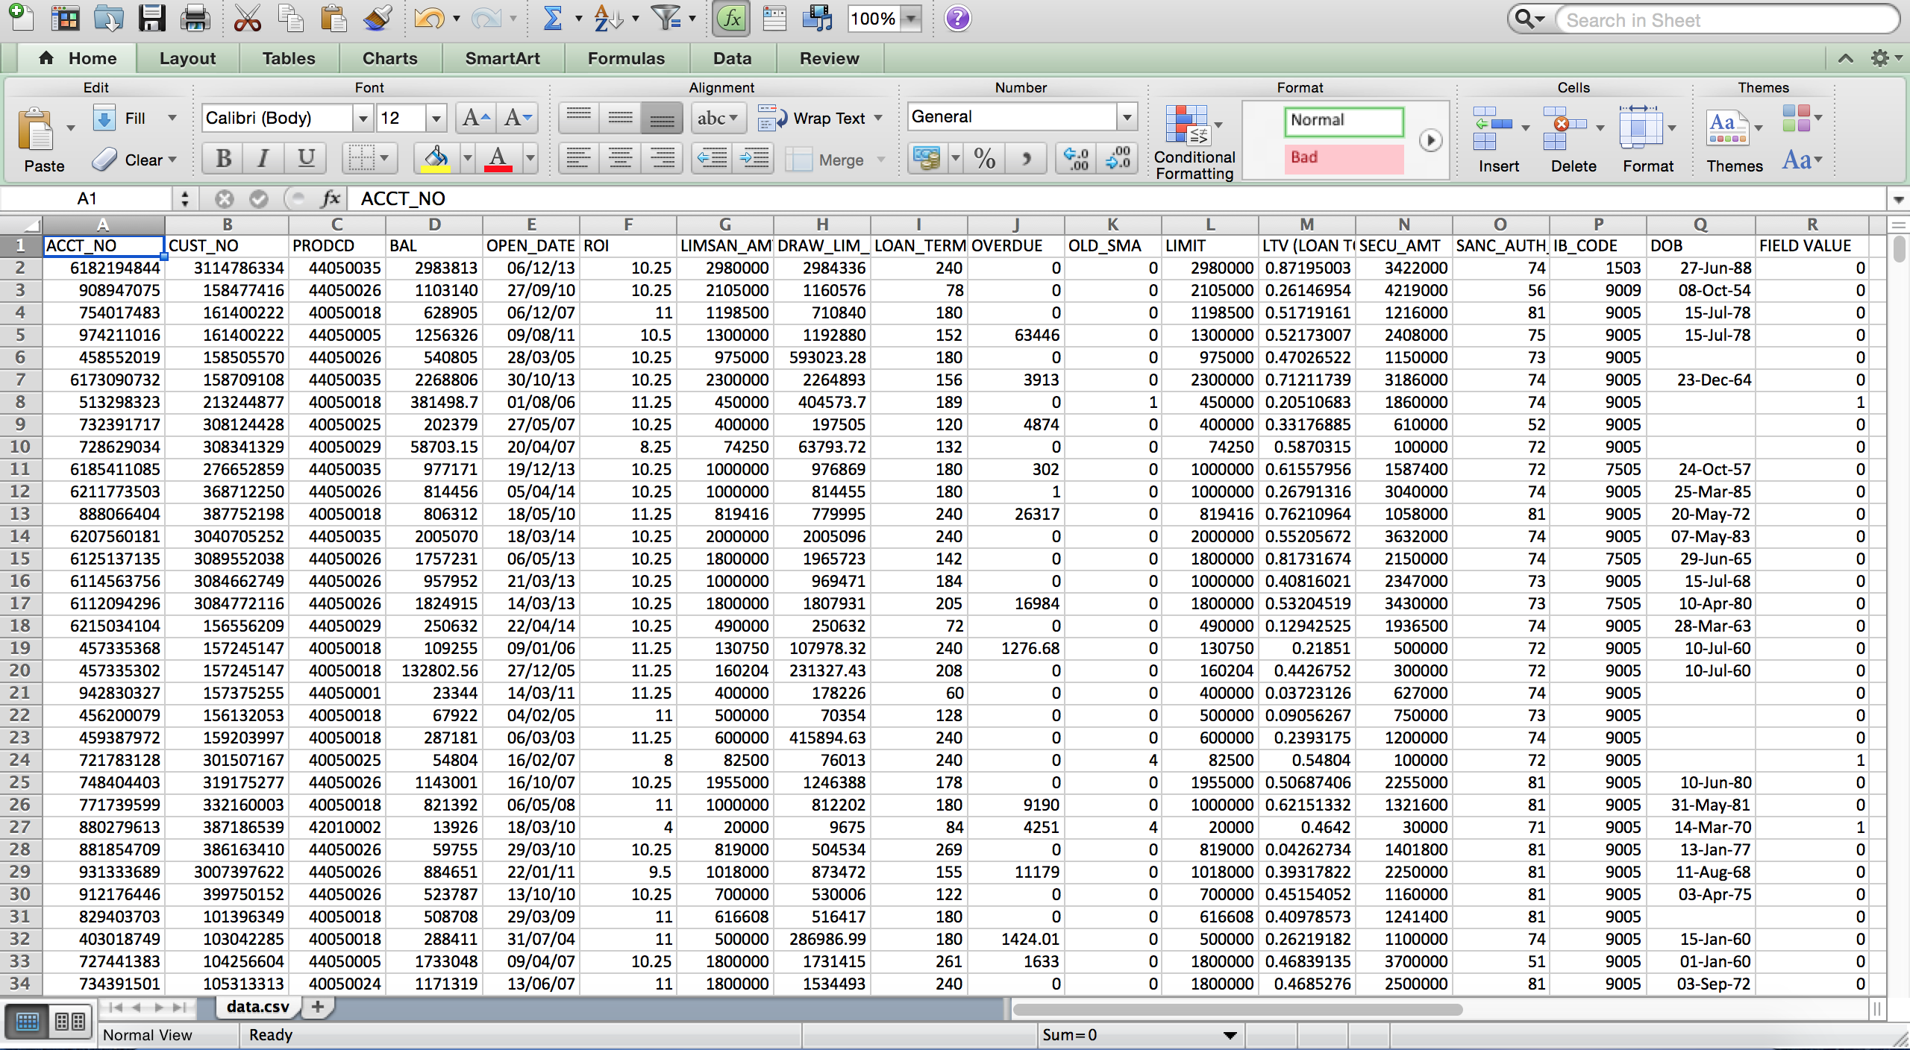
Loan Data

Slide 7
Regression vs Classification
Basically, there are 2 types of problem in any type of Data Analysis. They are Regression and Classification.
Using Regression, we predict output which takes only continuous values. For example, predicting price of the houses using some number of variables.
In Classification, we predict the output which takes only discrete values. For example, in our case it is whether to give a loan to customers or not.

Slide 8
Problem Statement
Based on the previous data of customer and bank details and whether customer paid his/her loan to the bank or not, our bank just want to predict whether to give loan to a new customer or not.
Since our output is of the form Yes/No ( which are discrete values), it’s a problem of classification and not regression.
So, we need to use standard classification technique like Decision tree classifier.

Slide 9
Decision Trees
Decision tree is a type of supervised learning algorithm that is mostly used in classification problems.
A decision tree is a graphical representation of possible solutions to a decision based on certain conditions.
In this technique, we split the population or sample into two or more homogeneous sets based on most significant differentiator in input variables.

Slide 10
Terminology in Decision Trees
ROOT Node: It represents entire population or sample and this further gets divided into two or more homogeneous sets.
SPLITTING: It is a process of dividing a node into two or more sub-nodes.
Decision Node: When a node splits into further sub-nodes, then it is called decision node.
Leaf/ Terminal Node: Nodes do not split is called Leaf or Terminal node.
Parent and Child Node: A node, which is divided into sub-nodes is called parent node of sub-nodes where as sub-nodes are the child of parent node.

Slide 11
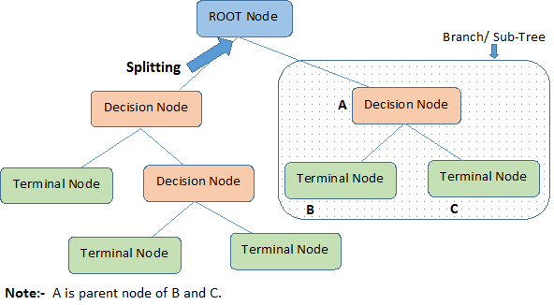
Decision Trees Terminology Diagram

Slide 12
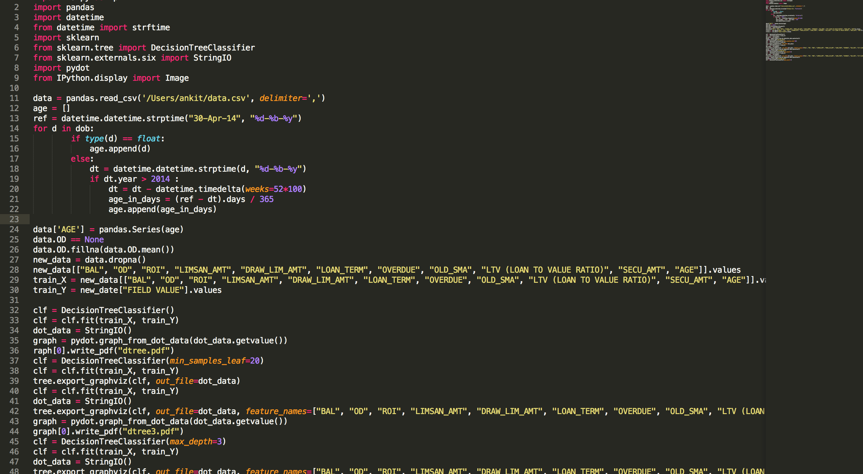
Code of the project
The code is open-sourced on my github account - https://github.com/ubermankapil/credit_risk

Slide 13
Decision Tree with depth = 3

Slide 14
Confusion Matrix
It is a table that is often used to describe the performance of a classification model on a set of test data for which the true values are known.
It can be tabulated for the prediction output of any classifier to check its performance and accuracy.

Slide 15
Confusion Matrix
Confusion Matrix for a decision tree with depth = 3
N = 50556 samples | Predicted : Issue loan | Predicted: Don’t issue loan
Actual: Issue loan | 48329 | 127
Actual: Don’t issue loan | 1175 | 925
Accuracy : (48329 + 925)/50556 = 0.9742. It means our classification model is predicting 97.42%
of correct results.
For a bank, the cost of issuing a loan to a customer who actually doesn’t deserve a loan is more than the cost of not issuing a loan to a customer who deserves a loan.

Slide 16
Loss in the model
N = 50556 samples | Predicted : Issue loan | Predicted: Don’t issue loan
Actual: Issue loan | 48329 | 127
Actual: Don’t issue loan | 1175 | 925
Loss Equation for the model :
Loss = 1175 * average loss bank suffers from 1 defaulter - 127 * average loss bank suffers from not giving loan to 1 customer who deserves loan
This loss needs to be minimized to make bank more profitable.

Slide 17
Decision tree with depth = 4

Slide 18
Confusion Matrix
Confusion Matrix for decision tree whose depth = 4
N = 50556 | Predicted : Issue loan | Predicted: Don’t issue loan 972
Actual : Issue loan | 48375 | 81
Actual: Don’t issue loan | 1209 | 891
Accuracy : (48375 + 891)/50556 = 0.9745. It means this classification model is predicting 97.45% of correct results.

Slide 19
What all is remaining now ?
Calculating the loss that bank may suffer, for different models.
After calculation of losses for each model, select that model which best minimizes the loss and maximizes the profit for the bank.
The model should reduce the number of cases of issuing bad loans.

Slide 20


