Slide 1
Portfolio Optimization: Analyzing Strategies for Maximum Returns
Team Members: Anuj Gupta (21d070014) Aryan Dangi () Aarya Bhuva () Snehaa Reddy () Aagam Shah ()

Slide 2
Introduction to Portfolio Optimization
Definition: Balancing risk and return by allocating capital across assets.
Objectives:
Maximize portfolio return.
Minimize risk within constraints.
Maintain diversification.
Relevance: Practical applications in finance and investment.

Slide 3
Problem Statement
Optimize asset allocation to achieve:
Target returns.
Diversified exposure.
Constraints:
Risk tolerance: max_risk.
Maximum allocation per asset: max_weight.

Slide 4
Data Overview
Dataset: asset_prices.csv
Timeframe: Data before 2022 for optimisation; 2022 onward for backtesting.
Features: Prices, returns, year, and month.
Key Metrics:
Mean Returns.
Covariance Matrix.

Slide 5
Optimization Techniques
Sequential Least Squares Programming (SLSQP):
Gradient-based method for constrained optimisation.
Ensures risk and weight constraints are satisfied.
Suitable for problems with smooth objective functions.
Quadratic Programming (QP):
Solves convex problems with a quadratic objective function.
Efficient for minimising risk while meeting linear constraints.
Delivers precise, globally optimal solutions for convex portfolios.
Differential Evolution (DE):
Evolutionary algorithm for non-linear, multi-modal problems.
Stochastic exploration enables broader solution search.
Ideal for scenarios with complex or non-linear constraints.

Slide 6
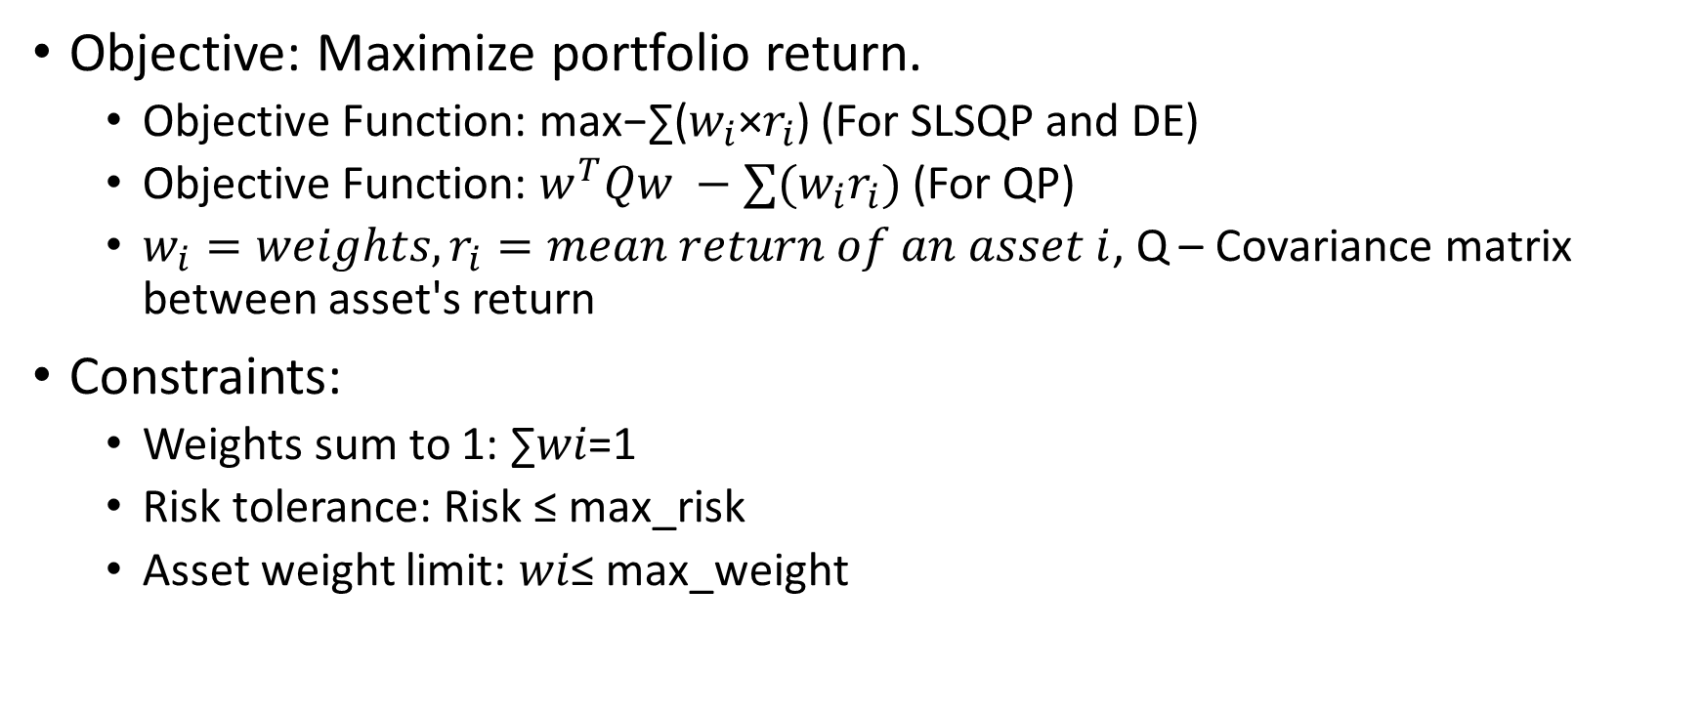
Optimization Model
Objective: Maximize portfolio return.
Objective Function: max⁡−∑($w_{i}$×$r_{i}$) (For SLSQP and DE)
Objective Function: $w^{T}Qw −∑(w_{i}r_{i})$ (For QP)
$w_{i}=weights, r_{i}=mean return of an asset i$, Q – Covariance matrix between asset's return
Constraints:
Weights sum to 1: ∑𝑤𝑖=1
Risk tolerance: Risk ≤ max_risk
Asset weight limit: 𝑤𝑖≤ max_weight

Slide 7
Implementation Workflow
Data preprocessing: Extract returns and prices.
Compute statistical metrics: Mean returns, covariance matrix.
Apply optimization methods: SLSQP, QP, DE.
Validate and backtest portfolio.

Slide 8
Optimization Results
Optimal Weights: Distribution of capital across assets.
Risk-Return Tradeoff:
Optimized Return: optimized_return
Optimized Risk: optimized_risk
Comparison of methods: SLSQP vs QP vs DE.

Slide 9
Backtesting Methodology
Timeframe: Data from 2022 onward.
Process:
Calculate portfolio returns using weights.
Compute cumulative returns.
Evaluate portfolio performance (Portfolio value at the end).

Slide 10
Key Insights, Challenges and Future Scope
Key Insights
Risk-adjusted returns improve with diversification constraints.
Performance is sensitive to input parameters like max risk and max weight.
Challenges
Data dependency: Results rely on the quality and timeframe of data.
Backtesting limitation: Real-world factors like transaction costs are excluded.
Future Scope
Incorporate real-world constraints: Transaction costs, liquidity, taxes.
Explore additional algorithms: Genetic algorithms and particle swarm optimisation.
Apply to different datasets: Broader asset classes and markets.

