Slide 1
MIA Lab Final Presentation: Hypothesis H
Group X: Name A, Name B, Name C

Slide 2
Group dependent classifiers
Hypothesis: The segmentation becomes more accurate with two classifiers, one for large structures and one for small structures, than one classifier for all the brain structures.
Hypothesis: The segmentation becomes more accurate with more than one classifier ( e.g. one for large structures and one for small structures) than one classifier for all brain structures

Slide 3
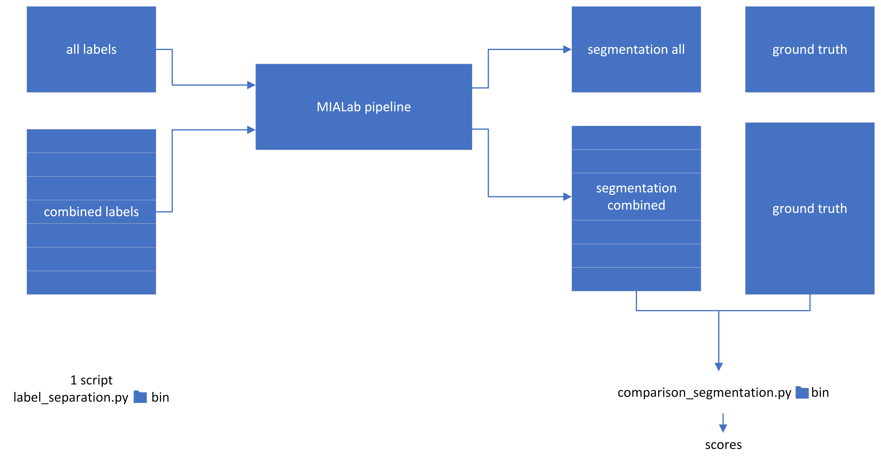
Methods – Pipeline Adaption

Slide 4
Methods – Parameter Search
Simplified grid search for two parameter of the classifier
Number of estimators
Max depth

Slide 5
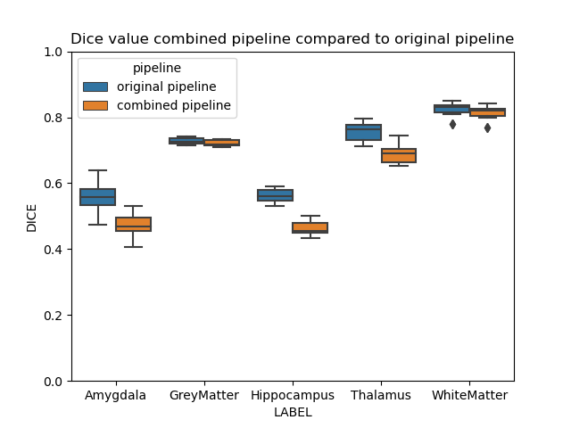
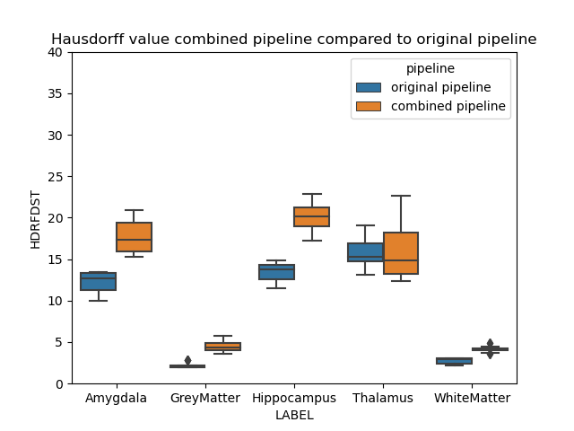
Experiment1 - 2 pipelines
Original pipeline: All labels were classified together
Combined pipeline: White and grey matter classified in one pipeline
Hippocampus, Amygdala, and Thalamus classified in another pipeline

Slide 6
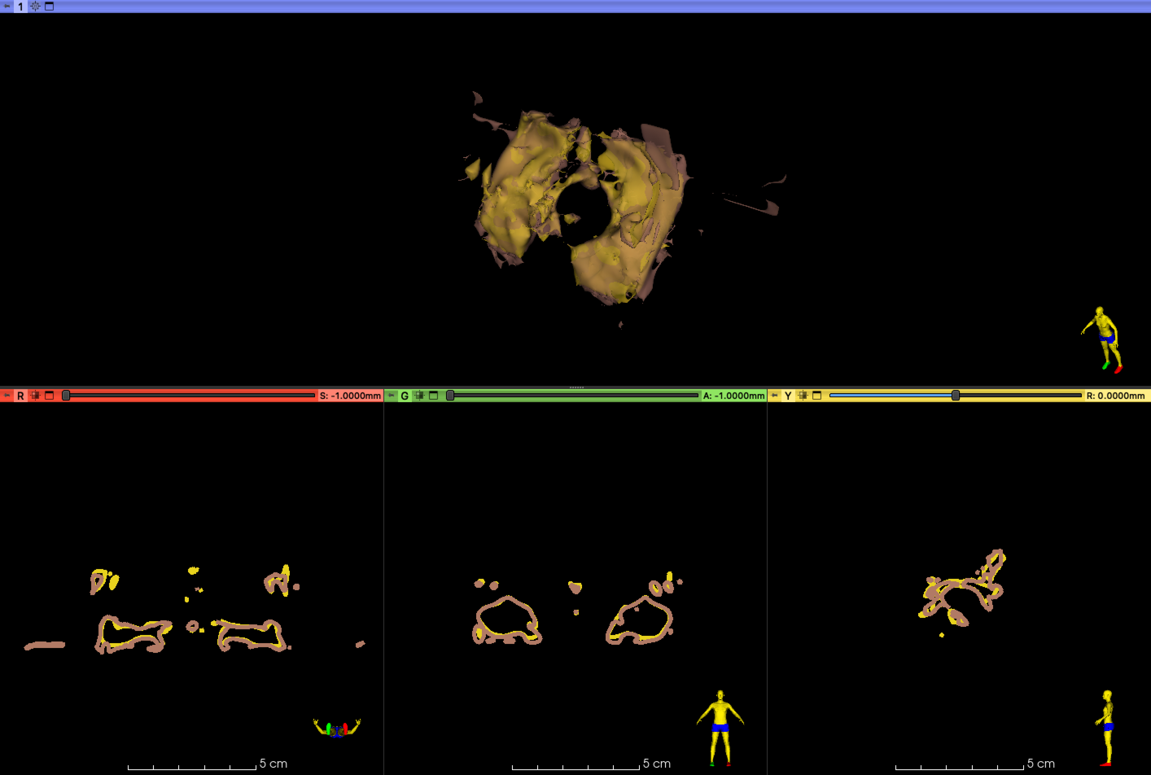
Experiment1 - Hippocampus
Gold: Original pipeline
Brown: Combined pipeline

Slide 7
Experiment1 - Hippocampus
Gold: Original pipeline
Brown: Combined pipeline

Slide 8
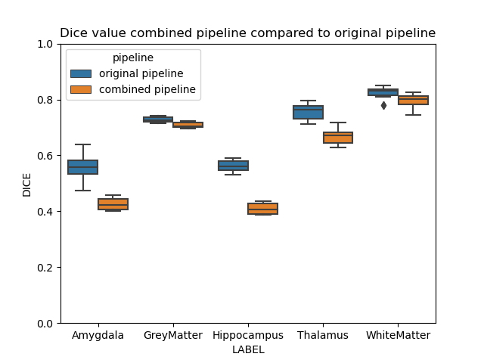
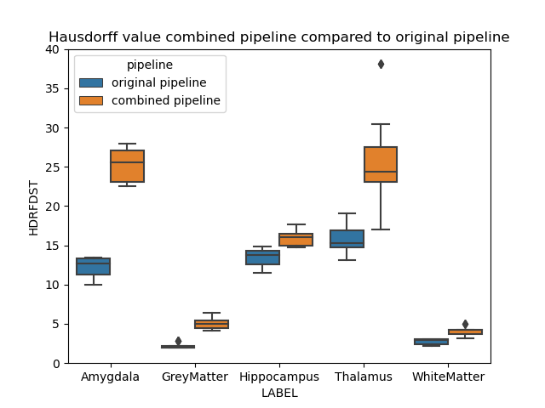
Experiment2 - 5 pipelines
Original pipeline: All labels were classified together
Combined pipeline: Each label was classified in one pipeline

Slide 9
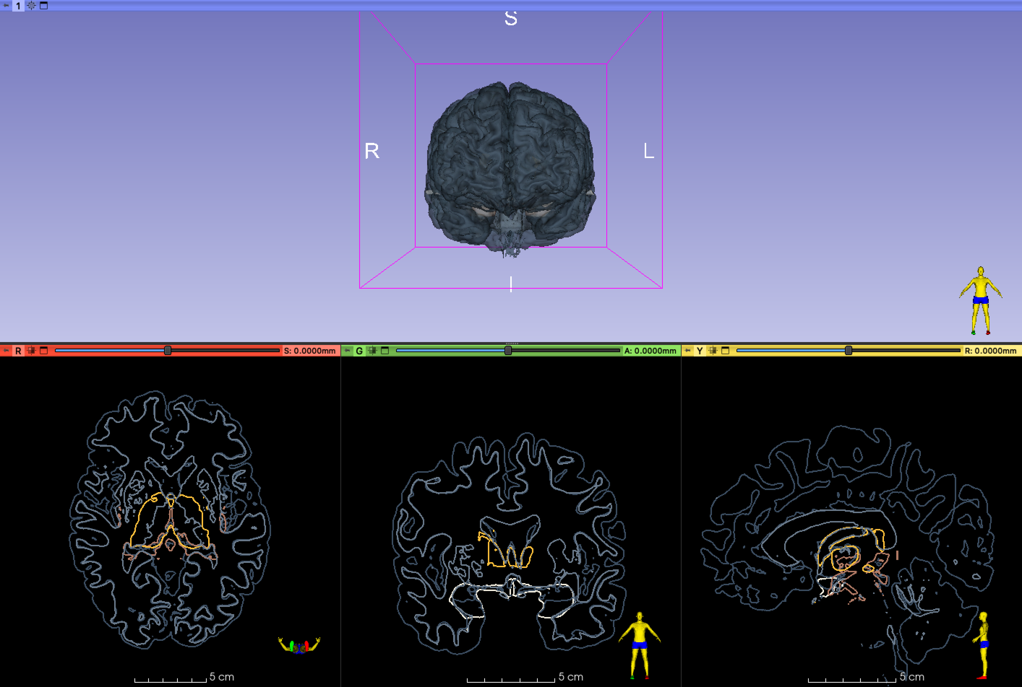
Experiment2 - Structural Overlap
Light grey: White matter
Dark grey: Grey matter
Light brown: Hippocampus
White: Amygdala
Gold: Thalamus

Slide 10
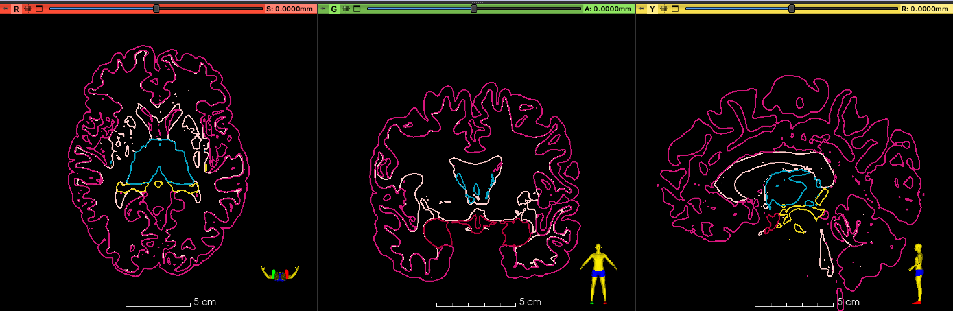

Slide 11
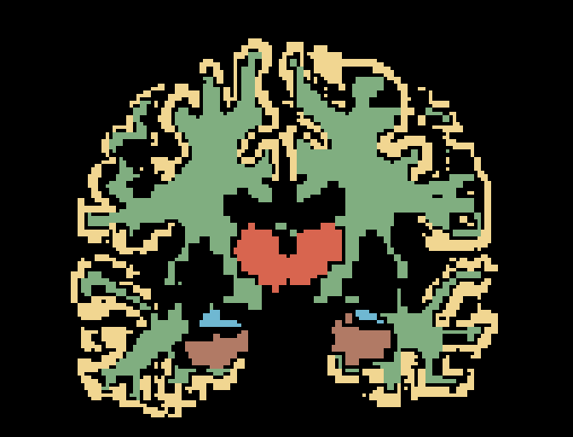
Experiment3 - 3 pipelines
Original pipeline: All labels were classified together
Combined pipeline: White and grey matter classified in first pipeline
Hippocampus, Amygdala classified in second pipeline
Thalamus classified in third pipeline

Slide 12
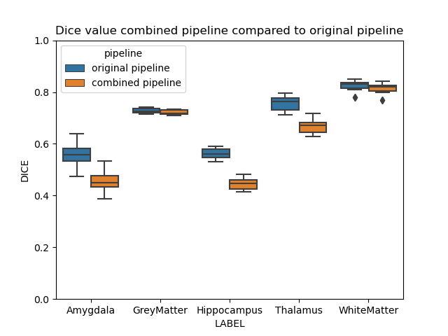
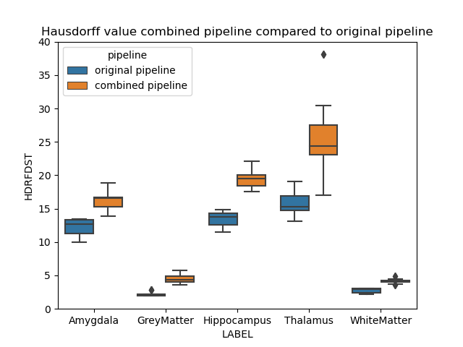
Experiment3 - 3 pipelines
Original pipeline: All labels were classified together
Combined pipeline: White and grey matter classified in first pipeline
Hippocampus, Amygdala classified in second pipeline
Thalamus classified in third pipeline

Slide 13
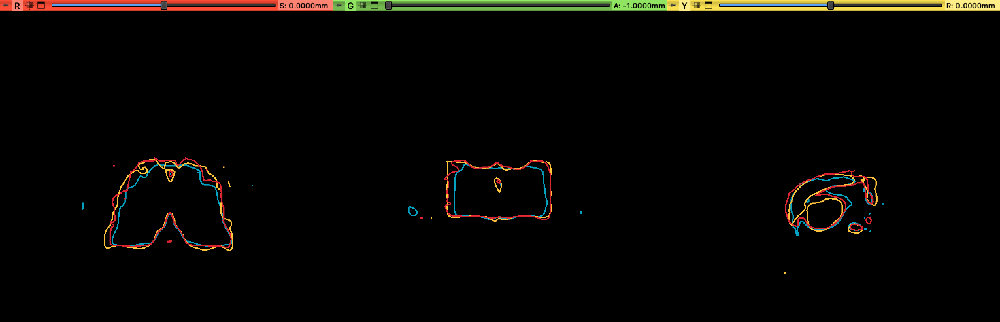
Experiment3 - Thalamus
Gold: Thalamus combined pipeline experiment3
Blue: Thalamus original pipeline
Red: Thalamus combined pipeline experiment1

Slide 14
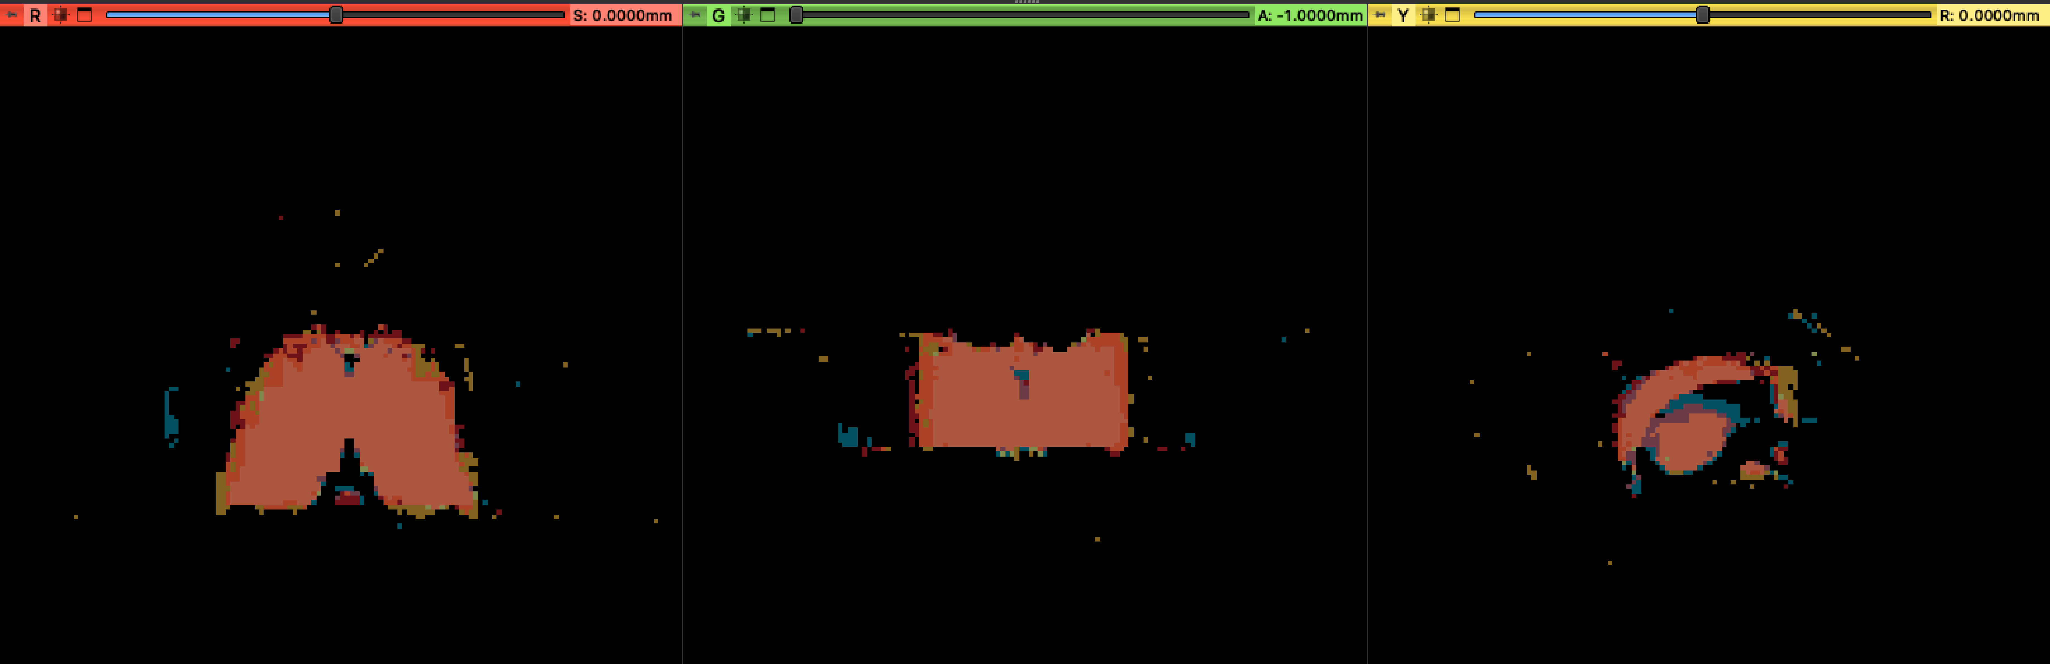
Experiment3 - Thalamus
Gold: Thalamus combined pipeline experiment3
Blue: Thalamus original pipeline
Red: Thalamus combined pipeline experiment1

Slide 15
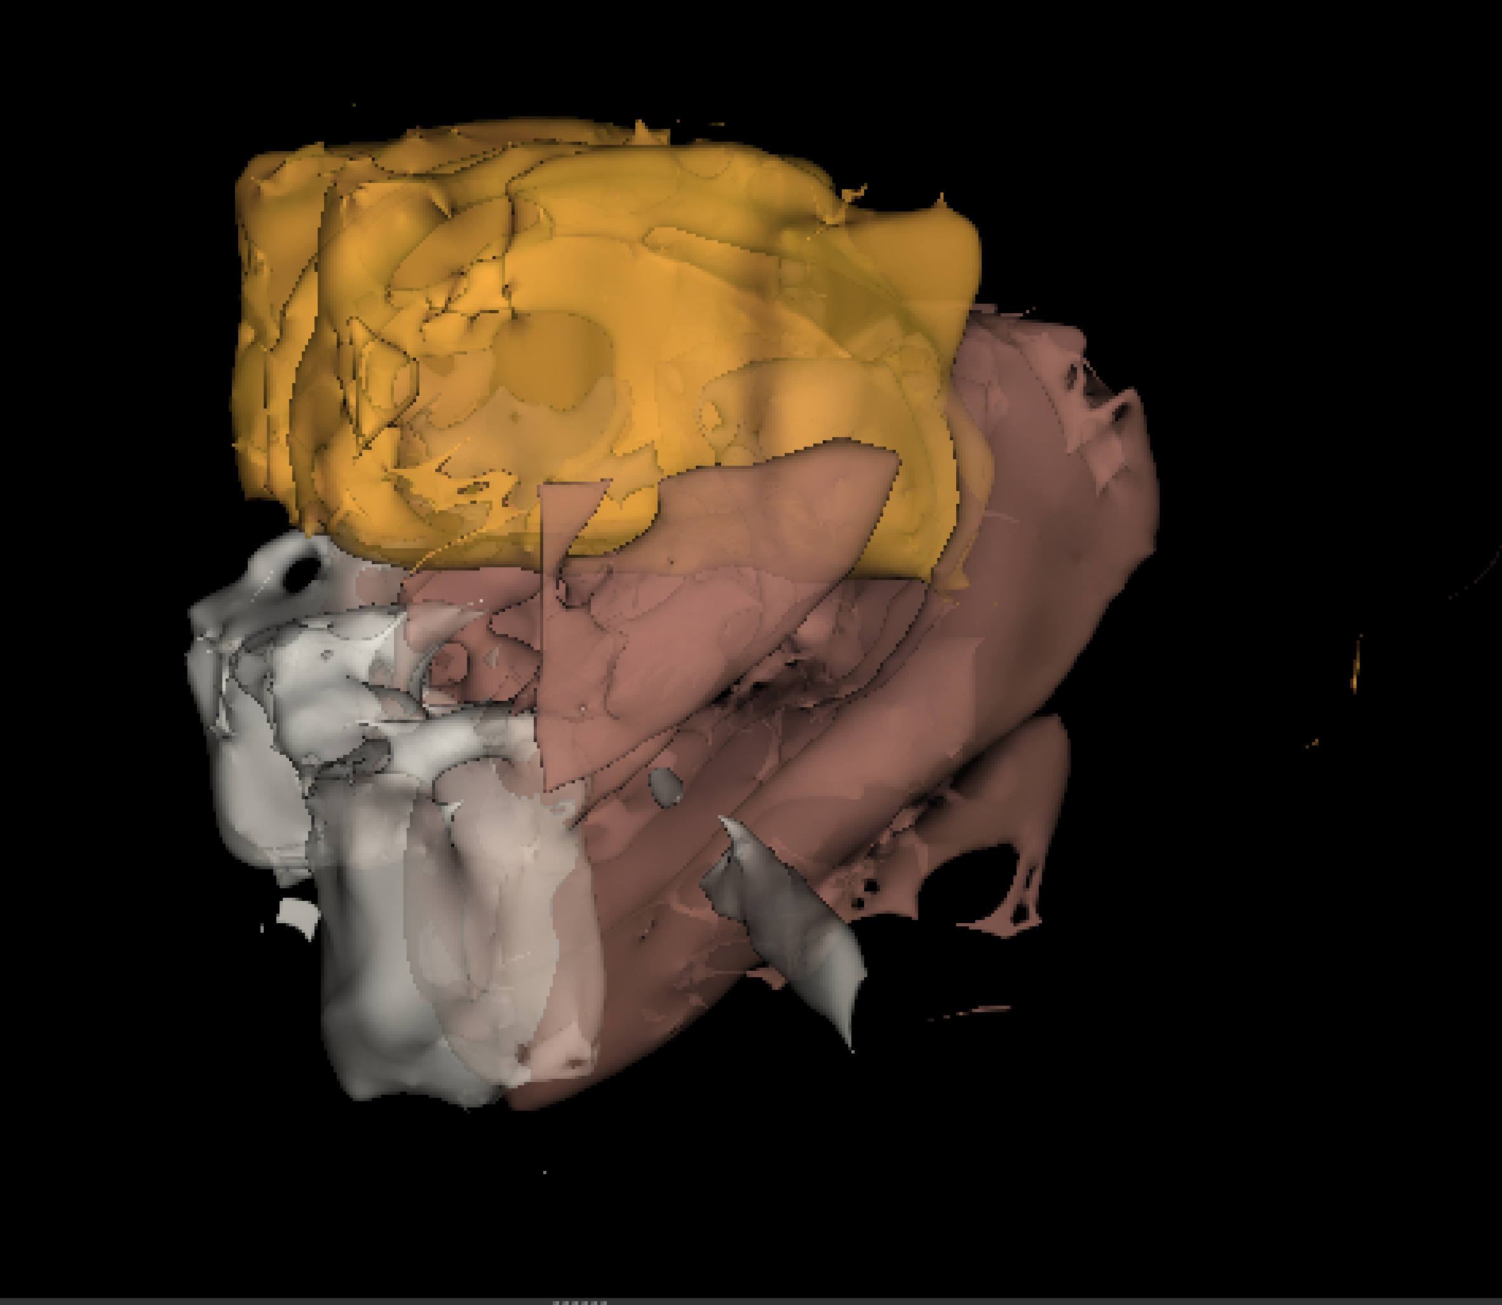
Conclusion
Hypothesis (currently) disproved
Currently time-consuming
Overlaps

Slide 16
Outlook
Features
Optimize Preprocessing
Implement Postprocessing
Keep the biggest volume
Combine all volumes
Randomize training and test data

Slide 17

Notes:
hsd dist
95 in add
maybe 90
seperated pip

