Slide 1
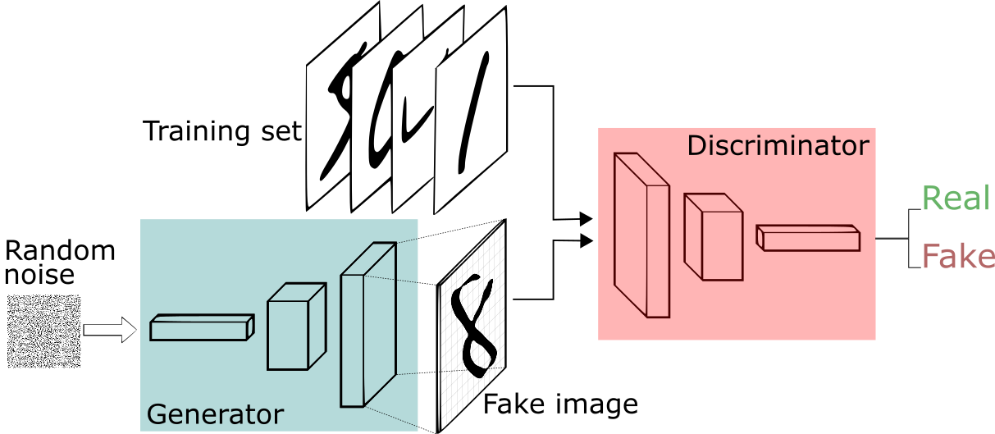


Generative Adversarial Neural Networks on FPGA
Embedded Deep Learning
Alessandro Mileto
March 03, 2023
Credits: https://sthalles.github.io/intro-to-gans/

Slide 2
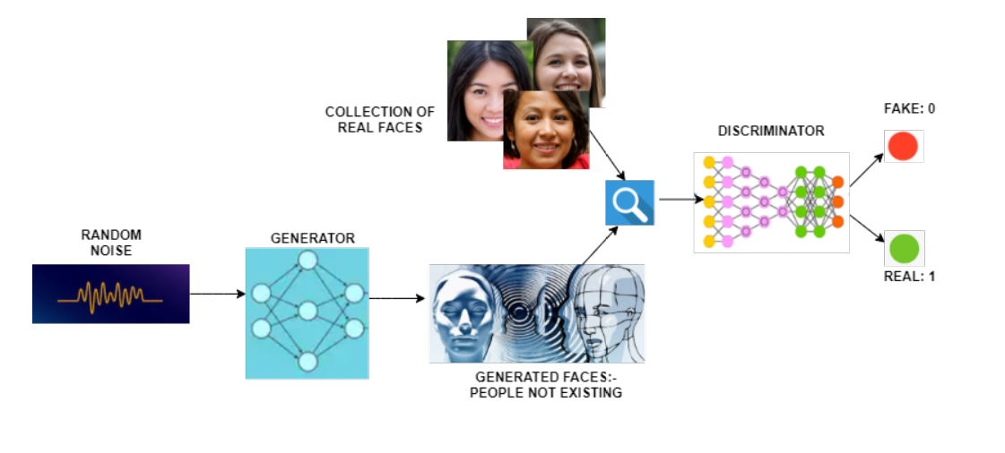
GENERATIVE ADVERSARIAL NETWORKS
THE HOLY GRAIL OF IMAGE GENERATION
Discriminator and generator
Data generation from noise
Training is a minimax game
Convergence Is cumbersome
Credits: https://medium.com/analytics-vidhya/introduction-to-generative-adversarial-networks-gans-852c8a29bd70

Slide 3
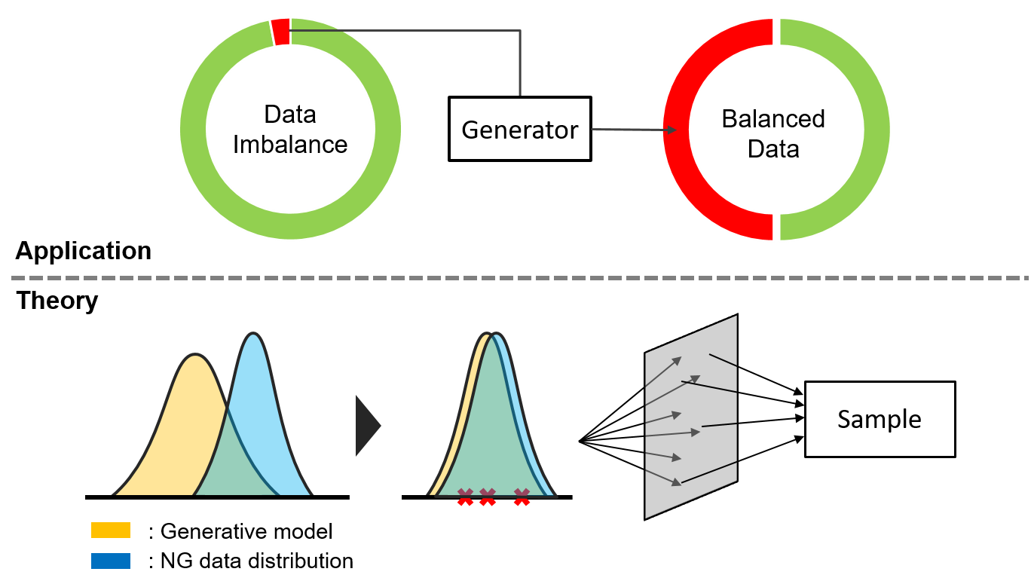
Gan: what for?
Images generation
Planning
Anomaly detection
imbalanced datasets augmentation
Credits: https://mobilemonitoringsolutions.com/wp-content/uploads/2019/01/data_imbalance3.png

Slide 4
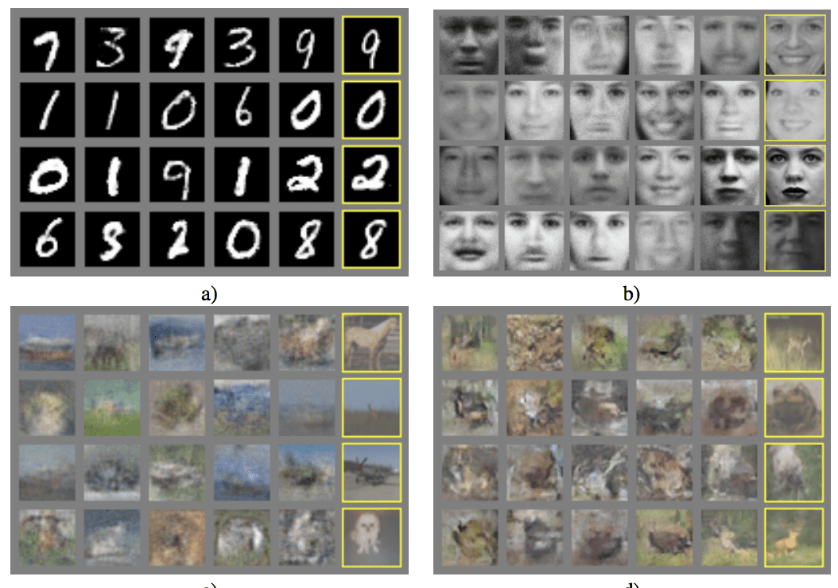
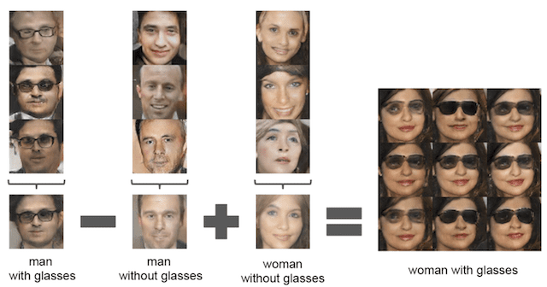
Gan: examples
Credits for the images: https://machinelearningmastery.com/impressive-applications-of-generative-adversarial-networks/

Slide 5
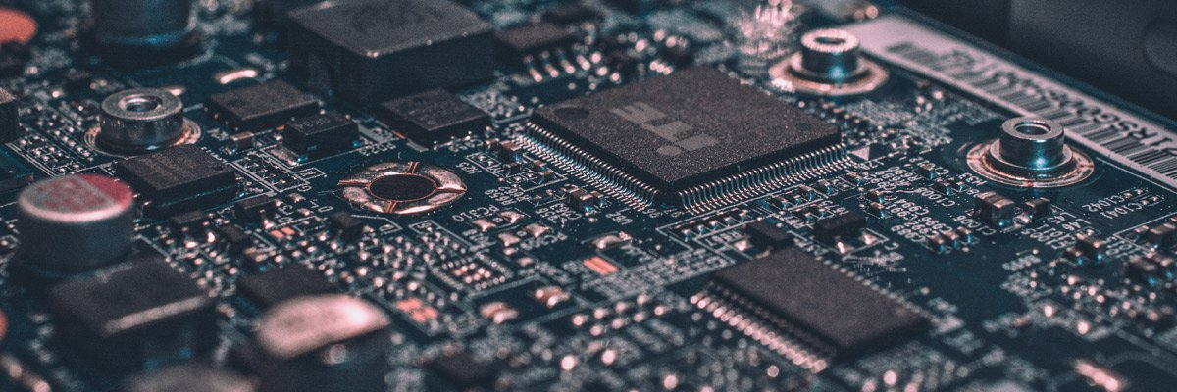
Embedded deep learning: oh dear, why?
Modern applications require low latencies
Privacy matters: keep data close to the user
model complexity has to be tuned appropriately
Some embedded devices have programmable fabric
Credits: https://www.plugandplaytechcenter.com/resources/tinyml-making-smart-devices-tinier-ever/
Did somebody say fpga?

Slide 6
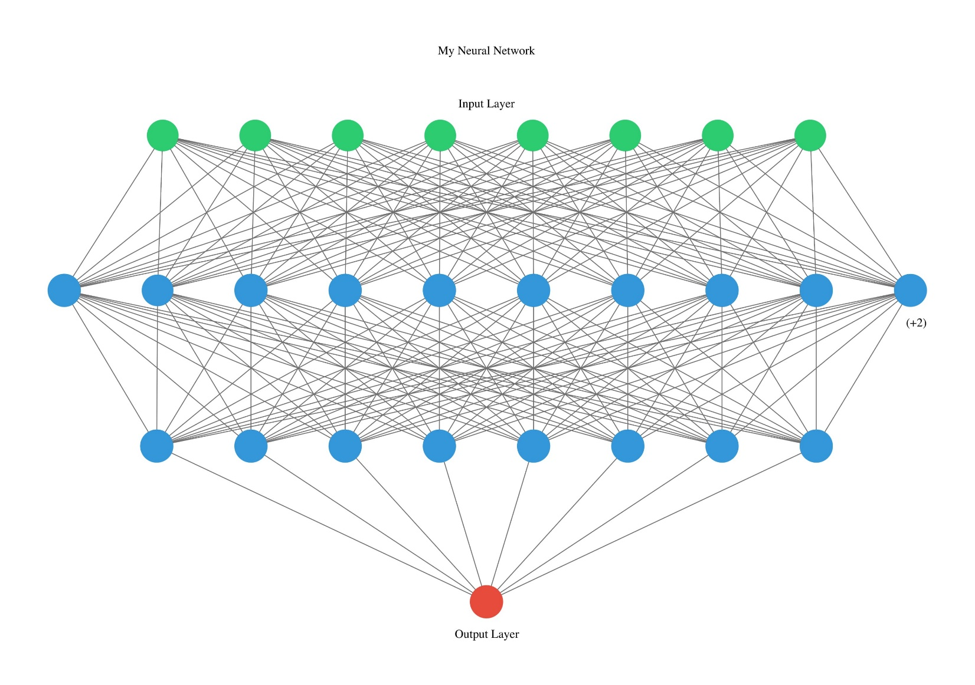
Slow down: Taming Model complexity
Modern applications are demanding
Deep learning models are complex
Embedded devices are constrained
Who is gonna save us now?
Did somebody say fpga?
https://towardsdatascience.com/visualizing-artificial-neural-networks-anns-with-just-one-line-of-code-b4233607209e

Slide 7
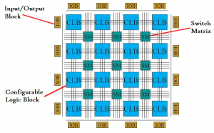
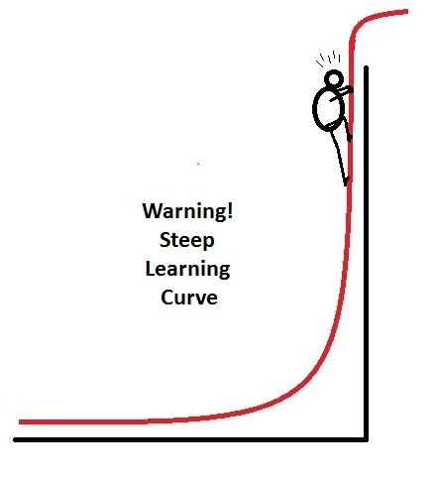
Fpga: programmable magic
Tailor made hardware acceleration
Limited Power consumption
No smooth sailing
https://semiconductorclub.com/what-is-fpga-introduction-to-fpgas/
Why so serious?
https://2.bp.blogspot.com/-WaXzouU9D3Y/UTZbaLVpRvI/AAAAAAAAANI/PB3p9nzT3oM/s1600/steep+learning+curve.jpg

Slide 8
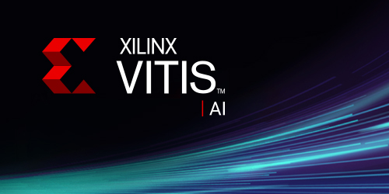
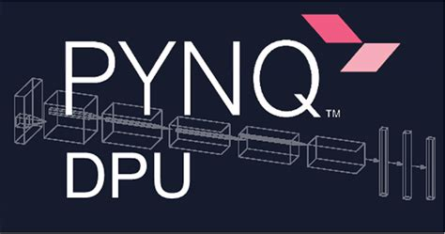
Brace yourself: vitis ai+ Pynq dpu
High level interface to the hardware
Libraries for scientific computing
Linux base
inspection
Quantization
Optimization (license required)
Compilation for dpu

Slide 9
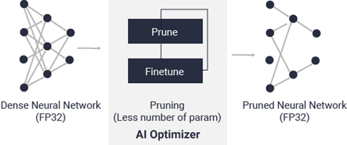
pruning: entia non sunt multiplicanda
Some model parameters are not needed
Pruning is about cutting parameters
Good pruning tools are not always free
https://docs.xilinx.com/r/2.5-English/ug1414-vitis-ai/Vitis-AI-Optimizer

Slide 10
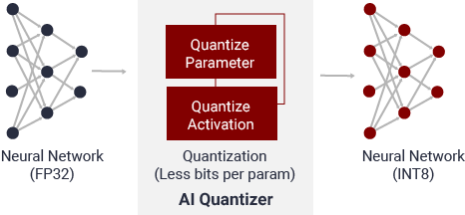
Quantization: integers are cool
Deep learning uses floating point precision
Integer arithmetic is fine for most applications
We need to go from floats to integers
https://docs.xilinx.com/r/2.5-English/ug1414-vitis-ai/Vitis-AI-Quantizer

Slide 11
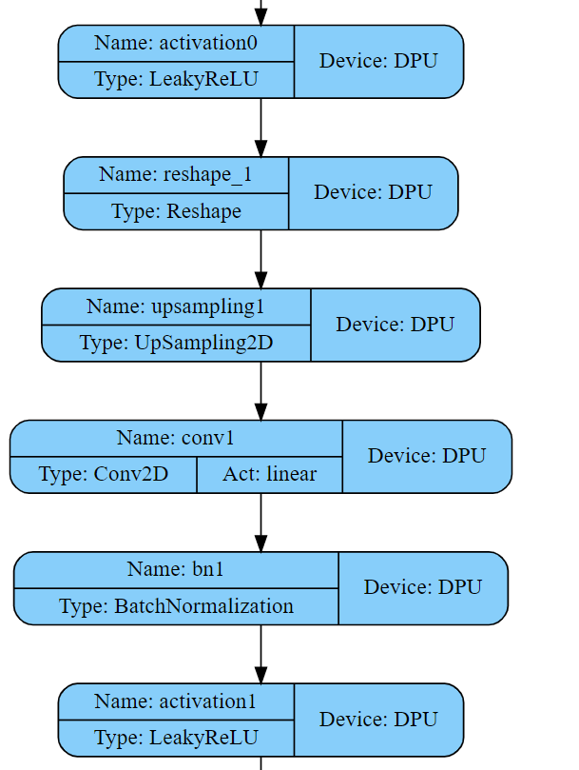
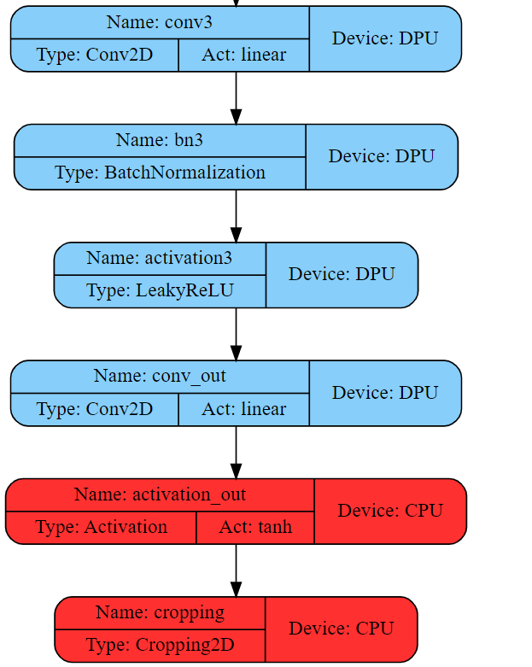
Quantized partitioned computation graph
Only the top of the network is not run on dpu

Slide 12
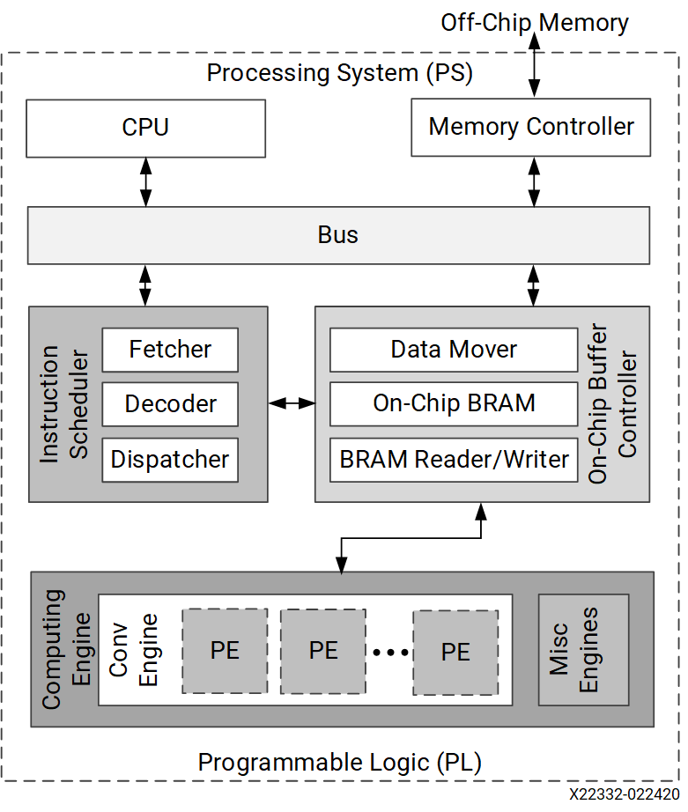
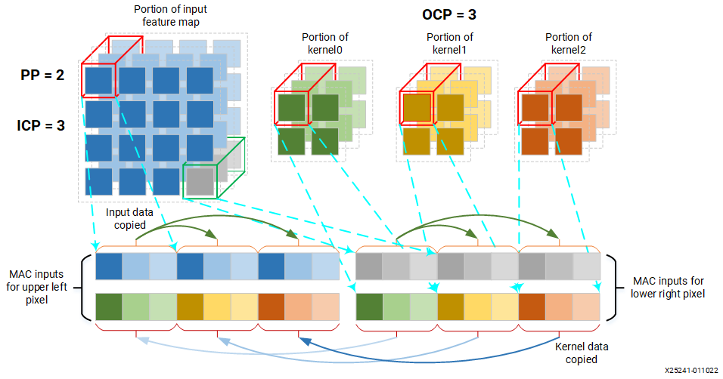
Dpu: One soft core to rule them all
Ip by Xilinx for accelerating tensor operations in integer arithmetic
This work leverages a single core DPUCZDX8G
Images: https://docs.xilinx.com/r/en-US/pg338-dpu/Hardware-Architecture

Slide 13
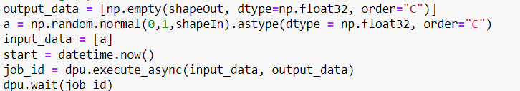
Pynq: the anti headaches
Running the network is as easy as…
NO more tears

Slide 14
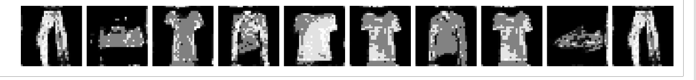
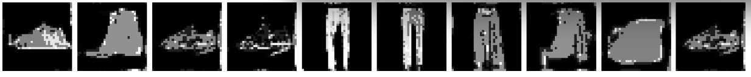
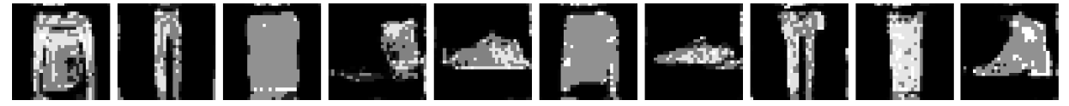
Unleash the beast: ultra96v2 at work

Slide 15
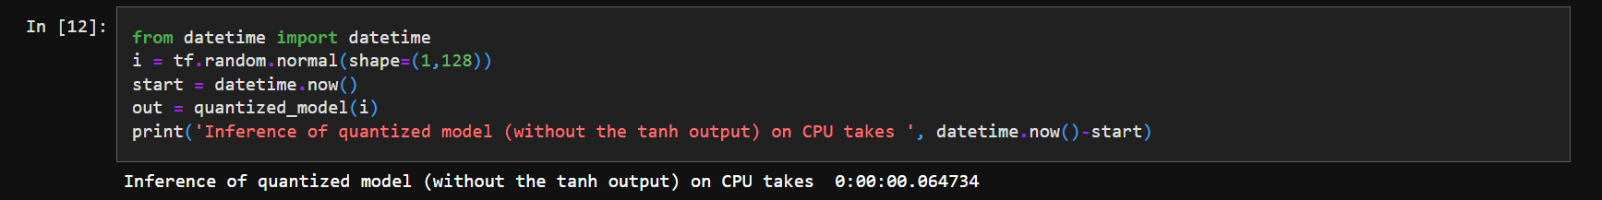
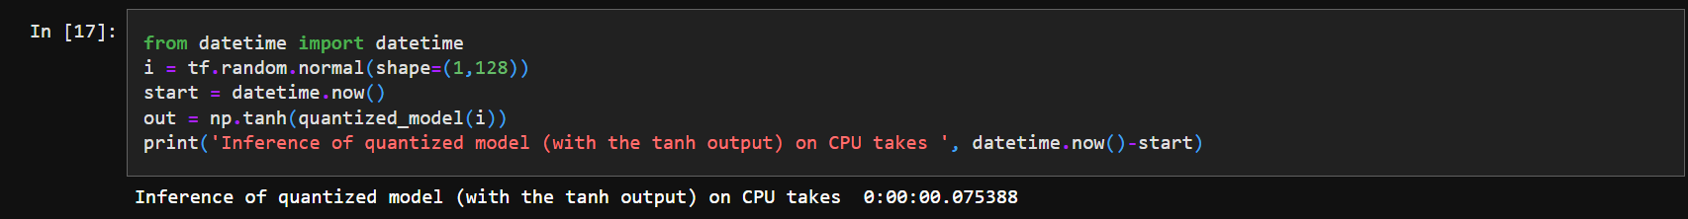
A very tiny benchmark
generating one image on cpu takes two and a half more than on dpu

Slide 16

One last word
Giving back: is it important?
NO!
It is crucial!

Slide 17
Thanks for your time!

