Slide 1
Data bases 2
Telco service application project documentation

Slide 2
Index
Specification
Revision of the specifications (if needed)
Conceptual (ER) and logical data models
Explanation of the ER diagram (if needed)
Explanation of the logical model (if needed)
Trigger design and code
ORM relationship design with explanations
Entities code
Interface diagrams or functional analysis of the specifications
List of components
Motivations of the components design (if needed)
UML sequence diagrams (optional, only for salient events)

Slide 3
Specifications
A telco company offers pre-paid online services to web users. Two client applications using the same database need to be developed.
Consumer Application:
The consumer application has a public Landing page with a form for login and a form for registration. Registration requires a username (which can be assumed as the unique identification parameter), a password and an email. Login leads to the Home page of the consumer application. Registration leads back to the landing page where the user can log in. The user can log in before browsing the application or browse it without logging in. If the user has logged in, his/her username appears in the top right corner of all the application pages. The Home page of the consumer application displays the service packages offered by the telco company. A service package has an ID and a name (e.g., “Basic”, “Family”, “Business”, “All Inclusive”, etc). It comprises one or more services. Services are of four types: fixed phone, mobile phone, fixed internet, and mobile internet. The mobile phone service specifies the number of minutes and SMSs included in the package plus the fee for extra minutes and the fee for extra SMSs. The fixed phone service has no specific configuration parameters. The mobile and fixed internet services specify the number of Gigabytes included in the package and the fee for extra Gigabytes. A service package must be associated with one validity period. A validity period specifies the number of months (12, 24, or 36). Each validity period has a different monthly fee (e.g., 20€/month for 12 months, 18€/month for 24 months, and 15€ /month for 36 months). A package may be associated with one or more optional products (e.g., an SMS news feed, an internet TV channel, etc.). The validity period of an optional product is the same as the validity period that the user has chosen for the service package. An optional product has a name and a monthly fee independent of the validity period duration. The same optional product can be offered in different service packages. From the Home page, the user can access a Buy Service page for purchasing a service package and thus creating a service subscription. The Buy Service page contains a form for purchasing a service package. The form allows the user to select one package from the list of available ones and choose the validity period duration and the optional products to buy together with the chosen service. The form also allows the user to select the start date of his/her subscription.

Slide 4
After choosing the service packages, the validity period and (0 or more) optional products, the user can press a CONFIRM button. The application displays a CONFIRMATION page that summarizes the details of the chosen service package, the validity period, the optional products and the total price to be pre-paid: (monthly fee of service package * number of months) + (sum of monthly fees of options * number of months). If the user has already logged in, the CONFIRMATION page displays a BUY button. If the user has not logged in, the CONFIRMATION page displays a link to the login page and a link to the REGISTRATION page. After either logging in or registering and immediately logging in, the CONFIRMATION page is redisplayed with all the confirmed details and the BUY button. When the user presses the BUY button, an order is created. The order has an ID and a date and hour of creation. It is associated with the user and with the service package, its validity period and the chosen optional products. It also contains the total value (as in the CONFIRMATION page) and the start date of the subscription. After creating the order, the application bills the customer by calling an external service. If the external service accepts the billing, the order is marked as valid and a service activation schedule is created for the user. A service activation schedule is a record of the services and optional products to activate for the user with their date of activation and date of deactivation. If the external service rejects the billing, the order is put in the rejected status and the user is flagged as insolvent. When an insolvent user logs in, the home page also contains the list of rejected orders. The user can select one of such orders, access the CONFIRMATION page, press the BUY button and attempt the payment again. When the same user causes three failed payments, an alert is created in a dedicated auditing table, with the user Id, username, email, and the amount, date and time of the last rejection.

Slide 5
Employee Application:
The employee application allows the authorized employees of the telco company to log in. In the Home page, a form allows the creation of service packages, with all the needed data and the possible optional products associated with them. The same page lets the employee create optional products as well. A Sales Report page allows the employee to inspect the essential data about the sales and about the users over the entire lifespan of the application: • Number of total purchases per package. • Number of total purchases per package and validity period. • Total value of sales per package with and without the optional products. • Average number of optional products sold together with each service package. • List of insolvent users, suspended orders and alerts. • Best seller optional product, i.e. the optional product with the greatest value of sales across all the sold service packages.
The call to the external service must be simulated with a function that returns true or false pseudo-randomly. For testing purposes, the demonstration should be able to show at least one case in which the service call fails and one case in which the service call succeeds.
The aggregate data of the sales report must be computed by triggers that populate materialized view tables. The documentation must describe the SQL code of the view that would compute the aggregate data, the logical schema of the materialized view table(s) that store the aggregate data and the triggers that populate the content of the materialized view table(s).

Slide 6
Specification interpretation
We tried to be as compliant as possible with the specification. Nevertheless, we introduced some modifications.
First of all we included in the same page registration and login forms.
Secondly we introduced a buy button for each service package listed in the home page. So, the buy page refers to a single service package previously selected in the home page.
Finally, in accordance with the suggestions of the teachers, we included in the confirmation page two buttons in order to simulate payment approvals and rejections.

Slide 7
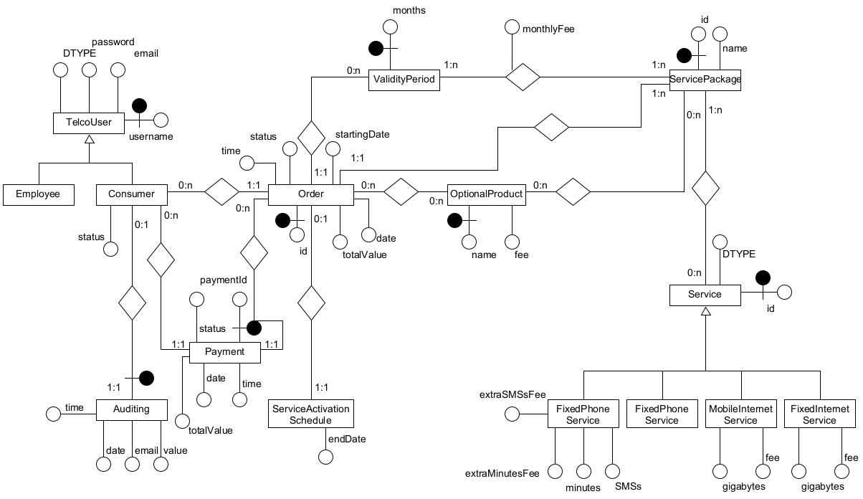
Entity Relationship

Slide 8
Motivations of the ER design
As shown in the ER model, we assumed that users fall back into two categories (consumers and employees). For this reason we introduced an hierarchy whose father entity set is TelcoUser and whose children are Employee and Consumer. We decided to put a flag (integer attribute) on the Consumer in order to distinguish a solvent Consumer (status = 0) from an insolvent one (status = 1).
As remarked into the specifications, we used the same strategy for the Order table to separate newly created orders (status = 0) from REJECTED (status = 1) and ACCEPTED (status = 2) ones. For this reason we included the attribute status in this entity set as well.
The Payment entity set has been introduced for convenience to keep track of all the payments made by the consumers. Given that a payment could fail, we introduced a status attribute here as well, using the convention:
0 for APPROVAL;
1 for REJECTION.
Next, we introduced another hierarchy to model services with the entity set service as a father. In this way, we avoid including four many-to-many different relatioships between service package and the subtypes of the service.
As far as validity periods and service packages are concerned, we decided to model monthlyFee as an attribute of the relationship between the two entities.
An important remark is that we modelled ValidityPeriod as an entity set with only one attribute (months).
Finally, the many-to-many relationship between ServicePackage and OptionalProduct has to be clearly distinguished from the many-to-many relationship between OptionalProduct and Order. In fact, the former stands for the possibility of associating a given optional product to a service package purchase, while the latter represents the inclusion of an optional product into an order.

Slide 9
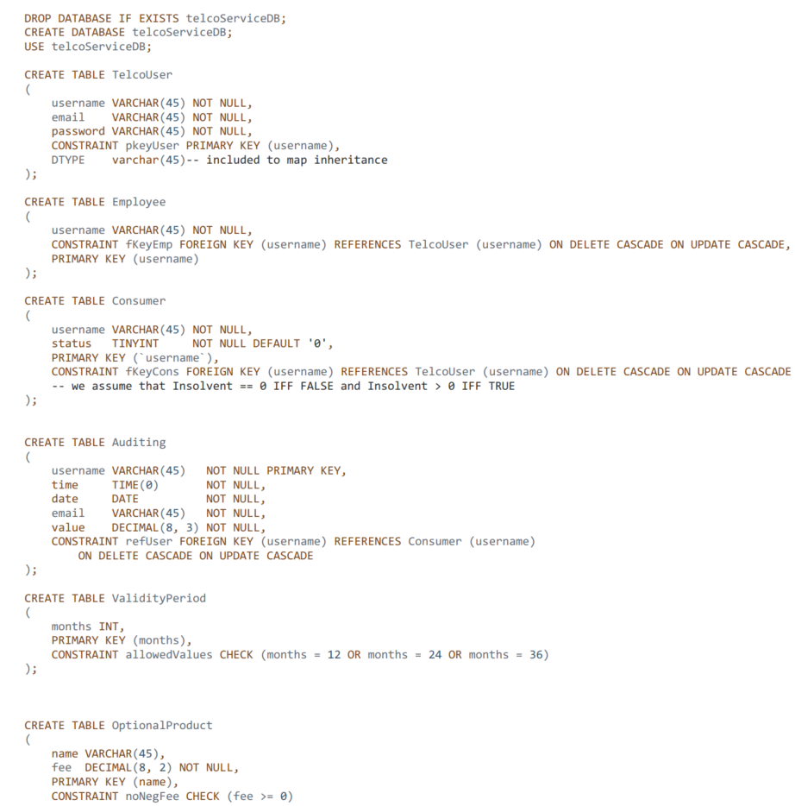
Relational model

Slide 10
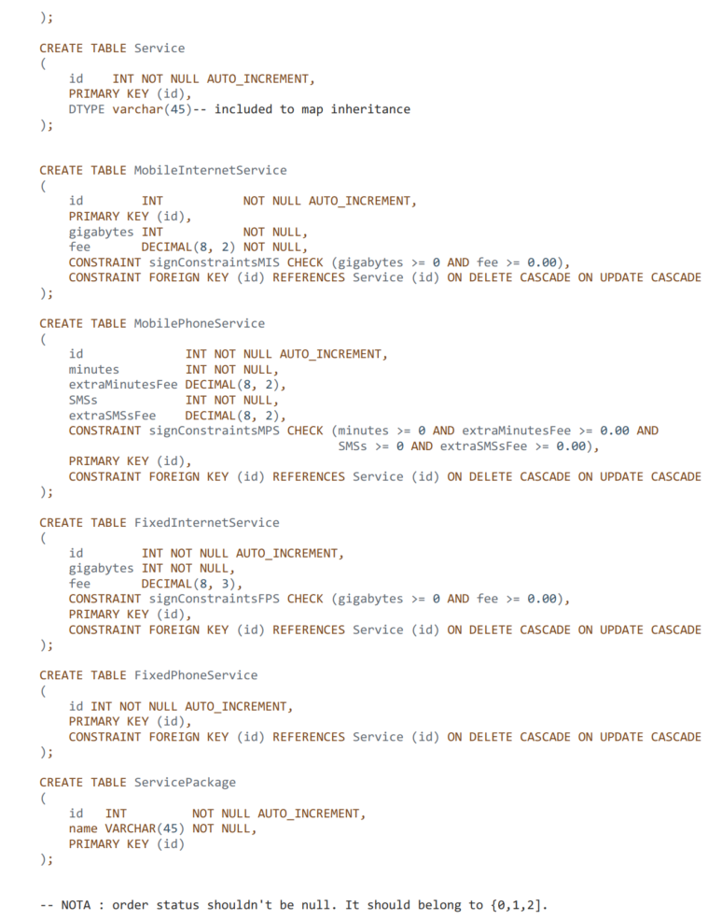

Slide 11
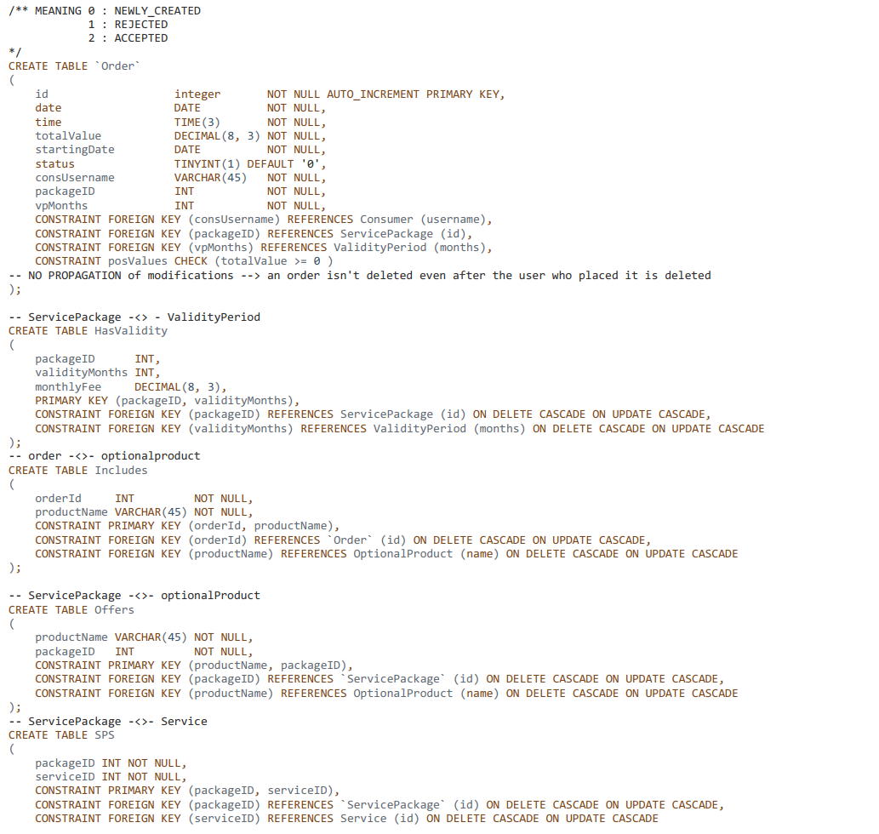

Slide 12
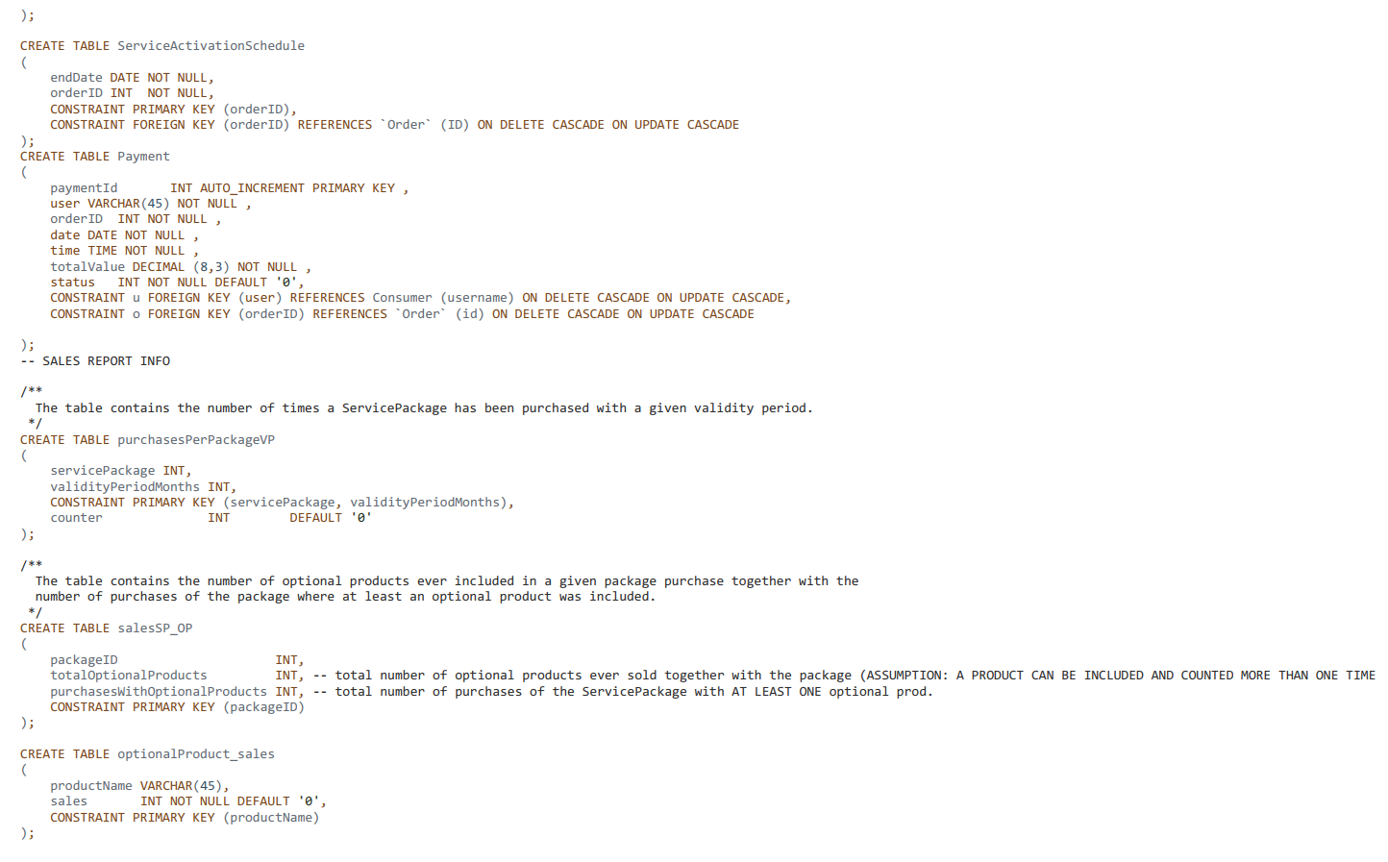

Slide 13
Motivations of the logical design
TelcoUser, Consumer and Employee
We introduced three tables and we modelled the hierarchical relationship by means of foreign key constraints. The attribute DTYPE is used to support the ORM (as we will show later).
Service and children entity sets
The modelling strategy is the same as TelcoUser, Consumer and Employee.
ValidityPeriod
We have introduced a separate table with only three possible values for the attribute months (12, 24 and 36 as remarked into the specification) by means of a SQL constraint.
ServiceActivationSchedule
This entity only includes the endDate attribute related to the service subscription to whom it is associated. The other attributes depend on the related order.
ServicePackage
We assumed that there cannot be two different ServicePackages with the same name (UNIQUE CONSTRAINT).

Slide 14
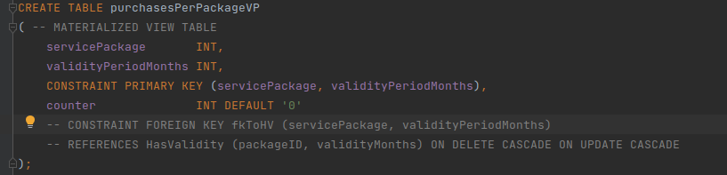
Motivations of the logical design
Considerations on consistency
A foreign key constraint
would have been appropriate to grant a better consistency level as far as the PurchasesPerPackageVP table is concerned but it was deliberately omitted because, given that we chose to use a separate trigger to initialize the tuples of the table above on each new ServicePackage tuple insertion, this would have resulted in a foreign key constraint violation. In fact, at the time in which an insertion of a tuple <SP, VP, 0> is carried out by the trigger the corresponding ServicePackage in the database (transaction has not committed yet).
Similar considerations apply to salesSP_OP and OptionalProduct_sales tables.

Slide 15
Trigger design & code
createServiceActivationSchedule
After an update on the Order table is issued, for each updated row, if the update concerns the status column and its value is set to 2 (order ACCEPTED) then the corresponding ServiceActivationSchedule is created.
updateOrderOnPayment
After an insertion of a tuple into the Payment table, if the status of the payment is rejected (status = 1), then the corresponding order is marked as rejected. Otherwise, the order is marked as accepted (status = 2).
setUserSolvent
After an update on the Order table, for each updated row, if the status switches from REJECTED to ACCEPTED and there are no more REJECTED orders associated with the related consumer, then an update on the Consumer table is issued to mark the user as SOLVENT.
createAlertOnThirdFailedPayment
After an insertion on the payment table, for each inserted tuple, if the status attribute of the inserted tuple is equal to 1 (payment REJECTED) and there are exactly three failed payments associated with the user related to the new inserted tuple then, if there is no alert associated with the given user, a new one is created.

Slide 16
Trigger design & code
markUserInsolventAfterFailedPayment
For each row inserted into the payment table, if the value of the status attribute is 1 (payment rejected) then the associated user is marked as insolvent (whatever his previous status was).
onServicePackageInsertion
After an insertion on the table service package, for each inserted tuple, an insertion into the salesSP_OP table is issued so that the counters associated with the id of the newly created package are set to 0. Likewise, three insertions on the purchasesPerPackageVP table are executed in order to carry out the counter initialization.
onOptionalProductInsertion
For each newly created OptionalProduct tuple a counter of the sales is initialized to 0 inserting a new tuple into the optionalProduct_sales table.

Slide 17
Trigger design & code
updateSalesSPVP
After an insertion on the table Payment, for each tuple, if the payment is approved an update on purchasesPerPackageVP is issued to increment the value of the sales counter related to the ServicePackage - VaildityPeriod couple associated with the tuple inserted in Payment (through the corresponding Order tuple).
updateSalesSPOP
After an insertion on the table Payment, for each tuple, if the payment is approved and the related order includes at least one optional product then an update on salesSP_OP is issued to increment the value of the sales with optional products counter corresponding to the ServicePackage associated with the tuple inserted in Payment (through the corresponding Order tuple) . The total number of optional products ever sold with the given service package is incremented as well. Moreover, a stored procedure is called to align the content of the optionalProduct_sales table. More specifically, for each optional product associated with the accepted order, the counter of the sales of the product is incremented by one.

Slide 18
Trigger design motivation
Given that we used the DBMS MariaDB/MySQL, STATEMENT-level triggers where not available. So, every trigger is designed to work on row granularity. Moreover, all triggers fire AFTER the described events because, according to our design choices, there has been no need to introduce before triggers to manipulate modifications made to the database. Possibly, BEFORE triggers could have been included to grant a better consistency level. For instance, an additional trigger could be used to prevent an Employee from associating two Service entities of the same type (eg. two different MobileInternetService) with the same ServicePackage.

Slide 19
Trigger design motivation
As far triggering cycle is concerned, the triggers which fire on the insertion of ServicePackage and OptionalProduct tuples do not activate other tirggers as they only manage tuples initialization in the managed sales report tables. The same holds true for triggers which fire as soon as an ACCEPTED Payment is inserted into the database and manipulate the statistics to keep track of bought optional products and service packages sales. The triggers mantaining the status of orders, instead, can cause other trigger to fire. For instance, in one case updateOrderOnPayment sets the status of the Order associated with each inserted ACCEPTED Payment to ACCEPTED (status = 2) and this activates createServiceActivationSchedule and the trigger setUserSolvent. In the other case, the insertion of a REJECTED Payment causes the former trigger to activate setUserInsolvent because this latter fires whenever an Order is marked as rejected. Moreover, a failed payment causes the firing of createAlertOnThirdFailedPayment too because on three failed purchases an alert has to be created. Given that all the triggers activated in sequence do not call each other (neither directly nor indirectly), the absence of (mutually ) recursive calls is enough to conclude triggers termination.

Slide 20
ORM design

Slide 21
Relationship Auditing - Consumer
responsibility
A → B … describe ORM here
The relationship is marked by means of a @OneToOne tag
B → A … describe ORM here
Auditing
Consumer
1:1
0:1
A
*
B
1
A
B

Slide 22
Relationship Consumer - Order
responsibility
A → B … describe ORM here
The relationship is marked by means of a @OneToOne tag
B → A … describe ORM here
Order
Consumer
1:1
0:n
A
*
B
1
A
B

Slide 23
Relationship ServiceActivationSchedule - Order
responsibility
A → B … describe ORM here
The relationship is marked by means of a @OneToOne tag
B → A … describe ORM here
SAS
Order
1:1
0:1
A
*
B
1
A
B

Slide 24
Relationship Order - ValidityPeriod
responsibility
A → B … describe ORM here
The relationship is marked by means of a @OneToOne tag
B → A … describe ORM here
Order
ValidityPeriod
1:1
0:n
A
*
B
1
A
B

Slide 25
Relationship Order - ServicePackage
responsibility
A → B … describe ORM here
The relationship is marked by means of a @OneToOne tag
B → A … describe ORM here
Order
SP
1:1
1:n
A
*
B
1
A
B

Slide 26
Relationship Order - Payment
responsibility
A → B … describe ORM here
The relationship is marked by means of a @OneToOne tag
B → A … describe ORM here
Order
Payment
0:n
1:1
A
*
B
1
A
B

Slide 27
Relationship Consumer - Payment
responsibility
A → B … describe ORM here
The relationship is marked by means of a @OneToOne tag
B → A … describe ORM here
Consumer
Payment
0:n
1:1
A
*
B
1
A
B

Slide 28
Relationship Order - OptionalProduct
responsibility
A → B … describe ORM here
The relationship is marked by means of a @OneToOne tag
B → A … describe ORM here
Order
OP
0:n
0:n
A
*
B
1
A
B

Slide 29
Relationship ServicePackage - OptionalProduct
responsibility
A → B … describe ORM here
The relationship is marked by means of a @OneToOne tag
B → A … describe ORM here
SP
OP
1:n
0:n
A
*
B
1
A
B

Slide 30
Relationship ServicePackage - ValidityPeriod
responsibility
A → B … describe ORM here
The relationship is marked by means of a @OneToOne tag
B → A … describe ORM here
SP
ValidityPeriod
1:n
1:n
monthlyFee
A
*
B
1
A
B

Slide 31
Relationship ServicePackage - Service
responsibility
A → B … describe ORM here
The relationship is marked by means of a @OneToOne tag
B → A … describe ORM here
SP
Service
1:n
0:n
A
*
B
1
A
B

Slide 32
ORM design motivations
If there are aspects of the ORM that you want to illustrate or motivate, write your explanations after each relationship ORM design slide or at the end of the ORM design section

Slide 33
Entity TelcoUser
package entities;
import java.io.Serializable;
import javax.persistence.*;
@NamedQuery(name = "TelcoUser.checkCredentials",
query = "SELECT t "
+ "FROM TelcoUser t "
+ "WHERE t.username = :username and t.password = :password")
@Entity
@Table (name ="TelcoUser", schema = "telcoServiceDB")
@Inheritance (strategy = InheritanceType.JOINED)
@DiscriminatorColumn(name = "DTYPE") //defaults to a String
public class TelcoUser implements Serializable {
private static final long serialVersionUID = 1L;
@Id
private String username;
private String email;
private String password;
//constructor, getter and setter
}

Slide 34
Entity Consumer
package entities;
import javax.persistence.DiscriminatorValue;
import javax.persistence.Entity;
import javax.persistence.EnumType;
import javax.persistence.Enumerated;
import javax.persistence.NamedQueries;
import javax.persistence.NamedQuery;
import javax.persistence.Table;
@NamedQueries({
@NamedQuery(name = "Consumer.checkCredentials", query = "SELECT c FROM Consumer c WHERE c.username = :username and c.password = :password"),
@NamedQuery(name = "Consumer.findUserByStatus", query = "SELECT c FROM Consumer c WHERE c.status = :status")
})
@Entity
@Table (name = "Consumer", schema = "telcoServiceDB")
@DiscriminatorValue("CONS")
public class Consumer extends TelcoUser{
private static final long serialVersionUID = 1L;
@Enumerated(EnumType.ORDINAL)
private UserStatus status = UserStatus.SOLVENT;
//constructor, getter and setter
}

Slide 35
Entity Employee
package entities;
import javax.persistence.*;
@NamedQuery(name = "Employee.checkCredentials",
query = "SELECT e FROM Employee e WHERE e.username = ?1 and e.password = ?2")
@Entity
@Table (name = "Employee", schema = "telcoServiceDB")
@DiscriminatorValue("EMP")
public class Employee extends TelcoUser {
private static final long serialVersionUID = 1L;
}
//constructor, getter and setter
}

Slide 36
Entity Auditing
package entities;
import java.util.Date;
import javax.persistence.Entity;
import javax.persistence.Id;
import javax.persistence.NamedQueries;
import javax.persistence.NamedQuery;
import javax.persistence.OneToOne;
import javax.persistence.PrimaryKeyJoinColumn;
import javax.persistence.Table;
import javax.persistence.Temporal;
import javax.persistence.TemporalType;
@NamedQueries({
@NamedQuery (name = "Auditing.findAll", query = "SELECT a FROM Auditing A")
})
@Entity
@Table (name = "Auditing", schema = "telcoServiceDB")
public class Auditing {
@Id
private String username;
private String email;
private double value ;
@Temporal (value = TemporalType.TIME)
private Date time;
@OneToOne @PrimaryKeyJoinColumn (name = "username")
private Consumer insolventConsumer;
//constructor, getter and setter
}

Slide 37
Entity FixedInternetService
package entities;
import javax.persistence.*;
@Entity
@DiscriminatorValue("FIS")
@Table (name = "FixedInternetService", schema = "telcoServiceDB")
public class FixedInternetService extends Service{
private static final long serialVersionUID = 1L;
private int gigabytes;
private double fee;
//constructor, getter and setter
}

Slide 38
Entity FixedPhoneService
package entities;
import javax.persistence.DiscriminatorValue;
import javax.persistence.Entity;
import javax.persistence.Table;
@Entity
@DiscriminatorValue ("FPS")
@Table (name = "FixedPhoneService", schema = "telcoServiceDB")
public class FixedPhoneService extends Service{
private static final long serialVersionUID = 1L;
//constructor, getter and setter
}

Slide 39
Entity MobileInternetService
package entities;
import javax.persistence.*;
@Entity
@DiscriminatorValue ("MIS")
@Table(name ="MobileInternetService", schema="telcoServiceDB")
public class MobileInternetService extends Service {
private static final long serialVersionUID = 1L;
private int gigabytes;
private double fee;
//constructor, getter and setter
}

Slide 40
Entity MobilePhoneService
package entities;
import javax.persistence.*;
@Entity
@DiscriminatorValue ("MPS")
@Table(name = "MobilePhoneService", schema="telcoServiceDB")
public class MobilePhoneService extends Service{
private static final long serialVersionUID = 1L;
private int minutes;
private double extraMinutesFee;
private int SMSs;
private double extraSMSsFee;
//constructor, getter and setter
}

Slide 41
Entity OptionalProduct_sales
package entities;
import java.io.Serializable;
import javax.persistence.Entity;
import javax.persistence.Id;
import javax.persistence.NamedQueries;
import javax.persistence.NamedQuery;
import javax.persistence.Table;
@NamedQueries({
@NamedQuery (name="OptionalProduct_sales.findBestSeller", // there //could be more than one best seller
query = "SELECT S"
+ " FROM OptionalProduct_sales S "
+ "ORDER BY S.sales DESC")
})
@Entity
@Table (name="optionalProduct_sales" , schema = "telcoServiceDB")
public class OptionalProduct_sales implements Serializable{
private static final long serialVersionUID = 1L;
@Id
private String productName;
private int sales ;
//constructor, getter and setter
}

Slide 42
Entity OptionalProduct
package entities;
import javax.persistence.Entity;
import javax.persistence.Id;
import javax.persistence.NamedQueries;
import javax.persistence.NamedQuery;
import javax.persistence.Table;
/**
*The class models the entity OptionalProduct.
*The entity set (ER MODEL) has a ManyToMany relationship with ServicePackage *but this side (OP -> PS)
*doesn't need to be mapped. The same holds true for the ManyToMany *relationship with Order.
*/
@Entity
@NamedQueries({ @NamedQuery (name = "OptionalProduct.findAll", query = "SELECT ops FROM OptionalProduct ops")})
@Table(name = "OptionalProduct", schema="telcoServiceDB")
public class OptionalProduct {
@Id
private String name;
private double fee;
//constructor, getter and setter

Slide 43
Entity Order
package entities;
import java.io.Serializable;
import java.util.Calendar;
import java.util.Collection;
import java.util.Date;
import javax.persistence.*;
@NamedQueries (
{@NamedQuery (name = "Order.findOrdersByUserAndStatus",
query = "SELECT o FROM Order o WHERE o.consumer = :consumer and o.status = :status"),
@NamedQuery (name= "Order.findOrdersByStatus", query = "SELECT o FROM Order o WHERE o.status=:status")})
@Entity
@Table (name = "Order", schema = "telcoServiceDB")
public class Order implements Serializable{
private static final long serialVersionUID = 1L;
@Id
@GeneratedValue(strategy= GenerationType.IDENTITY)
private int id;
@Temporal (TemporalType.TIME)
private Date time;
@Temporal(TemporalType.DATE)
private Calendar date;
private double totalValue;
@Temporal (TemporalType.DATE)
private Calendar startingDate;
@Enumerated(EnumType.ORDINAL)
private OrderStatus status = OrderStatus.NEWLY_CREATED; //DEFAULT NEWLY-CREATED -> SPECIFY ?
//Order is the owner of the MANY-TO-ONE relation between Order and Consumer
@ManyToOne @JoinColumn (name="consUsername")
private Consumer consumer;
@ManyToOne (fetch=FetchType.LAZY) //because whenever a package is fetched its associated services are fetched as well
@JoinColumn(name="packageID")
private ServicePackage servicePackage;
@ManyToOne (fetch = FetchType.EAGER) @JoinColumn(name="vpMonths")
private ValidityPeriod validityPeriod;
@OneToOne (mappedBy = "order")
private ServiceActivationSchedule serviceActivationSchedule ;
@ManyToMany (fetch = FetchType.LAZY) //check
@JoinTable (name="Includes", joinColumns =
@JoinColumn(name = "orderID"),
inverseJoinColumns = @JoinColumn(name = "productName"), schema ="telcoServiceDB")
private Collection<OptionalProduct> includedOptionalProducts;
//constructor, getter and setter
}

Slide 44
Entity Payment
package entities;
import java.util.*;
import javax.persistence.Entity;
import javax.persistence.EnumType;
import javax.persistence.Enumerated;
import javax.persistence.Id;
import javax.persistence.JoinColumn;
import javax.persistence.OneToOne;
import javax.persistence.Table;
@Entity
@Table (name ="Payment", schema = "telcoServiceDB")
public class Payment {
@Id
private int paymentId;
@OneToOne @JoinColumn (name = "user")
private Consumer user;
@OneToOne @JoinColumn (name = "orderID")
private Order order;
@Enumerated(EnumType.ORDINAL)
private PaymentStatus status ;
private Calendar date;
private Date time;
private double totalValue ;
//constructor, getter and setter
}

Slide 45
Entity PurchasesPackageValidity
package entities;
import java.io.Serializable;
import javax.persistence.EmbeddedId;
import javax.persistence.Entity;
import javax.persistence.NamedQueries;
import javax.persistence.NamedQuery;
import javax.persistence.Table;
import entities.embeddable.PackageVPKEY;
@NamedQueries({
@NamedQuery (name="PurchasesPackageValidityPeriod.findAll", query = "SELECT p FROM PurchasesPackageValidityPeriod p"),
@NamedQuery (name="PurchasesPackageValidityPeriod.purchasesSP",
query = "SELECT p.key.servicePackage, sum(p.counter) FROM PurchasesPackageValidityPeriod p GROUP BY p.key.servicePackage"),
@NamedQuery (name = "PurchasesPackageValidityPeriod.purchasesNoOptionalProducts",
query = "SELECT p.key.servicePackage, sum(p.counter)- (S.purchasesWithOptionalProducts) "
+ "FROM PurchasesPackageValidityPeriod p, SalesSP_OP S "
+ "WHERE p.key.servicePackage = S.packageID "
+ "GROUP BY p.key.servicePackage")
})
@Entity
@Table(name = "purchasesPerPackageVP", schema = "telcoServiceDB")
public class PurchasesPackageValidityPeriod implements Serializable{
private static final long serialVersionUID = 1L;
@EmbeddedId
private PackageVPKEY key;
private int counter;
//constructor, getter and setter
}

Slide 46
Entity SalesSP_OP
package entities;
import java.io.Serializable;
import javax.persistence.Entity;
import javax.persistence.Id;
import javax.persistence.NamedQueries;
import javax.persistence.NamedQuery;
import javax.persistence.Table;
@NamedQueries({
@NamedQuery (name="SalesSP_OP.purchasesOptionalProducts",
query = "SELECT S.packageID,S.purchasesWithOptionalProducts "
+ " FROM SalesSP_OP S ")
})
@Entity
@Table(name = "salesSP_OP", schema = "telcoServiceDB")
public class SalesSP_OP implements Serializable {
private static final long serialVersionUID = 1L;
@Id
private int packageID;
private int totalOptionalProducts;
//constructor, getter and setter
}

Slide 47
Entity ServiceActivationSchedule
package entities;
import java.io.Serializable;
import java.util.Calendar;
import javax.persistence.*;
/**
* Class which models a ServiceActivationSchedule. It is of no use for the *application except for
* demo and debugging purposes.
*/
@NamedQueries(
{@NamedQuery(name = "ServiceActivationSchedule.findAll",
query = "Select s from ServiceActivationSchedule s")}
)
@Entity
@Table(name = "ServiceActivationSchedule" ,schema="telcoServiceDB")
public class ServiceActivationSchedule implements Serializable{
private static final long serialVersionUID = 1L;
@Id
private int orderID;
@Temporal(value = TemporalType.DATE)
private Calendar endDate;
@OneToOne @PrimaryKeyJoinColumn(name="orderID")
private Order order ;
//constructor, getter and setter
}

Slide 48
Entity ServicePackage
package entities;
import javax.persistence.*;
import java.io.Serializable;
import java.util.*;
/**
* Class which models a ServicePackge
*/
@Entity
@NamedQueries({ @NamedQuery (name = "ServicePackage.findAll",
query = "SELECT s FROM ServicePackage s")})
@Table (name = "ServicePackage", schema = "telcoServiceDB")
public class ServicePackage implements Serializable {
private static final long serialVersionUID = 1L;
@Id @GeneratedValue (strategy = GenerationType.IDENTITY)
private int id;
private String name;
@ManyToMany (fetch = FetchType.EAGER )
@JoinTable (name="SPS", joinColumns =
@JoinColumn(name = "packageID"), //owner
inverseJoinColumns = @JoinColumn(name = "serviceID"), schema ="telcoServiceDB") //service //FATHER entity
private List<Service> services ;
/*
* Fetch type is LAZY because optional products that could be associated with a given product
* are retrieved only when the user explicitly asks.
*/
@ManyToMany (fetch = FetchType.LAZY)
@JoinTable (name="Offers", joinColumns =
@JoinColumn(name = "packageID"), //packageID is the owner of the relation according to this //choice (no natural owner).
inverseJoinColumns = @JoinColumn(name = "productName"),schema ="telcoServiceDB")
private List<OptionalProduct> optionalProducts;
@ElementCollection (fetch = FetchType.EAGER) //entity key element collection (no cascading, inverse and orphan //removal)
@CollectionTable (name = "HasValidity",
joinColumns = @JoinColumn(name = "packageID"), schema = "telcoServiceDB")
@MapKeyJoinColumn (name = "validityMonths")
@Column (name = "monthlyFee")
private Map<ValidityPeriod, Double> costs;
//constructor, getter and setter
}

Slide 49
Entity ValidityPeriod
package entities;
import java.io.Serializable;
import javax.persistence.Entity;
import javax.persistence.Id;
import javax.persistence.Table;
@Entity
@Table(name = "ValidityPeriod", schema="telcoServiceDB")
public class ValidityPeriod implements Serializable {
private static final long serialVersionUID = 1L;
/*
*MANYTOONE side of relationship between ValidityPeriod and ServicePackage can *be omitted because
*no access from a given validityPeriod to its associated ServicePackages is *done in the application.
*/
@Id
private int months;
public ValidityPeriod() {
}
//constructor, getter and setter
}

Slide 50
Functional analysis of the interaction
Describe the interaction diagrams of the application using any graphical notation (e.g., IFML or similar --- www.ifmledit.org) or a textual notation (see next slides)

Slide 51
Example of diagram
PAGE
PAGE COMPONENT
NAVIGATION
EVENT
ACTION
LOGIN PAGE
username, password
Login form [field: username
field: password]
Check Login
GoToHome
submit
user -> session
missions
wrong user + pswd
HOME

Slide 52
Example of textual notation
A Web application allows the management of travel expenses. After logging in, the user accesses a HOME page where there is a list of travel missions; a mission belongs to a user and has a date, a place, a description, a number of days of duration, and a status ("open", "finalized", "closed"). The list shows the date and place of the missions, which are sorted by date in descending order. On the HOME page there is a form, with which the user can create a new mission, by entering all the data, which are mandatory. A new mission is always in the "open" state. After creating a mission, one is returned to the HOME page. When the user selects a mission in the list, a DETAIL_MISSION page appears, showing all the mission data. If the mission is in the "open" state, a form appears for entering the expenses incurred during the mission; the form contains three fields: food costs, accommodation costs, transport costs. Sending the form data causes the mission status to change from "open " to “finalized ", and the return to the DETAIL_MISSION page. If the mission is in the "finalized“ status, a "close“ button appears which the user can click to report that he has received the reimbursement of expenses; this causes the mission status to change from "finalized" to "closed" and the return to the DETAIL_MISSION page. If the mission is in the "closed" status, the DETAIL_MISSION page shows mission data also the value of the three types of expenditure.
Pages (views), view components, events, actions

Slide 53
Components
Client components
Servlets
Views
Java Beans
Back end components
Entities
Entity1
Entity2
Business Components (EJBs)
BC1
(stateless or stateful)
Method BC11( params)
Method BC11( params)
BC2
(stateless or stateful)
Method BC21( params)
Method BC22( params)

Slide 54
Motivations of the components design
If there are aspects of the components design that you want to illustrate or motivate, write here your explanations

Slide 55
UML sequence diagrams
Only if needed to illustrate some relevant component interaction
CheckLogin
UserDAO
index.html
Session
GoToHome
new UserDAO (user, pass)
doPOST
checkCredentials()
user || null
POST
/CheckLogin
username
password
From: index.html
[user == null ] redirect
[user != null ] setAttribute ("user", user)
[user != null ] redirect
See slide “go to home”

