Slide 1

VuFind in the context of GLAM
Approaches in Linked Data
Julia Beck | j.beck@ub.uni-frankfurt.de | @j4lib
VuFind Summit 2020 Lightning Talk – 2020/10/01

Slide 2
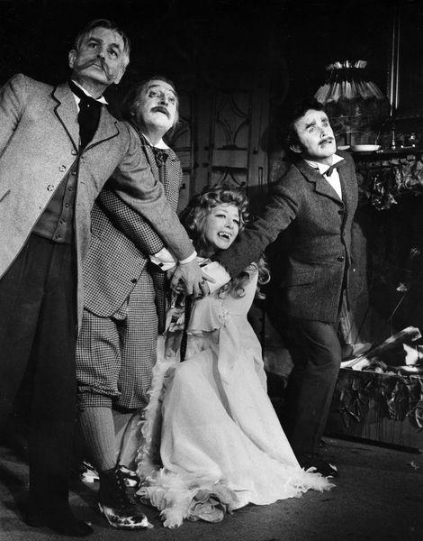
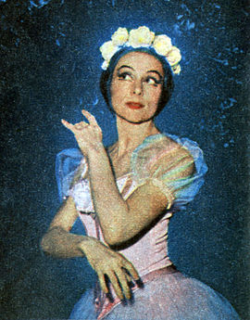
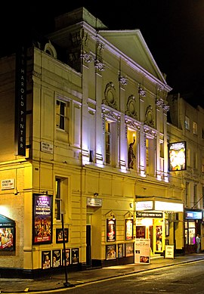
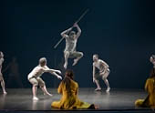
Specialized Information Service
Performing Arts
https://www.performing-arts.eu
Aggregates metadata from GLAM institutions from the performing arts domain (at the moment especially German-speaking institutions
~800.000
Objects
(Playbills, Photos, Scene models,
Videos, …)
~60.000
Persons
(Actors, Dancers, Directors, ...)
~6.000
Organizations
(Ensembles,
Institutions,
Groups, …)
~80.000
Events
(Festivals,
Performances,
Conferences, …)

Slide 3
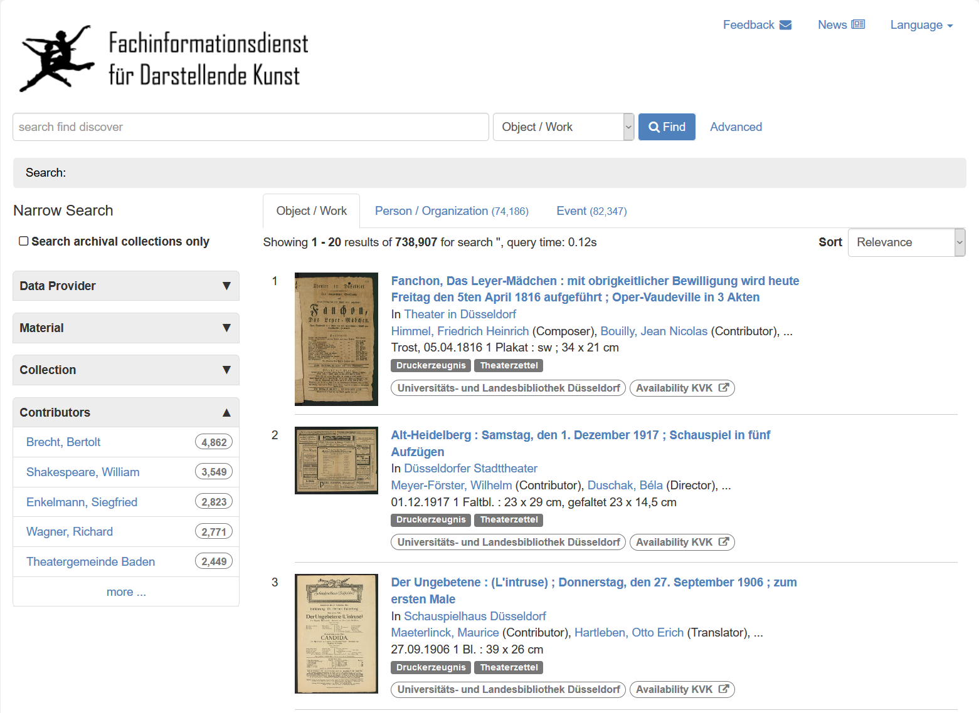
Search Tabs
Objects / Agents /
Events

Slide 4
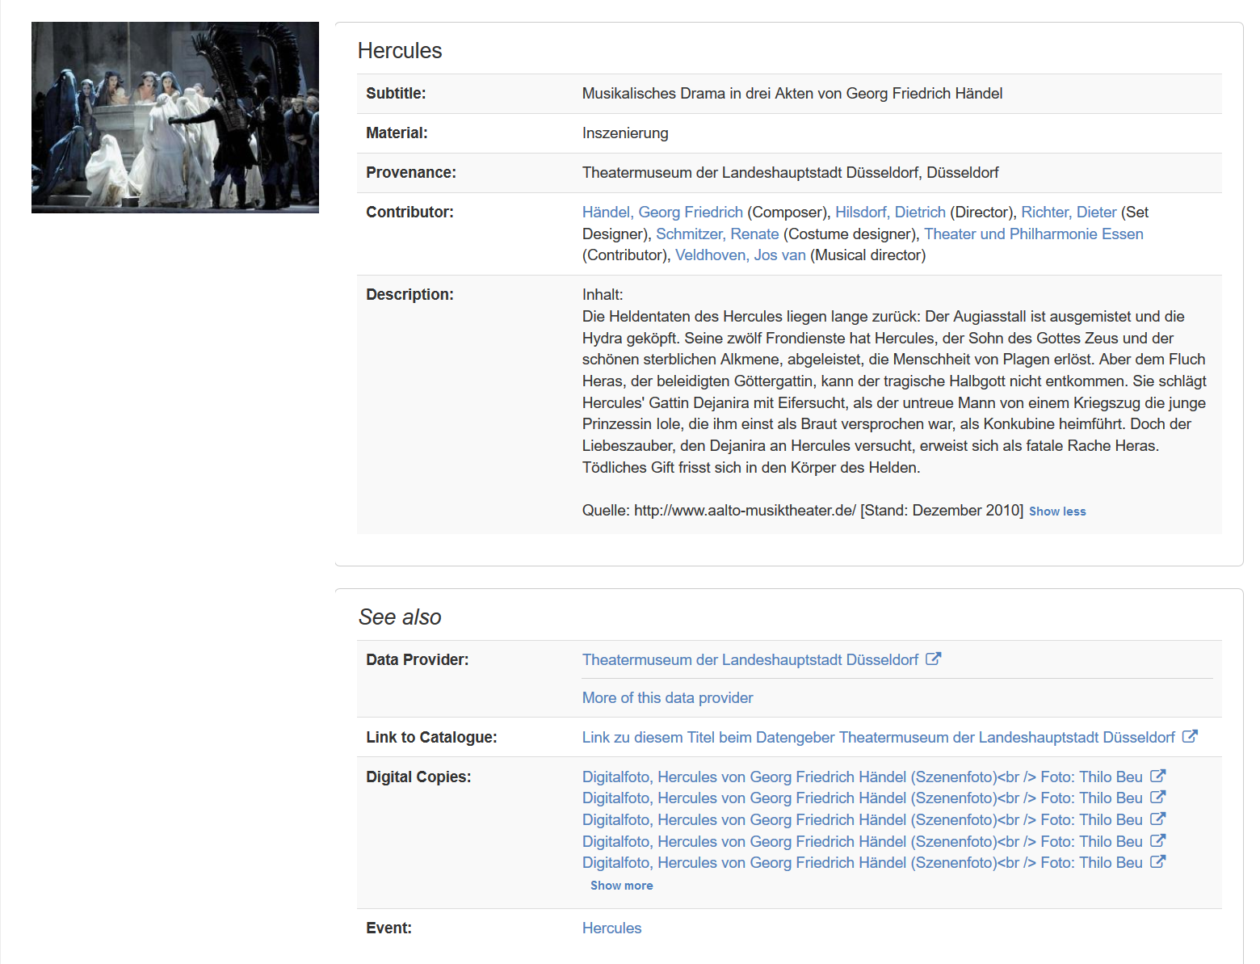
Links to
authority data
Links to
other digital
copies

Slide 5
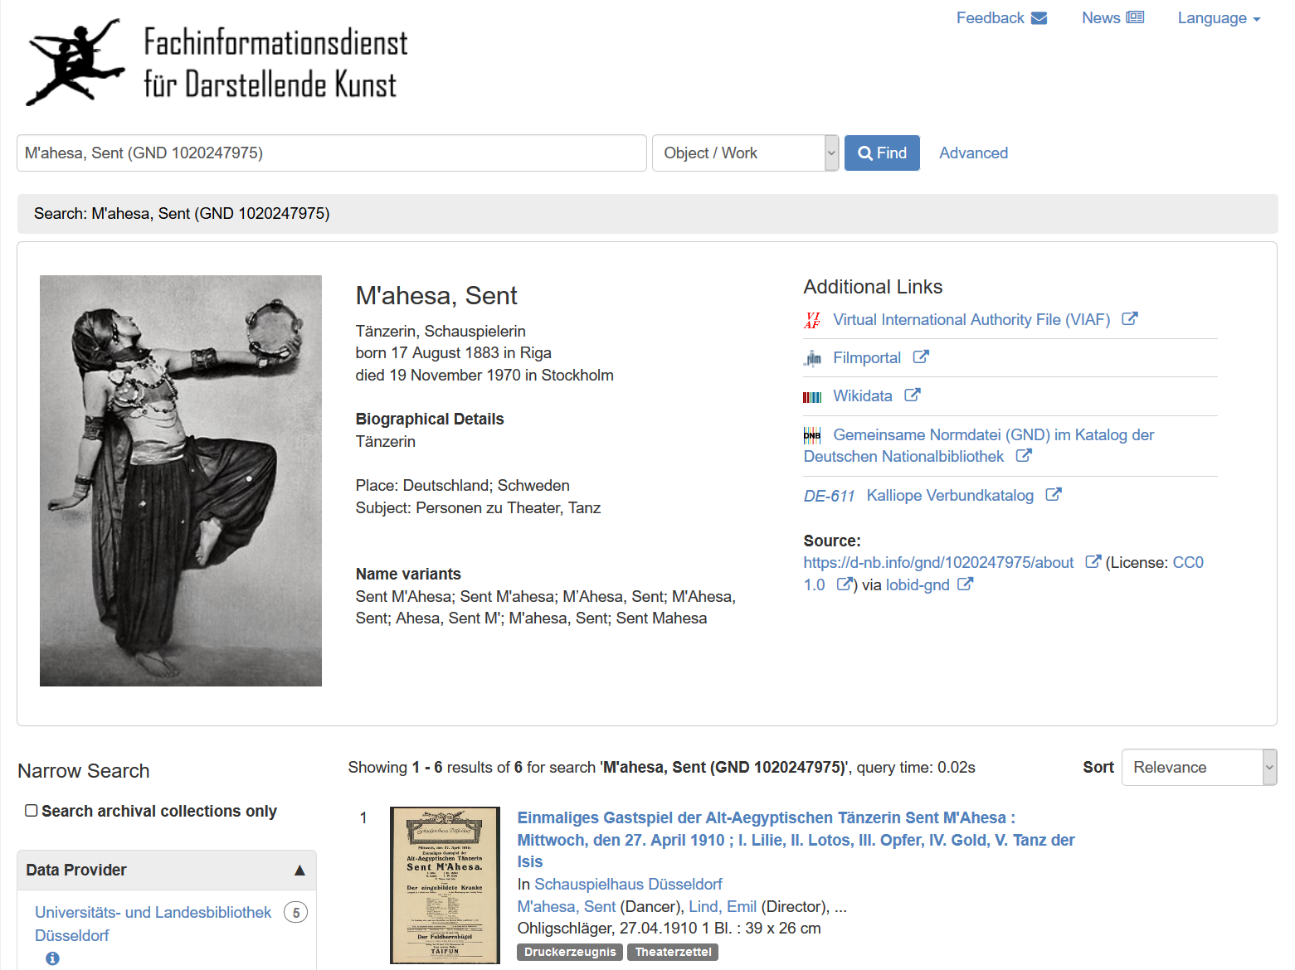
Linked Data on-the-fly: Fact Sheets for authority data

Slide 6
Changes to VuFind (Part I)
Data Model
Incoming data formated as XML (PICA, METS/MODS, EAD, MARC21, LIDO, …) or CSV / SQL / JSON (Individual Standards)
MARC was no option → Europeana Data Model (EDM)
Mappings to EDM XML “outside“ of VuFind → but we are re-using VuFind‘s Solr Schema and the Default Solr Record which allows us to use most VuFind functionalities out of the box without using MARC
fullrecord field in Solr contains EDM record → used for export and rendering “special“ fields

Slide 7
Changes to VuFind (Part II)
Changes to index and portal
Storing ids for linking agents and events
Heavy use of VuFind‘s authority core and offering search tabs for agent and event search
Using lobid API for on-the-fly “fact sheets“ about agents and events with German Authority File Number (GND) → this only works with „rich“ data with authority identifiers

Slide 8
No triple store involved but still trying to approach linked data
Code is available on github (https://github.com/ubffm/vufind)
TODO: Upgrade to VuFind 7 (currently Version 5.1)
TODO: Pull request! At least on the lobid connection

