Slide 1
Search Revenue Analysis
Automated, scalable processing of web sales and search data

Slide 2
Agenda
Business Problem
High‑Level Architecture
Architecture Walkthrough
Code Repo & Deployment
Scalability
Improvements/Open Items
Additional Documentation

Slide 3
Business Problem
External web search and sales data is received as raw files
Manual analysis does not scale and delays insights
Business needs automated processing to derive value from data
Key Business Questions
Which keywords are searched most frequently?
Which searches convert into product sales and revenue?
Which products are searched but not available or not visible?
Which keywords generate interest but do not result in a sale?
Solution
A serverless, event-driven data ingestion framework that automatically processes raw files, orchestrates workflows to process and produce curated datasets and metadata for analytics.
Notes:
Outstanding Questions :
What is the expected turn around time for the end data to be available?
Based on this, continues streaming or batch architecture
Expected to schedule or trigger based on the event the file is sent to s3 bucket
2. Access to the file data - control who can read the data
3. Would they be interested in the people who have searched but did not find the product? -- Example from the file
4. Data file – ipod touch & ipod nano – shown differently → differentiation as per Product Categories?

Slide 4
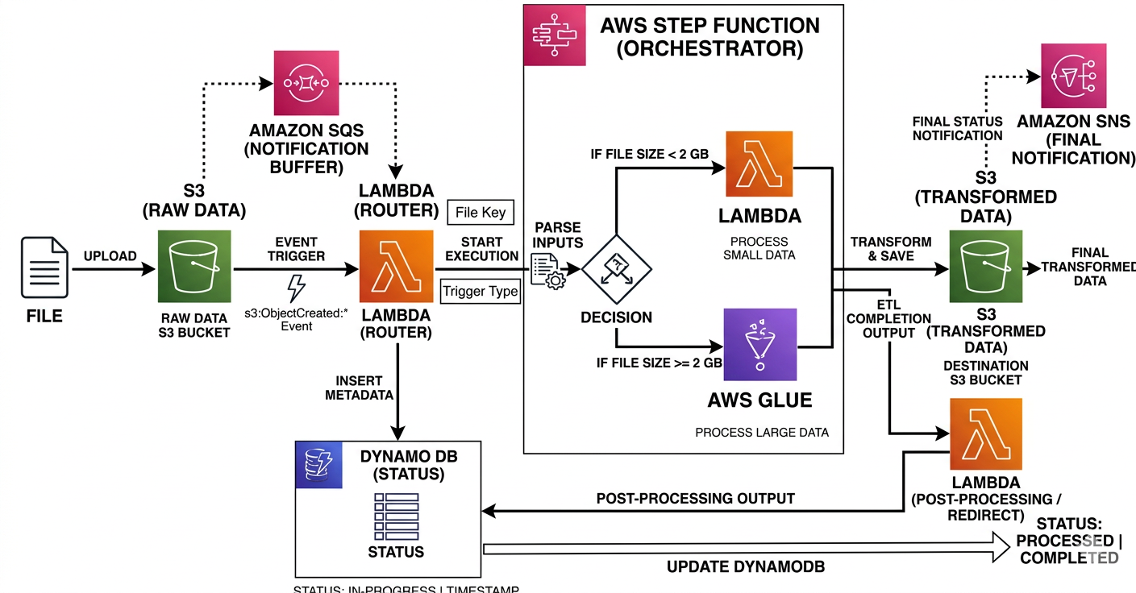
High‑Level Architecture
Legend:
Dotted – Future addons
Solid - Existing
Notes:
SQS for buffering incoming events
SNS for downstream notifications
S3 lifecycle policies and Parquet storage format

Slide 5
Architecture Walkthrough
Component | Service | Usage
Data Ingestion & Storage | AWS – S3 | Raw sales/search files are uploaded to S3
Event Trigger | AWS - Lambda | S3 event triggers Lambda to initiate processing
Orchestration | AWS – Step Function | Controls workflow, retries, and branching logic
Data Processing | AWS – Lambda/Glue | Glue for large‑scale transformations Lambda for lightweight processing
Logging & Monitoring | AWS – Cloud Watch | For run logs, metrics, alarms
Metadata Store | AWS – Dynamo DB | Fast access to load status
Programming Language | Python/Pyspark | For Lambda/Glue
Code Repository & Deployment | GitHub | Periodic code maintenance
Notes:
AWS : Amazon Web Services

Slide 6
Code Repo & Deployment
GitHub – for code maintenance & deployment
Source Control & Deployment Strategy
GitHub used for code versioning and collaboration
Infrastructure deployed using CloudFormation templates
Components include:
IAM Roles
Lambda Functions
Glue Jobs
Step Functions
Branching Strategy
Environment‑based branches: Dev / UAT / Prod
Feature‑specific branches
Code merged to main branch only after review
Link: https://github.com/ubharathv/prdsales_repo
Folder Name | Usage
Infrastructure | IAM roles & CloudFormation templates
Lambda | Python scripts
Glue | PySpark scripts
StepFunction | Step Function definitions (JSON)

Slide 7
Scalability
AWS Glue with Spark for large datasets
Dynamic Spark configuration based on file size
Streaming Option
Kinesis → Lambda → Step Functions → Glue Streaming → S3 → DynamoDB
Reliability & Monitoring
CloudWatch metrics and alarms
SNS notifications
Lambda retry policies
Dead‑letter queues for failures

Slide 8
Improvements/Open Items
Introduce SQS/SNS for buffering and notifications
Expand DynamoDB metadata model
Support multiple input files using manifest files
Adding a stage layer to store the raw source file copy in parquet format
This will help in maintaining historical source data copies and for reprocessing of data if needed
Handle different file formats (parquet), multiple delimiters (comma, pipe)
Schema validation using Glue Catalog & Crawlers
Data quality checks on output data
Standardize product naming and keywords
Improve logging, tagging, and retention
Create a production runbook
Enable selective component deployment via CI/CD and expand for S3 Bucket, Event and Dynamo DB table creation

Slide 9
Additional Documentation
Project Artifacts:
Testing:

