Slide 1
Chapter 2
Instructions: Language of the Computer
Notes:
The University of Adelaide, School of Computer Science
Chapter 2 — Instructions: Language of the Computer

Slide 2
Instruction Set
§2.1 Introduction
The repertoire of instructions of a computer
Different computers have different instruction sets
  But with many aspects in common
Early computers had very simple instruction sets
  Simplified implementation
Many modern computers also have simple instruction sets
Chapter 2 — Instructions: Language of the Computer — <number>
Notes:
The University of Adelaide, School of Computer Science
Chapter 2 — Instructions: Language of the Computer

Slide 3
The MIPS Instruction Set
Used as the example throughout the book
Stanford MIPS commercialized by MIPS Technologies (www.mips.com)
Large share of embedded core market
  Applications in consumer electronics, network/storage equipment, cameras, printers, …
Typical of many modern ISAs
  See Appendixes B and E
Chapter 2 — Instructions: Language of the Computer — <number>
Notes:
The University of Adelaide, School of Computer Science
Chapter 2 — Instructions: Language of the Computer

Slide 4
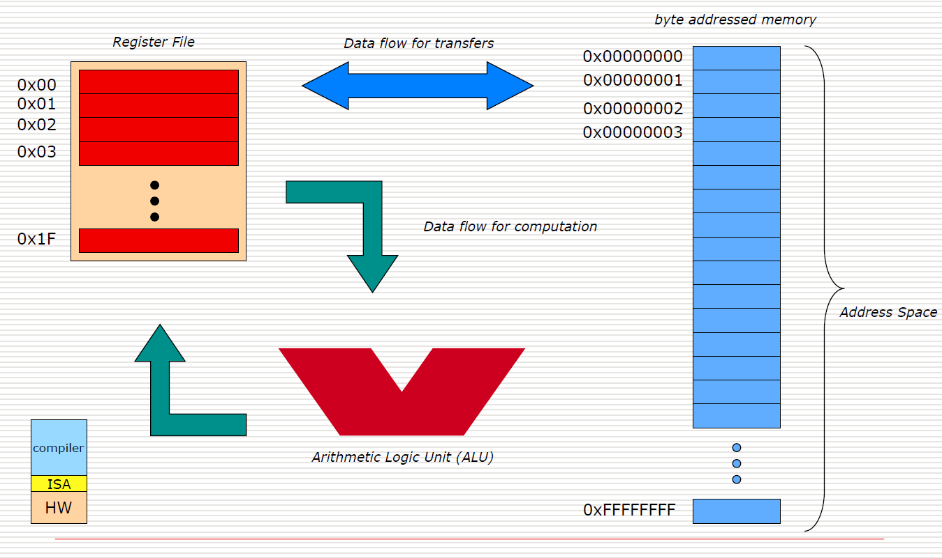
Instruction Set Architecture (ISA)

Slide 5
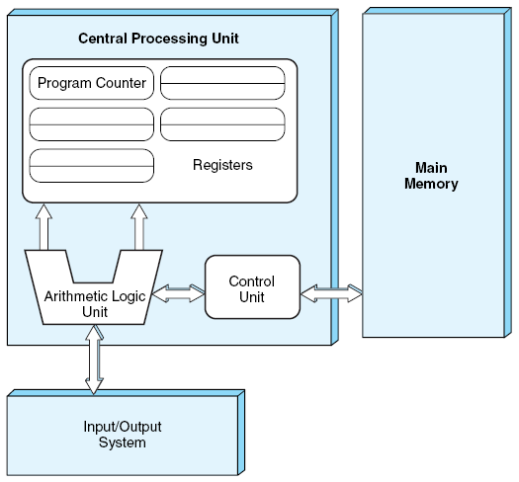
The Von Neumann Model

Slide 6
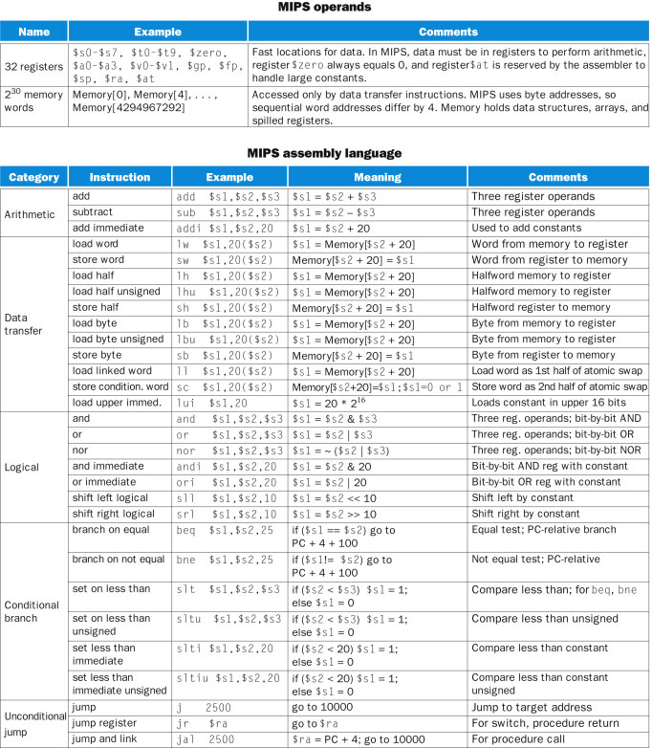

Slide 7
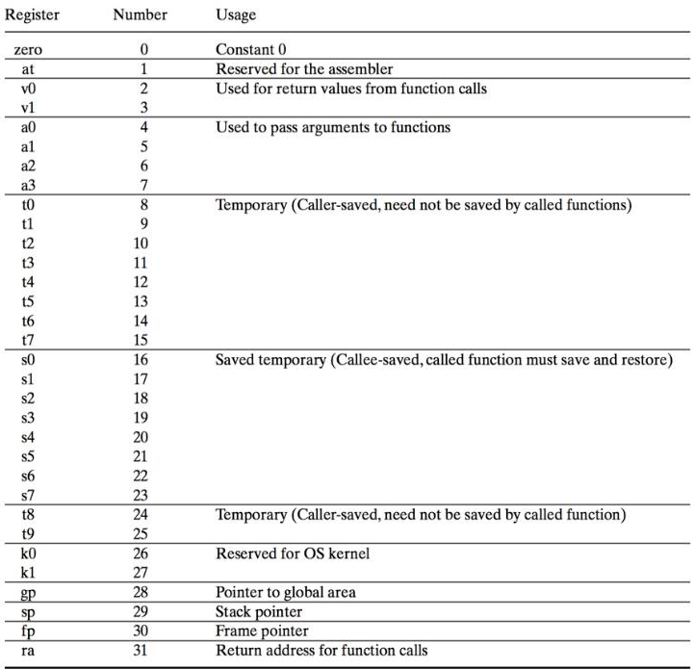

Slide 8
Arithmetic Operations
Add and subtract, three operands
  Two sources and one destination
add a, b, c # a gets b + c
All arithmetic operations have this form
Design Principle 1: Simplicity favours regularity
  Regularity makes implementation simpler
  Simplicity enables higher performance at lower cost
§2.2 Operations of the Computer Hardware
Chapter 2 — Instructions: Language of the Computer — <number>
Notes:
The University of Adelaide, School of Computer Science
Chapter 2 — Instructions: Language of the Computer

Slide 9
Arithmetic Example
C code:
f = (g + h) - (i + j);
Compiled MIPS code:
add t0, g, h # temp t0 = g + h
add t1, i, j # temp t1 = i + j
sub f, t0, t1 # f = t0 - t1
Chapter 2 — Instructions: Language of the Computer — <number>
Notes:
The University of Adelaide, School of Computer Science
Chapter 2 — Instructions: Language of the Computer

Slide 10
Register Operands
Arithmetic instructions use register
operands
MIPS has a 32 × 32-bit register file
  Use for frequently accessed data
  Numbered 0 to 31
  32-bit data called a “word”
Assembler names
  $t0, $t1, …, $t9 for temporary values
  $s0, $s1, …, $s7 for saved variables
Design Principle 2: Smaller is faster
  c.f. main memory: millions of locations
§2.3 Operands of the Computer Hardware
Chapter 2 — Instructions: Language of the Computer — <number>
Notes:
The University of Adelaide, School of Computer Science
Chapter 2 — Instructions: Language of the Computer

Slide 11
Register Operand Example
C code:
f = (g + h) - (i + j);
  f, …, j in $s0, …, $s4
Compiled MIPS code:
add $t0, $s1, $s2
add $t1, $s3, $s4
sub $s0, $t0, $t1
Chapter 2 — Instructions: Language of the Computer — <number>
Notes:
The University of Adelaide, School of Computer Science
Chapter 2 — Instructions: Language of the Computer

Slide 12
Program Template
# Title: Filename:
# Author: Date:
# Description:
# Input:
# Output:
################# Data segment #####################
.data
. . .
################# Code segment #####################
.text
main: # main program entry
. . .
. . .
. . .
Please see the File, “MIPS Quick Tutorial.pdf” more detailed information

Slide 13
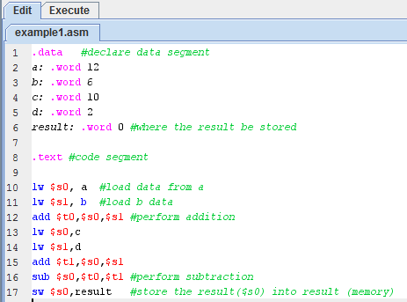
Example

Slide 14
Memory Operands
Main memory used for composite data
  Arrays, structures, dynamic data
To apply arithmetic operations
  Load values from memory into registers
  Store result from register to memory
Memory is byte addressed
  Each address identifies an 8-bit byte
Words are aligned in memory
  Address must be a multiple of 4
MIPS is Big Endian
  Most-significant byte at least address of a word
  c.f. Little Endian: least-significant byte at least address
Chapter 2 — Instructions: Language of the Computer — <number>
Notes:
The University of Adelaide, School of Computer Science
Chapter 2 — Instructions: Language of the Computer

Slide 15
Memory Operand Example 1
C code:
g = h + A[8];
  g in $s1, h in $s2, base address of A in $s3
Compiled MIPS code:
  Index 8 requires offset of 32
    4 bytes per word
lw $t0, 32($s3) # load word
add $s1, $s2, $t0
offset
base register
Chapter 2 — Instructions: Language of the Computer — <number>
Notes:
The University of Adelaide, School of Computer Science
Chapter 2 — Instructions: Language of the Computer

Slide 16
Memory Operand Example 2
C code:
A[12] = h + A[8];
  h in $s2, base address of A in $s3
Compiled MIPS code:
  Index 8 requires offset of 32
lw $t0, 32($s3) # load word
add $t0, $s2, $t0
sw $t0, 48($s3) # store word
Chapter 2 — Instructions: Language of the Computer — <number>
Notes:
The University of Adelaide, School of Computer Science
Chapter 2 — Instructions: Language of the Computer

Slide 17
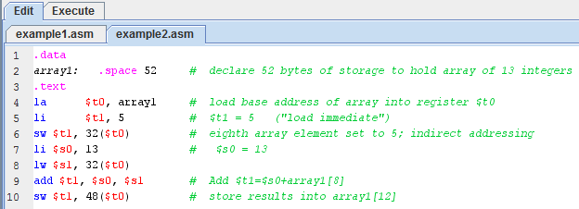
Example2
Chapter 2 — Instructions: Language of the Computer — <number>

Slide 18
Registers vs. Memory
Registers are faster to access than memory
Operating on memory data requires loads and stores
  More instructions to be executed
Compiler must use registers for variables as much as possible
  Only spill to memory for less frequently used variables
  Register optimization is important!
Chapter 2 — Instructions: Language of the Computer — <number>
Notes:
The University of Adelaide, School of Computer Science
Chapter 2 — Instructions: Language of the Computer

Slide 19
Immediate Operands
Constant data specified in an instruction
addi $s3, $s3, 4
No subtract immediate instruction
  Just use a negative constant
  addi $s2, $s1, -1
Design Principle 3: Make the common case fast
  Small constants are common
  Immediate operand avoids a load instruction
Chapter 2 — Instructions: Language of the Computer — <number>
Notes:
The University of Adelaide, School of Computer Science
Chapter 2 — Instructions: Language of the Computer

Slide 20
The Constant Zero
MIPS register 0 ($zero) is the constant 0
  Cannot be overwritten
Useful for common operations
  E.g., move between registers
  add $t2, $s1, $zero
Chapter 2 — Instructions: Language of the Computer — <number>
Notes:
The University of Adelaide, School of Computer Science
Chapter 2 — Instructions: Language of the Computer

Slide 21
Unsigned Binary Integers
Given an n-bit number
§2.4 Signed and Unsigned Numbers
Range: 0 to +2^{n} – 1
Example
  0000 0000 0000 0000 0000 0000 0000 1011₂
  = 0 + … + 1×2³ + 0×2² +1×2¹ +1×2⁰
  = 0 + … + 8 + 0 + 2 + 1 = 11₁₀
Using 32 bits
  0 to +4,294,967,295
Chapter 2 — Instructions: Language of the Computer — <number>
Notes:
The University of Adelaide, School of Computer Science
Chapter 2 — Instructions: Language of the Computer

Slide 22
2s-Complement Signed Integers
Given an n-bit number
Range: –2^{n – 1} to +2^{n – 1} – 1
Example
  1111 1111 1111 1111 1111 1111 1111 1100₂
  = –1×2³¹ + 1×2³⁰ + … + 1×2² +0×2¹ +0×2⁰
  = –2,147,483,648 + 2,147,483,644 = –4₁₀
Using 32 bits
  –2,147,483,648 to +2,147,483,647
Chapter 2 — Instructions: Language of the Computer — <number>
Notes:
The University of Adelaide, School of Computer Science
Chapter 2 — Instructions: Language of the Computer

Slide 23
2s-Complement Signed Integers
Bit 31 is sign bit
  1 for negative numbers
  0 for non-negative numbers
–(–2^{n – 1}) can’t be represented
Non-negative numbers have the same unsigned and 2s-complement representation
Some specific numbers
  0: 0000 0000 … 0000
  –1: 1111 1111 … 1111
  Most-negative: 1000 0000 … 0000
  Most-positive: 0111 1111 … 1111
Chapter 2 — Instructions: Language of the Computer — <number>
Notes:
The University of Adelaide, School of Computer Science
Chapter 2 — Instructions: Language of the Computer

Slide 24

Signed Negation
Complement and add 1
  Complement means 1 → 0, 0 → 1
Example: negate +2
  +2 = 0000 0000 … 0010₂
  –2 = 1111 1111 … 1101₂ + 1
  = 1111 1111 … 1110₂
Chapter 2 — Instructions: Language of the Computer — <number>
Notes:
The University of Adelaide, School of Computer Science
Chapter 2 — Instructions: Language of the Computer

Slide 25
Sign Extension
Representing a number using more bits
  Preserve the numeric value
In MIPS instruction set
  addi: extend immediate value
  lb, lh: extend loaded byte/halfword
  beq, bne: extend the displacement
Replicate the sign bit to the left
  c.f. unsigned values: extend with 0s
Examples: 8-bit to 16-bit
  +2: 0000 0010 => 0000 0000 0000 0010
  –2: 1111 1110 => 1111 1111 1111 1110
Chapter 2 — Instructions: Language of the Computer — <number>
Notes:
The University of Adelaide, School of Computer Science
Chapter 2 — Instructions: Language of the Computer

Slide 26
Representing Instructions
Instructions are encoded in binary
  Called machine code
MIPS instructions
  Encoded as 32-bit instruction words
  Small number of formats encoding operation code (opcode), register numbers, …
  Regularity!
Register numbers
  $t0 – $t7 are reg’s 8 – 15
  $t8 – $t9 are reg’s 24 – 25
  $s0 – $s7 are reg’s 16 – 23
§2.5 Representing Instructions in the Computer
Chapter 2 — Instructions: Language of the Computer — <number>
Notes:
The University of Adelaide, School of Computer Science
Chapter 2 — Instructions: Language of the Computer

Slide 27
MIPS R-format Instructions
op
rs
rt
rd
shamt
funct
6 bits
5 bits
5 bits
5 bits
5 bits
6 bits
Instruction fields
  op: operation code (opcode)
  rs: first source register number
  rt: second source register number
  rd: destination register number
  shamt: shift amount (00000 for now)
  funct: function code (extends opcode)
Chapter 2 — Instructions: Language of the Computer — <number>
Notes:
The University of Adelaide, School of Computer Science
Chapter 2 — Instructions: Language of the Computer

Slide 28
R-format Example
op
rs
rt
rd
shamt
funct
6 bits
5 bits
5 bits
5 bits
5 bits
6 bits
add $t0, $s1, $s2
special
$s1
$s2
$t0
0
add
0
17
18
8
0
32
000000
10001
10010
01000
00000
100000
00000010001100100100000000100000₂ = 02324020₁₆
Chapter 2 — Instructions: Language of the Computer — <number>
Notes:
The University of Adelaide, School of Computer Science
Chapter 2 — Instructions: Language of the Computer

Slide 29
Hexadecimal
Base 16
  Compact representation of bit strings
  4 bits per hex digit
0 | 0000 | 4 | 0100 | 8 | 1000 | c | 1100
1 | 0001 | 5 | 0101 | 9 | 1001 | d | 1101
2 | 0010 | 6 | 0110 | a | 1010 | e | 1110
3 | 0011 | 7 | 0111 | b | 1011 | f | 1111
Example: eca8 6420
  1110 1100 1010 1000 0110 0100 0010 0000
Chapter 2 — Instructions: Language of the Computer — <number>
Notes:
The University of Adelaide, School of Computer Science
Chapter 2 — Instructions: Language of the Computer

Slide 30
MIPS I-format Instructions
op
rs
rt
constant or address
6 bits
5 bits
5 bits
16 bits
Immediate arithmetic and load/store instructions
  rt: destination or source register number
  Constant: –2¹⁵ to +2¹⁵ – 1
  Address: offset added to base address in rs
Design Principle 4: Good design demands good compromises
  Different formats complicate decoding, but allow 32-bit instructions uniformly
  Keep formats as similar as possible
Chapter 2 — Instructions: Language of the Computer — <number>
Notes:
The University of Adelaide, School of Computer Science
Chapter 2 — Instructions: Language of the Computer

Slide 31

Stored Program Computers
The BIG Picture
Instructions represented in binary, just like data
Instructions and data stored in memory
Programs can operate on programs
  e.g., compilers, linkers, …
Binary compatibility allows compiled programs to work on different computers
  Standardized ISAs
Chapter 2 — Instructions: Language of the Computer — <number>
Notes:
The University of Adelaide, School of Computer Science
Chapter 2 — Instructions: Language of the Computer

Slide 32
Logical Operations
Instructions for bitwise manipulation
§2.6 Logical Operations
Operation | C | Java | MIPS
Shift left | << | << | sll
Shift right | >> | >>> | srl
Bitwise AND | & | & | and, andi
Bitwise OR | | | | | or, ori
Bitwise NOT | ~ | ~ | nor
Useful for extracting and inserting groups of bits in a word
Chapter 2 — Instructions: Language of the Computer — <number>
Notes:
The University of Adelaide, School of Computer Science
Chapter 2 — Instructions: Language of the Computer

Slide 33
Shift Operations
op
rs
rt
rd
shamt
funct
6 bits
5 bits
5 bits
5 bits
5 bits
6 bits
shamt: how many positions to shift
Shift left logical
  Shift left and fill with 0 bits
  sll by i bits multiplies by 2^{i}
Shift right logical
  Shift right and fill with 0 bits
  srl by i bits divides by 2^{i} (unsigned only)
Chapter 2 — Instructions: Language of the Computer — <number>
Notes:
The University of Adelaide, School of Computer Science
Chapter 2 — Instructions: Language of the Computer

Slide 34
AND Operations
Useful to mask bits in a word
  Select some bits, clear others to 0
and $t0, $t1, $t2
$t2
0000 0000 0000 0000 0000 1101 1100 0000
$t1
0000 0000 0000 0000 0011 1100 0000 0000
$t0
0000 0000 0000 0000 0000 1100 0000 0000
Chapter 2 — Instructions: Language of the Computer — <number>
Notes:
The University of Adelaide, School of Computer Science
Chapter 2 — Instructions: Language of the Computer

Slide 35
OR Operations
Useful to include bits in a word
  Set some bits to 1, leave others unchanged
or $t0, $t1, $t2
$t2
0000 0000 0000 0000 0000 1101 1100 0000
$t1
0000 0000 0000 0000 0011 1100 0000 0000
$t0
0000 0000 0000 0000 0011 1101 1100 0000
Chapter 2 — Instructions: Language of the Computer — <number>
Notes:
The University of Adelaide, School of Computer Science
Chapter 2 — Instructions: Language of the Computer

Slide 36
NOT Operations
Useful to invert bits in a word
  Change 0 to 1, and 1 to 0
MIPS has NOR 3-operand instruction
  a NOR b == NOT ( a OR b )
nor $t0, $t1, $zero
Register 0: always read as zero
$t1
0000 0000 0000 0000 0011 1100 0000 0000
$t0
1111 1111 1111 1111 1100 0011 1111 1111
Chapter 2 — Instructions: Language of the Computer — <number>
Notes:
The University of Adelaide, School of Computer Science
Chapter 2 — Instructions: Language of the Computer

Slide 37
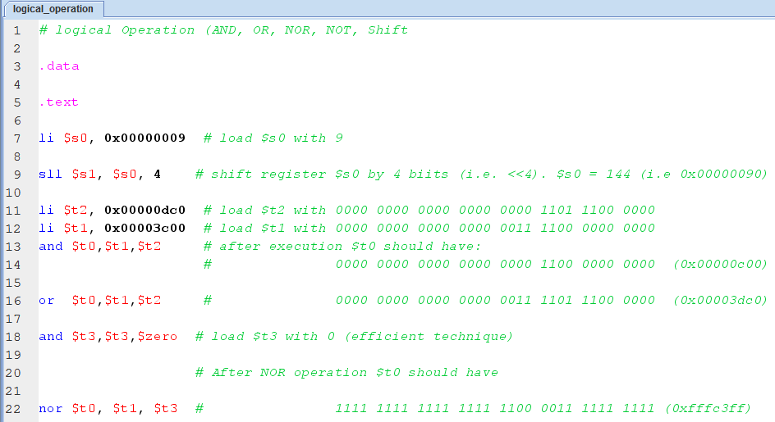
Logical Operation Example
Chapter 2 — Instructions: Language of the Computer — <number>

Slide 38
Conditional Operations
Branch to a labeled instruction if a condition is true
  Otherwise, continue sequentially
beq rs, rt, L1
  if (rs == rt) branch to instruction labeled L1;
bne rs, rt, L1
  if (rs != rt) branch to instruction labeled L1;
j L1
  unconditional jump to instruction labeled L1
§2.7 Instructions for Making Decisions
Chapter 2 — Instructions: Language of the Computer — <number>
Notes:
The University of Adelaide, School of Computer Science
Chapter 2 — Instructions: Language of the Computer

Slide 39

Compiling If Statements
C code:
if (i==j) f = g+h;
else f = g-h;
  f, g, … in $s0, $s1, …
Compiled MIPS code:
bne $s3, $s4, Else
add $s0, $s1, $s2
j Exit
Else: sub $s0, $s1, $s2
Exit: …
Assembler calculates addresses
Chapter 2 — Instructions: Language of the Computer — <number>
Notes:
The University of Adelaide, School of Computer Science
Chapter 2 — Instructions: Language of the Computer

Slide 40
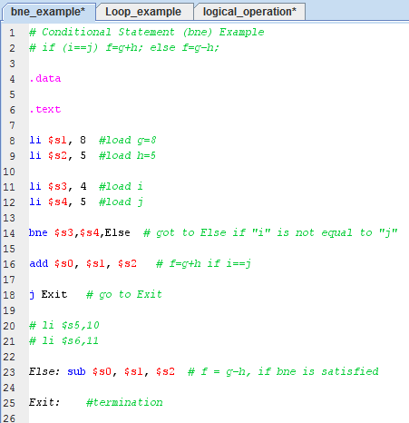
If Statement Example
Chapter 2 — Instructions: Language of the Computer — <number>

Slide 41
Compiling Loop Statements
C code:
while (save[i] ≠ k) i += 1;
  i in $s3, k in $s5, address of save in $s6
Compiled MIPS code:
Loop: sll $t1, $s3, 2
add $t1, $t1, $s6
lw $t0, 0($t1)
bne $t0, $s5, Exit
addi $s3, $s3, 1
j Loop
Exit: …
Chapter 2 — Instructions: Language of the Computer — <number>
Notes:
The University of Adelaide, School of Computer Science
Chapter 2 — Instructions: Language of the Computer

Slide 42
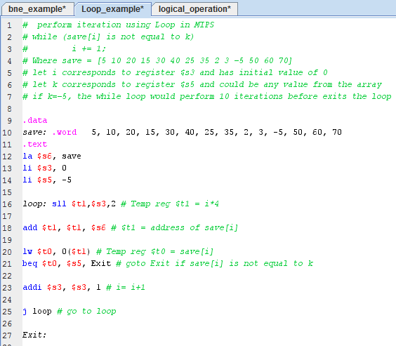
Loop Statement Example

Slide 43
Basic Blocks
A basic block is a sequence of instructions with
  No embedded branches (except at end)
  No branch targets (except at beginning)
A compiler identifies basic blocks for optimization
An advanced processor can accelerate execution of basic blocks
Chapter 2 — Instructions: Language of the Computer — <number>
Notes:
The University of Adelaide, School of Computer Science
Chapter 2 — Instructions: Language of the Computer

Slide 44
More Conditional Operations
Set result to 1 if a condition is true
  Otherwise, set to 0
slt rd, rs, rt
  if (rs < rt) rd = 1; else rd = 0;
slti rt, rs, constant
  if (rs < constant) rt = 1; else rt = 0;
Use in combination with beq, bne
  slt $t0, $s1, $s2 # if ($s1 < $s2)
  bne $t0, $zero, L # branch to L
Chapter 2 — Instructions: Language of the Computer — <number>
Notes:
The University of Adelaide, School of Computer Science
Chapter 2 — Instructions: Language of the Computer

Slide 45
Branch Instruction Design
Why not blt, bge, etc?
Hardware for <, ≥, … slower than =, ≠
  Combining with branch involves more work per instruction, requiring a slower clock
  All instructions penalized!
beq and bne are the common case
This is a good design compromise
Chapter 2 — Instructions: Language of the Computer — <number>
Notes:
The University of Adelaide, School of Computer Science
Chapter 2 — Instructions: Language of the Computer

Slide 46
Signed vs. Unsigned
Signed comparison: slt, slti
Unsigned comparison: sltu, sltui
Example
  $s0 = 1111 1111 1111 1111 1111 1111 1111 1111
  $s1 = 0000 0000 0000 0000 0000 0000 0000 0001
  slt $t0, $s0, $s1 # signed
    –1 < +1 ⇒ $t0 = 1
  sltu $t0, $s0, $s1 # unsigned
    +4,294,967,295 > +1 ⇒ $t0 = 0
Chapter 2 — Instructions: Language of the Computer — <number>
Notes:
The University of Adelaide, School of Computer Science
Chapter 2 — Instructions: Language of the Computer

Slide 47
Procedure Calling
Steps required
  Place parameters in registers
  Transfer control to procedure
  Acquire storage for procedure
  Perform procedure’s operations
  Place result in register for caller
  Return to place of call
§2.8 Supporting Procedures in Computer Hardware
Chapter 2 — Instructions: Language of the Computer — <number>
Notes:
The University of Adelaide, School of Computer Science
Chapter 2 — Instructions: Language of the Computer

Slide 48
Register Usage
$a0 – $a3: arguments (reg’s 4 – 7)
$v0, $v1: result values (reg’s 2 and 3)
$t0 – $t9: temporaries
  Can be overwritten by callee
$s0 – $s7: saved
  Must be saved/restored by callee
$gp: global pointer for static data (reg 28)
$sp: stack pointer (reg 29)
$fp: frame pointer (reg 30)
$ra: return address (reg 31)
Chapter 2 — Instructions: Language of the Computer — <number>
Notes:
The University of Adelaide, School of Computer Science
Chapter 2 — Instructions: Language of the Computer

Slide 49
Procedure Call Instructions
Procedure call: jump and link
jal ProcedureLabel
  Address of following instruction put in $ra
  Jumps to target address
Procedure return: jump register
jr $ra
  Copies $ra to program counter
  Can also be used for computed jumps
    e.g., for case/switch statements
Chapter 2 — Instructions: Language of the Computer — <number>
Notes:
The University of Adelaide, School of Computer Science
Chapter 2 — Instructions: Language of the Computer

Slide 50
Leaf Procedure Example
C code:
int leaf_procedure(int g, h, i, j)
{ int f;
f = (g + h) - (i + j);
return f;
}
  Arguments g, …, j in $a0, …, $a3
  f in $s0 (hence, need to save $s0 on stack)
  Result in $v0
Chapter 2 — Instructions: Language of the Computer — <number>
Notes:
The University of Adelaide, School of Computer Science
Chapter 2 — Instructions: Language of the Computer

Slide 51
Leaf Procedure Example
MIPS code:
leaf_procedure:
addi $sp, $sp, -4
sw $s0, 0($sp)
add $t0, $a0, $a1
add $t1, $a2, $a3
sub $s0, $t0, $t1
add $v0, $s0, $zero
lw $s0, 0($sp)
addi $sp, $sp, 4
jr $ra
Save $s0 on stack
Procedure body
Result
Restore $s0
Return
Chapter 2 — Instructions: Language of the Computer — <number>
Notes:
The University of Adelaide, School of Computer Science
Chapter 2 — Instructions: Language of the Computer

Slide 52
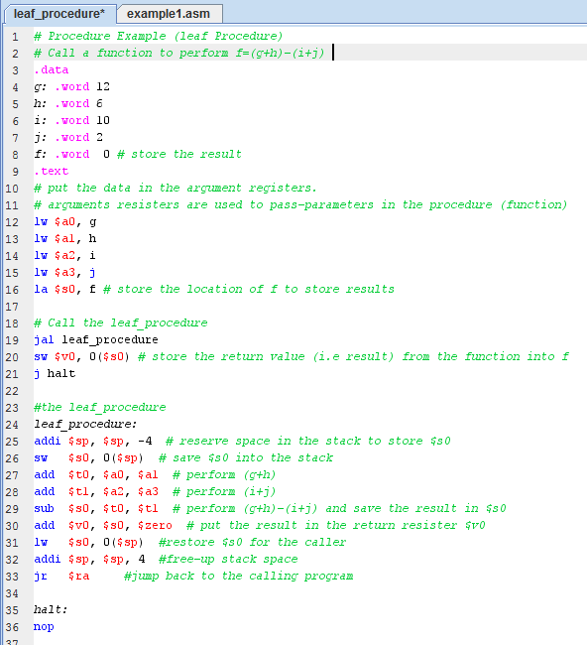
leaf_procedure Code:

Slide 53
Non-Leaf Procedures
Procedures that call other procedures
For nested call, caller needs to save on the stack:
  Its return address
  Any arguments and temporaries needed after the call
Restore from the stack after the call
Chapter 2 — Instructions: Language of the Computer — <number>
Notes:
The University of Adelaide, School of Computer Science
Chapter 2 — Instructions: Language of the Computer

Slide 54
Non-Leaf Procedure Example
C code:
int fact (int n)
{
if (n < 1) return 1;
else return n * fact(n - 1);
}
  Argument n in $a0
  Result in $v0
Chapter 2 — Instructions: Language of the Computer — <number>
Notes:
The University of Adelaide, School of Computer Science
Chapter 2 — Instructions: Language of the Computer

Slide 55
Non-Leaf Procedure Example
MIPS code:
fact:
addi $sp, $sp, -8 # adjust stack for 2 items
sw $ra, 4($sp) # save return address
sw $a0, 0($sp) # save argument
slti $t0, $a0, 1 # test for n < 1
beq $t0, $zero, L1
addi $v0, $zero, 1 # if so, result is 1
addi $sp, $sp, 8 # pop 2 items from stack
jr $ra # and return
L1: addi $a0, $a0, -1 # else decrement n
jal fact # recursive call
lw $a0, 0($sp) # restore original n
lw $ra, 4($sp) # and return address
addi $sp, $sp, 8 # pop 2 items from stack
mul $v0, $a0, $v0 # multiply to get result
jr $ra # and return
Chapter 2 — Instructions: Language of the Computer — <number>
Notes:
The University of Adelaide, School of Computer Science
Chapter 2 — Instructions: Language of the Computer

Slide 56
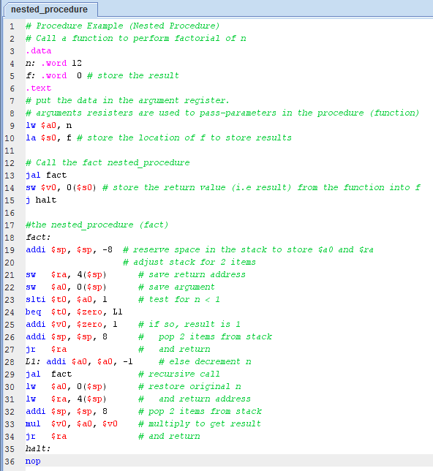
nested_procedure Code:

Slide 57

Local Data on the Stack
Local data allocated by callee
  e.g., C automatic variables
Procedure frame (activation record)
  Used by some compilers to manage stack storage
Chapter 2 — Instructions: Language of the Computer — <number>
Notes:
The University of Adelaide, School of Computer Science
Chapter 2 — Instructions: Language of the Computer

Slide 58

Memory Layout
Text: program code
Static data: global variables
  e.g., static variables in C, constant arrays and strings
  $gp initialized to address allowing ±offsets into this segment
Dynamic data: heap
  E.g., malloc in C, new in Java
Stack: automatic storage
Chapter 2 — Instructions: Language of the Computer — <number>
Notes:
The University of Adelaide, School of Computer Science
Chapter 2 — Instructions: Language of the Computer

Slide 59
Character Data
Byte-encoded character sets
  ASCII: 128 characters
    95 graphic, 33 control
  Latin-1: 256 characters
    ASCII, +96 more graphic characters
Unicode: 32-bit character set
  Used in Java, C++ wide characters, …
  Most of the world’s alphabets, plus symbols
  UTF-8, UTF-16: variable-length encodings
§2.9 Communicating with People
Chapter 2 — Instructions: Language of the Computer — <number>
Notes:
The University of Adelaide, School of Computer Science
Chapter 2 — Instructions: Language of the Computer

Slide 60
Byte/Halfword Operations
Could use bitwise operations
MIPS byte/halfword load/store
  String processing is a common case
lb rt, offset(rs) lh rt, offset(rs)
  Sign extend to 32 bits in rt
lbu rt, offset(rs) lhu rt, offset(rs)
  Zero extend to 32 bits in rt
sb rt, offset(rs) sh rt, offset(rs)
  Store just rightmost byte/halfword
Chapter 2 — Instructions: Language of the Computer — <number>
Notes:
The University of Adelaide, School of Computer Science
Chapter 2 — Instructions: Language of the Computer

Slide 61
String Copy Example
C code (naïve):
  Null-terminated string
void strcpy (char x[], char y[])
{ int i;
i = 0;
while ((x[i]=y[i])!='\0')
i += 1;
}
  Addresses of x, y in $a0, $a1
  i in $s0
Chapter 2 — Instructions: Language of the Computer — <number>
Notes:
The University of Adelaide, School of Computer Science
Chapter 2 — Instructions: Language of the Computer

Slide 62
String Copy Example
MIPS code:
strcpy:
addi $sp, $sp, -4 # adjust stack for 1 item
sw $s0, 0($sp) # save $s0
add $s0, $zero, $zero # i = 0
L1: add $t1, $s0, $a1 # addr of y[i] in $t1
lbu $t2, 0($t1) # $t2 = y[i]
add $t3, $s0, $a0 # addr of x[i] in $t3
sb $t2, 0($t3) # x[i] = y[i]
beq $t2, $zero, L2 # exit loop if y[i] == 0
addi $s0, $s0, 1 # i = i + 1
j L1 # next iteration of loop
L2: lw $s0, 0($sp) # restore saved $s0
addi $sp, $sp, 4 # pop 1 item from stack
jr $ra # and return
Chapter 2 — Instructions: Language of the Computer — <number>
Notes:
The University of Adelaide, School of Computer Science
Chapter 2 — Instructions: Language of the Computer

Slide 63
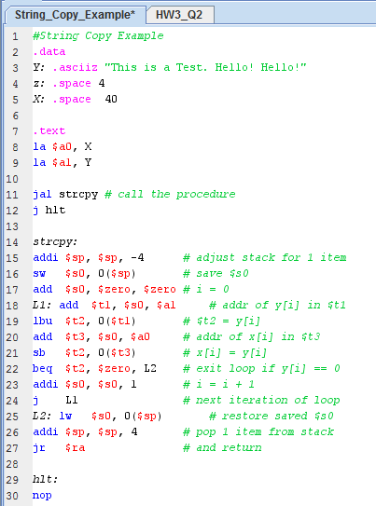
String_Copy_Example

Slide 64
32-bit Constants
Most constants are small
  16-bit immediate is sufficient
For the occasional 32-bit constant
lui rt, constant
  Copies 16-bit constant to left 16 bits of rt
  Clears right 16 bits of rt to 0
§2.10 MIPS Addressing for 32-Bit Immediates and Addresses
lui $s0, 61
0000 0000 0111 1101 0000 0000 0000 0000
ori $s0, $s0, 2304
0000 0000 0111 1101 0000 1001 0000 0000
Chapter 2 — Instructions: Language of the Computer — <number>
Notes:
The University of Adelaide, School of Computer Science
Chapter 2 — Instructions: Language of the Computer

Slide 65
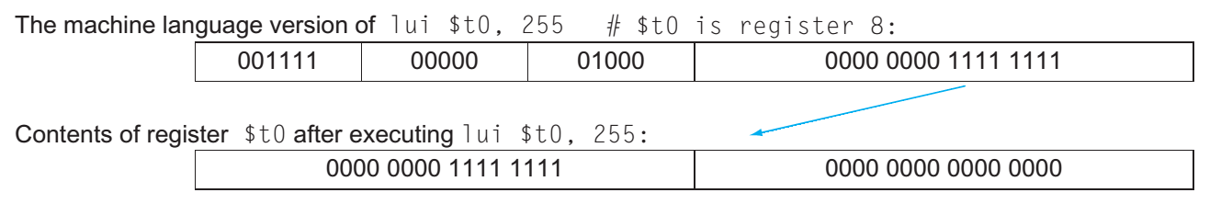
32-bit Constants
Chapter 2 — Instructions: Language of the Computer — <number>

Slide 66
Branch Addressing
Branch instructions specify
  Opcode, two registers, target address
Most branch targets are near branch
  Forward or backward
op
rs
rt
constant or address
6 bits
5 bits
5 bits
16 bits
PC-relative addressing
  Target address = PC+ offset × 4
  PC already incremented by 4 by this time
Chapter 2 — Instructions: Language of the Computer — <number>
Notes:
The University of Adelaide, School of Computer Science
Chapter 2 — Instructions: Language of the Computer

Slide 67
Jump Addressing
Jump (j and jal) targets could be anywhere in text segment
  Encode full address in instruction
op
address
6 bits
26 bits
(Pseudo)Direct jump addressing
  Target address = PC_{31…28} : (address × 4)
Chapter 2 — Instructions: Language of the Computer — <number>
Notes:
The University of Adelaide, School of Computer Science
Chapter 2 — Instructions: Language of the Computer

Slide 68
Target Addressing Example
Loop code from earlier example
  Assume Loop at location 80000
Loop: sll $t1, $s3, 2 | 80000 | 0 | 0 | 19 | 9 | 4 | 0
add $t1, $t1, $s6 | 80004 | 0 | 9 | 22 | 9 | 0 | 32
lw $t0, 0($t1) | 80008 | 35 | 9 | 8 | 0
bne $t0, $s5, Exit | 80012 | 5 | 8 | 21 | 2
addi $s3, $s3, 1 | 80016 | 8 | 19 | 19 | 1
j Loop | 80020 | 2 | 20000
Exit: … | 80024
Chapter 2 — Instructions: Language of the Computer — <number>
Notes:
The University of Adelaide, School of Computer Science
Chapter 2 — Instructions: Language of the Computer

Slide 69
Branching Far Away
If branch target is too far to encode with 16-bit offset, assembler rewrites the code
Example
  beq $s0,$s1, L1
  ↓
  bne $s0,$s1, L2
  j L1
  L2: …
Chapter 2 — Instructions: Language of the Computer — <number>
Notes:
The University of Adelaide, School of Computer Science
Chapter 2 — Instructions: Language of the Computer

Slide 70

Addressing Mode Summary
Chapter 2 — Instructions: Language of the Computer — <number>
Notes:
The University of Adelaide, School of Computer Science
Chapter 2 — Instructions: Language of the Computer

Slide 71
Arrays vs. Pointers
Array indexing involves
  Multiplying index by element size
  Adding to array base address
Pointers correspond directly to memory addresses
  Can avoid indexing complexity
§2.14 Arrays versus Pointers
Chapter 2 — Instructions: Language of the Computer — <number>
Notes:
The University of Adelaide, School of Computer Science
Chapter 2 — Instructions: Language of the Computer

Slide 72
Example: Clearing an Array
clear1(int array[], int size) { int i; for (i = 0; i < size; i += 1) array[i] = 0; } | clear2(int *array, int size) { int *p; for (p = &array[0]; p < &array[size]; p = p + 1) *p = 0; }
move $t0,$zero # i = 0 loop1: sll $t1,$t0,2 # $t1 = i * 4 add $t2,$a0,$t1 # $t2 = # &array[i] sw $zero, 0($t2) # array[i] = 0 addi $t0,$t0,1 # i = i + 1 slt $t3,$t0,$a1 # $t3 = # (i < size) bne $t3,$zero,loop1 # if (…) # goto loop1 | move $t0,$a0 # p = & array[0] sll $t1,$a1,2 # $t1 = size * 4 add $t2,$a0,$t1 # $t2 = # &array[size] loop2: sw $zero,0($t0) # Memory[p] = 0 addi $t0,$t0,4 # p = p + 4 slt $t3,$t0,$t2 # $t3 = #(p<&array[size]) bne $t3,$zero,loop2 # if (…) # goto loop2
Chapter 2 — Instructions: Language of the Computer — <number>
Notes:
The University of Adelaide, School of Computer Science
Chapter 2 — Instructions: Language of the Computer

Slide 73
Comparison of Array vs. Ptr
Multiply “strength reduced” to shift
Array version requires shift to be inside loop
  Part of index calculation for incremented i
  c.f. incrementing pointer
Compiler can achieve same effect as manual use of pointers
  Induction variable elimination
  Better to make program clearer and safer
Chapter 2 — Instructions: Language of the Computer — <number>
Notes:
The University of Adelaide, School of Computer Science
Chapter 2 — Instructions: Language of the Computer

Slide 74
Synchronization
Two processors sharing an area of memory
  P1 writes, then P2 reads
  Data race if P1 and P2 don’t synchronize
    Result depends of order of accesses
Hardware support required
  Atomic read/write memory operation
  No other access to the location allowed between the read and write
Could be a single instruction
  E.g., atomic swap of register ↔ memory
  Or an atomic pair of instructions
§2.11 Parallelism and Instructions: Synchronization
Chapter 2 — Instructions: Language of the Computer — <number>
Notes:
The University of Adelaide, School of Computer Science
Chapter 2 — Instructions: Language of the Computer

Slide 75
Synchronization in MIPS
Load linked: ll rt, offset(rs)
Store conditional: sc rt, offset(rs)
  Succeeds if location not changed since the ll
    Returns 1 in rt
  Fails if location is changed
    Returns 0 in rt
Example: atomic swap (to test/set lock variable)
  try: add $t0,$zero,$s4 ;copy exchange value
  ll $t1,0($s1) ;load linked
  sc $t0,0($s1) ;store conditional
  beq $t0,$zero,try ;branch store fails
  add $s4,$zero,$t1 ;put load value in $s4
Chapter 2 — Instructions: Language of the Computer — <number>
Notes:
The University of Adelaide, School of Computer Science
Chapter 2 — Instructions: Language of the Computer

Slide 76

Translation and Startup
Many compilers produce object modules directly
§2.12 Translating and Starting a Program
Static linking
Chapter 2 — Instructions: Language of the Computer — <number>
Notes:
The University of Adelaide, School of Computer Science
Chapter 2 — Instructions: Language of the Computer

Slide 77
Assembler Pseudoinstructions
Most assembler instructions represent machine instructions one-to-one
Pseudoinstructions: figments of the assembler’s imagination
move $t0, $t1 → add $t0, $zero, $t1
blt $t0, $t1, L → slt $at, $t0, $t1
bne $at, $zero, L
  $at (register 1): assembler temporary
Chapter 2 — Instructions: Language of the Computer — <number>
Notes:
The University of Adelaide, School of Computer Science
Chapter 2 — Instructions: Language of the Computer

Slide 78
Producing an Object Module
Assembler (or compiler) translates program into machine instructions
Provides information for building a complete program from the pieces
  Header: described contents of object module
  Text segment: translated instructions
  Static data segment: data allocated for the life of the program
  Relocation info: for contents that depend on absolute location of loaded program
  Symbol table: global definitions and external refs
  Debug info: for associating with source code
Chapter 2 — Instructions: Language of the Computer — <number>
Notes:
The University of Adelaide, School of Computer Science
Chapter 2 — Instructions: Language of the Computer

Slide 79
Linking Object Modules
On most systems, binary instructions must pass through a link editor (or linker) to create an executable module.
Link editors incorporate various binary routines into a single executable file as called for by a program’s external symbols.
Like assemblers, link editors perform two passes: The first pass creates a symbol table and the second resolves references to the values in the symbol table.
The next slide shows this process schematically.

Slide 80
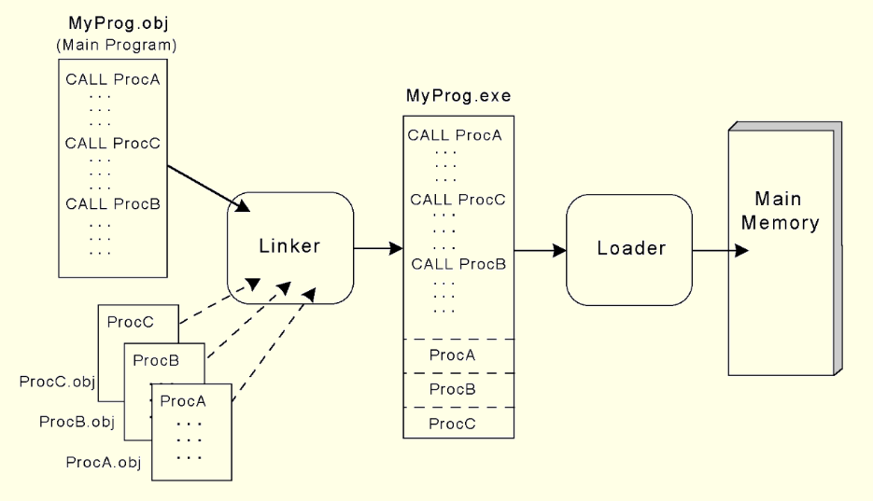
8.4 Programming Tools

Slide 81
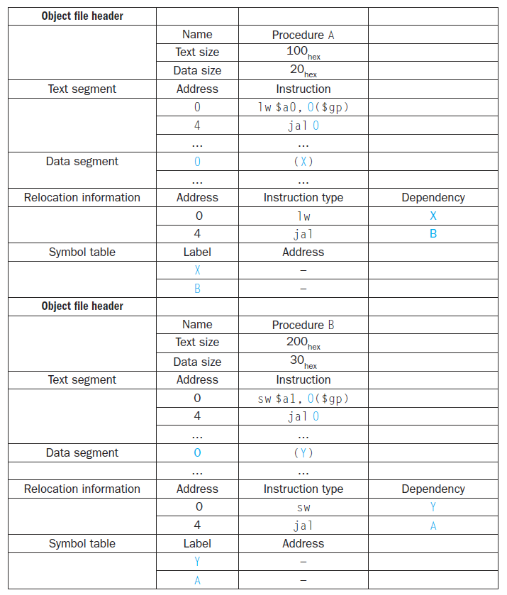

Slide 82
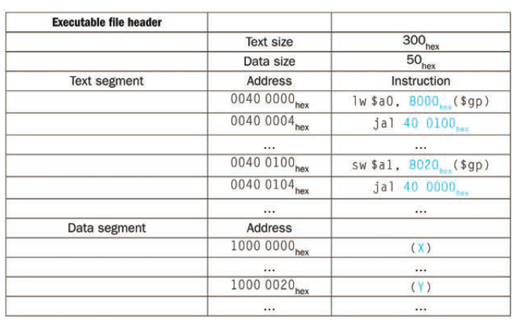
After Linking Object Modules
Chapter 2 — Instructions: Language of the Computer — <number>

Slide 83
Loading a Program
Load from image file on disk into memory
  1. Read header to determine segment sizes
  2. Create virtual address space
  3. Copy text and initialized data into memory
  4. Set up arguments on stack
  5. Initialize registers (including $sp, $fp, $gp)
  6. Jump to startup routine
    Copies arguments to $a0, … and calls main
    When main returns, do exit syscall
Chapter 2 — Instructions: Language of the Computer — <number>
Notes:
The University of Adelaide, School of Computer Science
Chapter 2 — Instructions: Language of the Computer

Slide 84
Dynamic Linking
Only link/load library procedure when it is called
  Requires procedure code to be relocatable
  Avoids image bloat caused by static linking of all (transitively) referenced libraries
  Automatically picks up new library versions
Chapter 2 — Instructions: Language of the Computer — <number>
Notes:
The University of Adelaide, School of Computer Science
Chapter 2 — Instructions: Language of the Computer

Slide 85
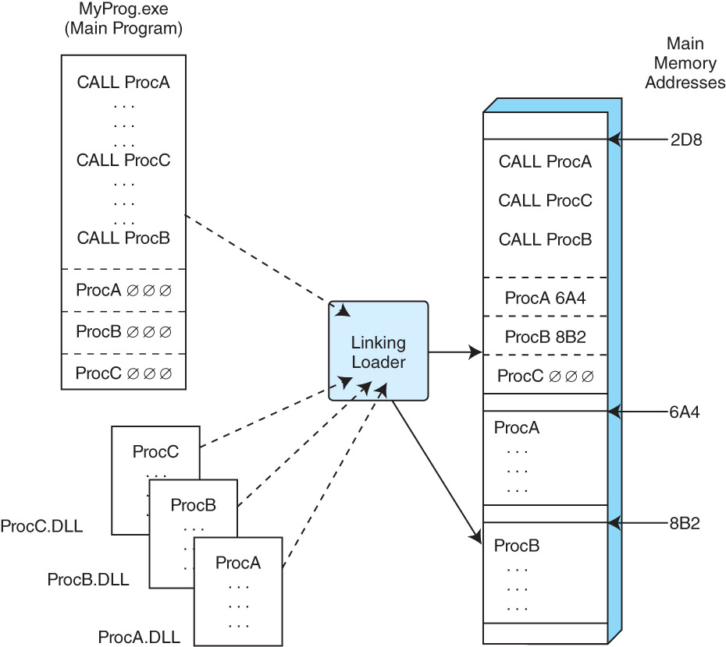
Dynamic Linking
Chapter 2 — Instructions: Language of the Computer — <number>

Slide 86
C Sort Example
Illustrates use of assembly instructions for a C bubble sort function
Swap procedure (leaf)
  void swap(int v[], int k)
  {
  int temp;
  temp = v[k];
  v[k] = v[k+1];
  v[k+1] = temp;
  }
  v in $a0, k in $a1, temp in $t0
§2.13 A C Sort Example to Put It All Together
Chapter 2 — Instructions: Language of the Computer — <number>
Notes:
The University of Adelaide, School of Computer Science
Chapter 2 — Instructions: Language of the Computer

Slide 87
The Procedure Swap
swap: sll $t1, $a1, 2 # $t1 = k * 4
add $t1, $a0, $t1 # $t1 = v+(k*4)
# (address of v[k])
lw $t0, 0($t1) # $t0 (temp) = v[k]
lw $t2, 4($t1) # $t2 = v[k+1]
sw $t2, 0($t1) # v[k] = $t2 (v[k+1])
sw $t0, 4($t1) # v[k+1] = $t0 (temp)
jr $ra # return to calling routine
Chapter 2 — Instructions: Language of the Computer — <number>
Notes:
The University of Adelaide, School of Computer Science
Chapter 2 — Instructions: Language of the Computer

Slide 88
The Sort Procedure in C
Non-leaf (calls swap)
  void sort (int v[], int n)
  {
  int i, j;
  for (i = 0; i < n; i += 1) {
  for (j = i – 1;
  j >= 0 && v[j] > v[j + 1];
  j -= 1) {
  swap(v,j);
  }
  }
  }
  v in $a0, k in $a1, i in $s0, j in $s1
Chapter 2 — Instructions: Language of the Computer — <number>
Notes:
The University of Adelaide, School of Computer Science
Chapter 2 — Instructions: Language of the Computer

Slide 89
The Procedure Body
move $s2, $a0 # save $a0 into $s2
move $s3, $a1 # save $a1 into $s3
move $s0, $zero # i = 0
for1tst: slt $t0, $s0, $s3 # $t0 = 0 if $s0 ≥ $s3 (i ≥ n)
beq $t0, $zero, exit1 # go to exit1 if $s0 ≥ $s3 (i ≥ n)
addi $s1, $s0, –1 # j = i – 1
for2tst: slti $t0, $s1, 0 # $t0 = 1 if $s1 < 0 (j < 0)
bne $t0, $zero, exit2 # go to exit2 if $s1 < 0 (j < 0)
sll $t1, $s1, 2 # $t1 = j * 4
add $t2, $s2, $t1 # $t2 = v + (j * 4)
lw $t3, 0($t2) # $t3 = v[j]
lw $t4, 4($t2) # $t4 = v[j + 1]
slt $t0, $t4, $t3 # $t0 = 0 if $t4 ≥ $t3
beq $t0, $zero, exit2 # go to exit2 if $t4 ≥ $t3
move $a0, $s2 # 1st param of swap is v (old $a0)
move $a1, $s1 # 2nd param of swap is j
jal swap # call swap procedure
addi $s1, $s1, –1 # j –= 1
j for2tst # jump to test of inner loop
exit2: addi $s0, $s0, 1 # i += 1
j for1tst # jump to test of outer loop
Move
params
Outer loop
Inner loop
Pass
params
& call
Inner loop
Outer loop
Chapter 2 — Instructions: Language of the Computer — <number>
Notes:
The University of Adelaide, School of Computer Science
Chapter 2 — Instructions: Language of the Computer

Slide 90
The Full Procedure
sort: addi $sp,$sp, –20 # make room on stack for 5 registers
sw $ra, 16($sp) # save $ra on stack
sw $s3,12($sp) # save $s3 on stack
sw $s2, 8($sp) # save $s2 on stack
sw $s1, 4($sp) # save $s1 on stack
sw $s0, 0($sp) # save $s0 on stack
… # procedure body
…
exit1: lw $s0, 0($sp) # restore $s0 from stack
lw $s1, 4($sp) # restore $s1 from stack
lw $s2, 8($sp) # restore $s2 from stack
lw $s3,12($sp) # restore $s3 from stack
lw $ra,16($sp) # restore $ra from stack
addi $sp,$sp, 20 # restore stack pointer
jr $ra # return to calling routine
Chapter 2 — Instructions: Language of the Computer — <number>
Notes:
The University of Adelaide, School of Computer Science
Chapter 2 — Instructions: Language of the Computer

Slide 91
Arrays vs. Pointers
Array indexing involves
  Multiplying index by element size
  Adding to array base address
Pointers correspond directly to memory addresses
  Can avoid indexing complexity
§2.14 Arrays versus Pointers
Chapter 2 — Instructions: Language of the Computer — <number>
Notes:
The University of Adelaide, School of Computer Science
Chapter 2 — Instructions: Language of the Computer

Slide 92
Example: Clearing an Array
clear1(int array[], int size) { int i; for (i = 0; i < size; i += 1) array[i] = 0; } | clear2(int *array, int size) { int *p; for (p = &array[0]; p < &array[size]; p = p + 1) *p = 0; }
move $t0,$zero # i = 0 loop1: sll $t1,$t0,2 # $t1 = i * 4 add $t2,$a0,$t1 # $t2 = # &array[i] sw $zero, 0($t2) # array[i] = 0 addi $t0,$t0,1 # i = i + 1 slt $t3,$t0,$a1 # $t3 = # (i < size) bne $t3,$zero,loop1 # if (…) # goto loop1 | move $t0,$a0 # p = & array[0] sll $t1,$a1,2 # $t1 = size * 4 add $t2,$a0,$t1 # $t2 = # &array[size] loop2: sw $zero,0($t0) # Memory[p] = 0 addi $t0,$t0,4 # p = p + 4 slt $t3,$t0,$t2 # $t3 = #(p<&array[size]) bne $t3,$zero,loop2 # if (…) # goto loop2
Chapter 2 — Instructions: Language of the Computer — <number>
Notes:
The University of Adelaide, School of Computer Science
Chapter 2 — Instructions: Language of the Computer

Slide 93
Comparison of Array vs. Ptr
Multiply “strength reduced” to shift
Array version requires shift to be inside loop
  Part of index calculation for incremented i
  c.f. incrementing pointer
Compiler can achieve same effect as manual use of pointers
  Induction variable elimination
  Better to make program clearer and safer
Chapter 2 — Instructions: Language of the Computer — <number>
Notes:
The University of Adelaide, School of Computer Science
Chapter 2 — Instructions: Language of the Computer

Slide 94
ARM & MIPS Similarities
ARM: the most popular embedded core
Similar basic set of instructions to MIPS
§2.16 Real Stuff: ARM Instructions
 | ARM | MIPS
Date announced | 1985 | 1985
Instruction size | 32 bits | 32 bits
Address space | 32-bit flat | 32-bit flat
Data alignment | Aligned | Aligned
Data addressing modes | 9 | 3
Registers | 15 × 32-bit | 31 × 32-bit
Input/output | Memory mapped | Memory mapped
Chapter 2 — Instructions: Language of the Computer — <number>
Notes:
The University of Adelaide, School of Computer Science
Chapter 2 — Instructions: Language of the Computer

Slide 95
Compare and Branch in ARM
Uses condition codes for result of an arithmetic/logical instruction
  Negative, zero, carry, overflow
  Compare instructions to set condition codes without keeping the result
Each instruction can be conditional
  Top 4 bits of instruction word: condition value
  Can avoid branches over single instructions
Chapter 2 — Instructions: Language of the Computer — <number>
Notes:
The University of Adelaide, School of Computer Science
Chapter 2 — Instructions: Language of the Computer

Slide 96

Instruction Encoding
Chapter 2 — Instructions: Language of the Computer — <number>
Notes:
The University of Adelaide, School of Computer Science
Chapter 2 — Instructions: Language of the Computer

Slide 97
The Intel x86 ISA
Evolution with backward compatibility
  8080 (1974): 8-bit microprocessor
    Accumulator, plus 3 index-register pairs
  8086 (1978): 16-bit extension to 8080
    Complex instruction set (CISC)
  8087 (1980): floating-point coprocessor
    Adds FP instructions and register stack
  80286 (1982): 24-bit addresses, MMU
    Segmented memory mapping and protection
  80386 (1985): 32-bit extension (now IA-32)
    Additional addressing modes and operations
    Paged memory mapping as well as segments
§2.17 Real Stuff: x86 Instructions
Chapter 2 — Instructions: Language of the Computer — <number>
Notes:
The University of Adelaide, School of Computer Science
Chapter 2 — Instructions: Language of the Computer

Slide 98
The Intel x86 ISA
Further evolution…
  i486 (1989): pipelined, on-chip caches and FPU
    Compatible competitors: AMD, Cyrix, …
  Pentium (1993): superscalar, 64-bit datapath
    Later versions added MMX (Multi-Media eXtension) instructions
    The infamous FDIV bug
  Pentium Pro (1995), Pentium II (1997)
    New microarchitecture (see Colwell, The Pentium Chronicles)
  Pentium III (1999)
    Added SSE (Streaming SIMD Extensions) and associated registers
  Pentium 4 (2001)
    New microarchitecture
    Added SSE2 instructions
Chapter 2 — Instructions: Language of the Computer — <number>
Notes:
The University of Adelaide, School of Computer Science
Chapter 2 — Instructions: Language of the Computer

Slide 99
The Intel x86 ISA
And further…
  AMD64 (2003): extended architecture to 64 bits
  EM64T – Extended Memory 64 Technology (2004)
    AMD64 adopted by Intel (with refinements)
    Added SSE3 instructions
  Intel Core (2006)
    Added SSE4 instructions, virtual machine support
  AMD64 (announced 2007): SSE5 instructions
    Intel declined to follow, instead…
  Advanced Vector Extension (announced 2008)
    Longer SSE registers, more instructions
If Intel didn’t extend with compatibility, its competitors would!
  Technical elegance ≠ market success
Chapter 2 — Instructions: Language of the Computer — <number>
Notes:
The University of Adelaide, School of Computer Science
Chapter 2 — Instructions: Language of the Computer

Slide 100

Basic x86 Registers
Chapter 2 — Instructions: Language of the Computer — <number>
Notes:
The University of Adelaide, School of Computer Science
Chapter 2 — Instructions: Language of the Computer

Slide 101
Basic x86 Addressing Modes
Two operands per instruction
Source/dest operand | Second source operand
Register | Register
Register | Immediate
Register | Memory
Memory | Register
Memory | Immediate
Memory addressing modes
  Address in register
  Address = R_{base} + displacement
  Address = R_{base} + 2^{scale} × R_{index} (scale = 0, 1, 2, or 3)
  Address = R_{base} + 2^{scale} × R_{index} + displacement
Chapter 2 — Instructions: Language of the Computer — <number>
Notes:
The University of Adelaide, School of Computer Science
Chapter 2 — Instructions: Language of the Computer

Slide 102
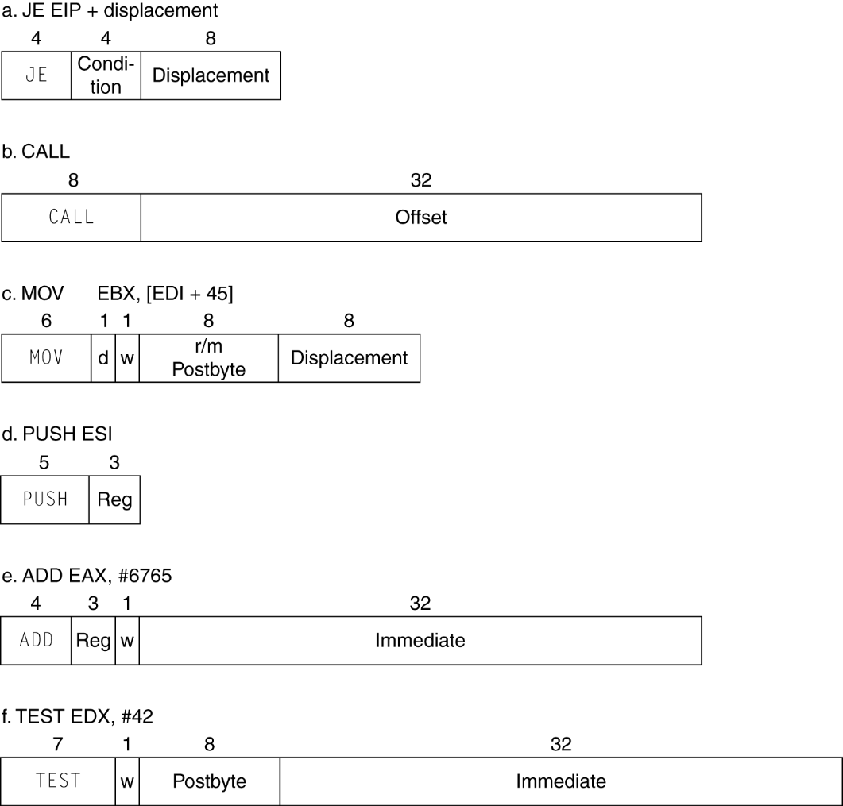
x86 Instruction Encoding
Variable length encoding
  Postfix bytes specify addressing mode
  Prefix bytes modify operation
    Operand length, repetition, locking, …
Chapter 2 — Instructions: Language of the Computer — <number>
Notes:
The University of Adelaide, School of Computer Science
Chapter 2 — Instructions: Language of the Computer

Slide 103
Implementing IA-32
Complex instruction set makes implementation difficult
  Hardware translates instructions to simpler microoperations
    Simple instructions: 1–1
    Complex instructions: 1–many
  Microengine similar to RISC
  Market share makes this economically viable
Comparable performance to RISC
  Compilers avoid complex instructions
Chapter 2 — Instructions: Language of the Computer — <number>
Notes:
The University of Adelaide, School of Computer Science
Chapter 2 — Instructions: Language of the Computer

Slide 104
ARM v8 Instructions
In moving to 64-bit, ARM did a complete overhaul
ARM v8 resembles MIPS
  Changes from v7:
    No conditional execution field
    Immediate field is 12-bit constant
    Dropped load/store multiple
    PC is no longer a GPR
    GPR set expanded to 32
    Addressing modes work for all word sizes
    Divide instruction
    Branch if equal/branch if not equal instructions
§2.18 Real Stuff: ARM v8 (64-bit) Instructions
Chapter 2 — Instructions: Language of the Computer — <number>

Slide 105
Fallacies
Powerful instruction ⇒ higher performance
  Fewer instructions required
  But complex instructions are hard to implement
    May slow down all instructions, including simple ones
  Compilers are good at making fast code from simple instructions
Use assembly code for high performance
  But modern compilers are better at dealing with modern processors
  More lines of code ⇒ more errors and less productivity
§2.19 Fallacies and Pitfalls
Chapter 2 — Instructions: Language of the Computer — <number>
Notes:
The University of Adelaide, School of Computer Science
Chapter 2 — Instructions: Language of the Computer

Slide 106

Fallacies
Backward compatibility ⇒ instruction set doesn’t change
  But they do accrete more instructions
x86 instruction set
Chapter 2 — Instructions: Language of the Computer — <number>
Notes:
The University of Adelaide, School of Computer Science
Chapter 2 — Instructions: Language of the Computer

Slide 107
Pitfalls
Sequential words are not at sequential addresses
  Increment by 4, not by 1!
Keeping a pointer to an automatic variable after procedure returns
  e.g., passing pointer back via an argument
  Pointer becomes invalid when stack popped
Chapter 2 — Instructions: Language of the Computer — <number>
Notes:
The University of Adelaide, School of Computer Science
Chapter 2 — Instructions: Language of the Computer

Slide 108
Concluding Remarks
Design principles
  1. Simplicity favors regularity
  2. Smaller is faster
  3. Make the common case fast
  4. Good design demands good compromises
Layers of software/hardware
  Compiler, assembler, hardware
MIPS: typical of RISC ISAs
  c.f. x86
§2.20 Concluding Remarks
Chapter 2 — Instructions: Language of the Computer — <number>
Notes:
The University of Adelaide, School of Computer Science
Chapter 2 — Instructions: Language of the Computer

Slide 109
Concluding Remarks
Measure MIPS instruction executions in benchmark programs
  Consider making the common case fast
  Consider compromises
Instruction class | MIPS examples | SPEC2006 Int | SPEC2006 FP
Arithmetic | add, sub, addi | 16% | 48%
Data transfer | lw, sw, lb, lbu, lh, lhu, sb, lui | 35% | 36%
Logical | and, or, nor, andi, ori, sll, srl | 12% | 4%
Cond. Branch | beq, bne, slt, slti, sltiu | 34% | 8%
Jump | j, jr, jal | 2% | 0%
Chapter 2 — Instructions: Language of the Computer — <number>
Notes:
The University of Adelaide, School of Computer Science
Chapter 2 — Instructions: Language of the Computer

