Slide 1
Chapter 5
Large and Fast: Exploiting Memory Hierarchy
Notes:
Morgan Kaufmann Publishers
Chapter 4 — The Processor

Slide 2
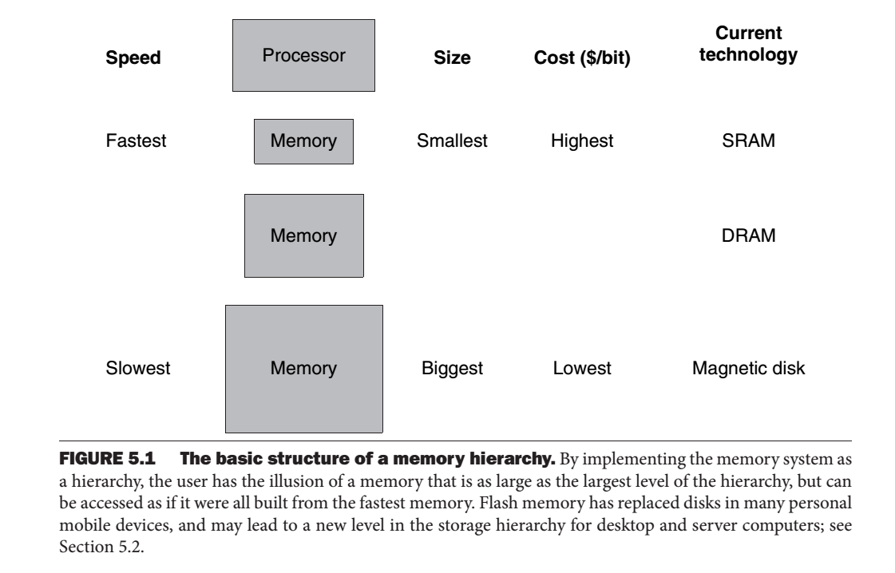
Memory Hierarchy
Chapter 5 — Large and Fast: Exploiting Memory Hierarchy — <number>

Slide 3
Principle of Locality
§5.1 Introduction
Programs access a small proportion of their address space at any time
Temporal locality
  Items accessed recently are likely to be accessed again soon
  e.g., instructions in a loop, induction variables
Spatial locality
  Items near those accessed recently are likely to be accessed soon
  E.g., sequential instruction access, array data
Chapter 5 — Large and Fast: Exploiting Memory Hierarchy — <number>
Notes:
Morgan Kaufmann Publishers
Chapter 5 — Large and Fast: Exploiting Memory Hierarchy

Slide 4
Taking Advantage of Locality
Memory hierarchy
Store everything on disk
Copy recently accessed (and nearby) items from disk to smaller DRAM memory
  Main memory
Copy more recently accessed (and nearby) items from DRAM to smaller SRAM memory
  Cache memory attached to CPU
Chapter 5 — Large and Fast: Exploiting Memory Hierarchy — <number>
Notes:
Morgan Kaufmann Publishers
Chapter 5 — Large and Fast: Exploiting Memory Hierarchy

Slide 5

Memory Hierarchy Levels
Block (aka line): unit of copying
  May be multiple words
If accessed data is present in upper level
  Hit: access satisfied by upper level
    Hit ratio: hits/accesses
If accessed data is absent
  Miss: block copied from lower level
    Time taken: miss penalty
    Miss ratio: misses/accesses
    = 1 – hit ratio
  Then accessed data supplied from upper level
Chapter 5 — Large and Fast: Exploiting Memory Hierarchy — <number>
Notes:
Morgan Kaufmann Publishers
Chapter 5 — Large and Fast: Exploiting Memory Hierarchy

Slide 6
Memory Technology
Static RAM (SRAM)
  0.5ns – 2.5ns, $500 – $1000 per GB
Dynamic RAM (DRAM)
  50ns – 70ns, $20 – $75 per GB
Magnetic disk
  5ms – 20ms, $0.20 – $2 per GB
Ideal memory
  Access time of SRAM
  Capacity and cost/GB of disk
§5.2 Memory Technologies
Chapter 5 — Large and Fast: Exploiting Memory Hierarchy — <number>
Notes:
Morgan Kaufmann Publishers
Chapter 5 — Large and Fast: Exploiting Memory Hierarchy

Slide 7
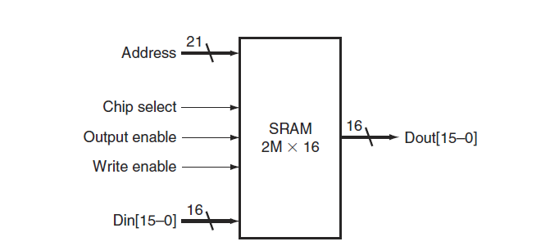
SRAM
Chapter 5 — Large and Fast: Exploiting Memory Hierarchy — <number>

Slide 8
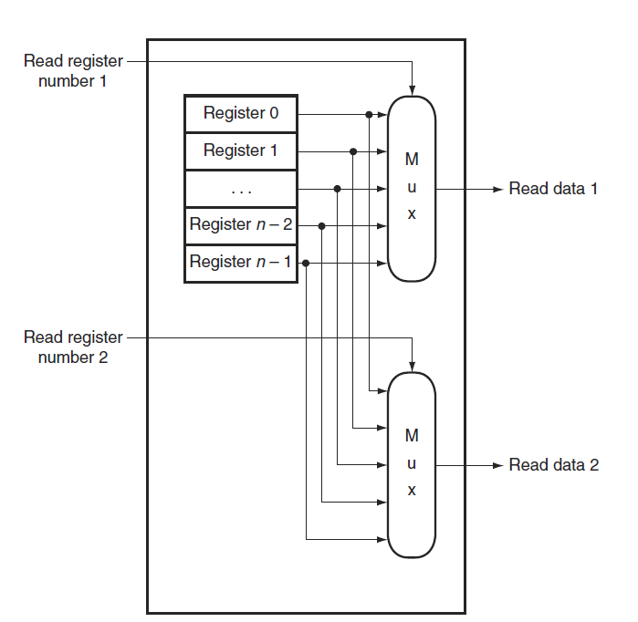
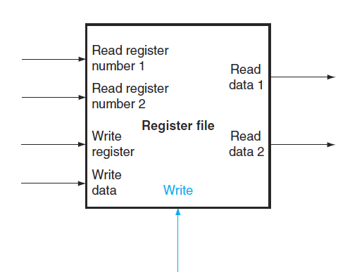
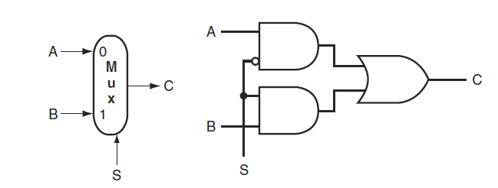
Register File
Chapter 5 — Large and Fast: Exploiting Memory Hierarchy — <number>

Slide 9
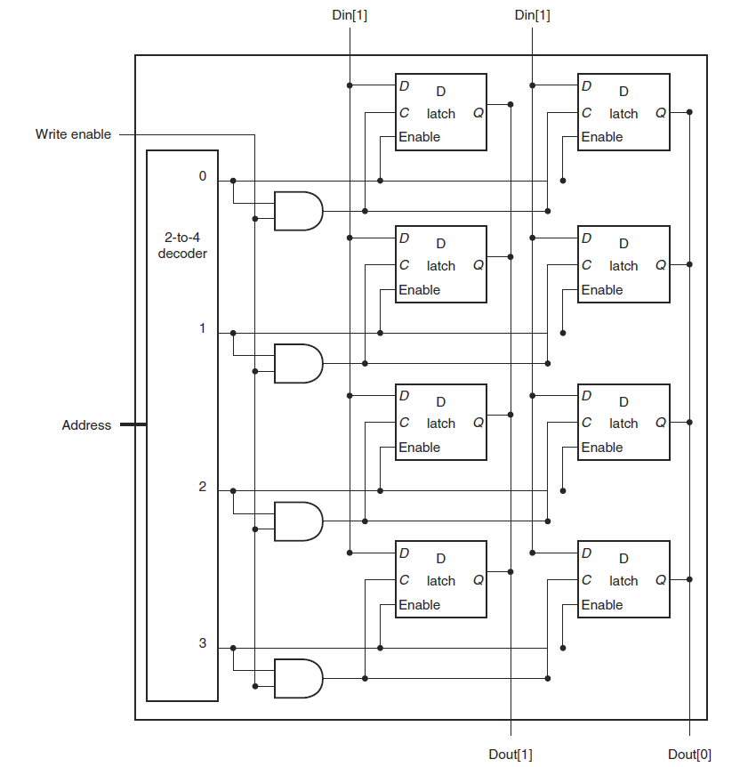
SRAM
Chapter 5 — Large and Fast: Exploiting Memory Hierarchy — <number>

Slide 10
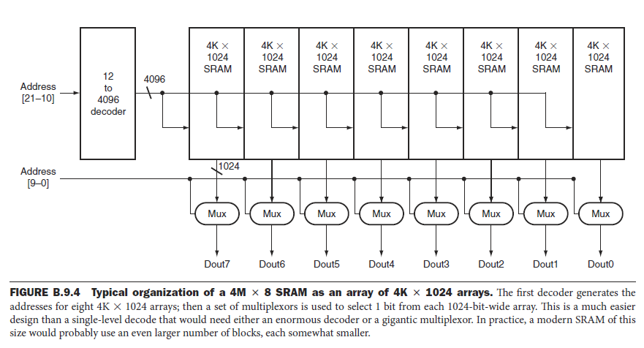
SRAM
Chapter 5 — Large and Fast: Exploiting Memory Hierarchy — <number>

Slide 11
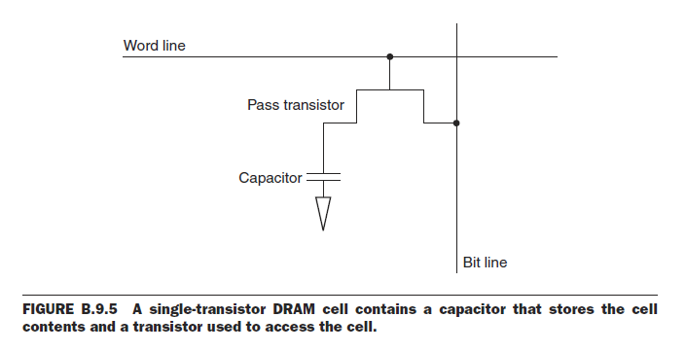
DRAM
Chapter 5 — Large and Fast: Exploiting Memory Hierarchy — <number>

Slide 12

DRAM Technology
Data stored as a charge in a capacitor
  Single transistor used to access the charge
  Must periodically be refreshed
    Read contents and write back
    Performed on a DRAM “row”
Chapter 5 — Large and Fast: Exploiting Memory Hierarchy — <number>

Slide 13
Advanced DRAM Organization
Bits in a DRAM are organized as a rectangular array
  DRAM accesses an entire row
  Burst mode: supply successive words from a row with reduced latency
Double data rate (DDR) DRAM
  Transfer on rising and falling clock edges
Chapter 5 — Large and Fast: Exploiting Memory Hierarchy — <number>
Notes:
Morgan Kaufmann Publishers
Chapter 5 — Large and Fast: Exploiting Memory Hierarchy

Slide 14
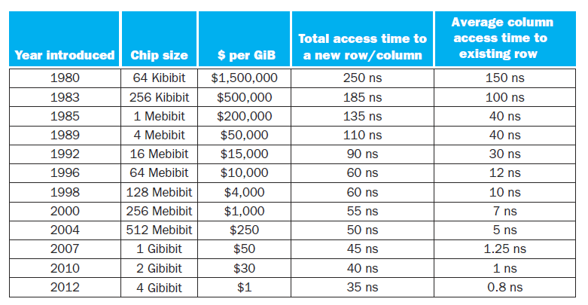
DRAM Generations
Chapter 5 — Large and Fast: Exploiting Memory Hierarchy — <number>
Notes:
Morgan Kaufmann Publishers
Chapter 5 — Large and Fast: Exploiting Memory Hierarchy

Slide 15


Flash Storage
§6.4 Flash Storage
Nonvolatile semiconductor storage
  100× – 1000× faster than disk
  Smaller, lower power, more robust
  But more $/GB (between disk and DRAM)
Chapter 6 — Storage and Other I/O Topics — <number>
Notes:
Morgan Kaufmann Publishers
Chapter 6 — Storage and Other I/O Topics

Slide 16
Flash Types
NOR flash: bit cell like a NOR gate
  Random read/write access
  Used for instruction memory in embedded systems
NAND flash: bit cell like a NAND gate
  Denser (bits/area), but block-at-a-time access
  Cheaper per GB
  Used for USB keys, media storage, …
Flash bits wears out after 1000’s of accesses
  Not suitable for direct RAM or disk replacement
  Wear leveling: remap data to less used blocks
Chapter 6 — Storage and Other I/O Topics — <number>
Notes:
Morgan Kaufmann Publishers
Chapter 6 — Storage and Other I/O Topics

Slide 17


Disk Storage
§6.3 Disk Storage
Nonvolatile, rotating magnetic storage
Chapter 6 — Storage and Other I/O Topics — <number>
Notes:
Morgan Kaufmann Publishers
Chapter 6 — Storage and Other I/O Topics

Slide 18
Disk Sectors and Access
Each sector records
  Sector ID
  Data (512 bytes, 4096 bytes proposed)
  Error correcting code (ECC)
    Used to hide defects and recording errors
  Synchronization fields and gaps
Access to a sector involves
  Queuing delay if other accesses are pending
  Seek: move the heads
  Rotational latency
  Data transfer
  Controller overhead
Chapter 6 — Storage and Other I/O Topics — <number>
Notes:
Morgan Kaufmann Publishers
Chapter 6 — Storage and Other I/O Topics

Slide 19
Disk Access Example
Given
  512B sector, 15,000rpm, 4ms average seek time, 100MB/s transfer rate, 0.2ms controller overhead, idle disk
Average read time
  4ms seek time
  + ½ / (15,000/60) = 2ms rotational latency
  + 512 / 100MB/s = 0.005ms transfer time
  + 0.2ms controller delay
  = 6.2ms
If actual average seek time is 1ms
  Average read time = 3.2ms
Chapter 6 — Storage and Other I/O Topics — <number>
Notes:
Morgan Kaufmann Publishers
Chapter 6 — Storage and Other I/O Topics

Slide 20
Disk Performance Issues
Manufacturers quote average seek time
  Based on all possible seeks
  Locality and OS scheduling lead to smaller actual average seek times
Smart disk controller allocate physical sectors on disk
  Present logical sector interface to host
  SCSI, ATA, SATA
Disk drives include caches
  Prefetch sectors in anticipation of access
  Avoid seek and rotational delay
Chapter 6 — Storage and Other I/O Topics — <number>
Notes:
Morgan Kaufmann Publishers
Chapter 6 — Storage and Other I/O Topics

Slide 21

Cache Memory
Cache memory
  The level of the memory hierarchy closest to the CPU
Given accesses X₁, …, X_{n–1}, X_{n}
§5.3 The Basics of Caches
How do we know if the data is present?
Where do we look?
Chapter 5 — Large and Fast: Exploiting Memory Hierarchy — <number>
Notes:
Morgan Kaufmann Publishers
Chapter 5 — Large and Fast: Exploiting Memory Hierarchy

Slide 22

Direct Mapped Cache
Location determined by address
Direct mapped: only one choice
  (Block address) modulo (#Blocks in cache)
#Blocks is a power of 2
Use low-order address bits
Chapter 5 — Large and Fast: Exploiting Memory Hierarchy — <number>
Notes:
Morgan Kaufmann Publishers
Chapter 5 — Large and Fast: Exploiting Memory Hierarchy

Slide 23
Tags and Valid Bits
How do we know which particular block is stored in a cache location?
  Store block address as well as the data
  Actually, only need the high-order bits
  Called the tag
What if there is no data in a location?
  Valid bit: 1 = present, 0 = not present
  Initially 0
Chapter 5 — Large and Fast: Exploiting Memory Hierarchy — <number>
Notes:
Morgan Kaufmann Publishers
Chapter 5 — Large and Fast: Exploiting Memory Hierarchy

Slide 24
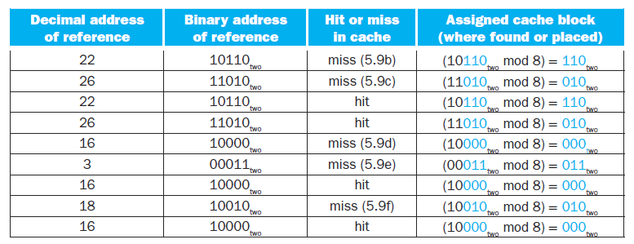
Cache Example
The Cache has 8-blocks, 1 word/block, direct mapped. The following addresses
are to be mapped in the Cache.
Chapter 5 — Large and Fast: Exploiting Memory Hierarchy — <number>

Slide 25
Cache Example
8-blocks, 1 word/block, direct mapped
Initial state
Index | V | Tag | Data
000 | N
001 | N
010 | N
011 | N
100 | N
101 | N
110 | N
111 | N
Chapter 5 — Large and Fast: Exploiting Memory Hierarchy — <number>
Notes:
Morgan Kaufmann Publishers
Chapter 5 — Large and Fast: Exploiting Memory Hierarchy

Slide 26
Cache Example
Word addr | Binary addr | Hit/miss | Cache block
22 | 10 110 | Miss | 110
Index | V | Tag | Data
000 | N
001 | N
010 | N
011 | N
100 | N
101 | N
110 | Y | 10 | Mem[10110]
111 | N
Chapter 5 — Large and Fast: Exploiting Memory Hierarchy — <number>
Notes:
Morgan Kaufmann Publishers
Chapter 5 — Large and Fast: Exploiting Memory Hierarchy

Slide 27
Cache Example
Word addr | Binary addr | Hit/miss | Cache block
26 | 11 010 | Miss | 010
Index | V | Tag | Data
000 | N
001 | N
010 | Y | 11 | Mem[11010]
011 | N
100 | N
101 | N
110 | Y | 10 | Mem[10110]
111 | N
Chapter 5 — Large and Fast: Exploiting Memory Hierarchy — <number>
Notes:
Morgan Kaufmann Publishers
Chapter 5 — Large and Fast: Exploiting Memory Hierarchy

Slide 28
Cache Example
Word addr | Binary addr | Hit/miss | Cache block
22 | 10 110 | Hit | 110
26 | 11 010 | Hit | 010
Index | V | Tag | Data
000 | N
001 | N
010 | Y | 11 | Mem[11010]
011 | N
100 | N
101 | N
110 | Y | 10 | Mem[10110]
111 | N
Chapter 5 — Large and Fast: Exploiting Memory Hierarchy — <number>
Notes:
Morgan Kaufmann Publishers
Chapter 5 — Large and Fast: Exploiting Memory Hierarchy

Slide 29
Cache Example
Word addr | Binary addr | Hit/miss | Cache block
16 | 10 000 | Miss | 000
3 | 00 011 | Miss | 011
16 | 10 000 | Hit | 000
Index | V | Tag | Data
000 | Y | 10 | Mem[10000]
001 | N
010 | Y | 11 | Mem[11010]
011 | Y | 00 | Mem[00011]
100 | N
101 | N
110 | Y | 10 | Mem[10110]
111 | N
Chapter 5 — Large and Fast: Exploiting Memory Hierarchy — <number>
Notes:
Morgan Kaufmann Publishers
Chapter 5 — Large and Fast: Exploiting Memory Hierarchy

Slide 30
Cache Example
Word addr | Binary addr | Hit/miss | Cache block
18 | 10 010 | Miss | 010
Index | V | Tag | Data
000 | Y | 10 | Mem[10000]
001 | N
010 | Y | 10 | Mem[10010]
011 | Y | 00 | Mem[00011]
100 | N
101 | N
110 | Y | 10 | Mem[10110]
111 | N
Chapter 5 — Large and Fast: Exploiting Memory Hierarchy — <number>
Notes:
Morgan Kaufmann Publishers
Chapter 5 — Large and Fast: Exploiting Memory Hierarchy

Slide 31

Address Subdivision (1024 words or 4 KiB)
Chapter 5 — Large and Fast: Exploiting Memory Hierarchy — <number>
Notes:
Morgan Kaufmann Publishers
Chapter 5 — Large and Fast: Exploiting Memory Hierarchy

Slide 32
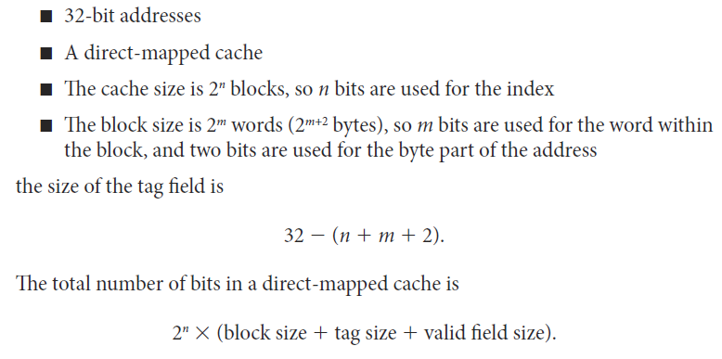
Example:
Chapter 5 — Large and Fast: Exploiting Memory Hierarchy — <number>

Slide 33
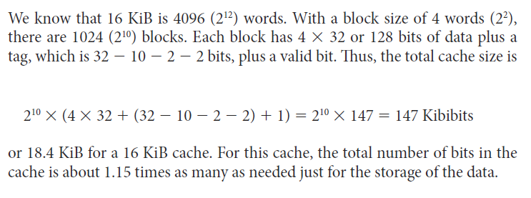
Example:
Chapter 5 — Large and Fast: Exploiting Memory Hierarchy — <number>

Slide 34
Example: Larger Block Size
64 blocks, 16 bytes/block
  To what block number does address 1200 map?
Block address = ⎣1200/16⎦ = 75
Block number = 75 modulo 64 = 11
This Block maps all addresses between 1200 and 1215
31
10
9
4
3
0
Tag
Index
Offset
22 bits
6 bits
4 bits
Chapter 5 — Large and Fast: Exploiting Memory Hierarchy — <number>
Notes:
Morgan Kaufmann Publishers
Chapter 5 — Large and Fast: Exploiting Memory Hierarchy

