Slide 1
University of Illinois at Urbana-Champaign Dept. of Electrical and Computer Engineering ECE 120: Introduction to Computing
Representations and Bits

Slide 2

Today’s Random Topic: History!
MIT students created the Big Screw Award, which is given to “whoever [sic] has screwed over the most students over the past year.”
One professor taught in French to win it.
The rest of my lectures will use this code:
Good luck!
Notes:
This isn’t MIT. So some students may actually speak French. I’d hate to waste my effort!

Slide 3
Represent One Type of Information with Another
We often represent one type of information with other patterns, physical quantities, and so forth.
examples
English letters represented by drawn patterns
colors represented by variations in radio signal amplitude
The mapping from one form to another is called a representation.

Slide 4
Follow These Simple Instructions
Please do so for the rest of today’s lecture.
You thought I was kidding?

Slide 5
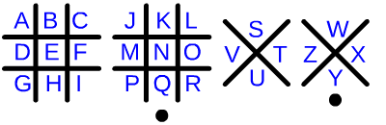
Knowing the Representation May Help You
The code above is called a tic-tac-toe code: each letter (information) is represented by a drawing (pattern).

Slide 6
What Do We Need to Make a Representation Useful?
What properties are necessary for a representation to be useful?
Hints:
Think about the tic-tac-toe code.
Think about algorithm properties.

Slide 7
First Answer: Representations Must be Well-Defined
All users must know the translation in advance.
Our goal is communication, not obfuscation.

Slide 8
Some Mappings May Not be Usable by Computers
If we use 10 digits to represent 26 letters as shown above, what does “143” mean?
Computers are dumb—they cannot guess.
0 | 1 | 2 | 3 | 4 | 5 | 6 | 7 | 8 | 9
A | B | C | D | E | F | G | H | I | J
K | L | M | N | O | P | Q | R | S | T
U | V | W | X | Y | Z
BED?
BOX?
VYN?

Slide 9
Second Answer: Representations Must be Unambiguous
Each pattern must represent at most one thing.
GREEN
4
GREEN
4
GOOD
BLUE
1
BLUE
BAD

Slide 10
But Some Patterns May Represent Nothing
In the representation below, the digits 0, 2, 7, 8, and 9 represent no color.
RED
3
GREEN
4
YELLOW
6
BLUE
1
PURPLE
5

Slide 11
Computers are Based on Electrons
In digital systems, electrons are all we have to represent information!
What can you ask about electrons?
How many electrons are in a certain place? (related closely to voltage)
So…
Choose a ground: 0V by definition.
Pick a higher voltage (called V_{dd}).
V_{dd}
1
(voltage)
0
0V

Slide 12
Computer Representations are Based on BInary digiTs
Now ask:
At a given physical location, what is the voltage?
Voltage near V_{dd} is a “1.”
Voltage near 0V is a “0.”
The location thus holds a binary digit, which we call a bit.
V_{dd}
1
(voltage)
0
0V

Slide 13
Physical Locations Enable Place Value
Each bit is somewhere on a computer chip.
So using positional / place value is natural.
decimal
26
binary
11010
sixteens
place
ones
place
tens
place
ones
place
eights
place
twos
place
fours
place

Slide 14
Represented by What? The Answer is Always “Bits”
Remember:
Electrons are all we have inside computers.
No decimal, no hexadecimal, no letters, no real numbers, no colors.
ALL computer representations are based on bits.
V_{dd}
1
(voltage)
0
0V

Slide 15
A Question for You: How Many Bits do We Need?
How many bits do we need to represent a whole number in the range…
from 0 to 31?
32 different integers
so we need 5 bits (2⁵ = 32 bit patterns)
from 0 to 100?
101 different integers
so we need 7 bits (2⁷ = 128 bit patterns)
Notes:
Remind them that every “thing” to be represented needs a different bit pattern to avoid ambiguity.

Slide 16
We Need One Bit Pattern for Each Possible Thing
Trick question: How many bits do we need to represent two books?
The Collected Works of Shakespeare
Our textbook by Patt & Patel
2 different books
so we need only 1 bit! (2¹ = 2 bit patterns)
What matters is the number of things, not what those things are.
Notes:
Joke that they shouldn’t try to correct typos using the 1-bit representation.

Slide 17
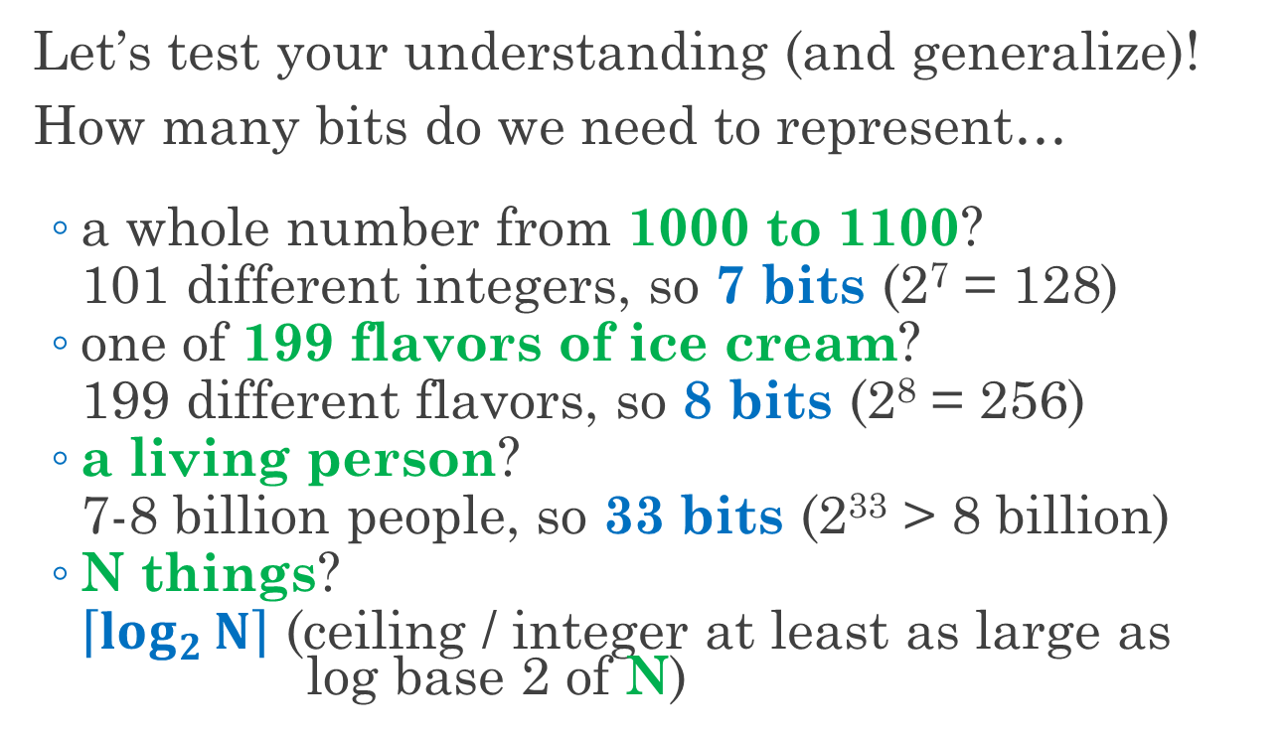
How Many Bits Do We Need to Represent N Things?
Let’s test your understanding (and generalize)!
How many bits do we need to represent…
a whole number from 1000 to 1100?
101 different integers, so 7 bits (2⁷ = 128)
one of 199 flavors of ice cream?
199 different flavors, so 8 bits (2⁸ = 256)
a living person?
7-8 billion people, so 33 bits (2³³ > 8 billion)
N things?
$\left\lceil \log_{2}{N}\right\rceil$ (ceiling / integer at least as large as log base 2 of N)

Slide 18
University of Illinois at Urbana-Champaign Dept. of Electrical and Computer Engineering ECE 120: Introduction to Computing
The Unsigned Representation

Slide 19
We Can Represent Anything with Bits
Recall: All information in a computer is represented with bits.
We can represent anything with bits.*
useful examples: integers real numbers human language characters (alphabet, digits, punctuation)
Important: Computers do not “know” the meaning of the bits!
* A computer only stores a finite number of bits, of course!

Slide 20
How Do We Decide What to Represent?
Let’s think about integer (whole number) representations.
What numbers should we represent?
Some random set?
Everyone in our class’ favorite number (mine is 42!)?
A contiguous set starting with 0?

Slide 21
Does the Representation Matter?
We want computers to do arithmetic.
How does a representation affect arithmetic?
Imagine that we represent numbers in the range [100, 131].
We need 5 bits (32 different numbers).
What happens if we add two numbers?
Can we represent the sum using the same representation?
Choose a contiguous range including 0.

Slide 22
Human Representations are Good Choices
Let’s borrow a human representation, base 2 from mathematics.
For example, 17₁₀ = 10001₂ 42₁₀ = 101010₂ 1000₁₀ = 1111101000₂
The subscripts indicate the base.
But computers have no “blank” bits!
Notes:
Ask students whether base 2 is acceptable before telling them that there are no blank bits.

Slide 23
The Unsigned Representation: Base 2 with Leading 0s
Use leading 0s to fix the number of bits (to N).
Result: the N-bit unsigned representation.
Using the 8-bit unsigned representation, 17₁₀ = 00010001 42₁₀ = 00101010 1000₁₀ =
Cannot be represented!
Notes:
Ask students how to represent 1000 using 8-bit unsigned.

Slide 24
What Can the Unsigned Representation Represent?
What range of integers can be represented with the N-bit unsigned representation?
smallest value… all 0s
largest value … all 1s
Note that 100…000₂ (N 0s after a 1) is 2^{N}.
The range is thus [0, 2^{N} - 1].

Slide 25
Use a Polynomial to Convert to Decimal
How can we calculate the decimal number represented by a bit pattern in an unsigned representation?
Remember the place values.
Let’s name the bits of the bit pattern:
a₅ a₄ a₃ a₂ a₁ a₀
Multiply each bit by its place value, then sum:
a₅32 + a₄16 + a₃8 + a₂4 + a₁2 + a₀1
= a₅2⁵ + a₄2⁴ + a₃2³ + a₂2² + a₁2¹ + a₀2⁰

Slide 26
What about Converting from Decimal?
What about finding the bit pattern that represents a decimal number D using an unsigned representation?
Seem harder?
Again, name our bits a_{i}.
In the unsigned representation, every bit pattern represents a different number.
Thus the a_{i} that represent D are unique.

Slide 27
Use the Same Polynomial to Convert from Decimal
The decimal number is given by
D = a₅2⁵ + a₄2⁴ + a₃2³ + a₂2² + a₁2¹ + a₀2⁰
All terms in the sum except for the last are even (they are multiples of 2).
So, if D is odd, a₀ = 1.
And if D is even, a₀ = 0.
We subtract out a₀, divide by 2, and use the same reasoning until we run out of digits.

Slide 28
Example: the Unsigned Bit Pattern for D = 37.
37 = a₅2⁵ + a₄2⁴ + a₃2³ + a₂2² + a₁2¹ + a₀2⁰
37 is odd, so a₀ = 1.
(37–1)/2 = (a₅2⁵ + a₄2⁴ + a₃2³ + a₂2² + a₁2¹)/2
18 = a₅2⁴ + a₄2³ + a₃2² + a₂2¹ + a₁2⁰
18 is even, so a₁ = 0.
(18 – 0)/2 = (a₅2⁴ + a₄2³ + a₃2² + a₂2¹)/2
9 = a₅2³ + a₄2² + a₃2¹ + a₂2⁰

Slide 29
Example: the Unsigned Bit Pattern for D = 37.
9 = a₅2³ + a₄2² + a₃2¹ + a₂2⁰
9 is odd, so a₂ = 1.
(9 – 1)/2 = (a₅2³ + a₄2² + a₃2¹)/2
4 = a₅2² + a₄2¹ + a₃2⁰
4 is even, so a₃ = 0.
(4 – 0)/2 = (a₅2² + a₄2¹)/2
2 = a₅2¹ + a₄2⁰

Slide 30
Example: the Unsigned Bit Pattern for D = 37.
2 = a₅2¹ + a₄2⁰
2 is even, so a₄ = 0.
(2 – 0)/2 = (a₅2²)/2
1 = a₅2⁰
Putting the bits together, we obtain
37₁₀ = 100101
Note: be sure to put the bits in the right order!

Slide 31
Example: the Unsigned Bit Pattern for D = 137.
We don’t need to write the polynomial…
137 (odd) → 1
(137 – 1) / 2 = 68 → 0
(68 – 0) / 2 = 34 → 0
(34 – 0) / 2 = 17 → 1
(17 – 1) / 2 = 8 → 0
(8 – 0) / 2 = 4 → 0
(4 – 0) / 2 = 2 → 0
(2 – 0) / 2 = 1 → 1
(1 – 1) / 2 = 0 (done)
137₁₀ = 10001001
Read the bits from
bottom to top (and
add leading 0s if
needed).

