Slide 1
University of Illinois at Urbana-Champaign Dept. of Electrical and Computer Engineering ECE 120: Introduction to Computing
Examples of C Programs with Loops

Slide 2
Time for Some Detailed Examples
Let’s do some examples of program execution.
Before you can execute a program, you need to learn how to compile.
You will learn that in the lab.
You should also take a look at the style guidelines for the class (see the Wiki).
The examples obey most style rules, but space is tight in slides.
You may want to get out a sheet of paper…
Notes:
Perhaps mention one style guideline: C ignores white space (almost always—not between the characters of an operator or in a keyword, though), so students should make use of white space to make their programs more legible.

Slide 3
Let’s See How This Loop Works
/* Print 20 Fibonacci numbers. */
int A = 1; int B = 1; int C; int D;
for (D = 0; 20 > D; D = D + 1) {
printf ("%d\n", A);
C = A + B;
A = B;
B = C;
}
NOTE: Example programs are available online. Feel free to try them before/during/after class.

Slide 4
One Statement/Step at a Time…
comment | A | B | C | D | output
before loop | 1 | 1 | bits | bits
init |  |  |  | 0
20 > D
print A |  |  |  |  | 1
C = A + B |  |  | 2
A = B | 1
B = C |  | 2
D = D + 1 |  |  |  | 1
Notes:
I plan to do this work on Notepad or something similar. I have a handout so that the students have the code. I’d do it on the board except that the video won’t capture it in that case. Be sure that the students get the order of for loops: init, test, body, update, and back to test until the test is false…

Slide 5
One Statement/Step at a Time…
comment | A | B | C | D | output
(previous slide) | 1 | 2 | 2 | 1
20 > D
print A |  |  |  |  | 1
C = A + B |  |  | 3
A = B | 2
B = C |  | 3
D = D + 1 |  |  |  | 2

Slide 6
One Statement/Step at a Time…
comment | A | B | C | D | output
(previous slide) | 2 | 3 | 3 | 2
20 > D
print A |  |  |  |  | 2
C = A + B |  |  | 5
A = B | 3
B = C |  | 5
D = D + 1 |  |  |  | 3

Slide 7
One Statement/Step at a Time…
comment | A | B | C | D | output
(previous slide) | 3 | 5 | 5 | 3
20 > D
print A |  |  |  |  | 3
C = A + B |  |  | 8
A = B | 5
B = C |  | 8
D = D + 1 |  |  |  | 4

Slide 8
One Statement/Step at a Time…
comment | A | B | C | D | output
(previous slide) | 5 | 8 | 8 | 4
20 > D
print A |  |  |  |  | 5
C = A + B |  |  | 13
A = B | 8
B = C |  | 13
D = D + 1 |  |  |  | 5

Slide 9
One Statement/Step at a Time…
comment | A | B | C | D | output
(previous slide) | 8 | 13 | 13 | 5
20 > D
print A |  |  |  |  | 8
C = A + B |  |  | 21
A = B | 13
B = C |  | 21
D = D + 1 |  |  |  | 6

Slide 10
Each Loop Iteration Prints One Number
The output column on the last few slides produces the first twenty numbers in the Fibonacci sequence (on separate lines, without commas):
1, 1, 2, 3, 5, 8, 13, … , 6765
Notes:
Run the program for them.

Slide 11
Steps for a Factorial Printing Program
Remember factorials?
N! = N × (N – 1) × … × 1
The next program…
prints a welcome message,
asks user to enter a number,
uses scanf to get the number,
checks that the user typed something valid,
calculates the factorial of the user’s number,
and prints the factorial.

Slide 12
Recall that main is a Sequence of Statements
When we develop a program,
we break down the problem into smaller steps,*
and express each step with C statements.
The six steps on the previous slide
Are written using C statements
And appear in order in main.
* Part 4 of our class describes a systematic way to do so. Also see P&P Ch. 6.

Slide 13
Before Statements, We Declare Variables
We need two variables.
In practice, a programmer may decide to declare more variables as they write statements.
This program is already finished, so we know how many variables it needs…
int number;
/* number given by user */
int factorial;
/* factorial of user's number */

Slide 14
How are Variable Names Chosen?
int number;
/* number given by user */
int factorial;
/* factorial of user's number */
Variable names
are chosen to describe their meaning,
but we use comments to give further details.
These variable names are all lower-case. Be consistent in how you use case with variable names in a program.
Notes:
The last comment will be somewhat cryptic for ECE120 students, but we must encourage them to form good habits. Sometimes other programmers on a team or even a company will specify the rules for how different types of identifiers must be chosen (for example, oneStyle, another_style, A_Third_Style, i32IncludesTypeInfo). Consistency is what matters, not the details of the style. In 120, students only see variables, so the concept of different types of identifiers may be difficult to explain.

Slide 15
Use printf to Write to the Display
The first two steps use printf.
/* Print a welcome message, followed by a blank line. */
printf (">--- Welcome to the factorial calculator! ---<\n\n");
/* Ask for and read the player's number into a variable. */
printf ("What factorial shall I calculate for you today? ");
Warning: On two lines only on slides.
Do not break format (between quotes) over multiple lines!

Slide 16
Next Step: Wait for the User to Type a Number
After asking the user to enter a number,
the program waits for the user
to type a decimal value using scanf.
scanf ("%d", &number)
The format specifier %d tells scanf to convert decimal ASCII to 2’s complement.
The expression &number tells scanf to store the result into the variable number.

Slide 17
Always Check the Return Value!
scanf ("%d", &number)
Remember that scanf also
returns 1 if successful (# of conversions)
returns -1 if the user typed something that isn’t a decimal number (such as “hahahaha” … those humans!)
A program can use the return value (the value of the scanf expression) to determine what has happened…

Slide 18
Next Step: Quit if the User Doesn’t Behave
if (1 != scanf ("%d", &number)) {
printf ("Only integers, please.\n");
return 3; /* Program failed. */
}
The program uses an if statement to check the result of scanf.
If the user doesn’t type a number, the program…
prints an error message, then
terminates and tells the OS that something went wrong (non-zero by convention).
Notes:
The “convention” is pretty weak and is mostly ignored these days. Even when it was more widely used, the meaning of various non-zero values was always per-program. Only 0 was really defined by convention (as success). I’m not sure whether to point out that “termination” in this way only applies to main. Most companies do not want code with asynchronous, unmanaged exit conditions, so we shouldn’t encourage this kind of error handling too strongly.

Slide 19
Time for Some Real Work!
for (factorial = number; 1 < number;
number = number - 1) {
factorial = factorial *
(number - 1);
}
Note that C allows you to add extra lines
in the middle of for loops
and in expressions
to make the code more readable.
Notes:
Point out that we added a line (slides only) before the update expression and that we broke the factorial assignment into two lines (also only in the slides). These changes do not affect the meaning of the code (in contrast to an earlier slide, in which a quoted string / format was broken over two lines—that change is NOT acceptable).

Slide 20
Example: Factorial of 4
comment | factorial | number
before loop | bits | 4
init | 4
1 < number
loop body | 12
number = number - 1 |  | 3
1 < number
loop body | 24
number = number - 1 |  | 2

Slide 21
Example: Factorial of 4
comment | factorial | number
(previous slide) | 24 | 2
1 < number
loop body | 24
number = number - 1 |  | 1
1 < number
after loop | 24 | 1

Slide 22
Second Example: Factorial of 7
comment | factorial | number
before loop | bits | 7
init | 7
1 < number
loop body | 42
number = number - 1 |  | 6
1 < number
loop body | 210
number = number - 1 |  | 5

Slide 23
Second Example: Factorial of 7
comment | factorial | number
(previous slide) | 210 | 5
1 < number
loop body | 840
number = number - 1 |  | 4
1 < number
loop body | 2520
number = number - 1 |  | 3

Slide 24
Second Example: Factorial of 7
comment | factorial | number
(previous slide) | 2520 | 3
1 < number
loop body | 5040
number = number - 1 |  | 2
1 < number
loop body | 5040
number = number - 1 |  | 1

Slide 25
Second Example: Factorial of 7
comment | factorial | number
(previous slide) | 5040 | 1
1 < number
after loop | 5040 | 1

Slide 26
Last Step: Print the Answer
printf ("\nThe factorial is %d.\n",
factorial);
The format specifier %d tells printf to convert 2’s complement to decimal ASCII.
The variable factorial is the expression to be printed.
Then the program terminates (successfully): return 0;

Slide 27
University of Illinois at Urbana-Champaign Dept. of Electrical and Computer Engineering ECE 120: Introduction to Computing
Learning to Read C Code

Slide 28
Another Useful Skill: Reading Code
You can learn a lot by reading code
How to express types of problems.
How to properly use application programming interfaces (APIs) for networking, mathematics, graphics, sound, animation, user interfaces, and so forth.
How to make code easy to read (style).

Slide 29
It’s Often Necessary to Read Code to Understand It
We try to make you write plenty of comments.
When we give you code for class assignments, it will be well-commented (DISCLAIMER: THIS IS NOT A WARRANTY!)
In the real world…
You will be lucky to find comments.
Remember the Big Screw award?
You will be really lucky to find comments in a language that you understand.

Slide 30
Let’s Do an Exercise in Code Reading Together
Our next example has no topical comments and uses one-letter variable names.
Let’s figure out what it does.
For more exercises of this type,
use the ECE120 C Analysis tool.
But note that the tool
has only 14 examples.
Type an answer before you press ‘Check Answer.’
Notes:
Students can sometimes be over-confident, and opportunities for code-reading are somewhat limited. Online packages and examples may be bad and/or beyond their ability at this point.

Slide 31
Structure is Similar to Previous Examples
Take a look at the program.
Basic structure is similar to previous examples:
print a prompt,
wait for input,
check input for correctness,
compute something, and
print a result.

Slide 32
What Input is Expected?
Look at the following:
the scanf format,
the arguments (types must match),
the error check and the error message.
As input, the program requires…
two 2’s complement numbers (%d) (variables A and C)
separated by an ASCII character (%c) (variable B)

Slide 33
Now Look at the Computation
if-else structure with five cases.
The last case is an error condition.
The other four are ways of calculating variable D.
Notice that variable D is used for the final output.

Slide 34
When Does the Computation Print an Error?
The last case is reached when…
B is NOT a ‘+’, AND
B is NOT a ‘–’, AND
B is NOT a ‘/’, AND
B is NOT a ‘*’.
In other words, the code generates an error
unless the user enters +, –, /, or *
as the character between two integers.

Slide 35
How is D Computed?
First case: when B is ‘+’, D is A + C.
Second case: when B is ‘–’, D is A – C.
Third case: when B is ‘/’, D is A / C.
Fourth case: when B is ‘*’, D is A * C.
So … the program is doing what?
computing the value of an expression with one arithmetic operator

Slide 36
University of Illinois at Urbana-Champaign Dept. of Electrical and Computer Engineering ECE 120: Introduction to Computing
Learning to Test Your Programs

Slide 37
A Necessary Skill: Testing Code
How do you know that your program works?
There’s only one correct answer: test it!*
Brooks’ Rule of Thumb
1/3 planning and design
1/6 writing the program
1/2 testing
Just because your program compiles does not mean your program works!
*Becoming a good tester will take years. Don’t worry if it seems tough.

Slide 38
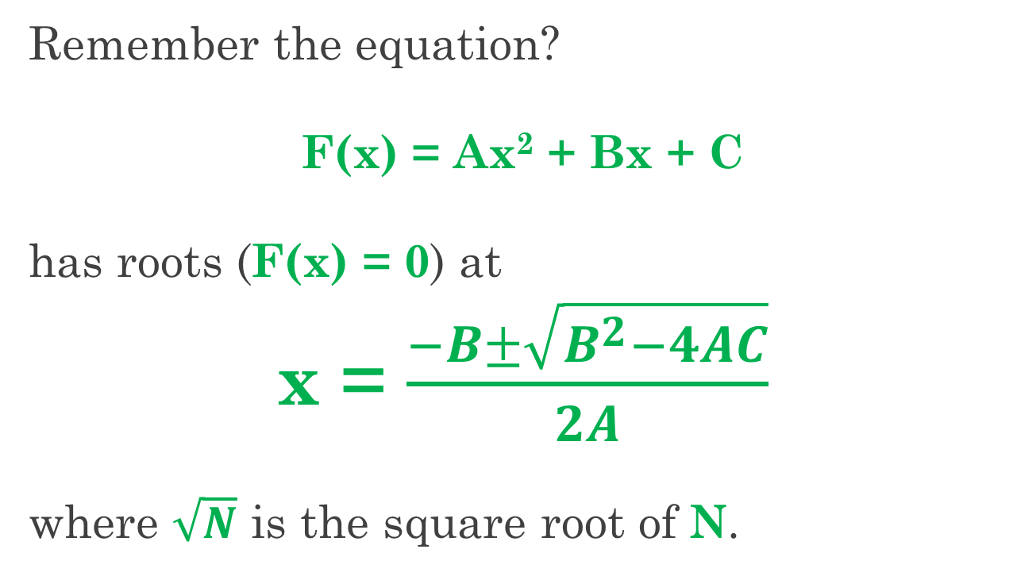
Our Next Program Calculates the Roots of a Quadratic
Remember the equation?
F(x) = Ax² + Bx + C
has roots (F(x) = 0) at
x = $\frac{−B±\sqrt{B^{2}−4AC}}{2A}$
where $\sqrt{N}$ is the square root of N.

Slide 39
Every Statement Must be Executed
How can we test our program?
Let’s start with something simple.
Let’s say that we have a statement that is never executed by tests.
Does the statement work correctly?
How can we know? We have no tests!
So, no, it does not work correctly.
At a minimum, we must execute every statement (called full code coverage).

Slide 40
What Happens When We Run the Program?
Imagine that we compile and run the program.
Take a look at the code.
The first statement is a printf.
The printf always executes, so
we can check whether the printf works
by simply looking at the output.

Slide 41
Choose a Line of Text as Our First Test
The program then waits for input with scanf.
What input should we give?
Let’s just choose something concrete.
Say “0 0 0” (and then <Enter> to start).
What are the values of variables a, b, and c?
0, 0, and 0
What does scanf return?
What happens next?
3
Skip the “then” block!
Notes:
You may need to remind them that scanf returns the number of conversions made successfully; 3, in this case.

Slide 42
Continue Analyzing Until the End
With input “0 0 0” our program next
prints the equation to be solved, and
calculates the discriminant D.
What is the value of D?
(Remember that a, b, and c are all 0.)
So which of the three if-else blocks is executed (first, second, or third)?
And what is x1?
0
second
0 / 0 → NaN
Notes:
Run the code to demonstrate the output. Input is “0 0 0” <Enter>. Point out the prompt, too.

Slide 43
Was that a Bug?
I think so.
The equation is not quadratic when a is 0.
The person who wrote the code perhaps didn’t think of that case.
And neither did I when I edited the code to present to you.
Bugs can be subtle, and testing can be hard!
We won’t fix the bug.

Slide 44
Remember: We Want Full Code Coverage
Let’s try again with input “1 0 0”.
The same parts of the code execute.
And x1 is?
So the single root is at 0, and the program ends successfully.
Our equation was F(x) = x² (+0x + 0), so plugging in x = 0 does produce F(x) = 0.
But our test does not execute all code!
0
Notes:
Again, run the code to demonstrate the output. Input is “1 0 0” <Enter>. Point out the root output, too. Output may be -0.

Slide 45
Adjust the Inputs to Change the if-else Results
What statements did not execute?
“then” block of scanf check
first case of if-else solution computation
third case of if-else solution computation
Let’s adjust our inputs to execute the other solution cases.
“1 0 0” gave the second case because D was not positive and D was 0.

Slide 46
Use “1 0 1” to Test the Third if-else Case
To get D negative, change c to 1 (then D is -4 == 0 * 0 – 4 * 1 * 1).
For the next test,
we type “1 0 1”,
and the program tells us
there are no real roots.
Our equation was F(x) = x² (+ 0x) + 1, so in fact no value of x can produce F(x) = 0.
Notes:
Again, run the code to demonstrate the output. Input is “1 0 1” <Enter>. Point out the output.

Slide 47
Use “1 1 0” to Test the First if-else Case
For the first if-else case, we need D positive.
To get D positive, change b to 1 and c to 0 (then D is 1 == 1 * 1 – 4 * 1 * 0).
For the next test,
we type “1 1 0”,
and the program gives roots at 0 and -1.
Our equation was F(x) = x² + x (+ 0), so F(x) = 0 at both x = 0 and at x = -1.
Notes:
Again, run the code to demonstrate the output. Input is “1 1 0” <Enter>. Point out the two roots.

Slide 48
We Need to Execute the “then” Block of scanf
So far, we have four tests: “0 0 0” (known bug), “1 0 0”, “1 0 1”, “1 1 0”
But we still need a test to execute the “then” block of the scanf check!
Anything that stops scanf from finding three numbers will do. Let’s type “hello”.
So five tests (and verifying the output by hand!) gives full code coverage for this program.
Notes:
Again, run the code to demonstrate the output. Input is “hello” <Enter>. Point out the output.

Slide 49
Good Testing Must Consider Both Purpose and Structure
Full code coverage is just a starting point.
In fact, you should notice that
one of our tests (“0 0 0”)
exposes a bug
in a statement that was already covered
by another test (“1 0 0”).
In general, good testing requires that one think carefully about the purpose of the code as well as the structure of the code.

Slide 50
So Easy that a Computer Can Do It
* * * * * * * * * * * * * * * * * * * * * * * * * * * * * * * * * * *
Full code coverage is easy to explain.
Finding tests to cover more statements means solving some equations.
Computers are good at that (well … pretty good).
The automatic programming feedback tool uses this approach to try to find bugs in your code:
generate tests to cover everything (if possible),
then compare your program’s results with a “gold” program (written by a professor or TA).
Notes:
Our tool is based on Dawson Engler’s (@Stanford) KLEE tool. It uses “concolic” (concrete + symbolic) testing, which is more or less the same idea as was applied in these notes: start with a concrete example, then tweak the variables to cover more code by solving equations based on test conditions in the code.

