Slide 1
University of Illinois at Urbana-Champaign Dept. of Electrical and Computer Engineering ECE 120: Introduction to Computing
Logic Gates

Slide 2
Today: How Can We Build Gates?
3. Functions on bits (Boolean operators, gates)
Circuits
4. Implementation?
Devices
2. Representations based on bits
Electrons
1. Two voltage levels → 1 bit
How can we build gates?

Slide 3
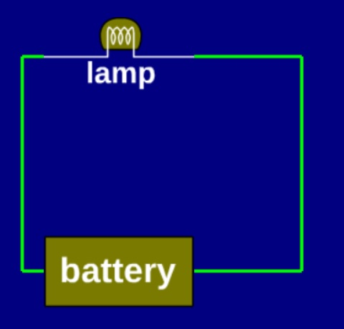
But First: Check Out My New Invention!
Last night I had a great idea.
I call it a “torch.”
At night, you can point it at things.
And they will be lit up.
Anything!
Your car or bike.
Your door lock.
A friend.
What do you think?
Notes:
It’s more fun if you pretend to be serious. Point out that it’s pretty simple, but that you think you can patent it. Ask if anyone wants to pre-purchase one. Then let them tell you that you should add a switch. Ask them why.

Slide 4
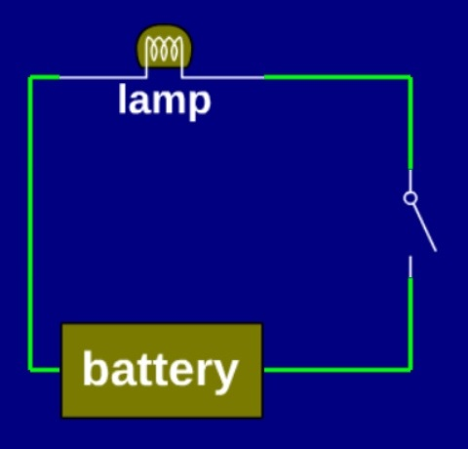
You Think I Should Do What?
Like this?
I think people already make those.
The switch is controlled by your thumb.
They call it a flashlight.
I won’t be able to patent it.
Notes:
If you want to continue the joke, you can tease them about not knowing about flashlights. The idea, of course, was to invent something new and be able to sell it. So suggesting that you make a flashlight is a bit silly.

Slide 5
Don’t Worry: Here’s Another Idea
So, you like switches?
Let’s put a bunch of switches together.
Each controlled by our
When we want to change a bit,
we will just flip a switch!
We’ll call it a hand-operated computer!
We’ll need about 2,000,000,000 switches.
What do you think?
your thumbs.
Notes:
Are they ready to take on Intel, ARM, IBM, Apple, and Samsung? They’ve been training for years with video games!

Slide 6
Still Don’t Like It? One Last Try…
What if we develop a voltage-controlled switch?
Then one switch
can control another switch,
which can control a third switch,
and so on!
Instead of using your thumbs, we can build circuits with 2,000,000,000 switches!
Now THAT’s a really cool idea!
Notes:
Try to get them excited. It’s a really cool idea regardless of whether they think so, after all. (Another joke: Don’t expect to win any international video game competitions if you’re not willing to train!)

Slide 7
Let’s Take a Bragging Break
John Bardeen, 1908-1991
1947: invented transistor at Bell Labs with Shockley & Brattain
1951: joined Illinois ECE faculty (and Physics)
1956: Nobel Prize, Physics
1972: second Nobel Prize, Physics, for Bardeen-Cooper-Schrieffer (BCS) theory of superconductivity

Slide 8
Bardeen’s First Ph.D. Student (1954)
Nick Holonyak, Jr., 1928-
1962: invented visible light LED at GE
1963: joined Illinois ECE faculty
(also invented laser diodes for CDs/DVDs, dimmer switches, and more)
1973: National Academy of Engineering
2003: National Medal of Technology
2008: National Inventors Hall of Fame
(among many other awards)

Slide 9
Holonyak’s First(?) Ph.D. Student (1967)
Greg Stillman, 1936-1999
1975: joined Illinois ECE faculty
invented avalanche photodiodes (for amplifying small photon sources), among many other things
1985: National Academy of Engineering
1985-1987: Founding Director of MNTL (the Micro- and Nano-Technology Lab)

Slide 10
Stillman’s First Ph.D. Student (1979)
Milton Feng, 1950-
1991: joined Illinois ECE faculty
2003: invented Terahertz transistors
Jan 2004: invented light-emitting transistor (with Nick!)
Nov 2004: invented transistor laser (also with Nick!)
2016: just retired…

Slide 11
But Not Just Faculty!
Jack Kilby, 1923-2005
1947: BSEE from Illinois
1958-59: invented integrated circuit at TI
(also invented the thermal printer and the handheld calculator)
1967: National Academy of Engineering
2000: Nobel Prize, Physics
(See why we expect a lot of you?)

Slide 12


Digital Electronics is Based on MOSFETs
Digital electronics today uses MOSFETs.
the material: Metal-Oxide Semiconductors
the mechanism: Field-Effect Transistors (electric field/voltage-controlled)
There are two kinds, named after the charge carrier,
n(egative)-type, and
p(ositive)-type,
drawn as shown here.
n-type
p-type
Notes:
They have not taken quantum mechanics, so be careful when talking about ‘holes’. They should remember valence electrons from high-school chemistry, and they should understand what it means for an orbital to be missing an electron. Charge carriers in semiconductor junctions aren’t too different, and they can learn more in ECE 440 (mention it). Mention crystal structures and band gaps … if you feel comfortable with them.

Slide 13
n-type is On With Positive Gate to Source/Drain Voltage
An n-type MOSFET
turns on (switch is closed, allowing current to flow)
if the voltage from gate (left terminal) to other terminals exceeds a threshold
If the voltage is smaller, the transistor is off (the switch is open).
n-type
if so, current
can flow
voltage >
threshold?
Notes:
I tell the students that I will try to say on/off and avoid closed/open, because I find the latter somewhat confusing.

Slide 14
Our Voltages Will Be Binary
We need two voltages:
0V, a ground
(this is the binary 0 value)
V_{dd}, around 1.5V, high voltage*
(this is the binary 1 value)
*Used to be 5V, but has been decreasing for decades. The rate of decrease is now slowing down.

Slide 15
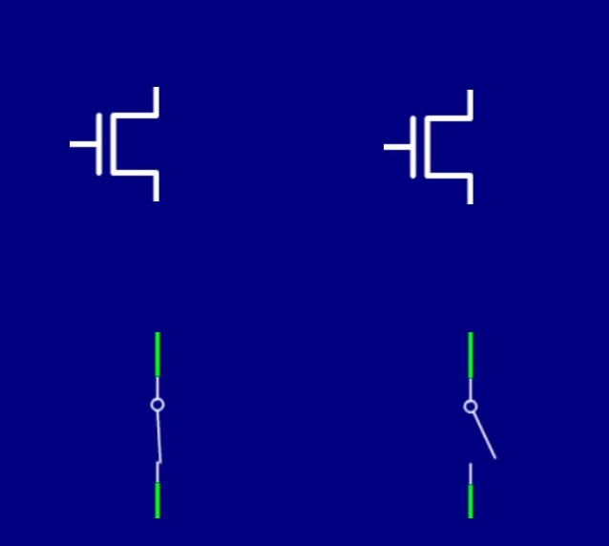
Use Binary Voltages to Control n-Type MOSFETs
n-type only turns on when gate voltage is high (V_{dd}).
An n-type can pull one terminal down to 0V with the other terminal.
1.5V
current can flow
0V
no current
0V
ON / CLOSED
OFF / OPEN
Notes:
Make it clear that that since all voltages are in the range [0,Vdd], a gate voltage of 0V means that the n-type transistor is off, regardless of what values the other terminals take.

Slide 16
p-type is On With Negative Gate to Source/Drain Voltage
A p-type MOSFET
turns on (switch is closed, allowing current to flow)
if the voltage from other terminals to the gate (left terminal) exceeds a threshold
If the voltage is smaller, the transistor is off (the switch is open).
p-type
if so, current
can flow
voltage >
threshold?

Slide 17
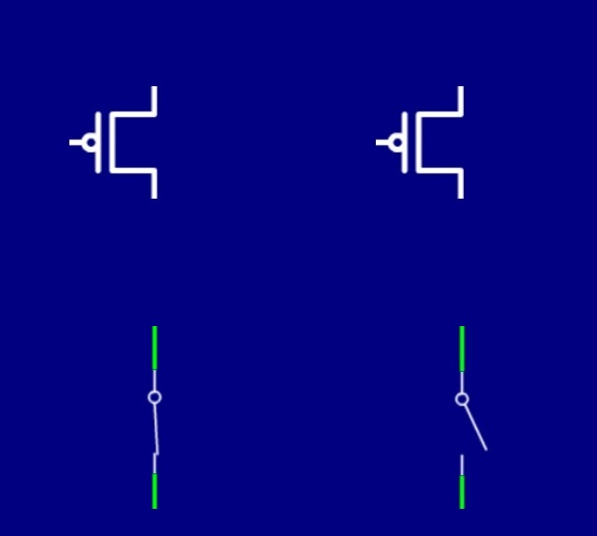
Use Binary Voltages to Control p-Type MOSFETs
p-type only turns on when gate voltage is low (0V).
A p-type can pull one terminal up to V_{dd} with the other terminal.
0V
current can flow
1.5V
no current
1.5V
ON / CLOSED
OFF / OPEN
Notes:
Make it clear that that since all voltages are in the range [0,Vdd], a gate voltage of 1.5V means that the p-type transistor is off, regardless of what values the other terminals take.

Slide 18
The Drawings Help You Remember How They Work
Notice the use of the inverter bubble on the p-type.
Use it to help you remember:
p-type turns on with low voltage (0V, or binary 0).
n-type turns on with high voltage (Vdd, or binary 1).
The names may not be so helpful (again, they refer to charge carriers).
p-type
n-type
Notes:
And, again, take ECE440 to learn more.

Slide 19
Gates are Based on Complementary MOS (CMOS)
So how do we build gates?
Gates use complementary structures of p-type and n-type MOSFETs.
Each gate uses an equal number of each type.
For that reason, we say that
most digital systems are based on CMOS,
or Complementary MOS.

Slide 20
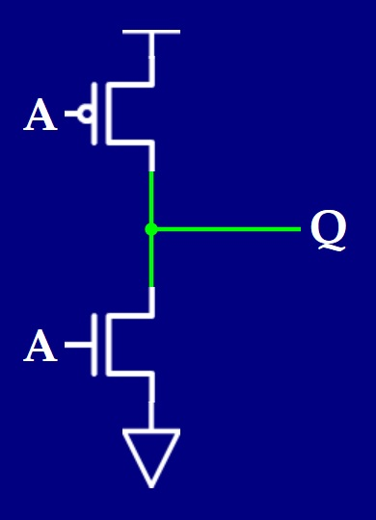
What Does This Gate Do? (when A=0V)
Q connected
to Vdd
Here is the simplest gate.
What does it do?
Let’s write a truth table!
ON
0V
A | Q
0V
1.5V
OFF
1.5V
0V

Slide 21
What Does This Gate Do? (when A=1.5V)
Here is the simplest gate.
What does it do?
Let’s write a truth table!
OFF
1.5V
A | Q
0V | 1.5V
1.5V
ON
1.5V
Q connected
to 0V
0V

Slide 22
It’s a NOT Gate!
Now convert the truth table from voltages to binary.
It’s a NOT gate!
A
Q
A | Q
0V | 1.5V
1.5V | 0V
(0)
(1)
(1)
(0)

Slide 23
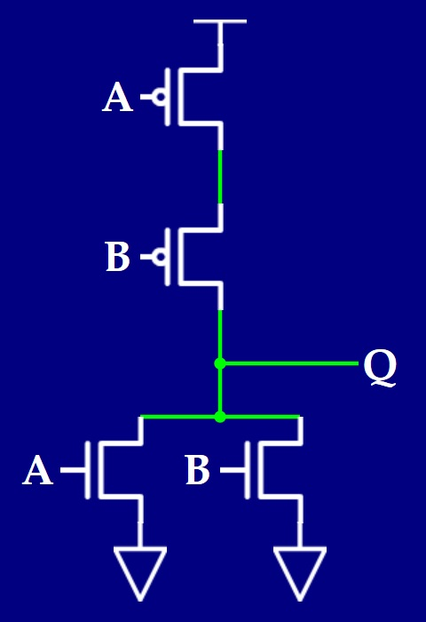
Let’s Analyze Another Structure
Q connected
to Vdd
What about this structure?
ON
A | B | Q
0 | 0
0 | 1
1 | 0
1 | 1
0V
1
ON
0V
OFF
OFF
0V
0V
Notes:
A first (top and bottom), then B, then Q.

Slide 24
Next, Assume A = 0 and B = 1
The A value is the same, so we leave the markings.
ON
A | B | Q
0 | 0
0 | 1
1 | 0
1 | 1
0V
1
OFF
0
1.5V
OFF
ON
0V
1.5V
Q connected
to 0V

Slide 25
Next, Assume A = 1 and B = 1 (BOTTOM LINE!)
The B value is the same, so we leave the markings.
OFF
A | B | Q
0 | 0
0 | 1
1 | 0
1 | 1
1.5V
1
OFF
0
1.5V
ON
0
ON
1.5V
1.5V
Q connected
to 0V
Notes:
Point out that we knew Q=0 from B=1, and we knew that Q was NOT connected to Vdd (would make a short!), so we didn’t really need to fill in A..

Slide 26
Finally, Assume A = 1 and B = 0
The A value is the same, so we leave the markings.
OFF
A | B | Q
0 | 0
0 | 1
1 | 0
1 | 1
1.5V
1
ON
0
0V
0
ON
OFF
0
0V
1.5V
Q connected
to 0V
Notes:
Again, we need do nothing once we examine the A=1 markings (which we already start with from the previous figure), but we’ll walk through it anyway. Ask what it is before moving on. They can probably guess—at least someone should have read about NOR already.

Slide 27
It’s a NOR Gate!
We see that Q = (A+B)’.
A | B | Q
0 | 0
0 | 1
1 | 0
1 | 1
1
0
0
0
NOR
gate
A
(A+B)’
B
Notes:
Students can think of the NOR as OR followed by NOT. You may need to remind them of the truth table of OR, but probably not.

Slide 28
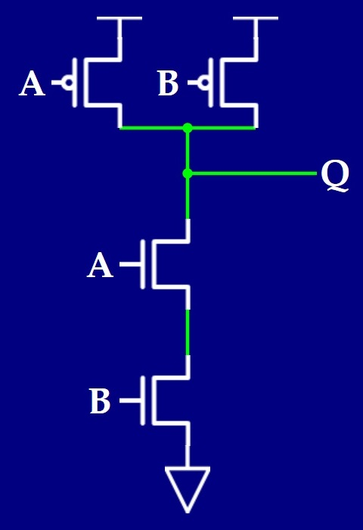
And Just One More to Analyze…
Q connected
to Vdd
What if A=0?
ON
A | B | Q
0 | 0
0 | 1
1 | 0
1 | 1
0V
1
OFF
1
0V
Notes:
Let’s do this one more quickly. Check A=0 and show that Q=1.

Slide 29
Notice that the Circuit is Symmetric in A and B
What if B=0?
0V
ON
A | B | Q
0 | 0
0 | 1
1 | 0
1 | 1
Q connected
to Vdd
1
1
1
OFF
0V
Notes:
They should note the symmetry and be able to give the answer for B=0 without further analysis, but show them anyway.

Slide 30
And if Both A = 1 and B = 1?
OFF
1.5V
OFF
A | B | Q
0 | 0
0 | 1
1 | 0
1 | 1
1.5V
1
1
ON
1.5V
1
ON
0
1.5V
Q connected
to 0V
Notes:
Again A, then B, then Q.

Slide 31
It’s a NAND Gate!
We see that Q = (AB)’.
A | B | Q
0 | 0
0 | 1
1 | 0
1 | 1
1
1
1
0
NAND
gate
A
(AB)’
B

Slide 32
Generalizing to More Inputs
Notice the common features
p-type always connected to Vdd.
n-type always connected to 0V.
One side is parallel, the other is serial (they are duals* of one another).
Can you generalize NAND/NOR to more inputs?
Let’s try it in the online tool…
*See Notes Section 2.2.1.
Notes:
Let them tell you what to do. It’s probably a good idea to pre-draw NAND2 and NOR2 and save them.

Slide 33
A Couple of Practical Limits
Gates scale to about 4 inputs before using more gates is a better approach.
One can easily
design an AND or an OR gate with CMOS
by swapping n-type with p-type,
but MOSFETs don’t work properly in those designs.
Try it in the online tool to see what happens.
(NAND followed by NOT is, of course, AND.)

Slide 34
University of Illinois at Urbana-Champaign Dept. of Electrical and Computer Engineering ECE 120: Introduction to Computing
Optimizing Logic Expressions

Slide 35
We Can Use Logical Completeness to Express Functions
A | B | C | F
0 | 0 | 0 | 0
0 | 0 | 1 | 0
0 | 1 | 0 | 0
0 | 1 | 1 | 0
1 | 0 | 0 | 0
1 | 0 | 1 | 1
1 | 1 | 0 | 1
1 | 1 | 1 | 1
Let the truth table to the right define the function F.
Recall that we can use the logical completeness construction to write F as a Boolean expression:
This row is…
And this is…
And this is …
AB’C
ABC’
ABC

Slide 36
What’s the Best Way to Write Function F?
A | B | C | F
0 | 0 | 0 | 0
0 | 0 | 1 | 0
0 | 1 | 0 | 0
0 | 1 | 1 | 0
1 | 0 | 0 | 0
1 | 0 | 1 | 1
1 | 1 | 0 | 1
1 | 1 | 1 | 1
So F = AB’C + ABC’ + ABC
But we can also write F = AB + AC.
What about F = A (B + C)?
Which one is best?

Slide 37
Your Answer Is Wrong! Choose a Metric First
The answer depends on our choice of metric!
How do we measure good?
Common answers for circuit design:
area / size / cost, OR
performance / speed, OR
power / energy consumption, OR
complexity / reliability.

Slide 38
We Use Heuristics for These Metrics
In practice, measuring exactly is expensive (~$50-100M for a full design, and ~$2-5M just for trying something.)
Instead, we use heuristics, which are ways of estimating a metric.
A good heuristic is
reasonably accurate, and
monotonic relative to a real measurement
(so that bigger estimates mean bigger measurements).

Slide 39
An Area Heuristic for ECE120
Here’s a heuristic for area:
Count literals (A, A’, B, B’, C, C’), then
Add the number of operations (not including complements for literals).
Why does it work? Remember gate structures?
each input (literal) → two transistors
operators into operators → two transistors
So it gives an approximate transistor count.
(But wires also take space!)

Slide 40
A Delay (Speed) Heuristic for ECE120
Here’s a heuristic for delay / speed:
Find the maximum number of gates between any input and any output.
Do not include complements for literals.
Why does it work?
Each gate takes time switch its output on/off.
We call this time a gate delay.
So it gives an approximate delay between inputs changing and outputs changing.
Notes:
Speed is limited by the delay from input to output. They will see how more directly in 2-3 weeks. Let them ignore complemented literals for now—we can count them when they understand why they’re usually free, but consistency with the area heuristic is better at this point.

Slide 41
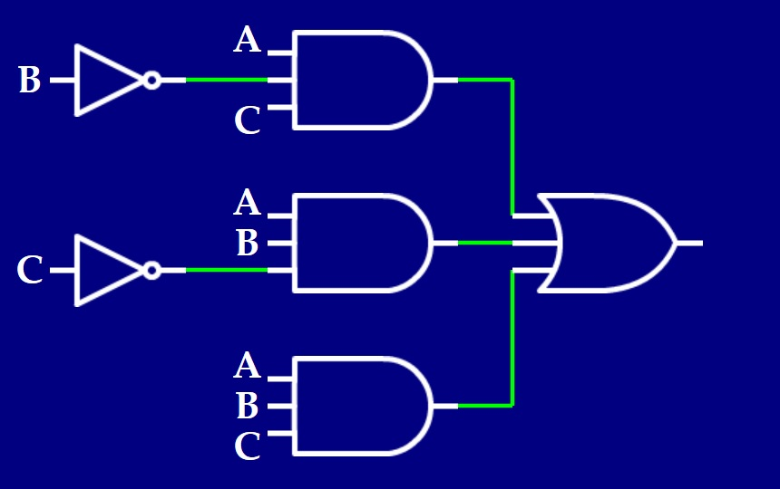
A Graphical View May Make Counting Easier
Number of literals is 9.
F = AB’C + ABC’ + ABC
Delay (on all
paths) is 2.
Number of
operators (gates) is 4.
Ignore these inverters for now.
Notes:
Most students find it easier to count graphically than algebraically, but explain that the two are equivalent when done correctly.
Make it clear: just ignore the area and delay of the input inverters for now.

Slide 42
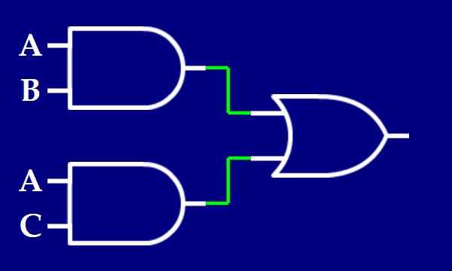
Let’s Analyze the Second Form of F
Number of literals is 4.
F = AB + AC
Number of
operators (gates) is 3.
Delay (on all
paths) is 2.
Notes:
Make it clear: just ignore the area and delay of the input inverters for now.

Slide 43
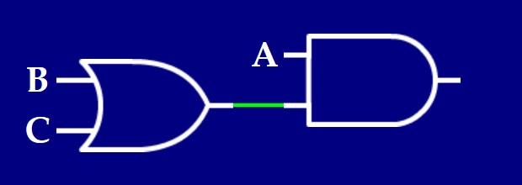
Let’s Analyze the Third Form of F
Number of literals is 3.
F = A (B + C)
Number of
operators (gates) is 2.
Delay (on longest
paths) is 2.
Notes:
Make it clear: just ignore the area and delay of the input inverters for now.

Slide 44
The Area Heuristic Favors F = A (B + C)
Let’s calculate the area heuristic for our three forms of F.
So F = A (B + C) is the smallest design.
Form of F | Lits | Ops | Area
AB’C + ABC’ + ABC
AB + AC
A (B + C)
9
4
13
4
3
7
3
2
5
Notes:
Let the students do it. Ops are counted regardless of number of inputs, so we have 3 x 3-input AND + 1 x 3-input OR in the first form. The transistors in the AND gates are covered by the literal counting. The output of the AND gates is what we are counting—each feeds into the OR gate at a cost of 2 transistors. The OR gate count is just extra, but we always have 1 “last” operation, so it doesn’t change monotonicity. It’s not the best heuristic, of course, but it’s easy.

Slide 45
All Forms Are Equivalent in Delay
All designs are the same for delay.
Form of F | Lits | Ops | Area | Delay
AB’C + ABC’ + ABC | 9 | 4 | 13
AB + AC | 4 | 3 | 7
A (B + C) | 3 | 2 | 5
2
2
2
Notes:
Don’t do anything here. The table is just filled from the preceding graphical results.

Slide 46
We Have a Winner: F = A (B + C)
F = A (B + C) is best by both metrics.
But the answers are not always so simple.
Sometimes no solution is best by both metrics.
See Section 2.1.1 for a simple example.
Later in our class, we will explore more space/time tradeoffs in design.
In practice, tradeoffs are commonplace.
Take a look at Section 2.1.6* for more.
Notes:
I may or may not do a set of slides on Pareto optimization. I have fun covering it in class, and usually find time for it. It’s not exam material, but it’s good for them to learn the idea early.

Slide 47
What About Power and Complexity?
* * * * * * * * * * * * * * * * * * * * * * * * * * * * * * * * * * *
These two metrics are beyond our class’ scope. You’ll see power in ECE385.
One heuristic for power
uses the fact that current flows when a transistor switches on/off
and uses simulation to estimate the number of times that happens.
Complexity is hard to measure, and is usually based on experience.

