Slide 1
University of Illinois at Urbana-Champaign Dept. of Electrical and Computer Engineering ECE 120: Introduction to Computing
Boolean Expression Terminology

Slide 2
Let’s Review and Define Some New Terms
literal a variable or its complement
examples: A, A’, B, B’, C, C’
sum several terms ORed together
examples: A + B, AB + B(C + D) + A’C,
A’B’ + D(A ⊕ B)(C + A’)
product several terms ANDed together
examples: AB, (A + B)(B + CD)(A’ + C),
(A’ + B’)(D + (A ⊕ B) + CA’)

Slide 3
Minterms Were Useful for Proving Logical Completeness
minterm on N inputs a product in which each variable or its complement appears exactly once (no other factors)
examples: AB’, A’B, AB (on inputs A, B)
AB’C, AB’C’, A’BC’
(on inputs A, B, C)

Slide 4
A Maxterm Produces a Function with One Zero Row
maxterm on N inputs a sum in which each variable or its complement appears exactly once (no other terms)
examples: (A + B’), (A’ + B), (A + B)
(on inputs A, B)
(A + B’ + C), (A + B’ + C’),
(A + ’B + C’)
(on inputs A, B, C)
Notes:
Be sure that students understand the duality. Minterms are functions with one 1 row in their truth tables. They saw them when we proved logical completeness of {AND,OR,NOT}. Maxterms are functions with one 0 row in their truth tables. There is a dual logical completeness proof based on maxterms, of course.

Slide 5
Sum-of-Products (SOP) Form is Quite Common
sum-of-products (SOP) a sum (OR) of products (AND) of literals
examples: AB + BC,
AB’ + C + A’C’D’,
but NOT A(B + C) + D

Slide 6
Product-of-Sums (POS) Form is Also Common
product-of-sums (POS)
a product (AND) of sums (OR) of literals
examples: (A + B)(B + C),
(A + B’)C(A’ + C’ + D’),
but NOT (A + BC)D

Slide 7
Canonical Forms Allow Easy Comparison, But Are Too Big
canonical SOP a sum of minterms; the expression produced by the logical completeness construction
canonical POS a sum of maxterms
What does canonical mean?
Unique (if we assume an ordering on variables).
Too many terms to be of practical value.
Notes:
Better solutions like BDDs (binary decision diagrams) are out of scope, of course. Students should learn the meaning of “canonical” and the idea of finding unique forms for identification, but they should not be encouraged to believe that canonical SOP/POS forms are important in practice.

Slide 8
Do You Know Mathematical Implication?
What does A→B mean?
A implies B.
In other words: if A is true, B is also true.
What if A is false?
In that case, is A→B true or false?
If A is false, A→B is true.

Slide 9
So the Following Odd Statements are True
All purple elephants can fly.
(X is a purple elephant → X can fly.)
Students who score above 125% in ECE120 fail the class.
(X scored above 125% → X fails.)
In both, the premise is false for any X, so the implications are true.

Slide 10
One Function Can Imply Another
A function G is an implicant of a second function F iff G operates on the same variables as F and G→F.
In other words, every row
with an output of 1 in G’s truth table
also has an output of 1 in F’s truth table.
0 rows in G’s truth table do not matter.
Notes:
Make sure that the students understand that the 0 rows allow G to imply F because implication is always true if the premise (left side) is false.

Slide 11
For Our Purposes, Implicants are Products of Literals
In digital design, we only refer to products of literals as implicants.
So we will assume that an implicant can be written as a product of literals.

Slide 12
We Can Use Implicants to Simplify Functions
As a first step towards simplifying a function F, we can ask:
Given an implicant G of F, can we remove any of its literals and obtain another implicant of F?
For example, take F = AB’C + ABC’ + ABC.
The first term (AB’C) is an implicant.
Can we remove any literals?
Notes:
Be sure that the students understand why AB’C is an implicant (put a 1 into OR and out comes a 1).

Slide 13
Try to Remove Each Literal to Find Only AC Implies F
A | B | C | F | B’C | AC | AB’
0 | 0 | 0 | 0 | 0 | 0 | 0
0 | 0 | 1 | 0 | 1 | 0 | 0
0 | 1 | 0 | 0 | 0 | 0 | 0
0 | 1 | 1 | 0 | 0 | 0 | 0
1 | 0 | 0 | 0 | 0 | 0 | 1
1 | 0 | 1 | 1 | 1 | 1 | 1
1 | 1 | 0 | 1 | 0 | 0 | 0
1 | 1 | 1 | 1 | 0 | 1 | 0
Start from AB’C and try to remove each literal.
B’C is not an implicant.
AC is an implicant.
AB’ is not an implicant.
Notes:
Be sure that the students understand the calculation. I don’t think they need to fill this table, though. But show them why B’C and AB’ are not implicants.

Slide 14
We Remove as Many Literals as We Can
So we can simplify F by replacing AB’C with AC:
F = AC + ABC’ + ABC
Checking the second term (ABC’), we find that we can eliminate C’ to obtain:
F = AC + AB + ABC
In the third term (ABC), we can eliminate B or C, but not both. Let’s pick B.
F = AC + AB + AC
Notes:
Be sure that the students understand why AB’C is an implicant (put a 1 into OR and out comes a 1).

Slide 15
Prime Implicants Have a Minimal Number of Literals
F = AC + AB + AC
But now we have a duplicate term, which we can eliminate to arrive at a simple form for F:
F = AC + AB
We can remove no more literals.
One more definition: An implicant G of F is a prime implicant of F iff none of the literals in G can be removed to produce other implicants of F.
AB and AC are prime implicants of F.

Slide 16
To Simplify, Write Function as a Sum of Prime Implicants
The conclusion is obvious:
To simplify a function F, write it as a sum of prime implicants.
Enjoy the algebra.
Good luck!
(Next, we’ll develop a graphical tool that lets us skip the algebra.)

Slide 17
University of Illinois at Urbana-Champaign Dept. of Electrical and Computer Engineering ECE 120: Introduction to Computing
Karnaugh Maps (K-Maps)

Slide 18
To Simplify, Write Function as a Sum of Prime Implicants
One way to simplify a function F:
Choose a set of prime implicants that, when ORed together, give F.
But our approach for picking prime implicants is not so easy.

Slide 19
List All Implicants for One Variable A
Let’s try a different approach.
Start with functions of one variable, A.
How many implicants are possible?
Remember:
There are only four functions on A!
We only consider products of literals.
(1 is the product of zero literals.)
A
A’
1

Slide 20
The Domain of a Boolean Function is a Hypercube
We can
represent the domain
of a Boolean function F on N variables
as an N-dimensional hypercube.
Each vertex in the hypercube corresponds to one combination of the N inputs.
The function F thus has one value for each vertex (each input combination).

Slide 21
Implicants for N=1 Correspond to Vertices and Edge
With N = 1 (one variable, A), a hypercube is just a line segment with two vertices.
The three possible implicants correspond to the two vertices and the one edge of the hypercube.
If we write the values of F by the vertices, we can see which implicants are covered with 1s.
A=0
A=1
A’
A
1
A

Slide 22
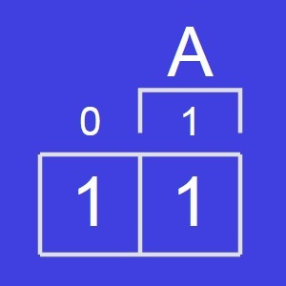
We Draw Function F(A) Using a 1-Variable K-Map
Instead of drawing a line segment, we can draw two boxes, as shown below.
We call this approach a Karnaugh map (K-map) on 1 variable.
The left box corresponds to A = 0, and the right corresponds to A = 1.
Each box represents
an input combination of A,
a vertex of the hypercube, and
an implicant (a minterm).

Slide 23
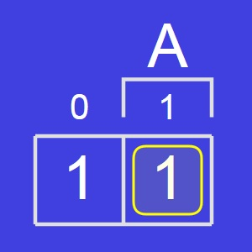
We Draw Function F Using a 1-Variable K-Map
We can mark implicants of F by circling boxes that contain 1s.
Here, we show a loop around the box corresponding to the implicant A.
To check whether an implicant is prime, we consider growing the loop to contain more boxes.
A circle that cannot grow is a prime implicant of F.

Slide 24
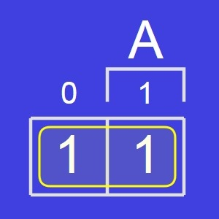
We Draw Function F Using a 1-Variable K-Map
For the function F shown, we can grow the loop to contain both boxes.
The loop is now as big as possible (the full K-map!), so it cannot grow further.
The result (the implicant 1) is a prime implicant of F.
So F(A) = 1.
Feel excited?

Slide 25
List All Implicants for Two Variables, A and B
Now consider two input variables, A and B.
How many implicants are possible?
Start with minterms…
And products of one literal…
And, of course …
AB
AB’
A’B
A’B’
A
A’
B
B’
1

Slide 26
Minterms Correspond to Vertices
With N = 2 (inputs A and B), a hypercube is a square: four vertices, four edges, and a face.
A=0
A=1
A’B’
AB’
B=0
B
B=1
A’B
AB
A

Slide 27
Single-Literal Implicants Correspond to Edges
Edges include both values of one variable.
B’
A=0
A=1
B=0
B
B=1
A’
A
B
A

Slide 28
The Implicant 1 Corresponds to the Face/Square
The face includes both values of both variables.
A=0
A=1
1
B=0
B
B=1
A

Slide 29
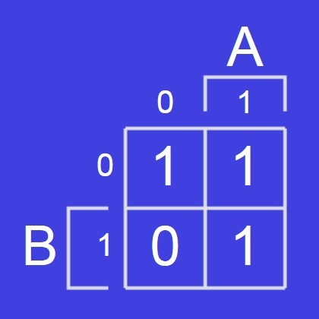
We Draw Function G(A,B) Using a 2-Variable K-Map
We can draw a K-map on 2 variables for the function G(A,B) as shown below.
Again, each box represents
an input combination
a vertex of the hypercube, and
an implicant (a minterm).

Slide 30
Process for Finding G(A,B) Using a K-Map
Now the problem is more interesting.
We want to find the largest loops
with power-of-2 edge lengths (1 or 2)
that together cover all 1s in G.
Why?
A loop that can’t grow is a prime implicant of G.
If we cover all 1s, the sum of the implicants gives the function G.
Notes:
Be sure that the students make the connection with our original goal: find a set of prime implicants that, when ORed together, give us the function G(A,B).

Slide 31
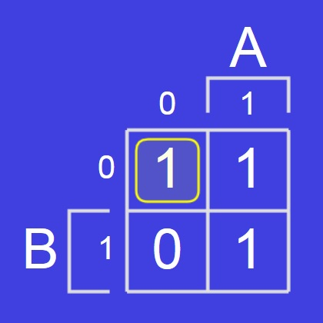
To Find G, Start by Picking a 1 and Circling It
Start by picking a 1 and circling it.
The minterm A’B’ is an implicant of G.
But it’s not a prime implicant of G.
We cannot grow the loop downward (cannot cover a 0—that would not be an implicant).
We can grow the loop to the right…

Slide 32
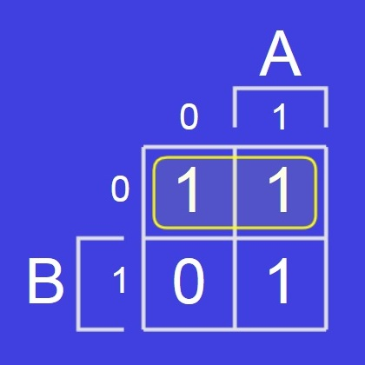
Grow the Loop Until We Get a Prime Implicant
Let’s grow the loop.
The loop now represents B’, which is a prime implicant of G.
But we didn’t cover one of the 1s in G yet.
We need a second loop.

Slide 33
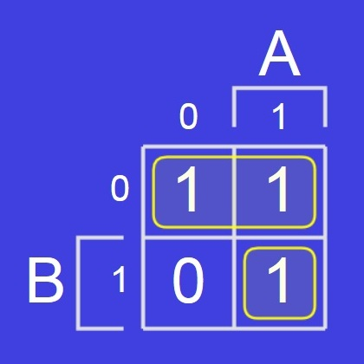
Start a Second Loop by Circling an Uncovered 1
The new loop represents the minterm AB, which is an implicant of G.
But it’s not a prime implicant of G.
We cannot grow the new loop to the left.
We can grow the new loop upward…

Slide 34
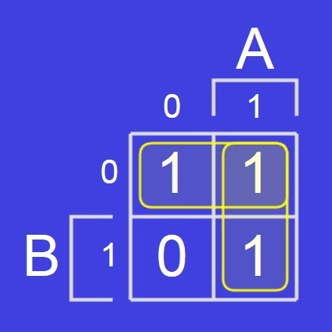
Again, Grow the Loop Until We Get a Prime Implicant
Let’s grow the loop.
The loop now represents A, which is a prime implicant of G.
Together, these two loops cover all 1s in G(A,B).
So we can write
G(A,B) = B’ + A
Now are you excited?

Slide 35
List All Implicants for Variables A, B, and C
Guess what’s next.
Three input variables: A, B, and C!
How many implicants are possible?
That’s right: lots.
A 3D hypercube is a cube.
Let’s count features instead.

Slide 36
A 3D Hypercube Has Vertices, Edges, Faces, and Cube
Now, let’s count.
# of vertices?
# of edges?
# of faces?
# of cubes?
So the total is 27.
A=0
A=1
8
12
B=0
6
B
C=1
B=1
1
C=0
A
Notes:
Let the students answer.

Slide 37
Notice a Pattern? 3^{N} Implicants on N Variables
N = 1 gives 3 implicants.
N = 2 gives 9 implicants.
N = 3 gives 27 implicants.
Maybe N gives 3^{N} implicants?
Why?
For each input variable, we have three choices:
include the variable
include the complemented variable, or
leave the variable out.
Notes:
Let the students answer.

Slide 38
How Can We Draw Boxes for the Cube?
Focus on the top half.
Each adjacent A,C pair shares an edge.
The last edge wraps around (from 10 to 00).
The top face is all four.
A=0
A=1
B=0
B
C=1
B=1
C=0
A
value of A,C
00
01
11
10

Slide 39
Loops Can be 1, 2, or 4 Boxes Wide
So we use Gray code order on the boxes (one bit changes at a time).
Loops can be
1 box wide (a vertex)
2 boxes wide (an edge)
4 boxes wide (the face)
Loops cannot be 3 boxes wide, because 3 boxes do not correspond to an implicant (implicants are hypercube features).

Slide 40
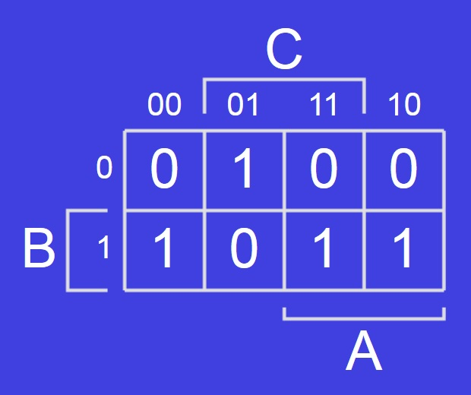
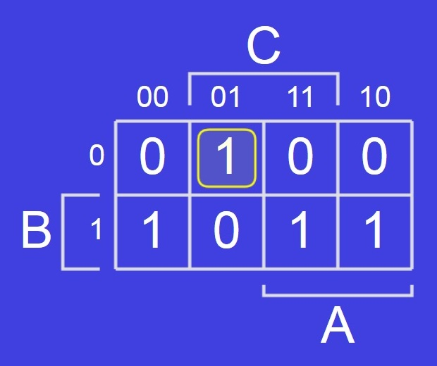
We Draw Function H(A,B,C) Using a 3-Variable K-Map
Here is a 3-variable K-map.
Let’s find a way to express H(A,B,C).
Start by circling a 1.

Slide 41
Some Minterms May Be Prime Implicants
The loop represents minterm A’B’C.
Is A’B’C a prime implicant of H?
Yes, since we cannot grow the loop left, right, nor downward.
Notes:
Let the students answer.

Slide 42
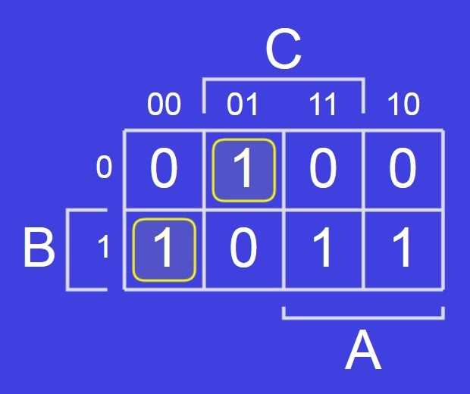
Don’t Forget to Check for Wrapping
Choose another 1 to cover and circle it.
The new loop is the minterm A’BC’.
Is A’BC’ prime for H(A,B,C)?
No, we can grow the loop to the left (wrap around).
Notes:
Let the students answer.

Slide 43
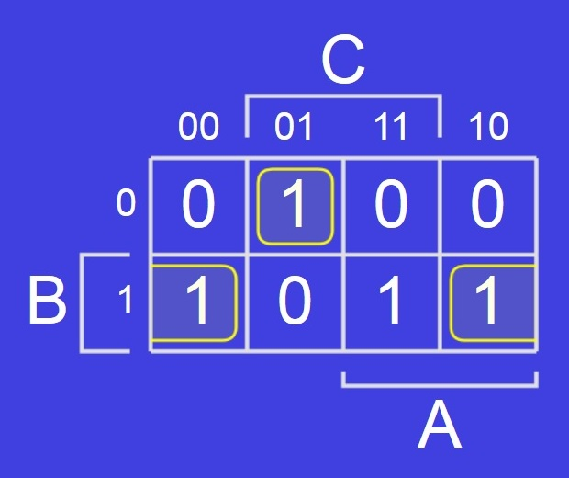
We Have Found a Second Prime Implicant
Grow the loop.
The new loop is BC’.
Is BC’ prime for H(A,B,C)?
Yes. A loop cannot have three 1s, and we cannot include the 0 in the row.
Notes:
Let the students answer.

Slide 44
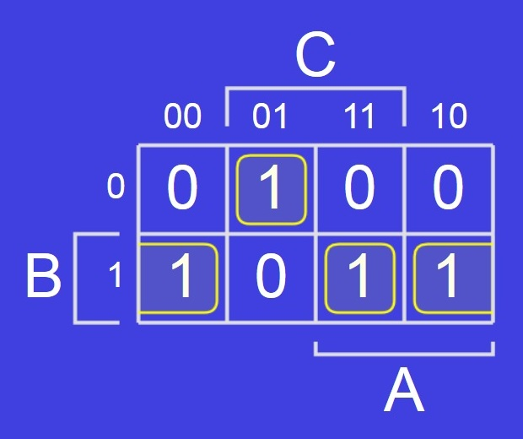
Keep Choosing Prime Implicants Until All 1s are Covered
We still have another 1 to cover. Circle it.
The new loop represents minterm ABC.
Is ABC a prime implicant of H?
No, we can grow the loop to the right.
Notes:
Let the students answer.

Slide 45
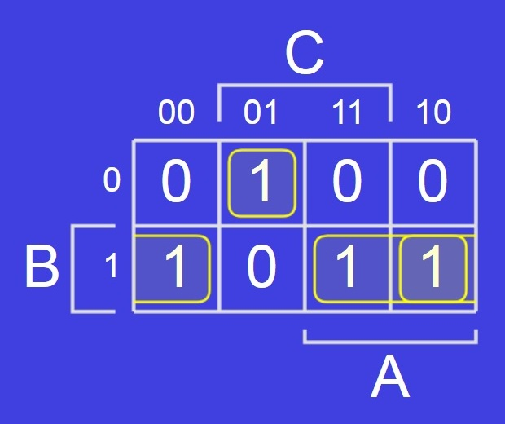
And We’re Done: H(A,B,C) = A’B’C + BC’ + AB
Grow the loop.
The new loop is AB.
Is AB prime for H(A,B,C)?
Yes.
So H(A,B,C) = A’B’C+BC’+AB
Notes:
Let the students answer.

Slide 46
K-Maps Extend Nicely to Four Variables
Now you’re excited?
Ok, on to 4 variables!
It’s hard to draw the hypercube.
But the K-map is not so bad.
Remember:
Gray code order in both directions.
1, 2, or 4-box loops (no 3-box loops!).

Slide 47
Goal: Minimal Number of Loops, Maximal Size per Loop
Your goal is to come up with
a minimal number of loops
of maximal size (all prime, of course).
that together cover all 1s in the function.
If you do so, the result will be optimal among SOP expressions* by our area heuristic (for 4 or fewer variables).
*A POS expression might be better, as might an expression using XORs.

Slide 48
Considerations for Optimizing with K-Maps
Sometimes you end up with loops that aren’t needed. If all of a loop’s 1s are covered by other loops, you can remove the loop.
To make the process faster,
try to start by covering 1s for which you need make no choices
(1s for which all directions with adjacent 1s can be included in one big loop).
But you may have to make choices, and there can be more than one optimal SOP form.
Notes:
Illustrate the idea with the tool! Or add an example or two here, if you’d rather.

Slide 49
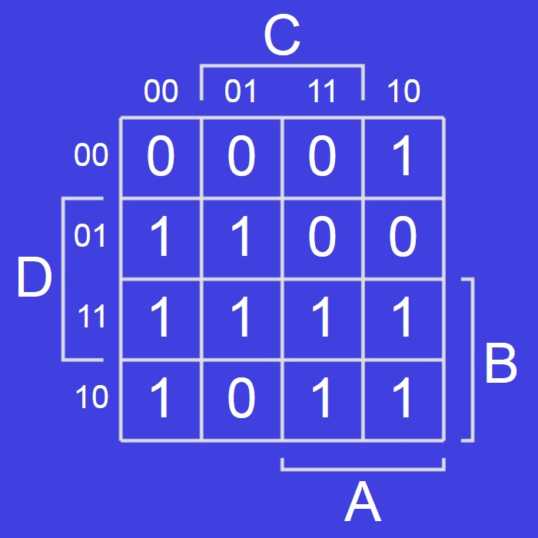
Here’s a 4-Variable K-Map
Here’s how a 4-variable K-map looks.
We won’t solve this one now.
Want to try it in the online tool?
Notes:
You can show them how to use the tool. There are a bunch of related exercises to help them learn to solve K-maps and to read off the resulting prime implicants. All of the figures are screenshots of the tool.

