Slide 1
University of Illinois at Urbana-Champaign Dept. of Electrical and Computer Engineering ECE 120: Introduction to Computing
Boolean Properties and Optimization

Slide 2
The Dual Form Swaps 0/1 and AND/OR
Boolean algebra has an interesting property called duality.
Let’s define the dual form of an expression as follows:
Starting with the expression,
swap 0 with 1 (just the values, not variables),
and swap AND with OR.

Slide 3
Every Boolean Expression Has a Dual Form
For example, what is the dual of
A + (BC) + (0 (D + 1) ) ?
First replace the 0 with 1 and the 1 with 0.
Then replace + (OR) with· (AND) and vice-versa.
We obtain:
A· (B + C)· (1 + (D· 0) )

Slide 4
The Dual of the Dual is the Expression
So what is the dual of
A· (B + C)· (1 + (D· 0) ) ?
Since we’re swapping things, swapping them again produces the original expression:
A + (BC) + (0 (D + 1) )
Thus any Boolean expression has a unique dual, and the dual of the dual is the expression (hence the term duality—two aspects of the same thing).

Slide 5
Pitfall: Do Not Change the Order of Operations
Be careful not to change the order of operations when finding a dual form.
For example, the dual form of
A + BC
is
A (B + C)
The operation on B and C must happen before the other operation.

Slide 6
Why Do You Care? One Reason: the Principle of Duality
Three reasons:
CMOS gate structures are dual forms
Quick way to complement any expression
the principle of duality
Let’s start with the last, which we’ll use shortly (when we examine more properties).
Principle of duality: If a Boolean theorem or identity is true/false, so is the dual of that theorem or identity.

Slide 7
Generalized DeMorgan is Quick and Easy
Let’s say that we have an expression F.
To find F’ … apply DeMorgan’s Laws …
Apply repeatedly, as many times as necessary.
Or use the generalized version based on duality:
Write the dual form of F.
Swap variables and complemented variables.
(That’s all.)

Slide 8
An Example of Finding a Complement with the Dual Form
F = AB (C + (DL’G(B’ + A + E))) (H + (J’A’B))
What’s F’?
The dual is
A + B + (C (D + L’ + G + (B’AE))) + (H (J’ + A’ + B))
So
F’ = A’ + B’ + (C’ (D’ + L + G’ + (BA’E’))) + (H’ (J + A + B’))
You can skip the middle step once you’re comfortable with the process.

Slide 9
We Can Derive a Gate’s Output from the n-type Network
What about CMOS gate structures?
Think about the network of n-type MOSFETS connecting an output Q to 0V.
For example, consider a set of four n-type arranged in parallel with inputs A, B, C, and D.
So Q = 0 if ANY of the transistors is on. In other words, Q is 0 when A + B + C + D.
Thus Q = (A + B + C + D)’. A NOR gate.

Slide 10
We Can Also Derive Function from the p-type Network
What about the p-type transistors on the same gate?
They are arranged in series.
They connect Q to V_{dd}.
But p-type transistors are on when their gates are set to 0. So Q = 1 when ALL of the inputs are 0.
Thus Q = A’B’C’D’.
That’s the same expression, of course.

Slide 11
The Expressions are Related via Generalized DeMorgan
But notice that we can also
get the second form
by applying generalized DeMorgan to the first form.
Starting with
Q = (A + B + C + D)’,
we find the dual of A+B+C+D to be ABCD, so
Q = A’B’C’D’.

Slide 12
The Networks are Dual Forms of One Another
The complemented variables come from the use of p-type transistors.
The dual form is built into the gate design.
If we want to design a gate for something OTHER than NAND, NOR, NOT:
Write the output as Q = (expression)’,
Build that expression from n-type MOSFETs.
Build the dual of the expression from p-type MOSFETs.

Slide 13
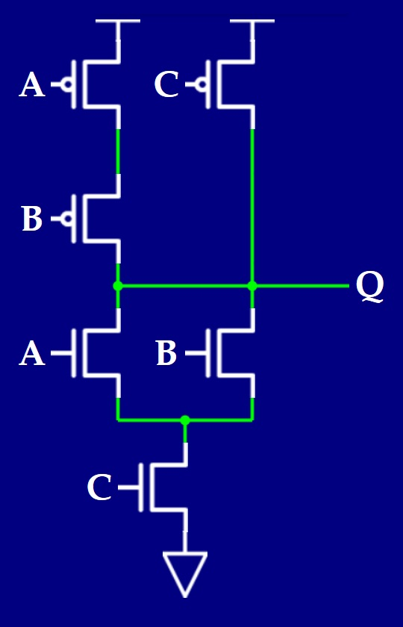
An Example of an Unusual Gate
Consider the gate here:
From the n-type network,
Q = ((A + B) C)’
The dual of the expression (ignoring the complement) is
AB + C
which is the structure of the p-type network.

Slide 14
Area and Speed for the Unusual Gate
So the function Q = ((A + B) C)’ requires six transistors and one gate delay.
We can, of course, limit ourselves to NAND/NOR gates.
In that case, Q = ((A’B’)’ C)’
We use one two-input NAND for (A’B’)’, and a second two-input NAND for Q.
If we assume that A’ and B’ are available, the NAND design requires eight transistors and two gate delays.

Slide 15
Optimization versus Abstraction
Most designers just use NAND and NOR (or, today, even higher-level abstractions!).
In general:
breaking abstraction boundaries can give us an advantage,
but the boundaries make the design task less complex,
which improves human productivity and reduces the likelihood of mistakes.
That’s another tradeoff.
Computer aided design (CAD) tools can perform some of these optimizations for us, too.
Notes:
Talk about hardware design languages (HDLs) and high-level synthesis (if you’re comfortable with the latter). ECE385 now makes use of System Verilog and targets FPGA synthesis, so the students will do hardware prototyping using a language similar to C rather than laying out gates and components.

Slide 16
Simple Boolean Properties
Easy, but useful to commit to memory for analyzing circuits…
1 + A = 1 0· A = 0
1· A = A 0 + A = A
A + A = A A· A = A
A· A’ = 0 A + A’ = 1
(Each row gives two dual forms.)

Slide 17
More Dual Form Boolean Properties
DeMorgan’s Laws are also dual forms
(A + B)’ = A’B’ (AB)’ = A’ + B’
What about distributivity? Here’s the rule that you know from our usual algebra
A(B + C) = AB + AC
(multiplication distributes over addition)
It’s also true in Boolean algebra: AND distributes over OR.

Slide 18
OR Also Distributes Over AND in Boolean Algebra
A(B + C) = AB + AC
Now take the dual form…
A + BC = (A + B)(A + C)
OR distributes over AND!
(Note that this property does NOT hold in our usual algebra. 14 + 7· 4 ≠ (14 + 7)(14 + 4) )

Slide 19
One More Property: Consensus
The last property is non-intuitive.
AB + A’C + BC = AB + A’C
It’s called “consensus” because
the first two terms TOGETHER (when both are true, and thus reach a consensus) imply the third term
so the third term can be dropped.

Slide 20
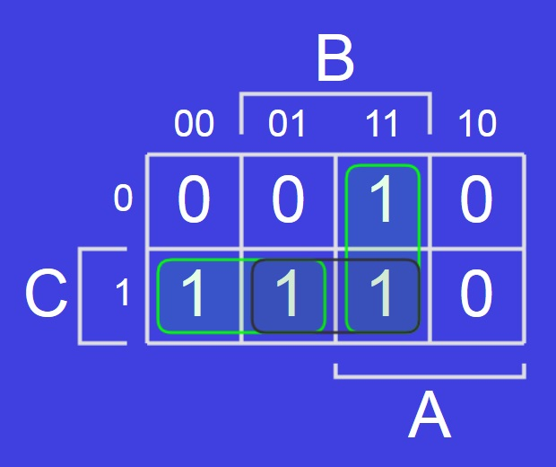
A K-Map Illustrates Consensus Well
Let’s look at a K-map.
AB is the vertical green loop.
A’C is the horizontal green loop.
BC is the black loop.

Slide 21
Consensus Has Two Dual Forms (SOP and POS)
And, of course, there is another form of consensus for POS form.
Start with our first form:
AB + A’C + BC = AB + A’C
Then find the dual to obtain:
(A + B)(A’ + C)(B + C) = (A + B)(A’ + C)

Slide 22
University of Illinois at Urbana-Champaign Dept. of Electrical and Computer Engineering ECE 120: Introduction to Computing
Don’t Care Outputs

Slide 23
Some Input Combinations May Not Matter
Sometimes, we don’t care whether a particular input combination generates a 0 or a 1.
For example,
when an input combination is impossible to generate, or
when outputs are ignored in the case of an input combination.

Slide 24
For Such Inputs, Use ‘x’ to Indicate “Don’t Care”
In such cases, we use ‘x’ (called a “don’t care”) in place of the desired output.
Indicates that either 0 or 1 is acceptable.
However: whatever we implement will generate a 0 or a 1, not a “don’t care.”
So we need to be sure that we really do not care.

Slide 25
Why Are “Don’t’ Cares” Useful?
More choices often means a “better” answer (for any choice of metric).
Say that you optimize a K-map for a function F.
Then you consider several other functions G, H, and J.
If you have to pick one of the four functions (F, G, H, or J), the choice can’t get worse, since you can always pick F, but the best choice may be better than F.

Slide 26
N “Don’t Cares” Allows 2^{N} Different Functions
Using x’s for outputs means allowing more than one function to be chosen.
Each x can become a 0 or a 1.
So optimizing with N x’s means choosing from among 2^{N} possible functions.

Slide 27
An Example with Two “Don’t Cares”
Let’s do an example.
The function F appears to the right, partially specified.
Let’s say that we don’t care about the value of F when AB=01.*
*This notation means A=0 AND B=1. You can infer that AB in this case does not mean A AND B because the product AB has a single truth value (0 or 1).
F |  | AB
 |  | 00 | 01 | 11 | 10
C | 0 | 0 |  | 1 | 0
 | 1 | 1 |  | 1 | 1

Slide 28
Solution for F with 0s: AB + B’C
One option is to fill the blanks with 0s.*
Then we can solve.
F = AB + B’C
But we could have chosen values other than 0, too.
*Without more information about F, filling with 0s is no better nor worse than any other choice.
F |  | AB
 |  | 00 | 01 | 11 | 10
C | 0 | 0 |  | 1 | 0
 | 1 | 1 |  | 1 | 1
0
0

Slide 29
Solution for F with a 0 and a 1: AB + C
For example, we could put a 0 and a 1…
And then solve.
F = AB + C
This function is better than the first one (it has one fewer literal).
F |  | AB
 |  | 00 | 01 | 11 | 10
C | 0 | 0 |  | 1 | 0
 | 1 | 1 |  | 1 | 1
0
1

Slide 30
Solution for F with “Don’t Cares”: B + C
Rather than solving for all four possibilities, let’s write x’s into the K-map.
The x’s can be 0s or 1s, so to solve the K-map,
we can grow loops to include x’s,
but we do not need to cover x’s.
F = B + C (the best possible answer)
F |  | AB
 |  | 00 | 01 | 11 | 10
C | 0 | 0 |  | 1 | 0
 | 1 | 1 |  | 1 | 1
x
x

Slide 31
Always Check that “Don’t Cares” Have No Ill Effects
When designing with x’s, it’s a good habit to verify that the 0s and 1s generated in place of x’s do not cause any adverse effects.
For our function, both x’s become 1s because they are inside a loop.
(We don’t have any more context for this example, so we are done.)
F |  | AB
 |  | 00 | 01 | 11 | 10
C | 0 | 0 |  | 1 | 0
 | 1 | 1 |  | 1 | 1
x
1
x
1

Slide 32
University of Illinois at Urbana-Champaign Dept. of Electrical and Computer Engineering ECE 120: Introduction to Computing
Caring About Don’t Cares and Glue Logic

Slide 33
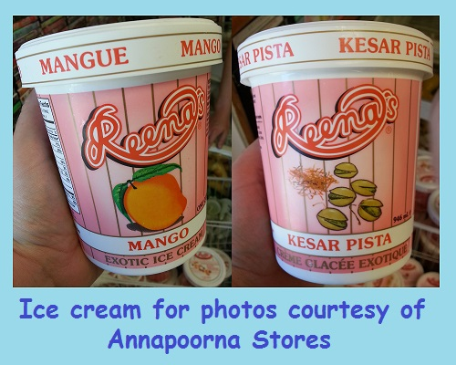
Let’s Have Some Ice Cream!
Let’s build something.
Anyone like ice cream?
Let’s build an ice cream dispenser.
Mango and pistachio!

Slide 34
Start by Specifying the Inputs and Outputs
inputs: three buttons
M(ango): 1 when it’s pushed
B(lend): 1 when it’s pushed
P(istachio): 1 when it’s pushed
outputs: two 2-bit unsigned numbers
C_{M}[1:0]: number of ½ cups of mango
C_{P}[1:0]: number of ½ cups of pistachio

Slide 35
The User Has Three Choices (and One Non-Choice)
M | B | P | C_{M} | C_{P}
0 | 0 | 0
0 | 0 | 1
0 | 1 | 0
0 | 1 | 1
1 | 0 | 0
1 | 0 | 1
1 | 1 | 0
1 | 1 | 1
Help fill in the truth table…
Push M, get one cup of mango.
Push B, get ½ cup of each.
Push P, get one cup of pistachio.
Push nothing, get nothing.
00
00
00
10
01
01
10
00

Slide 36
Fill the Rest with Don’t Cares
M | B | P | C_{M} | C_{P}
0 | 0 | 0 | 00 | 00
0 | 0 | 1 | 00 | 10
0 | 1 | 0 | 01 | 01
0 | 1 | 1
1 | 0 | 0 | 10 | 00
1 | 0 | 1
1 | 1 | 0
1 | 1 | 1
What about the rest?
Who cares?
Fill with x’s.
xx
xx
xx
xx
xx
xx
xx
xx

Slide 37
We Need to Solve for Each Output Bit
M | B | P | C_{M} | C_{P}
0 | 0 | 0 | 00 | 00
0 | 0 | 1 | 00 | 10
0 | 1 | 0 | 01 | 01
0 | 1 | 1 | xx | xx
1 | 0 | 0 | 10 | 00
1 | 0 | 1 | xx | xx
1 | 1 | 0 | xx | xx
1 | 1 | 1 | xx | xx
Now we can copy to K-maps. First, C_{M}[1].
C_{M}[1] = M
C_{M}[1] |  | BP
 |  | 00 | 01 | 11 | 10
M | 0
 | 1
0
0
x
0
1
x
x
x

Slide 38
Solve the Low Bit of Mango
M | B | P | C_{M} | C_{P}
0 | 0 | 0 | 00 | 00
0 | 0 | 1 | 00 | 10
0 | 1 | 0 | 01 | 01
0 | 1 | 1 | xx | xx
1 | 0 | 0 | 10 | 00
1 | 0 | 1 | xx | xx
1 | 1 | 0 | xx | xx
1 | 1 | 1 | xx | xx
Next, C_{M}[0].
C_{M}[0] = B
C_{M}[0] |  | BP
 |  | 00 | 01 | 11 | 10
M | 0
 | 1
0
0
x
1
0
x
x
x

Slide 39
Solve the High Bit of Pistachio
M | B | P | C_{M} | C_{P}
0 | 0 | 0 | 00 | 00
0 | 0 | 1 | 00 | 10
0 | 1 | 0 | 01 | 01
0 | 1 | 1 | xx | xx
1 | 0 | 0 | 10 | 00
1 | 0 | 1 | xx | xx
1 | 1 | 0 | xx | xx
1 | 1 | 1 | xx | xx
And C_{P}[1].
C_{P}[1] = P
C_{P}[1] |  | BP
 |  | 00 | 01 | 11 | 10
M | 0
 | 1
0
1
x
0
0
x
x
x

Slide 40
Solve the Low Bit of Pistachio
M | B | P | C_{M} | C_{P}
0 | 0 | 0 | 00 | 00
0 | 0 | 1 | 00 | 10
0 | 1 | 0 | 01 | 01
0 | 1 | 1 | xx | xx
1 | 0 | 0 | 10 | 00
1 | 0 | 1 | xx | xx
1 | 1 | 0 | xx | xx
1 | 1 | 1 | xx | xx
And, finally, C_{P}[0].
C_{P}[0] = B
C_{P}[0] |  | BP
 |  | 00 | 01 | 11 | 10
M | 0
 | 1
0
0
x
1
0
x
x
x

Slide 41
The Solution Requires No Gates!
The don’t cares made the functions so simple that we don’t even need any gates!
M
C_{M}[1]
C_{M}[0]
B
P
C_{P}[1]
C_{P}[0]

Slide 42
What if a User Pushes Two Buttons?
Let’s be careful.
What happens if a user presses M and B at the same time?
1.5 cups of mango
AND
0.5 cups of pistachio!
1
1
M
C_{M}[1]
C_{M}[0]
1
1
B
0
0
P
C_{P}[1]
C_{P}[0]
1

Slide 43
Don’t Cares: Not for Human Behavior!
In the best case, the cup overflows (2 cups of ice cream instead of 1 cup).
In the worst case,
the engineer of the mechanical system
assumed that we would not send 11, and
something worse happens when we do.
So we DO care.
Generally, using don’t cares when humans are involved is a bad idea.

Slide 44
Let’s Clean Up the Inputs
How can we fix the problem?
One approach:
choose specific outputs for each combination of inputs,
then solve the K-maps again.
Another approach:
clean up the inputs with more logic
prevent humans from ever producing bad combinations.

Slide 45
Use Glue Logic to Ensure that Assumptions Hold
For example, we can force all inputs to zero if the human presses more than one button.
Each of the AND gates produces a 1 iff the corresponding button is the ONLY 1 entered.
glue logic (dashed box)
M
C_{M}[1]
C_{M}[0]
B
C_{P}[1]
P
C_{P}[0]

Slide 46
The Inputs Can be Cleaned Up in Many Ways
Forcing invalid input combinations to zero is just one strategy.
We could also choose a priority on the buttons (six possible choices).
For example:
Pistachio overrides other buttons, and
Mango overrides Blend.
Or use a combination of approaches.

Slide 47
What About Picking Specific K-Maps?
In the case of our ice cream dispenser and the strategy shown, the two approaches are the same (just remove the dashed box!).
In general, however,
these approaches vary
in area, speed, and/or power.
Cleaning up the inputs is perhaps easier to understand.

