Slide 1
University of Illinois at Urbana-Champaign Dept. of Electrical and Computer Engineering ECE 120: Introduction to Computing
The Ripple Carry Adder

Slide 2
Build an Addition Device Based on Human Addition
Weeks ago, we talked about a “hardware device” to perform addition.
Now, you’re ready to design it.
Let’s start by reviewing the human approach.
Basing a design on the human approach
is usually the easiest way, and
often leads to a good design, too.
(Humans are pretty smart.)

Slide 3
Example: Addition of Unsigned Bit Patterns
Let’s do an example with 5-bit unsigned
01110 (14)
+ 00100 (4)
Good, we got the right answer!
1
1
1
0
0
1
0
(18)
Notes:
An unmodified slide from the first week of class. Students may remember it.

Slide 4
Name Signals (Bits) for Our Hardware Design
Let’s do an example with 5-bit unsigned
01110
+ 00100
Good, we got the right answer!
For least significant bit, C←0.
For other bits, C comes from next bit to right.
carry C
1
1
0
0
0
There is no “blank” bit.
A
B
sum S
1
0
0
1
0
Each 1-bit sum needs a C input.

Slide 5
Inputs and Outputs for a Full (One-Bit) Adder
Think about adding a single bit (a column).
A full adder* has three inputs
A (one bit of the number A)
B (one bit of the number B)
C_{in} (a carry input from the next least significant bit, or 0 for bit 0)
And a full adder produces two outputs
C_{out} (a carry output for the next most significant bit)
S (one bit of the sum S)
*A one-bit adder is called a “full adder” for historical reasons. A “half adder” adds two bits instead of three.

Slide 6
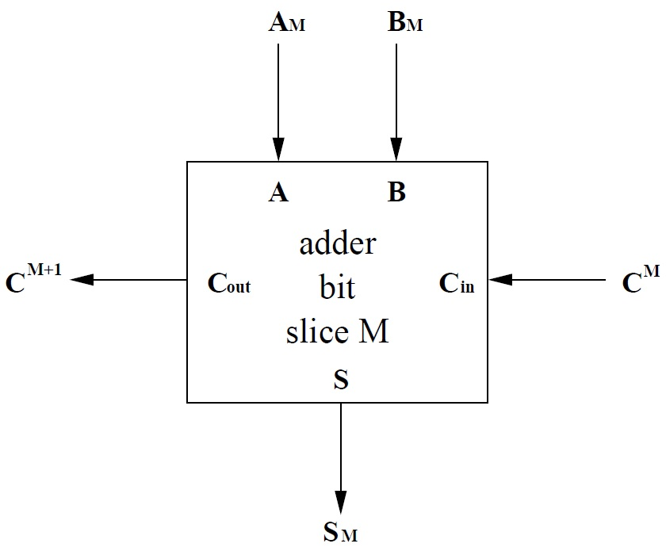
Connecting the Full Adder to the N-Bit Problem
Consider bit M of the addition (bit 0 is on the right, bit 1 to the left of bit 0, and so forth).
We need to add A_{M}, B_{M}, and C^{M} to produce bit S_{M}, of the sum and bit C^{M+1}, the carry into bit M+1 of the addition.
Notes:
I used superscripts for external C values to make them easier to distinguish visually from the internal names, but it may add more confusion, since there is no other significance to superscript vs. subscript here. I debated swapping this slide with the previous one (I/O for a one-bit adder).

Slide 7
Write a Truth Table for Full Adder Outputs
A | B | C_{in} | C_{out} | S
0 | 0 | 0
0 | 0 | 1
0 | 1 | 0
0 | 1 | 1
1 | 0 | 0
1 | 0 | 1
1 | 1 | 0
1 | 1 | 1
Let’s calculate the outputs for a full adder.
You may remember solving this truth table a few weeks ago.
But let’s do it again…
0
0
0
1
0
1
1
0
0
1
1
0
1
0
1
1
Notes:
An “extra slide” from Fall 2016, modified to use the names from the one-bit adder abstraction.

Slide 8
Fill a K-map for C_{out} from the Truth Table
A | B | C_{in} | C_{out} | S
0 | 0 | 0 | 0 | 0
0 | 0 | 1 | 0 | 1
0 | 1 | 0 | 0 | 1
0 | 1 | 1 | 1 | 0
1 | 0 | 0 | 0 | 1
1 | 0 | 1 | 1 | 0
1 | 1 | 0 | 1 | 0
1 | 1 | 1 | 1 | 1
Now fill in the truth table for C_{out}.
C_{out} |  | BC_{in}
 |  | 00 | 01 | 11 | 10
A | 0
 | 1
0
0
1
0
0
1
1
1

Slide 9
Solve the K-map to Find C_{out}
And find the loops.
So we can write C_{out} = AB + AC_{in} + BC_{in}
(called a majority function, by the way).
C_{out} |  | BC_{in}
 |  | 00 | 01 | 11 | 10
A | 0 | 0 | 0 | 1 | 0
 | 1 | 0 | 1 | 1 | 1

Slide 10
The Sum is Best Written as an XOR
A | B | C_{in} | C_{out} | S
0 | 0 | 0 | 0 | 0
0 | 0 | 1 | 0 | 1
0 | 1 | 0 | 0 | 1
0 | 1 | 1 | 1 | 0
1 | 0 | 0 | 0 | 1
1 | 0 | 1 | 1 | 0
1 | 1 | 0 | 1 | 0
1 | 1 | 1 | 1 | 1
What about S? We can (of course) use another K-map.
But a K-map doesn’t give us the best answer in this case (a rare case!).
S is 1 when an odd number of inputs are 1.
So S = A ⊕ B ⊕ C.

Slide 11
XOR Shows up as a Checkerboard Pattern
* * * * * * * * * * * * * * * * * * * * * * * * * * * * * * * * * * *
A | B | C_{in} | C_{out} | S
0 | 0 | 0 | 0 | 0
0 | 0 | 1 | 0 | 1
0 | 1 | 0 | 0 | 1
0 | 1 | 1 | 1 | 0
1 | 0 | 0 | 0 | 1
1 | 0 | 1 | 1 | 0
1 | 1 | 0 | 1 | 0
1 | 1 | 1 | 1 | 1
Here’s the K-map for S. Notice the checkerboard pattern of the XOR.
S |  | BC_{in}
 |  | 00 | 01 | 11 | 10
A | 0 | 0 | 1 | 0 | 1
 | 1 | 1 | 0 | 1 | 0
Notes:
Just for students’ enlightenment in spotting XORs in a K-map. It’s not critical that they be able to do so, so I will * the slide.

Slide 12
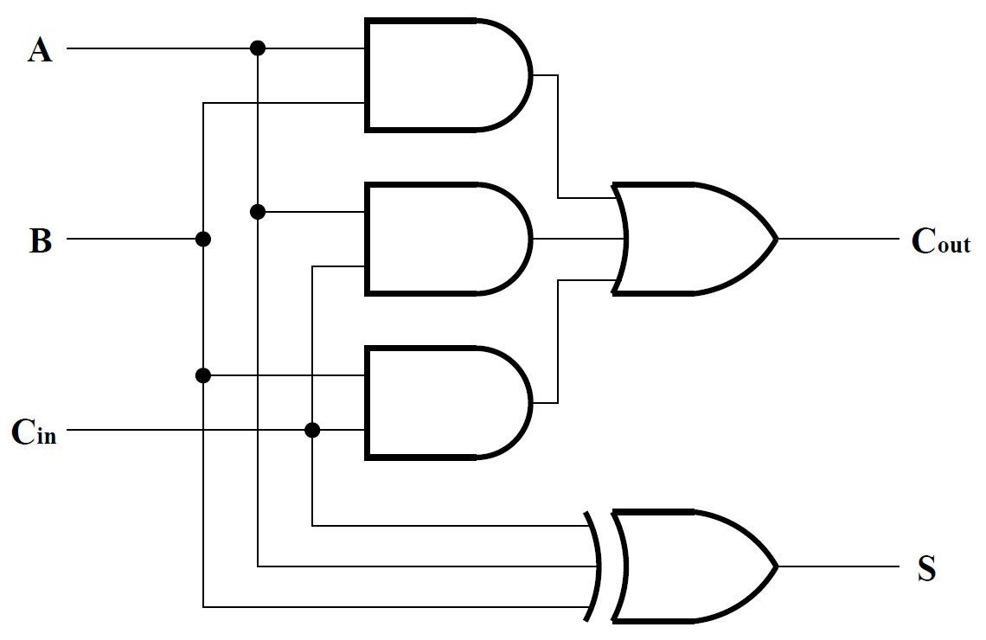
Circuit for a Full Adder Using AND, OR, and XOR
We can draw our full adder using AND, OR, and XOR.
Notes:
Spend some time explaining the majority function implementation, since the equation is not on the slide (and students have not seen many implementations yet). The XOR is pretty straightforward.

Slide 13
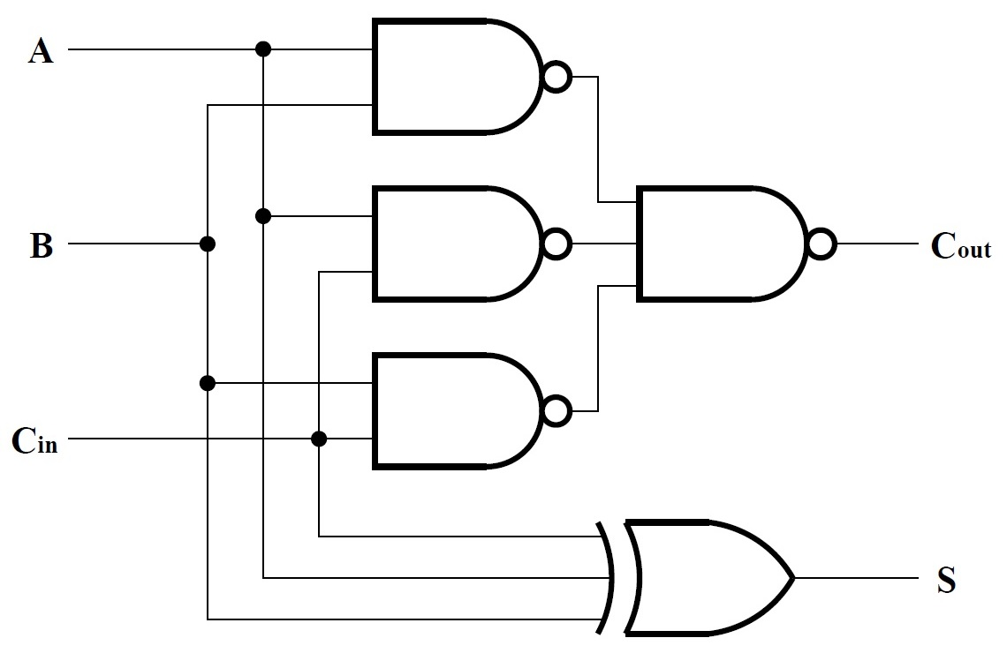
CMOS Implementation Using NAND and XOR
In CMOS, we replace AND/OR with NAND/ NAND.
The XOR remains as an XOR gate.
Notes:
Remind students that they’ve seen general SOP AND/OR to NAND/NAND conversion. This is just a specific case.

Slide 14
How Do We Add N Bits?
Use a full adder for each of the N columns.
Feed a 0 into C_{in} for the least significant bit.
C_{out} of the most significant bit is the adder’s carry out.
For the other carry signals, connect C_{out} of each bit to C_{in} of the next most significant bit.
Divide the bits of A and B amongst the full adders.
Collect the bits of S from the full adders.

Slide 15
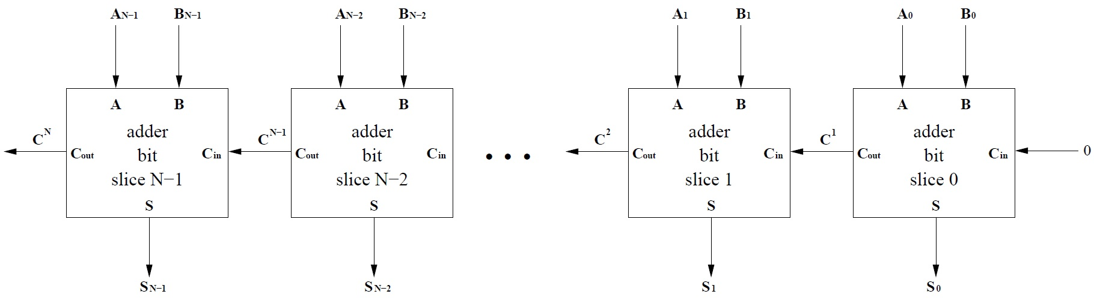
Use N One-Bit Adders to Build an N-Bit Adder
The figure below illustrates construction of an N-bit adder from N full adders.
This approach is called a ripple carry adder because the carry ripples slowly from low to high. We also call it a bit-sliced adder.

Slide 16
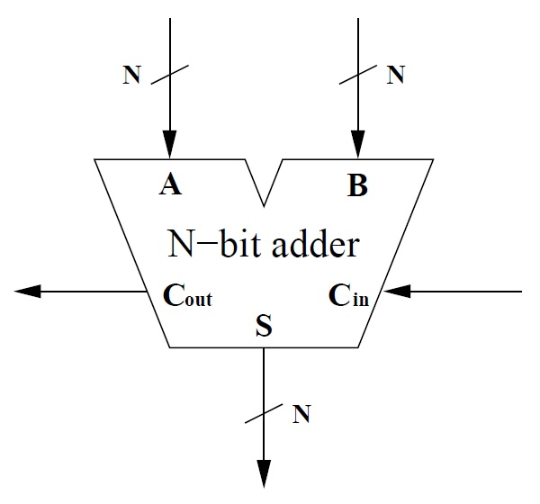
Symbol for an N-Bit Adder
We draw an N-bit adder as shown here.
Note the shape.
Note also the crosshatch and bit width (“N”) for multi-bit signals.

Slide 17
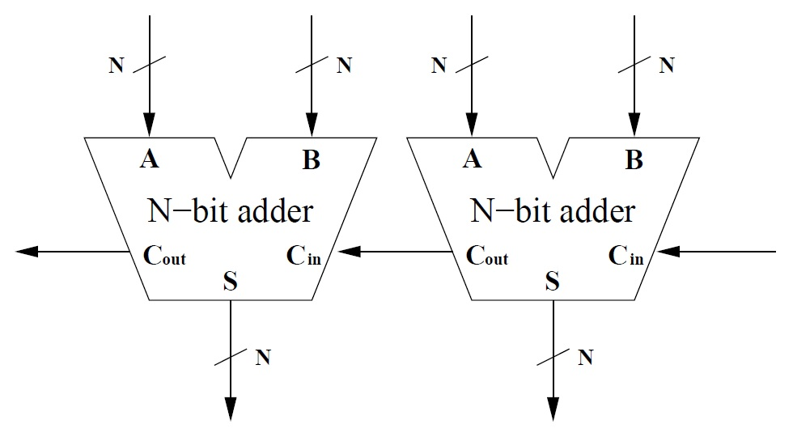
To Build a Bigger Adder, Just Connect C_{out} to C_{in}
We can build bigger adders by connecting adders together physically (as shown below) or virtually (by saving the carry out bit and using it as the carry in to the next adder).

Slide 18
University of Illinois at Urbana-Champaign Dept. of Electrical and Computer Engineering ECE 120: Introduction to Computing
Bit-Sliced Designs

Slide 19
What’s the Theory Behind a Ripple Carry Adder?
Think for a moment about addition.
Can you add 2-digit numbers?
What about 5-digit numbers?
What about 5,000-digit numbers?
Does it matter if I add more digits?
Have you ever seen a proof that you’re correct?
What kind of proof would you need?

Slide 20
Multi-Digit Addition is Correct by Induction
Probably a proof by induction…
You know how to add 1-digit numbers. Verifying an addition table suffices.
GIVEN that you can add N-digit numbers, show (based, for example, on place value) that you can add (N+1)-digit numbers.
But you didn’t know about proof by induction
when you learned how to add,
so you’ve probably never seen a proof.

Slide 21
The Ripple Carry Adder is Also Correct by Induction
When we designed a ripple carry adder, we also assumed proof by induction.
We know how to add one bit. We made a truth table (a binary addition table).
GIVEN that we can build an N-bit adder, show that we can build an (N+1)-bit adder by attaching a full (1-bit) adder to an (N-bit) adder.

Slide 22
Build an Addition Device Based on Human Addition
In ECE220, you will write recursive functions. These functions call themselves.
And you will use the same idea…
The answer for some base case (one or more stopping conditions) is known.
GIVEN that we can write a function that works for input of size N, show that we can write a function that works for size (N+1) by handling the extra “1” and calling the function recursively for the “N”.

Slide 23
The Three Contexts are the Same Mathematically
The approach is the same.
The part that sometimes confuses people (particularly for software/recursion, but sometimes also for hardware/bit slicing) is the ASSUMPTION in the inductive step.
You must assume that the design works for N pieces (bits, input size, or whatever).

Slide 24
All Three Approaches Require a “Leap of Faith”
You don’t need to design the system all at once for N (other than some base case).
In other words,
you must make a “leap of faith” and
assume that your answer works
before you actually design it!
People sometimes have trouble making such an assumption, but it’s just a standard part of an inductive proof.

Slide 25
Bit Slicing Requires Problem Decomposition
Bit slicing works for problems that
allow us to break off a small part of the problem,
say 1 bit (or a few bits),
and be able to solve the full problem using the solution for the remaining part and the 1 bit.
(That’s the inductive step.)

Slide 26
Signals Between Bit Slices Must be Fixed (and Few)
For hardware, we also need
to be able to express the “answer” for the remaining part
in a (small!) fixed number of bits.
Otherwise, the number of inputs and outputs to the bit slice changes from slice to slice!

Slide 27
Examples of Problems that Allow Bit Slicing
Addition / subtraction
Comparison
Check for power of 2
Check for multiples (of 3, 7, and so forth)
Division by constants
Pattern matcher
Bitwise logic operation

Slide 28
When Can’t We Used Bit Slicing?
One example: when the answer depends on ALL of the other bits (can’t summarize an answer for N bits).
For example, can you create a bit-sliced prime number identifier?
A_{N-1} A_{N-2} … A₅ ←(summary) 0 1 0 0 1
What information do you pass to bit 5?
All 5 bits? 01001? I have no idea!

