Slide 1
University of Illinois at Urbana-Champaign Dept. of Electrical and Computer Engineering ECE 120: Introduction to Computing
Bit-Sliced Comparator

Slide 2
How Do You Compare Unsigned Numbers?
Let’s develop a bit-sliced design to compare two unsigned numbers.
Which 8-bit unsigned number is bigger?
0 1 1 0 1 0 0 0
0 1 0 1 0 1 1 1
How did you know?
Did you start on the left or the right?

Slide 3
Humans Go from Left to Right
Usually, humans start on the left. Why?
As soon as we notice a difference, we’re done!
a₇a₆a₅a₄a₃a₂a₁a₀
b₇b₆b₅b₄b₃b₂b₁b₀
Bit-sliced hardware cannot stop in the middle.
The information flows from one end to the other.
Output wires produce the answer (in bits).
humans compare this way
0
1
1
0
1
0

Slide 4
Our Design Compares from Right to Left
Our comparator design will start on the right.
a₇a₆a₅a₄a₃a₂a₁a₀
b₇b₆b₅b₄b₃b₂b₁b₀
From least significant to most significant bit.
humans compare this way
our design will compare this way

Slide 5
Three Possible Answers for Comparison of A and B
When comparing two numbers, A and B, we have three possible outcomes:
A < B
A = B
A > B
To decide the answer for N+1 bits, we need:
the answer for N (less significant) bits,
one bit of A, and
one bit of B.

Slide 6
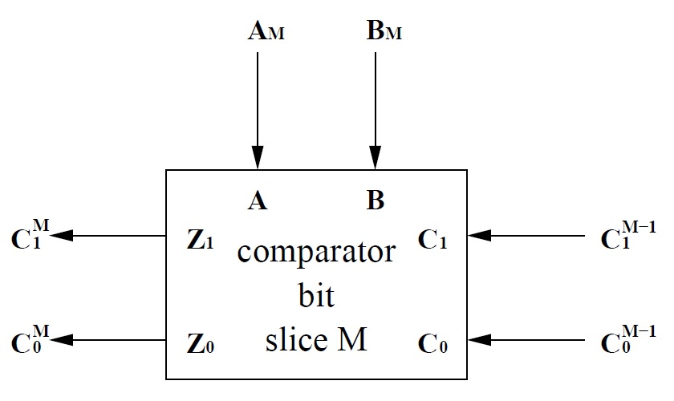
An Abstract Model of the Comparator Bit Slice
A question for you:
How many bits must pass between slices?
Two!
This figure shows an abstract model of our bit slice.
Notes:
Talk about the flow of information: the answer from M-1 bits comes from the right (in some unspecified representation). The bit slice makes a comparison based on that information and on a single bit of A and a single bit of B. The bit slice then encodes the answer (using the same representation) and passes it to the left.

Slide 7
We Need a Representation for Answers
Another question for you:
How do we represent the three possible answers?
Any way we want!
Our choice of representation will affect the amount of logic we need.
Here’s a good one…
C₁ | C₀ | meaning
0 | 0 | A = B
0 | 1 | A < B
1 | 0 | A > B
1 | 1 | not used
Notes:
When I designed the comparator, I thought about all of the possible encodings (afterward) to make sure that I hadn’t overlooked a much simpler solution. For something this simple, tools can explore the space automatically, but for more complex designs, human intuition is still necessary, as they will see on a much broader scale with the LC-3 microarchitecture in the book.

Slide 8
A Single Bit Requires Two Minterms on A, B
Let’s start by solving a single bit.
In this case, there are no less significant bits.
So we consider only A and B.
Fill in the meanings, then the bits.
Note that Z₁ and Z₀ are minterms.
A | B | Z₁ | Z₀ | meaning
0 | 0
0 | 1
1 | 0
1 | 1
0
0
A = B
0
1
A < B
1
0
A > B
0
0
A = B
Notes:
You may need to flip back to the representation on the previous slide after the students give the meanings..

Slide 9
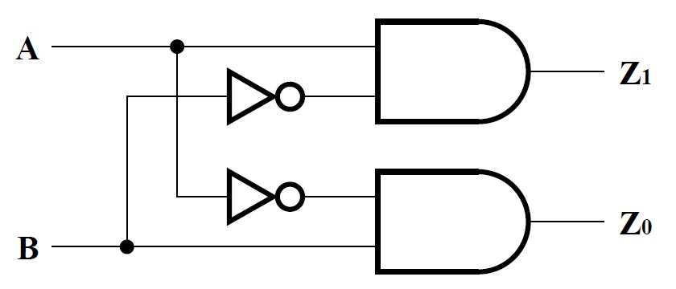
Comparing Two Bits is Fairly Easy
An implementation for a single bit appears below.
This structure forms the core of our bit slice, since it compares one bit of A with one bit of B.
Notes:
You may want to mention to the students that these two minterms are the ones that appear in A XOR B, so ORing them together gives an equal / not equal comparison (using only 1 bit).

Slide 10
When A and B are Equal, Pass Along the Answer
Now for the full problem.
We’ll start with the case of A = 0 and B = 0.
A | B | C₁ | C₀ | meaning | Z₁ | Z₀ | meaning
0 | 0 | 0 | 0 | A = B
0 | 0 | 0 | 1 | A < B
0 | 0 | 1 | 0 | A > B
0 | 0 | 1 | 1 | ???
0
0
A = B
0
1
A < B
1
0
A > B
x
x
don’t care
Notes:
Representation is replicated in the incoming bits, so you shouldn’t need to flip back.

Slide 11
When A and B are Equal, Pass Along the Answer
Is there any difference when A = 1 and B = 1?
No, outputs are the same as the last case.
A | B | C₁ | C₀ | meaning | Z₁ | Z₀ | meaning
1 | 1 | 0 | 0 | A = B
1 | 1 | 0 | 1 | A < B
1 | 1 | 1 | 0 | A > B
1 | 1 | 1 | 1 | ???
0
0
A = B
0
1
A < B
1
0
A > B
x
x
don’t care
Notes:
Representation is replicated in the incoming bits, so you shouldn’t need to flip back.

Slide 12
When A and B Differ, Override the Previous Answer
What about case of A = 0 and B = 1?
Always output A < B (for valid inputs).
A | B | C₁ | C₀ | meaning | Z₁ | Z₀ | meaning
0 | 1 | 0 | 0 | A = B
0 | 1 | 0 | 1 | A < B
0 | 1 | 1 | 0 | A > B
0 | 1 | 1 | 1 | ???
0
1
A < B
0
1
A < B
0
1
A < B
x
x
don’t care
Notes:
Representation is replicated in the incoming bits, so you shouldn’t need to flip back.

Slide 13
When A and B Differ, Override the Previous Answer
And the case of A = 1 and B = 0?
Always output A > B (for valid inputs).
A | B | C₁ | C₀ | Meaning | Z₁ | Z₀ | meaning
1 | 0 | 0 | 0 | A = B
1 | 0 | 0 | 1 | A < B
1 | 0 | 1 | 0 | A > B
1 | 0 | 1 | 1 | ???
1
0
A > B
1
0
A > B
1
0
A > B
x
x
don’t care
Notes:
Representation is replicated in the incoming bits, so you shouldn’t need to flip back.

Slide 14
Z₁ is a Majority Function
Let’s use a K-map to solve Z₁.
What are the loops?
AB’
AC₁
B’C₁
So Z₁ = AB’ + AC₁ + B’C₁
Z₁ |  | AB
 |  | 00 | 01 | 11 | 10
C₁C₀ | 00 | 0 | 0 | 0 | 1
 | 01 | 0 | 0 | 0 | 1
 | 11 | x | x | x | x
 | 10 | 1 | 0 | 1 | 1

Slide 15
Z₀ is Also a Majority Function
Now let’s use a K-map to solve Z₀.
What are the loops?
A’B
A’C₀
BC₀
So Z₀ = A’B + A’C₀ + BC₀
Z₀ |  | AB
 |  | 00 | 01 | 11 | 10
C₁C₀ | 00 | 0 | 1 | 0 | 0
 | 01 | 1 | 1 | 1 | 0
 | 11 | x | x | x | x
 | 10 | 0 | 1 | 0 | 0
Notes:
You may want to point out the symmetry between A, B, C1 and C0, and Z1 and Z0.

Slide 16
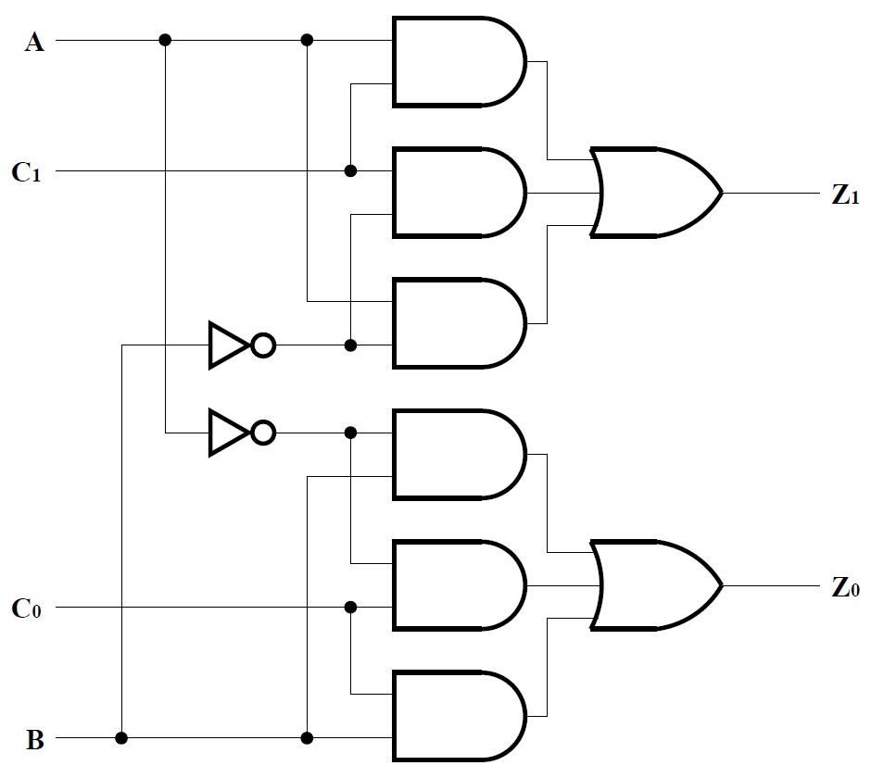
Full Implementation as SOP Expressions
Z₁ = AB’ + AC₁ + B’C₁
Z₀ = A’B + A’C₀ + BC₀
Notice the symmetry.
And the single-bit core.
Notes:
The problem is inherently symmetric, but the single-bit core only appears in the design because we have chosen a representation in which exchanging A and B means exchanging the bits passed between slices. The single-bit core shows up because we pass information from low to high bits: the current A and B bits override all others.

Slide 17
University of Illinois at Urbana-Champaign Dept. of Electrical and Computer Engineering ECE 120: Introduction to Computing
Analyzing and Optimizing the Bit-Sliced Comparator

Slide 18
Area Heuristic for One Comparator Bit Slice is 20
Let’s analyze area and delay.
How many literals?
How many operators?
So area is 20.
12
8 (6 AND, 2 OR)

Slide 19
How Many Gate Delays to Z₁?
A to Z₁:
C₁ to Z₁:
C₀ to Z₁:
B to Z₁:
2 gate delays
2 gate delays
not relevant
2 gate delays (ignoring NOT)
Delays to Z₀ are symmetric.

Slide 20
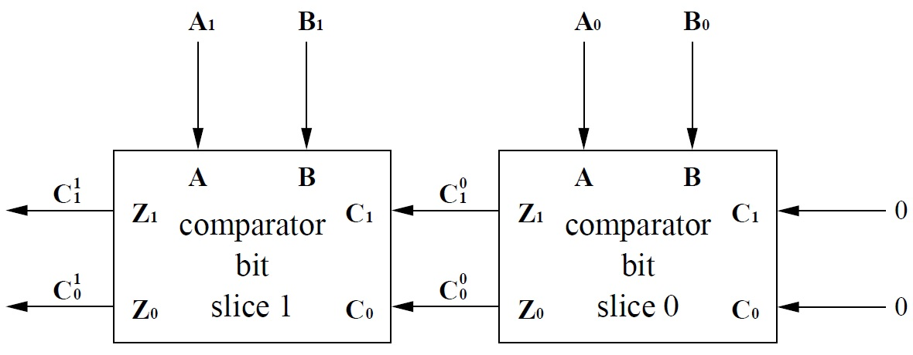
Extending from One Bit Slice to N Bit Slices
What happens in an N-bit design?
Say that A and B are available at time 0.
0
0
0
0

Slide 21
Constant Inputs are Available Arbitrarily Early
What about the 0s on the right?
Available “forever” … (time -∞).
0
0
0
0
- ∞
- ∞

Slide 22
Use Bit Slice Timing to Calculate Times Between Slices
Now we must
use the delays that we found for one bit slice
to calculate times for inter-slice C values.
Recall that
all A and B bits are available at time 0,
so the C to Z delays are the most important.
We found
C₁ to Z₁: 2 gate delays
C₀ to Z₀: 2 gate delays

Slide 23
Calculate the Time at Which C^{M} Becomes Available
When available?
When available?
0
0
0
0
4
2
- ∞
- ∞
4
2
Notes:
Remind the students that the longest path is what matters. So the first bit slice’s outputs depend on A0 and B0, but the second bit slice’s outputs depend on C1 and C0.

Slide 24
A More Detailed Version of Our Calculations
Grey is “not relevant,” and green is maximum (time at which Z_{i} is available).
(bit slice 0) | A | B | C₁ | C₀
input available at | 0 | 0 | -∞ | -∞
delay from input to Z₁ | +2 | +2 | +2
Z₁ not available until | 2 | 2 | -∞
delay from input to Z₀ | +2 | +2 |  | +2
Z₀ not available until | 2 | 2 |  | -∞
Notes:
At least a few students were left somewhat puzzled by the calculations, so I am adding a more detailed version to illustrate the process. For each input, we compute <time at which input is available> + <delay from input to output>, then take the max over those sums to find the time at which the output is available.

Slide 25
A More Detailed Version of Our Calculations
Grey is “not relevant,” and green is maximum (time at which Z_{i} is available).
(bit slice 1) | A | B | C₁ | C₀
input available at | 0 | 0 | 2 | 2
delay from input to Z₁ | +2 | +2 | +2
Z₁ not available until | 2 | 2 | 4
delay from input to Z₀ | +2 | +2 |  | +2
Z₀ not available until | 2 | 2 |  | 4
Notes:
At least a few students were left somewhat puzzled by the calculations, so I am adding a more detailed version to illustrate the process. For each input, we compute <time at which input is available> + <delay from input to output>, then take the max over those sums to find the time at which the output is available.

Slide 26
Generalize the Result to an N-Bit Comparator
$C_{1}^{0}$ and $C_{0}^{0}$are available at time 2 (2 gate delays).*
$C_{1}^{1}$ and $C_{0}^{1}$are available at time 4.
When are $C_{1}^{N−1}$ and $C_{0}^{N−1}$available (these are the answer for an N-bit comparator)?
*In the notes, the inverters are counted, so paths from A and B are slightly longer, and all timings are increased by 1.
N-bit answer is available at time 2N.

Slide 27
We May be Able to Improve Our Comparator Design
Can we do better?
(You should ask: better in what sense?)
Can we reduce delay?
Unlikely with a bit-sliced design.
Not easy to implement most functions with one gate.
Can we reduce area?
Maybe …
Let’s do some algebra.

Slide 28
Use Algebra to Find Common Subexpressions (A’B, AB’)
Start with Z₁ = AB’ + AC₁ + B’C₁
then use distributivity to pull out C₁:
Z₁ = AB’ + (A + B’)C₁
and rewrite the (A + B’) factor as a NAND:
Z₁ = AB’ + (A’B)’C₁
Similarly, Z₀ = A’B + (AB’)’C₀
Notice that we now reuse AB’ and A’B.
Notes:
Also remind the students that AB’ and A’B were the minterms for the comparison of a single bit of A and B.

Slide 29
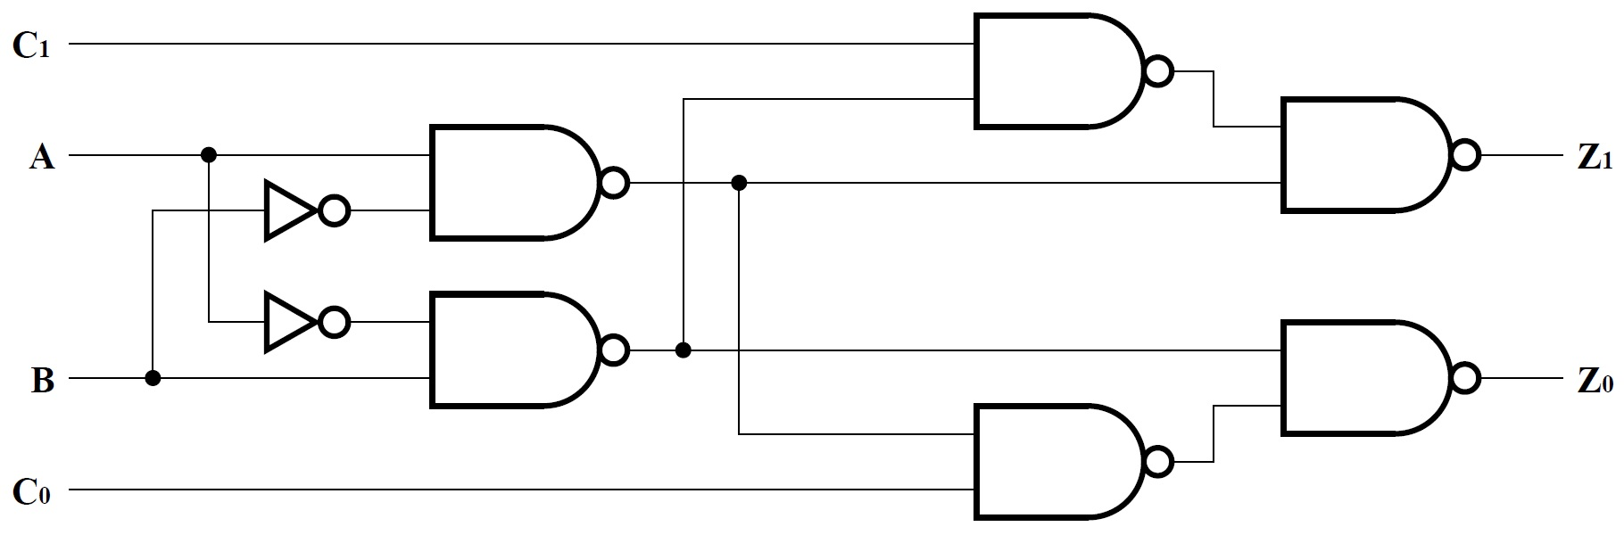
The New Implementation Uses Fewer Gates
The diagram below shows the new equations using NAND gates.
The single-bit core is here.
Z₁ = [ (AB’)’ ((A’B)’C₁)’ ]’
= AB’ + (A’B)’C₁
((A’B)’C₁)’
(AB’)’
(A’B)’
Notes:
The last step for Z1 is just an application of DeMorgan’s laws.
The design is still symmetric, so we don’t need to verify that Z0 is correct (they can if they would like to do so).

Slide 30
Area Heuristic for the New Design is 12
Let’s analyze area for the new design.
How many literals?
How many operators?
6
6 (NAND)
Notes:
Add 6+6 to get 12. That’s a 40% reduction in area.

Slide 31
Delay Analysis for the New Design
3 gate delays (ignoring NOT)
A to Z₁:
C₁ to Z₁:
B to Z₁:
2 gate delays
50% slower?!
3 gate delays

Slide 32
Calculate the Time at Which C^{M} Becomes Available
When available?
When available?
0
0
0
0
5
3
- ∞
- ∞
5
3
Notes:
Remind the students that the longest path is what matters. So the first bit slice’s outputs depend on A0 and B0, but the second bit slice’s outputs depend on C1 and C0.

Slide 33
A More Detailed Version of Our Calculations
Grey is “not relevant,” and green is maximum (time at which Z_{i} is available).
(bit slice 0) | A | B | C₁ | C₀
input available at | 0 | 0 | -∞ | -∞
delay from input to Z₁ | +3 | +3 | +2
Z₁ not available until | 3 | 3 | -∞
delay from input to Z₀ | +3 | +3 |  | +2
Z₀ not available until | 3 | 3 |  | -∞
Notes:
At least a few students were left somewhat puzzled by the calculations, so I am adding a more detailed version to illustrate the process. For each input, we compute <time at which input is available> + <delay from input to output>, then take the max over those sums to find the time at which the output is available.

Slide 34
A More Detailed Version of Our Calculations
Grey is “not relevant,” and green is maximum (time at which Z_{i} is available).
(bit slice 1) | A | B | C₁ | C₀
input available at | 0 | 0 | 3 | 3
delay from input to Z₁ | +3 | +3 | +2
Z₁ not available until | 3 | 3 | 5
delay from input to Z₀ | +3 | +3 |  | +2
Z₀ not available until | 3 | 3 |  | 5
Notes:
At least a few students were left somewhat puzzled by the calculations, so I am adding a more detailed version to illustrate the process. For each input, we compute <time at which input is available> + <delay from input to output>, then take the max over those sums to find the time at which the output is available.

Slide 35
The Slice-to-Slice Paths are the Important Ones
$C_{1}^{0}$ and $C_{0}^{0}$are available at time 3 (2 gate delays).*
$C_{1}^{1}$ and $C_{0}^{1}$are available at time 5.
When are $C_{1}^{N−1}$ and $C_{0}^{N−1}$available (these are the answer for an N-bit comparator)?
*In the notes, the inverters are counted, so paths from A and B are slightly longer, and all timings are increased by 1.
N-bit answer is available at time 2N+1.

Slide 36
Overall: Much Better Area for Slightly More Delay
So the new design
reduces area by about 40% (area 12N compared to area 20N).
increases delay by 1 (2N+1 gate delays compared to 2N gate delays).

Slide 37
Can We Do Even Better?
Yes, but it’s not as easy.
For example, we can design a slice
that compares multiple bits of A and B.
See Notes 2.4.6 for an example.
We can also solve the full N-bit problem.
In other words, trade more human work and complexity for better area and delay.

Slide 38
University of Illinois at Urbana-Champaign Dept. of Electrical and Computer Engineering ECE 120: Introduction to Computing
A Comparator for 2’s Complement

Slide 39
Comparing 2’s Complement Is Different from Unsigned
Let’s design a comparator for 2’s complement numbers.
Is the function the same as with unsigned (like addition)?
For unsigned, 1001 > 0101.
Is the same true with 2’s complement?
No.
Should we just start over?

Slide 40
Start with the Sign Bits
Let’s try a little harder first…
If we compare two non-negative numbers,
the approach IS the same.
Right?
Maybe we can just use some extra logic to handle the sign bits?

Slide 41
Consider All Possible Combinations of Sign Bits
Let’s make a table based on the sign bits:
A_{s} | B_{s} | interpretation | solution
0 | 0 | A ≥ 0 AND B ≥ 0 | use unsigned comparator
0 | 1 | A ≥ 0 AND B < 0
1 | 0 | A < 0 AND B ≥ 0
1 | 1 | A < 0 AND B < 0
A > B
A < B
unknown
Notes:
Walk through the table and the interpretations with the students, then talk about the solutions. Note that the 01 and 10 answers are backwards (unsigned on all bits would give A<B and A>B, respectively), and we don’t know what to do with 11.

Slide 42
Interpret 2’s Complement as Unsigned
Remember our “simple” rule for translating 2’s complement bit patterns to decimal?
The pattern A = a_{N-1}a_{N-2} … a₁a₀
has value V_{A} = -a_{N-1}2^{N-1} + a_{N-2}2^{N-2} + … + a₀2⁰
Let A be negative (a_{N-1} = 1).
Interpreted as unsigned, the same bits have value V_{A} + 2^{N}.*
*The statement is true by definition of 2’s complement, actually.

Slide 43
Negative Numbers Can be Compared Directly
What happens if we feed two negative 2’s complement numbers into our unsigned comparator?
We compare V_{A} + 2^{N} with V_{B} + 2^{N}.
And we get an answer: <, =, or >.
Let’s say that we find V_{A} + 2^{N} < V_{B} + 2^{N}.
In that case, V_{A} < V_{B}, so we have the right answer for 2’s complement.
The same result holds for other answers.

Slide 44
We Need Special Logic for the Sign Bits
Now we can complete our table:
A_{s} | B_{s} | interpretation | solution
0 | 0 | A ≥ 0 AND B ≥ 0 | use unsigned comparator
0 | 1 | A ≥ 0 AND B < 0 | A > B
1 | 0 | A < 0 AND B ≥ 0 | A < B
1 | 1 | A < 0 AND B < 0 | use unsigned comparator
Notes:
Be sure that the students understand the problem with the 01 and 10 cases now.

Slide 45
Simply Flip the Wires on the Most Significant Bit
Can we just flip the wires on the sign bits?
For A_{s} = 0 and B_{s} = 1,
we feed in A_{N-1} = 1 and B_{N-1} = 0, and
the unsigned comparator produces A > B.
For A_{s} = 1 and B_{s} = 0,
we feed in A_{N-1} = 0 and B_{N-1} = 1, and
the unsigned comparator produces A < B.
What about when A_{s} = B_{s}?
Flipping the bits then has no effect!
Answers are also correct in those cases.

Slide 46
One Comparator with a Control Signal can Do Both
Can we use a single comparator to perform both kinds of comparisons?
Yes, if we
add a control signal S
to tell the comparator whether to do unsigned (S=0) or 2’s complement (S=1) comparison.
Simply XOR’ing the most significant bits of A and B with S suffices.
This approach leverages flexibility in the problem to reduce the logic needed.
Analyze the design to understand how it works.
Notes:
The flexibility comes from the fact that when the MSBs of A and B are equal, using 00 or 11 (either type of equal bit) is equivalent for comparison purposes.

