Slide 1
University of Illinois at Urbana-Champaign Dept. of Electrical and Computer Engineering ECE 120: Introduction to Computing
A Power-of-Two Checker

Slide 2
Powers of Two are Easy to Spot in Binary
Let’s do another bit-sliced design.
Can we check whether an unsigned number represents a power of two?
What does a power of two look like in bits?
For 5-bit unsigned, the powers of 2 are...
00001, 00010, 00100, 01000, 10000
A power of two has exactly one 1 bit (with place value 2^{N} for some N, of course!).

Slide 3
The Answers are Not Always Enough
So our design will answer the following: Is A = a_{N-1}a_{N-2}…a₁a₀ a power of two?
How many answers are possible?
Two: Yes, and No.
A trick question:
How many bits do we need to pass between slices?
That’s right: TWO bits.

Slide 4
What Extra Information Do We Need?
Why not just one? An answer only needs 1 bit!
Say that we pass bits from right to left.
If the bits a_{N-2}…a₁a₀ represent a power of two, is a_{N-1}a_{N-2}…a₁a₀ be a power of two?
What if a_{N-2}…a₁a₀ does not represent a power of two?
In that case, we can’t tell whether a_{N-1}a_{N-2}…a₁a₀ is a power of two or not!
What else do we need to know?
Iff a_{N-1} = 0.

Slide 5
For Inductive Step, We Must Know Whether all Bits are 0
Imagine that we have completed N-1 bits.
Under what conditions can number A be a power of two?
a_{N-1} = 1 and the rest is all 0s, or
a_{N-1} = 0 and the rest is a power of two.
For #2, we need to know whether the rest of the bits form a power of two.
But for #1, we also need to know whether the rest of the bits are all 0.

Slide 6
There are Three Possible Messages between Bit Slices
The “yes” cases for #1 and #2 do not overlap: all 0 bits is not a power of two.
The “no” cases need not be further separated:
all 0s means no 1 bits
a power of two means one 1 bit
more than one 1 bit means “no” to both questions
That’s all we need to know. Three possible messages between slices, so two bits.

Slide 7
We Need a Representation for Answers
I’ll use the following representation.
Others may be better.
C₁ | C₀ | meaning
0 | 0 | no 1 bits
0 | 1 | one 1 bit
1 | 0 | not used
1 | 1 | more than one 1 bit

Slide 8
We Need a Representation for Answers
Let’s build a slice that operates on two bits of A.
In the bit slice, we call them A and B.
Inputs from the previous bit slice are C₁ and C₀.
Outputs to the next bit slice are Z₁ and Z₀.
Direction of our operation doesn’t matter. Either will do.

Slide 9
Two Zeroes Do Not Change the Result
Let’s fill in a truth table.
We’ll start with the case of A = 0 and B = 0.
A | B | C₁ | C₀ | meaning | Z₁ | Z₀ | meaning
0 | 0 | 0 | 0 | no 1s
0 | 0 | 0 | 1 | one 1
0 | 0 | 1 | 0 | ???
0 | 0 | 1 | 1 | >one 1
0
0
no 1s
0
1
one 1
x
x
don’t care
1
1
>one 1
Notes:
Representation is replicated in the incoming bits, so you shouldn’t need to flip back.

Slide 10
One 1 Input Increments the Count of 1 Bits
Now consider A = 0 and B = 1.
A | B | C₁ | C₀ | meaning | Z₁ | Z₀ | meaning
0 | 1 | 0 | 0 | no 1s
0 | 1 | 0 | 1 | one 1
0 | 1 | 1 | 0 | ???
0 | 1 | 1 | 1 | >one 1
0
1
one 1
1
1
>one 1
x
x
don’t care
1
1
>one 1
Notes:
Representation is replicated in the incoming bits, so you shouldn’t need to flip back.

Slide 11
One 1 Input Increments the Count of 1 Bits
The case for A = 1 and B = 0 is the same.
A | B | C₁ | C₀ | meaning | Z₁ | Z₀ | meaning
1 | 0 | 0 | 0 | no 1s
1 | 0 | 0 | 1 | one 1
1 | 0 | 1 | 0 | ???
1 | 0 | 1 | 1 | >one 1
0
1
one 1
1
1
>one 1
x
x
don’t care
1
1
>one 1
Notes:
Representation is replicated in the incoming bits, so you shouldn’t need to flip back.

Slide 12
Two 1s in the Number Rules Out Powers of Two
Finally, consider A = 1 and B = 1.
A | B | C₁ | C₀ | meaning | Z₁ | Z₀ | meaning
1 | 1 | 0 | 0 | no 1s
1 | 1 | 0 | 1 | one 1
1 | 1 | 1 | 0 | ???
1 | 1 | 1 | 1 | >one 1
1
1
>one 1
1
1
>one 1
x
x
don’t care
1
1
>one 1
Notes:
Representation is replicated in the incoming bits, so you shouldn’t need to flip back.

Slide 13
We Solve Z₁ as a POS Expression
Let’s use a K-map to solve Z₁. POS looks good.
What are the loops?
(C₁ + A + B)
(C₀ + A)
(C₀ + B)
So Z₁ = (C₁ + A + B) (C₀ + A)(C₀ + B)
Z₁ |  | AB
 |  | 00 | 01 | 11 | 10
C₁C₀ | 00 | 0 | 0 | 1 | 0
 | 01 | 0 | 1 | 1 | 1
 | 11 | 1 | 1 | 1 | 1
 | 10 | x | x | x | x

Slide 14
We Solve Z₀ as an SOP Expression
Now let’s solve Z₀. SOP and POS are the same.
What are the loops for SOP?
C₀
A
B
So Z₀ = (C₀ + A + B)
Z₀ |  | AB
 |  | 00 | 01 | 11 | 10
C₁C₀ | 00 | 0 | 1 | 1 | 1
 | 01 | 1 | 1 | 1 | 1
 | 11 | 1 | 1 | 1 | 1
 | 10 | x | x | x | x

Slide 15
We Can Reuse Some Factors with Algebra
Notice that we can reuse factors from Z₁ to calculate Z₀:
Z₁ = (C₁ + A + B)(C₀ + A)(C₀ + B)
Z₀ = (C₀ + A + B) = (C₀ + A) + (C₀ + B)
Let’s draw the bit slice, then analyze its area and delay.

Slide 16
Area is 6N, and Delay is N Gate Delays for N Bits
Here is an implementation of the bit slice using NAND and NOR. Let’s find area.
How many literals?
How many operations?
And delay?
2 on all paths.
So N gate delays for N bits.
7
C₁
5 (4 NOR, 1 NAND)
A
B
Z₁
C₀
A
C₀
Z₀
B
Notes:
Note that area of 12 handles 2 bits, so overall area is 6N. Overall delay is N because 2 gate delays handles 2 bits.

Slide 17
Need One More Gate Delay to Get the Answer
But we don’t get an answer!
Our N-bit checker,
composed of N/2 bit slices,
produces only a “count” of 1 bits (0, 1, or “many”).
We want yes (P = 1) or no (P = 0)!
Looking at the representation, the fastest solution is to add an XOR gate at the end.
P = Z₁ ⊕ Z₀ from the last bit slice.
So delay is actually N + 1 gate delays.

Slide 18
University of Illinois at Urbana-Champaign Dept. of Electrical and Computer Engineering ECE 120: Introduction to Computing
Building with Abstraction and a First Example

Slide 19
Optimization at the Level of Gates is Always Possible
One can always solve a problem by
developing complete Boolean expressions,
solving for “good” forms with K-maps (or algebra, with more variables),
implementing the resulting equations,
tuning logic to reduce gate sizes (number of inputs) and fanout (the number of gates using a single gate’s output).
You can now perform such a process.
Notes:
Point out that students (1) don’t have a lot of experience with the process yet, and (2) don’t have the details of particular semiconductor processes with regard to how many inputs or fanouts are “good.” But that’s ok—those things they can look up and/or learn over time. The main point is that they understand the tradeoff between human time and optimization. (Next slide…)

Slide 20
But Optimization at Gate Level is Rarely Needed
Such detail is rarely needed for a satisfactory solution.
Instead, humans can
use abstraction and build with components such as adders and comparators, or
use extra levels of logic to describe functions more intuitively.
Computer-aided design (CAD) tools
can help with low-level optimizations.
In many cases, CAD tools can do better than humans because they explore more options.

Slide 21
Tradeoffs are Always Made in Some Context
Context is important!
If a mechanical engineer produces a 0.5% boost in efficiency for internal combustion engines sized for automobiles, that engineer will probably win a major prize.
In our field, engineers spend a lot of time
improving the designs of arithmetic units and memory, and
improving CAD tools’ ability to optimize.

Slide 22
But Optimization at Gate Level is Rarely Needed
“Premature optimization is the root of all evil.” – Sir C.A.R. “Tony” Hoare
Don’t spend time optimizing
something that is likely to change, nor
something that does not contribute much to the overall system goodness (any metric).
The flip side:
don’t ignore scaling issues when choosing algorithms, and
don’t design in a way that prohibits/inhibits optimization.
Notes:
Students will need examples to help them understand. With scaling, one can use the example of returning the first midterm by walking around the room with each exam, asking each student in turn (even ones that have already gotten theirs back!), “Is your name X?” Total time: N^2. For prohibiting optimization, perhaps mention a company (not by name?) that uses non-standard interfaces for standard functions (such as USB). They do it to create an artificial monopoly so that they can charge higher prices, but they can only do so because the non-standard interfaces prevent/discourage people from providing better (cheaper, faster, lower-power) replacement parts.

Slide 23
First Example: Subtraction
Let’s start with something simple.
Let’s build a subtractor.
How do we subtract as humans?

Slide 24
Example: Subtraction of 5-Digit Numbers
Let’s do an example with 5-digit numbers
12345
- 871
Negate by finding
the “9’s complement”
and adding 1.
Notes:
Just like you learned in elementary school!

Slide 25
Example: Subtraction of 5-Digit Numbers
Let’s do an example with 5-digit numbers
12345
+ 99129
Good, we got the right answer (12345 – 871 = 11474)!
We have no
space for
that digit!
1
1
1
1
1
4
7
4

Slide 26
Use an Adder to Implement a Subtractor
Ok, maybe your elementary school taught subtraction a different way.
But you probably did use that approach in your ECE120 homework to subtract unsigned and 2’s complement values.
A – B = A + (NOT B) + 1
(where “NOT” applies to all bits of B)
Instead of mimicking the human subtraction process, let’s use an adder to implement a subtractor…

Slide 27
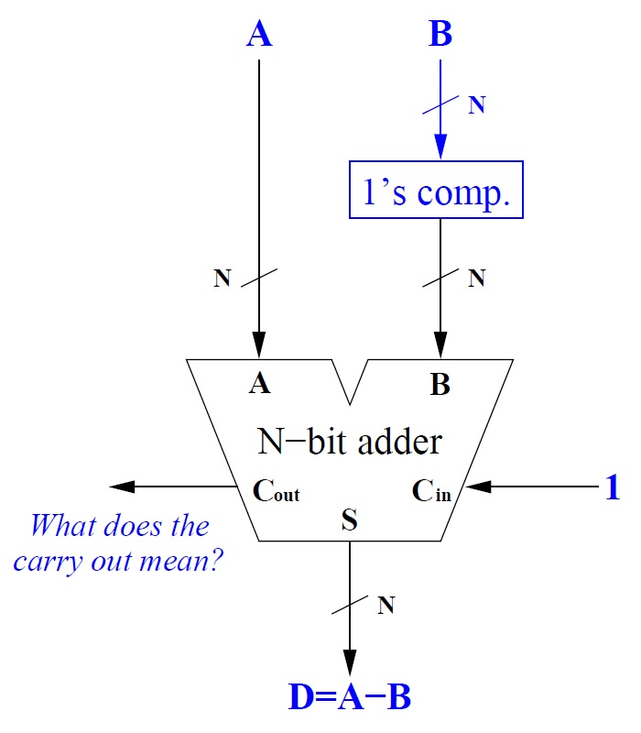
Use an Adder to Implement a Subtractor
Take a look at the design to the right.
The core is an N-bit adder.
We want to calculate the difference D = A – B.
We modify the inputs slightly to perform the subtraction.

Slide 28
Convert B to its 1’s Complement
The input A is unchanged.
The input B is transformed to its 1’s complement.
How do we implement 1’s complement?
N inverters!

Slide 29
With C_{in} = 1, the Adder Produces A - B
Finally, the C_{in} input is set to 1.
So what does the adder calculate?
A + (NOT B) + 1
which is A – B, as desired.

Slide 30
Calculate D to Understand the Carry Out Signal
What does the carry out C_{out} mean?
Remember that the 1’s complement is (2^{N} – 1) – B.
So we obtain D = A + (2^{N} – 1) – B + 1 = A – B + 2^{N}

Slide 31
Carry Out Signal (Opposite Sense) Still Means Overflow
So D = A – B + 2^{N}.
But C_{out} is the 2^{N} term from the adder.
Thus
C_{out} = 1 means A ≥ B
C_{out} = 0 means A < B
So for unsigned subtraction C_{out} = 0 indicates overflow!

Slide 32
Use a Control Signal to Select between Operations
What if we want a device that does both addition and subtraction?
We need a way to choose the operation.
Add a control signal S
S = 0: addition
S = 1: subtraction
And then modify the adder inputs with S
A …
B …
C_{in} …
unmodified
B XOR S (bitwise)
S
Notes:
Let the students answer. Be sure that they understand the modifications. Consider both the S=0 and S=1 cases at the end (walk through the different inputs).

Slide 33
University of Illinois at Urbana-Champaign Dept. of Electrical and Computer Engineering ECE 120: Introduction to Computing
Checking for Upper-Case Characters

Slide 34
Task: Checking for an Upper-Case Letter
Let’s design logic to check whether an ASCII character is an upper-case letter.
In ASCII, 'A' is 1000001 (0x41), and 'Z' is 1011010 (0x5A).
Let’s say that the ASCII character is in C = C₆C₅C₄C₃C₂C₁C₀.
How can we check whether C represents an upper-case letter?

Slide 35
We Will Need a BIG Truth Table!
C₆ | C₅ | C₄ | C₃ | C₂ | C₁ | C₀ | U(C)
0 | 0 | 0 | 0 | 0 | 0 | 0
0 | 0 | 0 | 0 | 0 | 0 | 1
0 | 0 | 0 | 0 | 0 | 1 | 0
0 | 0 | 0 | 0 | 0 | 1 | 1
0 | 0 | 0 | 0 | 1 | 0 | 0
0 | 0 | 0 | 0 | 1 | 0 | 1
0 | 0 | 0 | 0 | 1 | 1 | 0
0 | 0 | 0 | 0 | 1 | 1 | 1
Should we write a truth table for U(C)?
Can we skip to the ones that matter?
0
0
0
0
0
0
0
0
Notes:
See if the students will let you fill it in… with their help, of course!

Slide 36
Let’s Break the Truth Table into Eight Pieces
Can we break the truth table into pieces?
For example, let’s break the truth table
into eight truth tables
of 16 rows each.
Each piece represents one value of C₆C₅C₄.
We can solve each piece with a K-map on C₃C₂C₁C₀.

Slide 37
Some Functions are Quite Simple
Or maybe we don’t need a K-map for some.
Remember that 'A' is 1000001 (0x41), and 'Z' is 1011010 (0x5A).
Think about the table for C₆C₅C₄ = 000?*
What is the function of C₃C₂C₁C₀?
(In other words, no ASCII character with C₆C₅C₄ = 000 is an upper-case letter.)
* This notation means C₆ = 0 AND C₅ = 0 AND C₄ = 0.
0

Slide 38
Only Two of Our Functions are Not the 0 Function
For reference: 'A' is 1000001 (0x41), and 'Z' is 1011010 (0x5A).
Which of our eight functions are not the 0 function?
C₆C₅C₄ = 100
C₆C₅C₄ = 101
Let’s solve K-maps for these two.
Let’s call the function T₄.
Let’s call the function T₅.
Notes:
Let the students answer. The relevant ASCII mapping is on the slide.

Slide 39
Solve T₄ Using a Single Loop
Let’s solve T₄. Should we use SOP or POS?
T₄ is a maxterm!
T₄ = (C₃ + C₂ + C₁ + C₀)
T₄ |  | C₃C₂
 |  | 00 | 01 | 11 | 10
C₁C₀ | 00 | 0 | 1 | 1 | 1
 | 01 | 1 | 1 | 1 | 1
 | 11 | 1 | 1 | 1 | 1
 | 10 | 1 | 1 | 1 | 1

Slide 40
Solve T₅ as a POS Expression
Let’s solve T₅. POS is better again.
What are the loops? for SOP?
(C₃’ + C₂’)
(C₃’ + C₁’ + C₀’)
So T₅ = (C₃’ + C₂’)· (C₃’ + C₁’ + C₀’)
T₅ |  | C₃C₂
 |  | 00 | 01 | 11 | 10
C₁C₀ | 00 | 1 | 1 | 0 | 1
 | 01 | 1 | 1 | 0 | 1
 | 11 | 1 | 1 | 0 | 0
 | 10 | 1 | 1 | 0 | 1

Slide 41
Combine T₄ and T₅ to find U(C)
How do we combine T₄ and T₅ to find the full upper-case checker function U(C)?
Remember:
T₄ applies when C₆C₅C₄ = 100, and
T₅ applies when C₆C₅C₄ = 101.
So …?
AND T₄ with C₆C₅’C₄’,
AND T₅ with C₆C₅’C₄, and
OR the results together.

Slide 42
A Good Solution, But Maybe We Can Do Less Work?
So U(C) = C₆C₅’C₄’ (C₃ + C₂ + C₁ + C₀) + C₆C₅’C₄ (C₃’ + C₂’)(C₃’ + C₁’ + C₀’)
That’s a pretty small and fast solution.
But we still had to do a fair bit of work.
Is there an easier way?
Consider the following: to check for an upper-case letter, we need to know whether
C ≥ 1000001 AND C ≤ 1011010

Slide 43
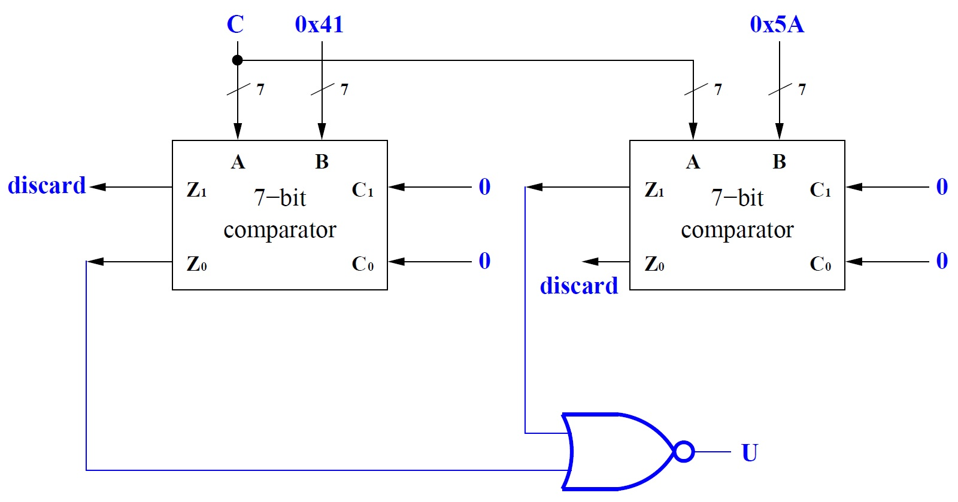
Use Two Comparators to Calculate U(C)
What about this approach?
Z₀ = 1
implies
C < 0x41
Z₁ = 1
implies
C > 0x5A
Notes:
Explain the operation. Either implied condition means that U(C) is false. If both implied conditions are false, U(C) is true.

Slide 44
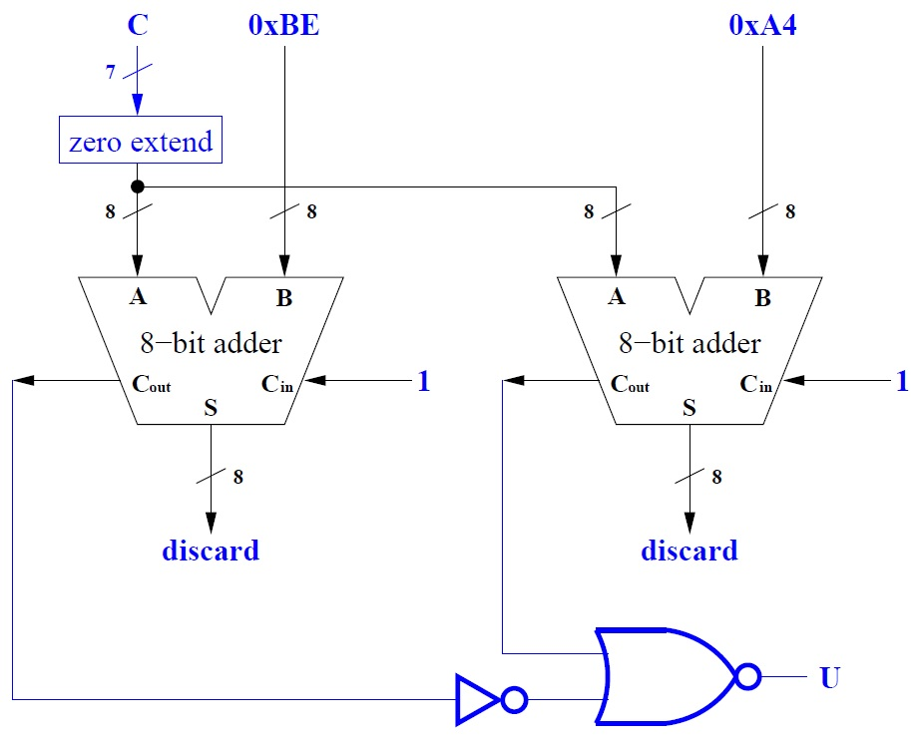
Or Use Two Adders to Calculate U(C)
Or this approach?
Note that the adders are performing subtractions.
Notes:
Remember that Cout = 0 for A – B means A < B.

Slide 45
Inefficient, But Simple to Design
Quite large and slow compared with our first solution?
Consider two arguments:
CAD tools can optimize away much of the extra overhead.
Software executing on data center servers around the world executes the adder design even less efficiently, but it’s constantly in use on hundreds of thousands of machines.

