Slide 1
University of Illinois at Urbana-Champaign Dept. of Electrical and Computer Engineering ECE 120: Introduction to Computing
Multiplexers (MUXes)

Slide 2
Task: Checking for a Lower-Case Letter
What if we also need logic to check whether an ASCII character is a lower-case letter.
In ASCII, 'a' is 1100001 (0x61), and 'z' is 1111010 (0x7A).
Recall that 'A' is 1000001 (0x41), and 'Z' is 1011010 (0x5A).
Can we reuse our solutions for upper-case letters?
Of course we can!

Slide 3
Change C₅’ to C₅ to Obtain L(C) from U(C)
Let’s again say that the ASCII character is in C = C₆C₅C₄C₃C₂C₁C₀.
By breaking up the truth table, we obtained
U(C) = C₆C₅’C₄’ (C₃ + C₂ + C₁ + C₀) + C₆C₅’C₄ (C₃’ + C₂’)(C₃’ + C₁’ + C₀’)
But lower-case characters are only different from upper-case in C₅, which is 1 instead of 0.
L(C) = C₆C₅C₄’ (C₃ + C₂ + C₁ + C₀) + C₆C₅C₄ (C₃’ + C₂’)(C₃’ + C₁’ + C₀’)

Slide 4
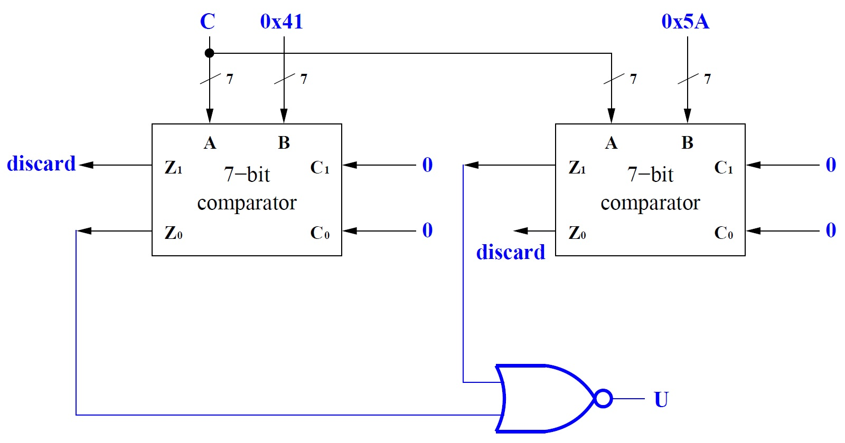
Change Comparator Input to Calculate L(C)
Or just change the comparators’ inputs.
0x61
0x7A
Z₀ = 1
implies
C < 0x41
Z₁ = 1
implies
C > 0x5A
0x7A
0x61
L
Notes:
Explain the operation. Either implied condition means that U(C) is false. If both implied conditions are false, U(C) is true.

Slide 5
Want Logic to Choose Between Two Signals
What if we want one design to check for either upper-case or lower-case letters?
In a few examples,
we added a control signal S
to select between functions.
Can we design logic
that uses a control signal S to select
between two arbitrary signals, D₁ (when S = 1) and D₀ (when S = 0)?

Slide 6
Truth Tables for a 2-to-1 Multiplexer
S | D₁ | D₀ | Q
0 | 0 | 0 | 0
0 | 0 | 1 | 1
0 | 1 | 0 | 0
0 | 1 | 1 | 1
1 | 0 | 0 | 0
1 | 0 | 1 | 0
1 | 1 | 0 | 1
1 | 1 | 1 | 1
A full truth table for such logic appears to the right.
But we could shorten it as shown below…
S | D₁ | D₀ | Q
0 | x | 0 | 0
0 | x | 1 | 1
1 | 0 | x | 0
1 | 1 | x | 1
Unselected inputs do
not matter (marked
with “x”).
Notes:
Talk about the full truth table before revealing the shortened version.

Slide 7
We Normally Use the Most Compact Truth Table
In this case, we can even write outputs in terms of other inputs, as shown here.
S | Q
0 | D₀
1 | D₁
S | D₁ | D₀ | Q
0 | x | 0 | 0
0 | x | 1 | 1
1 | 0 | x | 0
1 | 1 | x | 1
Unselected inputs do
not matter (marked
with “x”).

Slide 8
Expression for a 2-to-1 Multiplexer
S | D₁ | D₀ | Q
0 | 0 | 0 | 0
0 | 0 | 1 | 1
0 | 1 | 0 | 0
0 | 1 | 1 | 1
1 | 0 | 0 | 0
1 | 0 | 1 | 0
1 | 1 | 0 | 1
1 | 1 | 1 | 1
Let’s solve with a K-map.
Q = S’D₀ + SD₁
Q |  | D₁D₀
 |  | 00 | 01 | 11 | 10
S | 0
 | 1
0
1
1
0
0
0
1
1
Notes:
Fill in the K-map, then solve it.

Slide 9
Expression for a 2-to-1 Multiplexer
But Q just selects D₀ or D₁ (as desired)!
Q = S’D₀ + SD₁
Could we have just written this expression using the table to the right? Q is D₀ when S = 0, and D₁ when S = 1…
S | Q
0 | D₀
1 | D₁

Slide 10
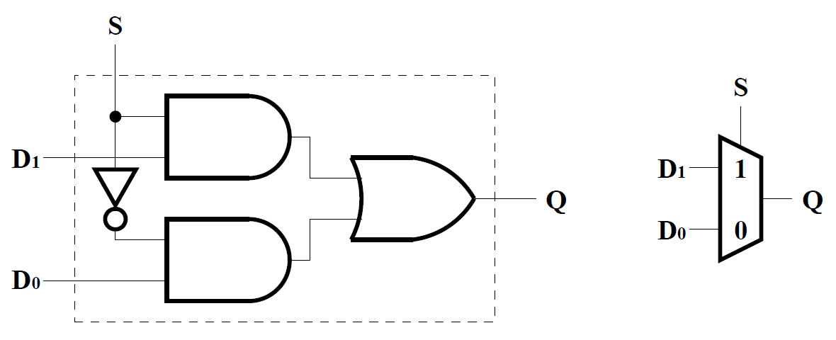
Implementation and Symbolic Form of a 2-to-1 Mux
The circuit below shows a 2-to-1 mux (multiplexer), for which the symbolic form appears to the right.

Slide 11
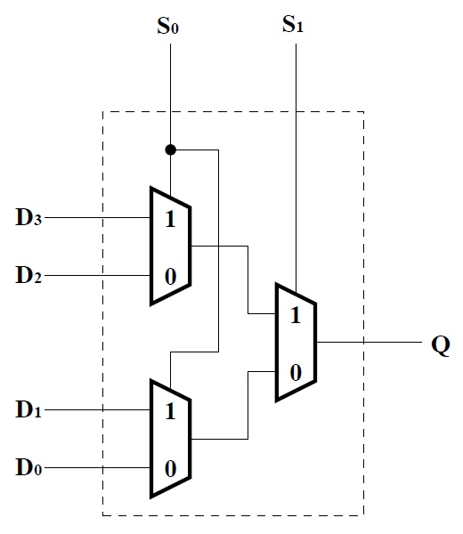
Selecting from More than Two Expressions
What if we want to select between four expressions, D₃, D₂, D₁, and D₀?
One answer is to use muxes hierarchically:
start by using one 2-to-1 mux (signal S₁)
to decide between D₃ or D₂ and D₁ or D₀.
D₃ or D₂
D₁ or D₀

Slide 12
For the Second Level, Use More Muxes
But how do we deliver two expressions to each mux input?
Use more muxes (both controlled by S₀)!
Notice that S₁S₀ then allows us to choose from four expressions.
D₃ or D₂
D₁ or D₀

Slide 13
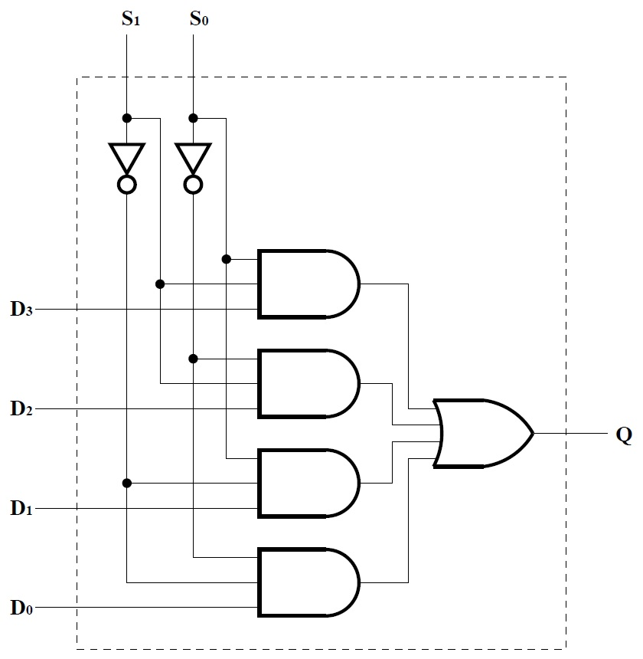
AND Gates Represent Minterms ANDed with Data Inputs
For something as common as a mux, we typically build directly from gates.
Notice that each AND gate produces a minterm of S₁, S₀ ANDed with the corresponding D_{i}.
D₃S₁S₀
D₂S₁S₀’
D₁S₁’S₀
D₀S₁’S₀’

Slide 14
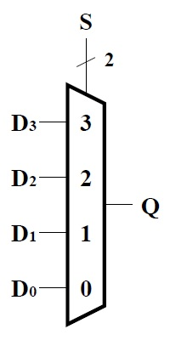
A 2^{N}-to-1 Mux Requires N Select Bits
The diagram to the right shows the symbolic form of a 4-to-1 mux.
We can, of course, further extend this idea to build 8-to-1 muxes, 16-to-1 muxes, and so forth.
When selecting amongst P = 2^{N} inputs D_{P-1} … D₀ we need N bits of select input, S_{N-1} … S₀.

Slide 15
Can Use Sets of Muxes to Select Amongst Groups of Bits
We can also generalize the idea of multiplexers by
using a common control signal
to select between groups of inputs.
Generally,
an N-to-M multiplexer
represents M separate (N/M)-to-1 muxes
each with log₂(N/M) select bit inputs
(typically N/M = 2^{K} for some integer K).

Slide 16
Example of a Set of Muxes with Common Select Input
For example, recall the design of the N-bit adder and subtractor.
We could have used a 2N-to-N mux
to choose between B_{i} and B_{i}’ for the adder’s B input
based on a common (one-bit) control signal S.
(Previously, we used the nature of the mux’ data inputs, B_{i} versus B_{i}’, to simplify each mux’ logic to an XOR gate.)

Slide 17
Another Design Problem: Checking Four Types of ASCII
Now think again about our ASCII checker.
Say that we want four kinds of comparison:
control characters (0x00 to 0x1F),
lower-case letters (0x41 to 0x5A),
upper-case letters (0x61 to 0x7A), and
digits (0x30 to 0x39).
How can we design logic to check for any of the four types?

Slide 18
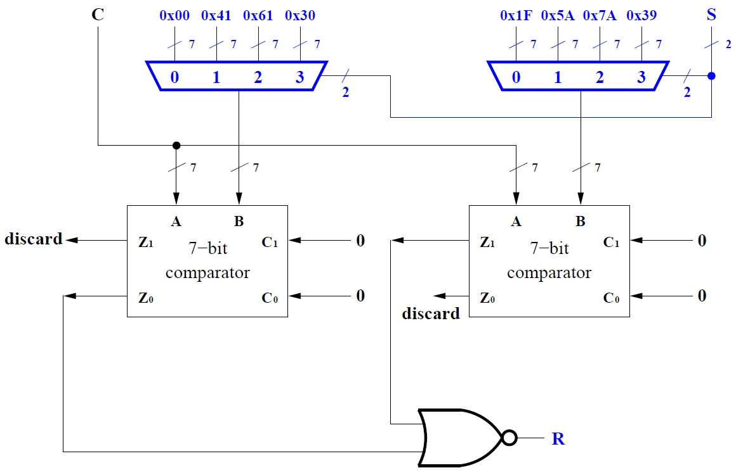
The Answer? Use Muxes! Two 28-to-7 Muxes

Slide 19
University of Illinois at Urbana-Champaign Dept. of Electrical and Computer Engineering ECE 120: Introduction to Computing
Decoders

Slide 20
How Can We Decode a Representation?
What if we have
designed a representation using N bits,
and have an N-bit value in that representation,
but need separate signals for each of the 2^{N} possible bit patterns?
Applications include
naming sets of bits, which we explore in 3-4 weeks, when we examine memory, and
generating arbitrary functions dynamically, a technique used for many years in reconfigurable hardware devices.
Notes:
… and homework. What a motivation.

Slide 21
A Decoder’s Outputs Have Exactly One 1 Bit
In other words,
given a set of N bits,
we want to generate a signal for each possible combination of the N bits.
These signals correspond to the minterms on the N bits.
Exactly one of the resulting signals has the value 1.

Slide 22
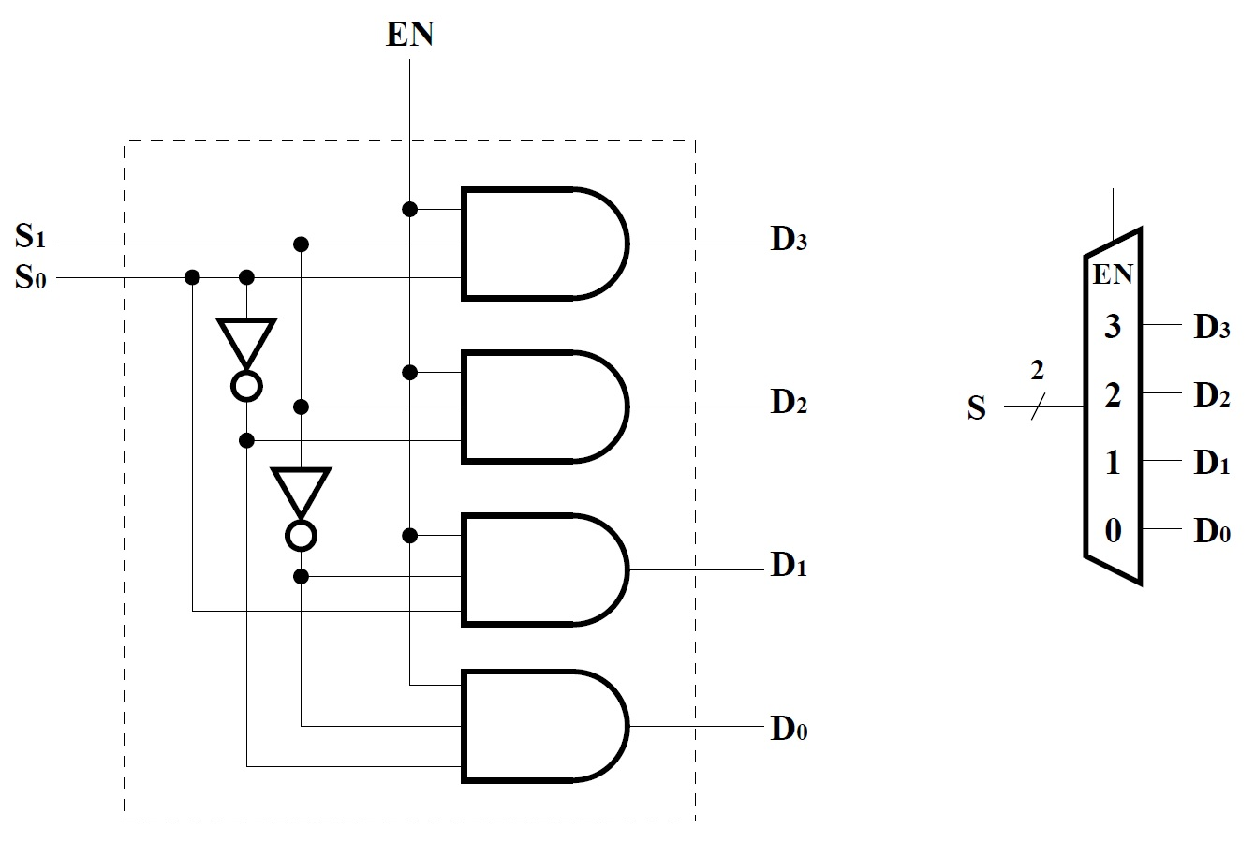
A 2-to-4 Decoder with Enable Produces Zero or One 1 Bit
We call the logic to perform such a task a decoder.
An example of a 2-to-4 decoder is shown to the right.
The decoder here has an enable signal. If EN = 0, all outputs are 0.

Slide 23
A Trapezoid that Widens Represents a Decoder
The symbolic form for a decoder is a trapezoid.
The N-bit signal to be decoded enters from the smaller side.
The 2^{N} outputs exit from the larger side.
If the decoder has an enable signal, it is typically drawn on a small side of the trapezoid.

Slide 24
Decoders and Muxes Both Calculate All Minterms
Notice that the internal structure of a decoder looks similar to that of a mux.
In a mux, minterms are combined with per-minterm inputs and ORed together in a single output.

Slide 25
Decoder Outputs Allow Separate Use of Each Minterm
The decoder allows the minterm signals to be used separately.
For example, each decoder output might control the mechanical release for a different product in a vending machine.

Slide 26
Early Reconfigurable Hardware Used Decoders
Or we can use a decoder
to compose arbitrary functions on the inputs
by ORing together the right set of minterms.
Doing so is equivalent to composing a function with a mux by connecting 0s and 1s to its inputs.
But a single decoder can be used construct many functions, while the mux allows only one function.
Such an approach allowed
programmable logic arrays (PLAs)
to dynamically produce arbitrary functions,
thus providing reconfigurable hardware.

