Slide 1
University of Illinois at Urbana-Champaign Dept. of Electrical and Computer Engineering ECE 120: Introduction to Computing
Storing a Bit: the Gated D Latch

Slide 2
Everything So Far Has Been Combinational Logic
So far, we have talked only about combinational logic.
Combinational logic allows us to solve the following type of problem:
given a set of bits as input,
how can we combine them to produce other sets of bits (Boolean expressions)?
But where do the input bits come from?

Slide 3
Now Let’s Look at Sequential Logic
Today, we will start to look at sequential logic.
Sequential logic
stores bits as state, and
its behavior depends on the state (the values of the stored bits),
just like the behavior of a C program can depend on the current values of variables.

Slide 4
A Dual “Inverter” Loop Serves a Specific Purpose
What is a 1-input NAND gate?
An inverter / NOT.
Remember the gate structures?
What does the circuit here do?
It has no inputs!
How can we analyze it?
Q
P
Notes:
Gate structures: NOT is the same as a 1-input NAND or a 1-input NOR. Simply reduce the parallel/serial constructs to a single transistor each.

Slide 5
Start Solving by Picking a Value for Some Variable
First, write a truth table.
Then pick a value.
Say Q = 0.
Which implies what about P?
P = 1.
Which implies what about Q?
Q = 0 (be sure to check!).
Q
P
Q | P
0
1
Notes:
Not all circuits are stable. If we connect three inverters in a loop, we get a ring oscillator. Beyond the scope of the class, but easy to understand why.

Slide 6
Trace Logic Values to Find Stable States
We say that this state (Q = 0, and P = 1, as shown in the truth table) is stable because the values do not continue to change forever.
What if we instead pick Q = 1?
In that case, what is P?
And what does P = 0 imply for Q?
Again, be sure to check stability.
Q
P
Q | P
0 | 1
1
0

Slide 7
The Dual-Inverter Loop Stores One Bit
We say that this circuit is bistable because it has two stable states (bi- = two).
Bits on a chip are typically stored using this kind of dual-inverter loop.
But … how do we set a value?
Q
P
Q | P
0 | 1
1 | 0
Notes:
Let the students think about it before continuing.

Slide 8
Use an Extra Input to Set the Bit Q
S
Let’s add an input.
We will call it S’.
What happens when S’ is 1?
The new input has no effect! (green is the previous truth table)
What if S’ = 0?
Q = 1! And P = 0.
So S’ Sets the bit Q to 1.
Q
P
S’ | Q | P
0
1
0
1
0
1
1
1
0

Slide 9
Active Low Inputs are Named with “Bar” (NOT)
Why did we call the input S’?
(Call it “S bar,” by the way.)
The action induced by S’,
to S(et) the bit Q,
occurs when S’ = 0 (S’ is low).
We say that the input S’ is active low.
And we name it S’ instead of S to indicate how the input should be used.

Slide 10
What About Resetting Q to 0?
S
So we can set Q = 1.
But … what if we want Q = 0?
Keep flipping the power on and off until we get lucky?
(Maybe not.)
Any ideas?
Q
P
S’ | Q | P
0 | 1 | 0
1 | 1 | 0
1 | 0 | 1

Slide 11
Use an Extra Input to Reset the Bit Q
S
Another input? Sure.
We will call it R’.
What happens when R’ is 1?
The new input has no effect! (green is the previous table)
What if R’ = 0 and S’ = 1?
P = 1! And Q = 0.
So R’ Resets the bit Q to 0.
Q
P
R
R’ | S’ | Q | P
0
1
0
1
1
0
1
0
1
1
0
1
1
1
1
0

Slide 12
An R’-S’ Latch Consists of Two NAND Gates
S
This circuit has a name!
It’s an R’-S’ latch (“R bar, S bar latch”).
Store a 1 bit by lowering S’ to 0.
Store a 0 bit by lowering R’ to 0’.
Q
P
R
R’ | S’ | Q | P
0 | 1 | 0 | 1
1 | 0 | 1 | 0
1 | 1 | 0 | 1
1 | 1 | 1 | 0

Slide 13
Avoid Setting Both S’ and R’ to 0 Simultaneously
S
What if we set both S’ and R’ to 0 at the same time?
Q = 1 and P = 1.
But when we raise the inputs, we may leave the stored bit in either state.
Or, worse, the loop may not settle into digital voltages (metastable).
Do NOT lower both at once!
Q
P
R
R’ | S’ | Q | P
0 | 1 | 0 | 1
1 | 0 | 1 | 0
1 | 1 | 0 | 1
1 | 1 | 1 | 0
Notes:
Patient: My head hurts whenever I touch it!
Doctor: So stop touching it.

Slide 14
Extra Gates Prevent the Forbidden Input Combination
D
S
We can add a couple more NAND gates to prevent setting both S’ and R’ to 0.
Let’s check the truth table.
So Q stores D…
Q
P
R
D | R’ | S’ | Q | P
0
1
0
1
0
1
1
0
1
0

Slide 15
We Can Simplify the Design to Copy D to Q
D
S
There’s an easier way to implement such a circuit, though…
So Q stores D…
Q
P
R
D | R’ | S’ | Q | P
0 | 0 | 1 | 0 | 1
1 | 1 | 0 | 1 | 0

Slide 16
Extra Inputs Control Copying of D to Q
D
S
Let’s add more inputs to the new gates, too.
Now our design only copies D to Q when WE = 1.
Q
P
WE
R
WE | D | R’ | S’ | Q | P
1 | 0 | 0 | 1 | 0 | 1
1 | 1 | 1 | 0 | 1 | 0

Slide 17
The Circuit Can Also Store a Bit
What happens when WE = 0?
The circuit stores the last bit from D (same truth table as before!).
This circuit is called a gated D latch.
WE | D | R’ | S’ | Q | P
1 | 0 | 0 | 1 | 0 | 1
1 | 1 | 1 | 0 | 1 | 0
0 | x | 1 | 1 | 0 | 1
0 | x | 1 | 1 | 1 | 0

Slide 18
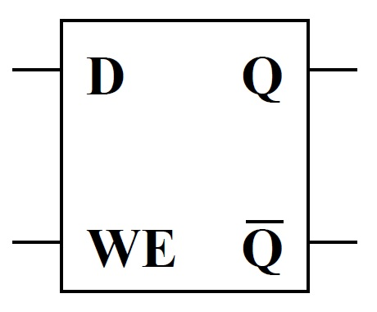
This Design is Called a Gated D Latch
D
S
Symbolically, a gated D latch is drawn as shown here.
Notice that P has been replaced by Q’, since they are always complements of one another.
Q
P
WE
R

Slide 19
University of Illinois at Urbana-Champaign Dept. of Electrical and Computer Engineering ECE 120: Introduction to Computing
The Clock Abstraction

Slide 20
Latches Can be Used Directly for Sequential Systems
Many high-speed designs are based on latches.
A set of latches serves as input to combinational logic.
The outputs are stored in latches.
And so forth. (Eventually making a loop.)
D
Q
D
Q
combinational
logic
WE
Q
WE
Q

Slide 21
Complemented Inputs are Usually “Free”
Now you can understand why complemented inputs are usually “free” (do not require inverters to generate).
If inputs come from latches, we can simply connect wires to the Q or to the Q’ outputs.
D
Q
D
Q
combinational
logic
WE
Q
WE
Q

Slide 22
A Clock Signal is Idealized as a Square Wave
A clock signal is used to drive the WE inputs of the latches.
The clock is (ideally) a square wave.
So a 4 GHz clock repeats:
0.125 nanoseconds at 0V,
0.125 nanoseconds at V_{dd}.
time
CLK

Slide 23
Sets of Latches Alternate Write Enable Sense
Alternating sets of latches accept input in alternating clock phases (low and high).
D
Q
D
Q
combinational
logic
WE
Q
WE
Q
CLK
copies D to Q
when CLK = 0
Clock frequency is limited by logic delay.
copies D to Q
when CLK = 1

Slide 24
Reality is Substantially More Challenging
Ideally, the clock
is a square wave, and
edges arrive at all latches at the same time.
In the real world,
there are no square waves, and
“at the same time” is not meaningful (an effect of special relativity).
We will use a simpler abstraction.
And leave the problem of clock skew (timing of clock edges) to the circuit designers.

Slide 25
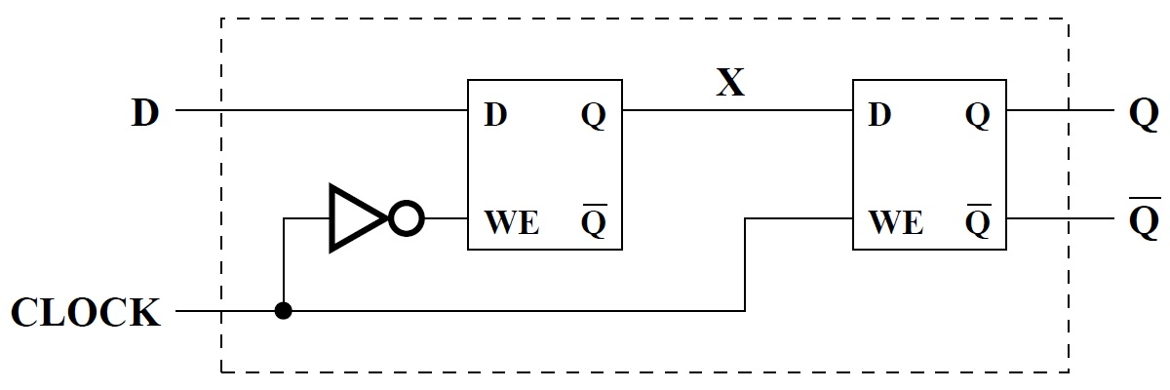
Assume Flip-Flops and a Common Clock in Our Class
In particular, we combine consecutive sets of latches into “flip-flops” (as shown below),
and only allow combinational logic between flip-flops.
no combinational logic here

Slide 26
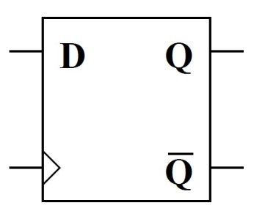
Our Class Uses only One Type of Flip-Flop
Design below (symbol to right) shows
a master-slave implementation (using two gated D latches) of
a positive-edge-triggered D flip-flop.
Note the use of a triangle for the clock input.

Slide 27
What Does the Name Mean?
A “flip-flop” stores one bit, and changes value once each clock cycle.
A “D flip-flop” accepts the bit to store using a D(ata) input.
“Positive-edge-triggered” means that the flip-flop’s value changes on the rising edge (low to high) of the clock signal.

Slide 28
Our Simplifying Assumptions Imply Discrete Time
So what does our use of flip-flops and ignoring clock skew imply?
Discrete time!
Time is an integer.
Each clock cycle is one unit of time.
Flip-flops copy their D inputs to their Q outputs on the rising edge of the clock.
Between integer values of time, we assume that nothing changes.

Slide 29
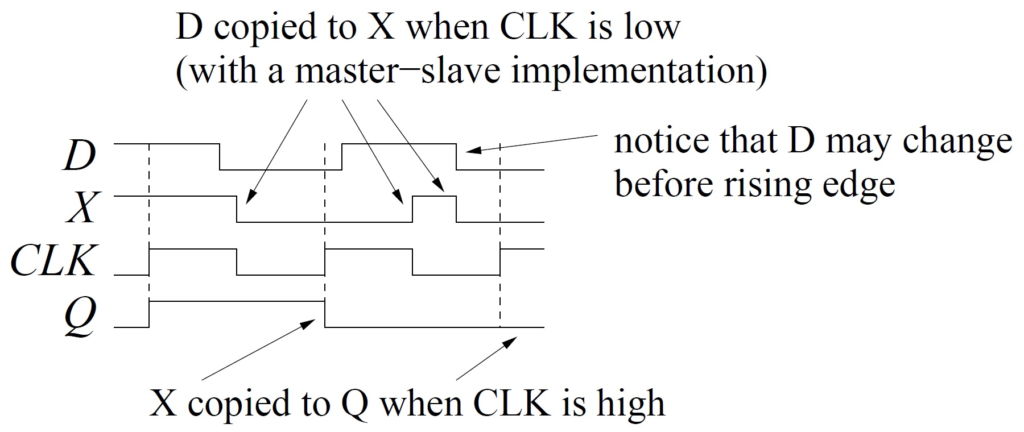
Our Flip-Flop Stores a New Bit on Each Rising Clock Edge
Let’s see how our flip-flop works internally. Remember that X is between the two latches.
Notes:
Start on the left and explain. D actually rises in the second cycle but falls again before the rising clock edge.
Be sure that the students understand: since D is copied to X while the clock is low, the value of D *just before* the rising edge is copied from X to Q and held for one full clock cycle. In reality, of course, the edges are not sharp, and we need some time for D to propagate to X, and for X to propagate to Q.

Slide 30
Our Flip-Flop Stores a New Bit on Each Rising Clock Edge
In our class, all of your designs for sequential systems will be clocked synchronous sequential circuits. These assume use of
flip-flops (for us, positive-edge-triggered D flip-flops) and
a common (synchronous) clock signal.
Components such as latches and flip-flops are examples of sequential feedback circuits. You should understand how they work, but we don’t expect you to design any.

