Slide 1
University of Illinois at Urbana-Champaign Dept. of Electrical and Computer Engineering ECE 120: Introduction to Computing
Static Hazards*
Notes:
This material is NOT REQUIRED LEARNING, but it’s good for them to have some idea of the complexities of timing that are swept under the rug in ECE120. They will need to deal with more of the complexity in ECE385, and should have some amount of knowledge before they head off for any kind of hardware-related internship.

Slide 2
Circuit Timing Can Cause Problems with Functionality
* * * * * * * * * * * * * * * * * * * * * * * * * * * * * * * * * * *
For our class, you need understand only the basics of timing:
how to estimate delay (as gate delays),
and how to check for stable states (trace changes until nothing changes).
In later classes, you will need to understand timing more deeply.
So let’s take a look at how timing matters, just as a preview.

Slide 3
Hazards, Glitches, and Errors
* * * * * * * * * * * * * * * * * * * * * * * * * * * * * * * * * * *
When a circuit may have a problem due to timing, we say that the circuit has a hazard.
If a combinational circuit’s output is temporarily incorrect, we say that its output exhibits a glitch.
When a sequential circuit enters a state (a set of stored bits) that it should not enter by design, we say that the circuit has an error.
Typically, an error implies a glitch, which in turn implies a hazard, but not vice-versa.

Slide 4
Static Hazards Allow for Change in Constant Output
* * * * * * * * * * * * * * * * * * * * * * * * * * * * * * * * * * *
The notes (Section 2.6.3* and following) discuss three types of hazards.
Static hazards
allow a combinational circuit’s output to change when moving between input combinations that should produce the same output.
With a static-1 hazard, for example, both input combinations should produce a constant output of 1, but the output may drop to 0 briefly because of timing.

Slide 5
Dynamic Hazards Allow Bouncing in Changing Output
* * * * * * * * * * * * * * * * * * * * * * * * * * * * * * * * * * *
Dynamic hazards
occur when an input combination changes from one that should produce an output of 0 to a combination that should produce an output of 1 (or vice-versa).
In these cases, the output should change exactly once.
If a dynamic hazard is present, the output may bounce between 0 and 1 before settling to its final value.

Slide 6
Essential Hazards Cannot be Eliminated
* * * * * * * * * * * * * * * * * * * * * * * * * * * * * * * * * * *
Essential hazards
are related to the function implemented by the circuit.
Unlike static and dynamic hazards, they cannot be eliminated.
In clocked synchronous sequential circuits (and, thus, in the designs in our class), all essential hazards are mapped to clock skew.

Slide 7
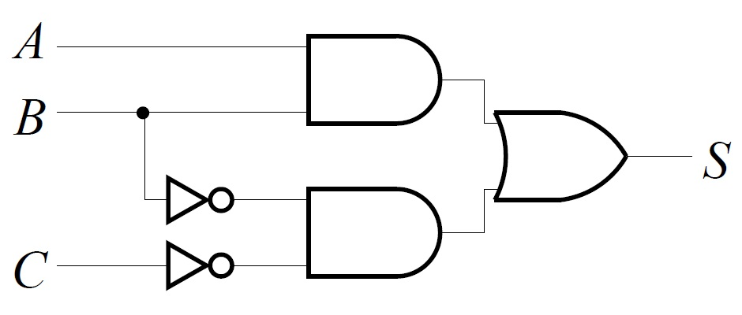
Removing Static Hazards
* * * * * * * * * * * * * * * * * * * * * * * * * * * * * * * * * * *
If glitches in a circuit’s output can cause problems, one can eliminate all static hazards.
Consider the circuit below. What is S?
S = AB + B’C’
Notes:
Ask the students.

Slide 8
The Output S Should Stay at 1
* * * * * * * * * * * * * * * * * * * * * * * * * * * * * * * * * * *
So S = AB + B’C’.
Let’s see what happens when we move from ABC = 110 to ABC = 100.
Both should produce S = 1.
2. AND output
drops to 0.
1. B changes from 1 to 0.
3. OR output
drops briefly to 0.
2. NOT output
rises to 1.

Slide 9
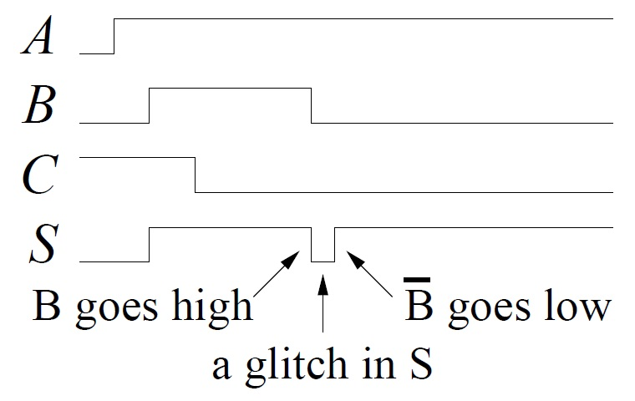
The Output S Drops to 0
* * * * * * * * * * * * * * * * * * * * * * * * * * * * * * * * * * *
The output glitches because the inverter for B delays the change in the lower AND gate.
low
high

Slide 10
Fix Static Hazards by Adding More Gates
* * * * * * * * * * * * * * * * * * * * * * * * * * * * * * * * * * *
What can we do?
Take a look at the K-map.
The loops represent the AND gates.
ABC = 110 to 100 moves between loops.
Let’s add a new loop (and a new AND gate).
The new AND gate will stay at 1.
S |  | BC
 |  | 00 | 01 | 11 | 10
A | 0 | 1 | 0 | 0 | 0
 | 1 | 1 | 0 | 1 | 1
Notes:
The students probably can’t answer, but it may be interesting to let them try.

Slide 11
Read the Notes for More Information
* * * * * * * * * * * * * * * * * * * * * * * * * * * * * * * * * * *
See Notes Sections 2.6.3* through 2.6.6* if you want to learn more.
Notes:
Ask the students.

Slide 12
University of Illinois at Urbana-Champaign Dept. of Electrical and Computer Engineering ECE 120: Introduction to Computing
Registers

Slide 13
A Register Stores a Set of Bits
Most of our representations use sets of bits: unsigned, 2’s complement, floating-point, ASCII.
Even messages between bit slices often require more than one bit to convey a given meaning.
A flip-flop stores a single bit.
A register is
a storage element
composed from one or more flip-flops
operating on a common clock.

Slide 14
Add an Input to Control Changing a Register’s Bits
A flip-flop stores a new bit every cycle.
With registers, we want to control when the bits change value.
So we add a LOAD (or LD) input.
When LOAD = 1 on a rising clock edge, the register stores a new set of bits.
When LOAD = 0, the register retains its currently stored bits.

Slide 15
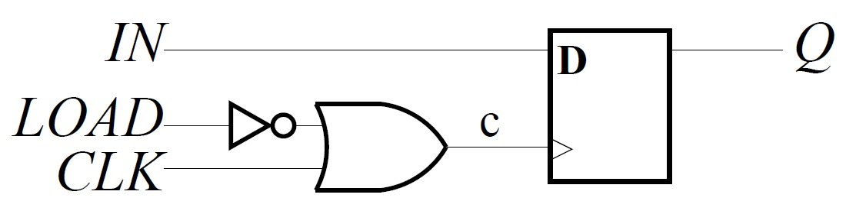
Clock Gating Uses Extra Gates to Hide the Clock Signal
How should we implement the LOAD input?
The approach below may seem attractive.
It’s called clock gating.
Generally, you should avoid this technique.

Slide 16
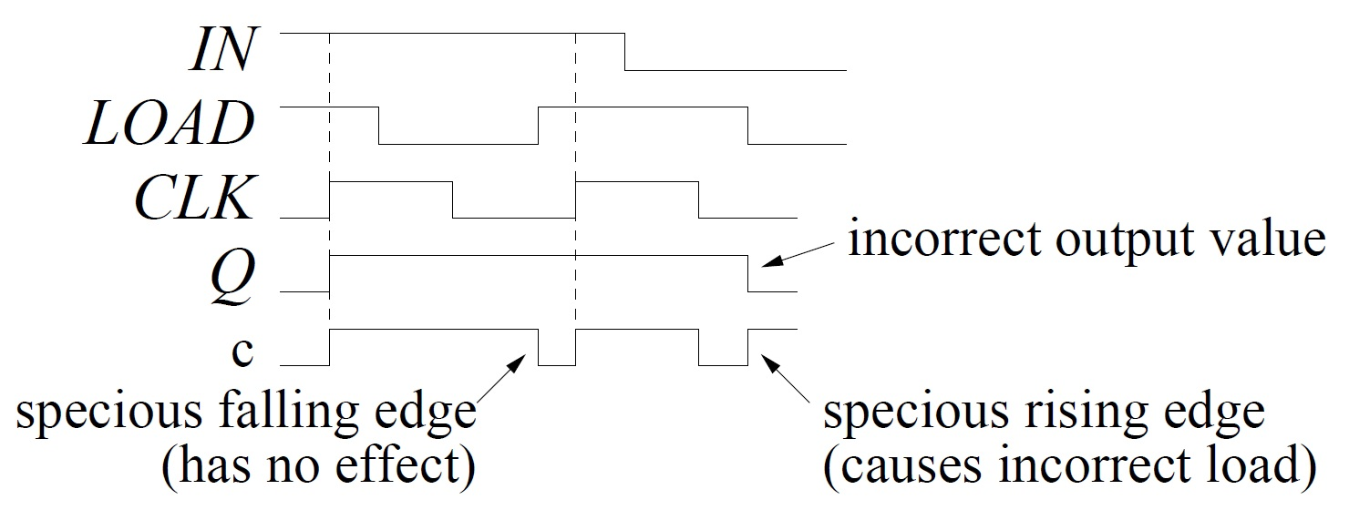
Changes to LOAD Must be Timed Carefully
From previous figure, c = LOAD’ + CLK.

Slide 17
Clock Gating Contributes to Clock Skew
More importantly,
the extra gates in front of CLK
contribute to clock skew!
So clock gating adds further complexity to the problem of distributing the clock signal to all of the flip-flops.
Except for one application (ripple counters, in a couple of weeks), you should always use and assume a common clock signal in our class (no clock gating).

Slide 18
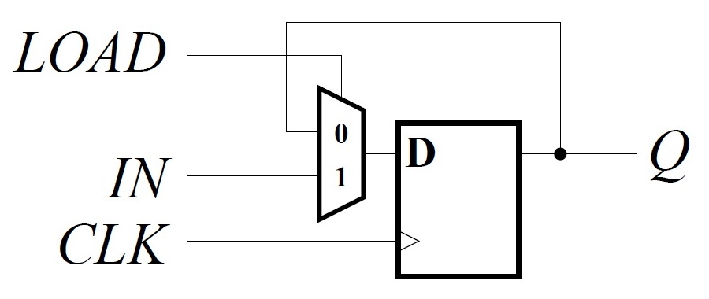
LOAD Controls Whether a Register Loads a New Value
So the question remains: How should we implement the LOAD input?
Use a mux!
Notes:
Ask the students. After showing the design, be sure that the students understand the operation of the mux: when LOAD = 0, Q goes back to D, so the register holds its stored bit indefinitely. When LOAD = 1, the bit provided on IN is copied into the flip-flop’s stored bit (on the rising edge of the clock).

Slide 19
A 1-Bit Register with a LOAD Input
The design below is a 1-bit register.
How can we create an N-bit register?
Use this design as a bit slice.
Notes:
Ask the students.

Slide 20
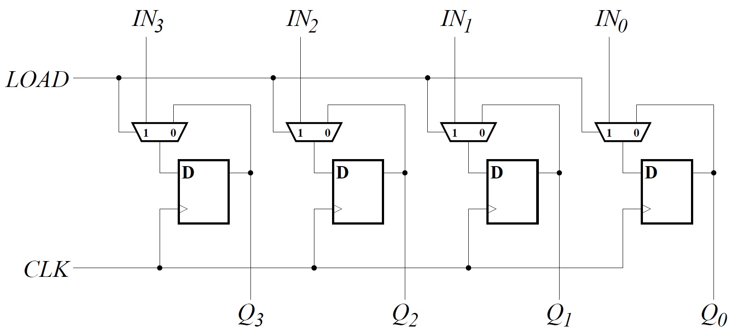
The LOAD Signal Controls All Bits of the Register
A 4-bit register with parallel load.
Notes:
Talk about the use of a single LOAD input to control the loading. Remind them of the common clock and that the LOAD signal is only actually used at the rising clock edge. These are positive-edge-triggered flip-flops.

Slide 21
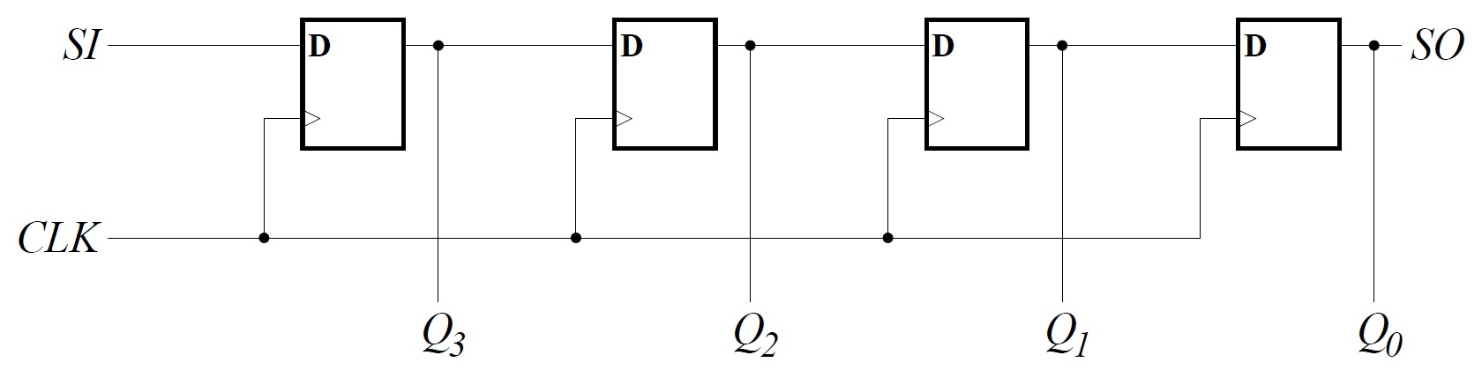
A Shift Register Shifts Bits from Flip-Flop to Flip-Flop
If we need to load registers one bit at a time, we can construct a shift register, as shown below (this one is a right shift register).
In every cycle, bits shift in from serial input SI and shift out through serial output SO.

Slide 22
Simple Shift Registers Have Many Applications
For example, optical networks can transmit bits at rates above 100 × 10⁹ / second (100 Gbps), but CMOS clock speeds rarely exceed 4-5 GHz.
Deserialization (and serialization, SERDES) can be done with shift registers:
shift into a 25-bit shift register at 100 GHz,
then read 25 bits out in parallel at 4 GHz.

Slide 23
Shift Registers Provide Fixed Delay
An example:
Data arrive from memory in a block (in a single cycle), but different parts of the data are needed in different cycles.
Solution? Use shift registers to deliver each part of the data to the computation elements in the correct cycle.

Slide 24
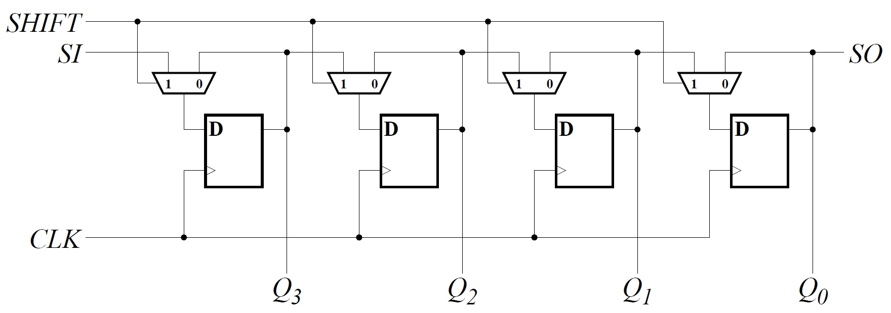
Shift Registers Can Also Be Designed to Stop Shifting
A shift register need not shift in every cycle. Below, we use the SHIFT input to make the register hold its current value (SHIFT = 0).

Slide 25
Shift Registers Also Require Fewer Wires
Serial load (shift registers) is also useful
when wires are the limiting resource,
as is usually the case with pins on a chip.
Recall that parallel load of an N-bit register requires N input wires (not counting LOAD).
Examples of such applications include
configuration of reconfigurable hardware such as Field-Programmable Gate Arrays (FPGAs, which you will use in ECE385),
and testing of digital systems (shift bits in, run for a cycle, shift bits out for testing).

Slide 26
Many Options for the Design of Shift Registers
direction (meaningful for some representations):
right: from most significant bit (MSB) to least significant bit (LSB)
left: from LSB to MSB.
boundaries: how to manage serial input
exposed: input signal for serial input SI
logical: shift in 0s (serial input)
arithmetic: shift based on 2’s complement
cyclic: connect SO back to SI, possibly through another register (allows building of bigger shifts from smaller ones).

Slide 27
We Can Combine Several Types
But we don’t have to pick one design.
Let’s build one register that performs one of four distinct operations based on control inputs C₁C₀.
For example…
How can we build it?
With a mux!
C₁C₀ | meaning
00 | retain current value
01 | shift left (low to high)
10 | load new value (from IN_{i})
11 | shift right (high to low)
Notes:
Ask the students.

Slide 28
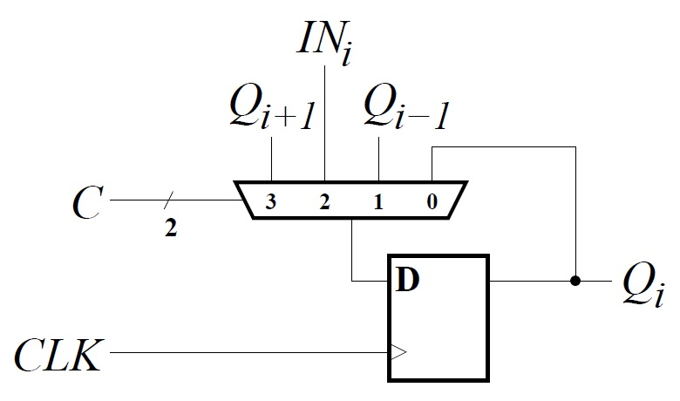
We Can Combine Several Types
Each bit of the register uses a 4-to-1 mux.
C₁C₀ | meaning
00 | retain current value
01 | shift left (low to high)
10 | load new value (from IN_{i})
11 | shift right (high to low)
Notes:
Walk through the four options: 0 = hold value, 1 = shift low to high, 2 = parallel load, 3 = shift high to low. For the shifts, we can add logic at SI/SO to handle whichever types of left/right shifts we want to produce.

