Slide 1
University of Illinois at Urbana-Champaign Dept. of Electrical and Computer Engineering ECE 120: Introduction to Computing
Serialization of Bit-Sliced Designs

Slide 2
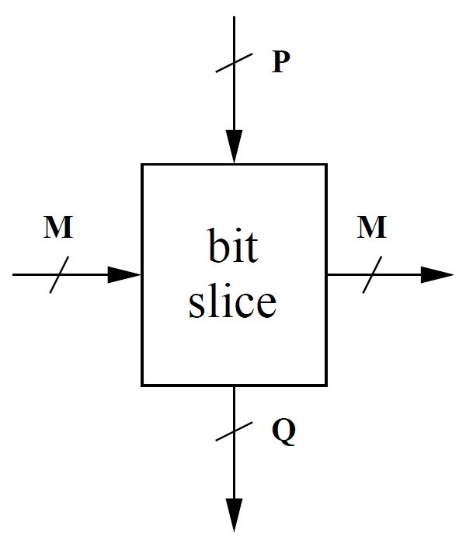
An Abstract Model of a Bit Slice
Consider a bit-sliced design.
Each bit slice computes a function of
P input bits, and
M bits from the previous bit slice.
And each bit slice produces
Q output bits, and
M bits for the next bit slice.

Slide 3
Use Flip-Flops to Serialize a Bit-Sliced Design
How do we handle N bits?
Previously, we used N copies of the bit slice.
But now we know how to store bits.
So we could instead
use one copy of the bit slice, and
pass the bit slice’s M outputs back as inputs in the next clock cycle.
Such an implementation is a serial design because it handles one bit at a time.

Slide 4
Boundary Conditions Add Some Complexity
But it’s not quite so simple.
What about the first bit slice?
That bit slice has no previous bit slice, so instead the M-bit input is 0s and 1s.
And what about the last bit slice?
The M-bit output to the next slice is not always acceptable as an answer. We sometimes need additional output logic.

Slide 5
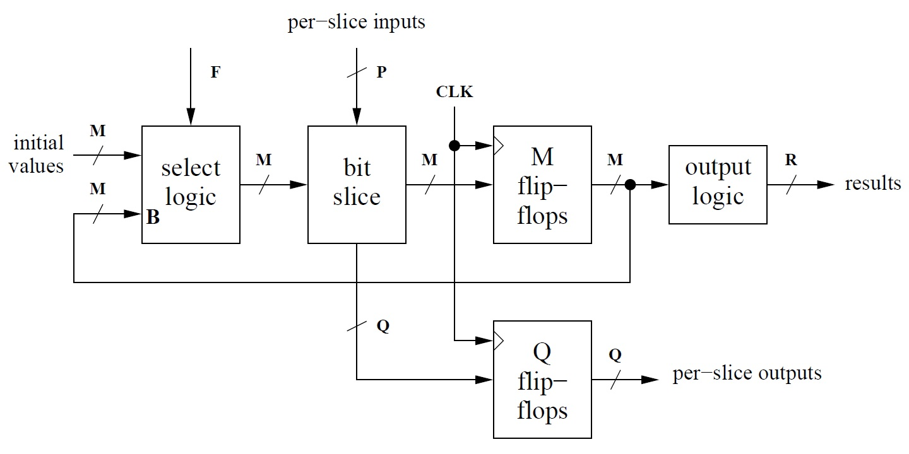
Not Much Work to Serialize a Design
This figure shows an abstract serial design.
usually 0s and 1s
F = 1
means
first bit
same logic as
with bit-sliced
design
What do we
need here?
Notes:
“Muxes” is a good answer to the last question. In the next slide, we’ll do more optimized implementations for 0s and 1s (the typical input).
May want to talk about use of flip-flops to store Q bits of output. These will be available in the next cycle, not immediately (when inputs are applied). Similarly, output results from design are available in the cycle AFTER the last bits are fed into the bit slice.

Slide 6
Muxes Suffice, But Let’s Optimize the Design a Little
M 2-to-1 muxes controlled by F suffice for the selection logic.
But since the initial values are usually 0s and 1s, we can optimize.
M flip-flops feed their stored values back into the selection logic. Let’s call these bits B_{i}.
And let’s call the M bits produced for the bit slice C_{i}.

Slide 7
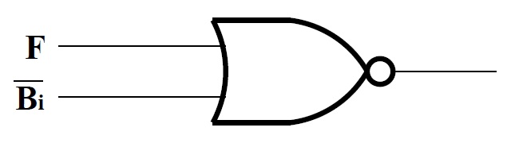
Need One NOR Gate When Initializing to 0
Start by assuming a 0 bit in place of B_{i} for the first bit (when F = 1).
And write a truth table for C_{i}.
From the table, we can write
C_{i} = F’B_{i} = (F + B_{i}’)’
Remembering that B_{i}’ is available from the flip-flop output, a single NOR gate suffices.
F | C_{i}
0 | B_{i}
1 | 0

Slide 8
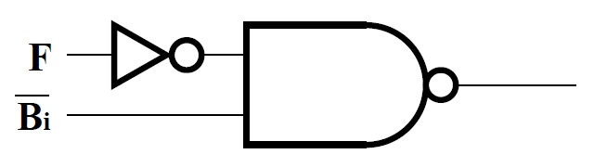
Need NAND and NOT When Initializing to 1
Now assume a 1 bit in place of B_{i} for the first bit (when F = 1).
And write a truth table for C_{i}.
From the table, we can write
C_{i} = F + B_{i} = (F’B_{i}’)’
Remembering that B_{i}’ is available from the flip-flop output, a NAND gate and an inverter for F suffices.
F | C_{i}
0 | B_{i}
1 | 1

Slide 9
University of Illinois at Urbana-Champaign Dept. of Electrical and Computer Engineering ECE 120: Introduction to Computing
Example of Serialization

Slide 10
Review of General Bit-Slice Model
General model parameters
N-bit operands
P bits of input from operands
Q bits of output produced
M bits between bit slices
R bits of final output (not shown; produced by output logic operating on M bits from last bit slice).

Slide 11
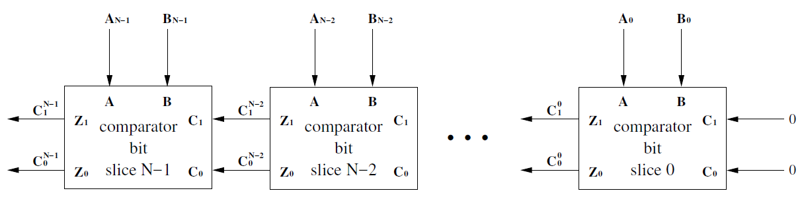
N-bit Bit-Slice Comparator
Comparator parameters
N-bit operands A_{N-1}A_{N-2}…A₁A₀ and B_{N-1}B_{N-2}…B₁B₀
P = 2
Q = 0
M = 2
R = 2

Slide 12
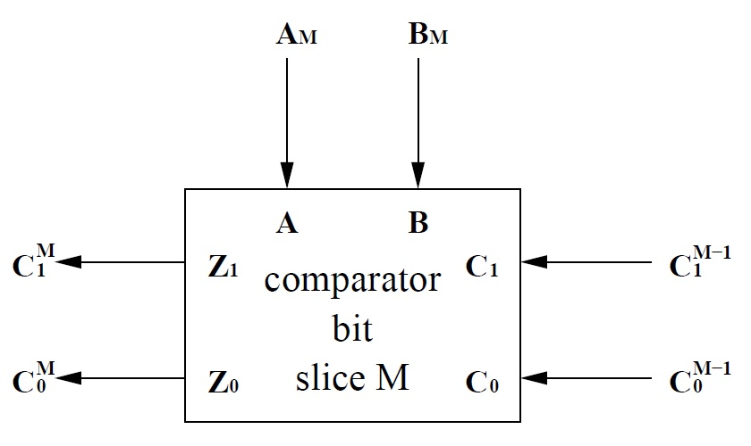
Parameter Values for a Serial Comparator
Comparator parameters
N-bit operands
P = 2
Q = 0
M = 2
R = 2
Notes:
M is overloaded. The M in the bit slice refers to the numbers of the external variables, not to the M in the bit slice design.

Slide 13
Initialization of a Serial Comparator
Our comparator bit slice uses the representation shown here to pass information between slices.
What values should be passed to the first bit slice?
A = B, so C₁C₀ = 00
C₁ | C₀ | meaning
0 | 0 | A = B
0 | 1 | A < B
1 | 0 | A > B
1 | 1 | not used
Notes:
Ask the students.

Slide 14
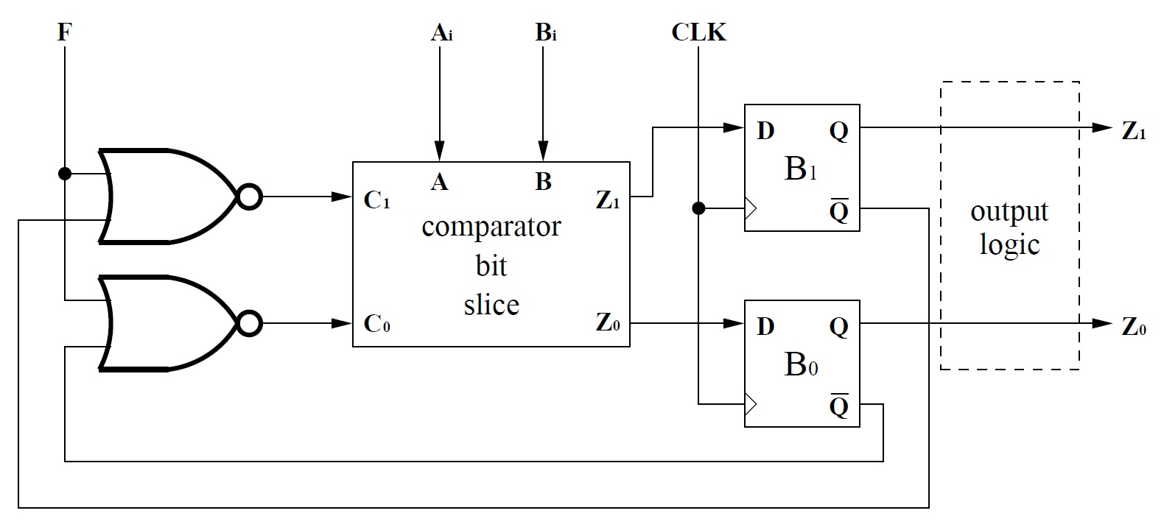
Example: A Serial Comparator
input operands (P = 2)
output logic
does nothing (R = 2)
initialized to 0
when F = 1
0 output flip-flops (since Q = 0)
two flip-flops (since M = 2)
Notes:
Walk through design.

Slide 15
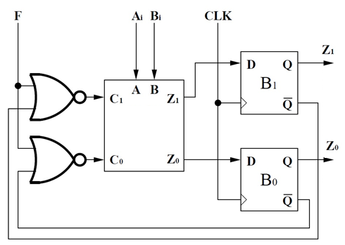
Discrete Time Implies Delayed Results: N = 4
(green = bit slice labels)
yellow = inputs
C₁ | C₀ | meaning
0 | 0 | A = B
0 | 1 | A < B
1 | 0 | A > B
1 | 1 | not used
cycle # | F | A | B | B₁ | B₀ | C₁ | C₀ | Z₁ | Z₀
0 | 1 | 0 | 1
1
2
3
4
bits
bits
0
0
0
1
0
1
1
0
1
0
1
0
1
0
1
0
0
1
0
1
1
0
0
0
1
1
0
1
0
0
1
x
x
x
0
1
0
?
?
?
blue = outputs
Notes:
For cycle 0, be sure that they understand why C1 and C0 are 0 (because F=1, so B1/B0 don’t matter). Also remind them that low bits are first, otherwise the Z1/Z0 outputs won’t make any sense.
Also point out that the answer is only available in cycle 4, even though all of the bits of A and B have been delivered to the comparator in cycle 3. The question marks are unknowns (not don’t cares). We could start processing a second set of 4-bit numbers in cycle 4—doing so will NOT interfere with B1 and B0 (until cycle 5), which drive the output values.

Slide 16
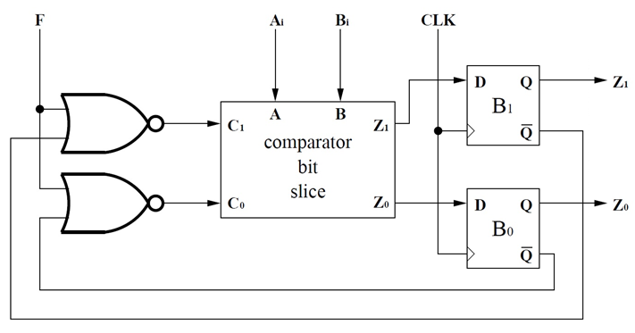
A Serial Comparator Consists of Three Parts
Let’s analyze the area of a serial comparator.
We have:
one bit slice,
two flip-flops, and
two 2-input NOR gates (selection logic).

Slide 17
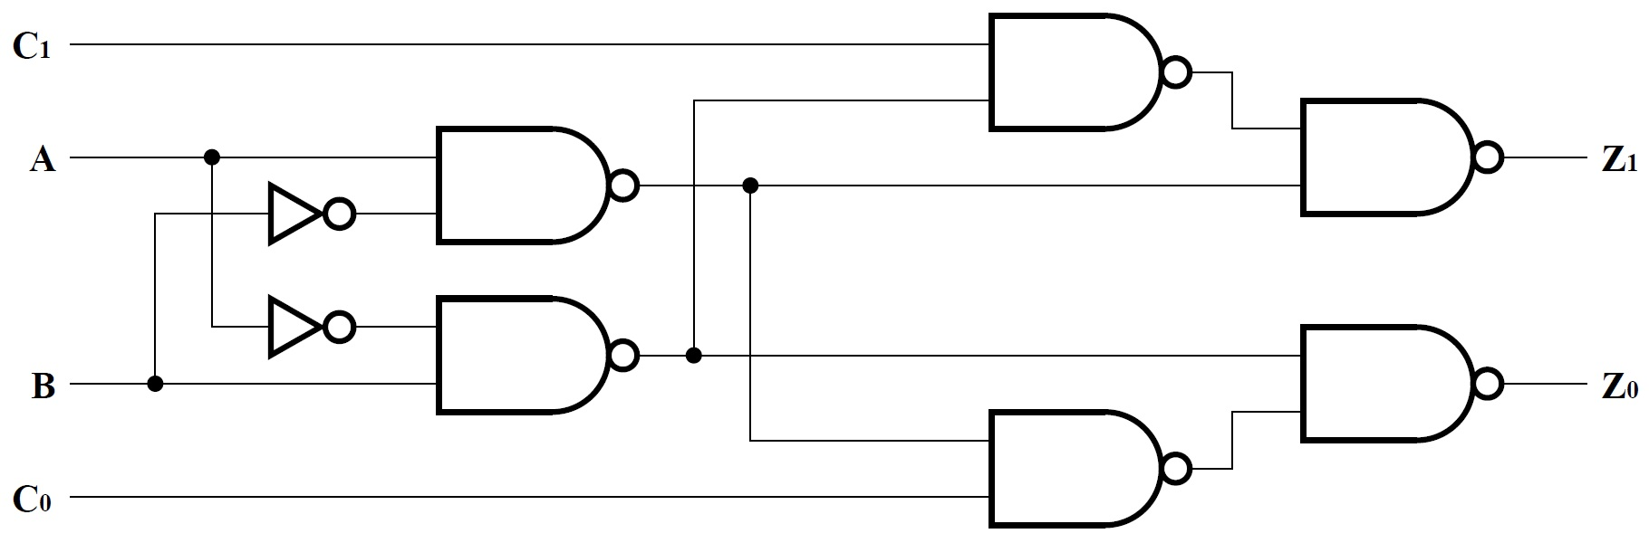
A Serial Comparator Contains One Bit Slice
Assume the smaller version of the bit slice. So we need six 2-input NAND gates and two inverters.

Slide 18
A Serial Comparator Consists of Three Parts
Let’s analyze the area of a serial comparator.
We have:
one bit slice,
two flip-flops, and
two 2-input NOR gates (selection logic).
six 2-input NAND and two inverters

Slide 19
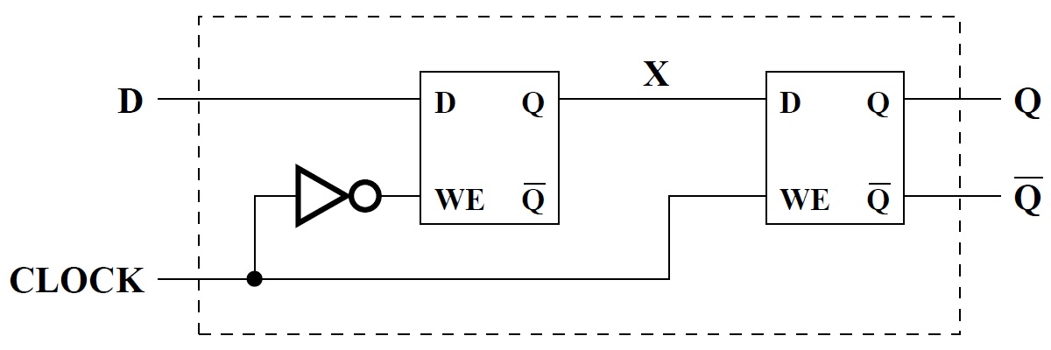
A Serial Comparator Uses Two Flip-Flops
A flip-flop is two latches and an inverter.
If we use NOR gates for the first latch, we don’t need the extra inverter.*
So eight 2-input gates and two inverters (each).
*And real designs, optimized at the transistor level, are even smaller.

Slide 20
A Serial Comparator Consists of Three Parts
Let’s analyze the area of a serial comparator.
We have:
one bit slice,
two flip-flops, and
two 2-input NOR gates (selection logic).
Total: 6+16+2 = 24 2-input gates and 2+4 = 6 inverters.
six 2-input NAND and two inverters
16 2-input gates and four inverters

Slide 21
Serial Design is Smaller for N ≥ 4
To handle N-bit operands, a bit-sliced design requires:
6N 2-input gates, and
2N inverters.
A serial design (independent of N) requires
24 2-input gates, and
6 inverters.
The serial design is smaller for N ≥ 4.

Slide 22
Serial Designs are Slower than Bit-Sliced Designs
The tradeoff? Serial designs are slower than bit-sliced designs.
Why?
There are three reasons:
All paths matter.
Selection logic and flip-flops add to delay.
Other logic may further reduce the speed of the common clock.
Let’s look at each in more detail.

Slide 23
All Paths Matter in a Serial Design
In an N-bit bit-sliced design,
All external inputs appear at time 0,
So only the slice-to-slice paths in the bit slice contribute to the multiplier on N.
Other paths contribute only constant time to the overall delay in the design.
In a serial design, all paths matter.
All input bits arrive in the cycle in which they are consumed, so
long paths from any input can slow down the design overall.

Slide 24
Flip-Flops and Selection Logic Add to Delay
Flip-flops take time
To store values,
To produce values.
And the selection logic sits between the flip-flops and the bit-slice inputs.
The clock cycle
must be long enough
to account for all of these delays.

Slide 25
Clock Speed is Determined by the Slowest Logic
The longest path through combinational logic determines the speed of the common clock.
In practice,
engineers identify complex and/or important elements and
work hard to make them fast or
to split them into several cycles.
Even if a serial design’s logic needs only 0.1 clock cycles, operating on N-bit operands still takes N clock cycles.

Slide 26
Assume Four Gate Delays On Either Side of Clock Edge
Let’s analyze the delay of a serial comparator.
We can count gate delays
in the bit slice, and
for the selection logic.
What about the flip-flops?
Let’s assume
four gate delays of stable D input needed before the rising edge, and
four gate delays after the rising edge.

Slide 27
When Are Inputs Available?
A rising edge arrives at t = 0 (gate delays).
also available at t = 4
available at t = 5
available at t = 4
Notes:
Be sure that the students understand: the unit is now GATE DELAYS, not cycles.
We assume that F, Ai, and Bi come from flip-flops, so we pay 4 gate delays for them.

Slide 28
Delay Analysis for the Bit Slice
3 gate delays (ignoring NOT)
A to Z₁:
C₁ to Z₁:
B to Z₁:
2 gate delays
Paid 4 gate delays for flip-flops.
3 gate delays
Notes:
Old slide modified slightly.
Note that we assumed that A, B, and F come from flip-flops (and paid 4 gate delays to get them!), so we can assume that A’ and B’ are also available at t=4.

Slide 29
When Are Results Stored?
A rising edge arrives at t = 0 (gate delays).
also available at t = 4
available at t = 7
stored at t = 11
available at t = 5
available at t = 4
Notes:
A/B to Z1/Z0 is +3, so 4 + 3 = 7. C1/C1 to Z1/Z0 is +2, so 5 + 2 = 7 also. The flip-flops need another 4 gate delays (by assumption) to store the bits on the rising edge.

Slide 30
Serial Design is At Least 5.5x Slower
To handle N-bit operands, a bit-sliced design requires 2N + 1 gate delays.
For a serial design,
the clock cycle must be at least 11 gate delays, and
we must execute for N cycles, so
N-bit operands require at least 11N gate delays.
The serial design is at least 5.5x slower.
(And may be even slower!)

Slide 31
Bit-Sliced and Serial Designs are Extrema
Both designs are simple.
Serial designs are relatively small, but slow.
Bit-sliced designs are fast, but large.
But we can build anything in between:
2 bit slices per cycle,
3 bit slices per cycle,
and so forth.
And/or optimize more than one bit slice (increase complexity).

Slide 32
An Example of Partial Serialization in Practice
In one generation of Intel processors,
the designers included 16-bit adders
clocked at twice the main clock speed (6 GHz instead of 3 GHz).
These adders could be used to …
perform a single 32-bit add (two cycles at 6 GHz), or
perform two 16-bit adds for multimedia codes.

Slide 33
University of Illinois at Urbana-Champaign Dept. of Electrical and Computer Engineering ECE 120: Introduction to Computing
Another Example of Serialization: Power-of-2 Checker

Slide 34
Review of General Bit-Slice Model
General model parameters
N-bit operands
P bits of input from operands
Q bits of output produced
M bits between bit slices
R bits of final output (not shown; produced by output logic operating on M bits from last bit slice).

Slide 35
Parameter Values for a Power-of-2 Checker
Power-of-2 checker parameters
N-bit operands
P = 2
Q = 0
M = 2
R = 1
A_{2M+1}
A_{2M}
power-of-2 checker
bit slice M
Notes:
The power-of-2 checker design from before processed TWO bits per bit slice instead of one.
M is overloaded. The M in the bit slice refers to the numbers of the external variables, not to the M in the bit slice design.

Slide 36
Initialization of a Power-of-2 Checker
Our power-of-2 checker bit slice uses the representation shown here to pass information between slices.
What values should be passed to the first bit slice?
No 1 bits yet, so C₁C₀ = 00
C₁ | C₀ | meaning
0 | 0 | no 1 bits
0 | 1 | one 1 bit
1 | 0 | not used
1 | 1 | >one 1 bit
Notes:
Ask the students.

Slide 37
Example: A Power-of-2 Checker
input operands (P = 2)
output logic
for answer (R = 1)
initialized to 0
when F = 1
A_{2i+1}
A_{2i}
Z
power-of-2 checker
bit slice
0 output flip-flops (since Q = 0)
two flip-flops (since M = 2)
Notes:
Walk through design.

Slide 38
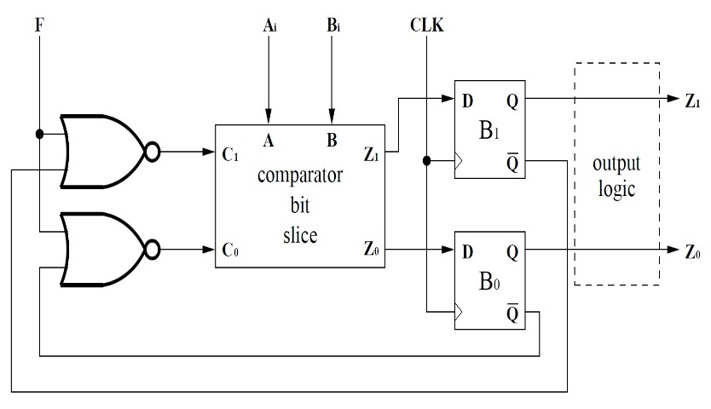
Discrete Time Implies Delayed Results: N = 8
(green = bit slice labels)
yellow = inputs
C₁ | C₀ | meaning
0 | 0 | no 1 bits
0 | 1 | one 1 bit
1 | 0 | not used
1 | 1 | >one 1 bit
cycle # | F | A | B | B₁ | B₀ | C₁ | C₀ | Z₁ | Z₀
0 | 1 | 0 | 0
1
2
3
4
bits
bits
0
0
0
0
0
0
1
0
0
0
0
0
1
0
0
0
0
1
0
1
0
1
0
1
0
0
1
0
1
1
1
x
x
x
1
1
?
?
?
?
blue = outputs
Z = B₁ ⊕ B₀ = 0
Notes:
For cycle 0, be sure that they understand why C1 and C0 are 0 (because F=1, so B1/B0 don’t matter). Also remind them that low bits are first, otherwise the Z1/Z0 outputs won’t make any sense.
Also point out that the answer is only available in cycle 4, even though all of the bits of A and B have been delivered to the comparator in cycle 3. The question marks are unknowns (not don’t cares). We could start processing a second set of 4-bit numbers in cycle 4—doing so will NOT interfere with B1 and B0 (until cycle 5), which drive the output values.

Slide 39
A Power-of-2 Checker Consists of Four Parts
Let’s analyze the area of a power-of-2 checker.
We have:
one bit slice,
two flip-flops,
two 2-input NOR gates (selection logic),
and a 2-input XOR.
16 2-input gates and four inverters

Slide 40
A Power-of-2 Checker Contains One Bit Slice
Here’s our design for the power-of-2 checker bit slice.
So we need three 2-input gates and two 3-input gates.
C₁
A
B
Z₁
C₀
A
C₀
Z₀
B

Slide 41
A Power-of-2 Checker Consists of Four Parts
Let’s analyze the area of a power-of-2 checker.
We have:
one bit slice,
two flip-flops,
two 2-input NOR gates (selection logic),
and a 2-input XOR.
Total: 3+16+2 = 21 2-input gates, 2 = 2 3-input gates, 4 = 4 inverters, and 1 2-input XOR.
three 2-input gates and two 3-input gates
16 2-input gates and four inverters

Slide 42
Serial Design is Smaller for N ≥ 10
To handle N-bit operands (2 bits per bit slice), a bit-sliced design requires:
3N/2 2-input gates (6N transistors),
N 3-input gates (6N transistors), and
1 2-input XOR.
A serial design (independent of N) requires
21 2-input gates (84 transistors),
2 3-input gates (12 transistors),
4 inverters (8 transistors), and
1 2-input XOR.
The serial design is smaller for N ≥ 10.

Slide 43
When Are Inputs Available?
A rising edge arrives at t = 0 (gate delays).
also available at t = 4
A_{2i+1}
A_{2i}
Z
power-of-2 checker
bit slice
available at t = 5
available at t = 4
Notes:
Be sure that the students understand: the unit is now GATE DELAYS, not cycles.
We assume that F, Ai, and Bi come from flip-flops, so we pay 4 gate delays for them.

Slide 44
Delay Analysis for the Bit Slice
And delay?
2 on all paths.
C₁
A
B
Z₁
C₀
A
C₀
Z₀
B
Notes:
Old slide reused in part.

Slide 45
When Are Results Stored?
A rising edge arrives at t = 0 (gate delays).
also available at t = 4
A_{2i+1}
A_{2i}
available at t = 7
Z
power-of-2 checker
bit slice
answer at t = 12
stored at t = 11
available at t = 5
available at t = 4
Notes:
A/B to Z1/Z0 is +2, and 4 + 2 = 6. But C1/C0 to Z1/Z0 is also+2, so 5 + 2 = 7. The flip-flops need another 4 gate delays (by assumption) to store the bits on the rising edge.

Slide 46
Serial Design is At Least 5.5x Slower
To handle N-bit operands, a bit-sliced design requires N + 1 gate delays.
For a serial design,
the clock cycle must be at least 11 gate delays, and
we must execute for N/2 cycles, so
N-bit operands require at least 11N/2 gate delays.
The serial design is at least ~5.5x slower.
(And may be even slower!)

