Slide 1
University of Illinois at Urbana-Champaign Dept. of Electrical and Computer Engineering ECE 120: Introduction to Computing
Finite State Machines (FSMs)

Slide 2
A Finite State Machine (FSM) Models a System
A model of a system
system moves among a finite set of states
motion based on external inputs
produces external outputs
Examples include:
coin/bill-operated machines,
many vehicle control systems, and
computers executing programs.

Slide 3
An FSM Consists of Five Parts
(bits)
a finite set of states
a set of possible inputs
a set of possible outputs
a set of transition rules
methods for calculating outputs
When implemented as a digital system, all parts of an FSM must be mapped to …
(bits)
(bits)
(Boolean expressions)
(Bool. expr’s)
bits!

Slide 4
A Digital FSM Must be Complete
We implement FSMs as clocked synchronous sequential circuits. (So state ID bits are stored in flip-flops.)
Given any state and any combination of inputs, a transition rule from the given state to a next state must be defined.
Self-loops–transitions from a state to itself–are acceptable.

Slide 5
Use Keyless Entry as a Motivating Example
meaning | state | driver’s door | other doors | alarm on?
vehicle
locked
LOCKED
locked
locked
no
driver door unlocked
DRIVER
unlocked
locked
no
all doors unlocked
UNLOCKED
unlocked
unlocked
no
alarm sounding
ALARM
locked
locked
yes
Table is a list of abstract states.
Notes:
Talk about keyless entry systems before developing the list of abstract states. Walk through using words. Example: When I walk up to my car, the doors are all locked, and the alarm is silent. Let’s create a state for that. And so forth. Make sure that they realize that answers sometimes require design decisions: should the doors lock or unlock when the alarm is on? Not clear.

Slide 6
A List of Abstract States Need Only List States
In a list of abstract states,
we can just list the states.
Adding human meanings is optional (good to have if state names are generic).
Including outputs
is also optional,
and implies that outputs depend only on state.*
*An extra assumption that we will always make in our class.

Slide 7
An Abstract Next-State Table Captures Expected Behavior
To specify transitions, we use a next-state table, which maps combinations of states and inputs into next states.
This is an abstract next-state table.
state | action/input | next state
LOCKED
push “unlock”
DRIVER
DRIVER
push “unlock”
UNLOCKED
(any)
push “lock”
LOCKED
(any)
push “panic”
ALARM

Slide 8
Abstract Next-State Table Does Not Answer All Questions
We wrote transitions for typical use cases, but the table can be incomplete, ambiguous, and even inconsistent.
For example, what happens if the user pushes “lock” and “unlock” at the same time?
state | action/input | next state
LOCKED | push “unlock” | DRIVER
DRIVER | push “unlock” | UNLOCKED
(any) | push “lock” | LOCKED
(any) | push “panic” | ALARM

Slide 9
Many Design Decisions are Usually Needed
All such design decision questions should eventually be considered, and preferably answered.
Be aware: any digital logic implementation will define answers.
Only when any possible answer is acceptable should you make use of “don’t cares.”
Typically, you should review the final implementation to determine how any questions left open are answered.

Slide 10
Abstract State Transition Diagram: the Same Information
push “lock”
LOCKED
We can represent the same information as a graph called an abstract state transition diagram.
DRIVER
push “unlock”
push “lock”
push “panic”
push “panic”
push “unlock”
push “lock”
push “lock”
ALARM
UN- LOCKED
push “panic”
push “panic”

Slide 11
It’s Time to Make Our Design Complete and Concrete
The abstract next-state table and the abstract state transition diagram (can) contain exactly the same information.
They answer the same questions.
And neither is complete.
So. It’s time for …
bits!

Slide 12
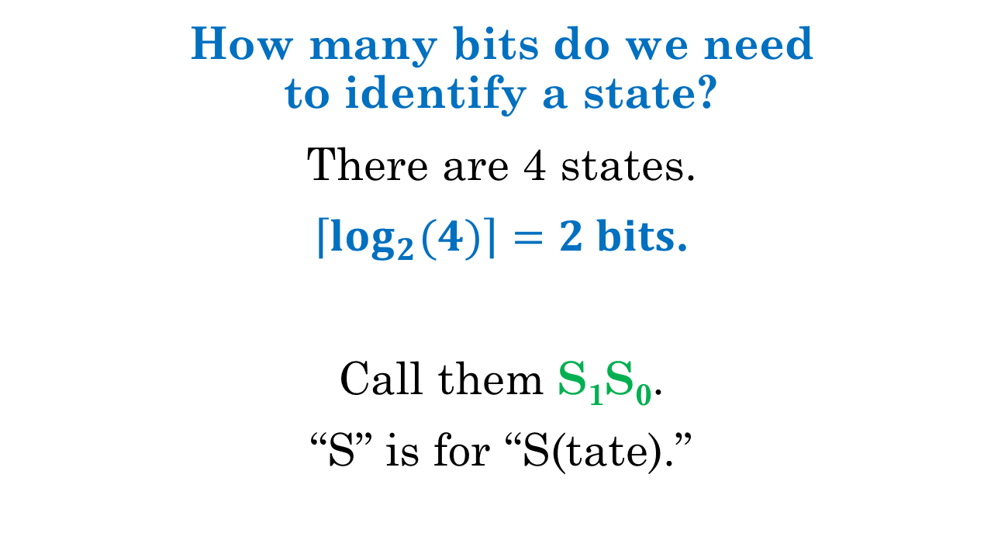
Let’s Start with the State Identifiers
How many bits do we need to identify a state?
There are 4 states.
$\left\lceil \log_{2}{(4)}\right\rceil =2 bits$.
Call them S₁S₀.
“S” is for “S(tate).”

Slide 13
All Outputs and Inputs Must Also Use Bits
What about outputs?
D driver door; 1 means unlocked
R remaining doors; 1 means unlocked
A alarm; 1 means alarm is sounding
And inputs?
U unlock button; 1 means it’s been pressed
L lock button; 1 means it’s been pressed
P panic button; 1 means it’s been pressed
Notes:
Remind students that we had three output columns and three input columns before revealing the sets of signals.

Slide 14
We Next Choose a Representation for States
Now we can choose a representation for states and rewrite our list of states.
The order of states in the list doesn’t matter.
meaning | state | S₁S₀ | D | R | A
vehicle locked | LOCKED | 00 | 0 | 0 | 0
driver door unlocked | DRIVER | 10 | 1 | 0 | 0
all doors unlocked | UNLOCKED | 11 | 1 | 1 | 0
alarm sounding | ALARM | 01 | 0 | 0 | 1

Slide 15
Choice of Representation Affects Amount of Logic Needed
As you may realize
from your experience with bit-sliced designs,
the representation does matter (for the amount of logic needed).
We will talk more later about ways to choose.

Slide 16
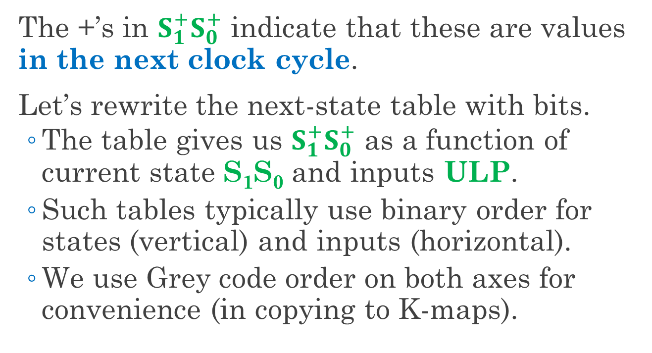
Use $S_{1}^{+}S_{0}^{+}$ to Denote the Next State (in Next Clock Cycle)
The +’s in $S_{1}^{+}S_{0}^{+}$ indicate that these are values in the next clock cycle.
Let’s rewrite the next-state table with bits.
The table gives us $S_{1}^{+}S_{0}^{+}$ as a function of current state S₁S₀ and inputs ULP.
Such tables typically use binary order for states (vertical) and inputs (horizontal).
We use Grey code order on both axes for convenience (in copying to K-maps).

Slide 17
How to Fill in the Next-State Table
Where should we start?
current state S₁S₀ | ULP
 | 000 | 001 | 011 | 010 | 110 | 111 | 101 | 100
00
01
11
10
What about
multiple buttons?
Let’s make
some design
decisions first…

Slide 18
Completing the Design Requires Decisions
To fill in the next-state table
starting with only the abstract design,
we need to make many design decisions,
including some that we haven’t even recognized yet.
For example,
What happens when the user presses more than one button?
What happens when the user presses “unlock” in the UNLOCKED state?
Notes:
See if the students already thought about the second question.
A third question we’ll leave for later, but let them brainstorm in advance, and possibly reveal this one to them if they think that they have thought of everything: should pushing unlock turn off the alarm in the ALARM state? If so, should it … unlock doors? Or go where? Does everyone have the same answer?
Also not discussed explicitly: what happens when no buttons are pressed?

Slide 19
Make Design Decisions Early When Possible
Let’s try to make decisions first.
Design decisions can shape the design, and may conflict with one another.
Making decisions early and writing them down ensures that
any issues are raised early, and that
known decisions are not overlooked
(in which case the final design answers them implicitly, with no human guidance).
Notes:
Unknown decisions may STILL be overlooked, of course!

Slide 20
Start by Deciding How to Handle Multiple Buttons
We’re going to start by prioritizing the buttons.
Our rules:
Panic has priority!
Lock has second priority.
Unlock only matters when neither of the others is pressed.
Notes:
Unknown decisions may STILL be overlooked, of course!

Slide 21

Start with the Panic Button (Highest Priority)
The next-state table gives us $S_{1}^{+}S_{0}^{+}$.
current state S₁S₀ | ULP
 | 000 | 001 | 011 | 010 | 110 | 111 | 101 | 100
00
01
11
10
01
01
01
01
01
01
01
01
01
01
01
01
01
01
01
01
panic button pushed

Slide 22
Continue with the Lock Button (Second Priority)
The next-state table gives us $S_{1}^{+}S_{0}^{+}$.
current state S₁S₀ | ULP
 | 000 | 001 | 011 | 010 | 110 | 111 | 101 | 100
00 |  | 01 | 01 |  |  | 01 | 01
01 |  | 01 | 01 |  |  | 01 | 01
11 |  | 01 | 01 |  |  | 01 | 01
10 |  | 01 | 01 |  |  | 01 | 01
00
00
00
00
00
00
00
00
lock button pushed

Slide 23
No Buttons? No Change. All Self-Loops
What if the user pushes nothing?
current state S₁S₀ | ULP
 | 000 | 001 | 011 | 010 | 110 | 111 | 101 | 100
00 |  | 01 | 01 | 00 | 00 | 01 | 01
01 |  | 01 | 01 | 00 | 00 | 01 | 01
11 |  | 01 | 01 | 00 | 00 | 01 | 01
10 |  | 01 | 01 | 00 | 00 | 01 | 01
00
01
11
10
no buttons pushed
Notes:
Point out that we didn’t actually discuss this question! (unless you did already, of course)

Slide 24
Finally, Unlock … But are We Done?
Two transitions were defined for Unlock.
from LOCKED
current state S₁S₀ | ULP
 | 000 | 001 | 011 | 010 | 110 | 111 | 101 | 100
00 | 00 | 01 | 01 | 00 | 00 | 01 | 01
01 | 01 | 01 | 01 | 00 | 00 | 01 | 01
11 | 11 | 01 | 01 | 00 | 00 | 01 | 01
10 | 10 | 01 | 01 | 00 | 00 | 01 | 01
10
What about
these?
11
from DRIVER
Notes:
Point out that we didn’t actually discuss this question! (unless you did already, of course)

Slide 25
We Have More Design Decisions to Make!
What should happen if we press “unlock” when the car is already fully unlocked (in the UNLOCKED state)?
Maybe just stay UNLOCKED.
What should happen if we press “unlock” while the alarm is sounding?
Continue to lock out an attacker / thief?
Or open the doors so that the owner can climb inside quickly?
Notes:
Emphasize that answers are not always clear, but leaving don’t cares may come up with an unknown third answer to the second question.

Slide 26
Let’s Implement Our Decisions
Ignore Unlock in both other cases.
current state S₁S₀ | ULP
 | 000 | 001 | 011 | 010 | 110 | 111 | 101 | 100
00 | 00 | 01 | 01 | 00 | 00 | 01 | 01 | 10
01 | 01 | 01 | 01 | 00 | 00 | 01 | 01
11 | 11 | 01 | 01 | 00 | 00 | 01 | 01
10 | 10 | 01 | 01 | 00 | 00 | 01 | 01 | 11
from ALARM
01
11
from UNLOCKED

Slide 27
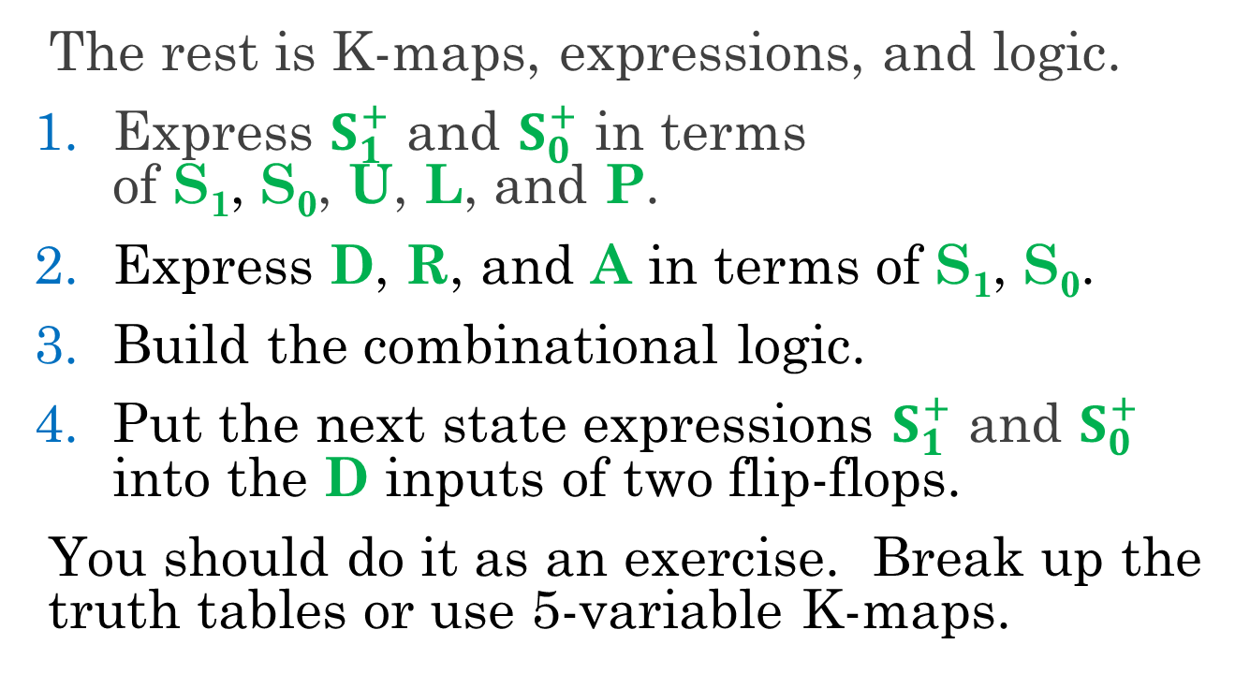
The Rest You Know How to Do
The rest is K-maps, expressions, and logic.
Express $S_{1}^{+}$ and $S_{0}^{+}$ in terms of S₁, S₀, U, L, and P.
Express D, R, and A in terms of S₁, S₀.
Build the combinational logic.
Put the next state expressions $S_{1}^{+}$ and $S_{0}^{+}$ into the D inputs of two flip-flops.
You should do it as an exercise. Break up the truth tables or use 5-variable K-maps.

Slide 28
One Last Tool: the Complete State Transition Diagram
The complete state transition diagram contains the information in both the state list and the next-state table.
inputs for this transition
state ID / outputs
ULP = _ _ _
STATE
S₁S₀/DRA
Notes:
Emphasize that answers are not always clear, but leaving don’t cares may come up with an unknown third answer to the second question.

Slide 29
Complete State Transition Diagram
ULP=100
ULP=000,x10
LOCKED
00/000
DRIVER
10/100
ULP=x10
ULP=000
abbreviate as ULP = x00
ULP=xx1
ULP=100
ULP=xx1
ULP=x10
ULP=
x10
ALARM
01/001
UN- LOCKED
11/110
ULP=000 or 100
ULP=xx1
ULP=xx1,x0x

Slide 30
Be Careful with Input Abbreviations
Input abbreviations can render a state transition diagram
incomplete (if labels fail to cover all input combinations), or
inconsistent (if labels indicate multiple next states).
For example,
self-loop from ALARM labeled ULP=xx1,x0x:
the patterns x01 match both labels!
In this case, these two combinations go to the same next state, so it’s ok.

Slide 31
University of Illinois at Urbana-Champaign Dept. of Electrical and Computer Engineering ECE 120: Introduction to Computing
Binary Counters

Slide 32
An FSM with No Inputs Moves from State to State
What happens if an FSM has no inputs?
(no inputs)
(no inputs)
SOME STATE
ANOTHER STATE
The FSM moves
from state to state.
THIRD STATE
(no inputs)
But there are finite many
states…
FOURTH STATE

Slide 33
Eventually, the States Form a Loop
So the FSM eventually returns to some state.
(no inputs)
(no inputs)
SOME STATE
ANOTHER STATE
THIRD STATE
(no inputs)
FOURTH STATE

Slide 34
A Counter Repeats a Loop of States (Forever)
An FSM without inputs is called a counter.
A counter may sometimes have inputs
to start/stop the counter
to reset the counter to a known state
and sometimes to make the counter count in different ways (for example, up or down).
But the basic idea is the same: the normal operation of a counter is a loop of states.

Slide 35
We Consider Both Synchronous and Ripple Counters
We focus mainly on
synchronous counters, for which the flip-flops use a common clock signal.
In other words, they are clocked synchronous sequential circuits, and allow us to pretend that time is discrete.
We will also look briefly at
ripple counters, in which flip-flop outputs are used to clock other flip-flops.
Such designs can save significant power.

Slide 36
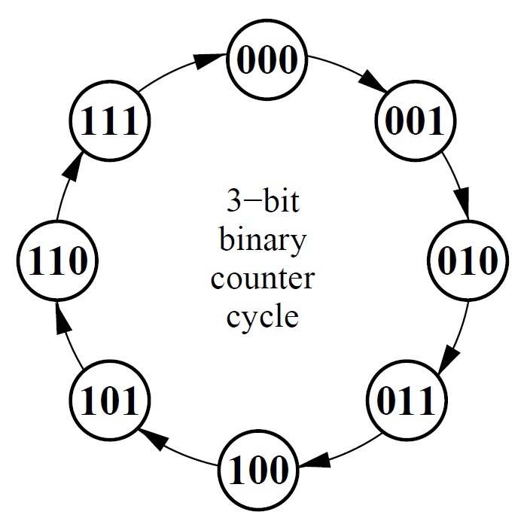
Example: 3-Bit Binary Counter
Let’s do an example.
The state transition diagram to the right defines a 3-bit binary counter.
The states correspond to unsigned numbers 0 to 7, after which the counter returns to the 000 state.
Notes:
Make sure that the students understand that we have done nothing mysterious with the state diagram. It just counts from 0 to 7 in unsigned, then returns to 0.

Slide 37
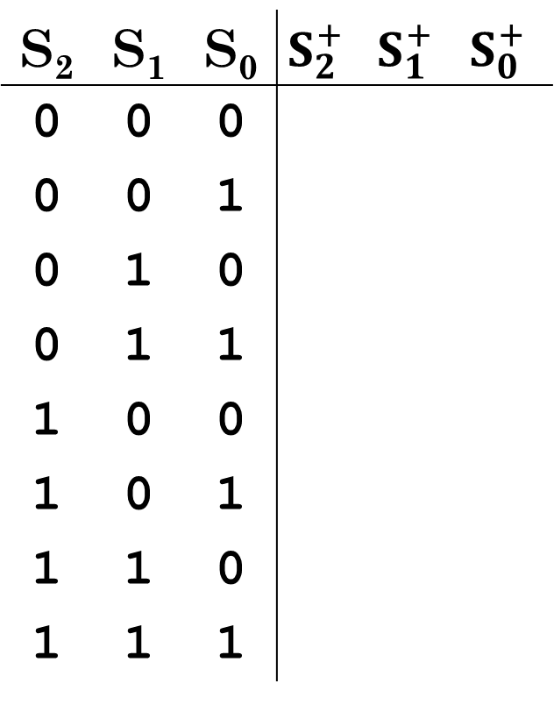
Write a Next-State Table
S₂ | S₁ | S₀ | $$S_{2}^{+}$$ | $$S_{1}^{+}$$ | $$S_{0}^{+}$$
0 | 0 | 0
0 | 0 | 1
0 | 1 | 0
0 | 1 | 1
1 | 0 | 0
1 | 0 | 1
1 | 1 | 0
1 | 1 | 1
Start by writing a next-state table.
0
0
1
0
1
0
0
1
1
1
0
0
1
0
1
1
1
0
1
1
1
0
0
0

Slide 38

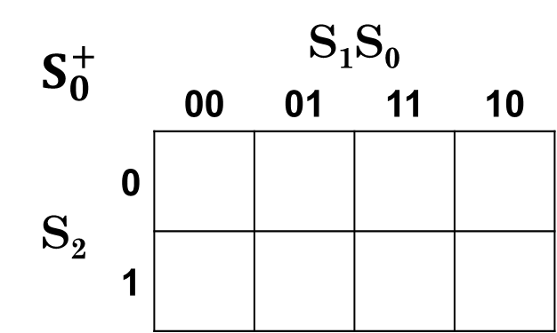
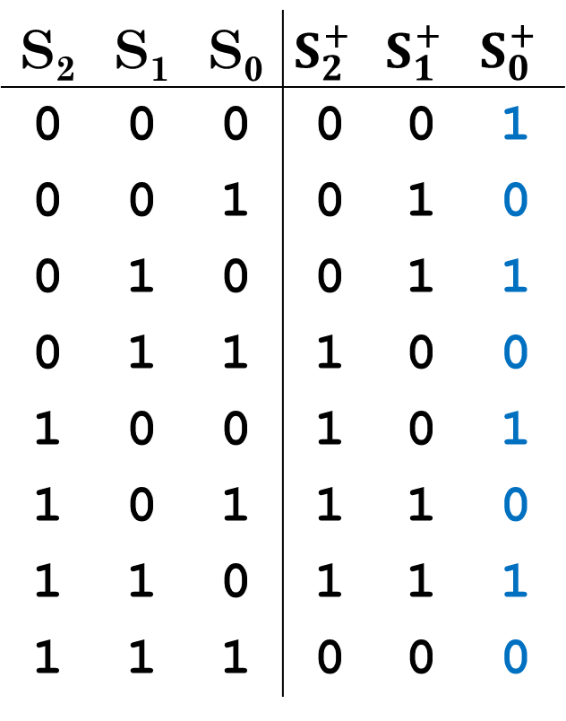
Now Use K-Maps to Express the Next-State Values
S₂ | S₁ | S₀ | $$S_{2}^{+}$$ | $$S_{1}^{+}$$ | $$S_{0}^{+}$$
0 | 0 | 0 | 0 | 0 | 1
0 | 0 | 1 | 0 | 1 | 0
0 | 1 | 0 | 0 | 1 | 1
0 | 1 | 1 | 1 | 0 | 0
1 | 0 | 0 | 1 | 0 | 1
1 | 0 | 1 | 1 | 1 | 0
1 | 1 | 0 | 1 | 1 | 1
1 | 1 | 1 | 0 | 0 | 0
Now copy into K-maps.
$S_{0}^{+}$ = S₀’ = S₀ ⊕ 1
$$S_{0}^{+}$$ |  | S₁S₀
 |  | 00 | 01 | 11 | 10
S₂ | 0
 | 1
1
0
0
1
1
0
0
1

Slide 39
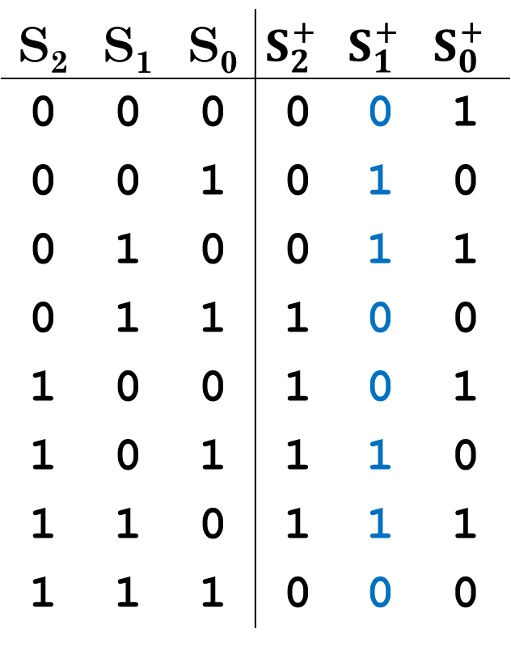

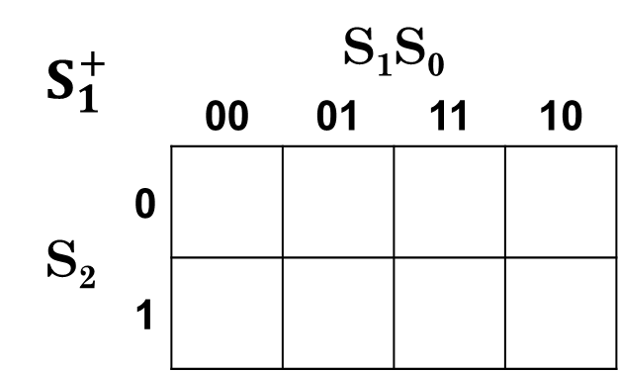
Now Use K-Maps to Express the Next-State Values
S₂ | S₁ | S₀ | $$S_{2}^{+}$$ | $$S_{1}^{+}$$ | $$S_{0}^{+}$$
0 | 0 | 0 | 0 | 0 | 1
0 | 0 | 1 | 0 | 1 | 0
0 | 1 | 0 | 0 | 1 | 1
0 | 1 | 1 | 1 | 0 | 0
1 | 0 | 0 | 1 | 0 | 1
1 | 0 | 1 | 1 | 1 | 0
1 | 1 | 0 | 1 | 1 | 1
1 | 1 | 1 | 0 | 0 | 0
Now copy into K-maps.
$S_{1}^{+}$ = S₁S₀’ + S₁’S₀
= S₁ ⊕ S₀
$$S_{1}^{+}$$ |  | S₁S₀
 |  | 00 | 01 | 11 | 10
S₂ | 0
 | 1
0
1
0
1
0
1
0
1

Slide 40
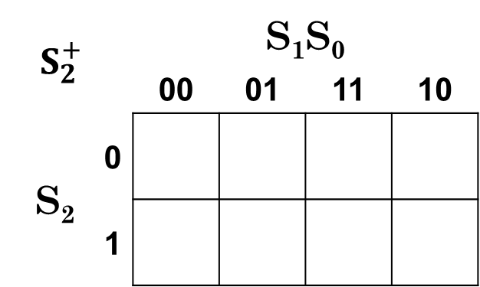
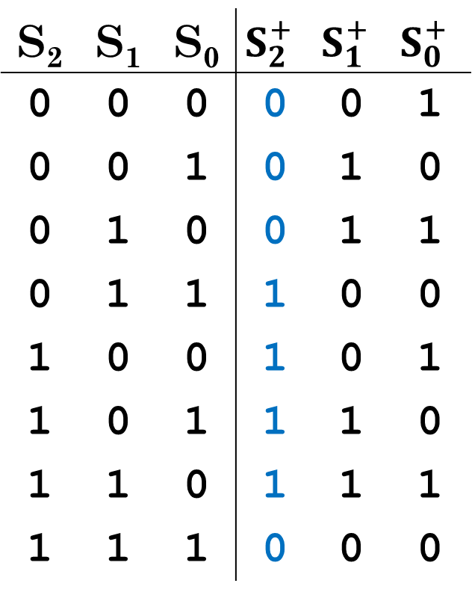

Now Use K-Maps to Express the Next-State Values
S₂ | S₁ | S₀ | $$S_{2}^{+}$$ | $$S_{1}^{+}$$ | $$S_{0}^{+}$$
0 | 0 | 0 | 0 | 0 | 1
0 | 0 | 1 | 0 | 1 | 0
0 | 1 | 0 | 0 | 1 | 1
0 | 1 | 1 | 1 | 0 | 0
1 | 0 | 0 | 1 | 0 | 1
1 | 0 | 1 | 1 | 1 | 0
1 | 1 | 0 | 1 | 1 | 1
1 | 1 | 1 | 0 | 0 | 0
Now copy into K-maps.
$S_{2}^{+}$ = S₂’S₁S₀ + S₂S₁’ + S₂S₀’
$$S_{2}^{+}$$ |  | S₁S₀
 |  | 00 | 01 | 11 | 10
S₂ | 0
 | 1
0
0
1
0
1
1
0
1

Slide 41
When Do Place Values Change in Decimal Counting?
When you count in decimal, when does a place value change?
For example, when does the number of thousands change?
What about the number of ten thousands?
Only when the lower digits are all 9.
0999 → 1000
1999 → 2000
2999 → 3000
09999 → 10000
19999 → 20000
29999 → 30000

Slide 42
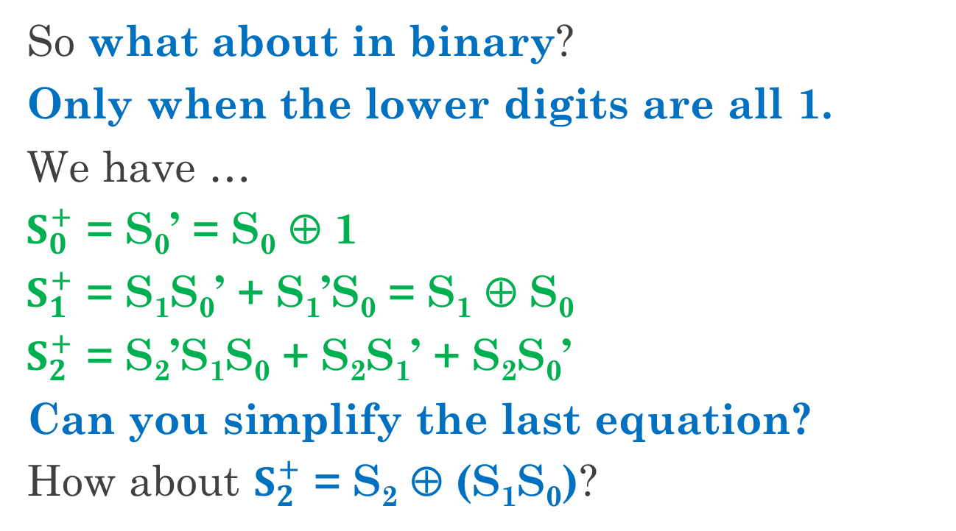
Can We Use Counting to Generalize the Counter Design?
So what about in binary?
Only when the lower digits are all 1.
We have …
$S_{0}^{+}$ = S₀’ = S₀ ⊕ 1
$S_{1}^{+}$ = S₁S₀’ + S₁’S₀ = S₁ ⊕ S₀
$S_{2}^{+}$ = S₂’S₁S₀ + S₂S₁’ + S₂S₀’
Can you simplify the last equation?
How about $S_{2}^{+}$ = S₂ ⊕ (S₁S₀)?
Notes:
Be sure that the students can map the reasoning from counting into the Boolean expression. The XOR means flipping the bit (changing the 4’s place). The AND means that ALL lower digits (the 2’s place and 1’s place, in this case) are 1.

Slide 43
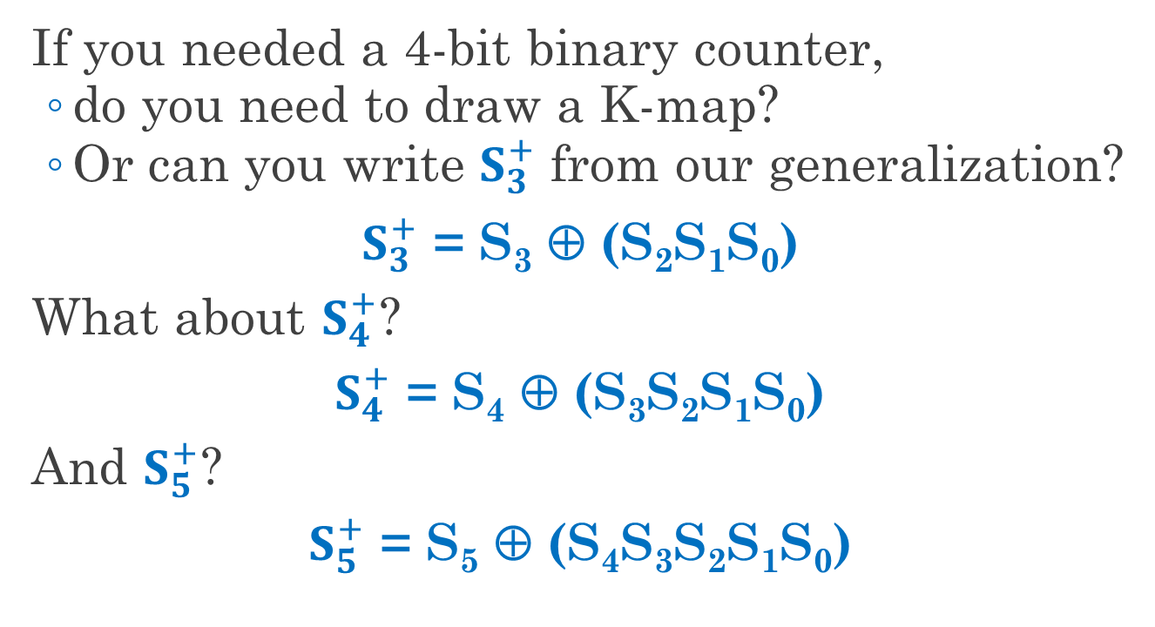
Use our General Formula to Build Bigger Counters
If you needed a 4-bit binary counter,
do you need to draw a K-map?
Or can you write $S_{3}^{+}$ from our generalization?
$S_{3}^{+}$ = S₃ ⊕ (S₂S₁S₀)
What about $S_{4}^{+}$?
$S_{4}^{+}$ = S₄ ⊕ (S₃S₂S₁S₀)
And $S_{5}^{+}$?
$S_{5}^{+}$ = S₅ ⊕ (S₄S₃S₂S₁S₀)

Slide 44
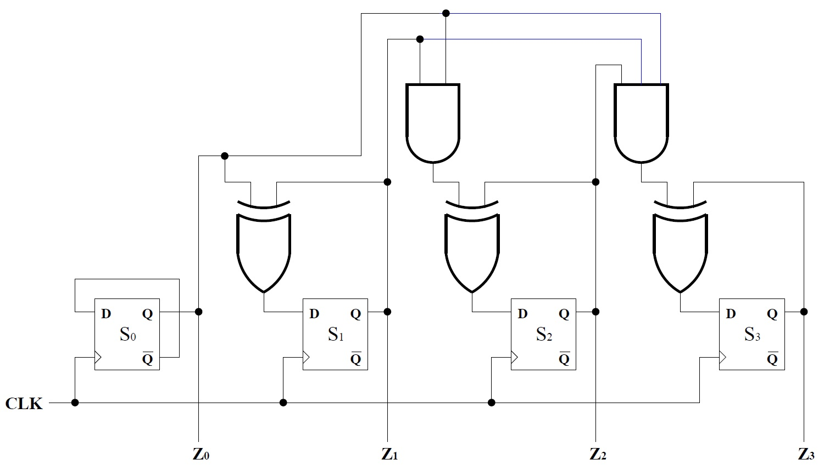
Binary Counter with Parallel Gating
Note that more
significant digits
are to the right (backwards).
ANDs of
lower digits
built in
parallel.
S₀
S₁S₀
S₂S₁S₀
Notes:
This is the form given in the equations. We can reuse terms to make the logic a little simpler (next slide).

Slide 45
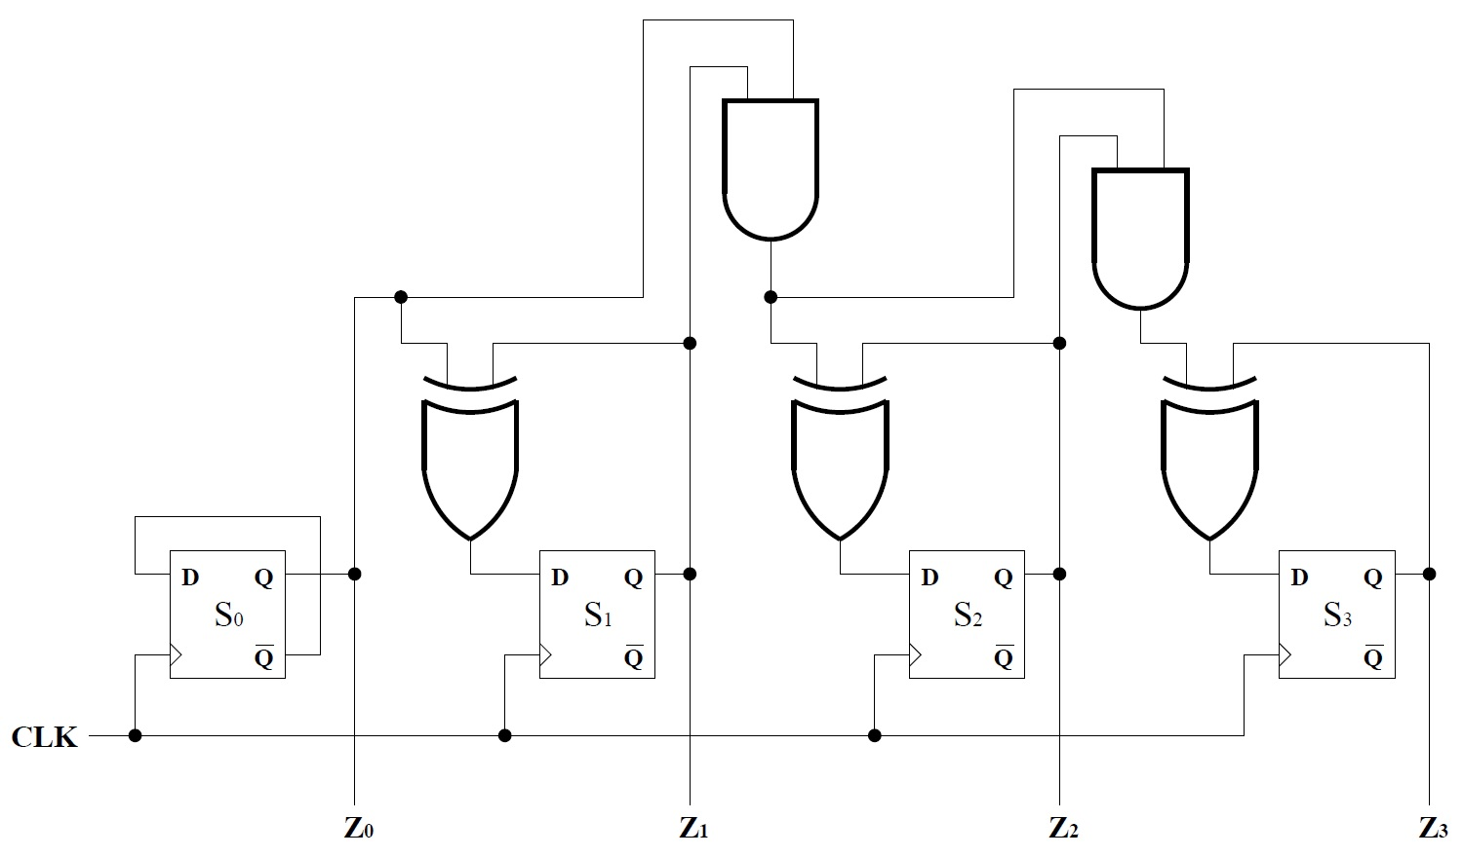
Binary Counter with Serial Gating
Note that more
significant digits
are to the right (backwards).
ANDs of
lower digits
built in
series.
S₀
S₁S₀
S₂S₁S₀
Notes:
Point out that the serial design is a bit slice for each bit of the counter. The bit slice uses one 2-input AND gate, one 2-input XOR gate, and one flip-flop.

Slide 46
Comparing Serial and Parallel Gating
Parallel gating gives
bigger gates (more area) and
less delay.
Serial gating gives
smaller gates (less area) but
more delay.
In practice,
gate sizes are limited, so
counters use a combination of the two approaches.

Slide 47
Flip-Flops in a Ripple Counter Do Not Share a Clock
We just designed a
synchronous binary counter
Now, let’s take a look at a binary ripple counter, in which the clock is not shared.
flip-flops use a common
clock
one loop
of states
outputs are binary (unsigned) numbers

Slide 48
Ripple Counters Require Less Power
In a ripple counter,
outputs from some flip-flops
are used to clock other flip-flops (used as the clock signal input).
Why?
Recall that changing gate output values implies electric current, which implies power consumption.
Clocking flip-flops more slowly reduces energy consumption.

Slide 49
Ripple Counters are Slower
What’s the tradeoff?
Changes to internal state
ripple through the counter from bit to bit, so
they are slower than synchronous counters.
What about clock skew?
In general, it may be an issue, but
we will only consider one simple design, and
more complex ripple counters can usually be designed in isolation from other logic.

Slide 50
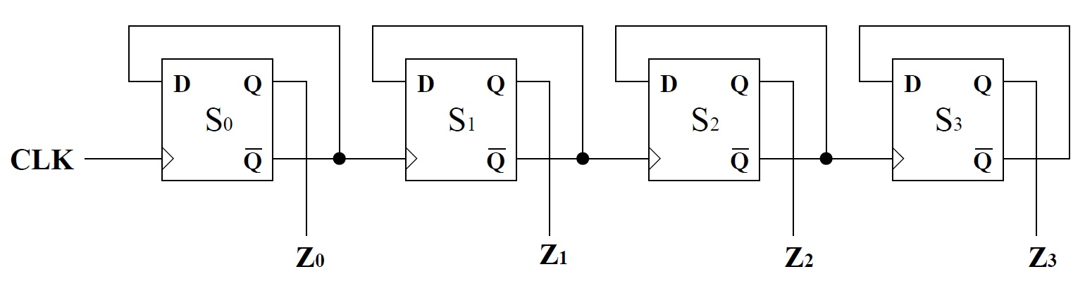
Binary Ripple Counters are Built from Bit Slices
S_{i}’ is the clock input
for S_{i+1}.
The figure below shows a 4-bit binary ripple counter.
As you can see, the design uses a simple bit slice.
S_{i}’ is also the D input for S_{i}.

Slide 51
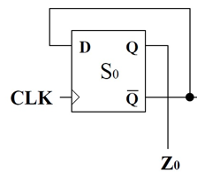
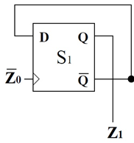
A Timing Diagram Illustrates Counting
CLK
Z₀
Z₁
Z₂
0
1
2
3
4
5
6
Notes:
Walk the students through the changes. Remind them that the bits always flip at the perceived rising edge. Also remind them that the “clock” is inverted for Z1 and Z2: Z0’ is the clock for Z1, so the FALLING edge causes a change. The green arrows can be drawn anywhere in the clock cycles. Delay caused by ripple is NOT illustrated in this diagram.

