Slide 1
University of Illinois at Urbana-Champaign Dept. of Electrical and Computer Engineering ECE 120: Introduction to Computing
Machine Models

Slide 2
FSM Outputs May or May Not Depend Directly on Inputs
As mentioned previously, for our class, FSM outputs depend only on state, not on FSM inputs.
Historically, such an FSM was called a Moore machine.
The more general model,
in which outputs may also depend on inputs,
was called a Mealy machine.

Slide 3
More General Model Always Used in Practice
In practice,
designers always use Mealy machines,
so FSM outputs may depend directly on inputs.
If a designer wants
an output to be independent of inputs,
the designer simply designs the FSM to meet that requirement.
So the names are just of historical interest.

Slide 4
Inputs May Allow Us to Design a Smaller FSM
Why use the general model?
Inputs carry information.
We can sometimes build a smaller FSM if we make use of that information.

Slide 5
More General Model Can Introduce Timing Issues
Why do we use the simpler model in ECE120?
If outputs depend directly on inputs,
output timing also depends on input timing,
so we lose the benefit of treating time as a discrete value (an integer).

Slide 6
An Example Illustrates the Tradeoffs
Let’s use an example to illustrate these tradeoffs.
Say that we want to recognize the sequence 01 in a serial input B.
Whenever B is 0 in one cycle and 1 in the next cycle, we set the output Z equal to 1.

Slide 7
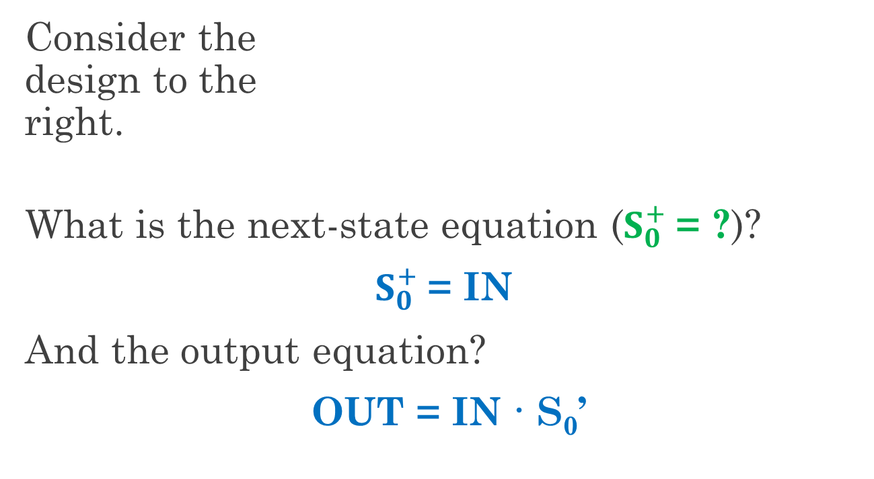
Mealy Machine for 01 Sequence Recognizer
Consider the design to the right.
What is the next-state equation ($S_{0}^{+}$= ?)?
$S_{0}^{+}$= IN
And the output equation?
OUT = IN · S₀’
IN
D
Q
S₀
Q
OUT
Current IN is 1.
Last IN was 0.

Slide 8
Transition Diagrams Look Different for Mealy Machines
Now let’s draw the state diagram.
We have two states.
Outputs depend on inputs, so
states cannot be labeled with outputs.
Instead, transitions are labeled with outputs.
IN
D
Q
S₀
Q
OUT
1/1
0
1
0/0
1/0
0/0
Notes:
Transition arcs are now labeled as input/output.

Slide 9

A Timing Diagram Reveals the Timing Issues
Recall that OUT = IN · S₀’
IN
D
Q
S₀
Q
OUT
S₀ is 0 after this edge.
OUT pulse width
depends on
input timing .
Notes:
(1) S0 is 0, (2) OUT rises with IN, (3) OUT falls at rising CLK (S0 is 1), (4) OUT pulse width depends on arrival time of IN=1 relative to rising clock edge. So: the output pulse may be arbitrarily thin!

Slide 10
We Can Usually Ignore the Narrow Output Problem
Usually, narrow output pulses don’t matter.
If inputs
come from flip-flops on the same clock,
changes arrive early enough (but may limit clock speed).
We may have problems if inputs are external or if outputs are used externally (not on the same clock).

Slide 11
How Can We Fix the Narrow Pulse Problem?
What if we need a wider output pulse?
Do we have to redesign the system entirely? (as a Moore machine)
No! Just add another flip- flop.
IN
D
Q
S₀
Q
OUT
IN
D
Q
S₀
Q
D
Q
OUT
S₁
Q
Notes:
Let the students think a little.

Slide 12
The New Flip-Flop Splits One State into Two
The new flip-flop splits the “1” state into “11” and “01” states.
IN
D
Q
S₀
Q
D
Q
OUT
S₁
1
Q
00/0
11/1
0
1
0
Note: the 01 state is not reachable from other states.
01/0
0
1
Notes:
Analysis: IN = 0 -> both S1 and S0 are 0 in next cycle, and OUT = S1. IN = 1 -> S0+ = 1, while S1+ = S0’.
If we’re not careful, the system may start in the 01 state, but it will never be in that state after the first cycle.

Slide 13
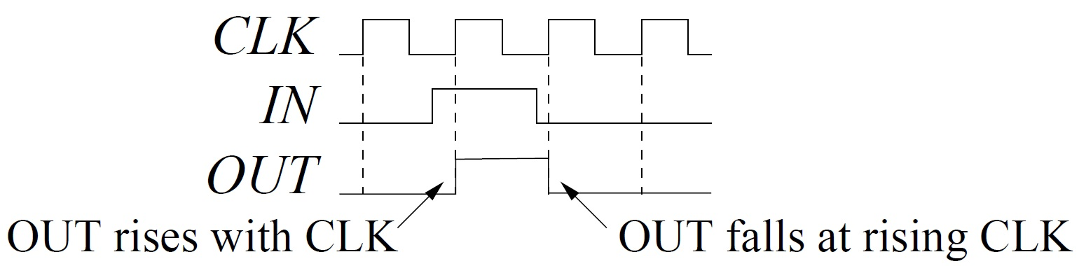
OUT is Delayed but High for a Full Cycle with Moore
IN
D
Q
S₀
Q
D
Q
OUT
S₁
Q
S₀ is 0 after this edge.
OUT is high
for a full
clock cycle.
(OUT=1 delayed to rising edge.)
Notes:
(1) S0 is 0, (2) OUT rises with CLK, so (3) OUT is delayed slightly by the flip-flop, (4) OUT falls at NEXT rising CLK, so (5) OUT pulse width is always a full clock cycle.

Slide 14
Summary of the Two Models
Moore: outputs depend only on state, not on inputs
Mealy: outputs can also depend on inputs
Mealy is used in practice.
Can reduce size of design, but
may create thin output pulses.
Solving these problems is easy: add flip-flops to make a Moore design.

Slide 15
University of Illinois at Urbana-Champaign Dept. of Electrical and Computer Engineering ECE 120: Introduction to Computing
FSM Design Process

Slide 16
We Follow a Six-Step Process to Design an FSM
Here is a structured methodology that you can use to develop an FSM.
There are six steps:
develop an abstract model
specify I/O behavior
complete the specification
choose a state representation
calculate logic expressions
implement with flip-flops and gates

Slide 17
Step 1: Develop an Abstract Model
First, we translate our ideas and thoughts
from human language
into a model with states and desired behavior.
For now, just capture intended use (no need to be thorough nor complete).
What are the different states of the system?
How do we expect it to move amongst these states?

Slide 18
Step 2: Specify I/O Behavior
Start to formalize a little by specifying input and output behavior.
Input and output must consist of bits.
How many inputs are needed?
What representation is used?
And the same questions for outputs.
Sometimes, the FSM I/O must match other systems, so representations (using bits) are already defined.

Slide 19
Step 3: Complete the Specification
We are now ready to resolve any ambiguities
by making design decisions
(in other words, choosing behavior).
Implicit assumptions should also be made clear and written down.
We may choose to leave some behavior as “don’t care,” but such a decision should be made carefully (and checked later).

Slide 20
Step 4: Choose a State Representation
The FSM state representation will affect logic for both next states and outputs.
Some ways to choose
match state to output (output patterns must be unique),
map states to hypercube such that transitions are mostly along edges, or
use human meaning for state bits.
The last is a good way to choose because it separates bits into meaningful groups that may not affect each other (thus simplifying logic).

Slide 21
Step 5: Calculate Logic Expressions
Once you have completed the specification of state IDs, next states, and outputs in bits, all that’s left is to build combinational logic.
If you have a lot of variables, breaking the truth tables up may help.
State bits that have human meaning also helps to simplify here: bits may be ignored if they are not relevant.

Slide 22
Step 6: Implement with Flip-Flops and Gates
State bits are stored in flip-flops.*
Next-state and output logic are built in the same way that you build any other combinational logic.
There’s nothing special about it.
Hook the next-state logic outputs to the D inputs of the flip-flops.
Output bits are functions of the flip-flop state.
*Registers, shift registers, and counters are fine, too. We’ll use those in a week or so.

Slide 23
A Quick Example: A 2-Bit Gray Code Counter
Let’s design a 2-bit Gray code counter using our methodology.
Our abstract model? A counter that goes through four states. Like this:
COUNT A
COUNT B
COUNT C
COUNT D

Slide 24
Defining I/O and Completing the Specification
Inputs: none (it’s a counter).
Outputs? 00, then 01, then 11, then 10, then back to 00.
No inputs, so … specification is complete!
COUNT A
COUNT B
COUNT C
COUNT D

Slide 25
Choose Output Bits as the State IDs
What about the representation?
The outputs are unique, so let’s use them as state IDs as well. Then we need no output logic.
COUNT A
00/00
COUNT B
01/01
COUNT C
11/11
COUNT D
10/10

Slide 26
Solve the Next-State Equations
S₁ | S₀ | $$S_{1}^{+}$$ | $$S_{0}^{+}$$
0 | 0
0 | 1
1 | 0
1 | 1
Now we can write equations from a truth table.
$S_{1}^{+}$ = S₀
$S_{0}^{+}$ = S₁’
0
1
1
1
0
0
1
0
COUNT A
00/00
COUNT B
01/01
COUNT C
11/11
COUNT D
10/10
Notes:
Let the students fill in the table and find the equations.

Slide 27
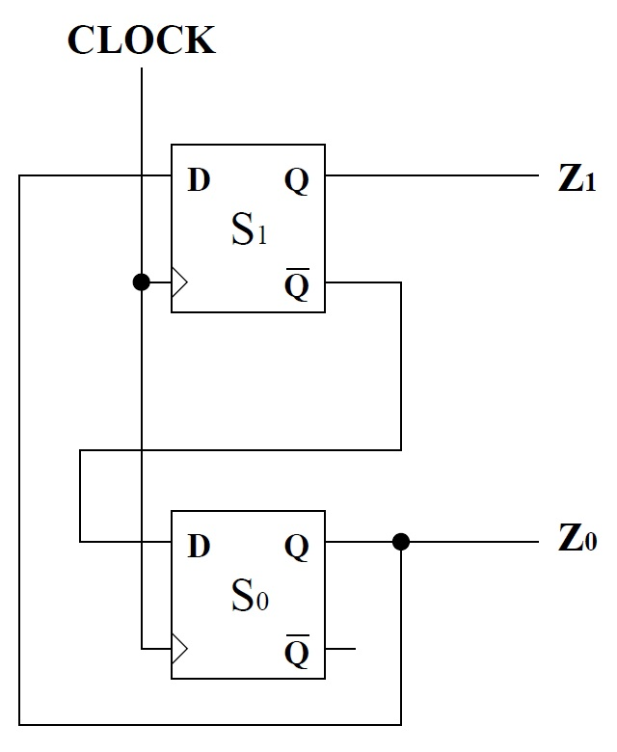
Implement Using Two Flip-Flops
Finally, we can implement, as shown below.
$S_{1}^{+}$ = S₀
$S_{0}^{+}$ = S₁’
Notes:
This implementation is easy, but take a minute to talk about the operation.

Slide 28
University of Illinois at Urbana-Champaign Dept. of Electrical and Computer Engineering ECE 120: Introduction to Computing
A Color Sequencer

Slide 29
Review the Six-Step Process
Recall our six-step process for FSM Design:
develop an abstract model
specify I/O behavior
complete the specification
choose a state representation
calculate logic expressions
implement with flip-flops and gates

Slide 30
Let’s Build a Color Sequencer
RGB | color
000 | black
001 | blue
010 | green
011 | cyan
100 | red
101 | violet
110 | yellow
111 | white
Let’s do another example.
Let’s build a color sequencer that cycles through a set of colors.
Imagine that we have an LED light that can output eight colors…
Our FSM will drive this light using the RGB signals.

Slide 31
Abstract Model for a Color Sequencer Has Five States
Our abstract model? A counter that goes through five colors. Like this:
RED
GREEN
CYAN
BLUE
WHITE

Slide 32
Next, Define Inputs and Outputs
RGB | color
000 | black
001 | blue
010 | green
011 | cyan
100 | red
101 | violet
110 | yellow
111 | white
Inputs: none (it’s a counter).
Outputs? We can just read RGB from the table for each state.

Slide 33
Outputs Represent Red, Green, and Blue
Let’s add the outputs (as /RGB) to the states.
RED
GREEN
CYAN
/100
/010
/011
BLUE
WHITE
/001
/111

Slide 34
Completing the Specification
No inputs, so … specification is complete!
RED
/100
GREEN
/010
CYAN
/011
/100
BLUE
/001
WHITE
/111

Slide 35
Use Unique Outputs as the Internal State IDs
Outputs are again unique, so use them as state IDs as well.
RED
/100
RED
100/100
GREEN
/010
CYAN
011/011
GREEN
010/010
CYAN
/011
/100
BLUE
/001
BLUE
001/001
WHITE
111/111
WHITE
/111

Slide 36
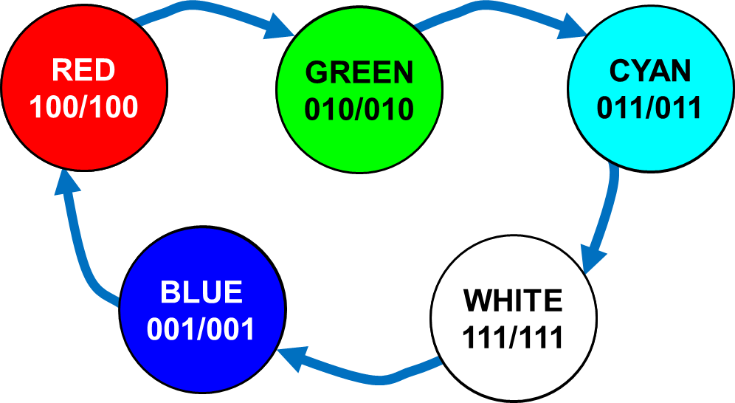
Write a Next-State Table
S₂ | S₁ | S₀ | $$S_{2}^{+}$$ | $$S_{1}^{+}$$ | $$S_{0}^{+}$$
0 | 0 | 0
0 | 0 | 1
0 | 1 | 0
0 | 1 | 1
1 | 0 | 0
1 | 0 | 1
1 | 1 | 0
1 | 1 | 1
Time for equations. Start by writing a next-state table.
x
x
x
1
0
0
0
1
1
1
1
1
0
1
0
x
x
x
x
x
x
0
0
1
Notes:
Walk around the states, then ask students what to fill in for the rest. Encourage don’t cares.

Slide 37
Now Use K-Maps to Express the Next-State Values
S₂ | S₁ | S₀ | $$S_{2}^{+}$$ | $$S_{1}^{+}$$ | $$S_{0}^{+}$$
0 | 0 | 0 | x | x | x
0 | 0 | 1 | 1 | 0 | 0
0 | 1 | 0 | 0 | 1 | 1
0 | 1 | 1 | 1 | 1 | 1
1 | 0 | 0 | 0 | 1 | 0
1 | 0 | 1 | x | x | x
1 | 1 | 0 | x | x | x
1 | 1 | 1 | 0 | 0 | 1
Now copy into K-maps.
$S_{0}^{+}$ = S₁
$$S_{0}^{+}$$ |  | S₁S₀
 |  | 00 | 01 | 11 | 10
S₂ | 0
 | 1
x
0
1
1
0
x
1
x

Slide 38
Now Use K-Maps to Express the Next-State Values
S₂ | S₁ | S₀ | $$S_{2}^{+}$$ | $$S_{1}^{+}$$ | $$S_{0}^{+}$$
0 | 0 | 0 | x | x | x
0 | 0 | 1 | 1 | 0 | 0
0 | 1 | 0 | 0 | 1 | 1
0 | 1 | 1 | 1 | 1 | 1
1 | 0 | 0 | 0 | 1 | 0
1 | 0 | 1 | x | x | x
1 | 1 | 0 | x | x | x
1 | 1 | 1 | 0 | 0 | 1
Now copy into K-maps.
$S_{1}^{+}$ = S₂’S₁ + S₂S₁’
= S₂ ⊕ S₁
$$S_{1}^{+}$$ |  | S₁S₀
 |  | 00 | 01 | 11 | 10
S₂ | 0
 | 1
x
0
1
1
1
x
0
x

Slide 39
Now Use K-Maps to Express the Next-State Values
S₂ | S₁ | S₀ | $$S_{2}^{+}$$ | $$S_{1}^{+}$$ | $$S_{0}^{+}$$
0 | 0 | 0 | x | x | x
0 | 0 | 1 | 1 | 0 | 0
0 | 1 | 0 | 0 | 1 | 1
0 | 1 | 1 | 1 | 1 | 1
1 | 0 | 0 | 0 | 1 | 0
1 | 0 | 1 | x | x | x
1 | 1 | 0 | x | x | x
1 | 1 | 1 | 0 | 0 | 1
Now copy into K-maps.
$S_{2}^{+}$ = S₂’S₀ = (S₂ + S₀’)’
$$S_{2}^{+}$$ |  | S₁S₀
 |  | 00 | 01 | 11 | 10
S₂ | 0
 | 1
x
1
1
0
0
x
0
x

Slide 40
Implement Using Three Flip-Flops and Two Gates
Finally, we can implement, as shown to the right.
$S_{2}^{+}$ = (S₂ + S₀’)’
$S_{1}^{+}$ = S₂ ⊕ S₁
$S_{0}^{+}$ = S₁
D
Q
R
S₂
Q
D
Q
G
S₁
Q
D
Q
B
S₀
Q
Notes:
This implementation is easy, but take a minute to talk about the operation.

Slide 41
Ready to Build It?
Are you excited?
Imagine that you go get your protoboard out.
You go to the lab.
You build the color sequencer.
You hook it to the LED light.
You turn it on.
…
It stays black.
Seem familiar?

Slide 42
Behavior Seems to Be Inconsistent
You debug for a while.
You play with wires.
You look at datasheets.
Everything seems right.
Sometimes it works.
Sometimes it flashes yellow or violet, then works.
Sometimes it stays black.
What’s going on?

Slide 43
Our Don’t Cares Become 0s for S₂
What happened to the “don’t care” states?
Let’s take a look.
We can use our K-maps or our equations.
For S₂, the x’s became 0s.
$$S_{2}^{+}$$ |  | S₁S₀
 |  | 00 | 01 | 11 | 10
S₂ | 0 | x | 1 | 1 | 0
 | 1 | 0 | x | 0 | x
000 → 0??
101 → 0??
110 → 0??
Notes:
Let the students say what happens before revealing the answers. They should know that x’s inside loops become 1s, while those outside become 0s.

Slide 44
One x Becomes a 1 for S₁
For S₁, the x for state 101 became a 1, and the others became 0s.
$$S_{1}^{+}$$ |  | S₁S₀
 |  | 00 | 01 | 11 | 10
S₂ | 0 | x | 0 | 1 | 1
 | 1 | 1 | x | 0 | x
000 → 00?
101 → 01?
110 → 00?

Slide 45
One x Becomes a 1 for S₀
For S₀, the x for state 110 became a 1, and the others became 0s.
So what comes after 000 (black)?
Black again!
$$S_{0}^{+}$$ |  | S₁S₀
 |  | 00 | 01 | 11 | 10
S₂ | 0 | x | 0 | 1 | 1
 | 1 | 0 | x | 1 | x
000 → 000
101 → 010
110 → 001

Slide 46
Full Transition Diagram Illustrates Buggy Behavior
We can add these states to our diagram.
RED
/100
RED
100/100
GREEN
/010
CYAN
011/011
GREEN
010/010
CYAN
/011
/100
VIOLET
101/101
BLUE
/001
YELLOW
110/110
BLUE
001/001
WHITE
111/111
BLACK
000/000
WHITE
/111

Slide 47
Avoid Bad States by Initializing the Counter State
What can we do? Let’s add a way to initialize.
We can…
choose a specific (hardwired) initial state at power-on (one from our loop*),
use muxes to enable ourselves to set the state arbitrarily at any time,
or use one signal to force the system into the loop, such as $S_{0}^{+}$ = (S₁’INIT’)’ (active low).
*Forcing all flip-flops to 0 doesn’t help!
Notes:
You may want to go back to the state diagram to show that any state ending in 1 enters the loop quickly. We just have to force the system out of 000 with this design.

Slide 48
One Can Always Backtrack in the Design Process
Alternatively,
we can go back to our K-maps and add loops.
We may need to iterate a couple of times to find a design that always works.
We could also just choose specific next states for the states outside of our loop.
These approaches require more logic.

