Slide 1

ECE 220 Computer Systems & Programming
Lecture 10 – Implementing Function in C and Run-Time Stack
February 14, 2019
Notes:
ECE Main Slide

Slide 2
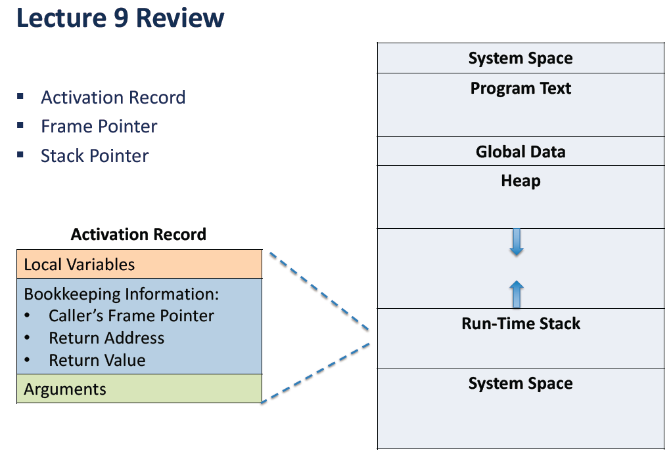

Slide 3
Run-Time Stack
Recall that local variables are stored on the run-time stack in an activation record
Frame pointer (R5) points to the beginning of a region of activation record that stores local variables for the current function
When a new function is called, its activation record is pushed on the stack; when it returns, its activation record is popped off of the stack.

Slide 4
Run-Time Stack
Memory
Memory
Memory
R6
Watt
R5
R6
R6
R5
main
R5
main
main
Before call
During call
After call

Slide 5
Activation Record
int NoName(int a, int b) { int w, x, y; . . . return y; }
y
x
w
dynamic link
return address
return value
a
b
locals
R5
bookkeeping
args
Name
Type
Offset
Scope
a
b
w
x
y
int
int
int
int
int
4
5
0
-1
-2
NoName
NoName
NoName
NoName
NoName

Slide 6
Activation Record Bookkeeping
Return value
space for value returned by function
allocated even if function does not return a value
Return address
save pointer to next instruction in calling function
convenient location to store R7 in case another function (JSR) is called
Dynamic link
caller’s frame pointer
used to pop this activation record from stack

Slide 7
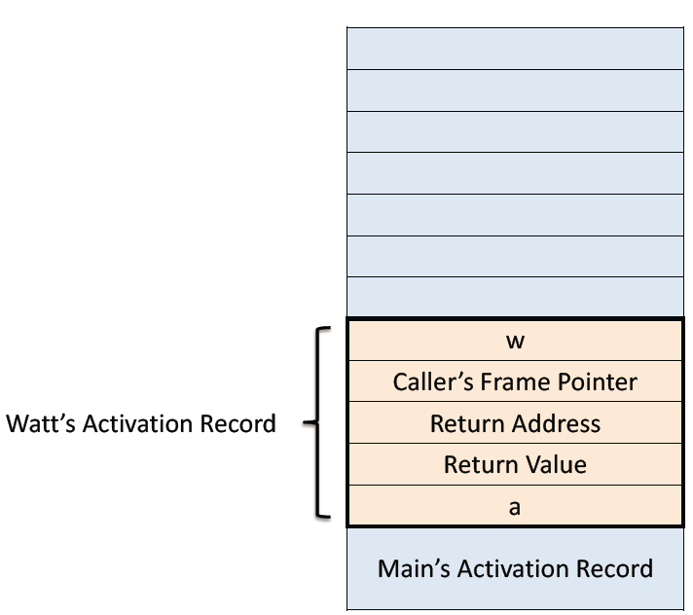
Example Function Call
int Volta(int q, int r) { int k; int m; ... return k; } int Watt(int a) { int w; ... w = Volta(w,10); ... return w; }

Slide 8
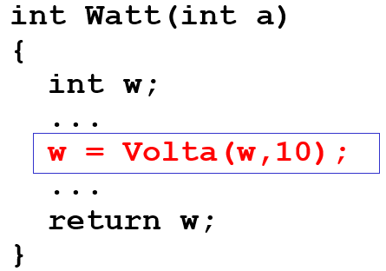
Calling the Function
25
10
25
q
r
w
dyn link
ret addr
ret val
a
w = Volta(w, 10);
; push second arg AND R0, R0, #0 ADD R0, R0, #10 ADD R6, R6, #-1 STR R0, R6, #0 ; push first argument LDR R0, R5, #0 ADD R6, R6, #-1 STR R0, R6, #0 ; call subroutine JSR Volta
new R6
R6
R5
xFD00
Note: Caller needs to know number and type of arguments, doesn't know about local variables.

Slide 9
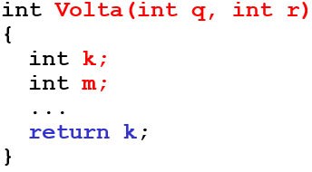
Starting the Callee Function
xFCFB
x3100
25
10
25
m
k
dyn link
ret addr
ret val
q
r
w
dyn link
ret addr
ret val
a
; leave space for return value ADD R6, R6, #-1 ; push return address ADD R6, R6, #-1 STR R7, R6, #0 ; push dyn link (caller’s frame ptr) ADD R6, R6, #-1 STR R5, R6, #0 ; set new frame pointer ADD R5, R6, #-1 ; allocate space for locals ADD R6, R6, #-2
new R6
new R5
R6
R5
xFD00

Slide 10
Ending the Callee Function
-43
217
xFCFB
x3100
217
25
10
25
m
k
dyn link
ret addr
ret val
q
r
w
dyn link
ret addr
ret val
a
return k;
; copy k into return value LDR R0, R5, #0 STR R0, R5, #3 ; pop local variables ADD R6, R5, #1 ; pop dynamic link (into R5) LDR R5, R6, #0 ADD R6, R6, #1 ; pop return addr (into R7) LDR R7, R6, #0 ADD R6, R6, #1 ; return control to caller RET
R6
R5
new R6
new R5
xFD00

Slide 11
Resuming the Caller Function
217
25
10
217
ret val
q
r
w
dyn link
ret addr
ret val
a
w = Volta(w,10);
JSR Volta ; load return value (top of stack) LDR R0, R6, #0 ; perform assignment STR R0, R5, #0
; pop return value; W=Volta(W,10) ADD R6, R6, #1
; pop arguments ADD R6, R6, #2
R6
new R6
R5
xFD00

Slide 12
Summary of LC-3 Function Call Implementation
Caller pushes arguments (last to first).
Caller invokes subroutine (JSR).
Callee allocates return value, pushes R7 and R5.
Callee allocates space for local variables.
Callee executes function code.
Callee stores result into return value slot.
Callee pops local vars, pops R5, pops R7.
Callee returns (JMP R7).
Caller loads return value and pops arguments.
Caller resumes computation…

Slide 13
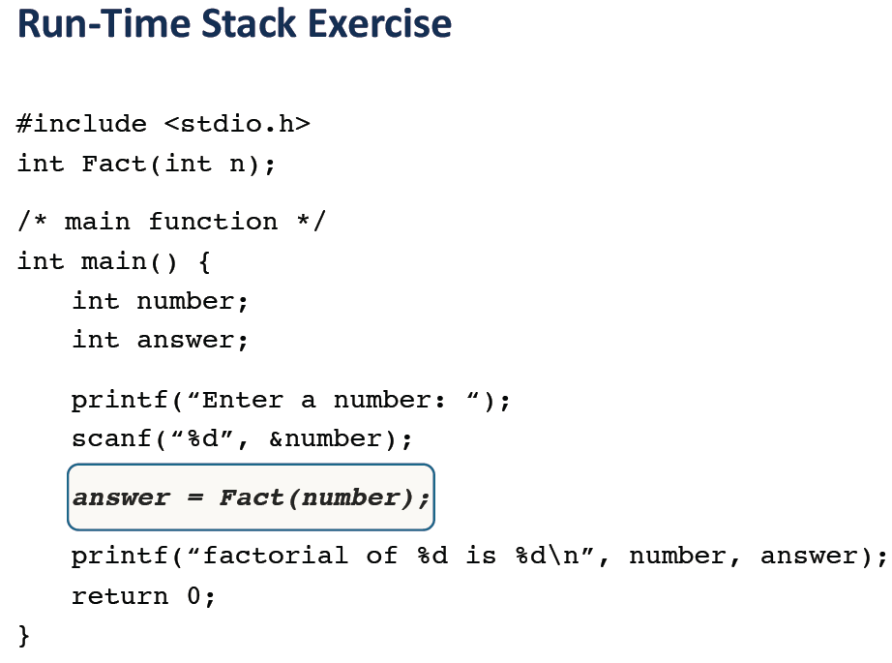
Adopted from Prof. Yuting’s lecture notes

Slide 14
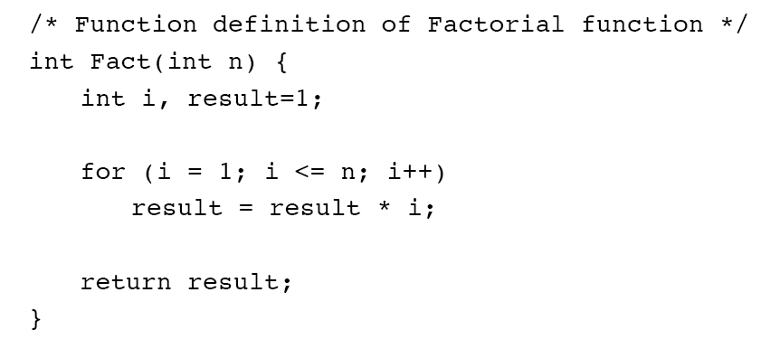

Slide 15
